Slide 1




Designing A 48 V to 24 V DC-DC Converter for Vehicle Application Using a Resonant Switched Capacitor Converter Topology versus Flyback Converter
ANDHRA UNIVERSITY COLLEGE OF ENGINEERING
FOR WOMEN
Department of Electrical Engineering
PROJECT GUIDE BY :
Mrs. B. N. M. DEEPIKA
Guest faculty, Department of EE,AUCEW
Andhra University-Visakhapatnam
PRESENTED BY;
S.CHIRUHASINI (320114214048) M.SHINI (320114214033) L. VIJAYAKUMARI (320114214029)

Slide 2

CONTENTS:
INTRODUCTION
LITERATURE REVIEW
METHODOLOGY
RESONANT SWITCHED CAPACITOR CONVERTER
FLYBACK CONVERTER
COMPARISION BETWEEN RSCC AND FLYBACK CONVERTER
SIMULATION RESULTS
APPLICATIONS
ADVANTAGES AND DISADVANTAGES
FUTURE SCOPE
CONCLUSION

Slide 3
INTRODUCTION
In the ever-evolving landscape of automotive technology, the demand for efficient power management solutions continues to surge.
.Among the critical components driving this advancement are DC-DC converters. Among the myriad of DC-DC converter topologies, the Resonant Switched Capacitor Converter (RSCC) and the Flyback Converter emerge as frontrunners, each offering unique advantages and trade-offs .
Switched Capacitor and Flyback Converter topologies for transitioning from a 48V to a 24V system.
Through comprehensive analysis and simulation, we aim to delineate the strengths and limitations of each approach, empowering engineers and researchers with valuable insights to inform their design decisions and propel the advancement of automotive power electronics into a new era of efficiency and reliability.

Slide 4
LITERATURE REVIEW
A literature survey designing a 48v to 24 v dc-dc converters for vehicle application would involve speed control of motors using Mat lab Simulink.
Design of a 48V to 24V DCDC converter for vehicle applications using a resonant switched capacitor converter (RSCC) versus a flyback converter involves a combination of electrical engineering principles, control systems, and renewable energy integration.
Leverage academic databases containing resources such as peer-reviewed journal articles, research papers, and textbooks in disciplines including electrical engineering, power electronics, Look for keywords such as "Switched capacitor converter," "Resonant converter," "PWM" and "EMI" Websites like IEEE Xplore, ScienceDirect, and Google Scholar are good places to search.

Slide 5
METHODOLOGY
Methodology for designing of a 48V to 24V DC-DC converter for vehicle applications, particularly focusing on a resonant switched capacitor converter topology versus a flyback converter, involve several critical stages to ensure efficiency, reliability, and safety.
Here's a structured methodology broken down into five key heading several critical stages to ensure efficiency, reliability, and safety.
Conceptual Design and Requirements Analysis.
Design and Simulation of the Converter Circuit.

Slide 6
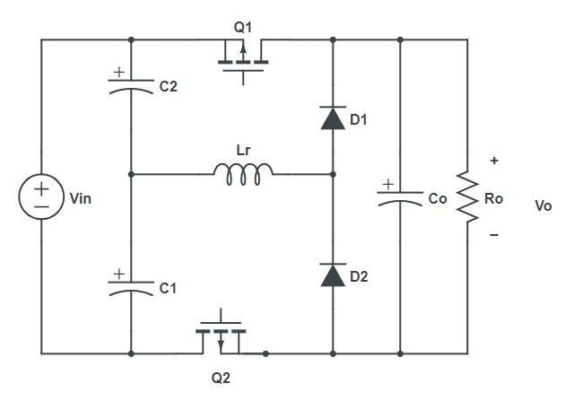
RESONANT SWITCHED CAPACITOR CONVERTER
A dual-phase half mode switched-capacitor converter with zero current switching (ZCS) is simulated, here.
Soft switching in both turn-on and turn-off of all power diodes and switches, dual-phase ability, high efficiency, low output voltage ripple, complementary drive signal, and light weight are the advantages of this converter.
The circuit diagram of a 48 V to 24 V converter with 100 W output power is shown in Figure 1.
Figure 1: ZCS dual-phase half mode switched capacitor converter

Slide 7
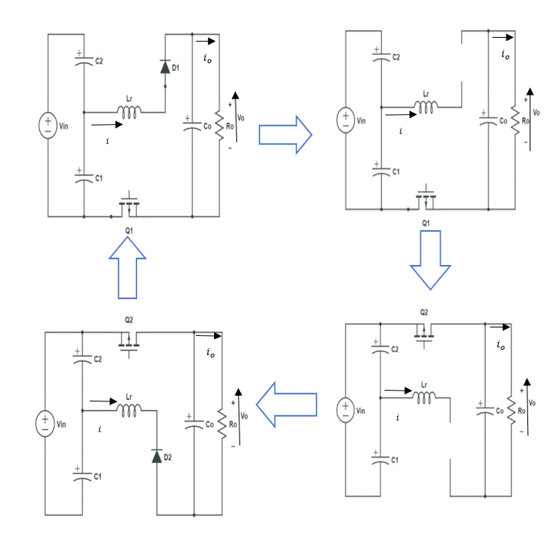
OPERATION MODE RSSC
Figure 2: operation mode of RSSC

Slide 8
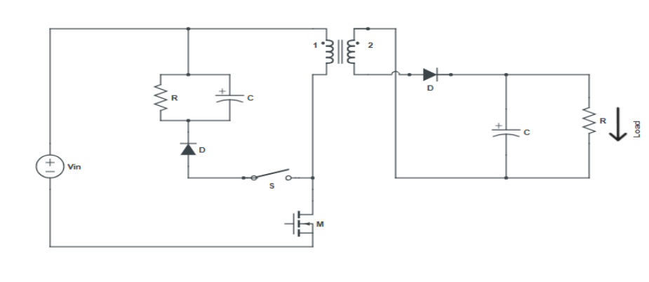
FLYBACK CONVERTER
A flyback converter is a type of isolated DC-DC converter used to step up or step-down voltage levels.
It operates by storing energy in the magnetic field of a transformer during the switch-on time and transferring it to the output during the switch-off time.
This transformer provides electrical isolation between the input and output, making the flyback converter suitable for applications requiring isolation, such as in power supplies for electronics, automotive, and industrial systems.
Figure 3: Flyback converter

Slide 9
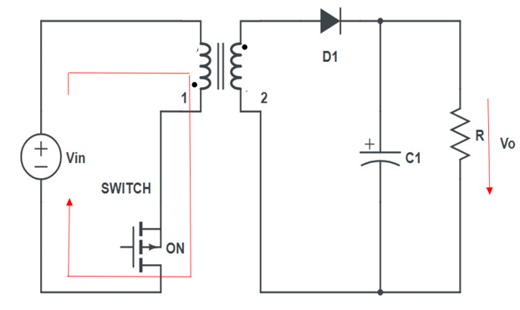
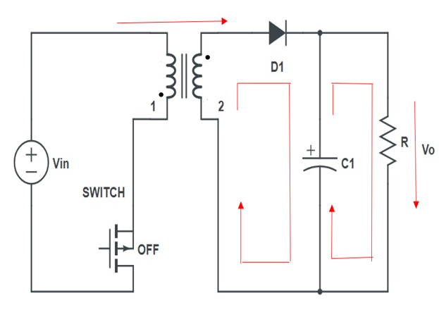
OPERATION MODE FLYBACK CONVERTER
Figure 4: Switch ON state
Figure 5: Switch OFF state

Slide 10
COMPARISON BETWEEN RSCC AND FLYBACK CONVERTER
Aspect | Resonant Switched Capacitor Converter | Flyback Converter
Operating Principle | Energy is transferred by switching capacitors and inductors in a resonant manner | Energy is transferred by storing energy in the transformer's magnetic field and then releasing it
Transformer Requirement | Not required | Required
Transformer Leakage Inductance Utilization | Not applicable | Utilizes leakage inductance for energy transfer, increasing efficiency
Voltage Regulation | Relatively easier due to simpler topology | Typically, more complex due to transformer characteristics
Efficiency | Highly dependent on capacitor quality and switching losses | Affected by transformer losses and leakage, but can be optimized with proper design
Size | Compact due to absence of transformer | Bulkier due to transformer
Voltage and Current Stress | Lower voltage and current stresses due to resonant operation | Higher voltage and current stresses due to transformer operation
Applications | Low power, high-frequency applications | Widely used in various power supply applications, including low and medium power levels

Slide 11
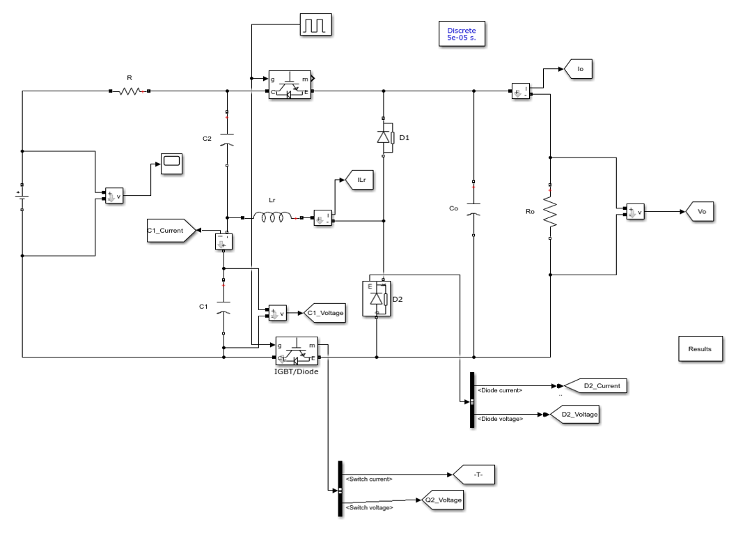
SIMULATION MODEL FOR RSCC

Slide 12
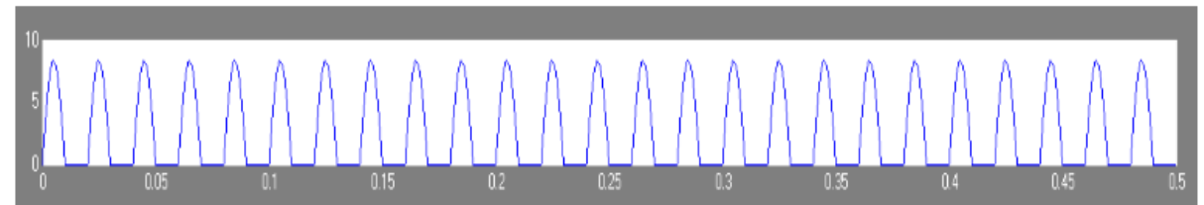
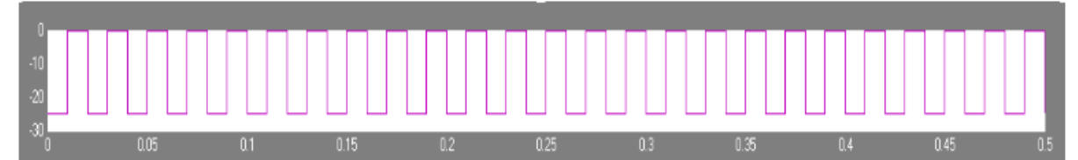
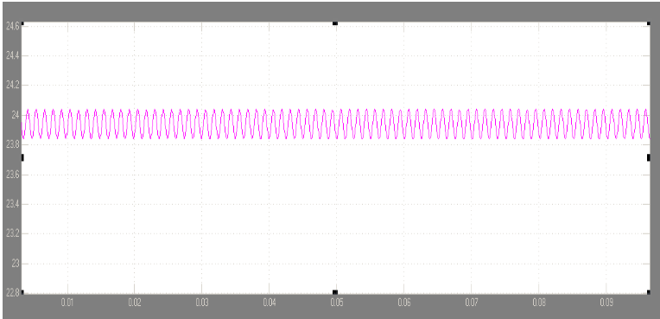
SIMULATION RESULTS FOR RSCC
Figure 6: ZCS Switched Current Waveform
Figure 7: ZCS Switched Voltage Waveform
Figure 8: ZCS dual-phase half mode SCC Output Voltage waveform

Slide 13
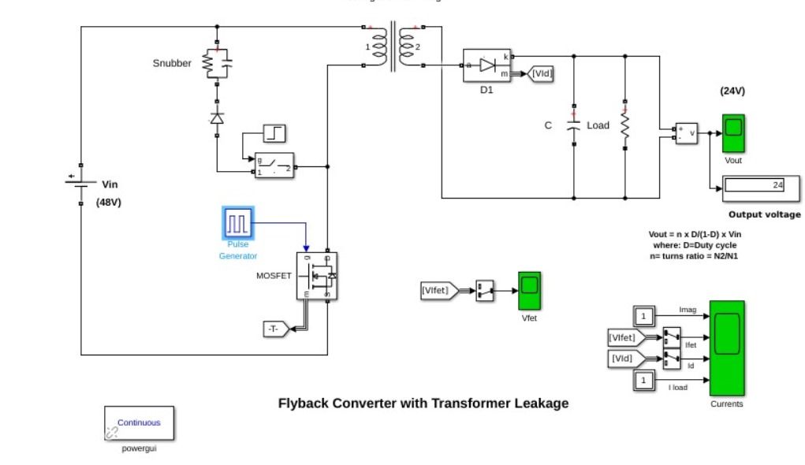
SIMULATION MODEL FOR FLYBACK CONVERTER

Slide 14
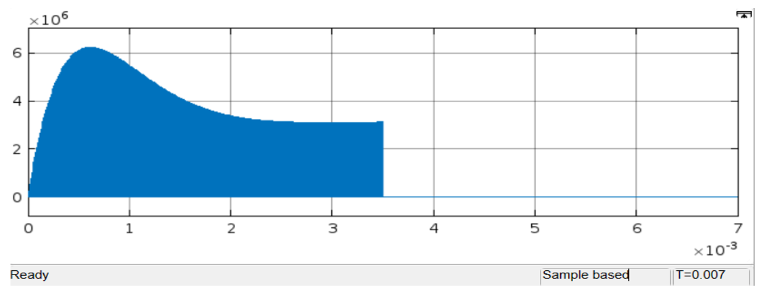
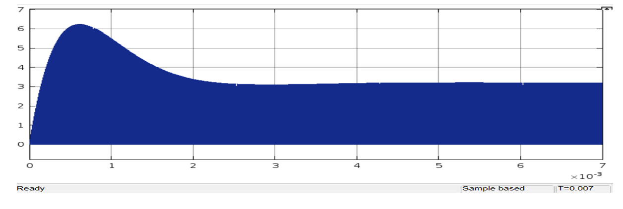
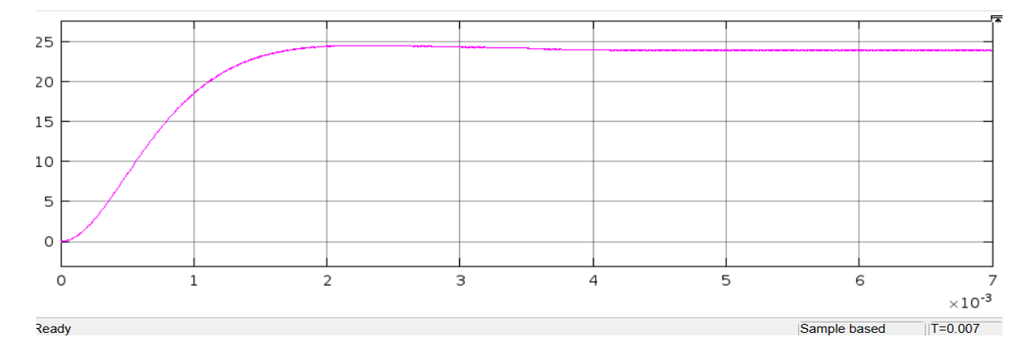
SIMULATION RESULTS FOR FLYBACK CONVERTER
Figure 9: Flyback Converter Output Current Waveform
Figure 10: Flyback Converter Output Voltage Waveform
Figure 11: Flyback Converter Output Voltage Waveform

Slide 15
APPLICATIONS FOR RSCC & FLYBACK CONVERTERS
Resonant Switched Capacitor Converters
DC-DC Voltage Conversion
LED Lighting
Photovoltaic (PV) Systems
Electric Vehicles (EVs)
Wireless Power Transfer (WPT)
Energy Harvesting
Grid-Tied Inverters
Flyback Converters
Power Supplies
LED Lighting
Battery Charging
Isolated Power Supplies(IPS)
Renewable Energy System
Automotive Electronics

Slide 16
ADVANTAGES
low volume and weight.
operation at low power range even under the no load condition without any dummy load.
inherent short circuit current limiting feature of this kinds of converters.
high power density.
low cost, due to no copper usage in the converter.
high transient response due to using capacitor instead of inductance.
DISADVANTAGES
limitation of the output voltage regulation, independence from the duty cycle.
variation of the output voltage by changing the output load, and in special case by input voltage tolerance.
limitation of the accessible power range.
low efficiency between 70 and 80 percent.
non zero equivalent output resistant.

Slide 17
CONCLUSION
In conclusion, the simulation results between the ZCS dual-phase half mode switched capacitor converter and the flyback converter with transformer leakage for a 48V to 24V DC-DC conversion application indicate distinct performance characteristics for each topology.
The ZCS switched capacitor converter showcased its strengths in achieving high efficiency and low output voltage ripple, which is ideal for applications where energy conservation and stable voltage are critical. Its ability to operate with zero current switching reduces stress on components, leading to potentially longer life and higher reliability.
This topology is particularly beneficial for applications that require lightweight and compact power supplies. On the other hand, the flyback converter's provision of galvanic isolation via the transformer is an essential feature for safety in many applications. While it may exhibit higher voltage ripple and slightly lower efficiency, the ability to provide isolation is often a non-negotiable aspect in vehicle and industrial applications.
The flyback converter is also highly scalable and can be designed for a wide range of power levels, making it versatile across different use cases. Ultimately, the choice between these topologies will depend on the specific requirements of the application.
For energy-sensitive and space-constrained environments, the ZCS switched capacitor converter may be the preferred choice. In contrast, for applications where isolation is paramount and efficiency can be slightly compromised, the flyback converter would be the suitable option

Slide 18
FUTURE SCOPE
The future scope for the topic "Designing a 48 V to 24 V DC-DC Converters for Vehicle Applications Using a Resonant Switched Capacitor Converter Topology Versus Flyback Converter" holds significant potential for further advancements and exploration in several key areas:
Efficiency Optimization
Integration with Vehicle Electrification
Advanced Semiconductor Technologies
Reliability and Robustness
System-Level Optimization
Environmental Considerations

Slide 19
THANK YOU…..

