Slide 1
HCL PASSWORD MANAGEMENT SYSTEM

Slide 2
PURPOSE OF PROJECT
WHY IS IT IMPORTANT?
Apart of our everyday lives.
The information it protects.
ISSUES WITH PASSWORD MANAGEMENT?
Difficult to remember:-
Complicated passwords.
Many different passwords.
Passwords that change frequently.
Passwords for systems that are used Infrequently.
How one issue can lead to another?
Write down their passwords.
Forget their passwords.
Use very simple, easily compromised passwords.
Reuse old passwords as often as possible.

Slide 3

HELLO!
I am PL.Sundar Velayutham
I am here because I love to give presentations.

Slide 4
OUTLINE OF PROJECT
1
Password Management System

Slide 5
Password manager software stores multiple passwords in a single database that can be accessed from various devices. For accessing the software, you just need to enter the master password.
The password manager software supports filling out the form (name and other details) in a single click. This benefits users to get their tasks done quickly, saving their time. At the same time, it keeps the intact information safe in a centralized database

Slide 6
SCOPE
The main purpose of the project is to develop an application called Online Password Manager. With increase in the usage of Internet and ATM, even common citizens who are not having computer to maintain a number of accounts and related passwords to go ahead with their day-to-day activities. These accounts could range from email accounts, social networking accounts, on-shopping accounts, bank accounts, on-line stocks trading accounts, credit card accounts and many others. One issue with maintaining all these accounts is that one has to remember a number of passwords. Quite a few people, unknowingly, either have the same password for all the accounts or write down all the passwords on a piece of paper and carry with them or have passwords that are very easy to remember that can be guessed easily by others, all of which are very risky and may lead to misuse of accounts, data loss or even financial loss. There is no proper way for a common person to save all these passwords securely and retrieve them when required.

Slide 7

INTENDED AUDIENCE
Password managers began as low-cost apps for consumers, tracking passwords and sign-ins to websites and applications, making it possible for users to create and manage long, hard-to-guess and unique passwords for all their accounts. Most work by encrypting the password lists with a single master password that only the user knows, so that even the password manager company employees themselves -- or hackers -- couldn't get into the password lists.
All the major password managers also have mobile apps, making it easy for users to log into their accounts from any device.

Slide 8
PROPOSED SYSTEM
There is a need for a centralized web based application to allow users to save all their passwords in a secured and format on the Internet so that they can be retrieved. This application not only allows the passwords to be saved in the centralized database it also facilities to retrieve the password whenever required .
The way it works is:
Users register.
They save their entire password.
If required the password is retrieved.

Slide 9
PROJECT OVERVIEW
Installation and Maintenance
STEP 6
Implementation,Intergration,Tsting
STEP 5
Coding
STEP 4
Product Desing
STEP 3
Feasibility Analysis
STEP 2
Planning
STEP 1

Slide 10
TOOLS AND TECHNOLOGIES
JAVA
Java is a high-level, class-based, object-oriented programming language that is designed to have as few implementation dependencies as possible.
HTML
The HyperText Markup Language, or HTML is the standard markup language for documents designed to be displayed in a web browser. It can be assisted by technologies such as Cascading Style Sheets and scripting languages such as JavaScript.
JSP
Jakarta Server Pages is a collection of technologies that helps software developers create dynamically generated web pages based on HTML, XML, SOAP, or other document types.

Slide 11
TOOLS AND TECHNOLOGIES
CSS
Cascading Style Sheets is a style sheet language used for describing the presentation of a document written in a markup language such as HTML. CSS is a cornerstone technology of the World Wide Web, alongside HTML and JavaScript.
JAVA SCRIPT
JavaScript is a lightweight, cross-platform, and interpreted scripting language. It is well-known for the development of web pages, many non-browser environments also use it. ... Client-side: It supplies objects to control a browser and its Document Object Model (DOM).
MY ECLIPSE IDE
MyEclipse is a commercially available Java EE IDE created and maintained by the company Genuitec, a founding member of the Eclipse Foundation.
MyEclipse is built upon the Eclipse platform, and integrates both proprietary and open source code into the development environment.

Slide 12
TOOLS AND TECHNOLOGIES
ORACLE
Oracle Database is a multi-model database management system produced and marketed by Oracle Corporation. It is a database commonly used for running online transaction processing, data warehousing and mixed database workloads.
Excel
Excel can work well with backend database systems such as oracle. As a result it can come in handy for pulling in your test results and in turn, reporting on them. Add to that the fact Excel is operating system independent; hence these functionalities can be leveraged across multiple operating systems.
Selenium Automation and Framework
Selenium is a portable framework for testing web applications. Selenium provides a playback tool for authoring functional tests without the need to learn a test scripting language.
Test automation frameworks are a set of rules and corresponding tools that are used for building test cases. It is designed to help engineering functions work more efficiently.

Slide 13
Follow the upcoming diagrams
High Level Use Case Diagram
Sequence Diagram
ER Diagram
A sequence diagram is a Unified Modeling Language (UML) diagram that illustrates the sequence of messages between objects in an interaction.
An entity–relationship model describes interrelated things of interest in a specific domain of knowledge. A basic ER model is composed of entity types and specifies relationships that can exist between entities.
Use-case diagrams describe the high-level functions and scope of a system.

Slide 14
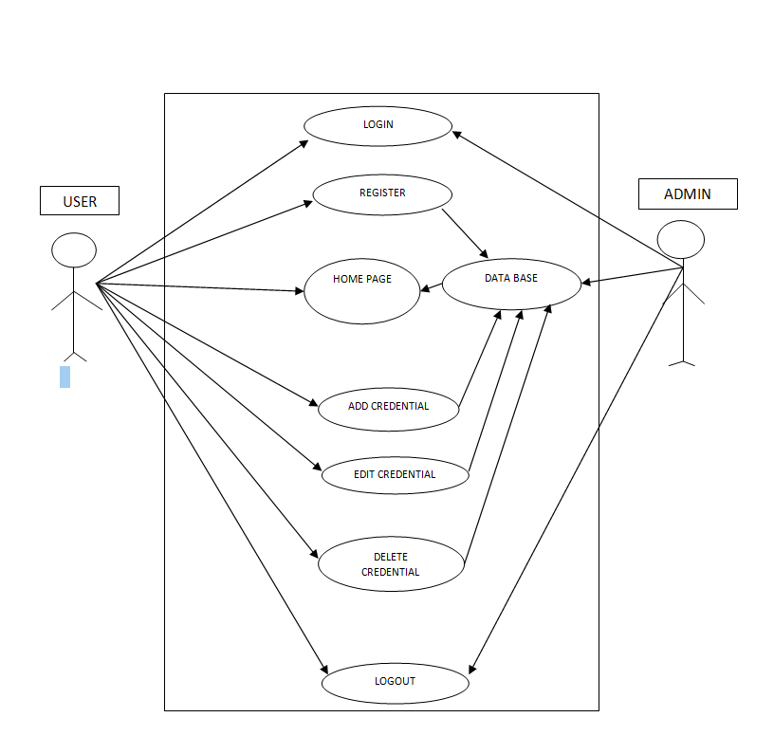
High Level Use Case Diagram

Slide 15
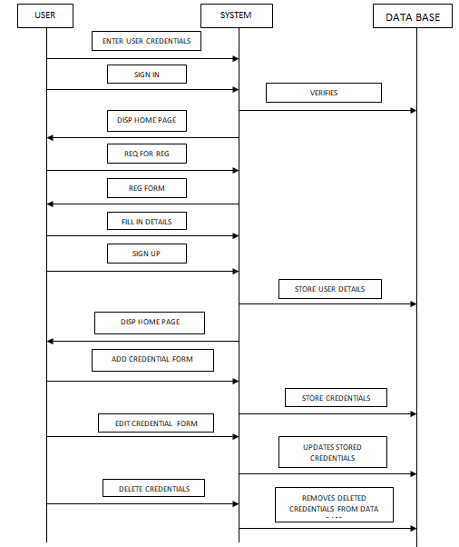
Sequence Diagram

Slide 16
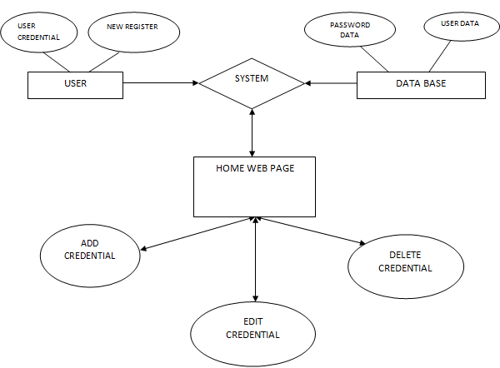
ER Diagram

Slide 17

QA PLAYS A VITAL ROLE IN SOFTWARE APPLICATION

Slide 18
Manual Testing
Manual testing is a software testing process in which test cases are executed manually without using any automated tool. All test cases executed by the tester manually according to the end user's perspective. It ensures whether the application is working, as mentioned in the requirement document or not.
STEP 1:- Cover page
STEP 2:-Test Scenario
STEP 3:-Test Case
STEP 4:-Defect Log
STEP 5:-RTM

Slide 19
Process Involved
Cover Page
It involes the Names of the Persons who prepares, reviews and Approves the Test Cases.
Test Scenario
Test Scenario is the possible ways to test a software application.
CP
TS
Test Case
The purpose of a test case is to determine if different features within a system are performing as expected and to confirm that the system satisfies all related standards, guidelines and customer requirements. The process of writing a test case can also help reveal errors or defects within the system.
Defect logging, a process of finding defects in the application under test or product by testing or recording feedback from customers and making new versions of the product that fix the defects or the clients feedback.
The Requirements Traceability Matrix (RTM) is a document that links requirements throughout the validation process. The purpose of the Requirements Traceability Matrix is to ensure that all requirements defined for a system are tested in the test protocols.
DL&RTM
Defect Log & RTM
TC

Slide 20
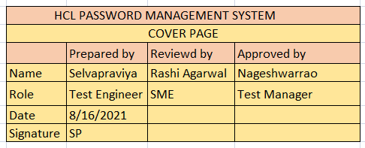
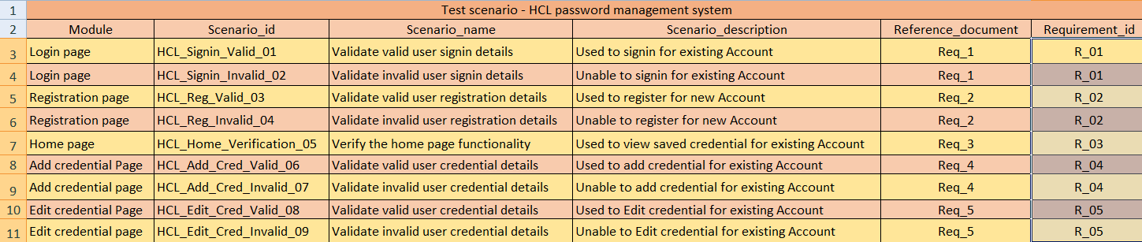

Slide 21
AutomationTesting
Selenium is a free (open-source) automated testing framework used to validate web applications across different browsers and platforms. You can use multiple programming languages like Java, C#, Python etc to create Selenium Test Scripts.

Slide 22
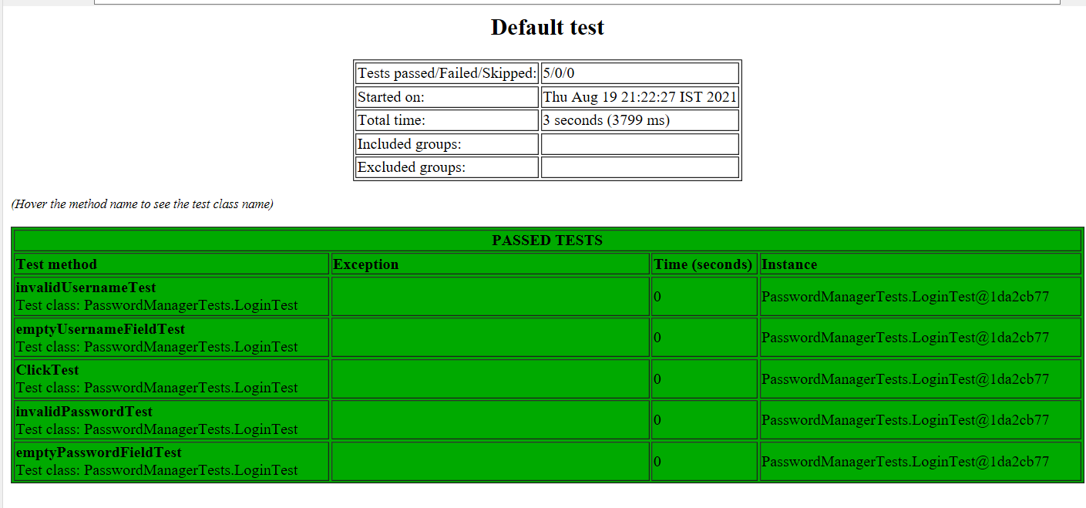

Slide 23
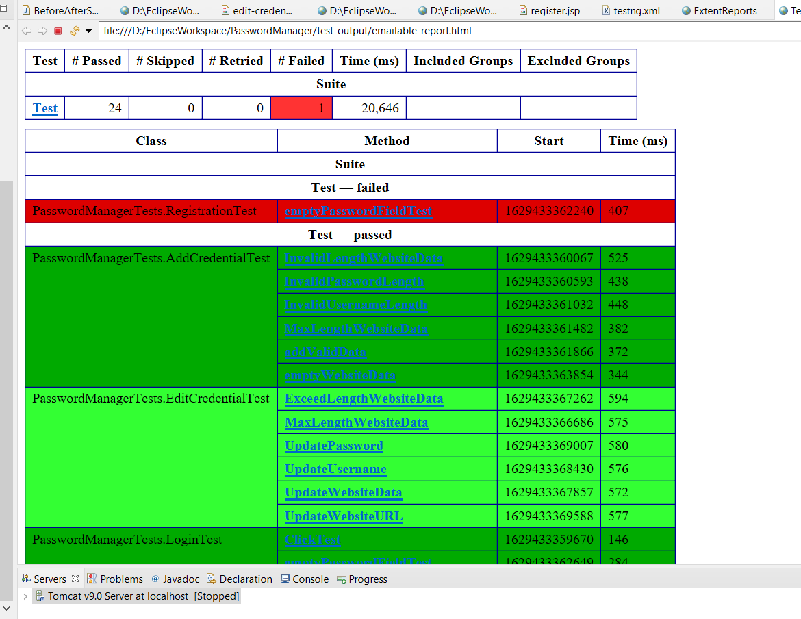

Slide 24
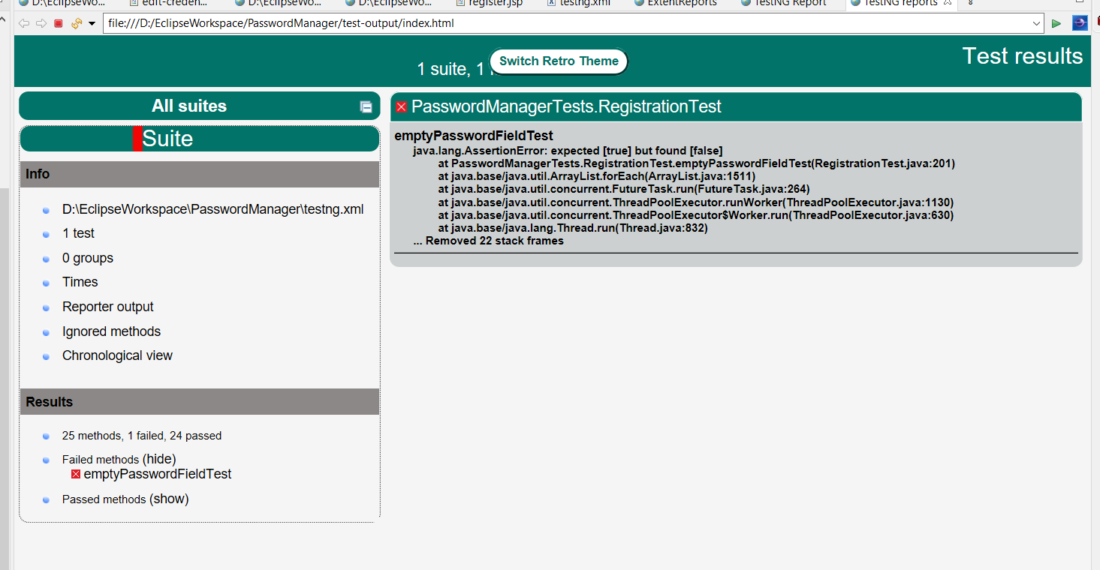

Slide 25
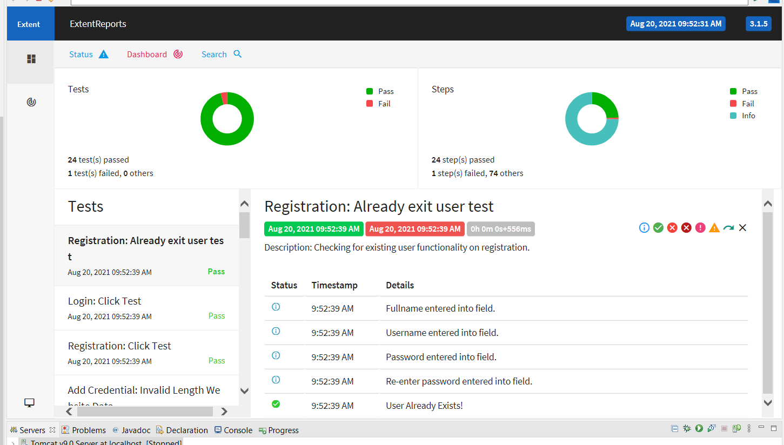

Slide 26
Benefits
This project offers user to enter the data through simple and interactive forms. This is very helpful for the client to enter the desired information through so much simplicity.
From every part of the project the user is provided with the links through framing so that he can go from one option of the project to other as per the requirement. This is bound to be simple and very friendly as per the user is concerned. That is, we can sat that the project is user friendly which is one of the primary concerns of any good project.
Data storage and retrieval will become faster and easier to maintain because data is stored in a systematic manner and in a single database

Slide 27
Limitations
The size of the database increases day-by-day, increasing the load on the database back up and data maintenance activity.
Training for simple computer operations is necessary for the users working on the system.

Slide 28
Conclusion
It has been a great pleasure for my team to work on this exciting and challenging project. This project proved good for our team as it provided practical knowledge of not only programming in JAVA and Servelets web based application and no some extent Windows Application will be great demand in future. This will provide better opportunities and guidance in future in developing projects independently and TOMCAT Server, but also about all handling procedure related with “HCL Password Management”. It also provides knowledge about the latest technology used in developing web enabled application and client server technology that will be great demand in future. This will provide better opportunities and guidance in future in developing projects independently.

Slide 29
Timeline
We had clear discussion on our project and what role who is going to play
Backend Process was completed
Manual Testing process was commenced with clear inputs from development side
Automation Testing was commenced & we had a clarity to involve POM, TestNG, Maven, Extended Reports
Started working on a complete Automation Project
Reviewed the project completely
14th Aug
15th Aug
16th Aug
17th Aug
18th Aug
19th Aug
20th Aug
21st Aug
22nd Aug
23rd Aug
24th Aug
25th Aug
Back End process started parallely while working on Documentation
User Interface work was done
Manual Testing Process was done
Automation Testing Process was done
That was a
Worked on PPT

Slide 30
THANKS!
Any questions ?
Visit the below site for the Complete Code part and Documentation
https://github.com/chirusandeep/Password-Manager

Slide 31


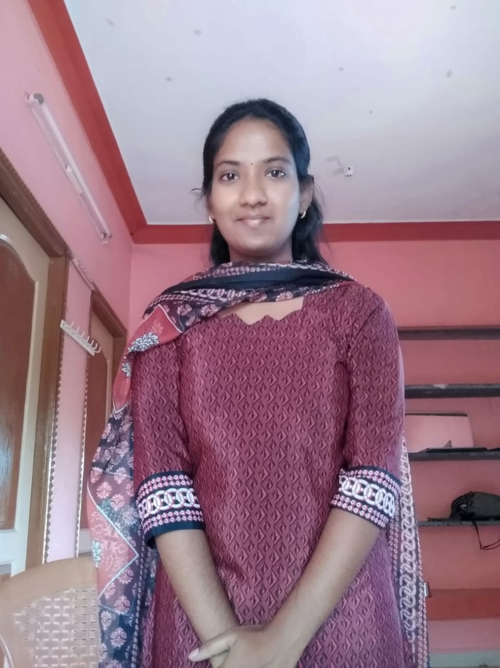
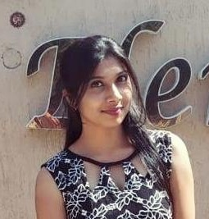
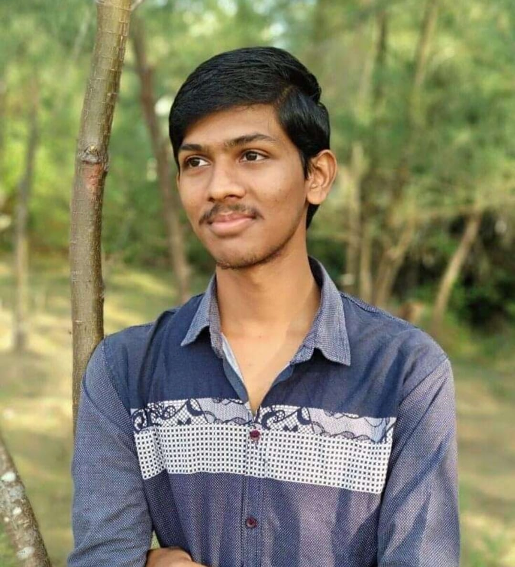
Team Presentation
PL.Sundar Velayutham Software Engineer
Automated end to end Web Application
Documentation and PPT
Chiru Sandeep Paleti Software Engineer
Front End and Back End
Developer
Selvapraviya S Software Engineer
Manual Testing
Anjali Avinash Patil Software Engineer
Automation Testing
Srinivas Ganisetty Software Engineer
Automation Testing

