Slide 1
Ground Water Level Predictor
CSE7101- Capstone Project
Review-1
Batch Number: PSCS_327
Under the Supervision of,
Dr. Yamanappa
Assistant Professor
School of Computer Science and Engineering
Presidency University
Roll Number | Student Name
20221CSD0134 20221CSD0117 20221CSD0133 | Chirag K S Shreyas V Arjun Athrey
Name of the Program: Ground Water Level Predictor
Name of the HoD: Dr. Pravinthraja S
Name of the Program Project Coordinator: Dr. H M Manjula
Name of the School Project Coordinators: Dr. Sampath A K , Dr. Geetha A

Slide 2
Problem Statement Number: PSCS 327
Organization: Presidency School of Computer Science (PSCS).
Category (Hardware / Software / Both) :Software
Problem Description: To create a software application that uses machine learning models to analyze meteorological and hydrological data (like rainfall, temperature, and soil type) to accurately predict future groundwater levels. This system will aid in sustainable water resource management and planning.

Slide 3
Content
Problem Statement
Objectives
Background and Related Work
Analysis of Problem Statement
Proposed Datasets
Innovation or Novel Contributions
Technology Stack & Requirements
Timeline of the Project
GitHub Link
References

Slide 4
Problem Statement
Groundwater is a critical source for drinking water and irrigation, but its levels are declining due to over-extraction and climate change.
The absence of reliable predictive models leads to reactive water management and unsustainable usage.
This project aims to develop an intelligent system to accurately forecast groundwater levels, providing timely data for sustainable resource planning.

Slide 5
Objectives
To collect and preprocess time-series data for groundwater levels, rainfall, temperature, and soil type for a specific region in Karnataka.
To develop and train various Machine Learning and Deep Learning models (e.g., Random Forest, LSTM, XGBoost) to predict future water levels.
To evaluate the models and identify the best-performing one based on accuracy metrics like RMSE and MAE.
To create an interactive visualization dashboard for stakeholders to view predictions and analyze trends.

Slide 6
Background & Related Work
Traditional methods for groundwater prediction often rely on statistical models like ARIMA, which are limited in capturing complex, non-linear patterns.
Recent studies demonstrate that Machine Learning models significantly outperform these traditional approaches.
Deep Learning models, particularly LSTMs, have shown great promise for time-series forecasting in hydrology due to their ability to recognize long-term dependencies in data.
A comprehensive survey of at least 10 IEEE/Scopus papers is underway to finalize the proposed methodology.

Slide 7
Proposed Datasets
Groundwater Level Data
Source: Central Ground Water Board (CGWB), India-WRIS
Description: Historical monthly water level data from observation wells in selected districts of Karnataka. This will be our target variable.
Meteorological Data
Source: India Meteorological Department (IMD)
Description: Daily/monthly historical data for rainfall, temperature, and humidity for the same geographical regions. These will be key predictor variables.
Geospatial Data (Optional)
Source: National Bureau of Soil Survey and Land Use Planning (NBSS\&LUP)
Description: Static data like soil type and land use patterns to provide additional context to the model.

Slide 8
Innovation / Novel Contribution
Hybrid Model: We propose using a hybrid CNN-LSTM model to capture both spatial correlations (from multiple well locations) and temporal dependencies in the data.
Ensemble Learning: We will explore ensemble techniques to combine predictions from multiple models, potentially leading to higher accuracy and robustness.
Decision-Support Dashboard: The project will culminate in a user-friendly web dashboard (using Streamlit/Flask) for easy interpretation of results by non-technical stakeholders like policymakers.

Slide 9
Analysis of Problem Statement
Critical Societal Need: This project addresses the urgent issue of water scarcity by creating a tool for sustainable groundwater management, which is vital for both agriculture and urban water security.
Core Technical Challenge: The problem is fundamentally a time-series forecasting task that requires training machine learning and deep learning models to predict future water levels based on complex historical data.
Primary Hurdle: The main difficulty lies in sourcing, cleaning, and integrating diverse datasets (e.g., groundwater levels, rainfall, temperature) from various official portals into a cohesive, usable format.
Proposed Solution: To develop a software application featuring an interactive dashboard that visualizes predictions and historical trends, providing actionable insights for policymakers and farmers.
SDG Alignment: The project directly contributes to UN SDG 6 (Clean Water and Sanitation) and SDG 13 (Climate Action).

Slide 10
Technology Stack
Programming & Data Manipulation: Python will be the primary language, utilizing libraries like Pandas and NumPy for data handling. R may be used for specific statistical analysis and model experimentation.
Machine Learning & Deep Learning: The core of the prediction engine will be built using Scikit-learn for classical ML models and TensorFlow/Keras for deep learning models.
Database: PostgreSQL for structured data or MongoDB for semi-structured data will be used for storage and management.
Visualization & Dashboarding: Data will be visualized using Matplotlib and Seaborn. The interactive user dashboard will be developed with tools like Streamlit, Flask, Plotly Dash, or Power BI.
Development Tools & Version Control: VS Code will be the primary code editor, with Git and GitHub used for version control and collaboration.
Hardware Requirements: A standard PC with a minimum of 8GB RAM is required. For efficient training of deep learning models, a high-performance system with dedicated GPU support is highly recommended.

Slide 11
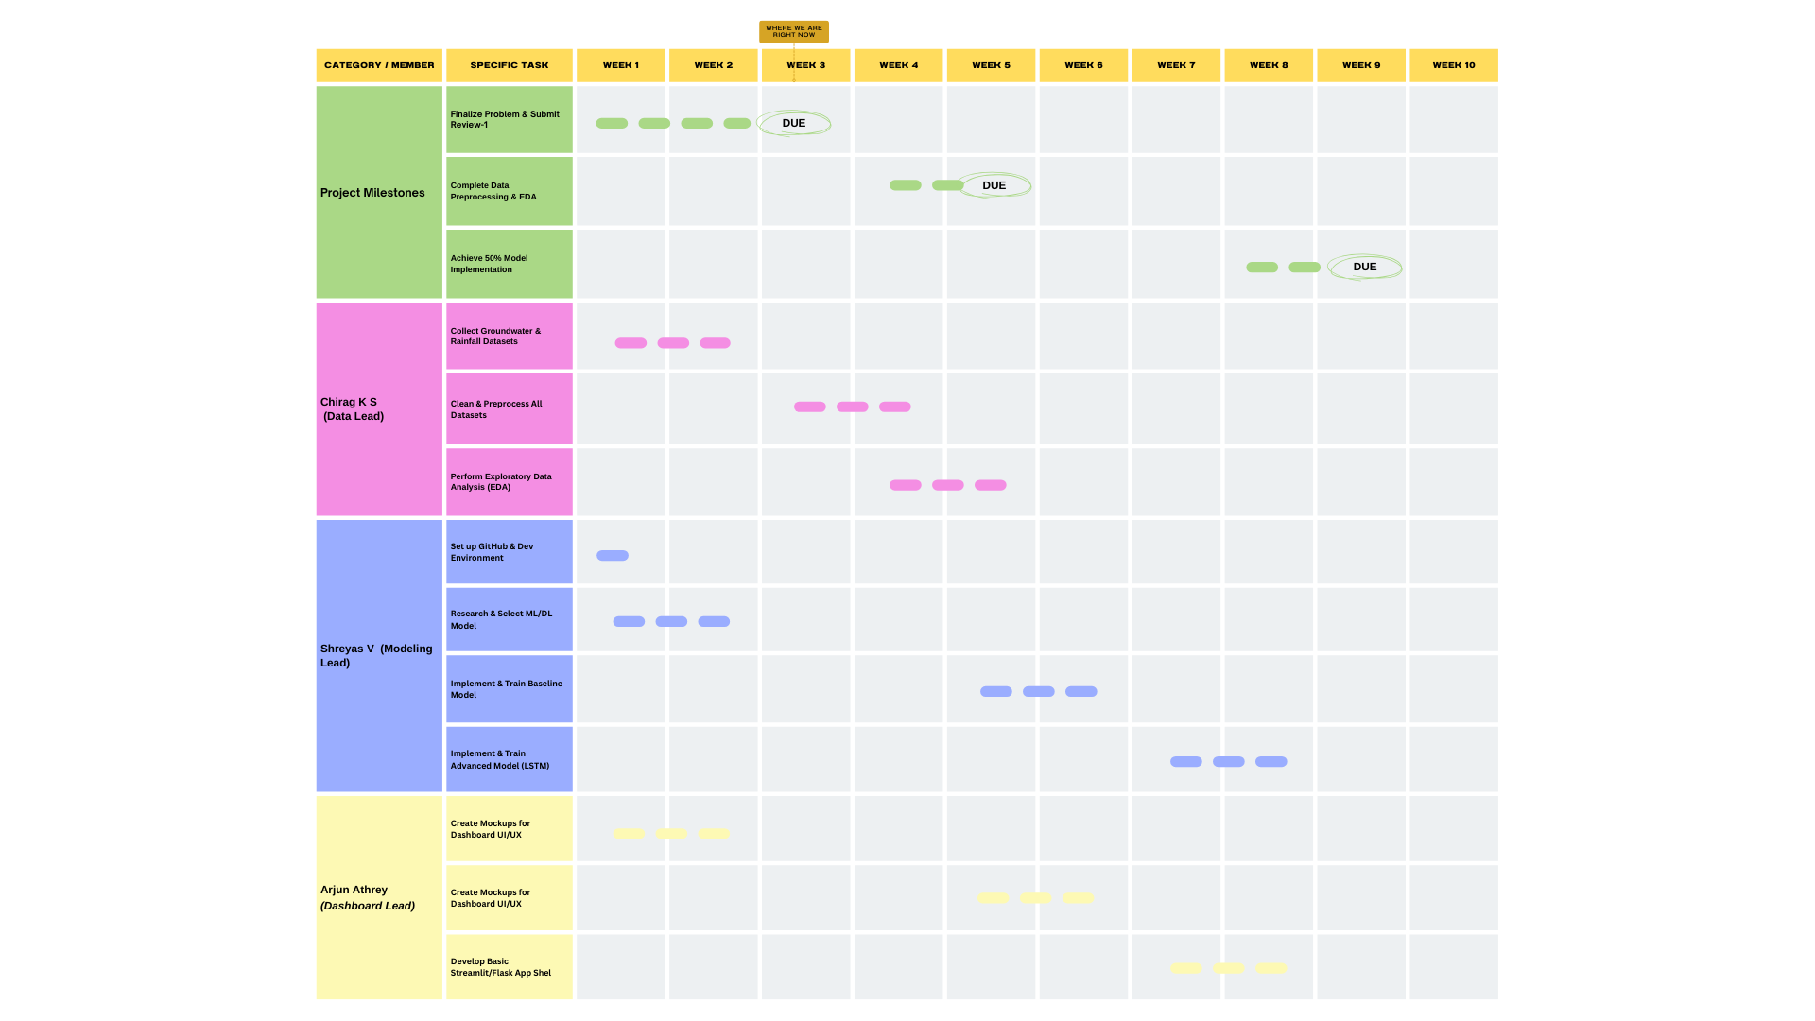
Timeline of the Project

Slide 12
Github Link
A public GitHub repository will be maintained for all project artifacts, including source code, documentation, datasets, and presentations.
The repository ensures version control and reproducibility.
Link: GitHub Link

Slide 13
References (IEEE Format)
[1] A. Kumar et al., “Groundwater level prediction using ML models,” IEEE Access, 2021.
[2] J. Smith, “Deep learning for water resource management,” IEEE Trans. NNLS, 2022.] R. Patel, “Time-series forecasting of groundwater levels,” Springer, 2020.

Slide 14


