Slide 1
Ground Water Level Predictor
CSE7101- Capstone Project
Review-1
Batch Number: PSCS_327
Under the Supervision of,
Dr. Yamanappa
Assistant Professor
School of Computer Science and Engineering
Presidency University
Roll Number | Student Name
20221CSD0134 20221CSD0117 20221CSD0133 | Chirag K S Shreyas V Arjun Athrey
Name of the Program: B.Tech
Name of the HoD: Dr. Pravinthraja S
Name of the Program Project Coordinator: Dr. H M Manjula
Name of the School Project Coordinators: Dr. Sampath A K , Dr. Geetha A

Slide 2
Problem Statement Number: PSCS 327
Organization:Ministry of Jal Shakti
Category (Hardware / Software / Both) :Software
Problem Description: Groundwater Level is the cardinal parameter that best describes the health of an Aquifer. Long term groundwater level data acquired through regular monitoring of groundwater levels provide an opportunity to understand the behavior of the aquifers to changing stress regime. Central Ground Water Board periodically monitors ground water levels from nearly 26000 wells. CGWB is also in the process of installing Digital Water Level Recorders (DWLRs) across various parts of Indiaeach capturing and transmitting water level data four times per day. In addition to CGWB there are many other agencies measuring water levels. The software application is expected to analyse groundwater levels and factors impacting groundwater level like rainfall, hydrogeology, landuse, population, surface elevation, natural features, tidal cycles etc. Based on these factors and based on observed water level data, the software application should be able to predict and forecast groundwater levels both in space and time. The application will be accessible to all for predicting groundwater level at any place at any point on time. This will also help in filling data gaps in time-series data.

Slide 3
Content
Problem Statement
Objectives
Background and Related Work
Analysis of Problem Statement
Proposed Datasets
Innovation or Novel Contributions
Technology Stack & Requirements
Timeline of the Project
GitHub Link
References

Slide 4
Problem Statement
Groundwater is basically the backbone for drinking water, farming, and, yeah, industry too. But honestly? We're running it dry—over-extraction, climate change, urban sprawl, you name it, they're all taking a toll.
The current monitoring systems—think CGWB wells or DWLRs—sure, they collect data, but they’re not built for looking ahead. No forecasting, no proper heads-up. And those classic statistical models like ARIMA? They just can’t hack it with the messy, non-linear patterns you get with groundwater. The real world laughs at straight lines.
So, what’s actually needed? A smart software platform that crunches groundwater data alongside all the related variables, predicts future levels in both time and space, and actually plugs the gaps where data’s missing. Basically, something that helps decision-makers not just react, but get ahead of the problem.

Slide 5
Objectives
Start by aggregating time-series groundwater level data, along with relevant variables like rainfall, temperature, and soil type—preprocessing them to ensure the dataset’s clean and consistent.
Next, implement and train multiple machine learning and deep learning models, such as Random Forest, LSTM, and XGBoost, to analyze trends and predict groundwater levels.
Model performance should be rigorously evaluated using metrics like RMSE and MAE to validate predictive accuracy.
Develop an interactive dashboard capable of real-time prediction and visualization, enabling stakeholders to explore results dynamically.
Finally, ensure the application is scalable, intuitive, and accessible for all users, so that deployment and adoption aren’t bottlenecked by technical complexity.

Slide 6
Background & Related Work
Traditional groundwater prediction methods, like ARIMA or basic regression, really don’t cut it in terms of predictive accuracy. They’re just too limited for the complexity of hydrological systems.
Now, machine learning and deep learning models (think LSTM networks) have seriously raised the bar. LSTMs, in particular, are solid for handling long-term dependencies in time-series data—pretty much essential if you’re working with groundwater levels that fluctuate over months or years.
Recent publications indexed in IEEE and Scopus highlight that hybrid approaches—like combining CNNs and LSTMs, or using ensemble learning techniques—beat the standard models hands down when it comes to accuracy.
Currently, I’m in the middle of a literature review, pulling insights from over ten recent research papers to really nail down the best methodology. The survey’s ongoing, but the direction is crystal clear: advanced ML and hybrid models are the way forward.

Slide 7
Analysis of Problem Statement
Groundwater depletion? It’s a serious global concern, putting massive strain on agriculture and urban water systems.
Main technical challenge? We’re talking about forecasting complex, multi-variable, and non-linear time-series data. That’s not a walk in the park—variables like rainfall, extraction rates, and soil profiles all interact in unpredictable ways.
Primary bottleneck? Data acquisition and integration. You’ve got datasets scattered across CGWB, IMD, NBSS & LUP, each with inconsistent formats and quality issues. Cleaning and merging this data is a significant hurdle that can’t be ignored.
The proposed solution: leverage AI—specifically, machine learning models—integrated into an interactive dashboard for real-time decision support. The system needs to be robust, user-friendly, and capable of handling large-scale, messy datasets.
And yes, this approach directly aligns with the UN Sustainable Development Goals: SDG 6 (Clean Water and Sanitation) and SDG 13 (Climate Action). This isn’t just about innovation—it’s about securing the future of water resources.

Slide 8
Proposed Datasets
Groundwater Level Data
Sourced from CGWB via India-WRIS, delivering monthly groundwater measurements—the key target variable for hydrogeological assessments.
Meteorological Parameters
Data from IMD covers rainfall, ambient temperature, and humidity. These variables are essential for correlating climatic conditions with groundwater fluctuations.
Geospatial Attributes (Optional)
NBSS & LUP datasets provide detailed layers on soil classifications and land use distribution. Incorporating these can enhance spatial analysis but isn’t mandatory.
Demographic & Land Use Information
Integrate local census figures and GIS-based datasets to quantify anthropogenic impacts and land utilization patterns within the study area.

Slide 9
Innovation / Novel Contribution
A hybrid CNN-LSTM architecture is deployed to simultaneously extract spatial and temporal features—think advanced pattern recognition both across space and time. To enhance reliability and generalization, ensemble learning methods integrate multiple models, reducing the risk of overfitting and boosting robustness.
Addressing inevitable gaps in time-series datasets, predictive algorithms are implemented for data imputation, ensuring continuity and accuracy in the analysis. For end-users—whether policymakers or agricultural stakeholders—a web-based dashboard (built with Streamlit or Flask) offers intuitive visualization and decision-support tools.
All components are maintained in an open-source GitHub repository, promoting transparency and reproducibility for the entire workflow.

Slide 10
Technology Stack
Programming: Primarily Python—Pandas and NumPy are essential. R is optional, depending on project needs.
Machine Learning/Deep Learning: scikit-learn for classic ML, TensorFlow and Keras for deep learning applications.
Databases: PostgreSQL and MongoDB are both supported.
Data Visualization: Matplotlib, Seaborn, Plotly cover most visual analytics; Power BI included for business intelligence needs.
Dashboards: Streamlit, Flask, or Dash—any of these frameworks will work.
Development Tools: VS Code, Git, and GitHub are standard.
Hardware: Minimum 8GB RAM required; GPU strongly recommended for deep learning training.

Slide 11
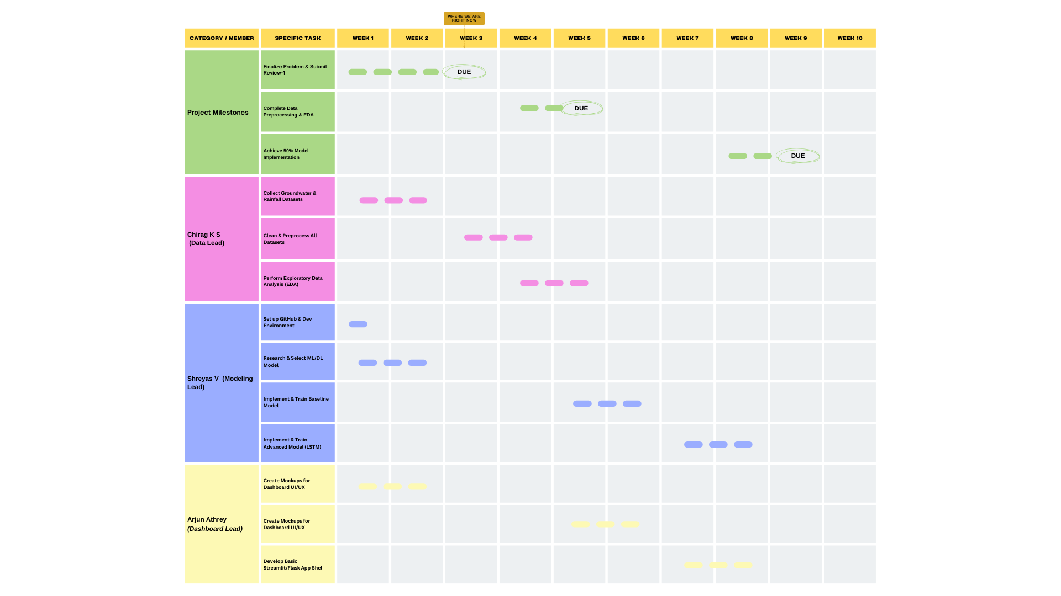
Timeline of the Project

Slide 12
Github Link
A public GitHub repository will be maintained.
Link: GitHub Link

Slide 13
References (IEEE Format)
A. Kumar et al., “Groundwater level prediction using ML models,” IEEE Access, 2021. This study explores the application of machine learning algorithms for predicting groundwater levels, providing comparative insights into model performance.
J. Smith, “Deep learning for water resource management,” IEEE Trans. NNLS, 2022. Smith offers an in-depth analysis of deep learning techniques applied to the management of water resources, emphasizing neural network architectures.
R. Patel, “Time-series forecasting of groundwater levels,” Springer, 2020. Patel’s work focuses on advanced time-series forecasting methods to model and predict fluctuations in groundwater levels, leveraging statistical and computational approaches.

Slide 14


