Slide 1
Sentiment analysis of comments received through E-consultation module
Review-1
Batch Number: CSD_8
Under the Supervision of,
Mr. Anand Haridas
Assistant Professor
School of Computer Science and Engineering
Presidency University
Roll Number | Student Name
20221CSD0134 | CHIRAG K S
20221CSD0133 | ARJUN ATHREY
20221CSD0145 | SRUSHTI S GOLAPPANAVAR
Name of the Program: B.Tech (Computer Science and Engineering{DATA SCIENCE})
Name of the HoD: Dr. Pravinthraja S
Name of the Program Project Coordinator: Dr. H M Manjula
Name of the School Project Coordinators: Dr. Sampath A K , Dr. Geetha A

Slide 2
Problem Statement Number: 25035
Organization: Ministry of Corporate Affairs (MoCA)
Category : Software
Problem Description:
The draft document soliciting comments is made available for a specified period, during which any stakeholder may submit their observations either on the overall amendment or on specific provisions of the draft legislation. In instances where a substantial volume of comments is received on draft legislation, there exists a risk of certain observations being inadvertently overlooked or inadequately analysed. In order to review each individual submission, leveraging AI-assisted tools will help ensure that all remarks are duly considered and systematically analysed. Requirement is the development of an AI model aimed at predicting the sentiments of the suggestions provided by stakeholders in the eConsultation module. It should also generate a visual representation in the form of a word cloud, highlighting the keywords utilised by the stakeholders within their suggestions.

Slide 3
Content
Problem Statement
Objectives
Analysis of Problem Statement
Proposed method and feasibility study
Literature review
Architecture Diagram
Git-hub Link
Timeline of the Project
References

Slide 4
Objectives
Automated Sentiment Classification: Categorize each comment’s tone (positive/negative/neutral) to gauge public reaction.
Theme Extraction: Identify frequently discussed topics and keywords (via topic modeling or keyword extraction).
Summarization: Generate concise summaries of the feedback to highlight main concerns and suggestions.
Duplication Detection: Find and cluster similar/identical comments to avoid redundant analysis.
Visualization: Present results through intuitive charts and word clouds (e.g. word clouds for positive/negative terms).
Dashboard Reporting: Deliver an interactive dashboard with sentiment distributions and drill-downs (per policy section or stakeholder group).

Slide 5
Analysis of Problem Statement
Analysis of Problem Statement
Scale: The number of comments can range from hundreds (small consultations) to tens of thousands or more (nationwide policy). Processing such volume manually is impractical.
Granularity Needed: Stakeholder feedback often spans multiple topics. For example, citizens might comment on distinct sections of a draft law; thus analysis must operate at multiple levels (overall sentiment and per-section/topic).
Text Variability: Comments are free-form, vary in length/style, and may include technical or legal language. NLP preprocessing (tokenization, removing stopwords, handling misspellings) is crucial.
Noise and Duplicates: Copy-pasted comments or bots can skew sentiment. The system must identify and deduplicate these (MCA faced 20K identical comments).
Timeliness: Outputs must be delivered rapidly. Automated pipelines (versus manual review) can reduce turnaround from weeks to days.

Slide 6
Analysis of Problem Statement (contd...)
Technology Stack Used
Programming & Platform
Python
Google Colab
VScode
Machine Learning & NLP
Scikit-learn (TF-IDF, Logistic Regression, SVM, Naive Bayes)
NLTK (VADER, stopwords)
TextBlob
HuggingFace Transformers
Visualization
Matplotlib
WordCloud

Slide 7
Analysis of Problem Statement (contd...)
Functional Analysis
Unstructured text requires preprocessing and vectorization
Different sentiment models may produce varying outputs
Aggregation is needed to derive meaningful insights
Visualization and summarization help administrators quickly understand feedback
Key Challenge
Designing a pipeline that is:
Re-runnable
Scalable
Accurate
Easy to integrate into a full-stack system

Slide 8
Proposed method and feasibility study
Proposed Method
Train multiple ML sentiment classifiers using TF-IDF features
Select the best model based on F1-score
Use pretrained models (VADER, TextBlob, HuggingFace) for comparison
Accept multiple user comments in a controlled input flow
Aggregate results, generate word cloud and summary
Feasibility Study
Technical Feasibility Uses open-source Python libraries and runs efficiently on Google Colab.
Operational Feasibility The system can process multiple comments interactively with minimal setup.
Scalability Can be extended to support multiple topics and users in a real portal.

Slide 9
Literature Review
Sentiment analysis is widely used in social media monitoring and feedback analysis
Transformer models have shown strong performance in understanding contextual sentiment
Existing systems lack tailored solutions for government e-Consultation platforms
The review highlights the need for an automated and explainable sentiment analysis system for public policy feedback.

Slide 10
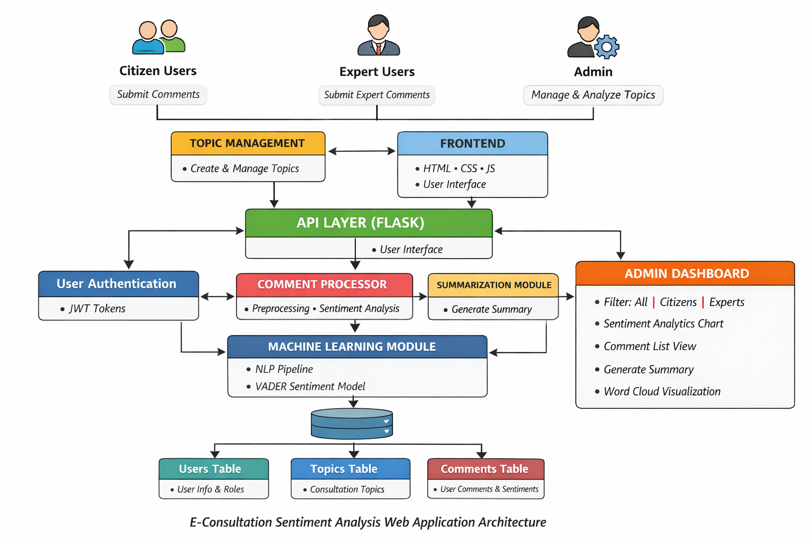
Architecture Diagram

Slide 11
Github Link
Github Link
https://github.com/chirustark17/Sentiment-analysis-of-comments-received-through-E-consultation-module
Visibility : Public

Slide 12
Timeline of the Project
Month | Phase | Key Activities | Deliverables
Month 1 | Data Collection & Setup | • Collect e-consultation comments and similar public datasets • Data cleaning and preprocessing (tokenization, stopword removal, deduplication) • Exploratory data analysis (word frequency, comment length) • Build baseline sentiment model | • Cleaned dataset • EDA report • Baseline sentiment classifier
Month 2 | Model Development | • Fine-tune sentiment models (BERT / RoBERTa) • Evaluate model performance against baseline methods • Develop initial text summarization prototype | • Trained sentiment model • Evaluation metrics • Summary generation prototype
Month 3 | Advanced Features | • Aspect / topic extraction • Duplicate comment detection • Generate word clouds and sentiment visualizations • Integrate models with dashboard UI | • Topic insights • Visual analytics • Functional dashboard
Month 4 | Testing & Final Delivery | • System testing and validation • Performance optimization • Final documentation and report preparation • GitHub code organization and submission | • Final system • Project report & PPT • Public GitHub repository

Slide 13
References
[1] B. Liu, Sentiment Analysis and Opinion Mining, Morgan & Claypool Publishers, San Rafael, CA, USA, 2012. (Foundational reference for sentiment analysis concepts used in this project.)
[2] C. J. Hutto and E. Gilbert, “VADER: A Parsimonious Rule-Based Model for Sentiment Analysis of Social Media Text,” in Proceedings of the 8th International AAAI Conference on Weblogs and Social Media (ICWSM), Ann Arbor, MI, USA, 2014, pp. 216–225. (Used for lexicon-based sentiment analysis in the proposed system.)
[3] J. Devlin, M.-W. Chang, K. Lee, and K. Toutanova, “BERT: Pre-training of Deep Bidirectional Transformers for Language Understanding,” in Proceedings of the 2019 Conference of the North American Chapter of the Association for Computational Linguistics (NAACL), Minneapolis, MN, USA, 2019, pp. 4171–4186. (Transformer-based models accessed via HuggingFace for sentiment analysis and summarization.)
[4] M. Lewis et al., “BART: Denoising Sequence-to-Sequence Pre-training for Natural Language Generation, Translation, and Comprehension,” in Proceedings of the 58th Annual Meeting of the Association for Computational Linguistics (ACL), Online, 2020, pp. 7871–7880. (Used for abstractive text summarization of public comments.)
[5] A. Go, R. Bhayani, and L. Huang, “Twitter Sentiment Classification using Distant Supervision,” Stanford University, Tech. Rep., 2009. (Publicly available sentiment dataset used as the base for training the machine learning model.)
[6] Federal Communications Commission (FCC), “Public Notice and Comment Procedures,” FCC, Washington, DC, USA. [Online]. Available: https://www.fcc.gov (Referenced to understand public consultation and comment-based regulatory feedback mechanisms.)

Slide 14


