Slide 1
Sentiment analysis of comments received through E-consultation module
Review-1
Batch Number: CSD_8
Under the Supervision of,
Mr. Anand Haridas
Assistant Professor
School of Computer Science and Engineering
Presidency University
Roll Number | Student Name
20221CSD0134 | CHIRAG K S
20221CSD0133 | ARJUN ATHREY
20221CSD0145 | SRUSHTI S GOLAPPANAVAR
Name of the Program: B.Tech (Computer Science and Engineering{DATA SCIENCE})
Name of the HoD: Dr. Pravinthraja S
Name of the Program Project Coordinator: Dr. H M Manjula
Name of the School Project Coordinators: Dr. Sampath A K , Dr. Geetha A

Slide 2
Problem Statement Number: 25035
Organization: Ministry of Corporate Affairs (MoCA)
Category : Software
Problem Description:
The draft document soliciting comments is made available for a specified period, during which any stakeholder may submit their observations either on the overall amendment or on specific provisions of the draft legislation. In instances where a substantial volume of comments is received on draft legislation, there exists a risk of certain observations being inadvertently overlooked or inadequately analysed. In order to review each individual submission, leveraging AI-assisted tools will help ensure that all remarks are duly considered and systematically analysed. Requirement is the development of an AI model aimed at predicting the sentiments of the suggestions provided by stakeholders in the eConsultation module. It should also generate a visual representation in the form of a word cloud, highlighting the keywords utilised by the stakeholders within their suggestions.

Slide 3
Content
Problem Statement
Objectives
Analysis of Problem Statement
Proposed method and feasibility study
Literature review
Architecture Diagram
Git-hub Link
Timeline of the Project
References

Slide 4
Objectives
Automated Sentiment Classification Classify stakeholder comments into Positive, Neutral, or Negative using transformer-based models.
Topic-wise Feedback Collection Allow citizens and experts to submit comments linked to consultation topics.
Administrative Analytics Dashboard Provide administrators with sentiment distributions, comment insights, and visual analytics.
Text Summarization Automatically generate concise summaries of large volumes of public feedback.
Keyword & Word Frequency Extraction Identify frequently used terms and major discussion themes through word-cloud visualization.
Data Export & Reporting Enable CSV/JSON export for reporting, policy analysis, and archival purposes.

Slide 5
Analysis of Problem Statement
Analysis of Problem Statement
Scale: The number of comments can range from hundreds (small consultations) to tens of thousands or more (nationwide policy). Processing such volume manually is impractical.
Granularity Needed: Stakeholder feedback often spans multiple topics. For example, citizens might comment on distinct sections of a draft law; thus analysis must operate at multiple levels (overall sentiment and per-section/topic).
Text Variability: Comments are free-form, vary in length/style, and may include technical or legal language. NLP preprocessing (tokenization, removing stopwords, handling misspellings) is crucial.
Noise and Duplicates: Copy-pasted comments or bots can skew sentiment. The system must identify and deduplicate these (MCA faced 20K identical comments).
Timeliness: Outputs must be delivered rapidly. Automated pipelines (versus manual review) can reduce turnaround from weeks to days.

Slide 6
Analysis of Problem Statement (contd...)
Technology Stack Used
Programming & Backend
Python
Flask (API Framework)
Flask-JWT-Extended (Authentication)
SQLAlchemy ORM
Database
PostgreSQL
Machine Learning / NLP
HuggingFace Transformers
DistilBERT – Sentiment Classification
T5-Small – Text Summarization

Slide 7
Technology Stack Used (Cont..)
Frontend
HTML
Bootstrap 5
Vanilla JavaScript
Visualization
Chart.js (Sentiment charts)
WordCloud / wordcloud2.js
Development Tools
VS Code
GitHub
Python Virtual Environment

Slide 8
Analysis of Problem Statement (contd...)
Functional Analysis
Stakeholder comments are unstructured textual data requiring NLP preprocessing.
Large-scale consultations may generate hundreds to thousands of responses.
Manual analysis is time-consuming and error-prone.
The system must automatically classify sentiment, summarize feedback, and extract key terms.
Administrators require interactive dashboards and exportable reports.
Key Challenge
Designing a pipeline that is:
Scalable for large consultation volumes
Accurate in sentiment interpretation
Secure with role-based access
Integrable into real government consultation portals

Slide 9
Proposed method and feasibility study
Proposed Method
The system implements a full-stack AI-powered consultation analysis platform.
Workflow:
User Authentication
Citizens and experts register/login.
JWT authentication ensures secure access.
Topic-Based Comment Collection
Admin creates consultation topics.
Users submit comments linked to a topic.
NLP Preprocessing
Lowercasing
URL removal
Special character filtering
Whitespace normalization

Slide 10
Proposed method and feasibility study
4. Sentiment Analysis
Pretrained DistilBERT transformer model
Classifies comments as Positive / Neutral / Negative
5.Text Summarization
T5-Small transformer model
Generates concise summaries of consultation feedback.
6.Word Frequency Extraction
Extracts top keywords from comments
Used to generate word clouds.
7.Analytics Dashboard
Sentiment distribution charts
Comment insights
Summary panel
Word cloud visualization
8.Data Export
CSV export for policy reporting and analysis.

Slide 11
Literature Review
Sentiment analysis is widely used in social media monitoring and feedback analysis
Transformer models have shown strong performance in understanding contextual sentiment
Existing systems lack tailored solutions for government e-Consultation platforms
The review highlights the need for an automated and explainable sentiment analysis system for public policy feedback.

Slide 12
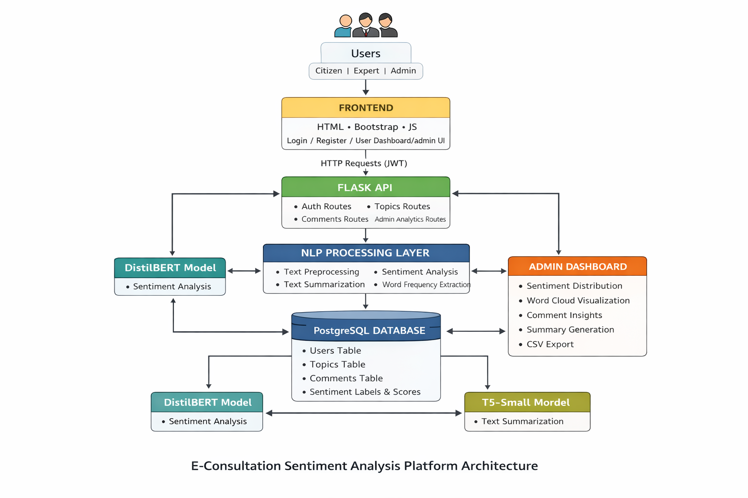
Architecture Diagram

Slide 13
Algorithm
Sentiment Analysis Algorithm
Fetch topic-specific comments from database.
Preprocess comment text:
lowercase conversion
remove URLs
remove special characters
Input processed text into DistilBERT sentiment classifier.
Model outputs probability scores.
Map predictions into:
Positive
Negative
Neutral (confidence threshold rule).
Store sentiment label and score in database.

Slide 14
Algorithm
Text Summarization Algorithm
Retrieve topic-filtered comments.
Preprocess and concatenate text.
Truncate input to maximum safe length.
Pass text to T5-Small summarization model.
Generate concise summary output.
Word Frequency Extraction
Combine topic comments.
Remove stopwords.
Tokenize text.
Count word frequencies.
Return Top-100 words for word cloud visualization.

Slide 15
System Features
Role-based authentication (Admin / Citizen / Expert)
Topic-wise consultation system
Transformer-based sentiment analysis
Automated text summarization
Word cloud keyword extraction
Admin analytics dashboard
CSV export for reporting
Secure JWT-based API communication

Slide 16
Github Link
Github Link
https://github.com/chirustark17/Sentiment-analysis-of-comments-received-through-E-consultation-module
Visibility : Public

Slide 17
Timeline of the Project
Month | Phase | Key Activities | Deliverables
Month 1 | Data Collection & Setup | • Collect e-consultation comments and similar public datasets • Data cleaning and preprocessing (tokenization, stopword removal, deduplication) • Exploratory data analysis (word frequency, comment length) • Build baseline sentiment model | • Cleaned dataset • EDA report • Baseline sentiment classifier
Month 2 | Model Development | • Fine-tune sentiment models (BERT / RoBERTa) • Evaluate model performance against baseline methods • Develop initial text summarization prototype | • Trained sentiment model • Evaluation metrics • Summary generation prototype
Month 3 | Advanced Features | • Aspect / topic extraction • Duplicate comment detection • Generate word clouds and sentiment visualizations • Integrate models with dashboard UI | • Topic insights • Visual analytics • Functional dashboard
Month 4 | Testing & Final Delivery | • System testing and validation • Performance optimization • Final documentation and report preparation • GitHub code organization and submission | • Final system • Project report & PPT • Public GitHub repository

Slide 18
References
[1] B. Liu, Sentiment Analysis and Opinion Mining, Morgan & Claypool Publishers, San Rafael, CA, USA, 2012. (Foundational reference for sentiment analysis concepts used in this project.)
[2] C. J. Hutto and E. Gilbert, “VADER: A Parsimonious Rule-Based Model for Sentiment Analysis of Social Media Text,” in Proceedings of the 8th International AAAI Conference on Weblogs and Social Media (ICWSM), Ann Arbor, MI, USA, 2014, pp. 216–225. (Used for lexicon-based sentiment analysis in the proposed system.)
[3] J. Devlin, M.-W. Chang, K. Lee, and K. Toutanova, “BERT: Pre-training of Deep Bidirectional Transformers for Language Understanding,” in Proceedings of the 2019 Conference of the North American Chapter of the Association for Computational Linguistics (NAACL), Minneapolis, MN, USA, 2019, pp. 4171–4186. (Transformer-based models accessed via HuggingFace for sentiment analysis and summarization.)
[4] M. Lewis et al., “BART: Denoising Sequence-to-Sequence Pre-training for Natural Language Generation, Translation, and Comprehension,” in Proceedings of the 58th Annual Meeting of the Association for Computational Linguistics (ACL), Online, 2020, pp. 7871–7880. (Used for abstractive text summarization of public comments.)
[5] A. Go, R. Bhayani, and L. Huang, “Twitter Sentiment Classification using Distant Supervision,” Stanford University, Tech. Rep., 2009. (Publicly available sentiment dataset used as the base for training the machine learning model.)
[6] Federal Communications Commission (FCC), “Public Notice and Comment Procedures,” FCC, Washington, DC, USA. [Online]. Available: https://www.fcc.gov (Referenced to understand public consultation and comment-based regulatory feedback mechanisms.)

Slide 19


