Slide 1

An agentic operating system for Indian Railways
Multi-agent AI that keeps trains on time, in real time.
FAR AWAY 2026 · Hackathon MVP · built on Hive

Slide 2
THE PROBLEM
India's railways are falling behind, on time.
19M
passengers carried every single day
ON-TIME PERFORMANCE, KEY ROUTES
94.2% in 2020
69,000 km
of track across the network
73.6% by 2023
0
real-time, system-wide intelligence today
A 20.6 point fall in just three years.
Rail Saarthi
01

Slide 3
CURRENT PAIN POINTS
Where the system breaks down today
Chronic delays
Fragmented scheduling
Aging infrastructure
80% of key routes run over capacity, with no slack to absorb a single slip.
Crew and platform assignments juggled by hand, control center to control center.
British-era signaling still gates throughput on critical sections.
No proactive comms
Freight vs passenger conflict
Siloed control centers
Passengers learn of disruptions late, if at all, with no live, trustworthy updates.
Shared tracks force constant trade-offs with no system-wide optimizer.
Each zone sees its own slice; no shared, real-time network awareness.
Rail Saarthi
02

Slide 4
SOLUTION
Rail Saarthi: an agentic OS for Indian Railways
What it is
What it does
What it replaces
A multi-agent AI system: Train, Station, Crew, Maintenance and Passenger agents coordinating on a live digital twin.
Makes real-time decisions across trains, stations, crew and freight: detect a delay, reroute platforms, swap crew, alert passengers.
Reactive, manual control-room firefighting → proactive, autonomous coordination that self-heals the timetable.
Deterministic rules decide what's feasible. LLMs choose among safe options and explain why.
Rail Saarthi
03

Slide 5
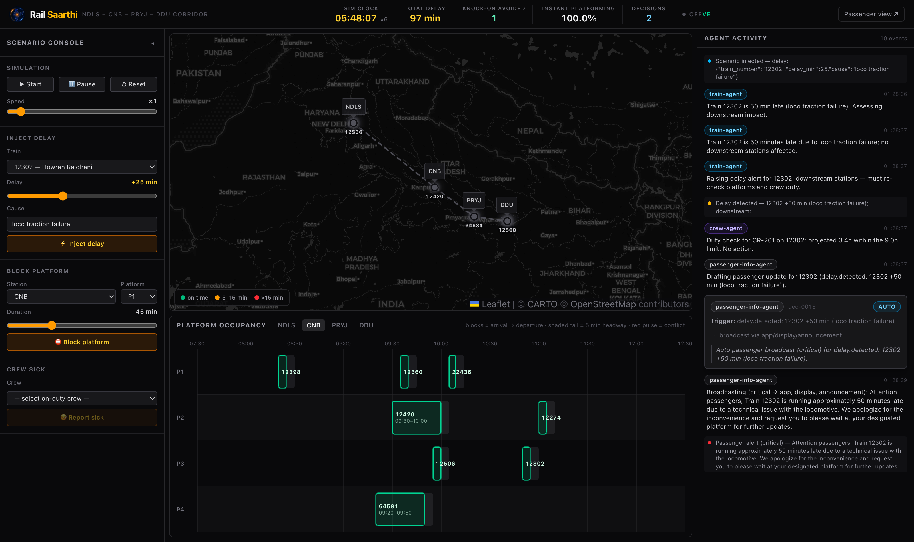
LIVE DEMO
Inject a 25-min delay. Watch the system self-heal.
Corridor map
live train positions on the NDLS to DDU line
Agent feed
the cascade resolving, decision by decision
Platform timeline
a conflict caught and avoided
KPI bar
instant platforming, avg delay, knock-on saved
Rail Saarthi
04

Slide 6
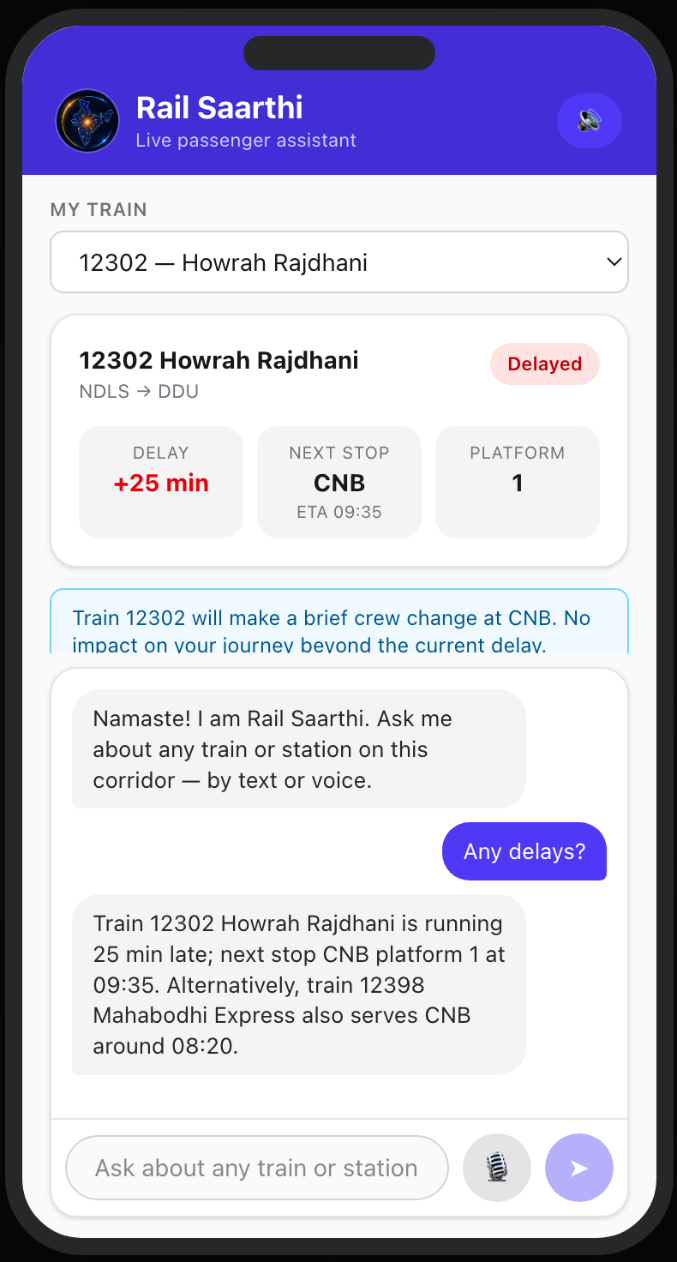
PASSENGER APP
The control room, in every passenger's pocket
Live train status
Delay, next stop and platform, refreshed in real time as the agents act.
Proactive alerts
Crew changes and disruptions are pushed to passengers before they even ask.
Ask anything
A voice or text assistant answers in plain language, in Hindi or English.
Smart alternatives
When a train runs late, it suggests the next service that gets you there.
Rail Saarthi
05

Slide 7
ARCHITECTURE
Agents on a shared bus, fed by live rail data
Train
Agent
Station
Agent
Crew
Agent
Maintenance
Agent
Passenger Info
Agent
CENTRAL MESSAGE BUS
DATA SOURCES
NTES
IRCTC
FOIS
SCADA
Weather
Stack: FastAPI · in-process event bus · SQLite · React · Hive agents
Rail Saarthi
06

Slide 8
IMPACT & METRICS
What the agents actually move
+34%
90%
<100ms
20%+
network throughput
instant platforming
agent response
fewer knock-on delays
vs naive dispatch (MDPI multi-agent study)
trains platformed without waiting, in sim
from event detected to decision proposed
cascade reduction across the corridor
Simulated results. Pilot validation planned.
Rail Saarthi
07

Slide 9
ROADMAP
One corridor today, the network tomorrow
PHASE 1
PHASE 2
PHASE 3
Hackathon MVP
Pilot
Scale
• Corridor simulation
• Delay injection
• Platform reassignment
• Live agent control room
• 5-station live corridor
• NTES integration
• Real crew & duty data
• Operator-in-the-loop
• National rollout
• RL-based dispatch
• Passenger AI chatbot
• Rail Madad integration
Rail Saarthi
08

