Slide 1
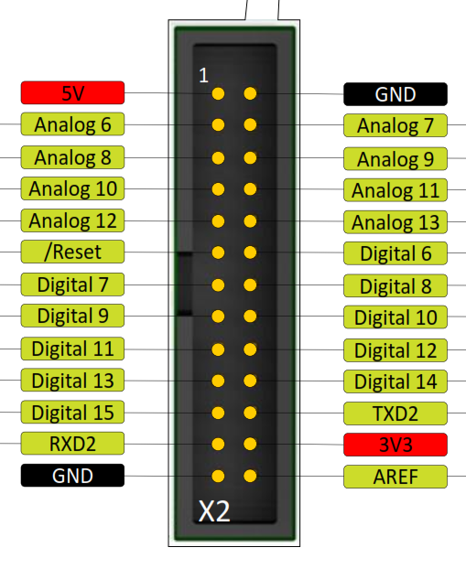
< PIN 22 Nextion RX YL
< PIN 23 Nextion TX BL

