Slide 2
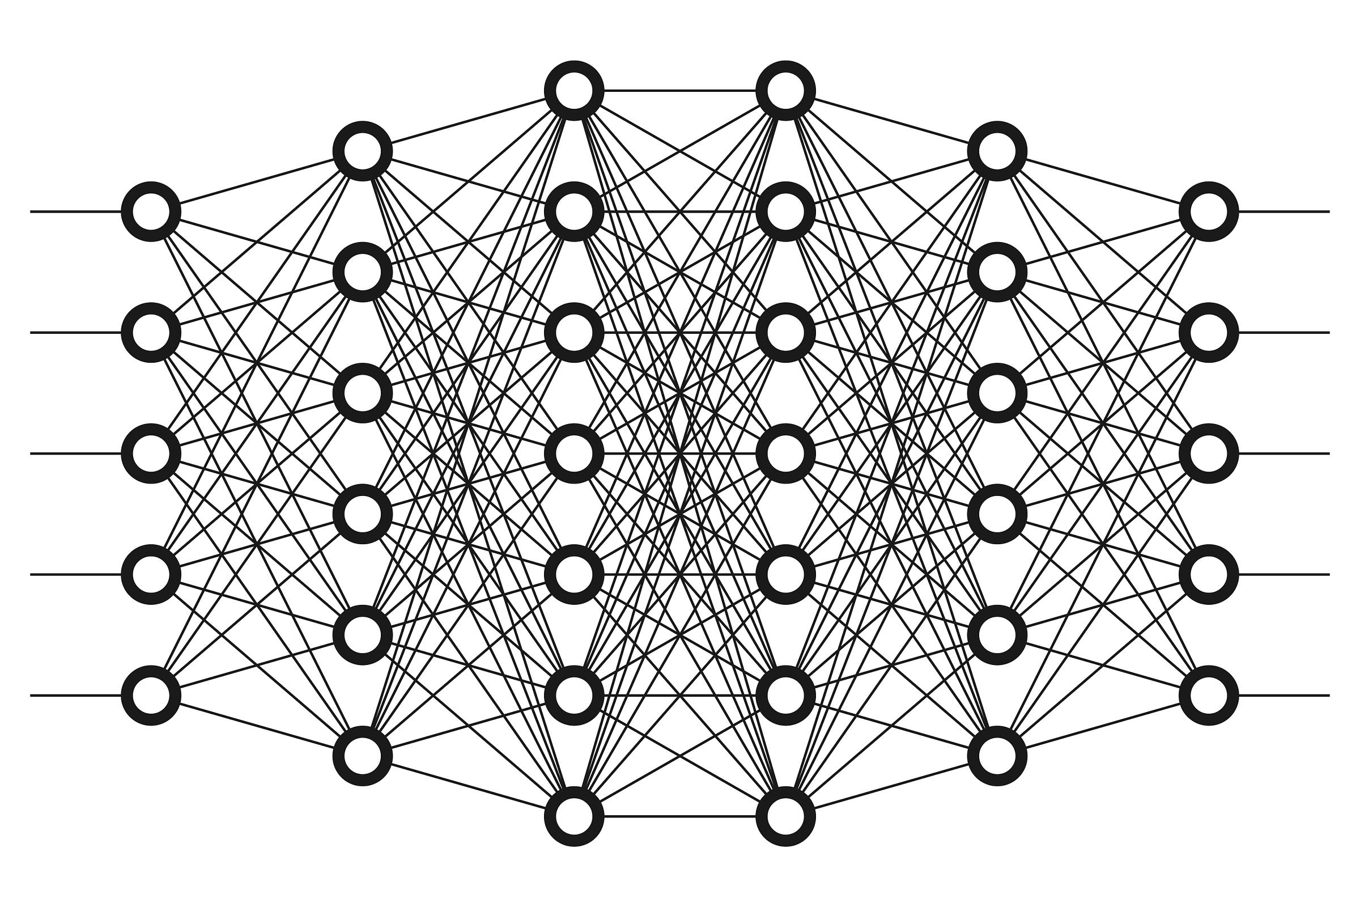

Forward pass
Backward pass
Optimization Step
Data
Send batch size to model
Compute Loss, L
Compute Gradient, 𝛁
Update Weights/model

Slide 3
Forward pass:
Backward pass
Optimization Step
Compute Loss
Update Weights/model
Compute Gradient
Forward pass:
Backward pass
AllReduce:
Average Gradients from each GPU
Optimization Step
Data
Send different batch to each GPU with Distributed Sampler
Compute Loss
Update Weights/model
Compute Gradient
Forward pass:
Backward pass
Optimization Step
Compute Loss
Compute Gradient
Update Weights/model

Slide 4
Forward pass:
Backward pass
Optimization Step
𝛁
𝛁
𝛁
L
𝛁
Update Weights/model
Compute Loss
Compute Gradient
Forward pass:
Backward pass
Optimization Step
Data
AllReduce:
Average Gradients
𝛁
𝛁
𝛁
L
𝛁
Compute Loss
Update Weights/model
Send different batch to each GPU with Distributed Sampler
Compute Gradient
Forward pass:
Backward pass
Optimization Step
𝛁
𝛁
𝛁
𝛁
L
Compute Loss
Compute Gradient
Update Weights/model

