Slide 1
Example trials
Notes:
for English-speakers

Slide 2
VAS task
Visual analog scale

Slide 3
とる
toru
とおる
tooru
Click on the slider based on what you think the word sounded like, then press the Spacebar to continue.
Notes:
Japanese VAS

Slide 4
とる
toru

Slide 5
とおる
tooru

Slide 6
かた
kata
かった
katta
Click on the slider based on what you think the word sounded like, then press the Spacebar to continue.
Notes:
Japanese VAS

Slide 7
かた
kata

Slide 8
かった
katta

Slide 9
risen
reason
Click on the slider based on what you think the word sounded like, then press the Spacebar to continue.
Notes:
English VAS

Slide 10
risen

Slide 11
reason

Slide 12
indent
intent
Click on the slider based on what you think the word sounded like, then press the Spacebar to continue.
Notes:
English VAS

Slide 13
indent

Slide 14
intent

Slide 15

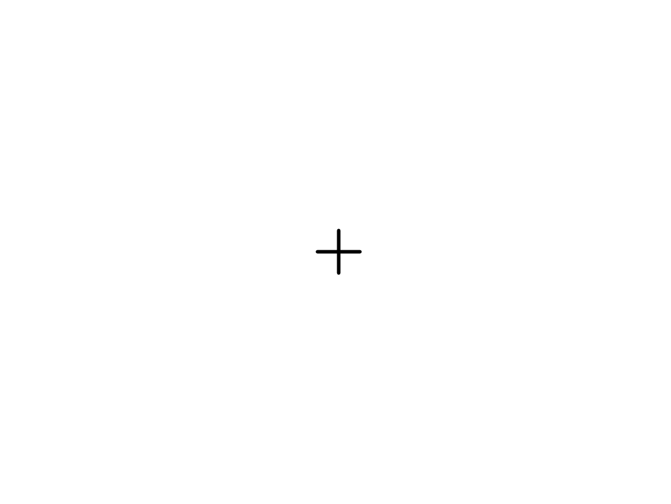
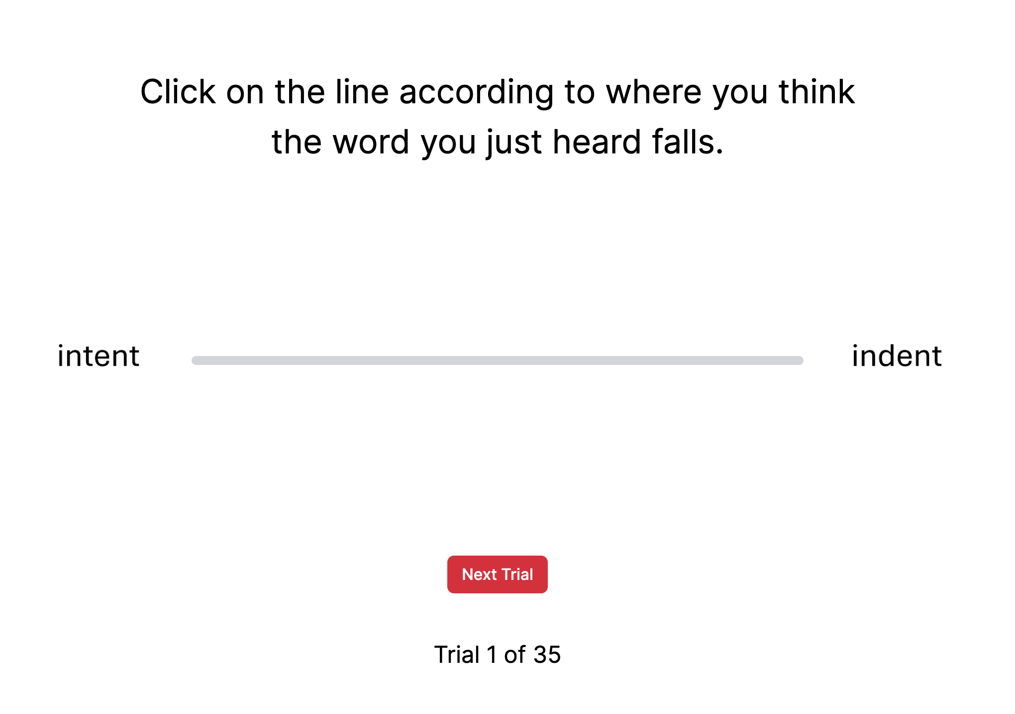

150 ms
duration of stimulus
かた
kata
かった
katta
150 ms
until response

Slide 16
AX discrimination task
Same-different speech discrimination

Slide 17
+
Notes:
old version

Slide 18
SAME or DIFFERENT?
[Stimulus A]
[500 ms ISI]
[Stimulus X]
Notes:
old version

Slide 19
SAME or DIFFERENT?
F
(Same)
J
(Different)
Notes:
old version

Slide 20

✓ Correct!
きいた
kiita
meaning: asked/heard
きた
kita
meaning: came
Press the Spacebar to continue.
Notes:
example: correct for “different” trial (old version)

Slide 21
✕ Incorrect!
きた
kita
meaning: came
きた
kita
meaning: came
Press the Spacebar to continue.
Notes:
example: incorrect for “same” trial (old version)

Slide 22
Fixation: 500 ms
Stimulus A
ISI: 500 ms
Stimulus X
Response
Feedback
OR
Notes:
old version

Slide 23
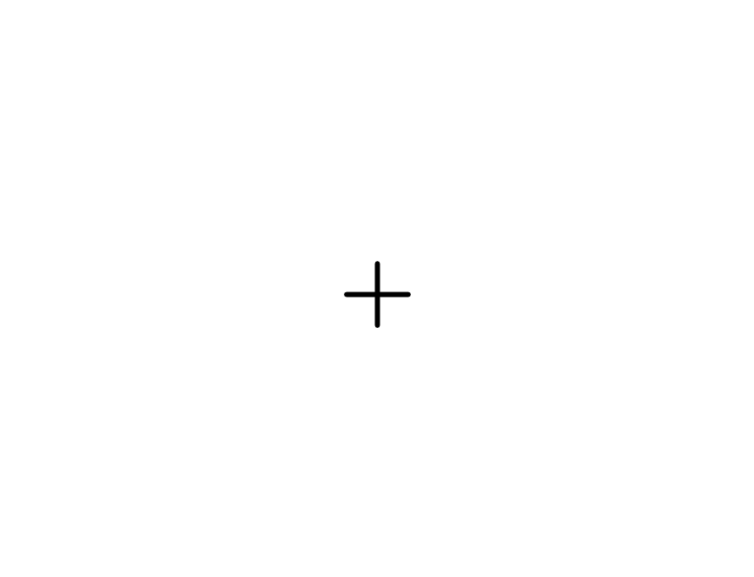

Slide 24
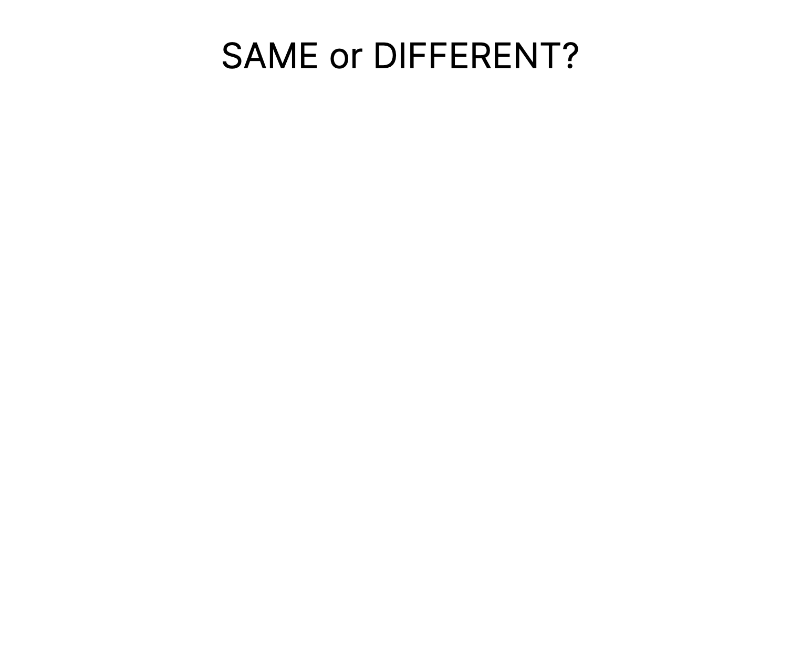

Slide 25
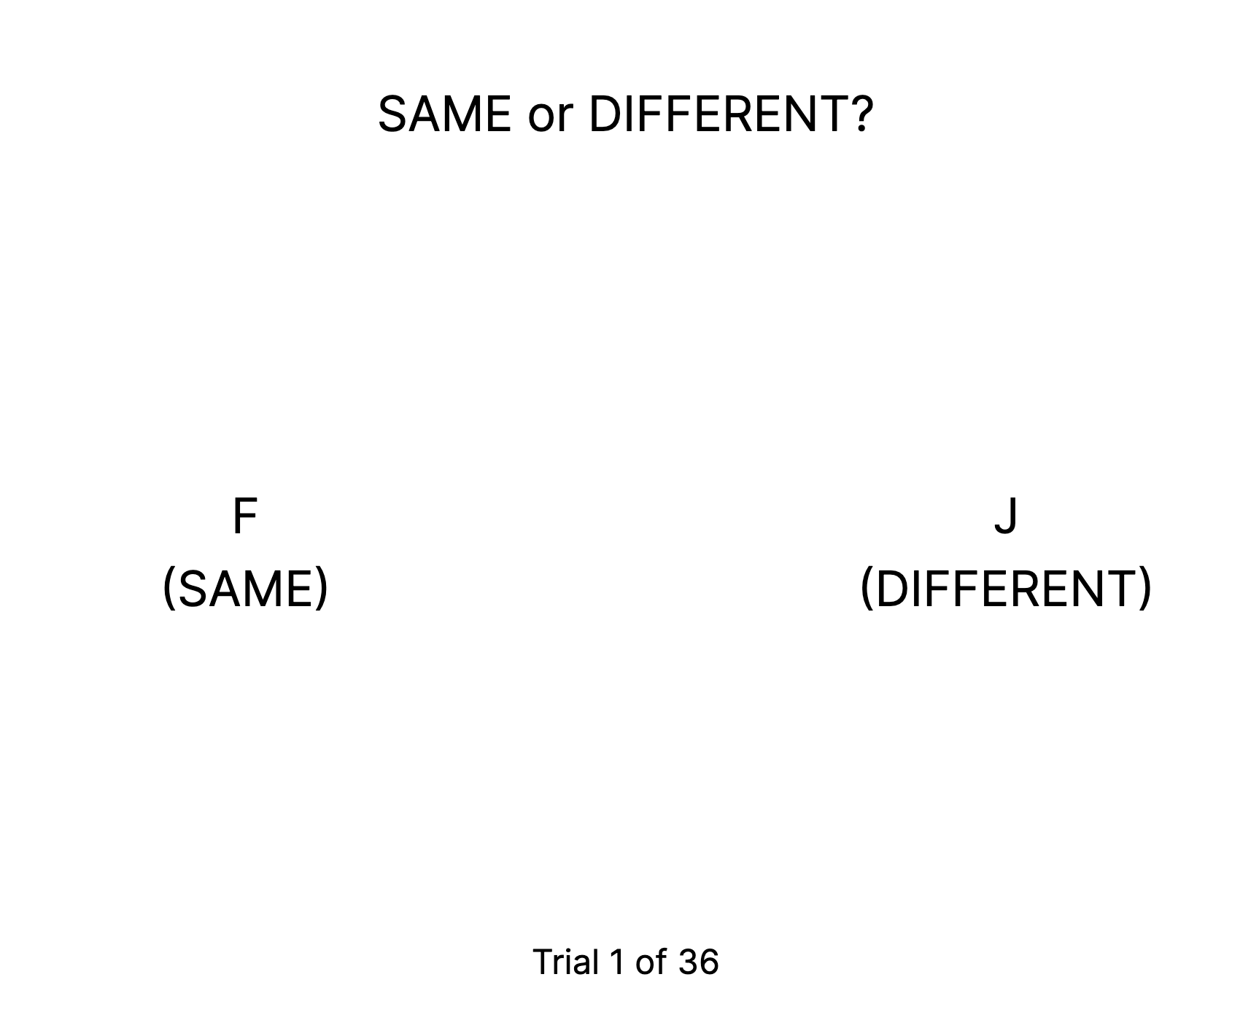

Slide 26
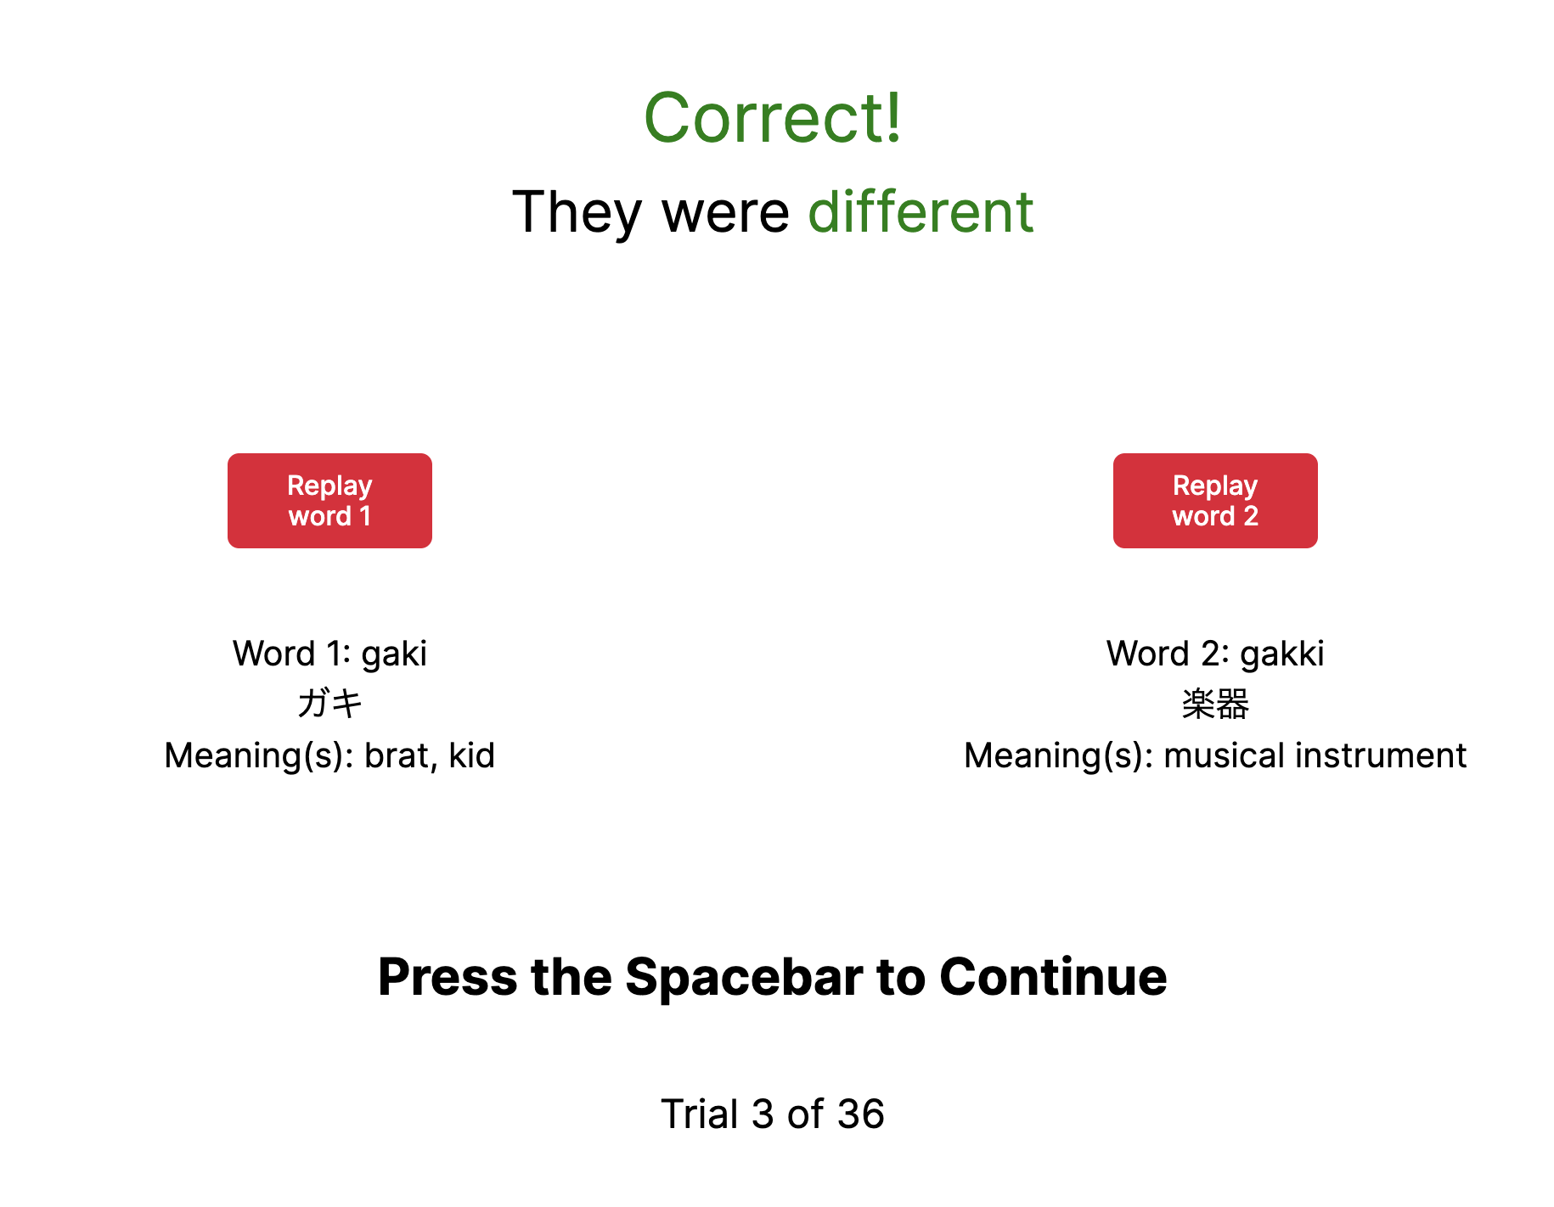

Slide 27
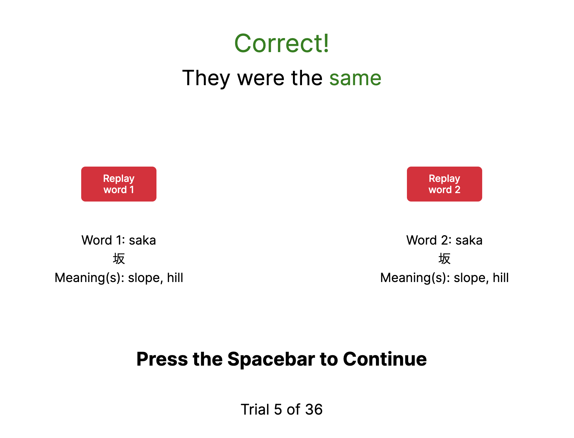

Slide 28
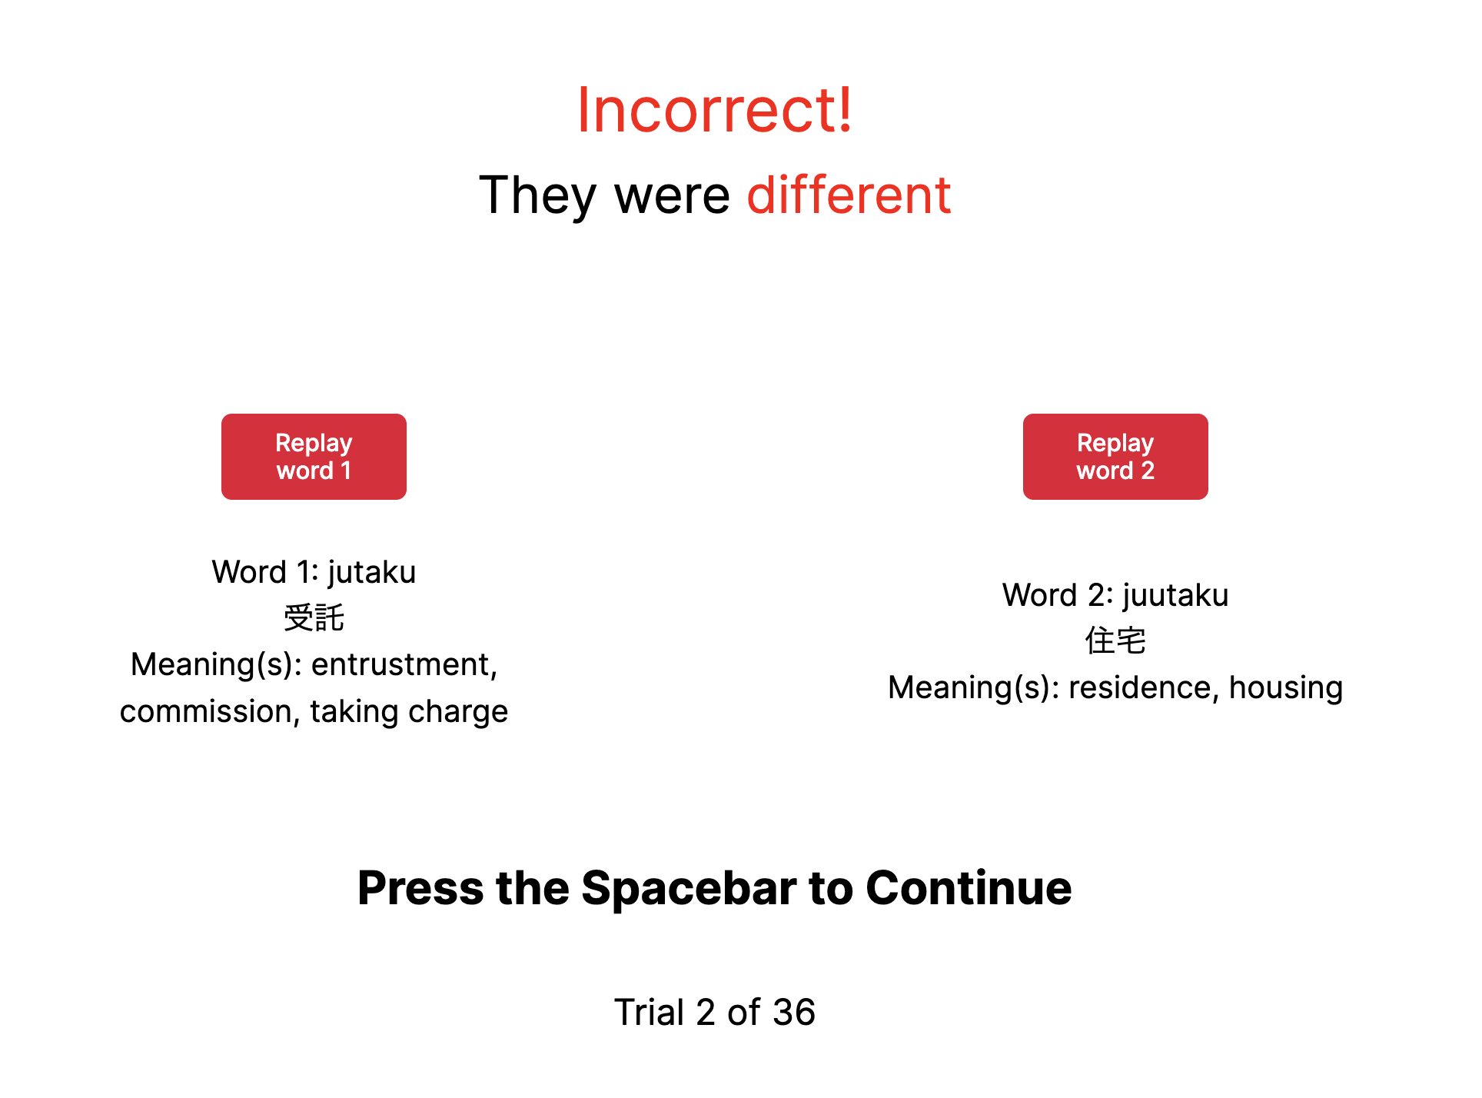

Slide 29
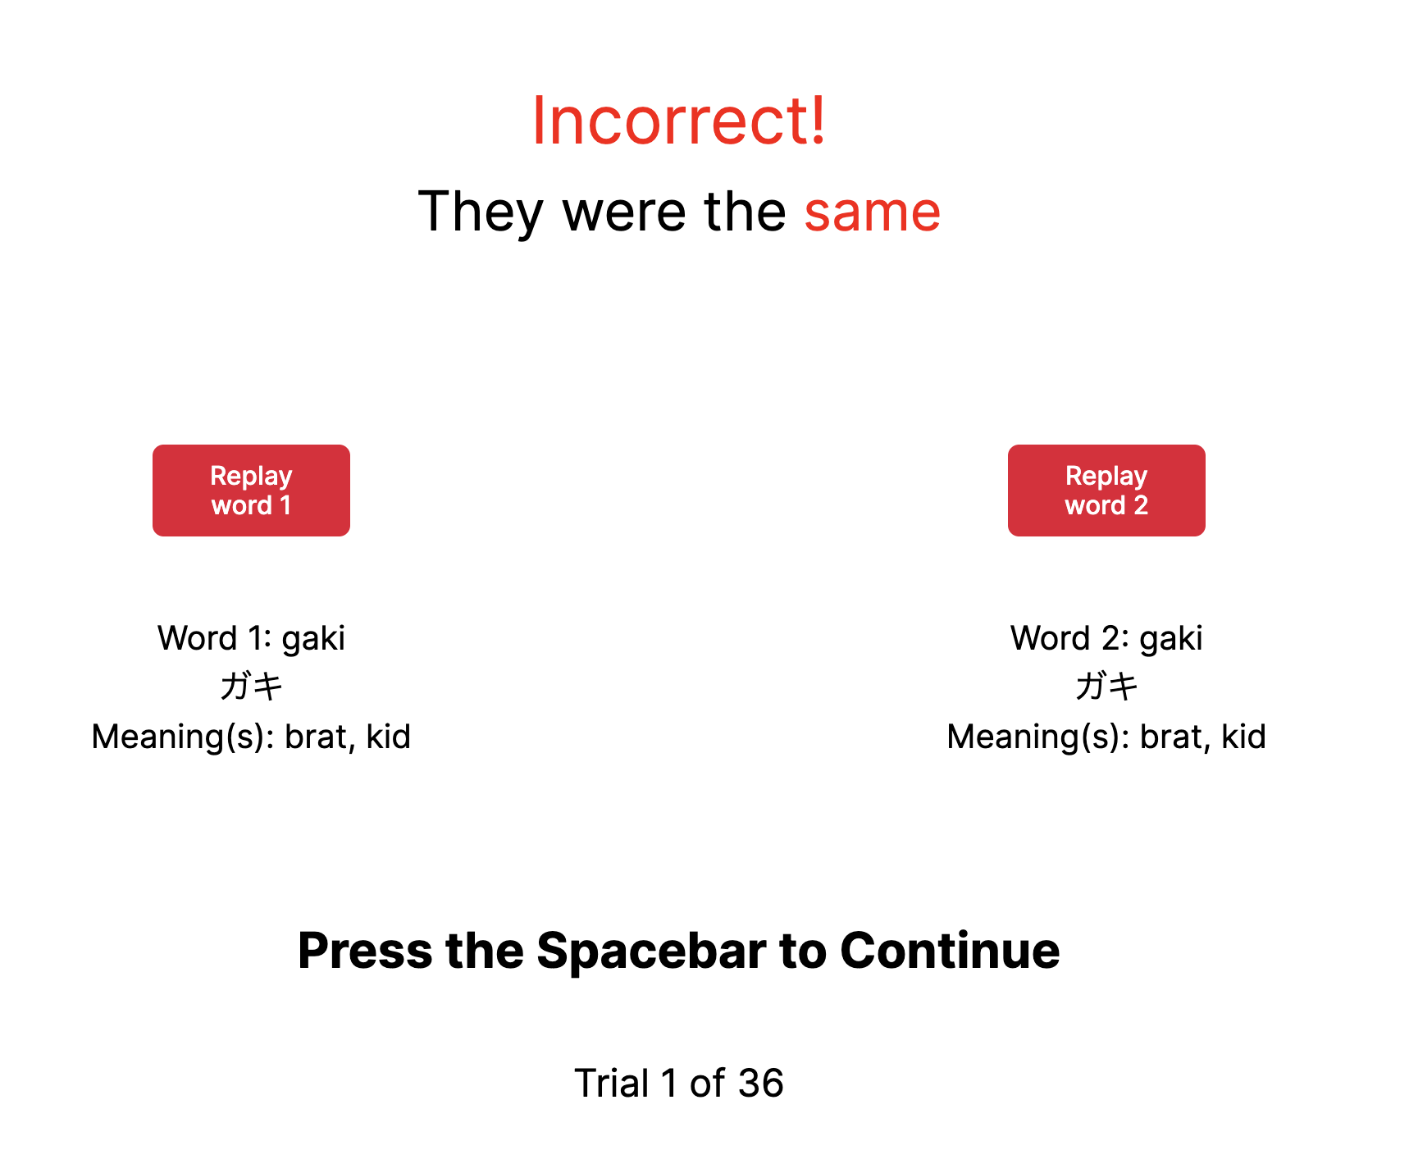

Slide 30
500 ms
fixation
Stim A
500 ms
ISI
Stim X
Response

Slide 32
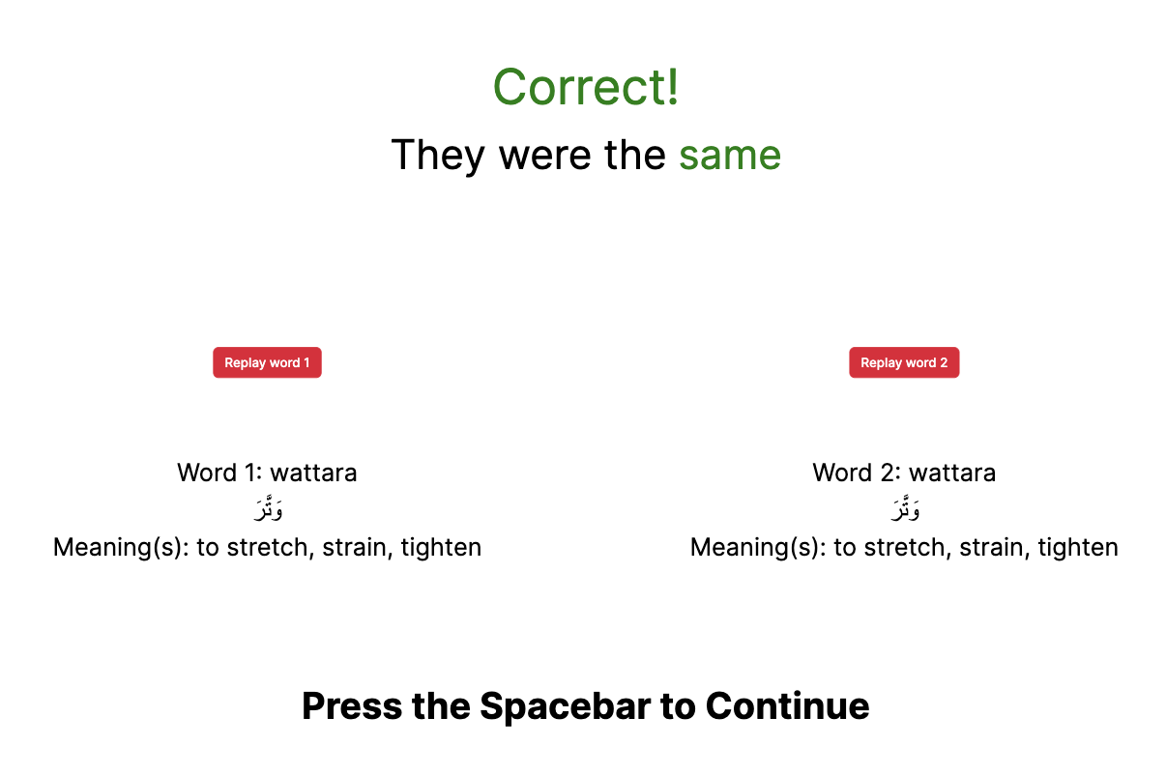
Notes:
Arabic example

Slide 33
MCPD listening assesssment
Multiple-choice partial dictation

Slide 34
