Slide 1
June 4th, 2024 Setup
Stand-mounted Shure SM48 Microphone + foam windscreen connected via XLR cable to Focusrite Scarlett 4i4 3rd Gen USB audio interface, connected to Macbook Pro
France 3 years, UK 6 years total, Japan from 9 years-22 years old, 1 year Australia, 13 years in the US, 37-years-old
each sentence repeated twice, ultimately spoken with slight but natural pause to better separate target word from carrier sentence
Notes:
we did the recording three times:
first time read as written with quotations around target word, sentences repeated only once (she forgot) = female-raw-recording-june-4-first-attempt
second time we tried without the quotations around target word because we both thought it sounded too unnatural, sentences repeated twice = female-raw-recording-june-4-second-attempt.wav
third time we put the quotations back because of too much coarticulation made it hard to isolate the words, sentences repeated twice = female-raw-recording-june-4-third-attempt.wav
generalized american with little regionalized influence, but to the careful listener may pick up on Japanese influence
note: r’s sounded slightly w-like

Slide 2
Please say “right” again

Slide 3
Please say “light” again

Slide 4
また「取る」と言ってください

Slide 5
また「通る」と言ってください

Slide 6
また「来た」と言ってください

Slide 7
また「切った」と言ってください

Slide 8
Sept 6th, 2024 set up
rerecording for new English words, because I dropped the L1 Japanese L2 English population, so no longer need the /r/-/l/ words and instead need English words to better match the Japanese targets
matching in use of some durational cues, number of syllables, and having two continua, one for consonant target phonemes and one for vowel target phonemes, just like the Japanese words
also changed kita/kitta to kata/katta because the /i/ sound was being devoiced meaning I wouldn’t have been able to make pitch manipulations
each sentence repeated twice, ultimately spoken with slight but natural pause to better separate target word from carrier sentence
Notes:
first attempt – English was good, kata/katta had vocal fry at the end of the utterance = female-raw-recording-sept-6-first-attempt.wav
second attempt – just kata/katta, did without the pause to avoid vocal fry, which was successful, only issue is the end just sounds a bit off because it sounds like there should be something afterwards (same problem as attempt #2 from the first time) = female-raw-recording-sept-6-second-attempt.wav

Slide 9
また「肩」と言ってください
Notes:
HL

Slide 10
また「勝った」と言ってください
Notes:
HLL

Slide 11
Please say “indent” again

Slide 12
Please say “intent” again

Slide 13
Please say “risen” again

Slide 14
Please say “reason” again

Slide 15
Source recordings for each contrast pair
female-raw-recording-june-4-third-attempt.wav
toru vs. tooru
noise: 0 – 4.62 s
female-raw-recording-sept-6-first-attempt.wav
indent vs. intent
risen vs. reason
noise: 19.04 – 21.19 s
female-raw-recording-sept-6-second-attempt.wav
kata vs. katta
noise: try 19.12 – 20.06

Slide 16
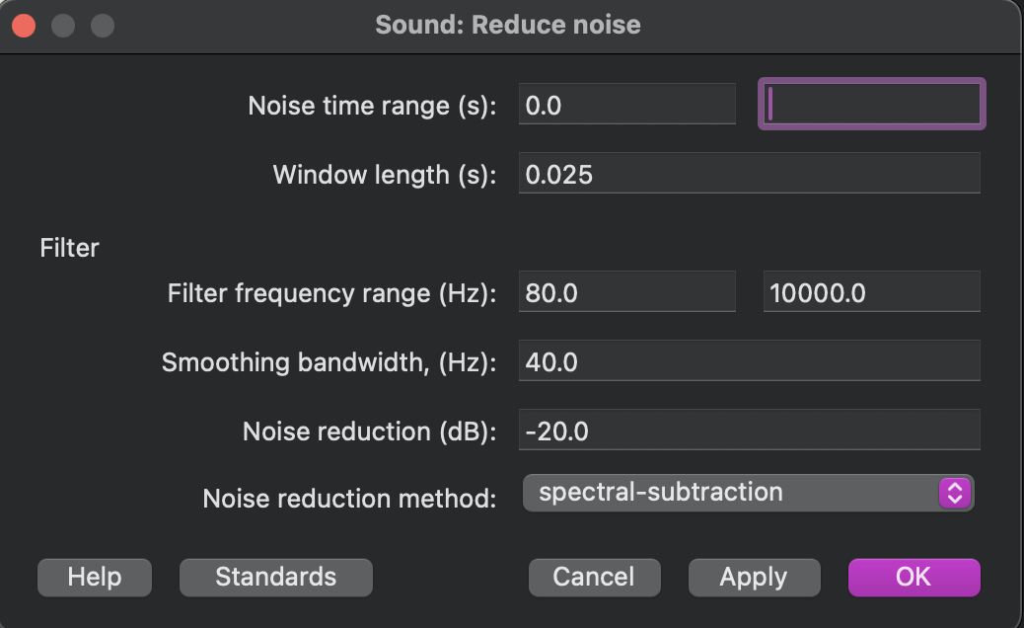
Pre-processing
denoise raw recordings
Filter > Reduce noise
standard parameters, just changed the noise time range

Slide 17
Choices
d/t: indent-2 and intent-1
i/ɪ: reason-1, risen-1
o/oo: toru-2 and tooru-1 (had most similar C1, C2, V2 durations after some tweaking, and most similar C2 spectral qualities by looks)
t/tt: kata-1b and katta-2b
manipulated katta-1b and katta-2b to add pulse points at glottal pulses to improve pitch tracking, original wav files saved as ”[name]-orig.wav” while manipulated files have the suffix “[name]-manip.wav”
sound -> to manipulation -> added pitch points -> get resynthesis (overlap-add)
I did not manipulate kata-1b or kata-2b (yet)
I am specifically using kata-1b-orig and katta-2b-manip

Slide 18
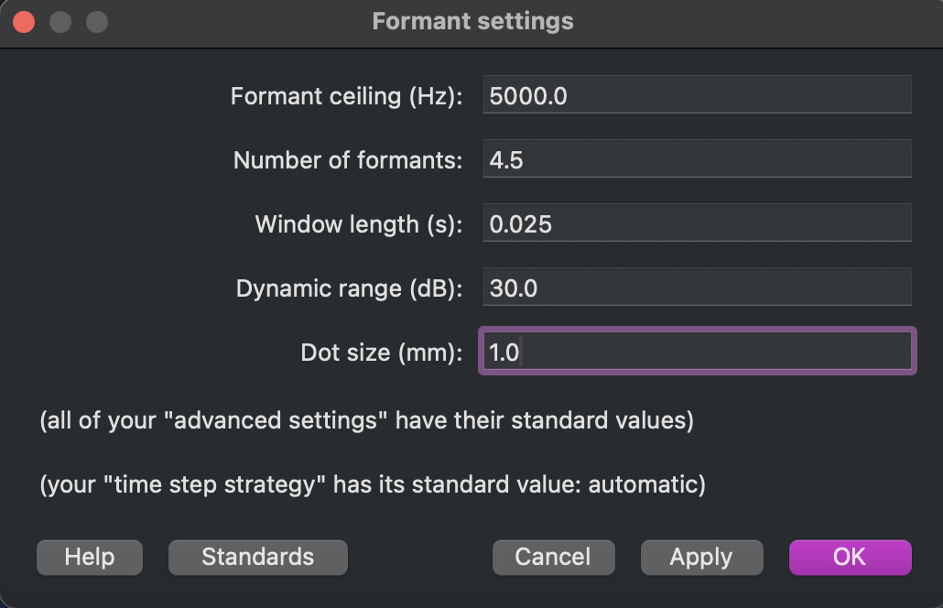
Other notes
needed to change formant settings for risen-1, risen-2, and reason-1 for better formant tracking, specifically formant ceiling and number of formants were changed from the standards
this resulted in risen-1 and reason-1 being the better tokens for the vowel (reason-2 had somewhat better tracking at the standards but ultimately less good than reason-1, especially with these settings)

Slide 19
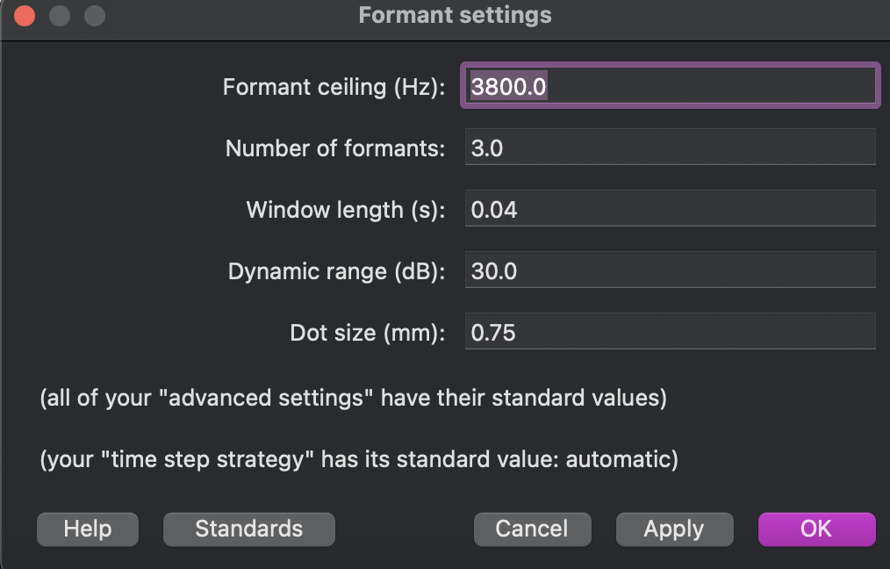
Other notes
these were the formant settings used in the script for reason-1 and risen-1
note changes from standards for the formant ceiling, number of formants, and window length

Slide 20
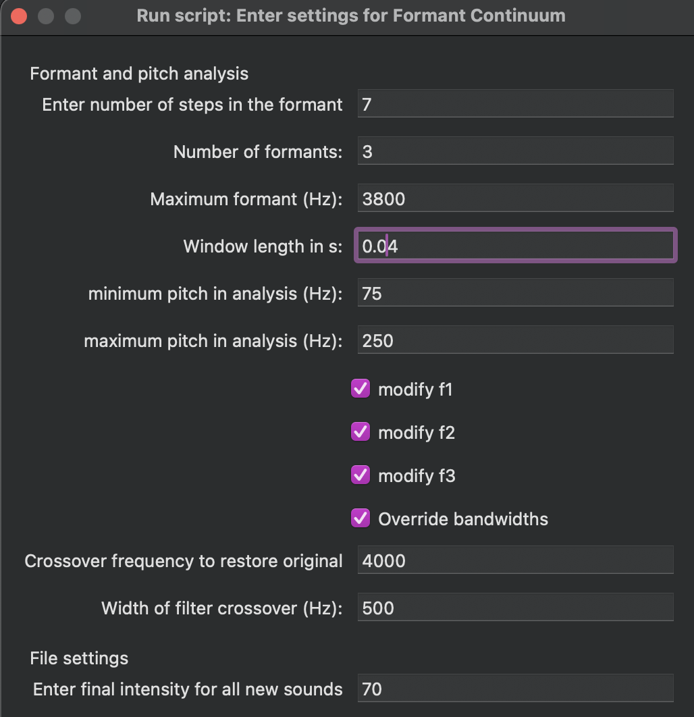
final script settings and manipulations for spectral continuum of reason vs risen
note that I’m modifying F1, F2, and F3 instead of just F1 and F2
adding 0.05 ms of silence as the precursor, and using the second syllable from reason_1 (right from the offset of the vowel) for the postcursor until the end of the file (which is about 0.05 s of silence after the word)
pitch manipulation of reason_1 is for the entire first syllable, multiple contour by 0.7, then raise pitch contour by 50 Hz (in that order)
also manipulated formant contours to better match what I see on the spectrogram
also the script automatically interpolates the formants in equal bark steps (not Hz)

Slide 21
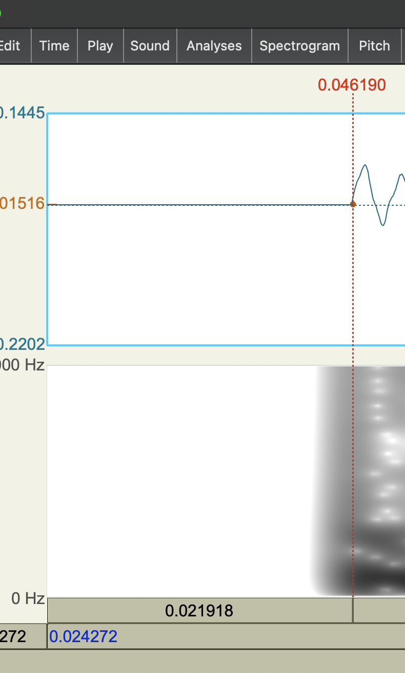
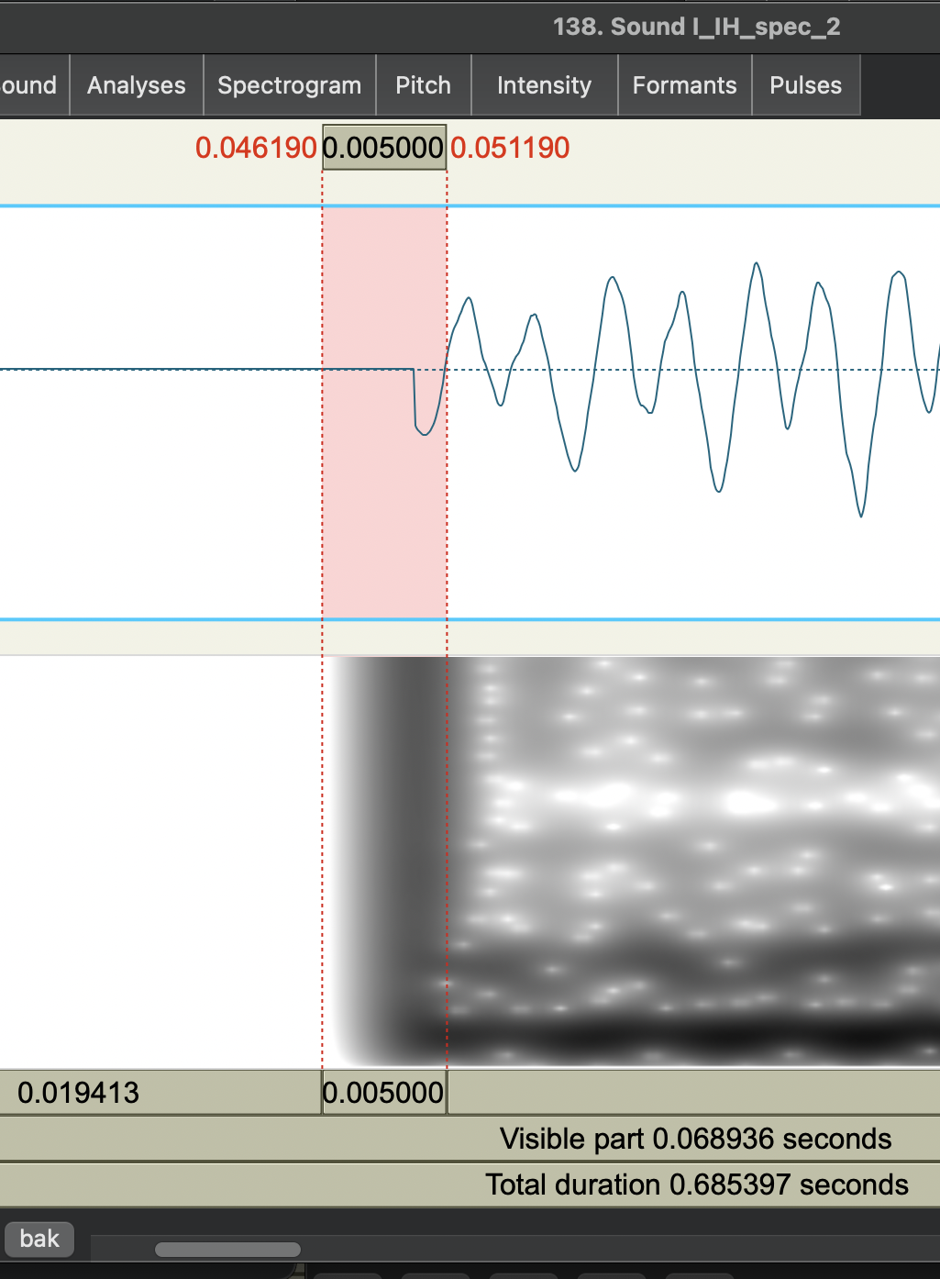
spectral continuum other notes
cut out 5 ms of high amplitude popping sound from every file that appeared due to appending 50ms of silence
for some reason this resulted half of the first period being cut off and the wave being started on a down cycle
new cut was made at nearest zero crossing

Slide 22
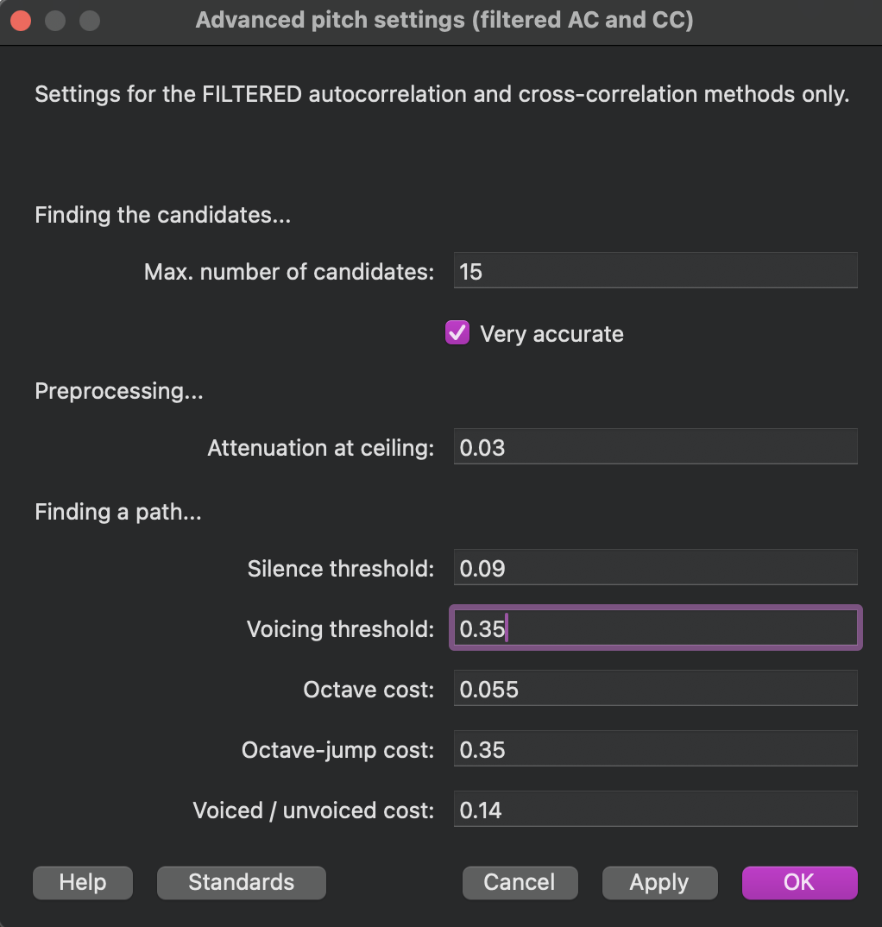
Other notes
pitch tracking for creaky voice of kata/katta from first attempt (kata/kata-[1/2]-a) is better after adjusting advanced pitch settings (filtered AC and CC), specifically voicing threshold
kata/katta-[1/2]a recordings are from YA-raw-recording-sept-6-first-attempt.wav
kata/katta-[1/2]b recordings are from YA-raw-recording-sept-6-second-attempt.wav

Slide 23
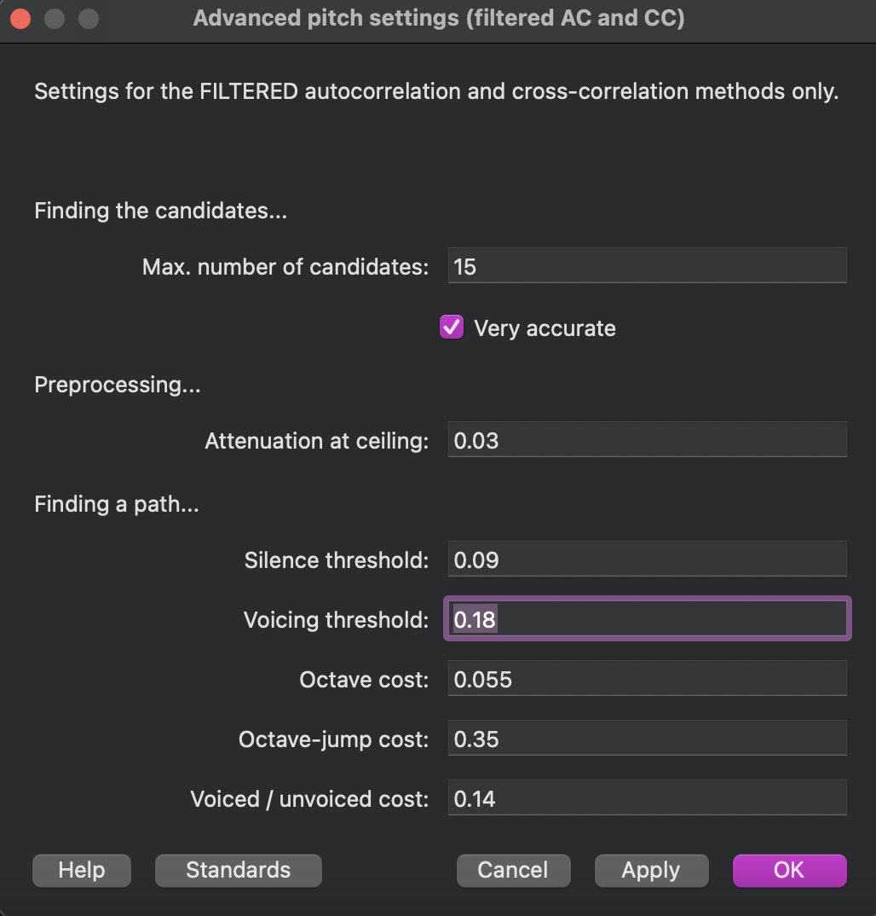
Other notes
for manipulated (with pulse points and pitch points added) katta-1b, pitch tracking only appeared when voicing threshold was lowered to 0.18
NOTE: once I changed pitch min and max to 50-500 Hz, pitch tracking appeared when voicing threshold was lowered to 0.25

Slide 24
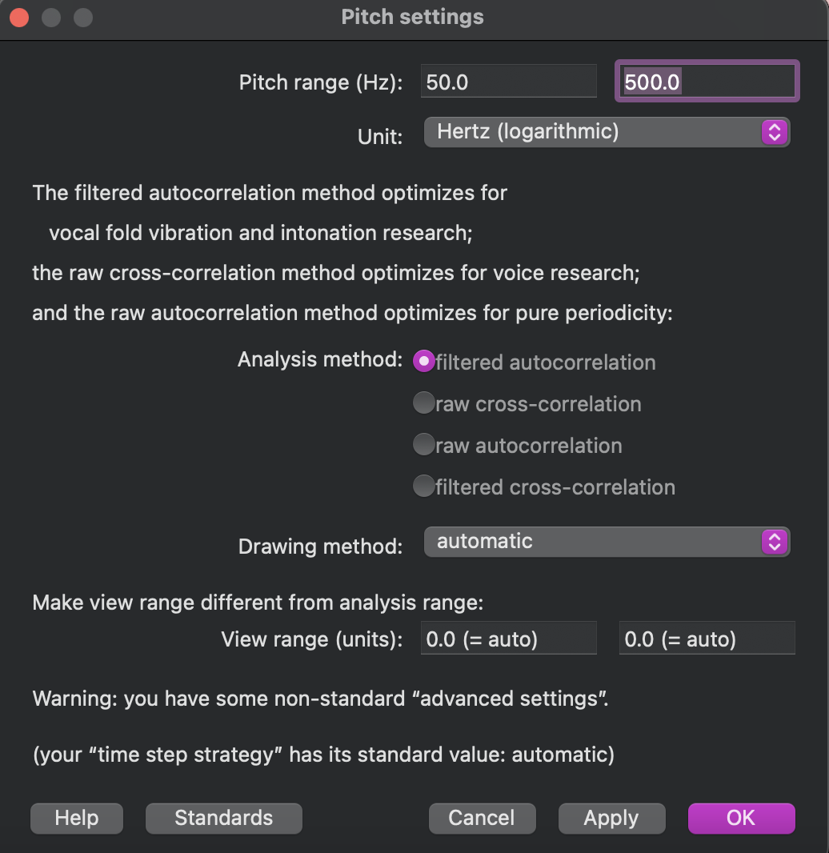
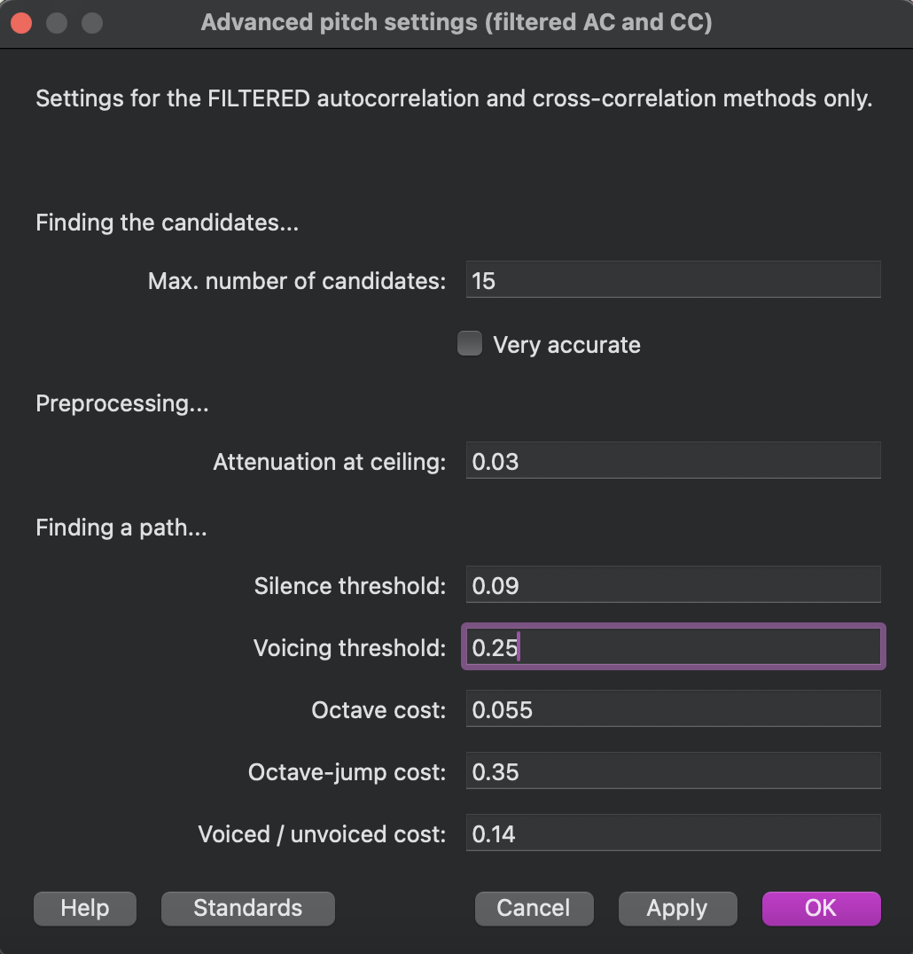
kata_1b_orig vs katta_2b_manip settings to make continuum
pitch settings 50 – 500 Hz (filtered autocorrelation)
advanced pitch settings (filtered ac and cc) voicing threshold 0.25
because the f0 contour scripts need the two files to have the same timing landmarks, I cut the beginning of katta_2b_manip.wav so that it has the same duration of silence before word onset as kata_1b_orig.wav, and the new wav file and textgrid are saved as “katta_2b_manip_time_aligned”

Slide 25
Segmentation for cues
d/t: VOT – following Winn,2020
burst = onset of burst release, nearest zero crossing
voicing = onset of regular, clearly periodic waveform (even if there is some aspiration on the waveform), nearest zero crossing after glottal pulse
i/ɪ (include transitions?): F1/F2
word onset = (including [ɹ] and vowel) nearest zero crossing before the first period for which the following period increases in amplitude, also the point in which formants appear more clearly on the spectrogram (more influenced by the second than the first)
vowel offset = nearest zero crossing before frication becomes visible on periodic waveforms (even if mid-period)
o/oo: vowel duration
vowel onset = nearest zero-crossing at the appearance of regular periodicity that corresponded well with the appearance of an f0 band in the spectrogram
vowel offset = nearest zero-crossing at the end of the vowel where the waveform reduced in amplitude (closure corresponding with C2), for one of the recordings there was a burst in the spectrogram at closure
t/tt: stop closure duration
closure onset = nearest zero-crossing after wave amplitude falls below 0.005 (rounded up)
closure offset = burst of following consonant
Note: zero-crossings are always at upward zero-crossings
Notes:
suggestions for vowels: using the criterion that there be no abrupt changes in formant movement throughout the vowel, no abrupt changes in fundamental frequency, and minimal extraneous noise (to facilitate resynthesis) (Kondaurova & Francis, 2008)

Slide 26
Segmentation for other stuff
d/t: F0
F0 at voicing onset = f0 at onset of regular, clearly periodic waveform (even if there is some aspiration on the waveform), nearest zero crossing after glottal pulse
F0 contour inflection point =
need some sort of intermediate value for the closure gesture (longer for /t/ than /d/)
closure onset: when wave amplitude gets below 0.0001 (or 0.001?), nearest zero-crossing
i/ɪ (include transitions?): duration
vowel onset = at onset of formant steady state portion on spectrogram, at nearest zero crossing before the first waveform period that is contained within the steady state portion according to the spectrogram
alternatively – midpoint of formant transition? since formant transition is faster in risen vs. reason - about 60% of the way into transition period – that’s where the first duration time point will be placed, then the peak of the duration time point will be placed at the actual formant steady state onset
o/oo: vowel pitch contour
vowel f0 steady state offset =
vowel f0 contour offset =
t/tt: pitch drop – maybe difference between them is (stable) pitch height of V1
each vowel onset = nearest zero-crossing before first sign of clear periodicity
each vowel offset = nearest zero-crossing after wave amplitude falls below 0.005 (rounded up)
Note: zero-crossings are almost always at upward zero-crossings
Notes:
suggestions for vowels: using the criterion that there be no abrupt changes in formant movement throughout the vowel, no abrupt changes in fundamental frequency, and minimal extraneous noise (to facilitate resynthesis) (Kondaurova & Francis, 2008)

Slide 27
L1 English contrasts
/d/ vs. /t/
indent vs. intent
primary cue: VOT
Step 1 (/d/): 21 ms -> Step 7 (/t/): 83 ms
secondary cue: vowel onset F0
Step 1 (/d/): 176 Hz -> Step 5 (/t/): 213 Hz
(original files)

Slide 28
/dɛn/ in indent
/tɛn/ in intent

Slide 29
L1 English contrasts
primary cue: F1/F2/F3 (includes /r/)
Step 1 (/i/) in blue -> Step 7 (/ɪ/) in red
important note: formant interpolations are in bark scale
/i/ vs. /ɪ/
reason vs. risen
secondary cue: vowel duration (includes /r/)
Step 1 (/i/): 176 ms -> Step 5 (/ɪ/): 75 ms (original files)
Step 1 (based on spectral Step 1): 234 ms -> Step 5 (based on original risen): 125 ms

Slide 30
F1/F2/F3 Formant Frequency Continuum
F3
F2
F1
blue = Step 1 (reason-like)
red = Step 7 (risen-like)

Slide 31
L2 Japanese contrasts
secondary cue: F0 drop from V1-V2
Step 1 (kata-like) in blue
Step 5 (katta-like) in red
important note: I used f0 interpolations are in log scale
/t/ vs. /tt/
kata vs. katta
closure duration
Step 1 (/t/): 99.6 ms -> Step 7 (/tt/): 180 ms
V1-V2 pitch difference:
(for C1V1C2V2 where C2 is t or tt)
Step 1 (/t/) -> Step 5 (/tt/)
kata V1 295-315-310 V2 207-117
katta: V1 310-330-325 V2 177-73
Notes:
notes:
the exact wav files used for this manipulation were kata_1b_orig.wav and katta_2b_manip_time_aligned.wav
within Praat, I renamed them to just kata and katta to simplify the naming process of the continua files
I first made each syllable roughly line up time wise as best as I could – I had originally tried to warp the duration of each syllable to be the mean duration between the two words but that resulted in weird pitch distortion, so I just tried to make the time marks of the syllables (and thus the start of voicing) roughly match up (I also adjusted this manually using the Pitch object (NOT the same as the PitchTier of the manipulation object) so that the voiced parts of the vowels lined up between the two words)
then, I interpolated pitch separately for each syllable (in log scale), starting from the kata endpoint and going to the Hz values of the katta endpoint, and then concatenated the syllables with the consonant closure from kata
this gave the five steps of the F0 drop cue, then for each of those five steps I created a duration continuum, just increasing the closure duration to the value for the katta endpoint (since each pitch step was starting with the duration from the katta step)
I did not make a second continuum with katta as the origin sound because the creaky voice makes it too poor of a starting point for manipulation
I also had to manually add pulse points to the manipulation object for the syllable 2 sounds because the Manipulation object is created only using raw auto-correlation periodicity tracking algorithm, which was not recognizing the F0 contour/pulses due to creaky voice (the F0 and pulse points of which were tracked fine using filtered auto-correlation) – it was only after manually adding the pulse points, then the add-overlap synthesis worked to perceptually change the pitch contour with the updated PitchTier from the interpolation
the pitch settings used for these continua is in the script

Slide 32
Pitch Drop Continuum
Syllable 1
Syllable 2
blue = Step 1 (kata-like)
red = Step 5 (katta-like)
Notes:
notes:
the exact wav files used for this manipulation were kata_1b_orig.wav and katta_2b_manip_time_aligned.wav
within Praat, I renamed them to just kata and katta to simplify the naming process of the continua files
I first made each syllable roughly line up time wise as best as I could – I had originally tried to warp the duration of each syllable to be the mean duration between the two words but that resulted in weird pitch distortion, so I just tried to make the time marks of the syllables (and thus the start of voicing) roughly match up (I also adjusted this manually using the Pitch object (NOT the same as the PitchTier of the manipulation object) so that the voiced parts of the vowels lined up between the two words)
then, I interpolated pitch separately for each syllable (in log scale), starting from the kata endpoint and going to the Hz values of the katta endpoint, and then concatenated the syllables with the consonant closure from kata
this gave the five steps of the F0 drop cue, then for each of those five steps I created a duration continuum, just increasing the closure duration to the value for the katta endpoint (since each pitch step was starting with the duration from the katta step)
I did not make a second continuum with katta as the origin sound because the creaky voice makes it too poor of a starting point for manipulation
I also had to manually add pulse points to the manipulation object for the syllable 2 sounds because the Manipulation object is created only using raw auto-correlation periodicity tracking algorithm, which was not recognizing the F0 contour/pulses due to creaky voice (the F0 and pulse points of which were tracked fine using filtered auto-correlation) – it was only after manually adding the pulse points, then the add-overlap synthesis worked to perceptually change the pitch contour with the updated PitchTier from the interpolation
the pitch settings used for these continua is in the script

Slide 33
L2 Japanese contrasts
/o/ vs. /oo/
toru vs. tooru
vowel duration:
Step 1 (/o/) : 104 ms -> Step 7 (/oo/): 329 ms
pitch contour (for CV1CV2 where V1 is o or oo)
(from V1 onset -> V1 maximum -> V1 offset -> V2 onset -> V2 offset):
Step 1 (/o/): -> Step 5 (/oo/):
F0 interpolations are in log scale
Notes:
Notes:
the exact wav files used in this manipulation were toru_2_mod.wav and tooru_1_mod.wav – within Praat, I renamed them toru and tooru to make the naming process of the continua files easier
first I will make two equivalent duration continua, one that starts from each endpoint (of JUST the vowel length – C1, C2, and V2 duration will remain constant)
then I will interpolate pitch between the endpoints of equivalent duration (this includes pitch across V1 and V2)
because of the creaks at the end of the word (at the end of V2), I chose to edit out the last of the creaky voice where the regularity of the periodicity breaks down, and then replace it with 50ms of silence (specifically I concatenated with overlap, with the overlap being 1 ms (0.001 s)
I did this for both toru and tooru, and both are now called toru_2_mod.wav and tooru_1_mod.wav respectively – this works better for the pulse tracking on the manipulation object for the pitch and duration manipulations
I also had to adjust the silence at the beginning so that the start of the two words would be aligned and thus each of the duration manipulated steps (made from each starting point – continuum steps made from toru and continuum steps made from tooru) would also be aligned in order to properly do the pitch manipulation
tooru_1_mod.wav had 0.050226757369614516 s before the start of the word
toru_2_mod.wav had 0.026341107871720115 s before the start of the word
so I added 0.02388564949 s to the start of toru_2_mod.wav and the corresponding text grid (new text grid is saved as toru_2_mod.TextGrid)
I made two versions of all 35 tokens (7 dur x 5 F0), since the duration and F0 manipulations done on Praat can only be done using one word as the origin word and then interpolate to the values of the other word – i.e., manipulations are only being done using one sound file as the origin, not a merge between the two
first I made two duration continua, one that is toru_origin and one that is tooru_origin
then I will make two different F0 continua from each of these that interpolate the F0 contours between the equivalent duration steps of the toru_origin and tooru_origin continua
ver 1: toru_dur origin and toru_f0 origin
ver 2: tooru_dur origin and tooru_f0 origin
then I will make a matrix of the final 35 stimuli that will be used that attempts to equally use stimuli between the two versions
very important note: the F0 continua at dur_1 and dur_7 are derived from the base files toru_2_mod.wav and tooru_1_mod.wav respectively, rather than the endpoints that were created from making the duration continuum
the F0 continua at dur_2, dur_3, and dur_4 were derived from the toru_origin duration continuum sounds
the F0 continua at dur_4, dur_5, and dur_6 were derived from the tooru_origin duration continuum sounds
so there are two versions of F0 continua at dur_4 step
I will choose whether the sounds of the F0 continuum at dur_4 will be from the toru_origin or tooru_origin version
for dur_4, I will probably use toru_origin for F0_1, F0_2, and maybe F0_3, and then tooru_origin for F0_4 and F0_5, and maybe F0_3
***final choices, from my own ear: I will use toru_origin for dur_4_F0_1, and tooru_origin for the rest of dur_4 series (F0_2, F0_3, F0_4, F0_5) – these just sounded more natural from tooru_origin, while only F0_1 sounded more natural from toru_origin (only slightly) – see the next slide

Slide 34
toru [o] as base word vs. tooru [oː] as base word
Primary: Vowel duration
 | 1 (104 ms ) | 2 | 3 | 4 | 5 | 6 | 7 (329 ms )
1 (toru-like – HL) | toru-origin
2
3
4
5 (tooru-like – HLL) |  |  |  |  |  |  | tooru-origin
Secondary: Pitch contour
Notes:
final picks for toru-tooru
Final stimuli choices for Vowel Duration x Pitch Contour continuum matrix

Slide 37
for continua-table.xslx
indent-intent
primary and secondary values taken from D_T_Continuum_Info.txt
reason-risen
primary values for F1/F2/F3 taken from vowel segment midpoint, which was time index 15 (of 30) of each step from the format_table_wide.xlsx output file
for secondary values were obtained from spectral_continuum_duration_info.txt (though the automatic naming scheme lists the shortest duration as step 1, step 1 is actually 234 ms, reason-like, and step 5 is 125 ms, risen-like)
kata-katta
primary values were taken from consonant-closure-duration-info.txt
secondary values were taken from the max F0 of the first syllable and the min F0 of the second syllable – these values were obtained by using the 7th time index (of 8) of each step (for both syllables) from the f0_interp column of the F0_kata_katta_syllable1_log.csv and F0_kata_katta_syllable2_log.csv files
toru-tooru
primary values were taken from vowel_length_interpolation.txt
secondary values for F0 contour were taken from time index 1, the time index at the end of the first vowel (the exact time point varies across duration steps, but it’s the time index before f0_interp is NA) and the final time index – because the interpolations of F0 at these time points are all a little different across the seven duration steps, I’m arbitrarily choosing to report the values from dur_4 tooru-origin (dur_4_F0_tooru_origin_toru_log.csv)

Slide 38
scripts that were used (and modified) to make the VAS stim
VOT-F0 for indent-intent:
http://www.mattwinn.com/praat/Make_VOT_Continuum_v33.txt
a tutorial for this specific script was officially published: Winn, M. B. (2020). Manipulation of voice onset time in speech stimuli: A tutorial and flexible Praat script. The Journal of the Acoustical Society of America, 147(2), 852–866. https://doi.org/10.1121/10.0000692
spectra/duration for reason-risen:
http://www.mattwinn.com/praat/Make_Formant_Continuum_v44.txt
http://www.mattwinn.com/praat/Make_Duration_Continuum.txt
closure duration/pitch drop for kata-katta:
http://www.mattwinn.com/praat/Make_Duration_Continuum.txt
https://github.com/ListenLab/Praat/blob/master/Interpolate_F0_contour_v3.txt and https://hrbosker.github.io/resources/scripts/interpolate-f0/
vowel duration/pitch contour for toru-tooru:
http://www.mattwinn.com/praat/Make_Duration_Continuum.txt
https://github.com/ListenLab/Praat/blob/master/Interpolate_F0_contour_v3.txt

Slide 40
toru-tooru secondary dimension step values at other duration steps
secondary dimension step | pitch contour (Hz) at dur_1 | pitch contour (Hz) at dur_7
1 | 275/280/178 | 276/302/183
2 | 285/253/171 | 281/262/171
3 | 295/228/162 | 286/226/161
4 | 306/206/155 | 291/196/151
5 | 317/186/148 | 297/170/142
Notes:
because the interpolations of F0 at these time points are all a little different across the seven duration steps, here are the values from dur_1 (toru-origin) and dur_7 (tooru-origin) out of ease (dur_1_F0_toru_origin_tooru_log.csv and dur_7_F0_tooru_origin_toru_log.csv)
I could probably expand this to all of the duration steps for the appendix

Slide 41
Pitch Contour Continuum at...
A. Duration Step 1 (toru-base)
B. Duration Step 7 (tooru-base)
blue = Step 1 (toru-like)
red = Step 5 (tooru-like)

Slide 42
about all VAS stim
RMS normalized to 67 dB using “Scale intensity” function
adapted from source script: https://github.com//ListenLab/Praat/blob/master/Scale_intensity_all_sounds_in_folder_v1.txt
saved as both wav and mp3 files
adapted from source script: http://www.mattwinn.com/praat/Save_all_selected_sounds.txt

Slide 43
notes on Arabic segmentation for discrimination stimuli
glottal stop (hamza, arabizi character = 3) starting point is midpoint of formant transition from preceding vowel in the presence of strong coarticulation
with weaker coarticulation, there seems to be a slight burst across all frequencies of the spectrum to correspond with the release of the glottal stop
what helped was at these regions, praat sometimes struggled with pulse placement
help from this paper: https://www.isca-archive.org/interspeech_2008/yegnanarayana08_interspeech.pdf
for words that are right next to others (coarticulation), I moved the boundaries to nearest zero-crossing

Slide 44
notes on Arabic segmentation for discrimination stimuli
for /r/’s there was some coarticulation for male speaker that resulted in the closing gesture for the /r/ showing up in the waveform and spectrogram before the actual /r/ flap closure, I did not include these bits because it sounded like “uh-r-” so I marked the beginning of /r/ words at about one waveform before the actual closure of the flap (indicated by very brief period of low amplitude periodicity and whiteness in the spectrogram)
this appeared with female speaker as well, who had well spaced words with very little articulation, so it may just be an artifact of trilled /r/’s – to keep things consistent, whenever this artifact appeared (which isn’t always consistent), I did not include it in the segmentation of the word, and the /r/ is perceived as a flap (unless it was a burst that was like less than 20 ms or something)

Slide 45
notes on Japanese segmentation for discrimination stimuli
I tried to cut out glottal stops before vowels and creaky voice on vowel offset
there is pre-voicing on “j” (e.g. “jutaku”) words that is included in segmentation

