Slide 1
Gradient categorization, linguistic diversity, and second language acquisition: Evidence from the use of multilingual training items in the perceptual learning of L2 phonemic contrasts
Chisom Obasih
Dissertation Proposal Defense
September 23, 2024
Notes:
about 25 minutes

Slide 2
Agenda
Quick literature review and motivation
Research questions
Linguistic targets
Experiment 1
Experiment 2
Experiment 3
Request for feedback
Notes:
What is the most important things to remind everyone for context, then focus on specific parts for feedback

Slide 3
Quick literature review and motivation

Slide 4
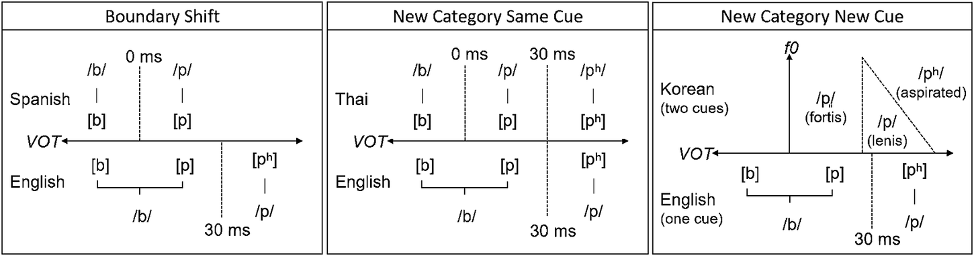
Learning new speech categories is difficult for adult learners, who face interference from their already-mapped L1 speech categories
Nagle & Baese-Berk (2022)
Notes:
The primary motivating problem of my dissertation is the observation that learning new speech categories is difficult for adults. This seems to be in part due to their L1 speech categories already being mapped in the perceptual space. In the example here, an English speaker has mapped perceptual categories for the phonemes /b/ and /p/ along the voice onset time acoustic dimension, with a category boundary at around 30 ms

Slide 5
Learning new speech categories is difficult for adult learners, who face interference from their already-mapped L1 speech categories
Nagle & Baese-Berk (2022)
Notes:
Which makes it difficult to learn the Spanish /b/ and /p/ phonemes, for which the perceptual boundary is shifted to a different location along the primary acoustic dimension. Learning the L2 Spanish categories would then involve shifting the boundary.

Slide 6
Learning new speech categories is difficult for adult learners, who face interference from their already-mapped L1 speech categories
Nagle & Baese-Berk (2022)
Notes:
Another difficult learning scenario is when a learner has to create a new L2 speech category by creating a perceptual boundary along the primary acoustic dimension where there previously was no distinction. An L1 English speaker learning Thai has to create a new category that separates the English /b/ phoneme into unaspirated voiced /b/ and unaspirated voiceless /p/, which is separate from aspirated voiceless /p/

Slide 7
Learning new speech categories is difficult for adult learners, who face interference from their already-mapped L1 speech categories
Nagle & Baese-Berk (2022)
Notes:
And another difficult scenario is when a learner has to create a new L2 speech category by integrating a new acoustic cue to carve the perceptual space to learn a new speech sound that may not exist in the L1

Slide 8
Learning new speech categories is difficult for adult learners, who face interference from their already-mapped L1 speech categories
Problem-focused: How do we make L2 speech category learning easier for (the auditory perceptual system of) adults?
Theory-focused: What is the role of gradient categorization (and linguistic diversity) in L2 speech category learning?
Notes:
These are all difficult learning scenarios that L2 learners inevitably face. This leads to asking broad questions. From a problem perspective, we can broadly ask, how do we make this easier for the perceptual system of adults? And from a theory perspective, we can ask, how do gradient categorization, and later on we’ll add linguistic diversity, play a role in L2 speech category learning? There are a observations that can make these questions more specific.

Slide 9
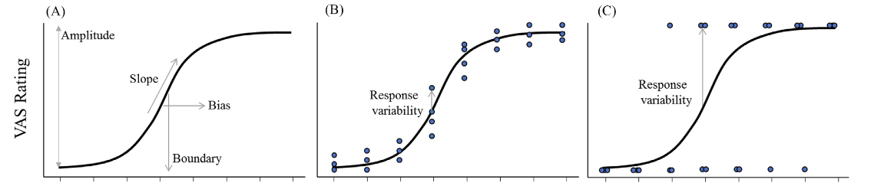
Degree of categorization gradiency can be measured from visual analog scale (VAS) slope and response variability
(Apfelbaum et al., 2022)
Notes:
First, as a reminder, categorization gradiency can be measured through the visual analog scale task, and gradiency can be operationalized using the measurements of slope and response variability

Slide 10
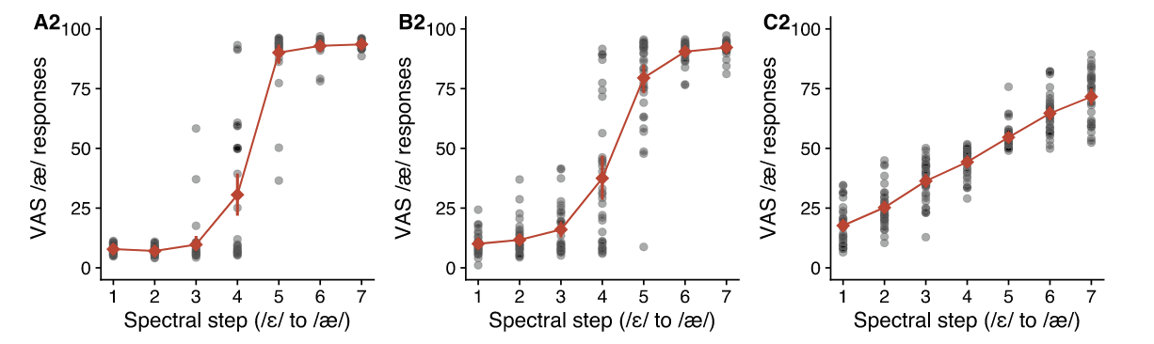
Some individuals respond more categorically, while others respond more gradiently
More categorical
More gradient
(Kim et al., 2020)
Notes:
using the VAS task, we see that there are individual differences in the degree of categorization gradiency for a given phonemic contrast, with some individuals responding more categorically, others responding more gradiently, and some individuals landing somewhere in-between

Slide 11
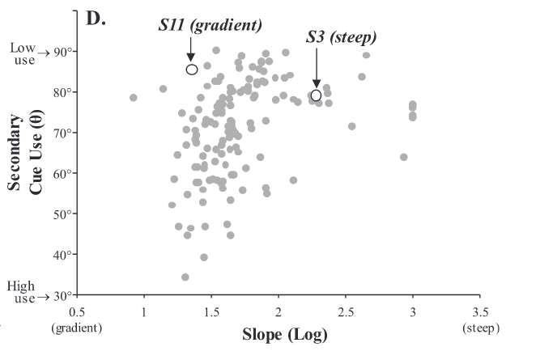
More gradient categorization is typically associated with increased secondary cue integration in L1 speech perception
(Kapnoula & McMurray, 2021)
Notes:
Another pertinent observation is that more gradient perception is typically associated with increased secondary cue integration. Although speech can be mostly categorized using the primary acoustic cue, the most optimal speech categorization occurs when integration multiple acoustic cues

Slide 12
Multiple cue integration, cue sensitivity, and perceptual flexibility is advantageous for learning novel L2 speech categories
Nagle & Baese-Berk (2022)
Notes:
This is relevant for L2 speech category learning because L2 perceptual learning involves reorganizing the speech perceptual space, and based on the learning scenarios we discussed before, we can see that integrated multiple cues, sensitivity to acoustic cues, and overall perceptual flexibility are all necessary for successful reorganization

Slide 13
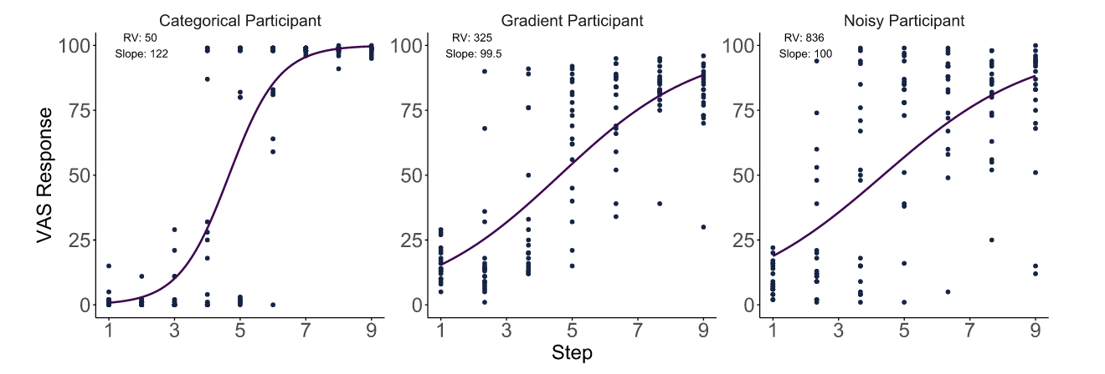
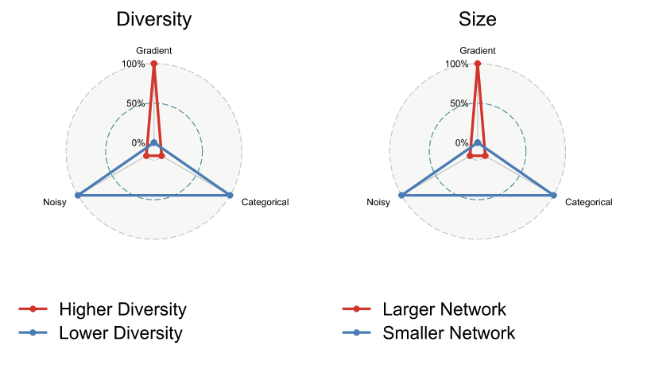
Children with more linguistically diverse and larger social networks are more likely to show gradient categorization
(Kutlu et al., 2024)
Notes:
Another relevant piece of empirical evidence is the observation that children with larger and more linguistically diverse social networks are more likely to respond gradiently, rather than categorically, or noisily

Slide 14
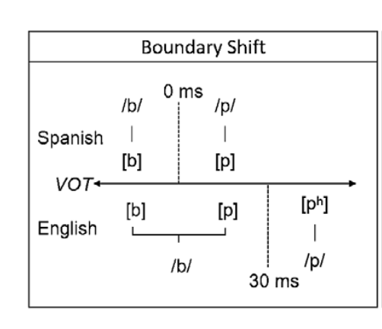
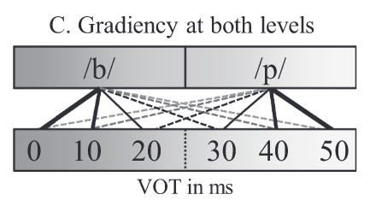
There may be a bidirectional relationship between gradient categorization and mutlilingualism, connected through perceptual flexibility
25 ms
(Nagle & Baese-Berk, 2022)
(Kapnoula & McMurray, 2021)
Notes:
It may be the case that there is a bidirectional relationship between gradient categorization and multilingualism. Being multilingual or being exposed to linguistic diversity may encourage gradient perception such that being familiar with different languages that have different perceptual boundaries enables a person to move around their own perceptual boundary as necessary depending on their language demands, also known as perceptual flexibility. In the other direction, as we discussed, this perceptual flexibility, encouraged through gradient perception, may make it easier to learn novel L2 speech categories, making it easier to become multilingual, to put it broadly
[audio: Thus, we can predict that by being familiar with different languages that have different perceptual boundaries, that enables a person to move around their own perceptual boundary as necessary depending on their language demands. This is called perceptual flexibility]

Slide 15
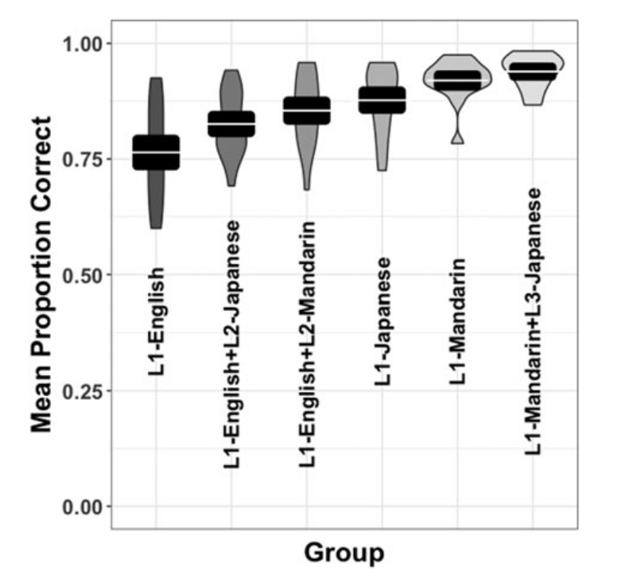
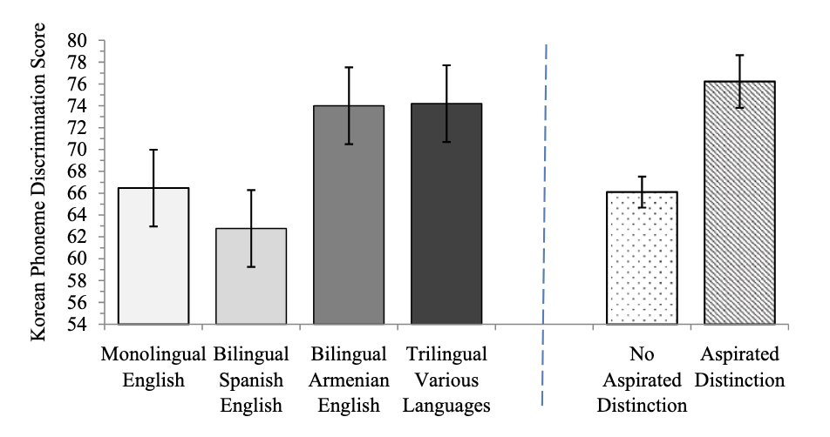
There is a perceptual advantage from having experience with languages that have a similar phonemic contrast as the target novel contrast or use a similar primary acoustic cue
Japanese pitch accent
(Patihis et al., 2015)
(Wiener & Goss, 2019)
Notes:
Lastly, it seems to be the case that there is not just a broad, generalized multilingual advantage, but an advantage with having specific language knowledge with languages that share a similar phonemic contrast or primary acoustic cue as the target language. On the left, multilinguals with knowledge of a language that distinguishes between aspirated and nonaspirated consonants did better in discriminating between Korean aspirated and non-aspirated contrast, and these were all listeners equally unfamiliar with Korean. On the right was with regards to perception of Japanese pitch accent, those with knowledge of Mandarin, which has a lexical contrast that primarily uses fundamental frequency like pitch accent did, did better than those without knowledge of Mandarin, and the advantage was additive such that those knowledge of Japanese and Mandarin outperformed monolingual Japanese or Mandarin speakers.

Slide 16
What are the roles of gradient categorization and linguistic diversity in L2 speech category learning?
Gradient perception is associated with perceptual flexibility
Perceptual flexibility is advantageous for L2 speech category learning
Gradient perception is correlated with having a linguistically diverse social network
Specific language experience is perceptually advantageous for learning target novel phonemic contrasts
Expose learners to “linguistic diversity” to push them towards the gradient perception and perceptual flexibility needed for efficient L2 speech category learning

Slide 17
Research questions

Slide 18
RQ1: Is increased experience with linguistic diversity (hereafter, experiential linguistic diversity) from one’s language history, usage, and exposure predictive of higher degrees of gradient categorization of L2 speech as it is with L1 speech? If so, do higher degrees of L2 gradient categorization predict the degree of usage of the secondary acoustic cue in the perception of L2 phonemic contrasts, as we see with L1 gradiency and secondary cue use?
RQ1: Experiential linguistic diversity (LD) and L1/L2 speech categorization gradiency and secondary cue use
Notes:
Does targeted exposure to linguistic diversity related to L2 linguistic targets shift the perceptual system towards gradient perception?
Does this linguistic diversity perceptual training lead to changes in L2 cue-weighting strategies?
Does this linguistic diversity perceptual training result in measurable improvement L2 speech perception as measured through listening assessments?

Slide 19
RQ2: Can we promote gradient categorization in listeners through specific exposure to linguistic diversity via perceptual training? If so, does gradient categorization increase perceptual sensitivity to discriminate between target language phonemic contrasts?
RQ2: Specific LD and L1/L2 speech categorization gradiency, L2 discrimination sensitivity
Notes:
Does targeted exposure to linguistic diversity related to L2 linguistic targets shift the perceptual system towards gradient perception?
Does this linguistic diversity perceptual training lead to changes in L2 cue-weighting strategies?
Does this linguistic diversity perceptual training result in measurable improvement L2 speech perception as measured through listening assessments?

Slide 20
RQ3: Does specific exposure to linguistic diversity through perceptual training lead to improvements in L2 speech perception and listening?
RQ3: Specific LD and L2 speech perception and listening
Notes:
Does targeted exposure to linguistic diversity related to L2 linguistic targets shift the perceptual system towards gradient perception?
Does this linguistic diversity perceptual training lead to changes in L2 cue-weighting strategies?
Does this linguistic diversity perceptual training result in measurable improvement L2 speech perception as measured through listening assessments?

Slide 21
Linguistic targets

Slide 22
To answer these research questions, I target L1 English listeners and train them to perceive L2 Japanese length contrasts
L1 English -> L2 Japanese
Length contrasts
Adults 18-40
Naïve listeners (online) and L2 learners (classroom)
Singleton vs. geminate consonants
Long vs. short vowels
Contrastive acoustic cue: duration
Specific linguistic diversity: perceptual training with Modern Standard Arabic*

Slide 23
Minimal pairs from both languages will be used for training with segments that are shared between languages
 | Japanese | Modern Standard Arabic (MSA)
Vowel contrast | all five vowels: /a, i, u, e, o/ | all three vowels /a, i, u/
Consonant contrast | mostly for voiceless stop consonants, fricatives, affricates and nasals, rarely for voiced consonants (except nasals) | all consonants
Chosen segments:
Vowels: /a, aa, i, ii, u, uu/
Consonants: /t, tt, k, kk, s, ss, ɕ, ɕɕ/ (latter is treated as equivalent to /ʃ/ in MSA)

Slide 24
Proposed methodology
Notes:
A description of the methodology including the data collection tools, methods of analyses to be employed

Slide 25
(I know this is a block of text rn)
Experiment 1: Aim 1 is to determine whether experiential linguistic diversity from listeners’ language history, usage, and exposure predicts (1) degree of gradient categorization of L1 and L2 speech and (2) perceptual flexibility and acoustic cue integration.
Experiment 2: Aim 2 is to investigate the effects of short-term, specific exposure to linguistic diversity through perceptual training on (1) gradient categorization of L1 and L2 speech and (2) L2 phoneme discrimination. Here, specific linguistic diversity is operationalized as the number of languages used in the perceptual discrimination training task.
Experiment 3: Aim 3 is to investigate the effects of long-term, specific exposure to linguistic diversity through perceptual training, in conjunction with foreign language classroom instruction, on the (1) gradient categorization of L1 and L2 speech, (2) L2 phoneme discrimination, and (3) L2 speech perception and listening.

Slide 26
Experiment 1

Slide 27






The goal of Experiment 1 is to explore the relationship between experiential linguistic diversity and categorization gradiency of L1 and L2 speech
L1 English mono- or multilinguals, online population
Goal: 100 participants
Participants
Visual analog scale (VAS) 2-dimensional continua (7x5 steps)
for L1 English and L2 Japanese contrasts
Stimuli
Linguistic diversity questionnaire (LD-Q)
L1 and L2 VAS
Tasks
Regression analysis between gradiency profiles predicted by latent profile analysis (LPA) and linguistic diversity measured through language entropy
Analyses
Notes:
make sure all of these are assertation evidence titles, even all these methodology slides

Slide 28
Experiment 1 is a one-day experiment expected to take ~1 hr
L1 and L2 VAS
LD-Q
L1 English continua:
/d/ vs. /t/ (indent vs. intent),
/i/ vs. /ɪ/ (reason vs. risen)
L2 Japanese continua:
/t/ vs. /tt/ (kata vs. katta)*,
/o/ vs. /oo/ (toru vs. tooru)
420 total trials
Part 1: Questions from LHQ3 to measure active use and exposure for known languages:
Active Multilingual Language Diversity (MLD-A)
Part 2: Passive use and exposure for both known and unknown languages
Passive Multilingual Language Diversity (MLD-P)

Slide 29
Experiment 2

Slide 30
Experiment 2
Purpose: train listeners with linguistic diversity perceptual training and assess categorization gradiency and L2 discrimination sensitivity
Participants: L1 English monolinguals, naïve to Japanese
Stimuli: VAS stimuli, discrimination minimal pairs
Procedure: VAS pre/post, discrimination pre/post test, 30 minute discrimination training with feedback, two experimental groups of low/high linguistic diversity, linguistic diversity questionnaire
Data analysis: LTA for change in categorization, d-prime for discrimination, regression analysis

Slide 31
The goal of Experiment 2 is to train naïve listeners to learn Japanese length contrasts using a linguistic diversity perceptual training task and measure changes in categorization and L2 perception
L1 English (functional) monolinguals, online population
Goal: 100 participants (50 per experimental group)
Participants
L1 and L2 1-dimensional VAS continua (7 steps)
Discrimination training minimal pairs: Japanese and Arabic, spoken by 2* speakers for each language, 18 pairs for each language (36 words)
Vowels: /a, aa, i, ii, u, uu/ - 6 pairs
Consonants: /t, tt, k, kk, s, ss, sh, ssh/ - 12 pairs
Discrimination testing minimal pairs: Japanese only, spoken by the same 2 speakers, 27 additional minimal pairs (54 words)
Vowels: /a, aa, i, ii, u, uu, o, oo, e, ee/ - 15 pairs
Consonants: /t, tt, k, kk, s, ss, ɕ, ɕɕ, tɕ, ttɕ, n, nn/ - 12 pairs
Stimuli

Slide 32


The goal of Experiment 2 is to train naïve listeners to learn Japanese length contrasts using a linguistic diversity perceptual training task and measure changes in categorization gradiency and L2 perception
L1 and L2 VAS
LD-Q
Tasks
Linguistic diversity perceptual discrimination training
Perceptual discrimination testing
Regression analyses: Latent transition analysis (LTA) to track changes in categorization gradiency and d-prime/RT to measure perceptual discrimination sensitivity
Analyses

Slide 33
Experiment 2 is a two-day experiment expected to take ~2 hr total
Pre-training
VAS
Discrimination pre-test
Discrimination training
Day 1
Low LD group: Japanese only
High LD group: Japanese and Arabic
288 total trials
112 total trials
108 total trials
Discrimination post-test
Post-training VAS
LD-Q
Day 2
108 total trials
112 total trials

Slide 34
Experiment 3

Slide 35
Experiment 3
Purpose: linguistic diversity perceptual training in addition to L2 Japanese classroom instruction
Participants: L2 Japanese classroom students
Stimuli: same as experiment 2
Procedure: mostly same as experiment 2, except 30 minute perceptual training sessions will repeat across 2-3 weeks, and will include control group of just classroom students, additionally dictation listening assessment pre/post test
Data analysis: accuracy for dictation listening assessment, then same as in Experiment 2

Slide 36
The goal of Experiment 3 is to supplement L2 Japanese classroom instruction with linguistic diversity perceptual training and measure changes in categorization gradiency, L2 perception, and L2 listening
L2 Japanese students, recruited from classrooms
Goal: 60 students*
Participants
L1 and L2 1-dimensional VAS continua (7 steps)
Japanese and Arabic vowel and consonant length minimal pairs
Partial dictation assessment sentences – 20 sentences with one blank word (target) – 10 words from training, 10 words from testing, spoken by 1 female speaker
Stimuli

Slide 37

The goal of Experiment 3 is to supplement L2 Japanese classroom instruction with linguistic diversity perceptual training and measure changes in categorization gradiency, L2 perception, and L2 listening
L1 and L2 VAS
LD-Q
Tasks
Discrimination training
Discrimination testing
Multiple-choice partial dictation (MCPD) listening assessment
Regression analyses: LTA for changes in categorization gradiency, d-prime/RT for discrimination sensitivity, accuracy for MCPD listening assessment
Analyses

Slide 38
Experiment 3 is a longitudinal experiment across 4 weeks
MCPD pre-test
Pre-training VAS
Discrimination pre-test
Week 1,
First Day
20 total trials
112 total trials
108 total trials
Discrimination training*
2x per week for 3 weeks
288 trials per session
Low LD group: Japanese only
High LD group: Japanese and Arabic
*Control group: No training
Weeks 2-4
Discrimination post-test
Post-training VAS
MCPD post-test
LD-Q
Week 4,
Final Day
108 total trials
112 total trials
20 total trials

Slide 39
Request for feedback

Slide 40
Request for feedback
1. LD-Q
Questions of Part 2
Measure of MLD using language entropy
2. VAS stimuli
planned manipulations (see extra slides)
(procedure) position of word endpoints for experiment 1
(procedure) attention checks
3. Ratio of training to testing stimuli for discrimination
4. Low LD vs. High LD trials – repeat Japanese trials to match trial number or shorten trial number?
5. Procedure order for Experiment 2 and 3: pre-test to post-test
6. MCPD listening assessment

Slide 41
More elaboration

Slide 42
The goal of Experiment 1 is to explore the relationship between experiential linguistic diversity and categorization gradiency of L1 and L2 speech
Purpose: explore connection between categorization gradiency and linguistic diversity background
Participants: L1 English listeners with any language background, naïve or not to
Stimuli: continuum stimuli for both L1 English and L2 Japanese
Procedure: VAS categorization task, linguistic diversity questionnaire
Data analysis: LPA for categorization and regression analysis
Notes:
make sure all of these are assertation evidence titles, even all these methodology slides

Slide 43
Experiment 1 is a one-day experiment expected to take ~1 hr
L1 and L2 VAS
LD-Q
Part 1: Select questions from Language History Questionnaire 3 (LHQ3) to measure active use and exposure for known languages
Results in measure of active Multilingual Language Diversity (MLD-A)
Part 2: Passive language use and exposure for both known and unknown languages
Results in measure of passive MLD (MLD-P)
2 blocks of L1 English followed by 2 blocks of L2 Japanese
35 tokens per continua, each token presented 3 times
105 trials per block, 420 total trials
position of endpoint words randomized across participants
two attention checks early on

Slide 44
とる
toru
とおる
tooru
Click on the slider based on what you think the word sounded like, then press the Spacebar to continue.
Notes:
Japanese VAS

Slide 45
risen
reason
Click on the slider based on what you think the word sounded like, then press the Spacebar to continue.
Notes:
English VAS

Slide 46
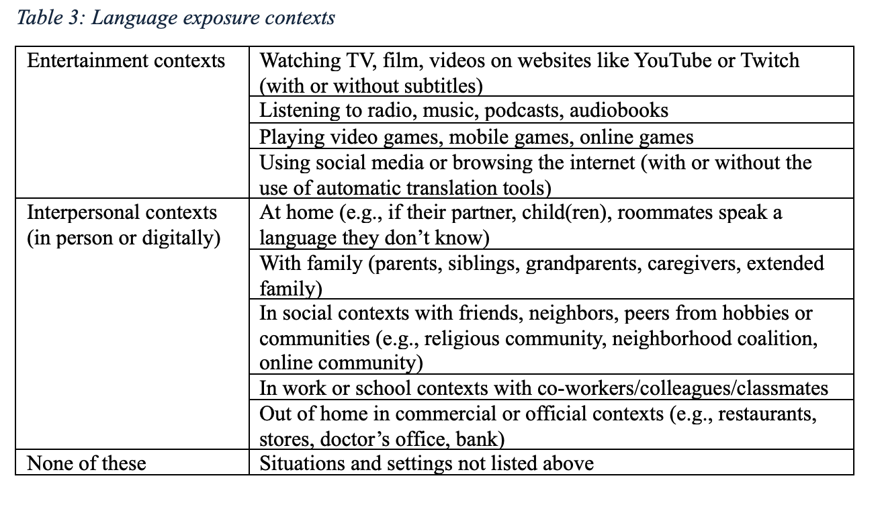
Linguistic diversity questionnaire

Slide 47
VAS stimuli vary in 7 equal steps along the primary dimension and 5 equal steps along the secondary dimension
/d/ vs. /t/
indent vs. intent
/i/ vs. /ɪ/
reason vs. risen
F1/F2:
Step 1 (/i/): 370 Hz -> Step 7 (/ɪ/): 500 Hz
2830 Hz 1960 Hz
VOT:
Step 1 (/d/): 25 ms -> Step 7 (/t/): 88 ms
F0:
Step 1 (/d/): 176 Hz -> Step 5 (/t/): 213 Hz
vowel duration:
Step 1 (/i/): 240 ms -> Step 5 (/ɪ/): 125 ms
L1 English contrasts

Slide 48
indent vs. intent
Primary cue: VOT
Secondary cue:
F0 onset
Step 5: /t/-like
213 Hz
176 Hz
Step 1: /d/-like
25 ms
88 ms
Step 1: /d/-like
Step 7: /d/-like

Slide 49
reason vs. risen
Primary cue: F1/F2 contour
Secondary cue:
Vowel duration
Step 1: /i/-like
2830 Hz
F2
Step 7: /ɪ/-like
1960 Hz
240 ms
125 ms
370 Hz
500 Hz
Step 1: /i/-like
Step 5: /ɪ/-like
F1

Slide 50
kata vs. katta
Primary cue:
closure duration
Secondary cue:
pre- to post-vowel pitch difference
V1
closure
V2
Step 5: /tt/-like
Step 1: /t/-like
Step 1: /t/-like
F0
105 ms
170 ms
Step 1: /t/-like
Step 7: /tt/-like
Step 5: /tt/-like

Slide 51
toru vs. tooru
Primary cue:
vowel duration
Secondary cue:
F0 contour

Slide 52
VAS stimuli vary in 7 equal steps along the primary dimension and 5 equal steps along the secondary dimension
/t/ vs. /tt/
kata vs. katta
/o/ vs. /oo/
toru vs. tooru
closure duration
Step 1 (/t/): 105 ms -> Step 7 (/tt/): 190 ms
vowel duration:
Step 1 (/o/) : 90 ms -> Step 7 (/oo/): 285 ms
V1-V2 pitch difference:
(for C1V1C2V2 where C2 is t or tt)
Step 1 (/t/) -> Step 5 (/tt/)
kata V1 295-315-310 V2 207-117
katta: V1 310-330-325 V2 177-73
pitch contour (for CV1CV2 where V1 is o or oo)
(from V1 onset -> V1 maximum -> V1 offset -> V2 onset -> V2 offset):
Step 1 (/o/): -> Step 5 (/oo/):
L2 Japanese contrasts

Slide 53
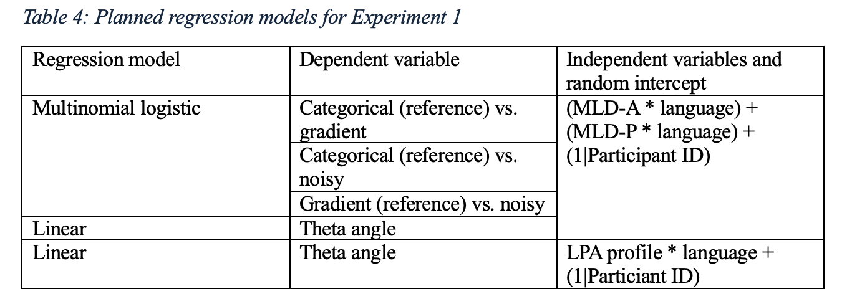
Experiment 1 Planned Analyses

Slide 54
Discrimination stimuli characteristics
Arabic + Japanese
AA, AB, BB, BA trial types, each trial type repeated twice
288 training trials
High LD (Arabic + Japanese): 18 minimal pairs x 8 repetitions x 2 languages
Low LD (Japanese only): 18 minimal pairs x 16 repetitions
108 test trials: Japanese only
27 minimal pairs x 4 trial types

Slide 55

Fixation: 500 ms
Stimulus A
ISI: 500 ms
Stimulus X
Response
Feedback
OR

Slide 56
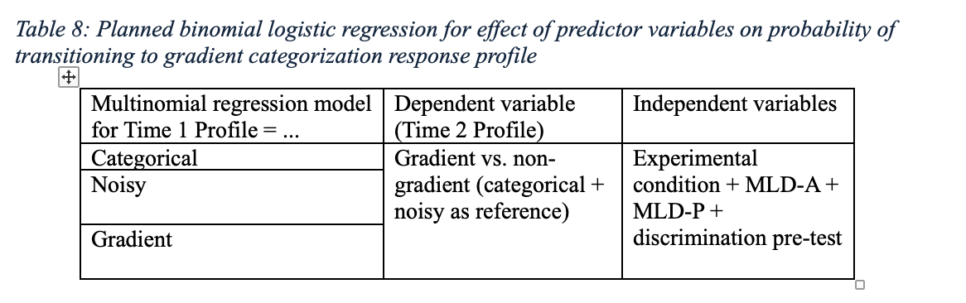
Experiment 2 Planned Analyses
Multivariate regression analysis: [d-prime, RT] ~ time*experimental-condition + time*L1-profile + time*L2-profile + MLD-A + MLD-P + (1|Participant ID) + (1|Stimulus Pair)

Slide 57
Partial dictation stimuli
20 sentences, each with one blank
10 words from training, 10 words from testing (balanced across 10 vowels and 10 consonants, 10 short segments and 10 long segments)
Correct answer, competing distractor (other half of minimal pair), two non-competing distractors that are phonetically or phonologically similar
Most words will be unfamiliar to learners, participants will be instructed just to listen, it’s okay if they don’t know what the word means
Learners must know how to read hiragana

Slide 58

Read the sentence and listen to the recording, then choose the best option that fills in the blank.
You may listen to the recording up to two times.
きのうかれが（ ）
きいた
きえた
きた
きった
Press the Spacebar to continue.

Slide 59
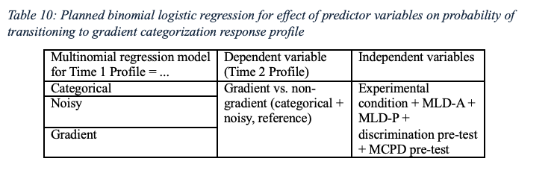
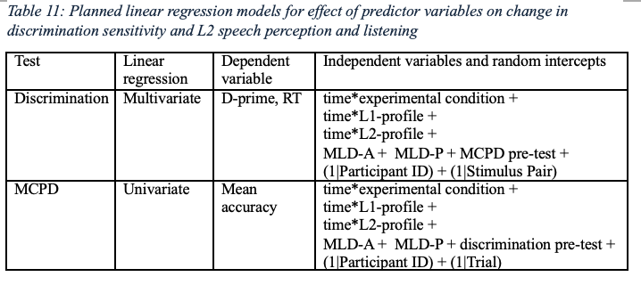
Experiment 3 Planned Analyses

Slide 60
Implications and applications
Theoretical: Understand role of gradient encoding in mechanisms of category learning
Behavioral: Directly benefits perception and comprehension, indirect benefits production and pronunciation
Motivational: Helps overcome earliest obstacles in language learning (learning new sounds) – reduces attrition
Pedagogical: Easy addition to classroom as supplemental activity
Practical: Low effort approach to gaining language learning experience
Broader: Encourages exposure to linguistic diversity, highlights importance of globalization

