Slide 1
Gradient Categorization, Linguistic Diversity, and Second Language Acquisition: Perceptual Learning of L2 Phonemic Contrasts Using a Multilingual Training Paradigm
Chisom O. Obasih
Dissertation Chair: Dr. Seth Wiener
Monday, August 4, 2025
Notes:
thank you for coming to the defense of my dissertation, titled:
[slow down when reading the title]
my dissertation deals with these three main theoretical frameworks, which I’ve color coded through the presentation
I also want to note that, if any relevant parties have any interest, all of my research instruments, data, and analysis materials are on this open science framework page

Slide 2
Background and Research Question
Notes:
first, I will briefly explain the background literature for these three topics that lead to my research questions

Slide 3
Learning new L2 phonemic contrasts is difficult for adults
Notes:
the primary problem I aimed to solve with my dissertation project is the fact that learning L2 phonemic contrasts is difficult for adults. when I say phonemic contrast, I am referring to a pair of speech sounds that change the meaning of the word when one is replaced by the other.

Slide 4

Learning new L2 phonemic contrasts is difficult for adults
English
/ɑ/
call
[ɑ]
[ɑɑ]
caall
10
30
duration in ms
Notes:
for example, in english, the speech sounds “a” and “aa” are acoustically different in duration, but if you take a word with one sound,
say “call”, as in the phrase “don’t call him” and replace it with the other sound,
say “caall”, as in the phrase “don’t caall him”
these are understood to carry the same meaning, with one just more emphasized than the other
that is because these two sounds that vary in duration are mapped to the same phoneme in English – this is the process of speech categorization

Slide 5


Learning L2 speech categories involves remapping acoustics to different or new categories
English
/ɑ/
Japanese
/ɑ/
Japanese
/ɑɑ/
obasan
middle-aged woman
[ɑ]
[ɑɑ]
[ɑ]
[ɑɑ]
obaasan
10
30
10
30
duration in ms
duration in ms
elderly woman
Notes:
however, in Japanese, if you take those same two sounds, “a” and “aa”, as in
“obasan” and
“obaasan” this change in sound *does* lead to a change in the meaning of the word. that is to say, the two sounds form a *phonemic contrast* because changing the phoneme changes the meaning of the word. for a language like Japanese, it is very important to be able to perceive and produce these sounds distinctively, otherwise you risk offending
a middle-aged woman by calling her
a grandma. this is because these two sounds that vary in duration
are mapped to different speech categories in Japanese. for L2 learners whose native language does not differentiate vowels by duration, such as English, learning the vowel length phonemic contrast can be a struggle because it involves using a familiar acoustic cue, here duration, in an unfamiliar way – and this process faces interference due to the existing L1 categories

Slide 6
Multilingualism and linguistic diversity may make learning L2 contrasts easier
Linguistic diversity
?
L2 speech learning
Notes:
(slow down - ) so what can we do to make learning these speech contrasts easier for L2 learners?
the solution I explored in my dissertation research was multilingualism.
specifically, I explored how linguistic diversity plays a role in L2 speech learning. this hypothesis came from several pieces of evidence in the literature that found that multilingualism – either speaking multiple languages or being exposed to/engaging in multiple languages, may make processing unfamiliar non-native sounds easier

Slide 7
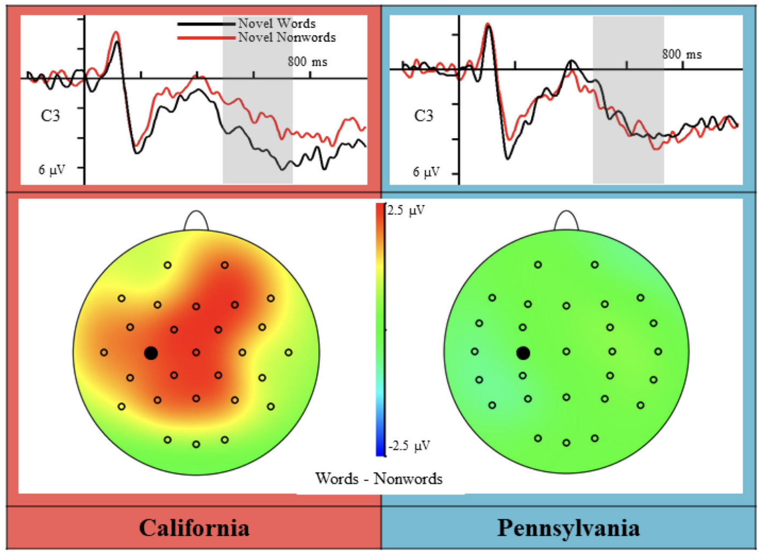
Exposure to general linguistic diversity has been found to provide an advantage for monolinguals in novel speech perception and learning
(Bice & Kroll, 2019)
Notes:
it is notable that this evidence was not limited multilinguals speakers. it was found that monolingual speakers in more linguistically diverse geographical areas showed higher neural sensitivity when learning novel L2 words, compared to monolinguals in a less linguistically diverse geographical area

Slide 8
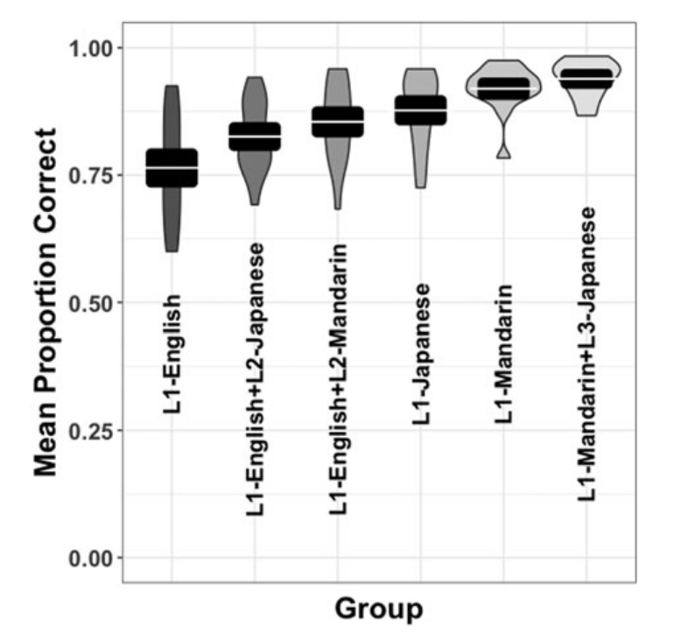
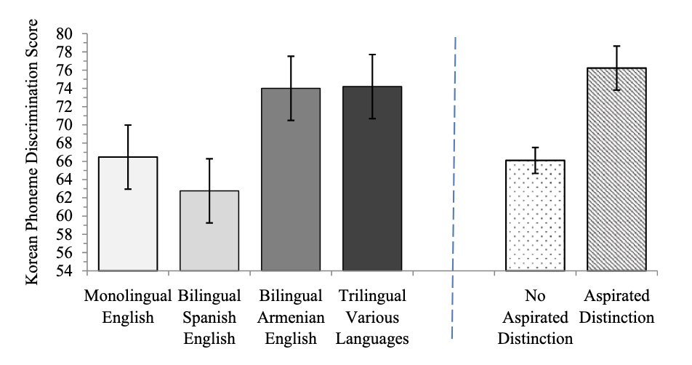
Experience with specific linguistic diversity has been found to provide an advantage to multilinguals in novel speech perception and learning
Korean aspiration distinction
Japanese pitch accent
(Patihis et al., 2015)
(Wiener & Goss, 2019)
Notes:
similarly, there is evidence that among multilinguals, there is a perceptual advantage with having specific language knowledge with languages that share a similar phonemic contrast or primary acoustic cue as the target language.
[it seems to be the case that there is not just a broad, generalized multilingual advantage, On the left, multilinguals with knowledge of a language that distinguishes between aspirated and nonaspirated consonants did better in discriminating between Korean aspirated and non-aspirated contrast, and these were all listeners equally unfamiliar with Korean. On the right was with regards to perception of Japanese pitch accent, those with knowledge of Mandarin, which has a lexical contrast that primarily uses fundamental frequency like pitch accent did, did better than those without knowledge of Mandarin, and the advantage was additive such that those knowledge of Japanese and Mandarin outperformed monolingual Japanese or Mandarin speakers.]

Slide 9
How does linguistic diversity play a role in L2 speech learning?
Linguistic diversity
L2 speech learning
?
Gradient categorization
Notes:
because I have a background in cognitive psychology, I was interested in investigating not only the association between linguistic diversity and L2 speech learning, but the perceptual mechanism that may be behind this potential association
and I had reason to believe that gradient categorization was link

Slide 10
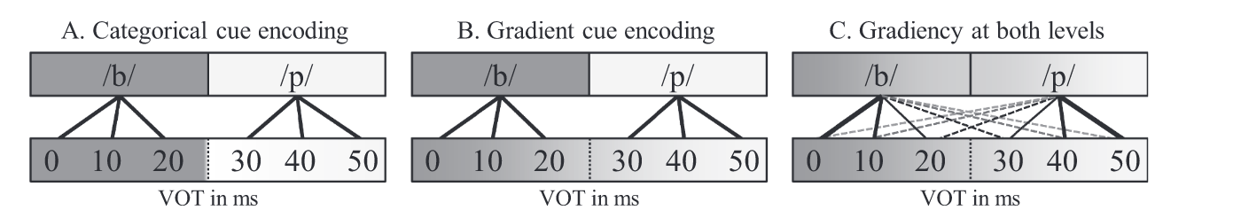
Gradient categorization retains the continuous nature of the acoustic features in speech when mapping to perceptual categories
(Kapnoula & McMurray, 2021)
Notes:
First, I want to briefly explain what I mean by gradient categorization. Gradient categorization describes categorization that retains the continuous features of the acoustic input of speech after mapping the input to speech categories. The ideas is that gradient perception allows you not only to track the minute differences in the acoustic signal, but to store those differences when encoding from acoustic signal to linguistic representation.
----
[audio: Thus, we can predict that by being familiar with different languages that have different perceptual boundaries, that enables a person to move around their own perceptual boundary as necessary depending on their language demands. This is called perceptual flexibility]

Slide 11
Gradient categorization retains the continuous nature of the acoustic features in speech when mapping to perceptual categories
/p/
Response
/b/
(Kapnoula & McMurray, 2021)
Notes:
if you were to plot a listener’s responses to speech that varied along the acoustic dimension in equal steps,
a categorical responder’s response curve would be steeper
while a gradient responder’s response curve would be more shallow
[audio: Thus, we can predict that by being familiar with different languages that have different perceptual boundaries, that enables a person to move around their own perceptual boundary as necessary depending on their language demands. This is called perceptual flexibility]

Slide 12
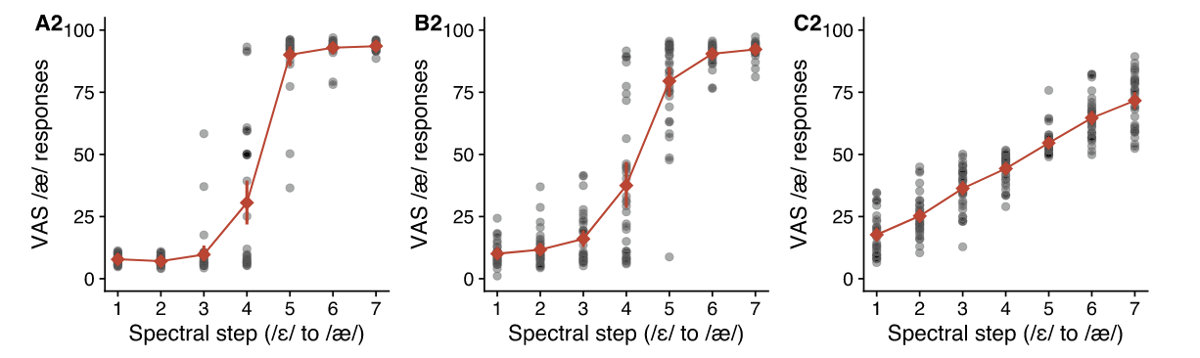
Some individuals perceive speech more categorically, while others perceive speech more gradiently
More categorical
More gradient
(Kim et al., 2020)
Notes:
(first phrase slowly) It is relevant to point out that individuals vary in their degree of categorization gradiency, which itself is on a continuous spectrum, as some people fall in between strictly categorical and strictly gradient. So what might lead to individuals having different perceptual strategies? One possibility could be the individuals linguistic environment

Slide 13
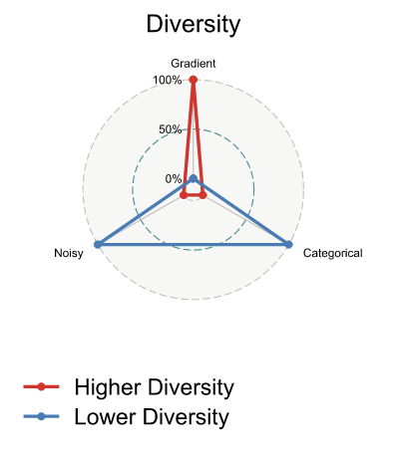
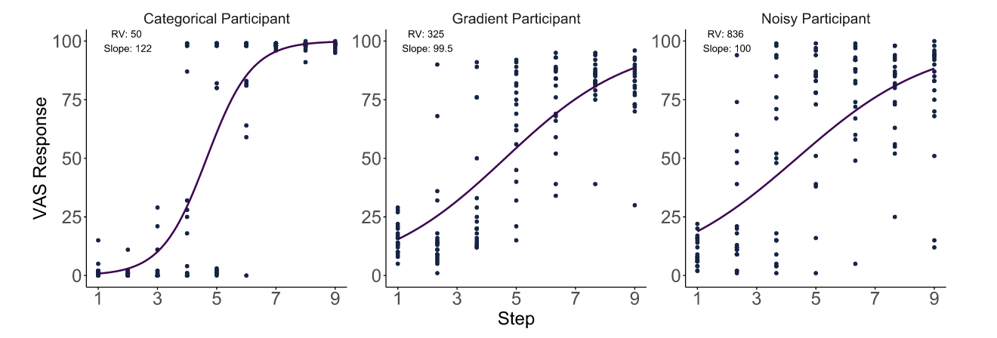
Children with more linguistically diverse social networks were found to show gradient categorization response patterns
(Kutlu et al., 2024)
Notes:
This hypothesis comes from the empirical evidence that that children with more linguistically diverse social networks are more likely to respond gradiently, rather than categorically, or noisily. this suggests that there might an effect on the perceptual system of those with linguistically diverse networks. so, what is the connection with L2 learning?

Slide 14
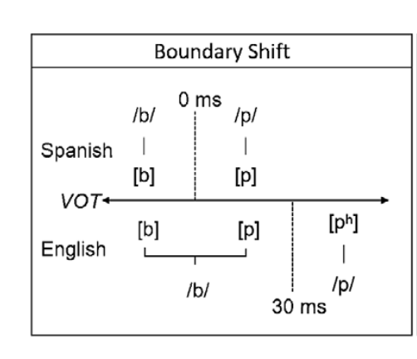
Gradient categorization may give the perceptual system the flexibility to remap or create new category boundaries
25 ms
(Nagle & Baese-Berk, 2022)
(Kapnoula & McMurray, 2021)
Notes:
The ability to gradiently track acoustics of speech input is relevant for second language acquisition, because
languages can use the same acoustic cues for the same phonemes,
but have different perceptual boundaries. Those that have experience with different languages have to recognize different category boundaries depending on the linguistic context. Thus, I predicted that experience with or exposure to different languages that have different perceptual boundaries
enables a person to move around their own perceptual boundary as necessary depending on their language demands

Slide 15
What are the roles of linguistic diversity and gradient categorization in L2 speech category learning?
Linguistic diversity
L2 speech learning
Gradient categorization
Notes:
to summarize the main pieces of evidence motivating this work,
linguistic diversity and language experience have been found to be perceptually advantageous for learning novel phonemic contrasts
Gradient perception has been found to be correlated with having a linguistically diverse social network
and gradient perception is associated with perceptual flexibility, which is theoretically advantageous for L2 speech category learning

Slide 16
What are the roles of linguistic diversity and gradient categorization in L2 speech category learning?
Linguistic diversity
L2 speech learning
Gradient categorization
Notes:
what remains unclear from the literature is that linguistic diversity has not connected directly with novel speech learning within active L2 learners,

Slide 17
What are the roles of linguistic diversity and gradient categorization in L2 speech category learning?
Linguistic diversity
L2 speech learning
Gradient categorization
Notes:
it is unclear how linguistic diversity is associated with gradient categorization of L2 speech and whether linguistic diversity can be used as an experimental manipulation to impact either of these two factors

Slide 18
What are the roles of linguistic diversity and gradient categorization in L2 speech category learning?
Linguistic diversity
L2 speech learning
Gradient categorization
Notes:
and, the evidence of the perceptual advantage of gradient categorization in L2 speech learning is also unclear

Slide 19
Expose learners to experimental linguistic diversity to push them towards the gradient categorization needed for efficient L2 speech learning
Linguistic diversity
L2 speech learning
?
Japanese
vowel length: toru vs. tooru
consonant length: kata vs. katta
Gradient categorization
Notes:
this led me to the hypothesis that drove my experiments, which was to intentionally expose listeners listeners to a specific kind of linguistic diversity to push their perceptual systems towards the degree of gradiency needed for efficient L2 speech category learning.
to explore the relationship between these three factors, I conducted three studies, with Japanese vowel length and consonant length as the target L2 phoneme, for example

Slide 20
Study 1
Linguistic diversity
L2 speech learning
Experiential LD
L1 and L2 gradient categorization
Notes:
first in Study 1, I investigated whether not only speaking multiple languages, but being exposed to multiple languages through one’s activities and environment have an impact on the degree of gradiency in both L1 and L2 speech categorization – this was referred to experiential linguistic diversity, from one’s experiences

Slide 21
Study 2
Linguistic diversity
L2 speech learning
Short-term Specific LD
Specific LD
L2 perceptual discrimination
Gradient categorization
Notes:
then in Study 2, I exposed listeners to that specific linguistic diversity and assessed whether the manipulation had an impact on L2 perceptual discrimination and on gradient categorization, as well as whether any changes in gradient categorization were associated with different learning outcomes

Slide 22
Study 3
Linguistic diversity
L2 speech learning
Long-term Specific LD
Specific LD
L2 perceptual discrimination
Gradient categorization
L2 listening assessment
Notes:
Study 3 was an extension of Study 2, where I extended the training paradigm to be a longitudinal study, I targeted L2 classroom learners, and I also assessed L2 listening using a custom-designed listening assessment task. Here I focused more on the effect of specific LD on the other two factors, rather than the connection between gradient categorization and L2 learning outcomes

Slide 23
Study 1
Notes:
so to move onto the methods and results of study 1

Slide 24
L1 English mono- and multilingual participants (n = 76) completed the Linguistic Diversity Questionnaire (LDQ) and the Visual Analog Scale (VAS) task
Linguistic diversity
L1 and L2 gradient categorization
Experiential LD
Notes:
I recruited 76 native English speakers online, welcoming all monolingual and multilingual speakers, and had them complete the linguistic diversity questionnaire, the LDQ, to measure experiential linguistic diversity, and the visual analog scale task, the VAS task, to measure gradient categorization of L1 and L2 speech

Slide 25
The LDQ measured experiential LD with quantitative scores of active and passive multilingual language diversity (MLD-A) and (MLD-P)
monolingual
multilingual
Notes:
I created the LDQ to produce quantitative scores measuring experiential linguistic diversity in two parts, with the first part derived from the existing Language History Questionnaire 3, which measured active multilingual language diversity in the aspects of speaking, listening, reading, and writing. the second part were questions I created inspired by number of other existing questionnaires and surveys, and measured passive use of language in the aspects of reading and listening, but not speaking and writing, so for example, a student at Carnegie Mellon who is exposed to a multitude of foreign languages due to the high international student population on campus. MLD scores at 0 indicate being a complete monolingual, while increasing scores up to 2 indicate increasing integrated use and exposure to 2, 3, and 4 languages

Slide 26

The VAS measured categorization responses using L1 and L2 speech continua that varied in equal steps along acoustic dimensions
indent
intent
L1 English
reason
risen
kata
katta
L2 Japanese
toru
tooru
Notes:
I used the VAS task to measure categorization responses for both L1 and L2 speech, using synthesized speech continua that morphed continuously from one word to the other in equal acoustic steps, which sounds like this
so I used two contrast pairs in English and two contrast pairs in Japanese

Slide 27
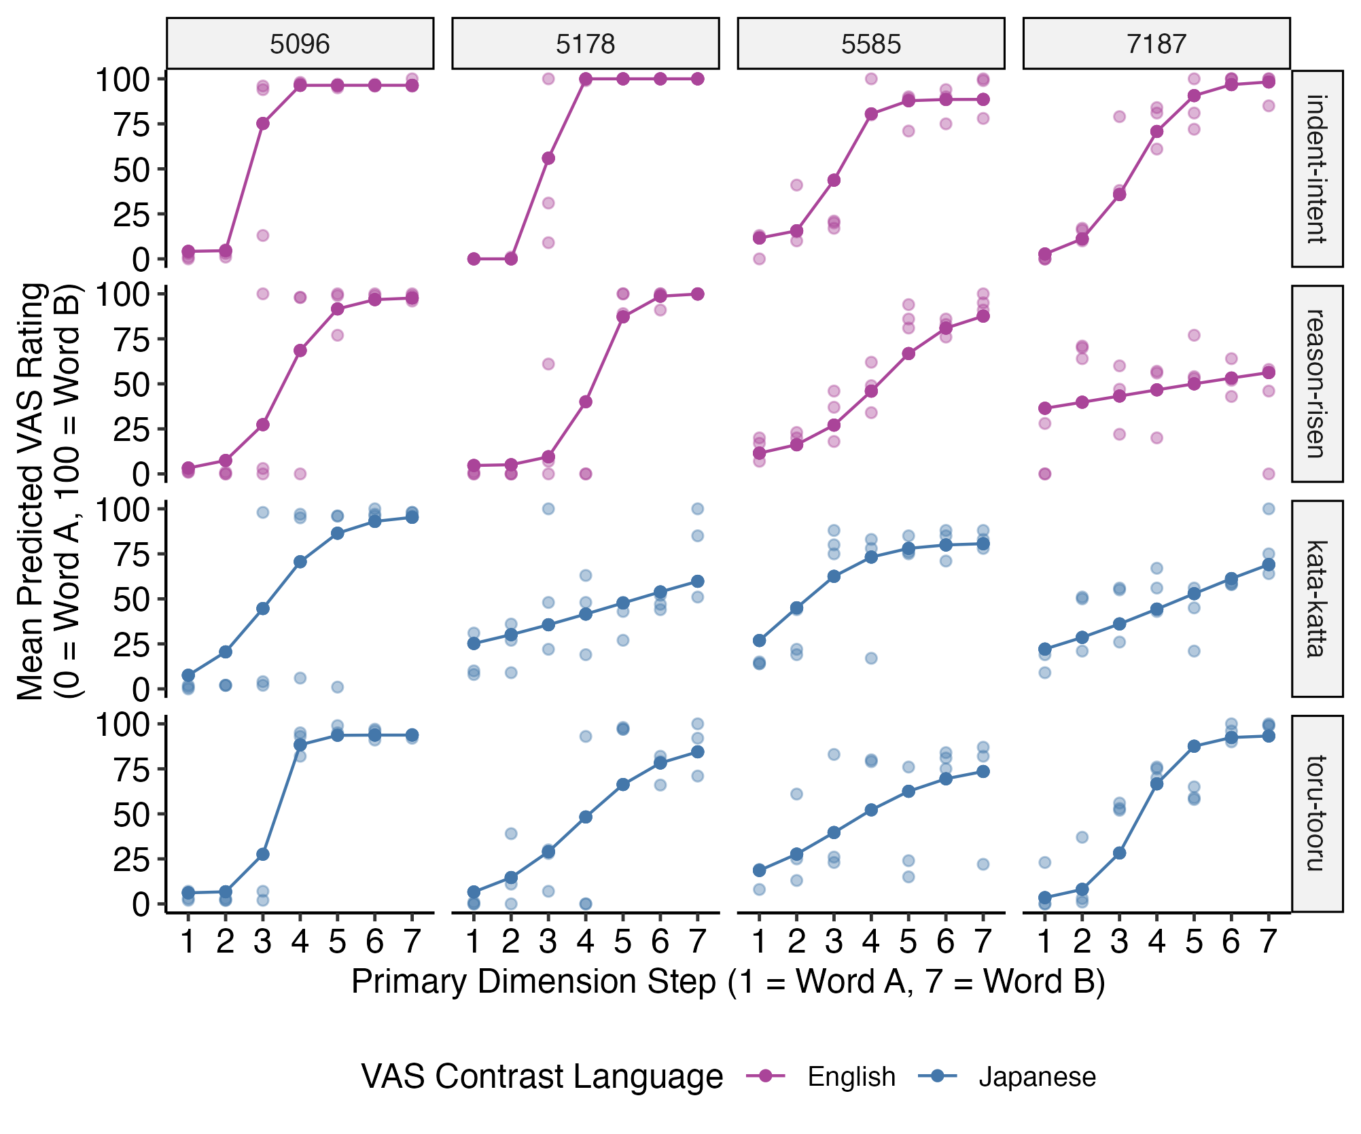
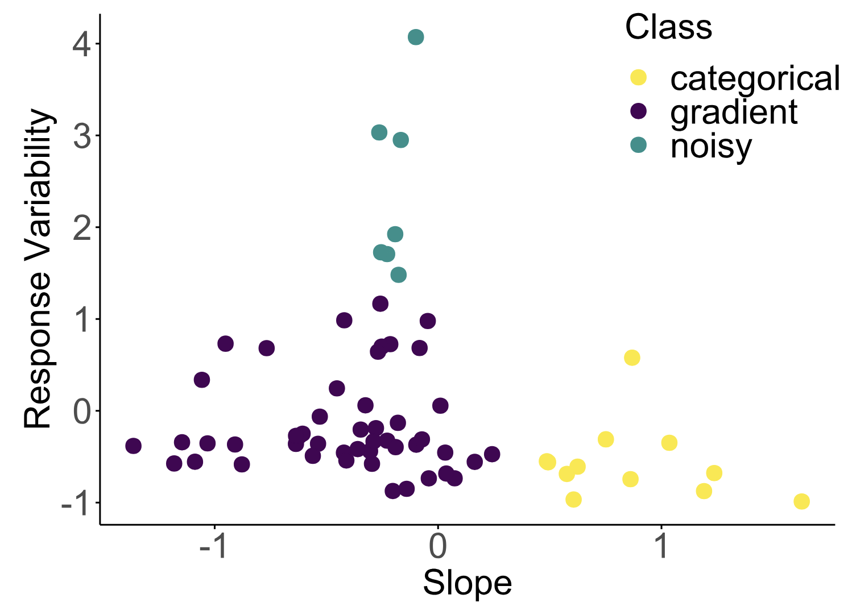
Categorical
Gradient
Noisy
(Kutlu et al., 2024)
Categorical: High slope, low response variability
Gradient: Low slope, low response variability
Noisy: High response variability
Notes:
as a reminder, VAS responses can be plotted as a response curve, which is the average rating to the speech continuum at each step, and two values are derived from this curve, which are slope and response variability.
high slope values correspond to a steeper, more categorical curve, whereas low slope values correspond to a shallower curve. response variability differentiates
gradient curves, which are low in response variability with points close to the curve, and
noisy curves, which are high in response variability with points at variable distances from the curve
the prior work from Kutlu, which found that children with linguistically diverse social networks showed more gradient categorization, used the VAS measures of slope and response variability to class the children into these response pattern profiles. although my data didn’t look exactly like this, I used this general heuristic when evaluating the results,
as my interest was in gradient response patterns, I was looking for values of low slope and low response variability

Slide 28
Participants varied in categorization measures both within and across L1 and L2 contrast pairs
Notes:
as was seen in previous research, participants in Study 1 varied substantially in how gradiently or categorically they responded to the VAS contrast pairs. what was also novel and interesting about study 1 was that I found that listeners varied in their response patterns not only between each other, varied in their own consistency to the different languages. participant 5096 was an example of someone who was consistent across all four pairs in only using the two end points. participant 5178 was an example of someone who had different response patterns for each language, as they were categorical in English but gradient in Japanese, and other people were not even consistent for pairs of the same language, like participant 7187, who was closer to categorical for indent-intent and toru-tooru, but more gradient for reason-risen and kata-katta
[transition sentence] -
so this finding demonstrates that it's clear people are different in how they categorize L1 and L2 contrast pairs, and I wanted to determine whether linguistic diversity predicted those differences

Slide 29
L1 English
L2 Japanese
Slope
Response Variability
MLD-A and MLD-P
Notes:
because I hypothesized that higher degrees of linguistic diversity would predict more gradient categorization, I expected this relationship, with high MLD scores predicting lower slope and lower response variability, for both the L1 English and L2 Japanese pairs

Slide 30
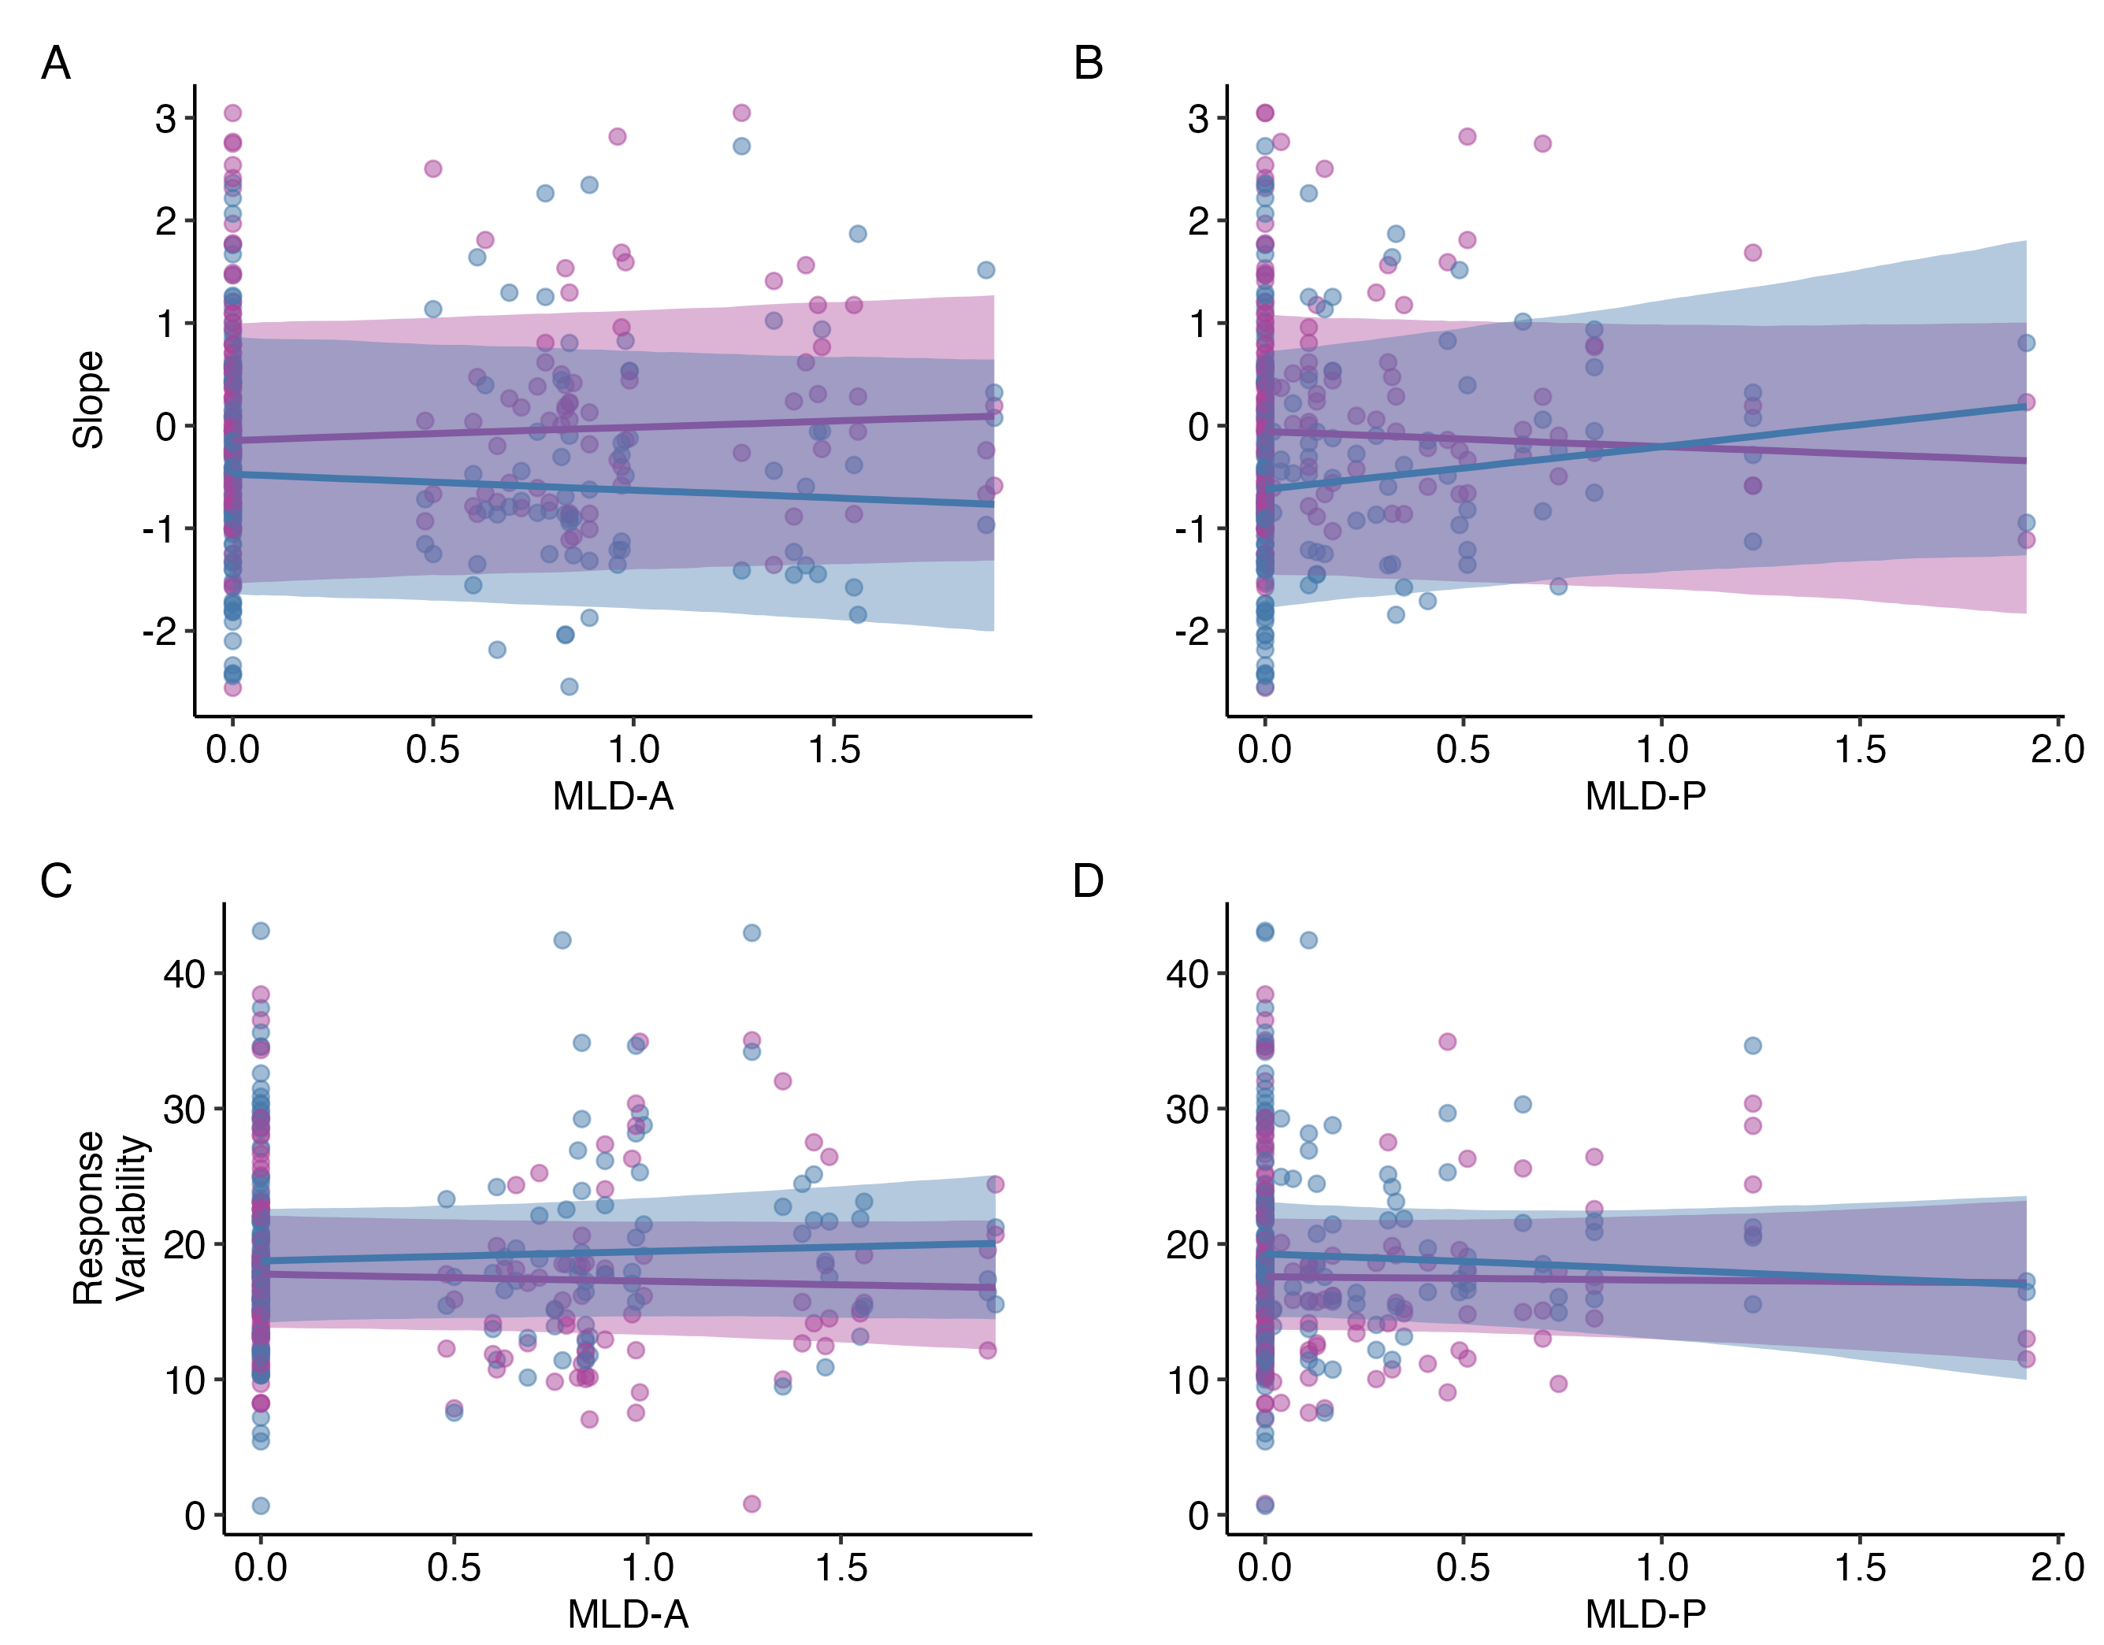
Experiential LD was not found to predict L1 or L2 categorization measures
L1 English
L2 Japanese
Notes:
what I saw instead was mostly flat trends for the relationship between the MLD scores and the slope and response variability values, and also these trends look like they might be different between the English and Japanese pairs, the results were not statistically significant
that means that this data did not show evidence that experiential linguistic diversity is associated with gradient categorization, or any particular categorization pattern

Slide 31
Experiential LD was not found to predict L1 or L2 categorization measures
L1 English
L2 Japanese
Linguistic diversity did not explain the individual differences in categorization response patterns
Notes:
so the overall take away for study 1 we saw highly variable differences within and among individuals, but linguistic diversity did not explain these individual differences

Slide 32
Study 2
Notes:
for study 2, I moved on to explore linguistic diversity as a speech training manipulation to see its effects on L2 speech learning outcomes

Slide 33
L1 English monolingual participants (n = 80) completed perceptual discrimination training with VAS and perceptual discrimination pre- and posttests
Linguistic diversity
L2 speech learning
Short-term Specific LD
Specific LD
L2 perceptual discrimination
Gradient categorization
Notes:
I recruited 80 monolingual native English speakers online, where they performed 30-minutes of perceptual training in one of two experimental groups, along with an AX discrimination test of L2 Japanese minimal pairs and the VAS task with L1 English and L2 Japanese pairs (same as study 1 just a bit shorter) immediately before and 24 hours after the training session.

Slide 34

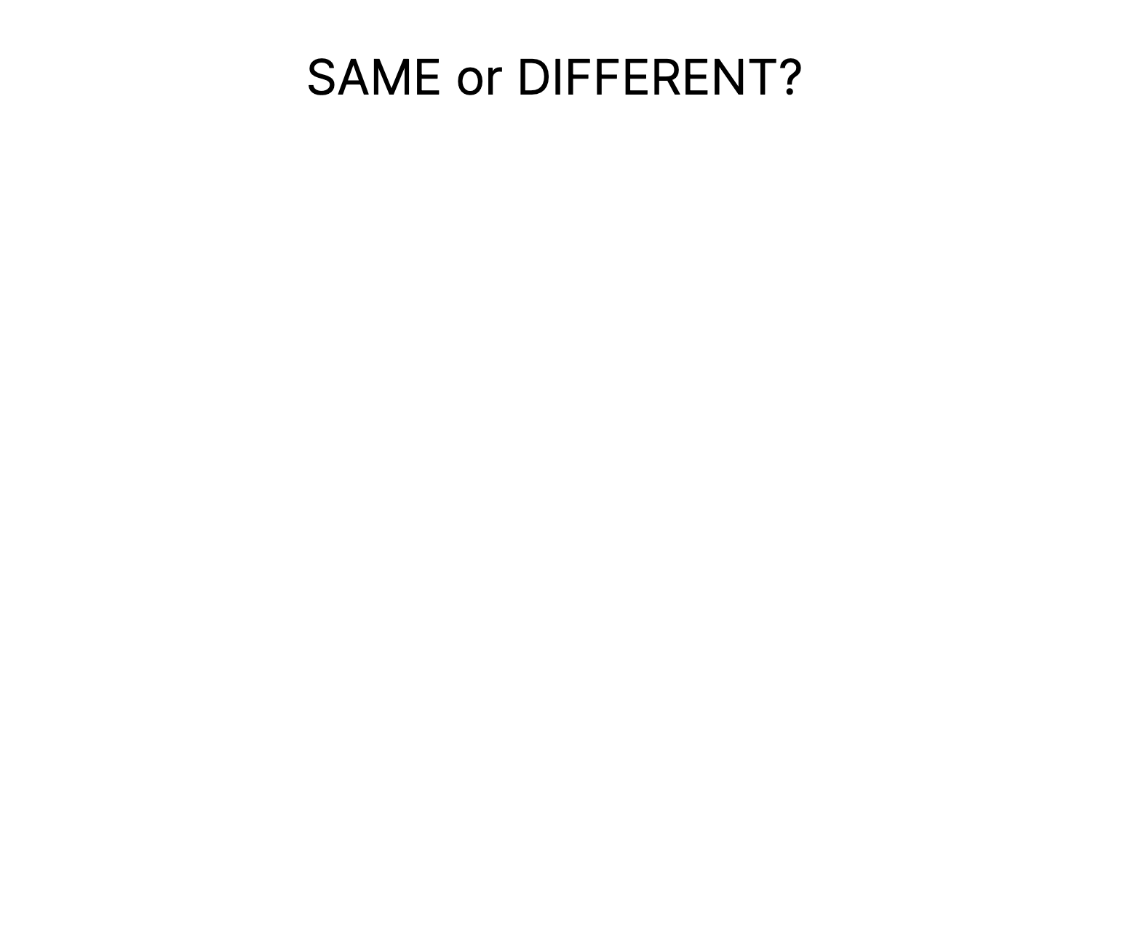
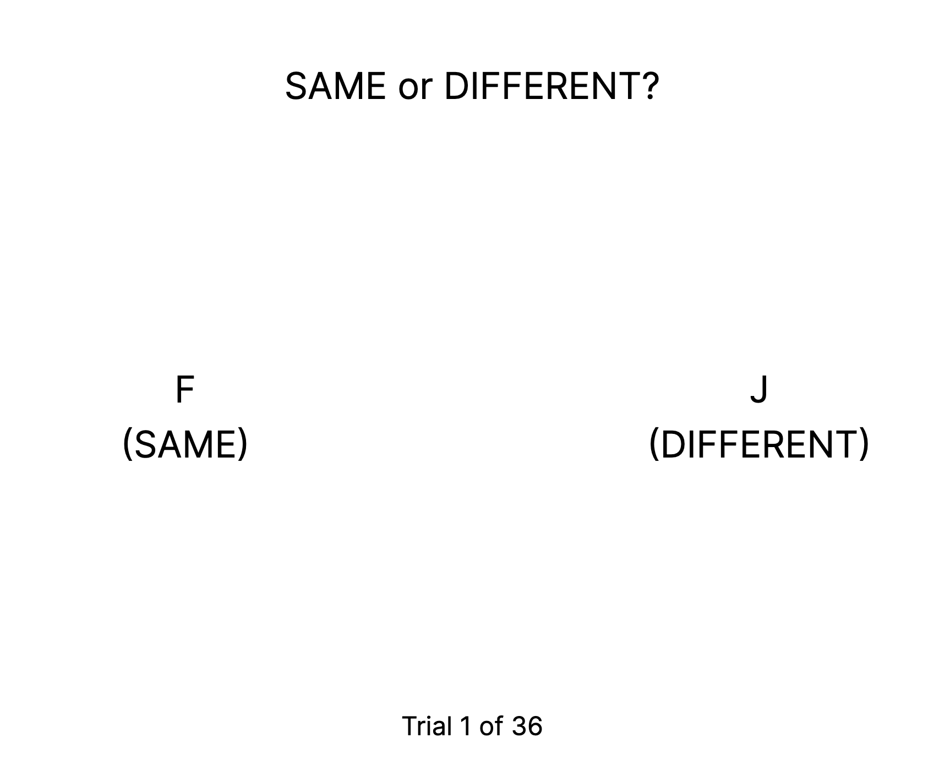

L2 perceptual discrimination
500 ms
fixation
Stim A
500 ms
ISI
Stim X
Response
Notes:
to briefly explain the perceptual discrimination pre- and posttests, this is the general trial structure the task, where participants had to discriminate between Japanese minimal pairs that differ by vowel length or consonant length. in the AX discrimination task, participants hear two sounds, stimulus A followed by stimulus X, and have to respond whether the two words were the same or different, for example

Slide 35
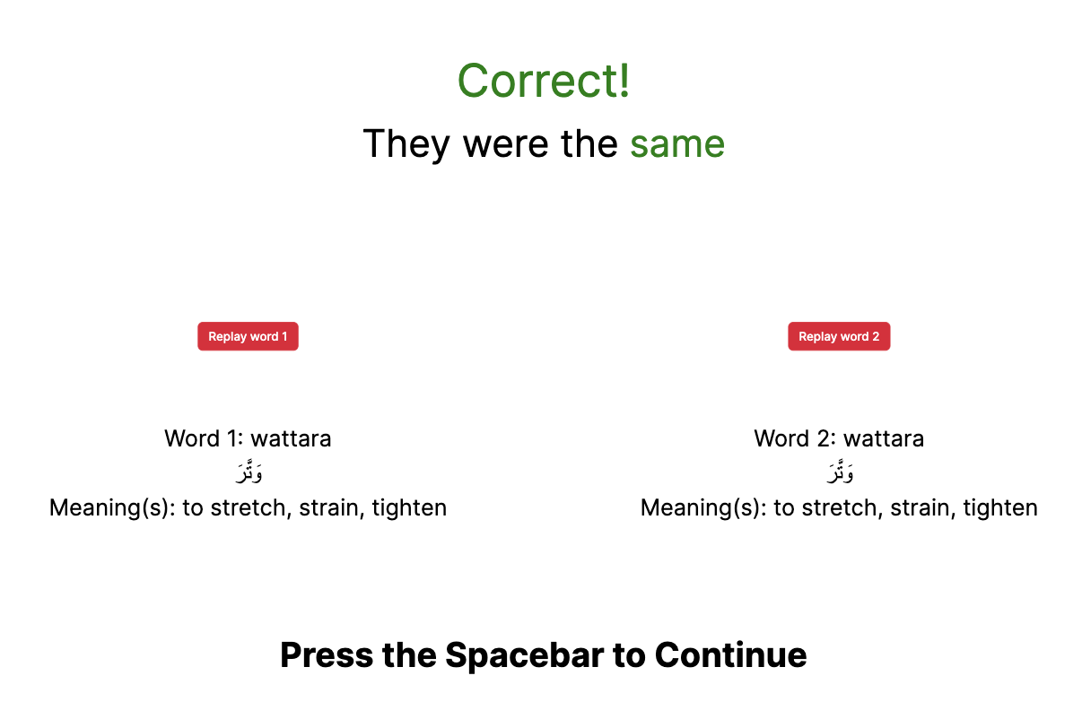
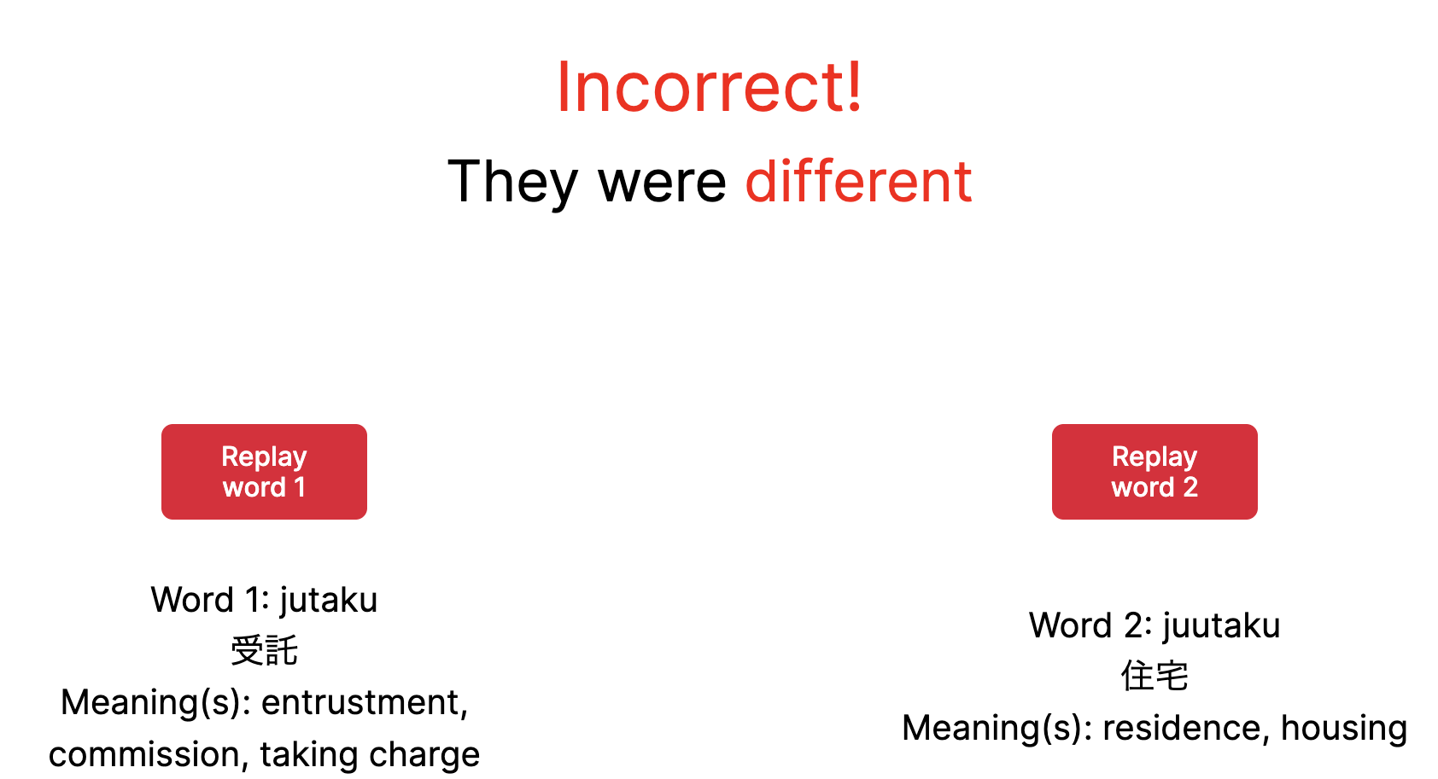
Listeners received feedback during perceptual training to learn how to tell minimal pairs apart
Notes:
the perceptual discrimination training has same trial structure, but participants received feedback after their responses to help them learn. because these are monolingual English speakers, I didn’t expect them to recognize any of the words they were hearing, so the feedback screen gave them a chance to read transcripts and word meanings.

Slide 36
Perceptual discrimination training introduced specific LD by training two experimental groups with either one language or two languages
Low LD
High LD
Japanese minimal pairs
oto vs. otto
shiru vs. shiiru
Japanese minimal pairs
oto vs. otto
shiru vs. shiiru
Modern Standard Arabic (MSA) minimal pairs
watara vs. wattara
kataba vs. kaataba
Notes:
the most important part of this training paradigm, and the most important part of study two, is how it was used to introduce specific linguistic diversity. participants were randomly assigned to either the low linguistic diversity group,
where they only trained with Japanese minimal pairs. or they were assigned to the high linguistic diversity group,
where they trained with Japanese minimal pairs and another language that contrasts words by vowel and consonant length,
which is Modern Standard Arabic, or MSA. so I called this “specific” linguistic diversity because I’m not just exposing listeners to another language, but another language that specifically contains the same phonemic contrasts as the target language
[other languages with independent vowel and consonant length: Arabic, Japanese, Hungarian, Malayalam, Tamil, and Finnish]

Slide 37
Low LD
High LD
Specific LD
Gradient categorization
Slope
Day 1 Day 2
Specific LD
L2 perceptual discrimination
Response Variability
Gradient categorization
L2 perceptual discrimination
Day 1 Day 2
Notes:
to explore whether specific linguistic diversity had an impact on gradient categorization, I compared the two groups to see how they differed in the change in the categorization measures of slope and response variability from before to after training. since all participants were monolinguals, I expected both groups to become more gradient in their categorization, so lower slope and lower response variability, but that the change would be stronger for the high LD group

Slide 38
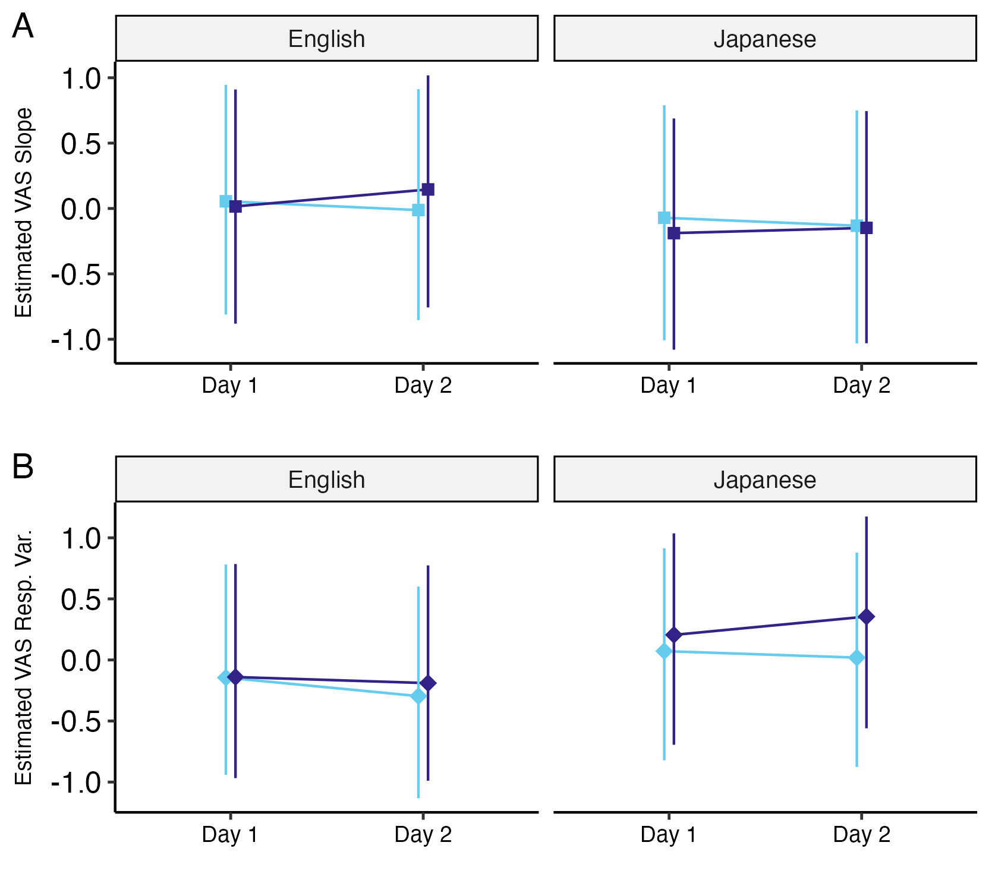
LD training condition did not lead to changes in L1 or L2 categorization measures
Specific LD
Gradient categorization
Low LD
High LD
n = 42
n = 38
Notes:
instead, I saw there were not significant differences between the low LD and high LD groups for either of the categorization measures for L1 English or L2 Japanese pairs
in fact, for both groups, the perceptual training did not seem to lead to changes at all in the categorization measures, as the average values for slope and response variability were relatively the same from before to after training

Slide 39
Low LD
High LD
Specific LD
Gradient categorization
Specific LD
L2 perceptual discrimination
Discrimination Accuracy
Day 1 Day 2
Gradient categorization
L2 perceptual discrimination
Notes:
for the impact of specific linguistic diversity on L2 perceptual discrimination, I expected for both groups to improve in discrimination accuracy after training, but for the improvement to be higher for the High LD group

Slide 40
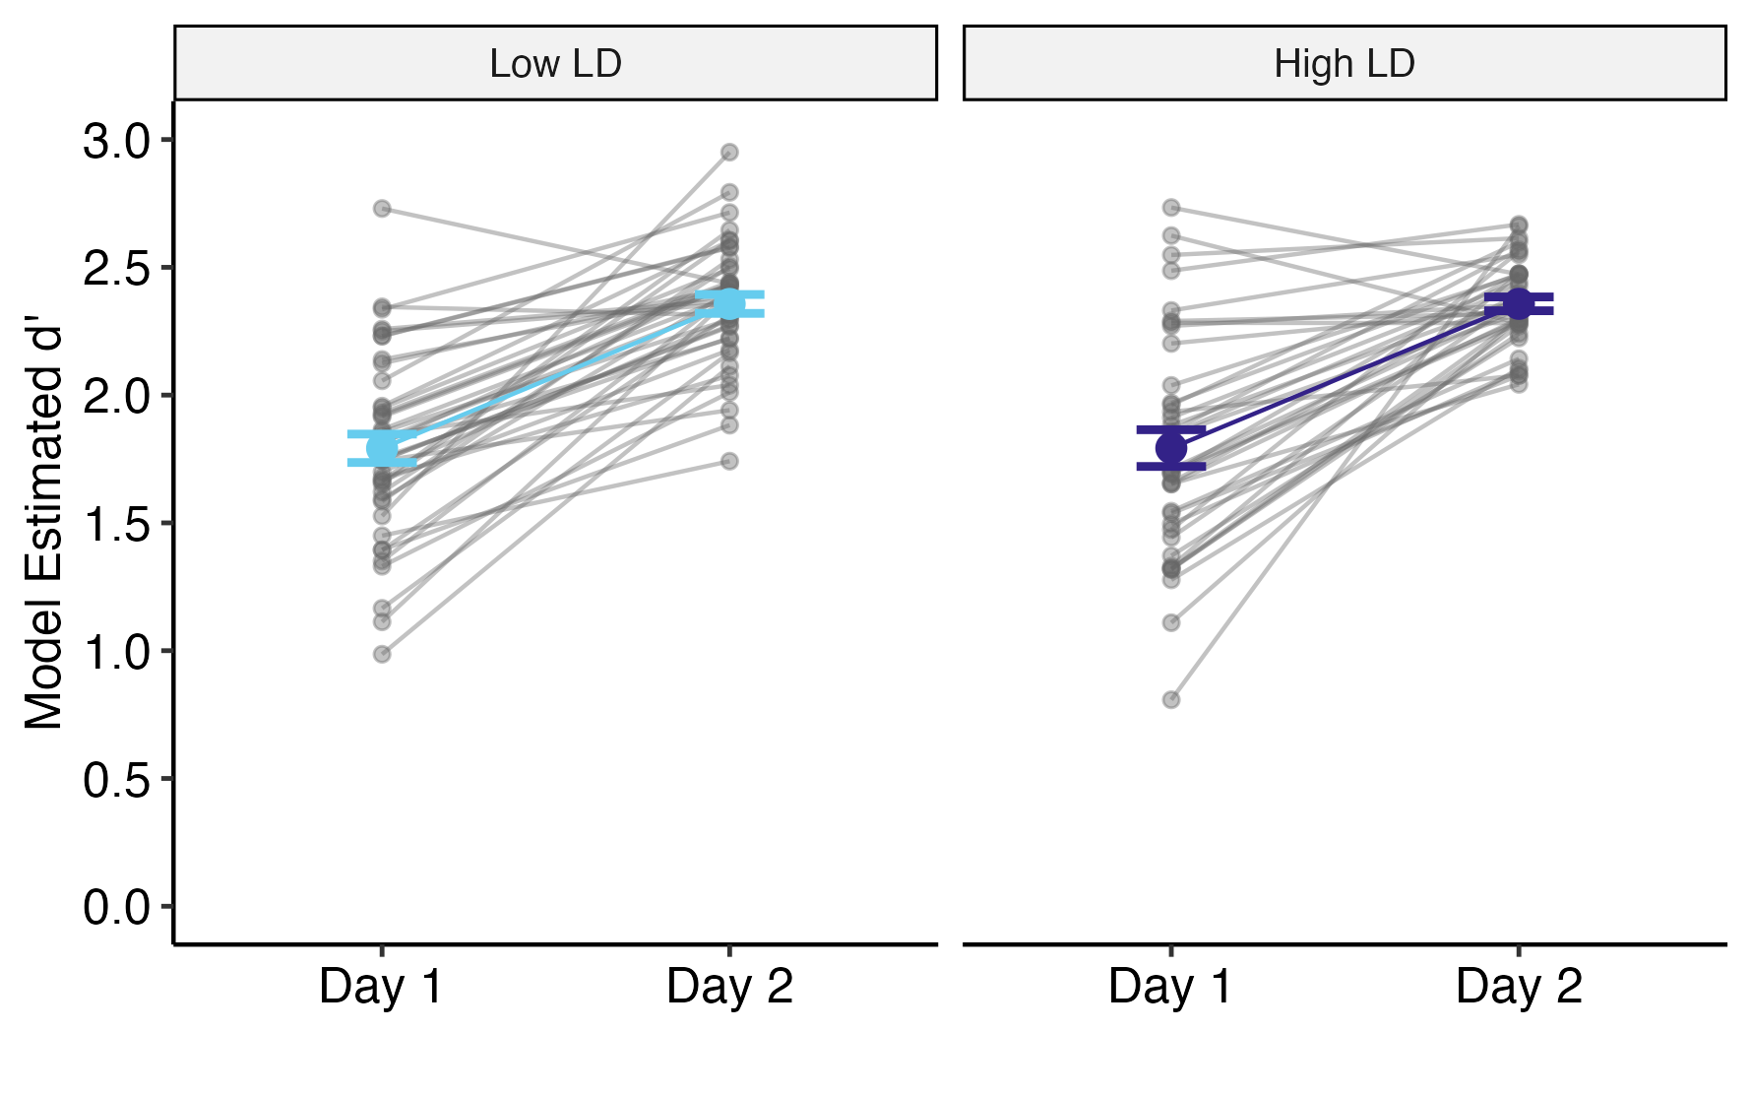
Although participants improved in L2 discrimination, learning was not different between LD training conditions
Training with multiple languages did not provide an additional learning advantage
Low LD
High LD
Specific LD
L2 perceptual discrimination
n = 42
n = 38
Notes:
I did see that both groups improved in discrimination accuracy, which demonstrates some L2 learning,
but the improvement from before to after training was not significantly different between the Low LD and High LD groups
the takeaway from this result is that training with multiple languages didn’t provide an additional learning advantage in this learning task

Slide 41
L1 English
L2 Japanese
Specific LD
Gradient categorization
Discrimination Accuracy
Specific LD
L2 perceptual discrimination
Slope
Discrimination Accuracy
Gradient categorization
L2 perceptual discrimination
Response Variability
Notes:
finally, to see whether gradient categorization predicted L2 perceptual discrimination ability, I collapsed the data between the two groups to look at the association between slope and response variability and discrimination accuracy at pretest and posttest, and I expected to see that low slope and response variability values, i.e. gradient categorization, would be associated with higher discrimination accuracy

Slide 42
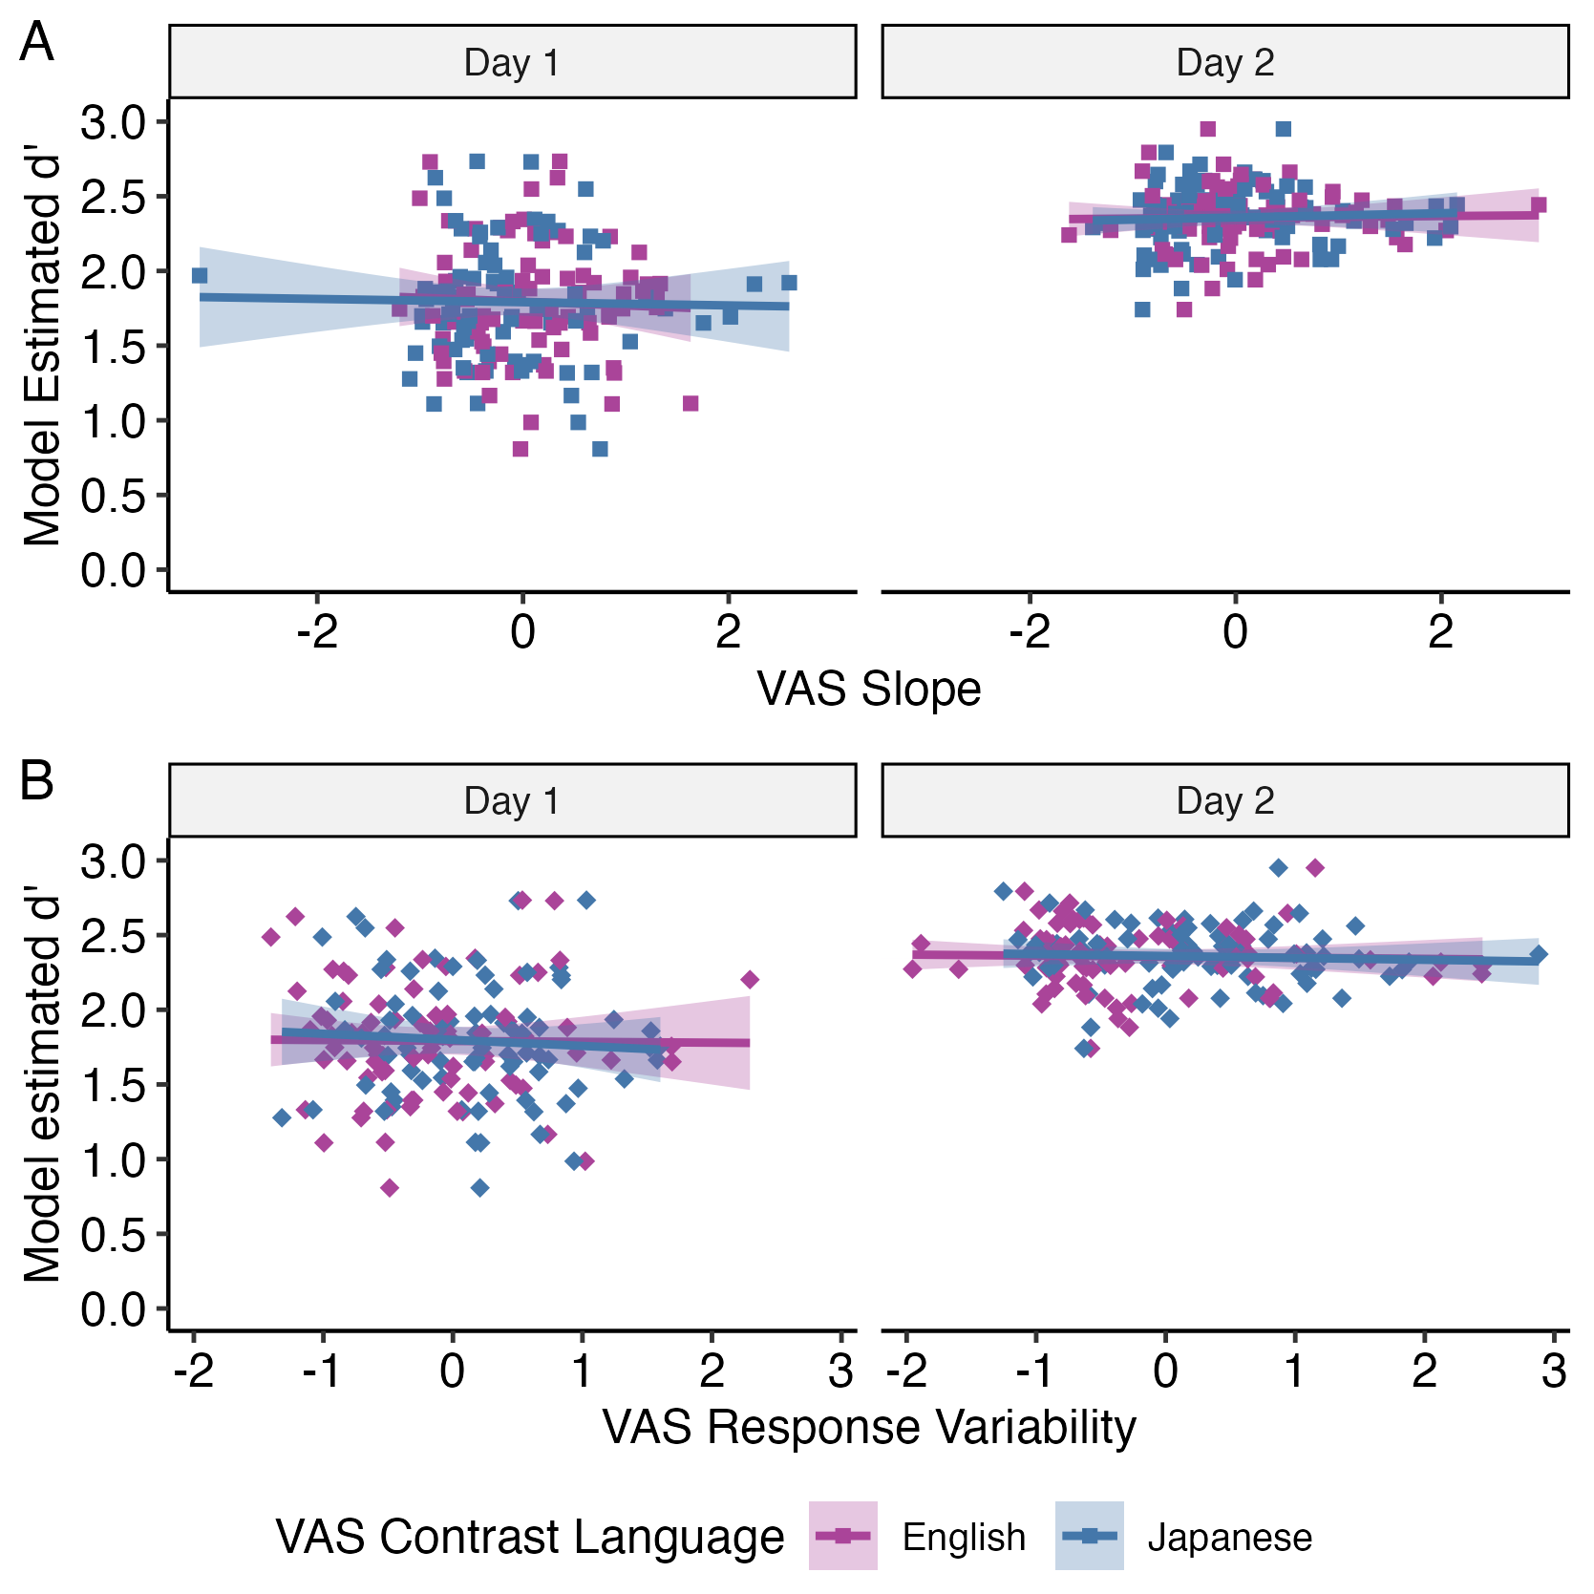
L1 English
L2 Japanese
L1 nor L2 categorization measures did not predict pre- or posttest L2 discrimination ability
Gradient categorization did not play a role in improving perceptual discrimination accuracy
Gradient categorization
L2 perceptual discrimination
Notes:
instead, the data showed that at both pretest and posttest,
there was no significant correlation between slope or response variability and discrimination accuracy, for either L1 or L2 categorization, as indicated by the flat trend lines
the takeaway from this result was that gradient categorization did not play a role in improving perceptual discrimination discrimination accuracy

Slide 43
Study 3
Notes:
so that was a bummer, but I moved on to explore using this perceptual training paradigm in an applied setting with classroom learners to see if training with linguistic diversity can boost learning when used as a classroom supplement

Slide 44
L2 Japanese classroom learners (n = 18) completed VAS, perceptual discrimination, and L2 listening assessment tasks before and after a period of longitudinal perceptual discrimination training
Linguistic diversity
L2 speech learning
Long-term Specific LD
Specific LD
L2 perceptual discrimination
Gradient categorization
L2 listening assessment
Notes:
I recruited 18 participants from university-level Japanese language classes for a longitudinal experiment during the semester from several American universities. everyone completed the VAS task, the perceptual discrimination test, and an L2 listening assessment before and after the period of training. The VAS task and perceptual discrimination pre and posttests were the same as in Study 2, and the perceptual training session was the same as in study 2, just repeated for six training sessions across 3-4 weeks

Slide 45
The effect of perceptual training on L2 learning was compared between training with different levels of specific LD and receiving classroom instruction alone
Control
Low LD
High LD
Classroom instruction
Classroom instruction
Japanese minimal pairs
oto vs. otto
shiru vs. shiiru
Classroom instruction
Japanese minimal pairs
oto vs. otto
shiru vs. shiiru
MSA minimal pairs
watara vs. wattara
kataba vs. kaataba
3-4 weeks between pre and post
Notes:
I randomly assigned students to either the Low LD or High LD experimental groups, and I also had a control group who did not undergo perceptual training, just received typical classroom instruction same as everyone else, and waited an equivalent amount of time as the training groups in between the pre and posttest time points.

Slide 46
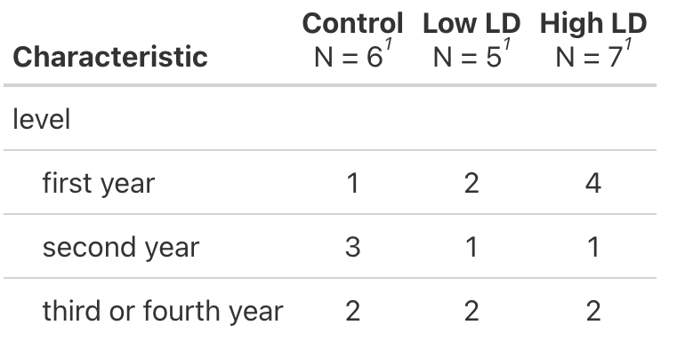
Notes:
6 universities: Carnegie Mellon University, University of Pittsburgh, Western Michigan University, Emory University, Northwestern University, University of Washington

Slide 47
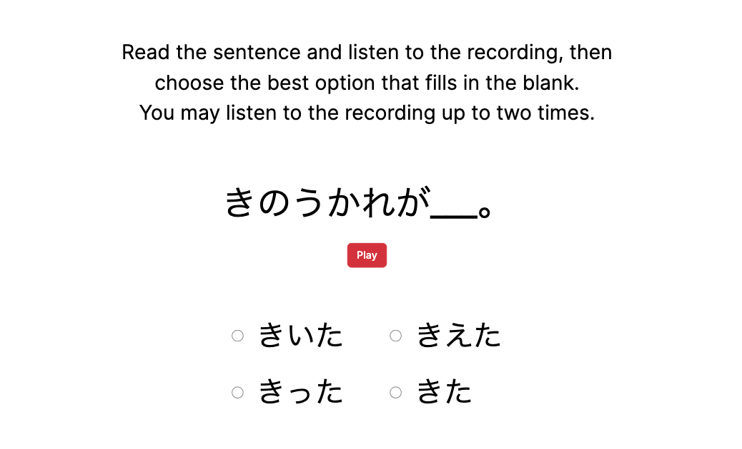
L2 listening assessment accuracy was measured by a multiple-choice partial dictation (MCPD) task using more natural L2 speech recordings
kinoo kare ga kiita
kiita
kieta
kitta
kita
Notes:
as I mentioned, the VAS and discrimination pre and posttests were the same as in Study 2, but the addition to study 3 was a listening assessment task where I tested participants abilities to accurately perceive the target phonemic contrasts in naturalistic speech recordings to simulate the kind of language demands they might actually face in the wild.
In the task, participants read a sentence with a missing word and needed choose the most appropriate answer after listening to the recording, like this
however, the tricky part is that I designed all of the choices to be the contrasting word in the minimal pair to be phonemically or phonetically similar to the correct answer,
which in this case is kiita, so this tests participants’ listening accuracy in the face of phonemically similar competition. the sentences were all syntactically ambiguous, and so this simulates a real world hearing situation where a person might be confused on if they heard kiita or kitta. they have to rely on accurate perception, and not context clues, to parse what what said

Slide 48
Control
Low LD
High LD
Specific LD
Gradient categorization
Slope
Pre Post
Specific LD
L2 perceptual discrimination
Response Variability
Specific LD
L2 listening assessment
Pre Post
Notes:
so to move onto the results of study 3, I first explored whether the longitudinal specific LD training paradigm lead listeners to more gradient categorization, so low slope and response variability, after training, and I predicted the strongest effect for the high LD group, follow by the Low LD group, with no effect for the control group who did not undergo perceptual training

Slide 49
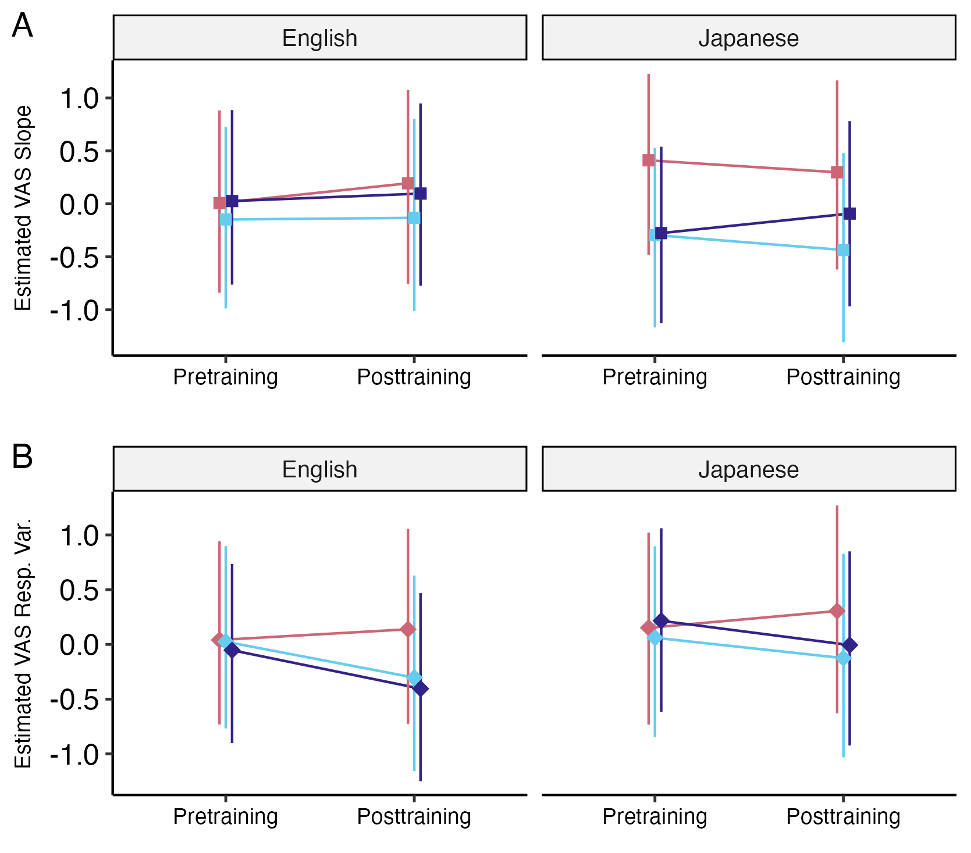
Control
Low LD
High LD
LD training condition did not lead to changes in L1 or L2 categorization measures
n = 6
n = 5
n = 7
?
Specific LD
Gradient categorization
Notes:
like study 2, the categorization measures were not very different between the Low LD and High LD training groups. interestingly, for response variability, there seems to be a trend that the training groups differed from the control group, however, this effect was not statistically significant. in fact, the average group values for slope and response variability were not statistically significantly different from before to after the training period for any of the groups.
however, given the low sample sizes, I was hesitant to come to any strong conclusion for these results one way or the other, and have deemed this result, for now, inconclusive

Slide 50
Control
Low LD
High LD
Specific LD
Gradient categorization
Discrimination Accuracy
Specific LD
L2 perceptual discrimination
Pre Post
Listening Assessment Accuracy
Specific LD
L2 listening assessment
Pre Post
Notes:
for the effect of the specific LD training on the two L2 learning outcomes, I predicted similar outcomes between the two tasks where all groups would show signs of learning after the period of training, or just classroom instruction for the control group, but that learning would be greater for the two training groups, and greatest for the High LD group

Slide 51
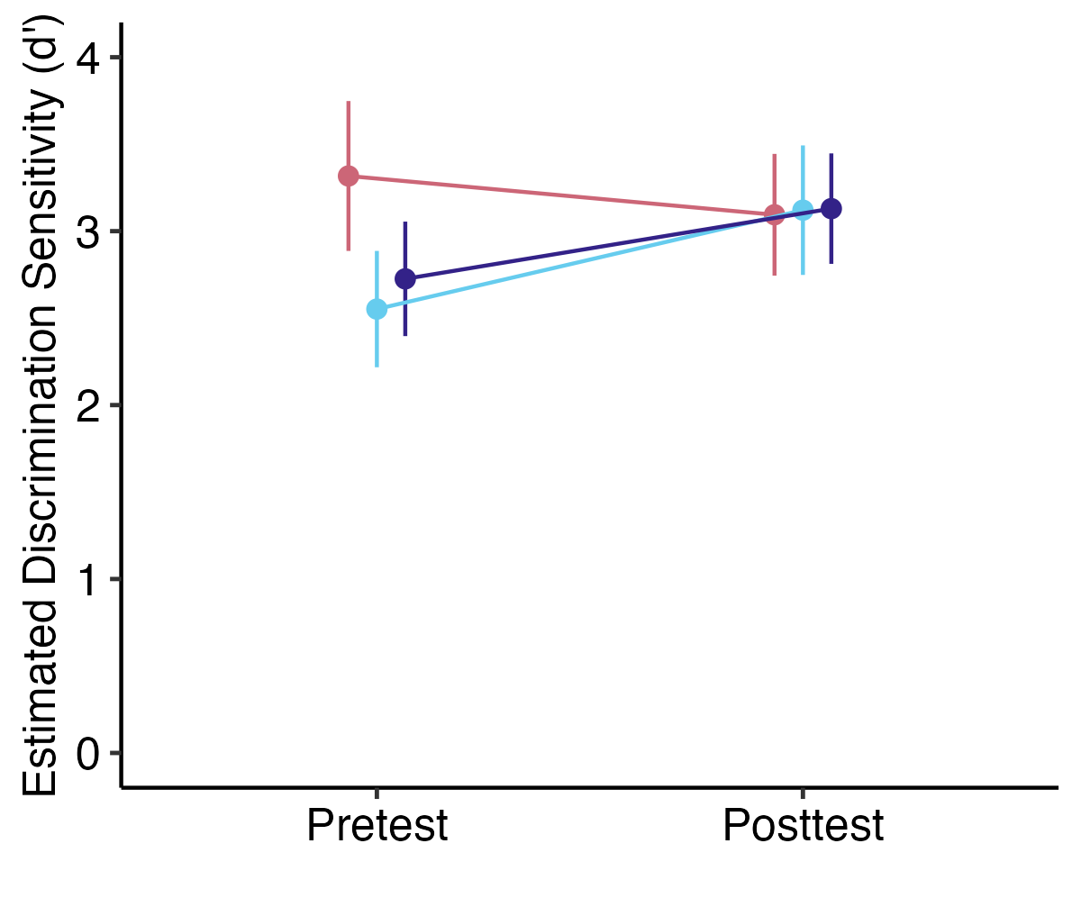
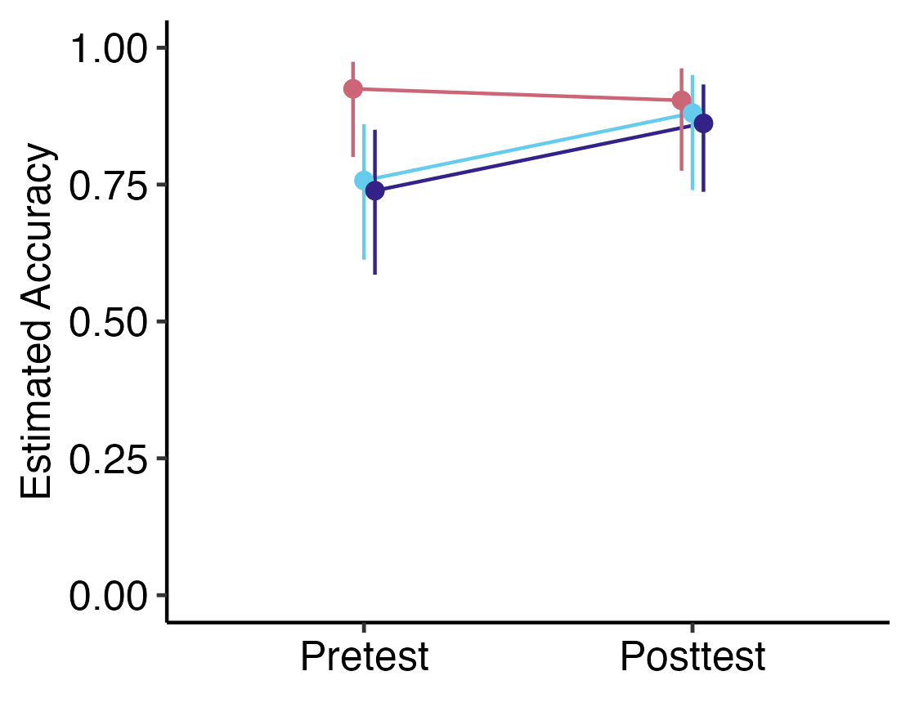
Control
Low LD
High LD
n = 6
n = 5
n = 7
There may be a benefit to perceptual training as a supplement to classroom instruction
?
?
Specific LD
L2 perceptual discrimination
Specific LD
L2 listening assessment
Notes:
instead, what I saw was, despite these trend lines, the three groups did not significantly improve in perceptual discrimination and listening assessment accuracy from pretest to posttest. however, although there was no difference between the low LD and high LD groups, these trends *seem* to show a difference between the control groups and training groups,
suggesting that the perceptual training *may* have had some sort of effect on L2 perceptual accuracy that was captured in both of these tasks separately.
this effect was not significant, so this study would benefit from a replication using larger sample sizes to determine if there is a true effect of perceptual training as a supplement to classroom instruction

Slide 52
Summary and Conclusion
Notes:
to summarize the findings of all three studies

Slide 53
What are the roles of linguistic diversity and gradient categorization in L2 speech category learning?
Linguistic diversity
L2 speech learning
?
Gradient categorization
Notes:
I go back to my original overarching research question and the relationships I looked at between each of these three factors. first, I found that
Linguistic diversity did not explain the individual differences in categorization response patterns. second, I found that
that training with multiple languages did not provide an additional learning advantage beyond training with just the target language. lastly, I found that
gradient categorization did not play a role in improving perceptual discrimination accuracy.

Slide 54
Gradient categorization
Linguistic diversity
L2 speech learning
monolingual
multilingual
Notes:
the next steps for this research of course to replicate the studies with larger sample sizes, but the research also benefit from refining and validating the research instruments I created. this could involve validating Part 2 of the LDQ, expanding the specific LD training paradigm to include more languages and/or different contrasts, and perhaps having the training be a semester-long or year-long supplement, using the VAS task to assess perception for a wider range of languages and contrasts

Slide 55
L2 speech learning
Notes:
regarding the multiple choice partial dictation task, future research should further validate the task, and it could be used in a classroom setting not just as a summative assessment, but as a diagnostic assessment to identify and address particularly problematic phonemic contrasts, and which contrasts are difficult for which students depending on their language backgrounds.

Slide 56
There may be a benefit to perceptual training as a supplement to classroom instruction
Notes:
with regards to classroom learning, I want to return to this takeaway that there may be a perceptual benefit to including perceptual training to supplement classroom instruction. that may not look exactly as it did in this research project, and the data didn’t suggest that it needs to be linguistic diversity training, but providing L2 learners with more opportunities to focus on difficult speech contrasts seems to lead to improvements beyond learning gained from classroom instruction. this is important because there is only so much classroom time and a lot of material to learn in a lot of different aspects, so focusing on minimal pairs is often not viewed as a priority. this research provides at least some preliminary evidence that giving learners focused time with something as simple as minimal pair training outside of class time can be meaningful in their L2 speech learning journeys. Thank you.

Slide 57
Acknowledgements
Dr. Seth Wiener
Dr. Lori Holt
Drs. Ethan Kutlu and Sanghee Kang
Drs. Christina Bjorndahl, Natalie Amgott
Yumiko Adachi, Joseph Garcia, Dr. Seth McCombie
Speakers for my stimuli & study participants
Funding bodies: NSF & Duolingo Inc.
Department of Psychology, Department of Languages, Cultures, & Applied Linguistics
LAPP Lab, Holt Lab
Austin Luor, Alana Hodson, Jenah Black, Christi Gomez
Leigh Montgomery & Dr. Gregory Thorkelson
Friends and family
Dr. Kem Obasih
Noah Satterlee <3
Notes:
[script needed]

Slide 58
Linguistic diversity
Gradient categorization
L2 speech learning
experiential LD not correlated with gradient categorization measures
variable within and between individuals
variable within and between language contrasts
stable across time, not easily manipulable by perceptual training
not correlated with gradient categorization measures
not affected by specific LD training
effect may take place over years, perceptual training too short
Notes:
[script needed]

Slide 59
Linguistic diversity
Gradient categorization
L2 speech learning
Created part 2 of LDQ, including equations to score MLD-P
MLD-P is a new construct that has yet to be validated
Novel use of specific LD as experimental manipulation
Used VAS task with wider variety of contrast pairs and languages
Created novel listening assessment task with naturalistic recordings not often used in psycholinguistics research
Notes:
[script needed]

Slide 60
Linguistic diversity
Gradient categorization
L2 speech learning
Future work should validate Part 2 questions with objective measures of passive exposure to LD
Future work should expand specific LD training by using more languages, contrasts, and time
Future work should supplement VAS with neuroimaging measures
Future work should validate MCPD listening assessment
Notes:
[script needed]

Slide 61
Agenda
Background
Research Gap, Hypothesis, Research Questions
Study 1
Study 2
Study 3
Summary, Implications, Future Directions
Notes:
there is a lot I cannot talk about due to time but I welcome questions

Slide 62
learning L2 speech involves learning new categories
category learning involves mapping from variable acoustics to discrete categories
people categorize in different ways – gradiently or categorically
what leads to these differences? one thing could be exposure to linguistic diversity
evidence of linguistic diversity being connected to gradient categorization
why gradient categorization may be helpful in L2 speech learning (including some conflicting prelim evidence)
Notes:
each of these points should last no more than 30 seconds
they can all be slide titles

Slide 63
RQ1: Is increased experience with linguistic diversity (hereafter, experiential linguistic diversity) from one’s language history, usage, and exposure predictive of higher degrees of gradient categorization of L2 speech as it is with L1 speech? If so, do higher degrees of L2 gradient categorization predict the degree of usage of the secondary acoustic cue in the perception of L2 phonemic contrasts, as we see with L1 gradiency and secondary cue use?
Notes:
Does targeted exposure to linguistic diversity related to L2 linguistic targets shift the perceptual system towards gradient perception?
Does this linguistic diversity perceptual training lead to changes in L2 cue-weighting strategies?
Does this linguistic diversity perceptual training result in measurable improvement L2 speech perception as measured through listening assessments?

Slide 64
RQ2: Can we promote gradient categorization in listeners through exposure to specific linguistic diversity via perceptual training? If so, does gradient categorization increase perceptual sensitivity to discriminate between target language phonemic contrasts?
Notes:
Does targeted exposure to linguistic diversity related to L2 linguistic targets shift the perceptual system towards gradient perception?
Does this linguistic diversity perceptual training lead to changes in L2 cue-weighting strategies?
Does this linguistic diversity perceptual training result in measurable improvement L2 speech perception as measured through listening assessments?

Slide 65
RQ3: Does exposure to specific linguistic diversity through perceptual training lead to improvements in L2 speech perception and listening?
Notes:
Does targeted exposure to linguistic diversity related to L2 linguistic targets shift the perceptual system towards gradient perception?
Does this linguistic diversity perceptual training lead to changes in L2 cue-weighting strategies?
Does this linguistic diversity perceptual training result in measurable improvement L2 speech perception as measured through listening assessments?

Slide 66
Specific aims
Experiment 1: Aim 1 is to determine whether experiential linguistic diversity from listeners’ language history, usage, and exposure predicts (1) degree of gradient categorization of L1 and L2 speech and (2) perceptual flexibility and acoustic cue integration.
Experiment 2: Aim 2 is to investigate the effects of short-term, specific exposure to linguistic diversity through perceptual training on (1) gradient categorization of L1 and L2 speech and (2) L2 phoneme discrimination. Here, specific linguistic diversity is operationalized as the number of languages used in the perceptual discrimination training task.
Experiment 3: Aim 3 is to investigate the effects of long-term, specific exposure to linguistic diversity through perceptual training, in conjunction with foreign language classroom instruction, on the (1) gradient categorization of L1 and L2 speech, (2) L2 phoneme discrimination, and (3) L2 speech perception and listening.

Slide 67
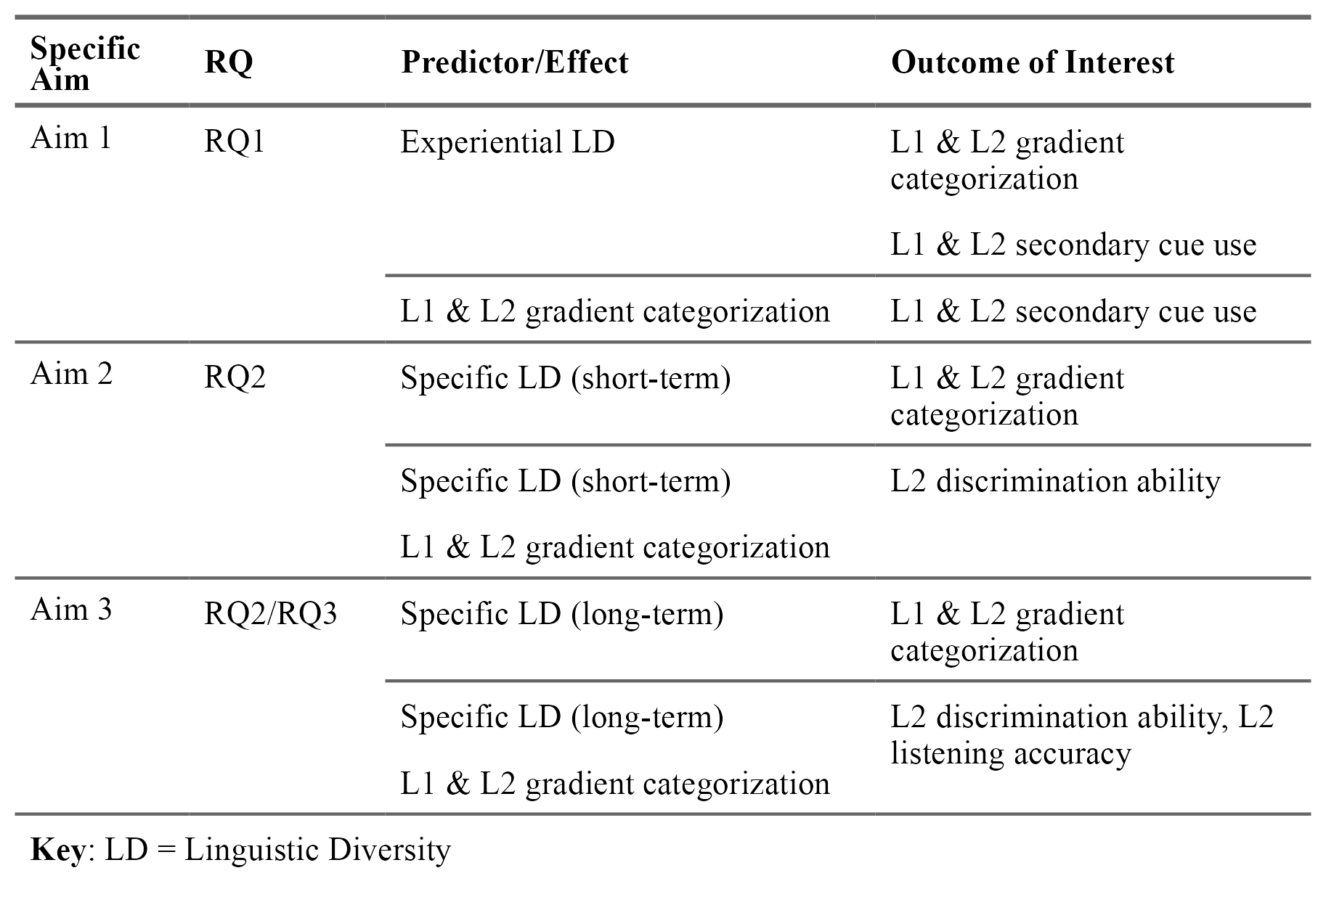

Slide 68


Study 1
n = 76
Participants completed the Linguistic Diversity Questionnaire (LDQ)
and the Visual Analog Scale (VAS) task
Notes:
recruited L1 English monolinguals and multilinguals from prolific
(just list the four pairs, and share example of continuum)
this is too busy, redo this in the previous slide

Slide 69
The LDQ scored two indices of multilingual language diversity (MLD) based on active and passive use of and exposure to linguistic diversity
monolingual
multilingual
MLD-A (active): native and learned languages; speaking, listening, reading, writing
MLD-P (passive): native, learned, and unfamiliar languages; listening and reading
Notes:
to quantify experiential linguistic diversity, the LDQ scored two factors using the multilingual language diversity, or MLD, index, a measure based on language entropy. this index offers a continuous measure of multilingualism by quantifying balanced language use, or the integration of multiple languages in a given context. we don’t have time to go into the math, but just know that the MLD index has a range of 0 to 2, where 0 indicates use of only a single language, and scores of 1, 1.58, and 2 indicate balanced use of 2, 3, and 4 languages respectively
I used the LDQ to create two MLD measures, MLD-A which measures active language use and exposure, taking into account all native and learned languages in the four language aspects of speaking, listening, reading, and writing, and passive language use and exposure to languages the participant reported knowing and not knowing in the domains of listening and reading but not speaking and writing for 10 daily contexts, so for example, overhearing a foreign language in the workplace if you work in a diverse office space.
instead of trying to explain all of this, I can say
I used two scores calculated from responses to the LDQ that ranged from 0 to 2, with 0 indicating complete monolingual, and increasing numbers indicating use of or exposure to more languages

Slide 70
Part 2 of the LDQ scored MLD-P based on passive use and exposure to linguistic diversity in 10 contexts
Category | Context | Context Label
Entertainment contexts | Watching TV, film, videos on websites like YouTube or Twitch (with or without subtitles) | Watching
 | Listening to radio, music, podcasts, audiobooks | Listening
 | Playing video games, mobile games, online games | Games
 | Using social media or browsing the internet, (with or without the use of automatic translation tools) – include here interacting with generative AI and using language learning apps | Online
Interpersonal contexts (in person or digitally) | At home (e.g., with your partner, child(ren), roommates) | Home
 | With family (parents, siblings, grandparents, caregivers, extended family – note: this may be the same as the context above for you) | Family
 | In social contexts with friends, neighbors, peers from hobbies or communities (e.g., religious community, neighborhood coalition, online community) | Social
 | In work or school contexts with co-workers/colleagues/classmates (this context can include taking language classes) | Work/school
 | Out of home in commercial or official contexts (e.g., restaurants, stores, doctor’s office, bank) | Out of home
None of these | Situations and settings not listed above. Please specify: | Other

Slide 71

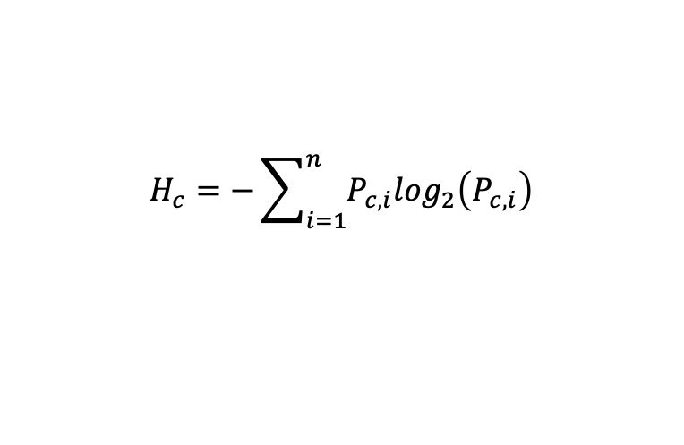

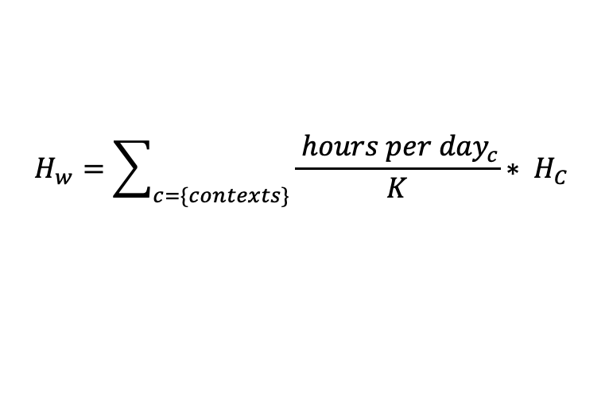
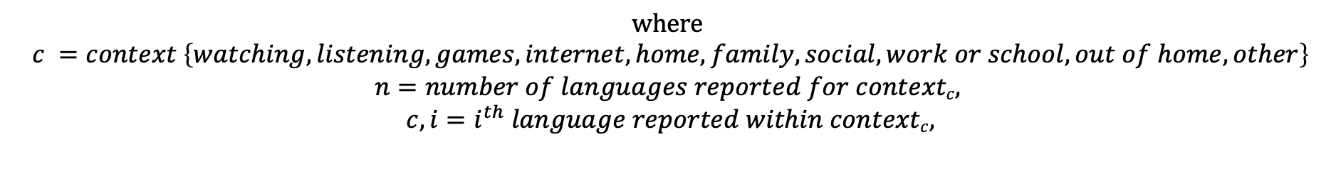
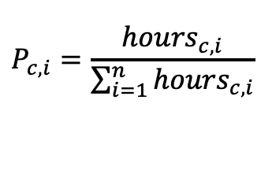
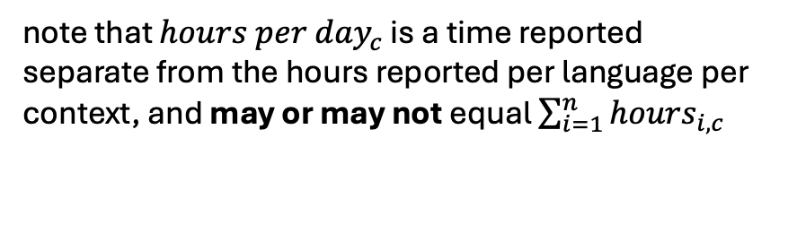
LDQ-Part 2 calculations
note that ${hours per day}_{c}$ is a time reported separate from the hours reported per language per context, and may or may not equal $\sum_{i=1}^{n}{{hours}_{i,c}}$
entropy per context:
$$H_{c}=−\sum_{i=1}^{n}{P_{c,i}\log_{2}\left(P_{c,i}\right)}$$
MLD-P = $H_{w}$ aka weighted entropy:
$$H_{w}=\sum_{c=\{contexts\}}{\frac{{ hours per day}_{c}}{K}∗ H_{C}}$$
where $P_{c,i}$ aka language proportion per context:
here K is a constant scaling factor used to weight each context, and K was set to 24 (to represent 24 hours, such that each context is weighted as a proportion of time spent per day in that context)
$$P_{c,i}=\frac{{hours}_{c,i}}{\sum_{i=1}^{n}{{hours}_{c,i}}}$$
$$where$$
$$c =context \left\{watching, listening, games, internet, home, family, social, work or school, out of home, other\right\}$$
$$n=number of languages reported for contextc,$$
$$c,i=i^{th} language reported within contextc,$$

Slide 72
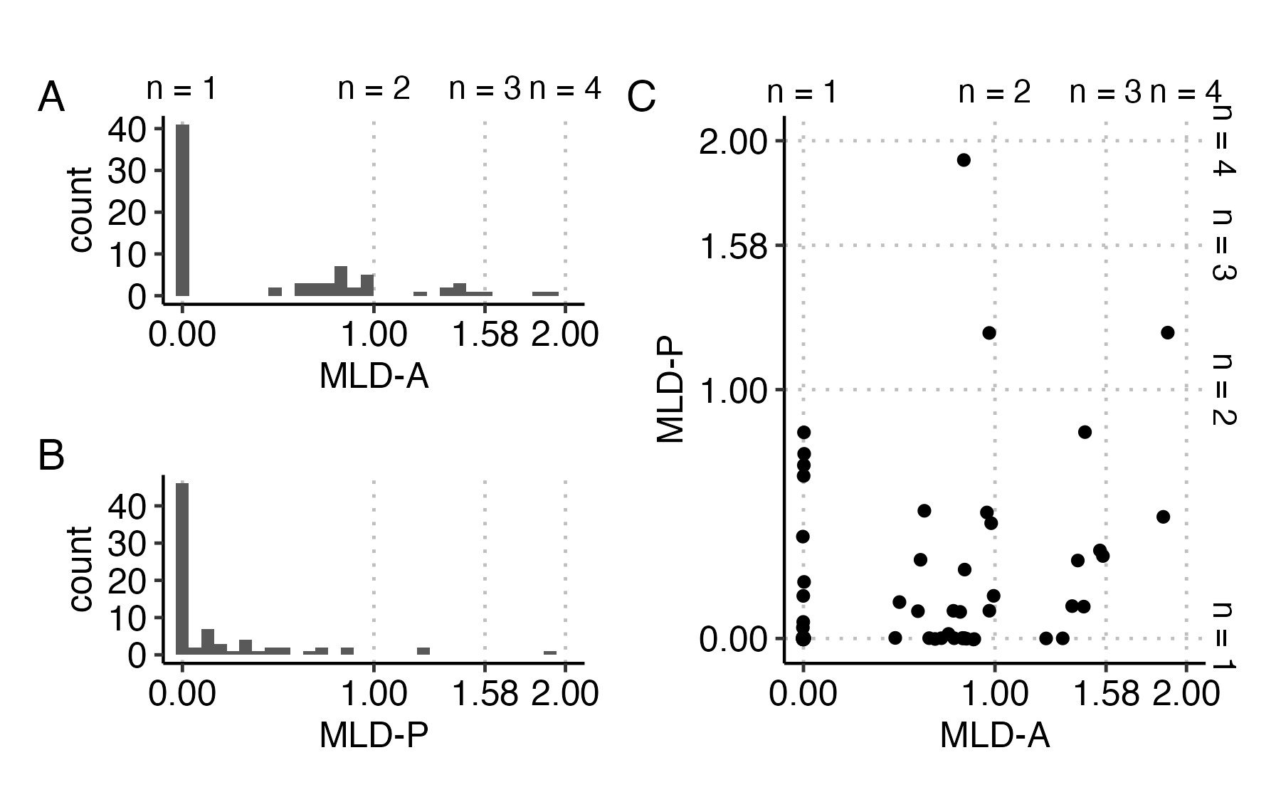
Most participants were strictly monolingual, but some monolinguals are passively exposed to multiple languages
Notes:
it’s hard to see, but most participants points lie on top of each other at 0, 0, indicating that they only speak one language in both active and passive contexts
not going to talk about this

Slide 73
reason
risen
Click on the slider based on what you think the word sounded like, then press the Spacebar to continue.
Notes:
English VAS

Slide 74
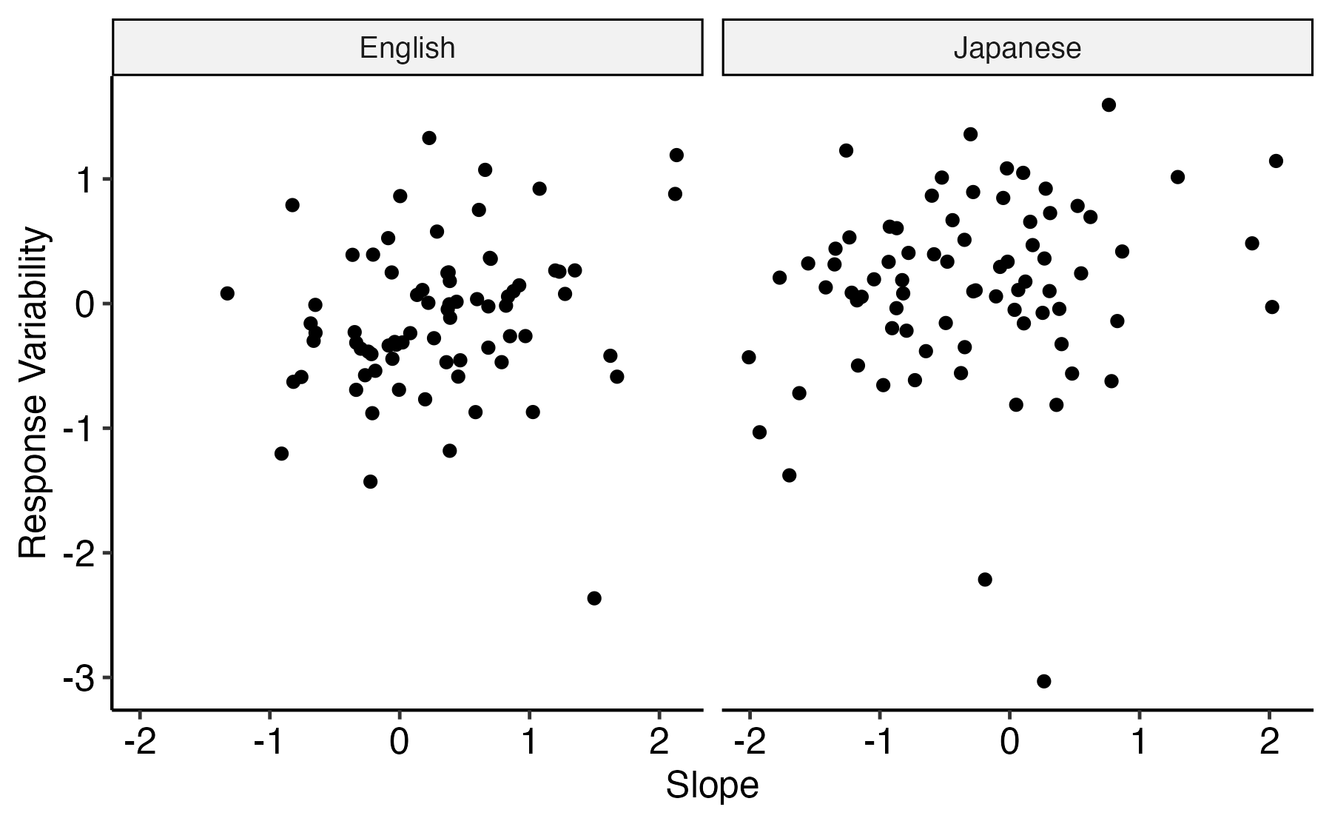

Slide 75
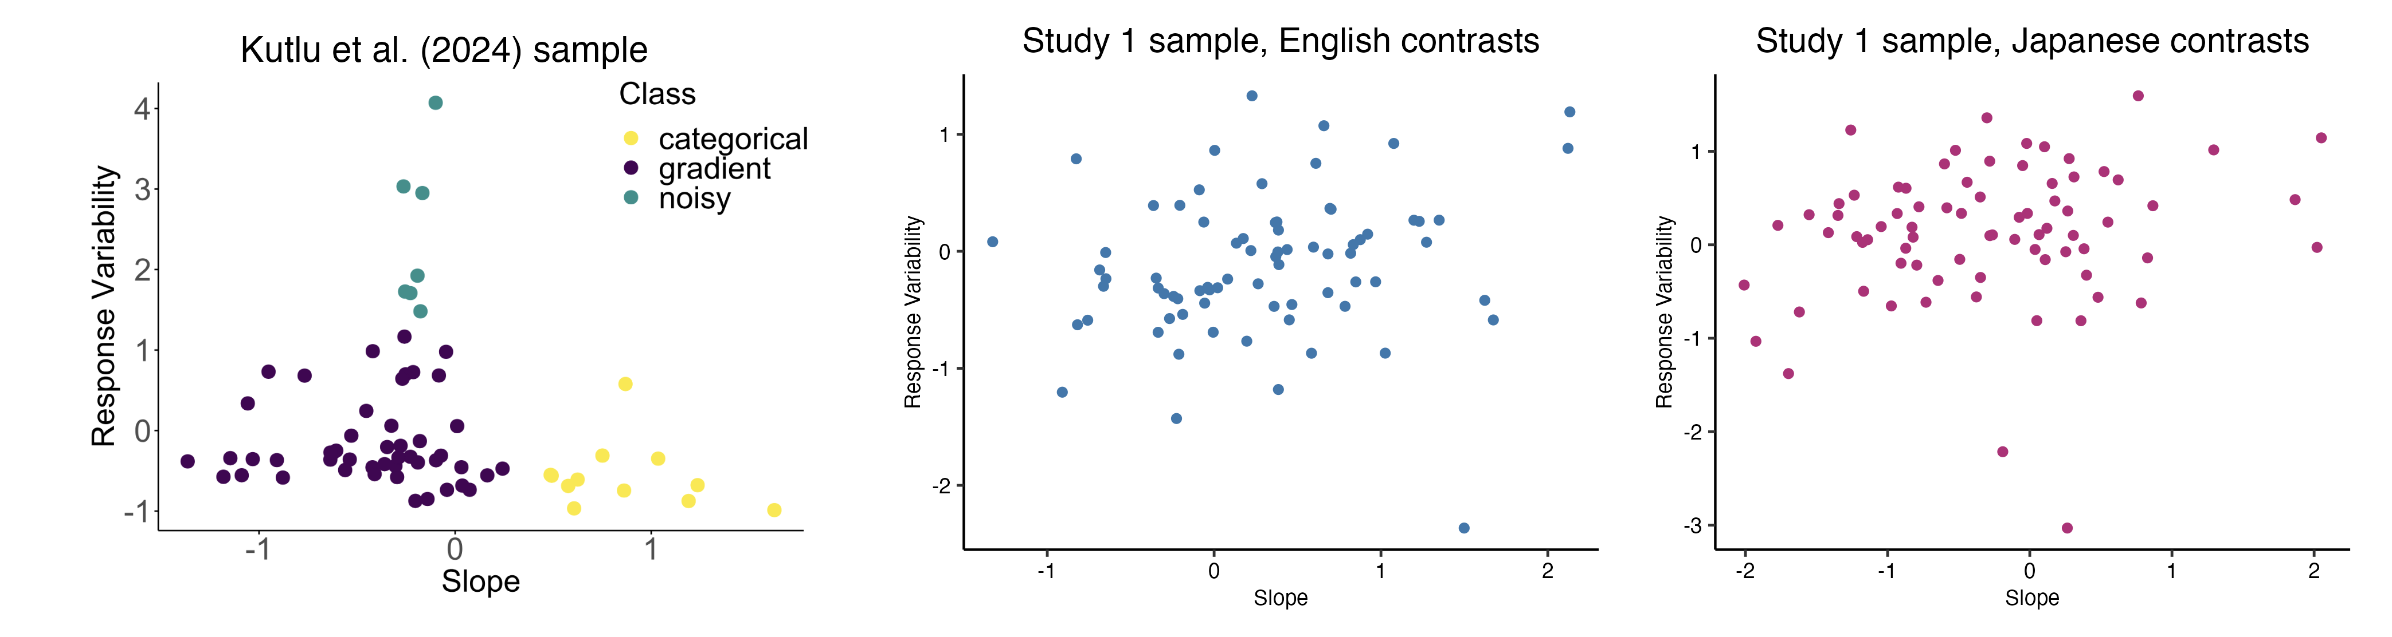

Slide 76
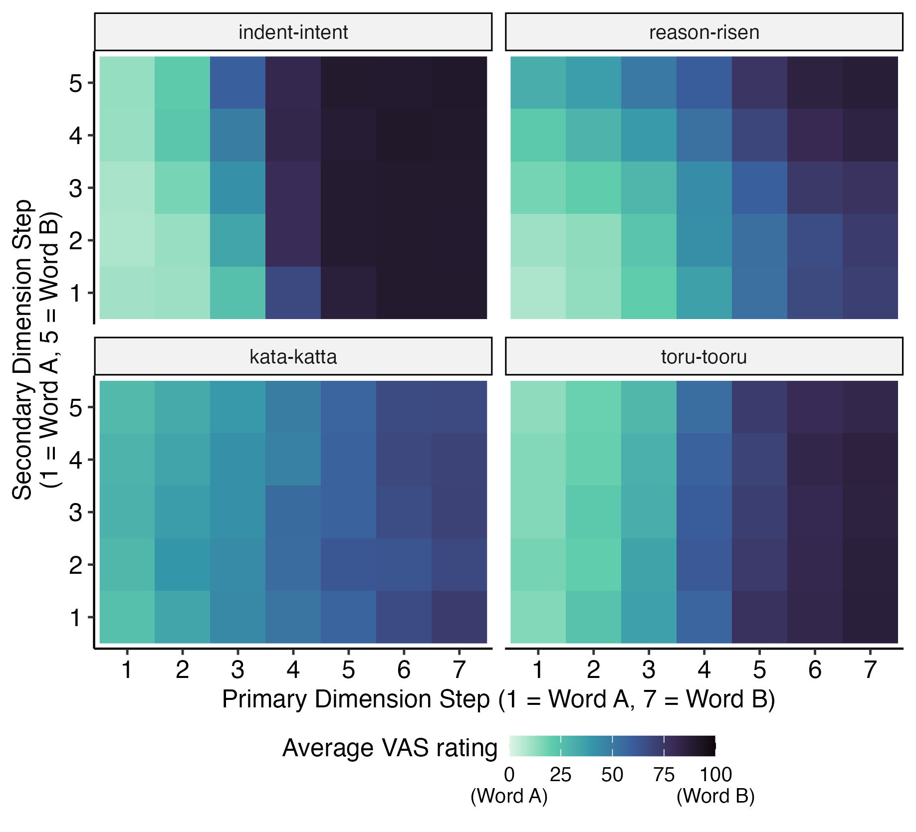

Slide 77
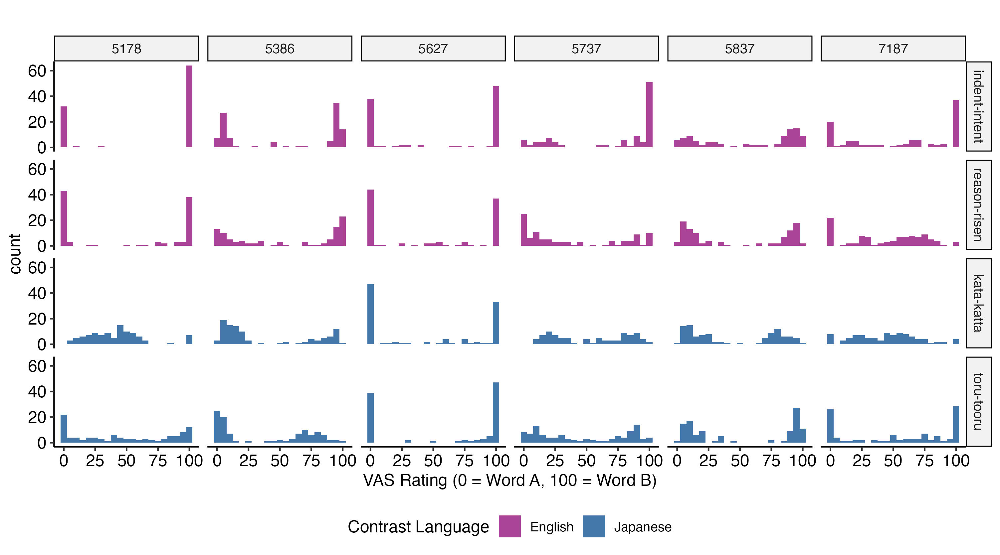

Slide 78
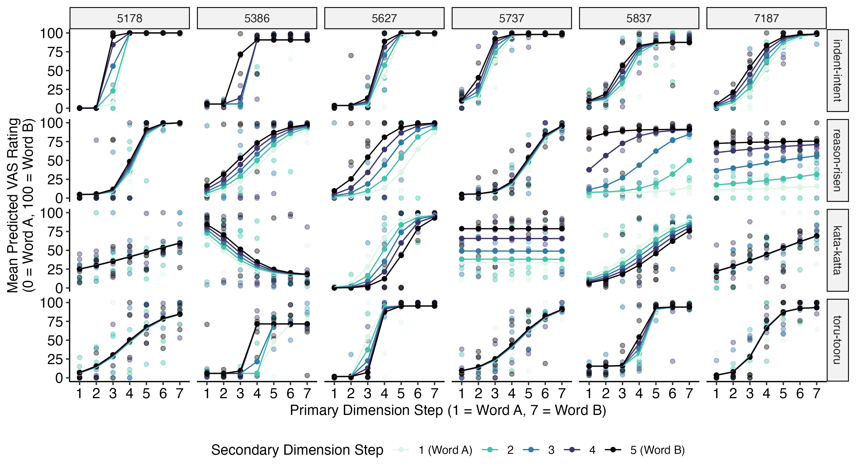
Notes:
slope - the measure of gradiency
response variability - how close the dots are to the line
redo this graph, hide this slide
transition sentence -
so it's clear people are different, and I wanted to see what is associated with these differences, so the purpose of this study is that I wanted to see if experience with linguistic diversity predicts they way in which people are different gradiently/categorically

Slide 79
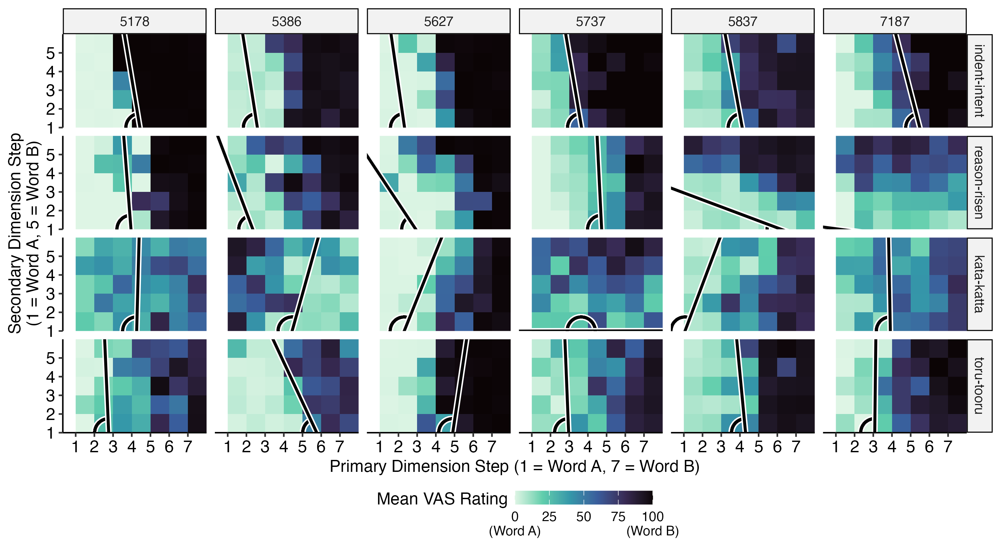

Slide 80
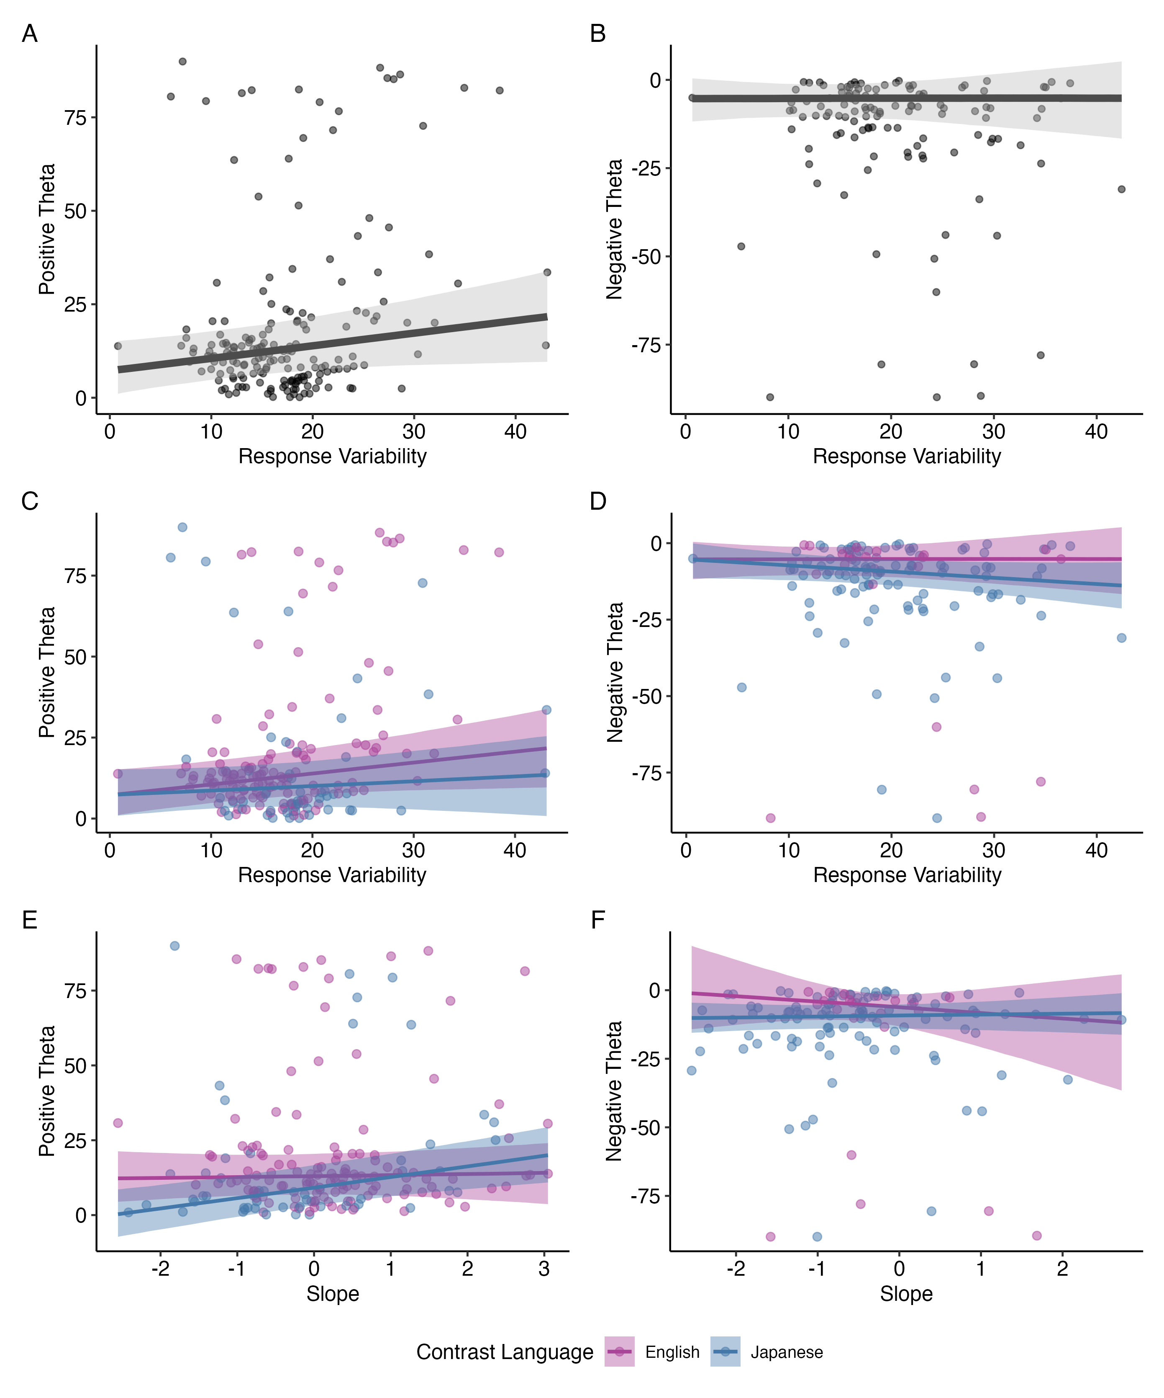
Notes:
might not discuss secondary cue use during defense presentation

Slide 81


Study 2 was a two-day experiment that took place at least 24 hours apart
AX discrimination pretest
Day 1
Low LD group: Japanese only
High LD group: Japanese and
Modern Standard Arabic (MSA)
Feedback provided
Japanese only
No feedback
AX discrimination posttest
Day 2
Japanese only
No feedback
Notes:
so this was the structure of study 2, they did VAS pre and post training, pre- and pos—test for discrimination, and the training itself, there was at least 24 hours in between
I will be comparing VAS pre/post training and discrimination pre/post test

Slide 82
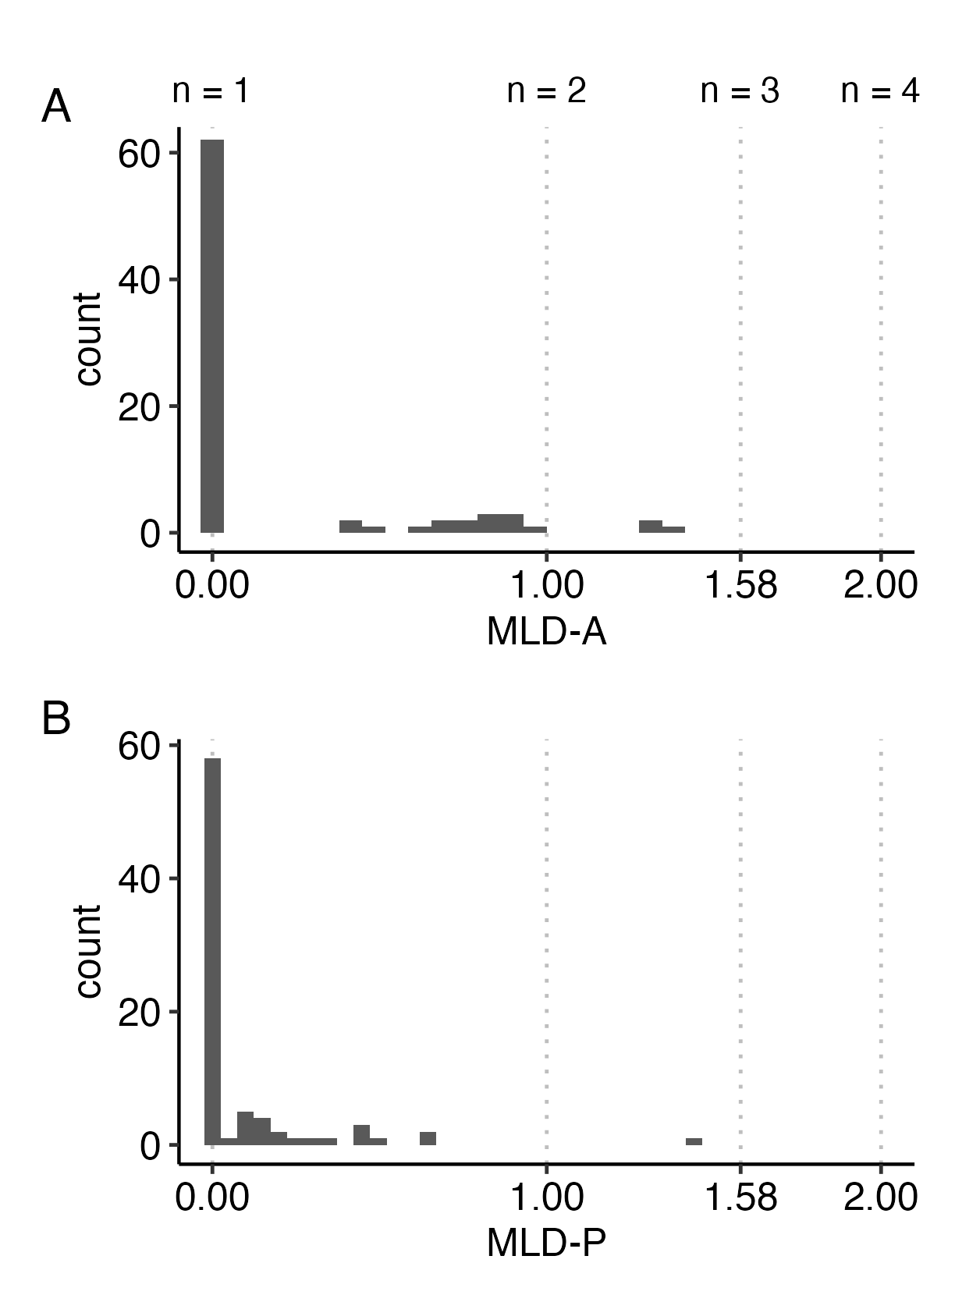

Slide 83
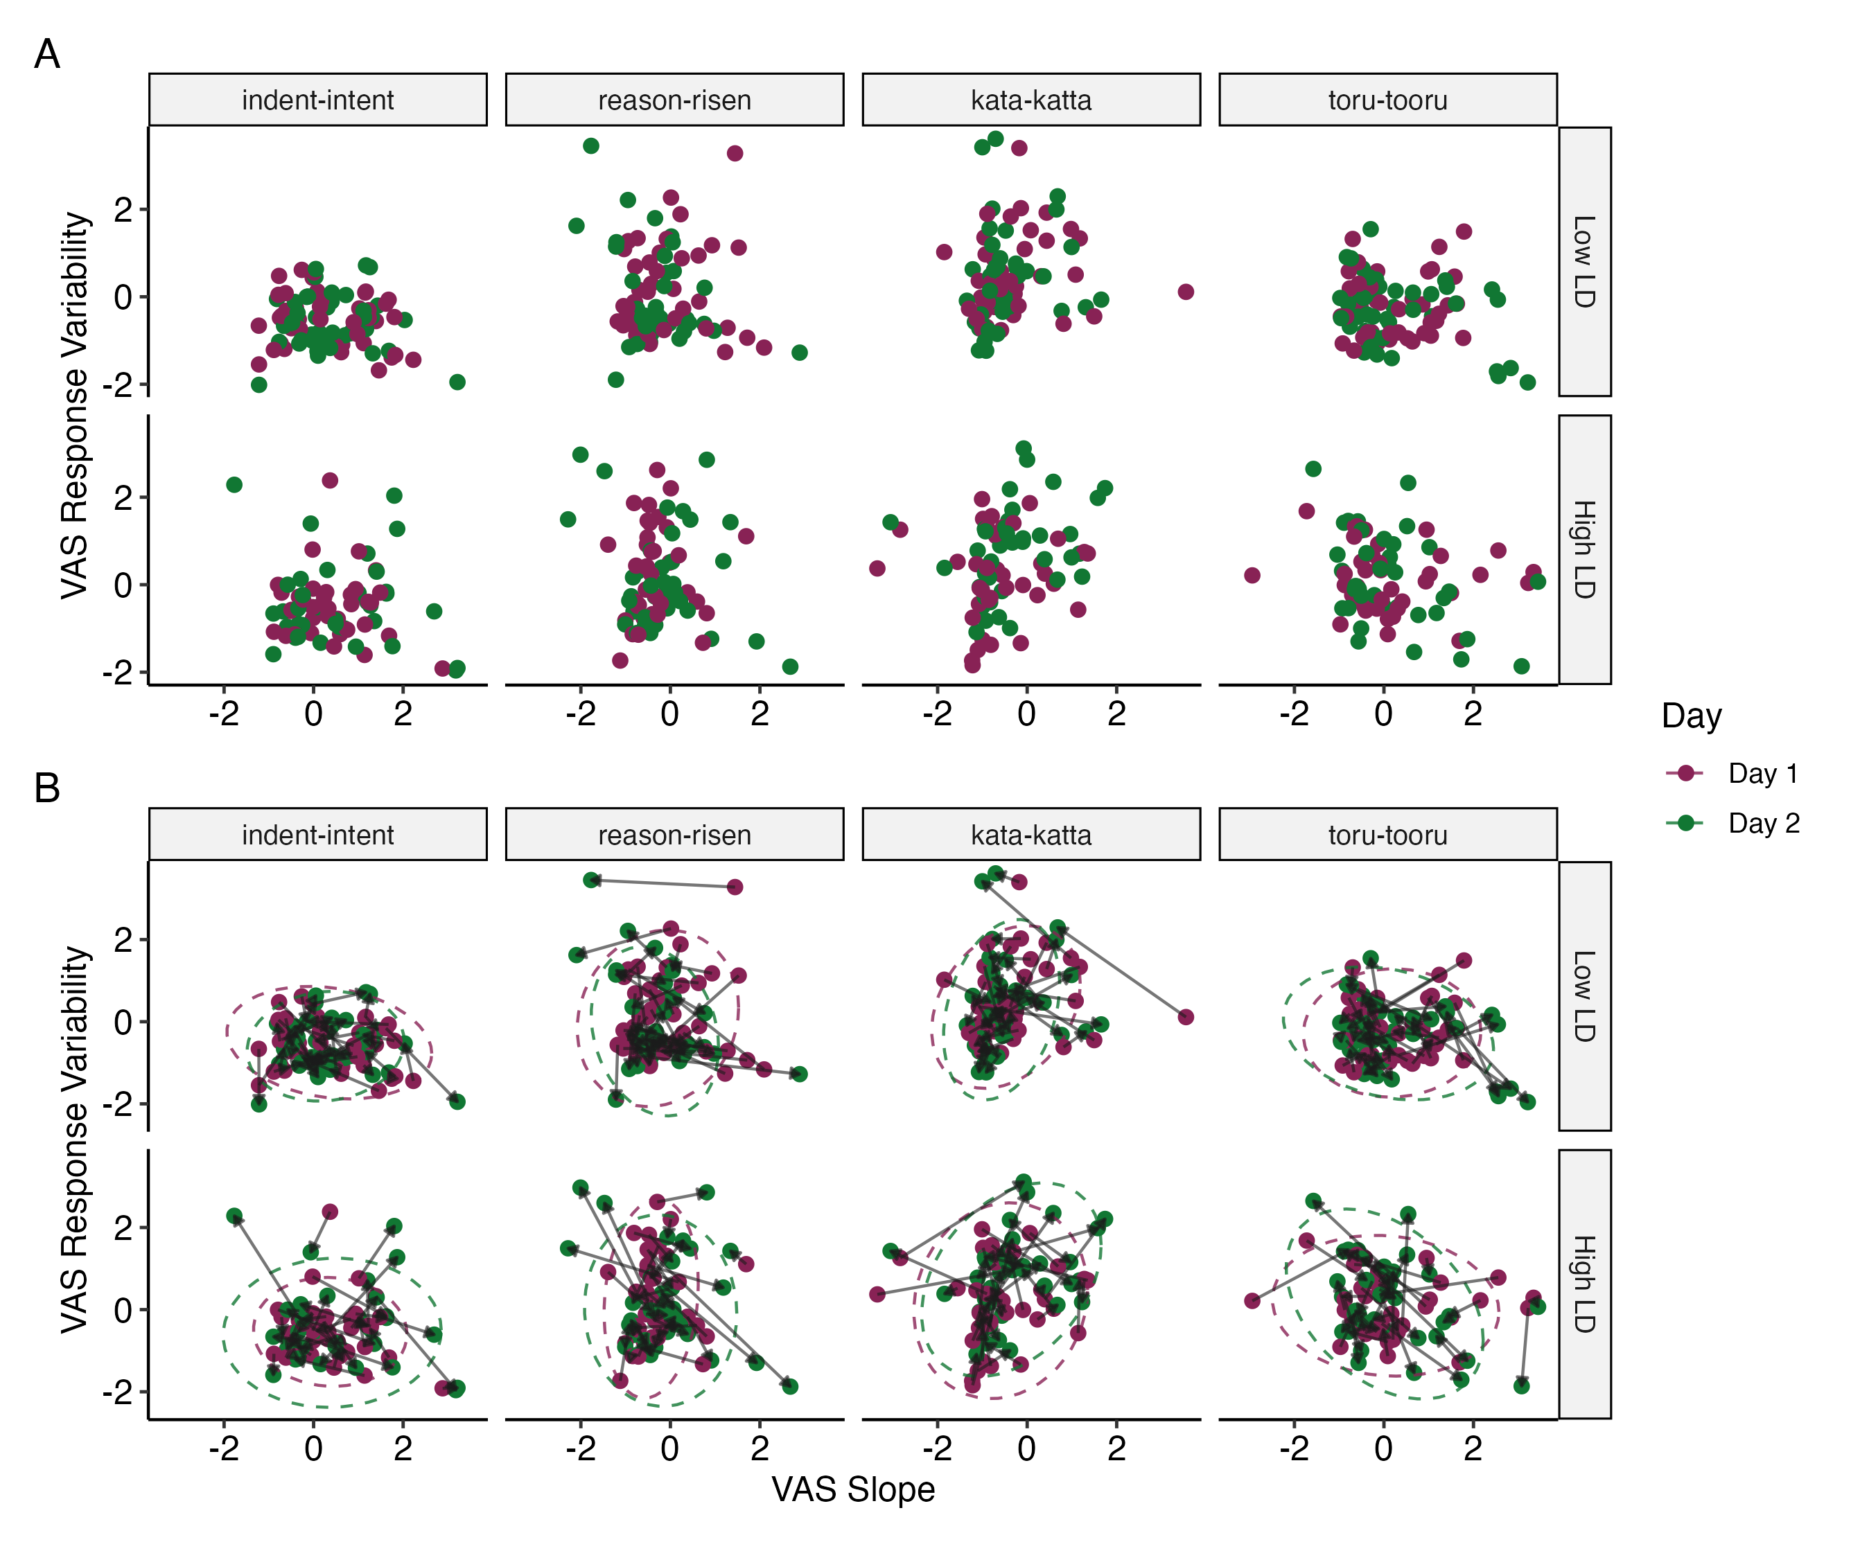

Slide 84
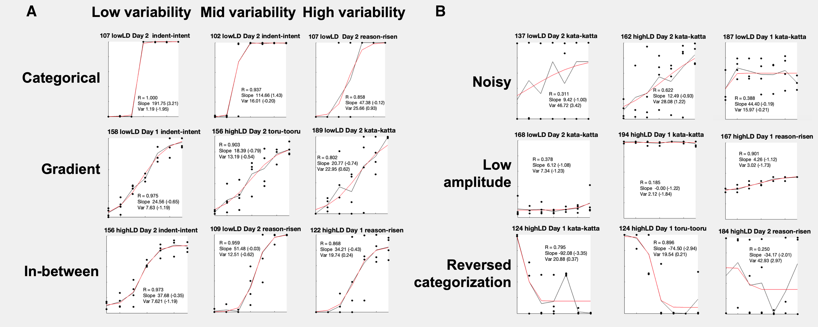

Slide 85
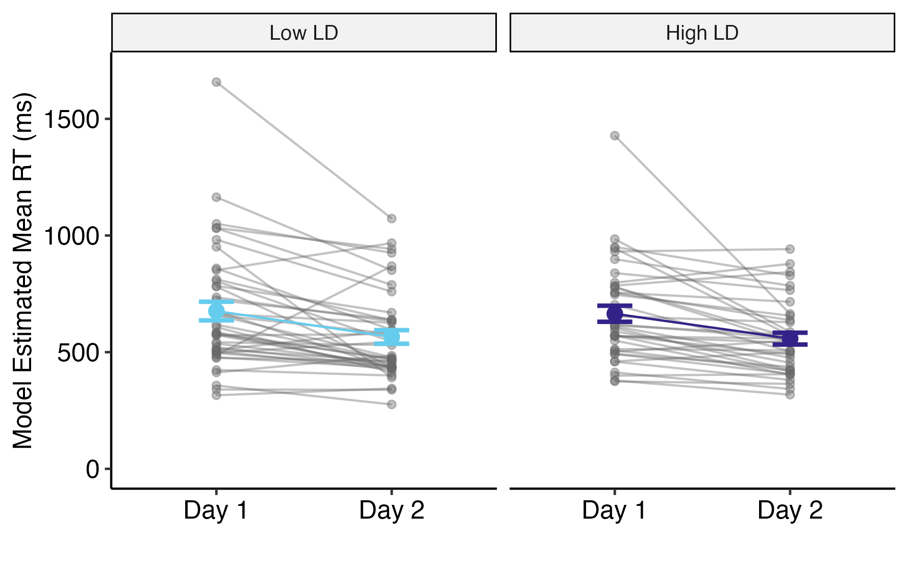
Notes:
reaction time

Slide 86
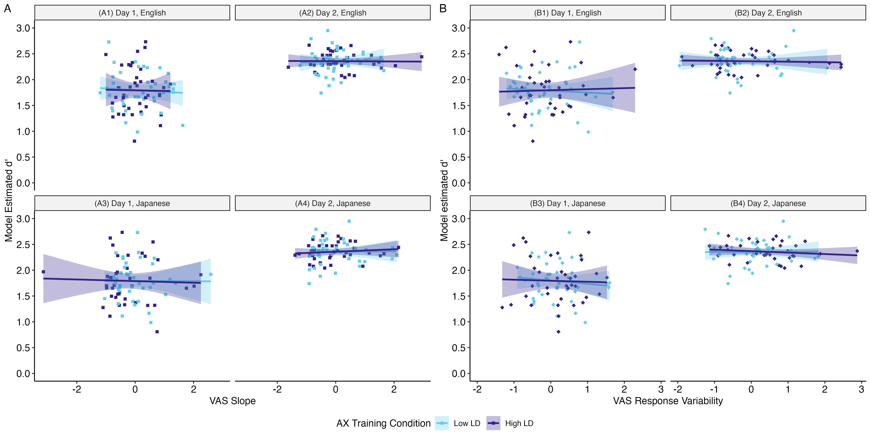
Notes:
remake this graph to be more simple

Slide 87
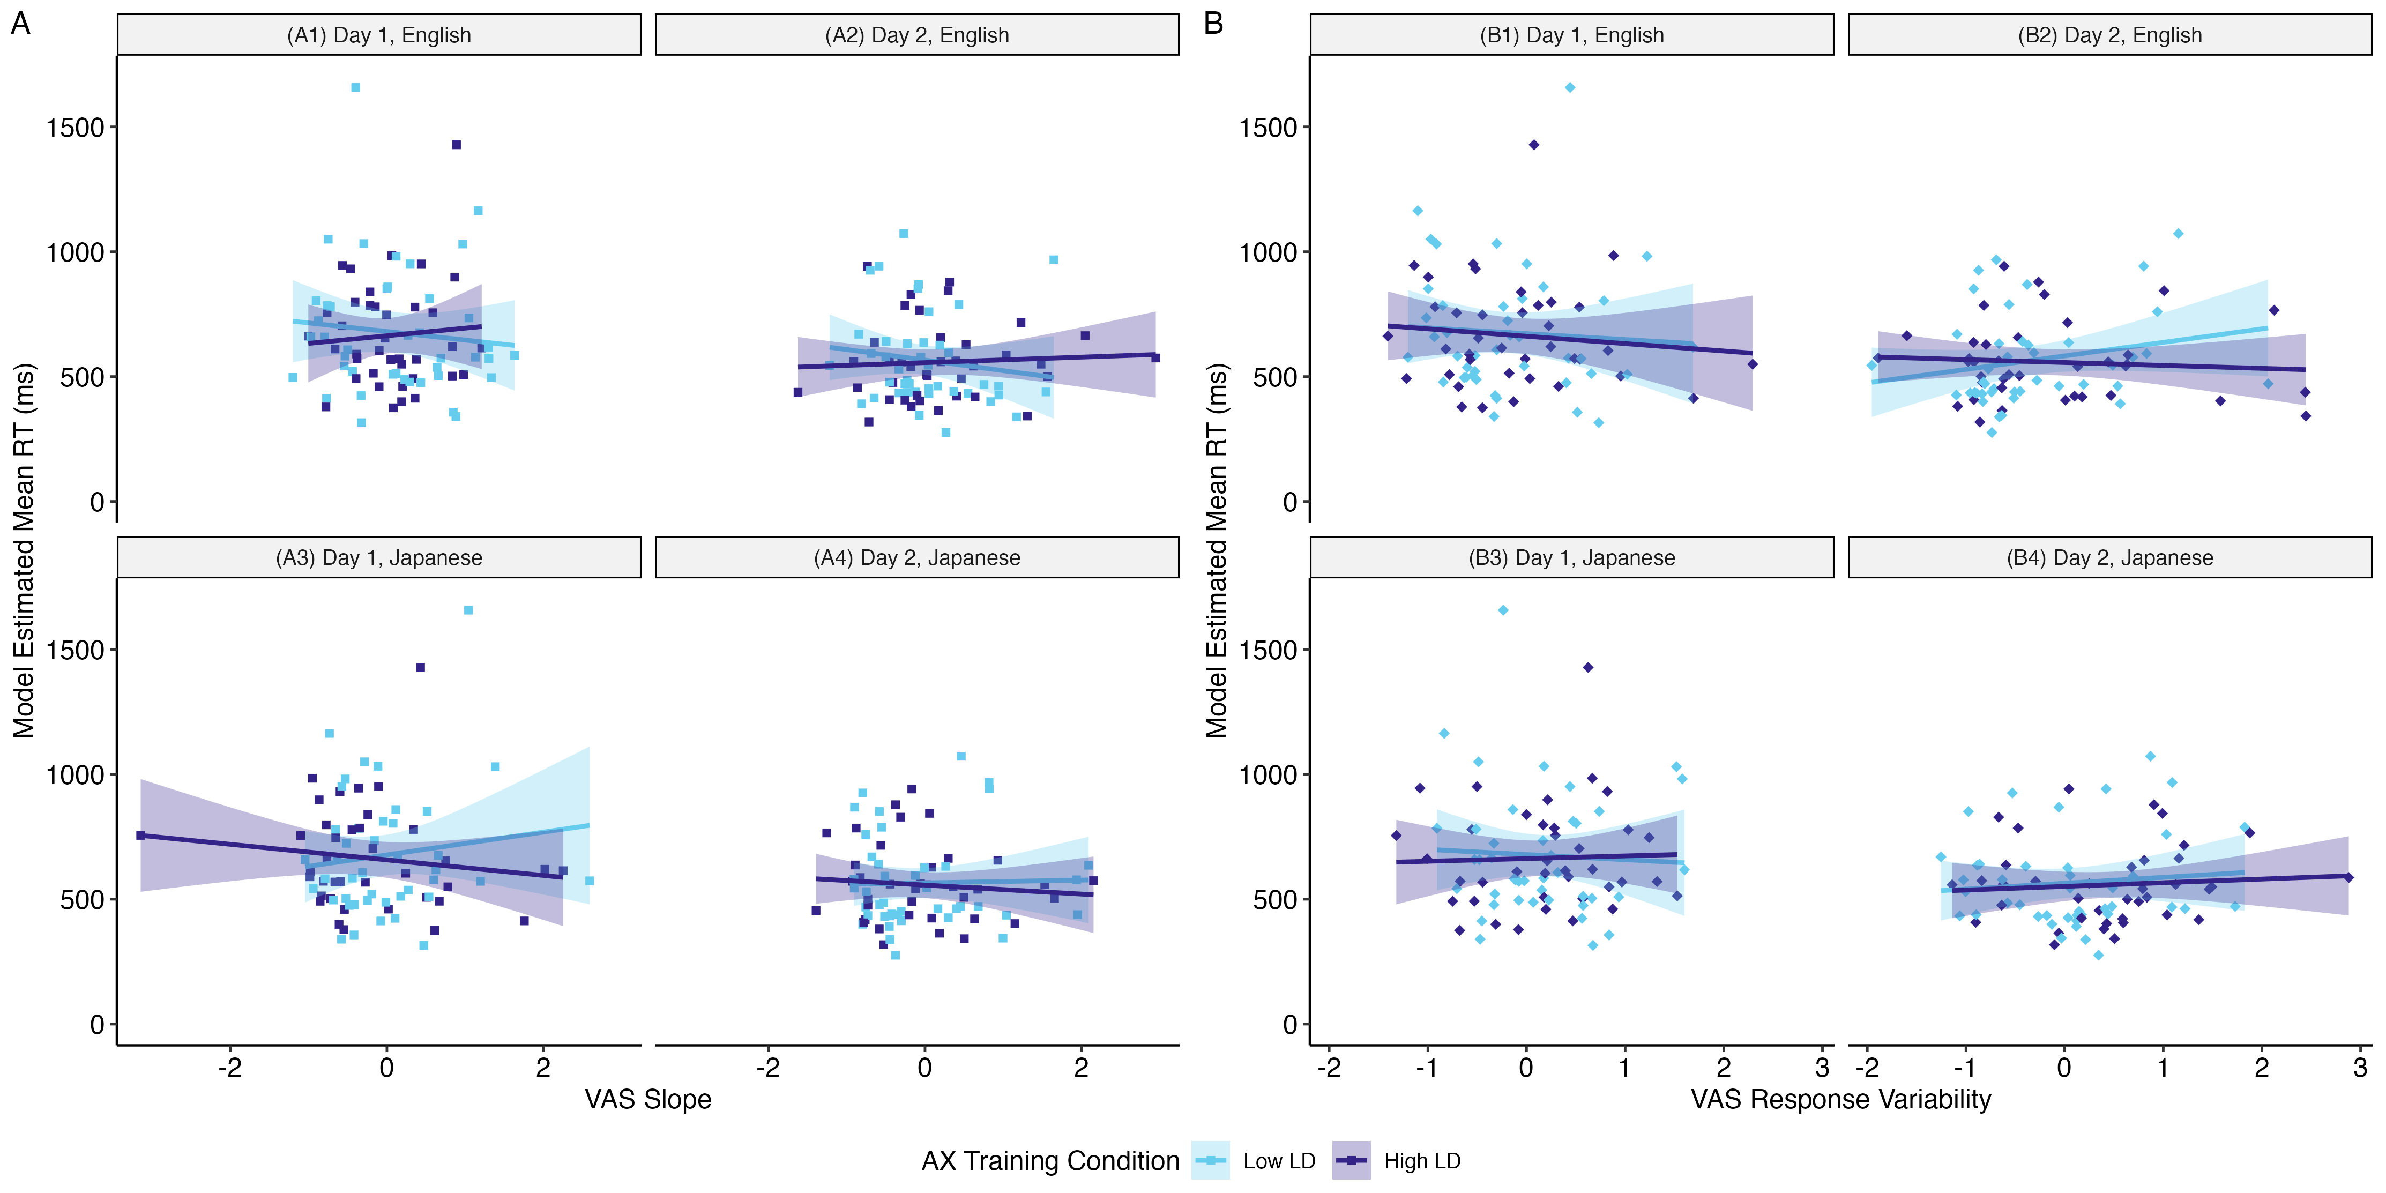
Notes:
VAS x reaction time

Slide 88
Study 3 was a longitudinal experiment across several weeks
MCPD pre-test
Week 1,
First Day
2x per week for 3 weeks
288 trials per session
Low LD group: Japanese only
High LD group: Japanese and MSA
*Control group: No training
Weeks 2-4
MCPD post-test
Week 4,
Final Day

Slide 89
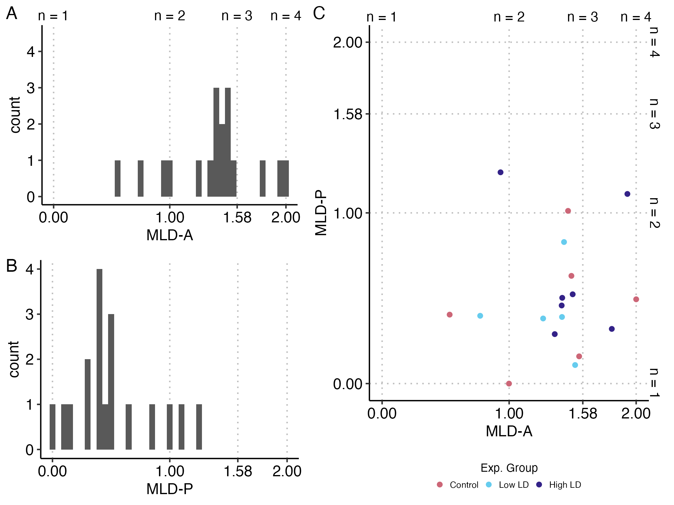

Slide 90
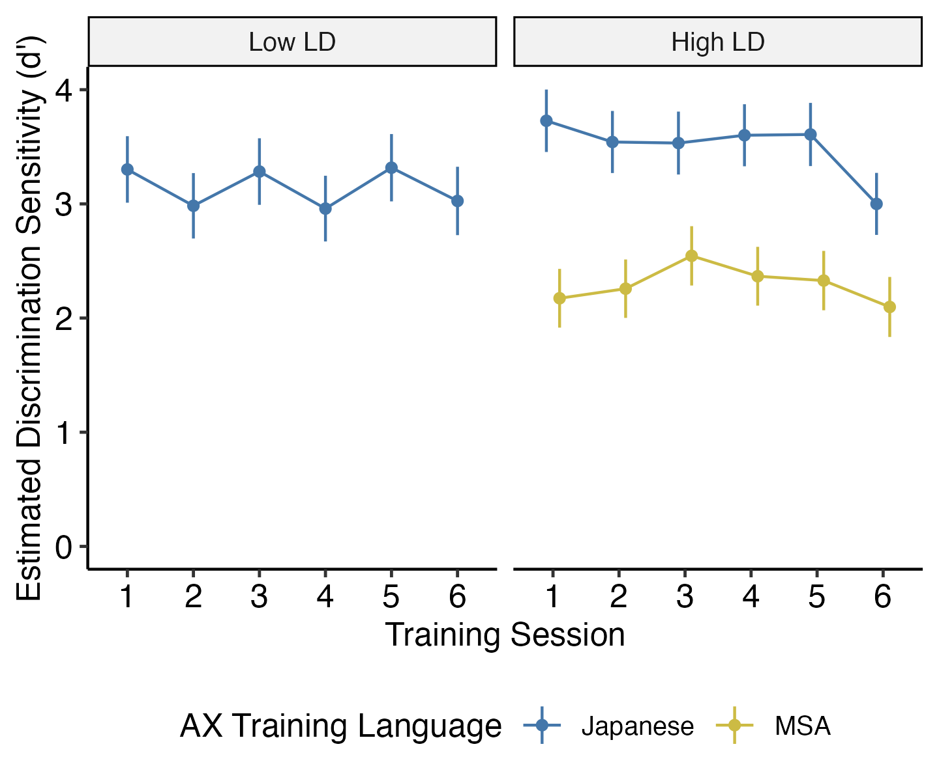

Slide 91
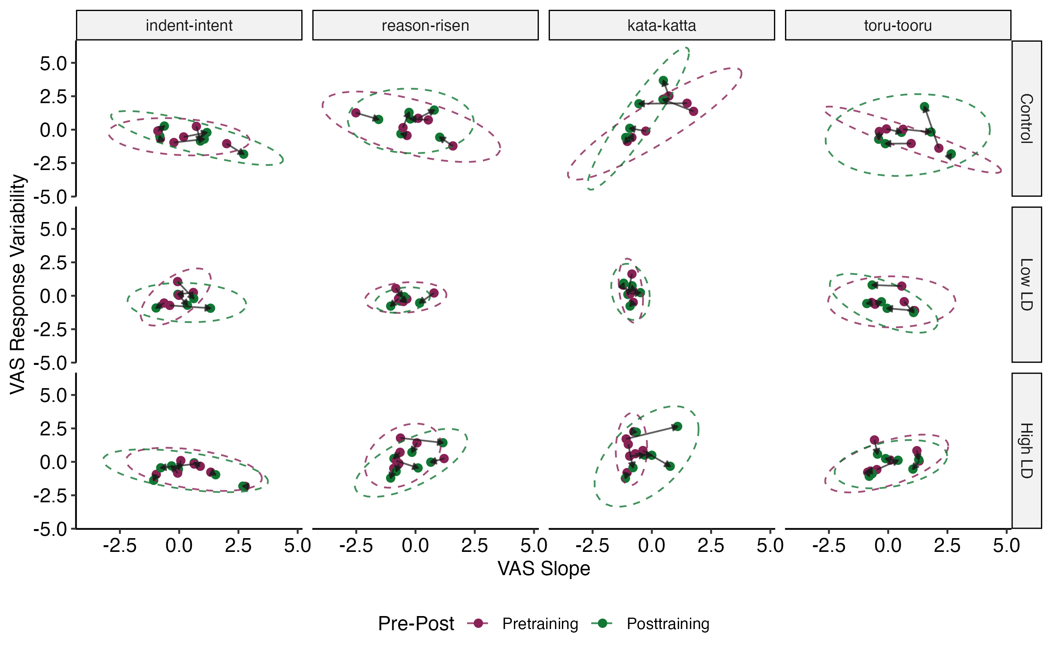

Slide 92
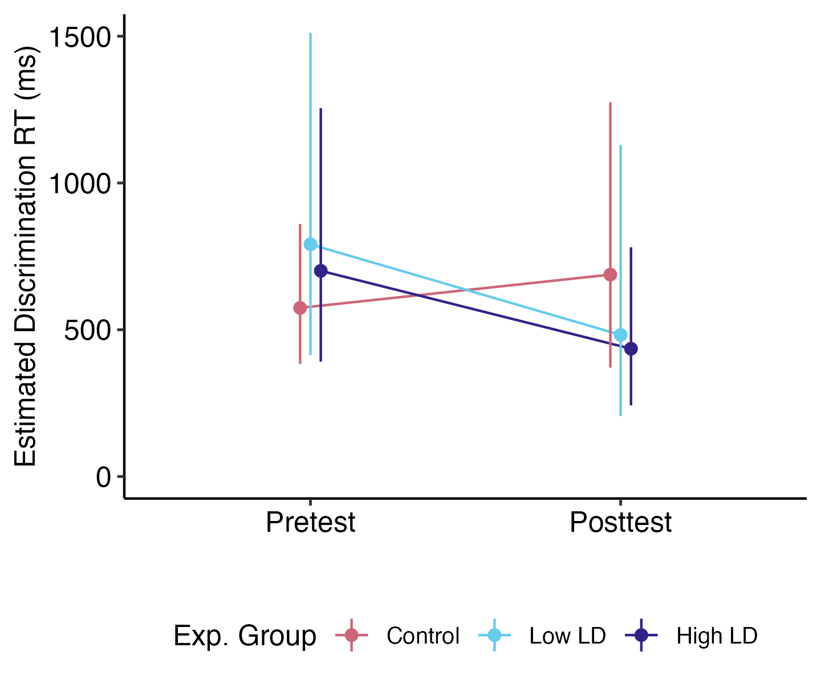

Slide 93
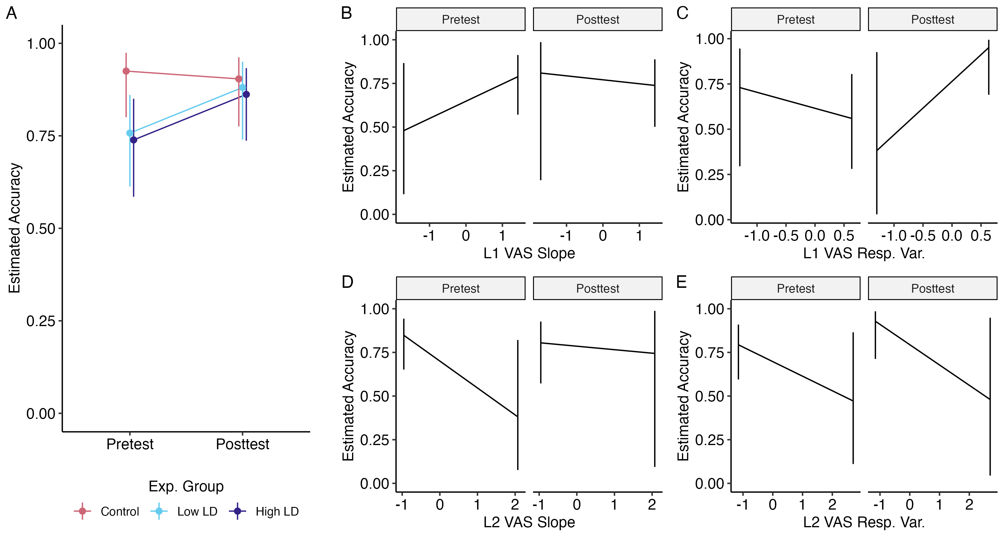

Slide 94
I made Part 2 of the LDQ
it should be validated with objective measures of linguistic diversity
I introduced novel manipulation to perceptual training
perhaps much longer study is needed (semester or year-long), perhaps with more languages
I created the MCPD task to assess listening ability for specific target L2 phonemic contrasts
could be further validated
provided further data of individual differences in categorization measured with the VAS
VAS is valuable, and can be supplemented with more fine-grained neuroimaging measures, like EEG and fMRI
Notes:
[script needed]

