Slide 1
Coherency Based Reduction of a Large Power System Using PSS/E
EEE 412 –Project Presentation
Group-4
Section G2

Slide 2
Coherency Based Reduction of a Large Power System Using PSS/E
EEE 412 –Project Presentation
Group-4
Section G2

Slide 3
Introduction
Why network reduction?
Classification: 2 types
Static
Dynamic
Notes:
Why: For example, when we have interest on a specific part of the network, for example, if a fault occurs, we focus on that specific part. So, the rest of the network which are distant form the fault area need not to analyzed in details while simulating the whole network
Static: In static reduction loads and generators are aggregated with their own kinds. Done mainly for power flow calculations
Dynamic: Dynamic reduction needs modifying the generator parameters, before aggregation so that time domain behavior of the network remains same before and after reduction.

Slide 4
Introduction
Why network reduction?
Classification: 2 types
Static
Dynamic
Notes:
Why: For example, when we have interest on a specific part of the network, for example, if a fault occurs, we focus on that specific part. So, the rest of the network which are distant form the fault area need not to analyzed in details while simulating the whole network
Static: In static reduction loads and generators are aggregated with their own kinds. Done mainly for power flow calculations
Dynamic: Dynamic reduction needs modifying the generator parameters, before aggregation so that time domain behavior of the network remains same before and after reduction.

Slide 5
Introduction
Why network reduction?
Classification: 2 types
Static
Dynamic
Notes:
Why: For example, when we have interest on a specific part of the network, for example, if a fault occurs, we focus on that specific part. So, the rest of the network which are distant form the fault area need not to analyzed in details while simulating the whole network
Static: In static reduction loads and generators are aggregated with their own kinds. Done mainly for power flow calculations
Dynamic: Dynamic reduction needs modifying the generator parameters, before aggregation so that time domain behavior of the network remains same before and after reduction.

Slide 6
Introduction
Why network reduction?
Classification: 2 types
Static
Dynamic
Notes:
Why: For example, when we have interest on a specific part of the network, for example, if a fault occurs, we focus on that specific part. So, the rest of the network which are distant form the fault area need not to analyzed in details while simulating the whole network
Static: In static reduction loads and generators are aggregated with their own kinds. Done mainly for power flow calculations
Dynamic: Dynamic reduction needs modifying the generator parameters, before aggregation so that time domain behavior of the network remains same before and after reduction.

Slide 7
Introduction
Why network reduction?
Classification: 2 types
Static
Dynamic
Notes:
Why: For example, when we have interest on a specific part of the network, for example, if a fault occurs, we focus on that specific part. So, the rest of the network which are distant form the fault area need not to analyzed in details while simulating the whole network
Static: In static reduction loads and generators are aggregated with their own kinds. Done mainly for power flow calculations
Dynamic: Dynamic reduction needs modifying the generator parameters, before aggregation so that time domain behavior of the network remains same before and after reduction.

Slide 8
Objectives
Discuss the methods of building a reduced equivalent model
39 Bus System
14 Bus System
Validate the results
Frequency
Voltage
Angular Speed

Slide 9
Objectives
Discuss the methods of building a reduced equivalent model
39 Bus System
14 Bus System
Validate the results
Frequency
Voltage
Angular Speed

Slide 10
Objectives
Discuss the methods of building a reduced equivalent model
39 Bus System
14 Bus System
Validate the results
Frequency
Voltage
Angular Speed

Slide 11
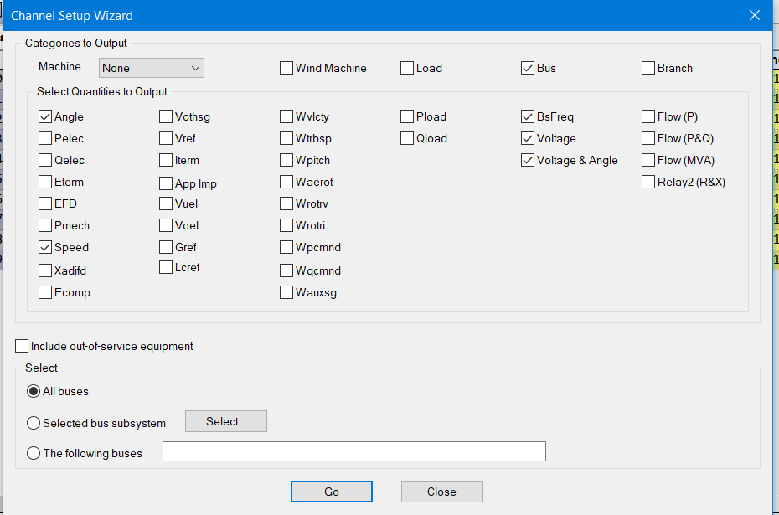
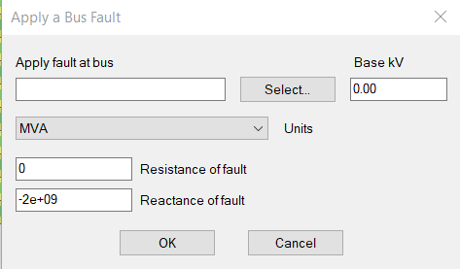
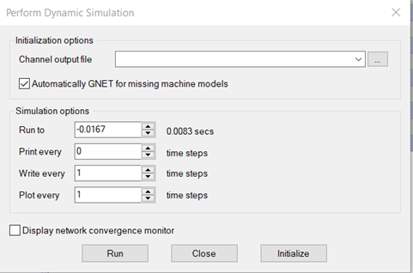
Coherency detection

Slide 12
Coherency detection

Slide 13
Coherency detection

Slide 14
Coherency detection
Fault applied at 1 s and cleared at 1.1 s
For 39 bus:
Fault applied at bus 30
For 14 bus:
Fault applied at bus 1

Slide 15
Coherency detection
Fault applied at 1 s and cleared at 1.1 s
For 39 bus:
Fault applied at bus 30
For 14 bus:
Fault applied at bus 1

Slide 16
Coherency detection
Fault applied at 1 s and cleared at 1.1 s
For 39 bus:
Fault applied at bus 30
For 14 bus:
Fault applied at bus 1

Slide 17
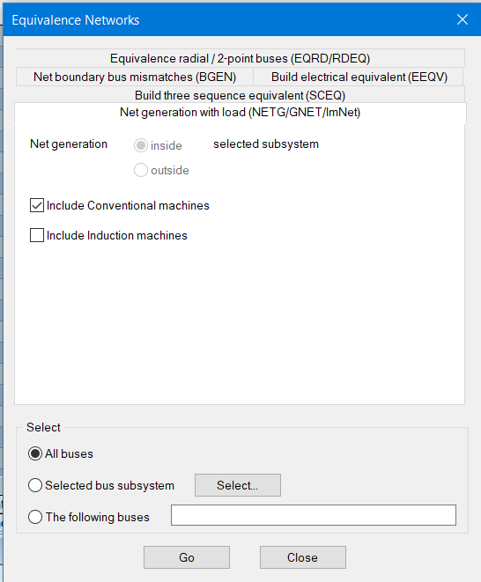
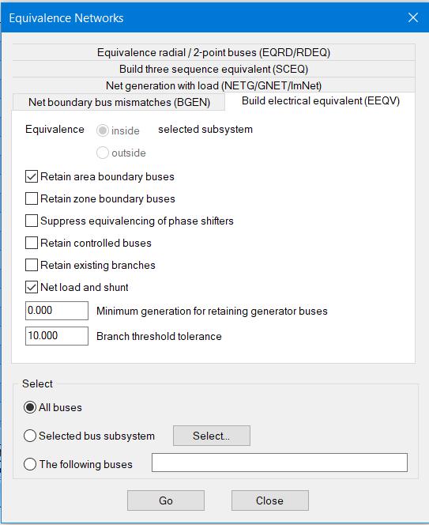
Network Equivalence

Slide 18
Network Equivalence
39 bus:
Internal networks are bus 1,2,25,30,37,39
14 bus:
Internal networks are bus 1,2,3,4,5

Slide 19
Network Equivalence
39 bus:
Internal networks are bus 1,2,25,30,37,39
14 bus:
Internal networks are bus 1,2,3,4,5

Slide 20
Network Equivalence
39 bus:
Internal networks are bus 1,2,25,30,37,39
14 bus:
Internal networks are bus 1,2,3,4,5

Slide 21
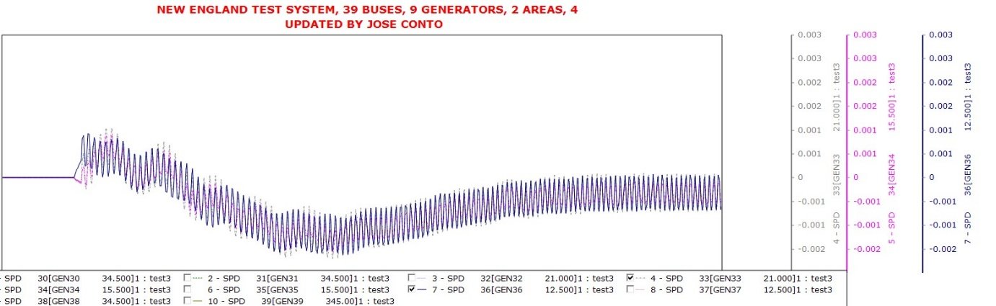
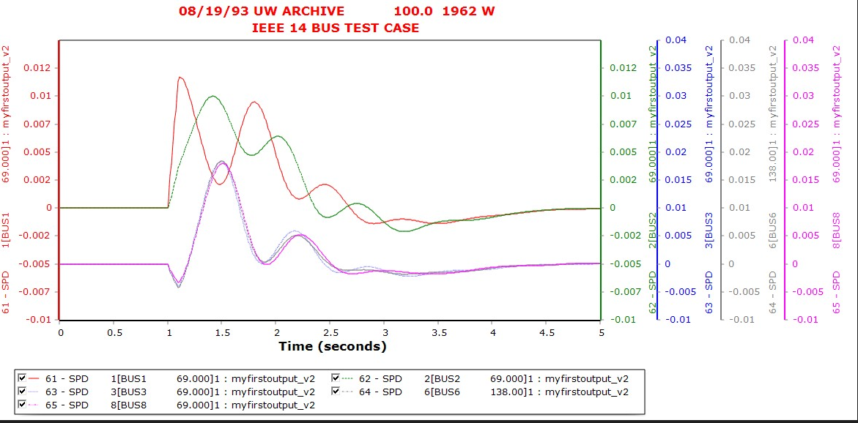
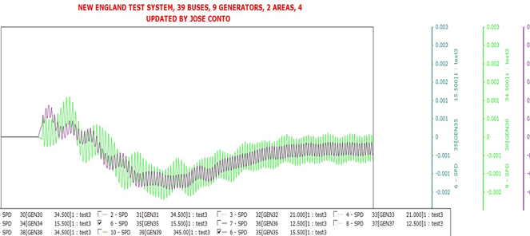
Result: Coherency detection (39 BUS System)
Fig: Rotor angle vs time plot of generator 33, 34 and 36

Slide 22
Result: Coherency detection (39 BUS System)
Fig: Rotor angle vs time plot of generator 35,38

Slide 23
Result: Coherency detection (14 BUS System)
Fig: Rotor angle vs time plot of all generators

Slide 24
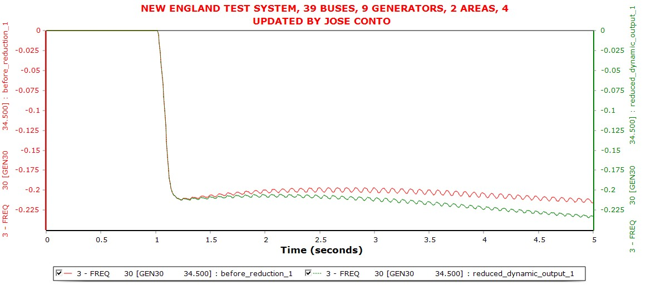
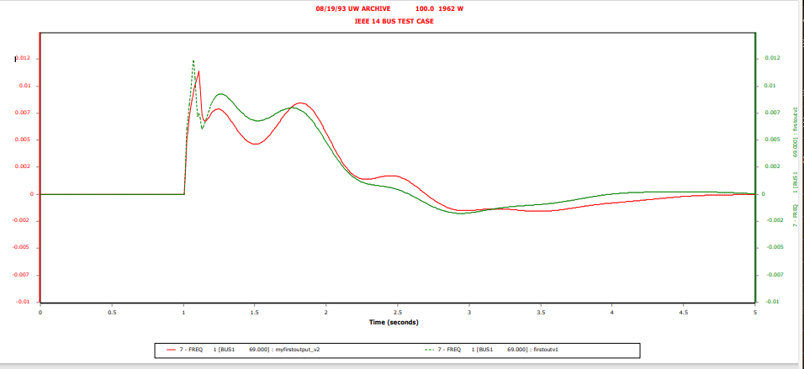
Result: Frequency (39 BUS System)
Notes:
We can see, the frequency matches in oscillation and deviates a little after some time period.

Slide 25
Result: Frequency (14 BUS System)
Notes:
We can see, the frequency matches in oscillation and deviates a little after some time period.

Slide 26
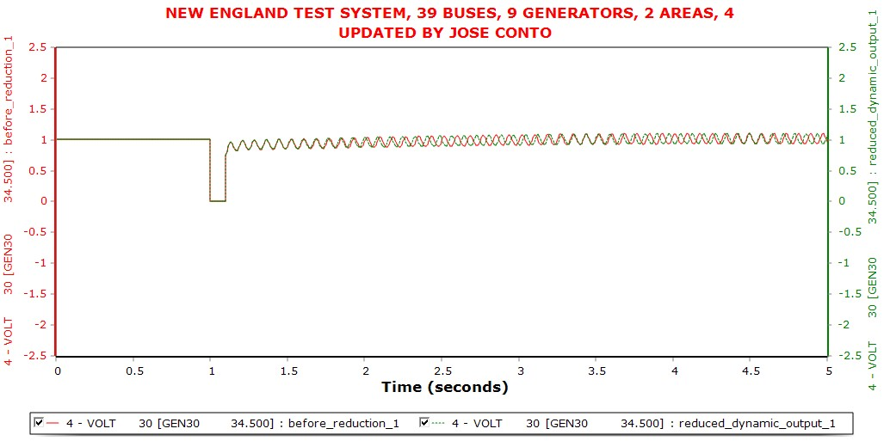
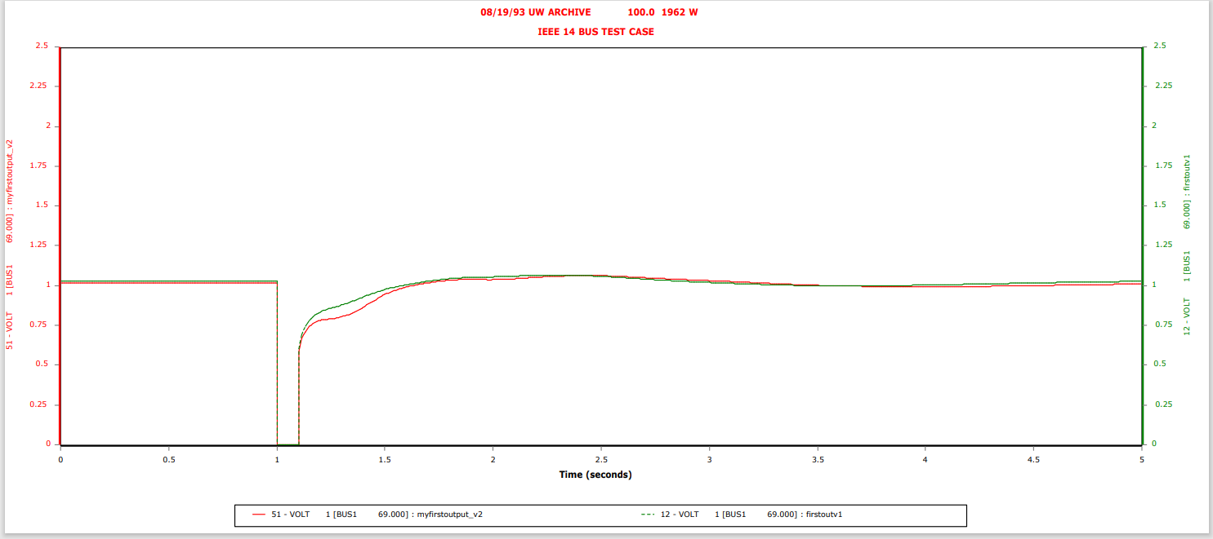
Result: Voltage (39 BUS System)
Notes:
The voltage profiles match perfectly with a slight deviations in phase.

Slide 27
Result: Voltage (14 BUS System)
Notes:
The voltage profiles match perfectly with a slight deviations in phase.

Slide 28
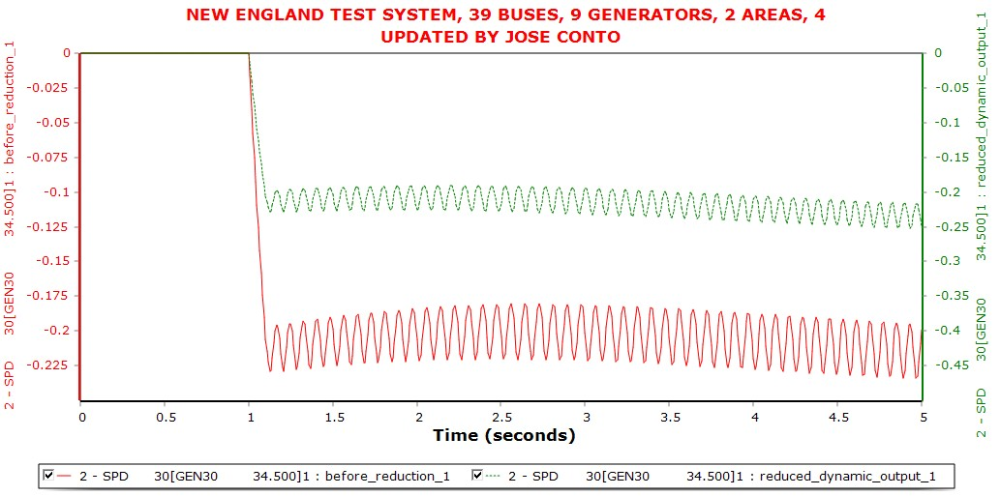
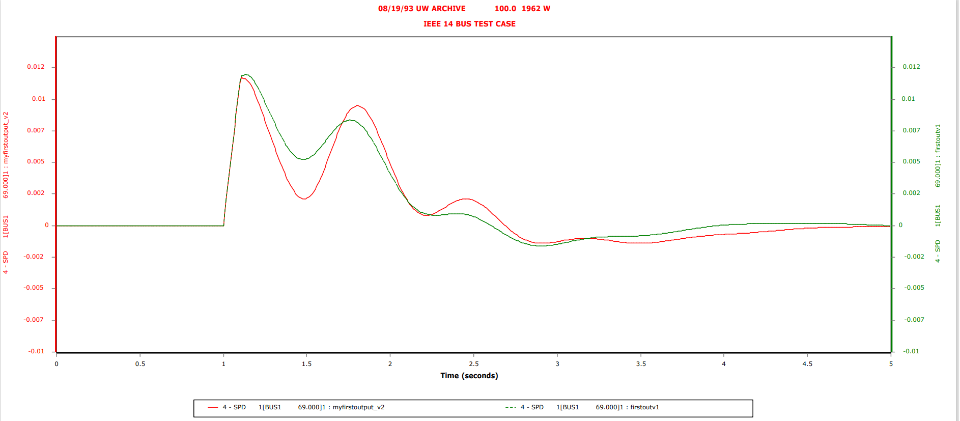
Result: Angular Speed (39 BUS System)
Notes:
The angular speed also shows the same result with a slight deviation.

Slide 29
Result: Angular Speed (14 BUS System)
Notes:
The angular speed also shows the same result with a slight deviation.

Slide 30
Summary of Reduction
Component | Original | After Reduction
Bus | 39 | 18
Generator | 10 | 7
Load | 19 | 21
Transmission lines | 34 | 27
Component | Original | After Reduction
Bus | 14 | 8
Generator | 5 | 4
Load | 11 | 10
Branch | 20 | 12

Slide 31
Summary of Reduction
Component | Original | After Reduction
Bus | 39 | 18
Generator | 10 | 7
Load | 19 | 21
Transmission lines | 34 | 27
Component | Original | After Reduction
Bus | 14 | 8
Generator | 5 | 4
Load | 11 | 10
Branch | 20 | 12

Slide 32
Summary of Reduction
Component | Original | After Reduction
Bus | 39 | 18
Generator | 10 | 7
Load | 19 | 21
Transmission lines | 34 | 27
Component | Original | After Reduction
Bus | 14 | 8
Generator | 5 | 4
Load | 11 | 10
Branch | 20 | 12

