Slide 1
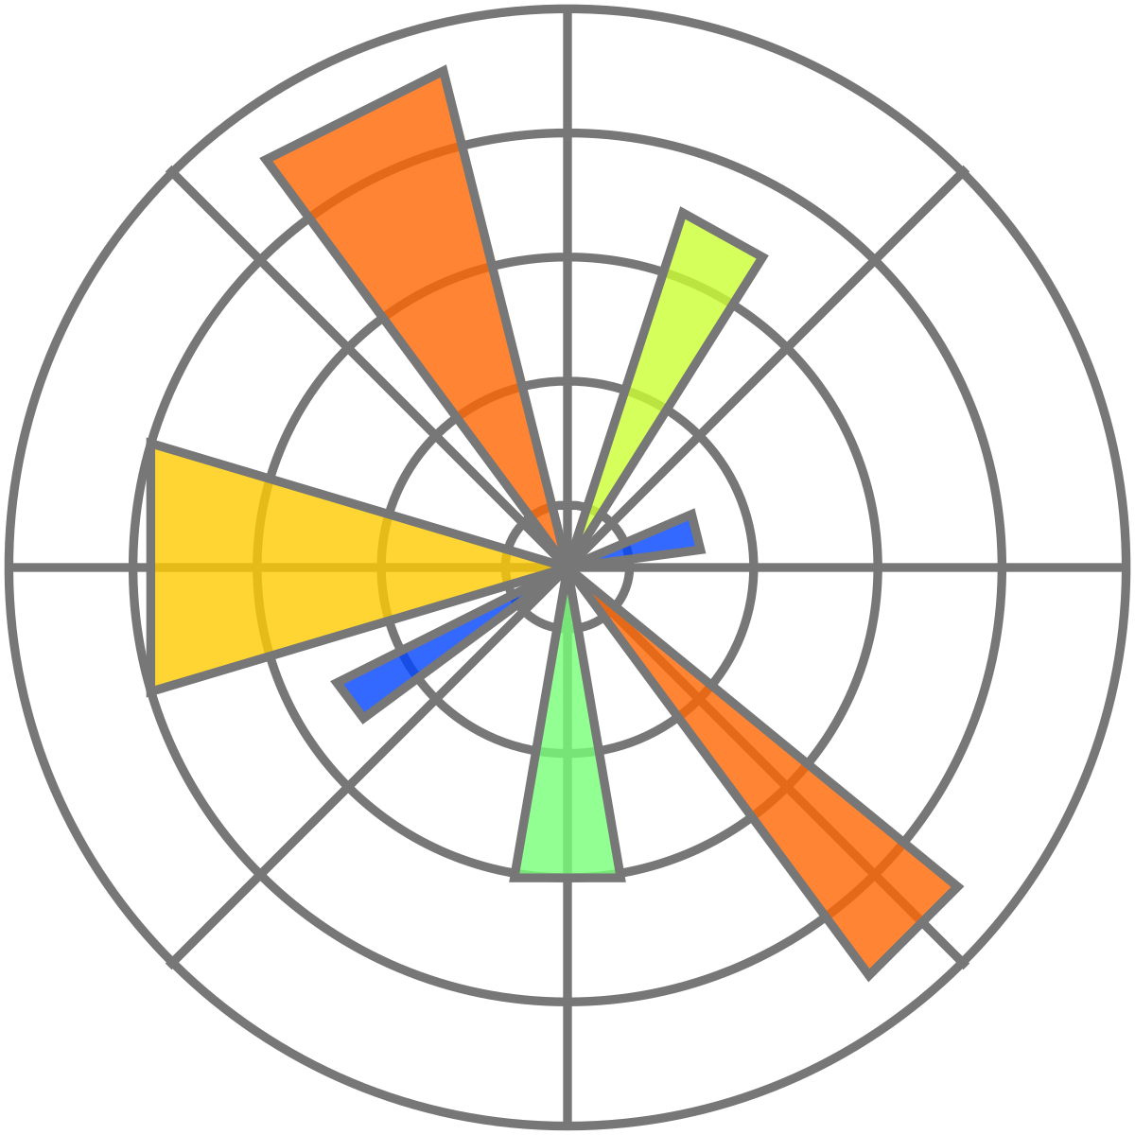

Matplotlib

Slide 2
Adebayo Olaonipekun
Machine Learning Engineer

Slide 3
Matplotlib: Introduction
Matplotlib is a powerful data visualization library in Python used to create insightful and visually appealing plots.
Matplotlib is a 2D plotting library for Python.
It offers a comprehensive set of tools to create static, interactive, and animated visualizations.
Widely used in data science, engineering, finance, academia, and other domains.
Provides a flexible and user-friendly interface for creating a wide range of plots and charts.
A crucial component in the data visualization ecosystem of Python.
Supports a variety of output formats, making it suitable for creating publication-quality figures.
Built on NumPy and seamlessly integrates with other libraries like Pandas and SciPy.
Continuously evolving with active development and a large community of users and contributors.

Slide 4
The Importance of Data Visualization
Data visualization plays a crucial role in data analysis and decision-making processes.
It allows us to present complex data in a visually intuitive manner, making it easier to identify patterns, trends, and outliers.
Visual representations of data help in better understanding the underlying information, enabling us to communicate findings effectively to diverse audiences.

Slide 5
Installing & Importing Matplotlib

Slide 6
The Basics of Matplotlib
Components of a Matplotlib Plot
A Matplotlib plot is composed of three main components: the figure, axes, and plot objects.
Figure: The top-level container that represents the entire figure or window where plots are drawn.
Axes: The area within the figure that hosts the actual plot. Axes provide a coordinate system where data is plotted.
Plot Objects: The visual elements such as lines, markers, bars, or other graphical representations within the axes.
Pyplot Interface
Matplotlib's "pyplot" interface is a state-based interface designed for simple and quick plot creation.
It provides a high-level interface for generating common plot types without explicitly creating figures and axes objects.
Pyplot automatically manages the figure and axes in the background, making it convenient for interactive plotting.

Slide 7
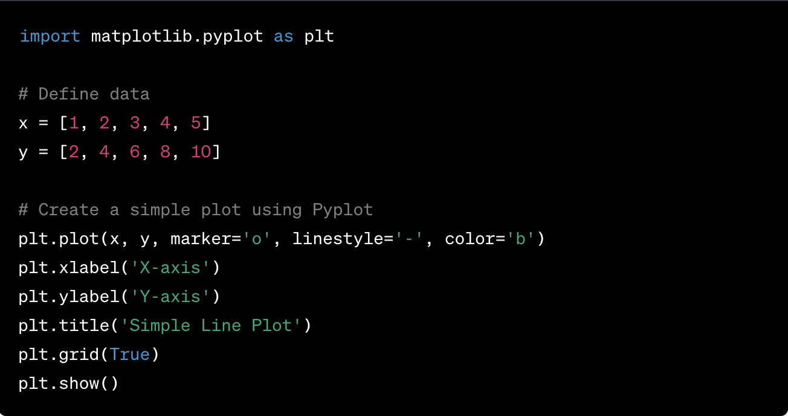
Sample Code

Slide 8
Line Plots
Creating Line Plots with plt.plot()
The plt.plot() function is used to create line plots in Matplotlib.
Provide the x and y data as arguments to the function to generate the plot.
Customizing Line Styles, Colors, and Markers
Control the appearance of the line using linestyle, color, and marker parameters.
linestyle: Set the style of the line (e.g., '-', '--', '-.', ':').
color: Define the color of the line (e.g., 'b' for blue, 'r' for red).
marker: Add markers on data points to make them stand out (e.g., 'o' for circles, '^' for triangles).
Adding Labels and Titles
Enhance the plot's readability by adding labels and titles using plt.xlabel(), plt.ylabel(), and plt.title().
Provide meaningful descriptions for the x and y axes and give the plot a descriptive title.

Slide 9
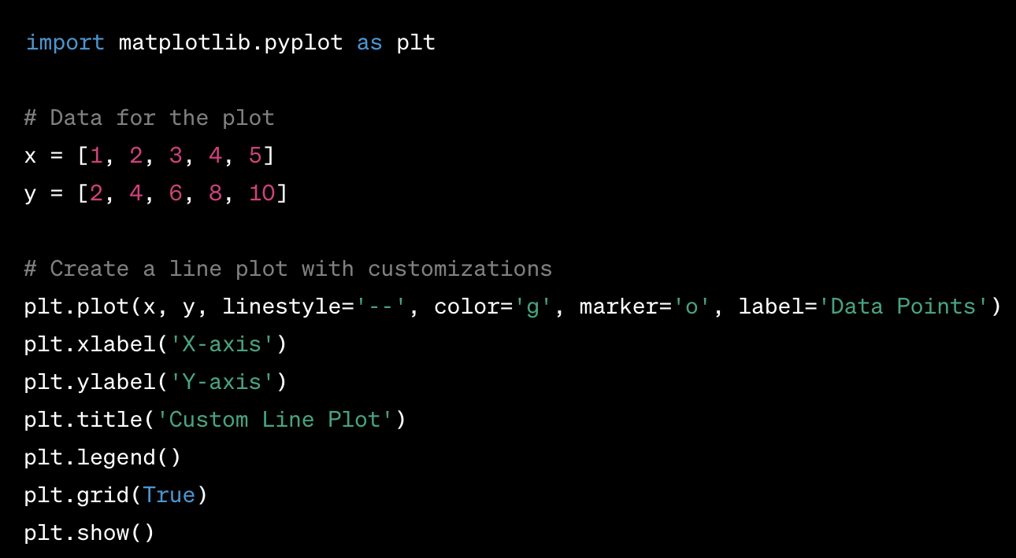
Sample Code

Slide 10
Scatter Plots
Creating Scatter Plots with plt.scatter()
The plt.scatter() function is used to create scatter plots in Matplotlib.
Unlike line plots, scatter plots do not connect data points with lines; they display individual data points as dots.
Representing Data Points
Scatter plots can represent multiple dimensions of data points using various visual attributes.
Size: Represent data points using different sizes to indicate a third variable.
Color: Use different colors to convey information about a categorical or continuous variable.
Transparency: Vary the transparency of data points to prevent overplotting and emphasize dense regions.
Customizing Scatter Plots
Adjust the marker size, color map, and transparency level for better visualization.
Enhance the plot with labels, titles, and legends as needed.

Slide 11
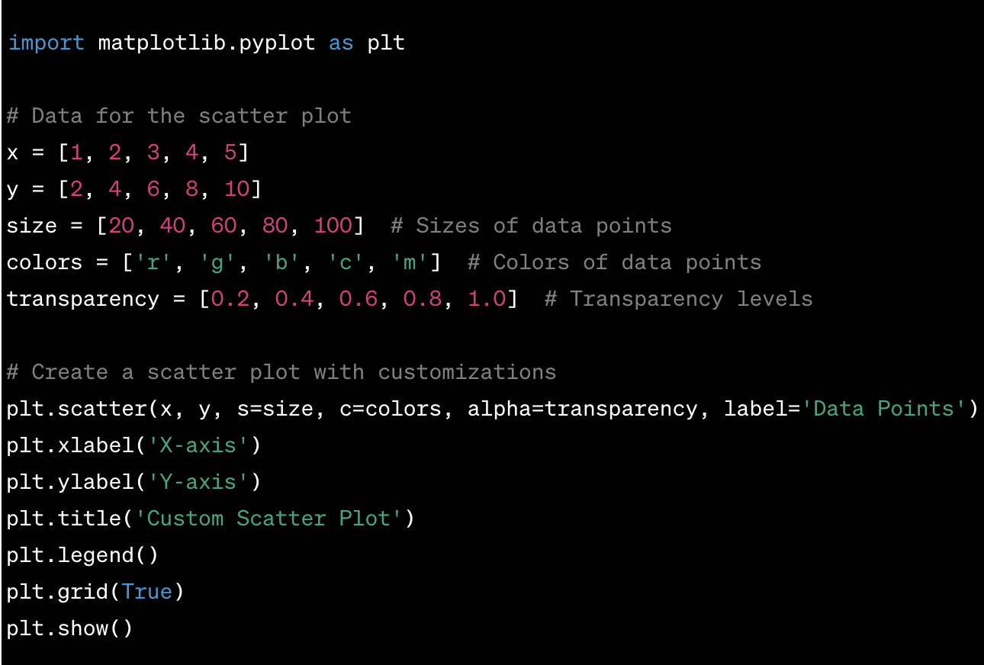
Sample Code

Slide 12
Bar Plots
Introducing Bar Plots
Bar plots are used to represent categorical data with rectangular bars.
Two main types: vertical and horizontal bar plots.
Vertical bar plots (default orientation) use plt.bar() and show bars along the x-axis.
Horizontal bar plots use plt.barh() and display bars along the y-axis.
Creating Vertical Bar Plots
Use plt.bar() to create vertical bar plots.
Provide the x-coordinates (categories) and the corresponding heights (values) as arguments.
Customize the appearance using parameters like width, color, and edgecolor.
Creating Horizontal Bar Plots
Use plt.barh() to create horizontal bar plots.
Provide the y-coordinates (categories) and the corresponding widths (values) as arguments.
Customize the appearance using parameters like height, color, and edgecolor.
Customizing Bar Plots
Adjust bar colors, width, edge properties, and labels for better visualization.
Add labels, titles, and legends to enhance the plot's clarity.

Slide 13
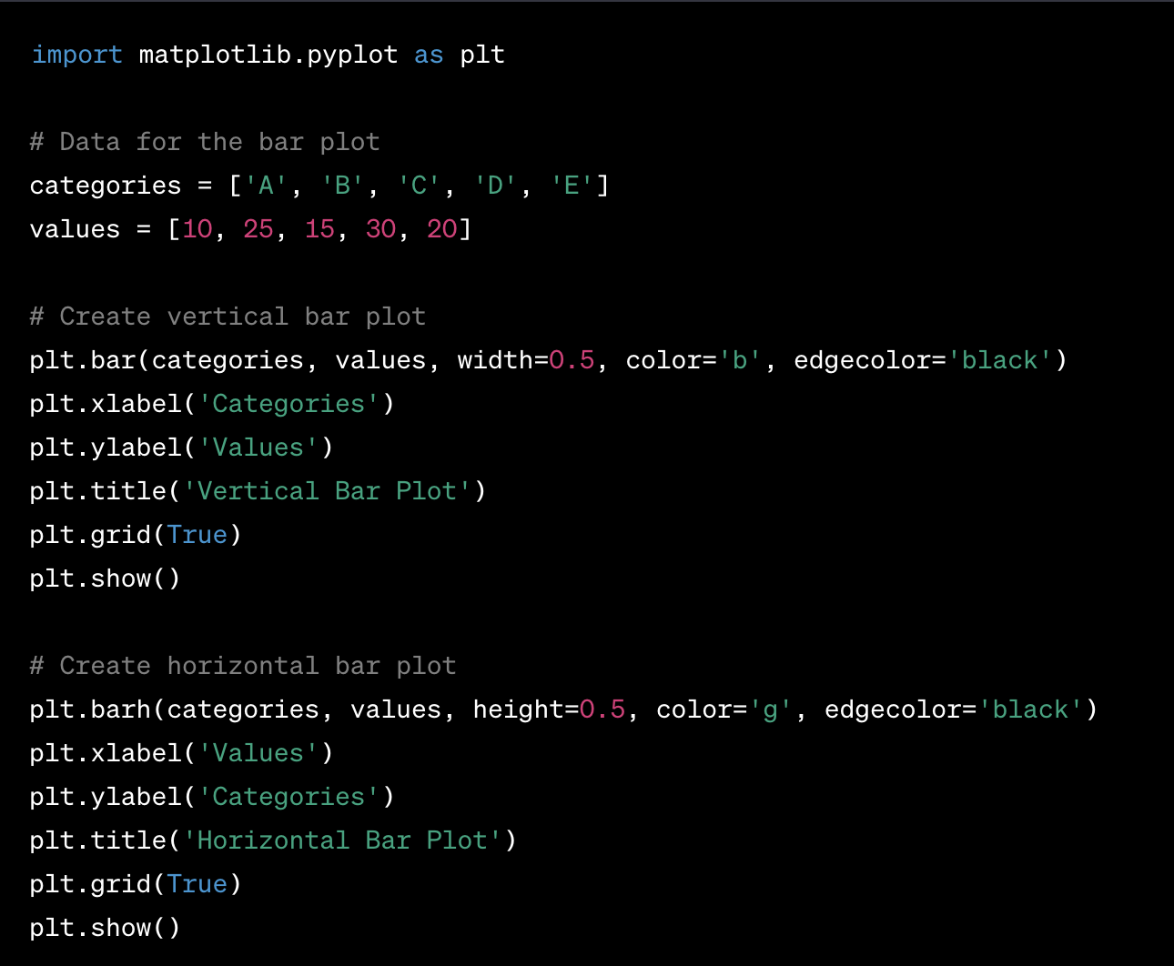

Sample Code

Slide 14
Histograms
Creating Histograms with plt.hist()
Histograms are used to visualize the distribution of continuous or discrete data.
Use plt.hist() to create histograms in Matplotlib.
Provide the data and the number of bins as arguments to create the histogram.
Binning
Binning defines the intervals (bins) into which the data is divided.
A higher number of bins show more details but may result in a noisy plot.
A lower number of bins provide a smoother plot but may overlook subtle patterns.
Density Plots
Density plots are an alternative to histograms, presenting smoothed continuous distributions.
Use the density parameter in plt.hist() to create density plots.
Density plots estimate the underlying probability distribution, allowing for better visual comparison.
Customizing Histograms
Adjust the appearance using parameters like color, edgecolor, and alpha.
Add labels, titles, and grid lines to improve the plot's clarity.

Slide 15
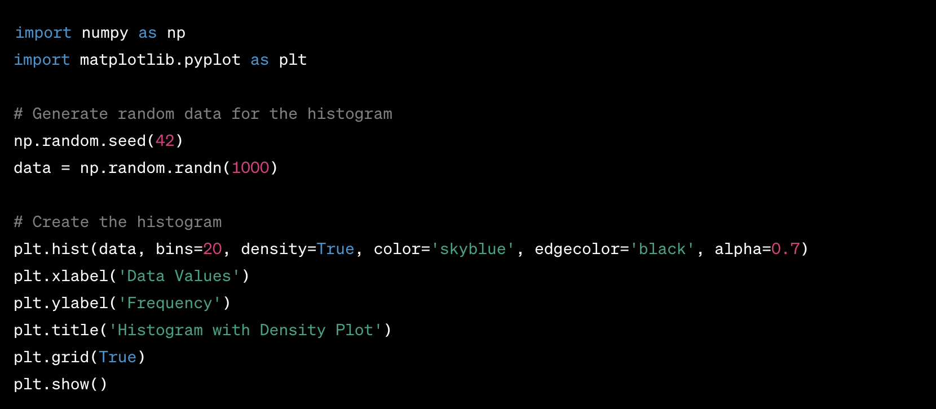
Sample Code

Slide 16
Pie Charts
Creating Pie Charts with plt.pie()
Pie charts are used to display the distribution of categorical data as a circular graph.
Use plt.pie() to create pie charts in Matplotlib.
Provide the data as an array or list, and the function automatically calculates the percentage of each category.
Percentage Formatting
By default, plt.pie() displays the raw values. You can format the pie chart to show percentages using the autopct parameter.
The autopct parameter takes a formatting string to specify how percentages should be displayed.
Exploding Slices
Explode a slice (pull it away from the center) to highlight a specific category.
Use the explode parameter, which accepts an array or list to define the extent of separation for each category.
Customizing Pie Charts
Customize colors, labels, sizes, and other parameters to improve visual aesthetics.
Add a legend, title, and grid lines to enhance the readability of the pie chart.

Slide 17
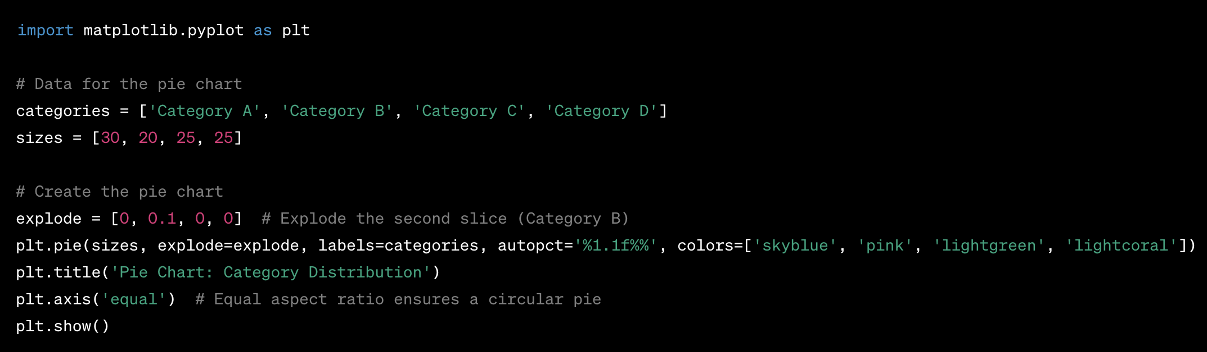
Sample Code

Slide 18
Subplots
Understanding Subplots
Subplots allow you to create multiple plots within a single figure.
Use plt.subplots() to generate a grid of subplots, where each subplot represents a distinct plot.
Creating Multiple Plots
plt.subplots() returns a figure object and an array of axes objects.
The axes objects are used to customize and plot data on each subplot.
Syntax for plt.subplots()
rows and cols specify the number of rows and columns in the subplot grid, respectively.
Customizing Subplots
Adjust the layout, spacing, and share axes between subplots as needed.
Use ax.set() methods to set labels, titles, and other attributes for each subplot.

Slide 19
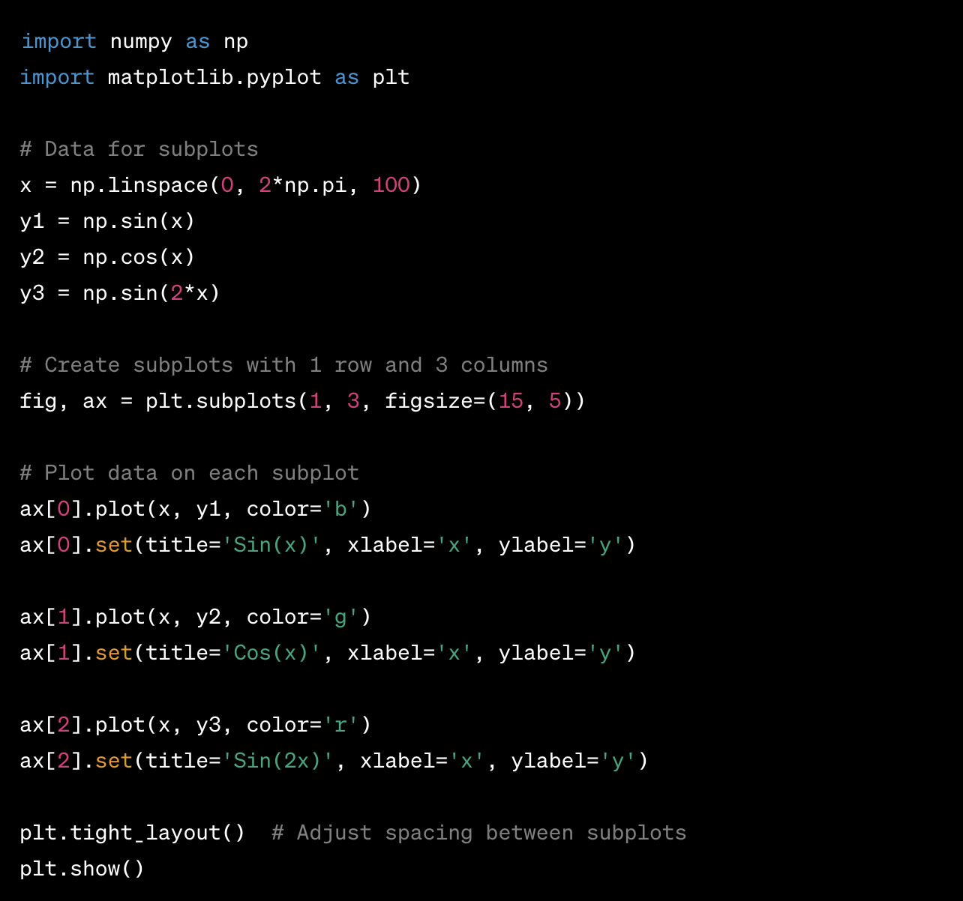
Sample Code

Slide 20
Adding Annotations
Importance of Adding Annotations
Annotations are essential for enhancing the clarity and understanding of plots.
Titles, labels, and annotations provide context and key information about the data.
Using plt.title()
plt.title() adds a title to the plot.
The title explains the purpose or content of the visualization.
Using plt.xlabel() and plt.ylabel()
plt.xlabel() and plt.ylabel() add labels to the x-axis and y-axis, respectively.
Labels describe the meaning of each axis and the units of measurement.

Slide 21
Adding Annotations (Cont.)
Using plt.text()
plt.text() allows adding text annotations at specified coordinates on the plot.
Text annotations can highlight specific data points or provide additional insights.
Note: Annotations are essential for presenting visualizations effectively. Titles convey the purpose of the plot, labels provide clarity, and text annotations add specific details. Use annotations thoughtfully to make your plots more informative and visually appealing.

Slide 22
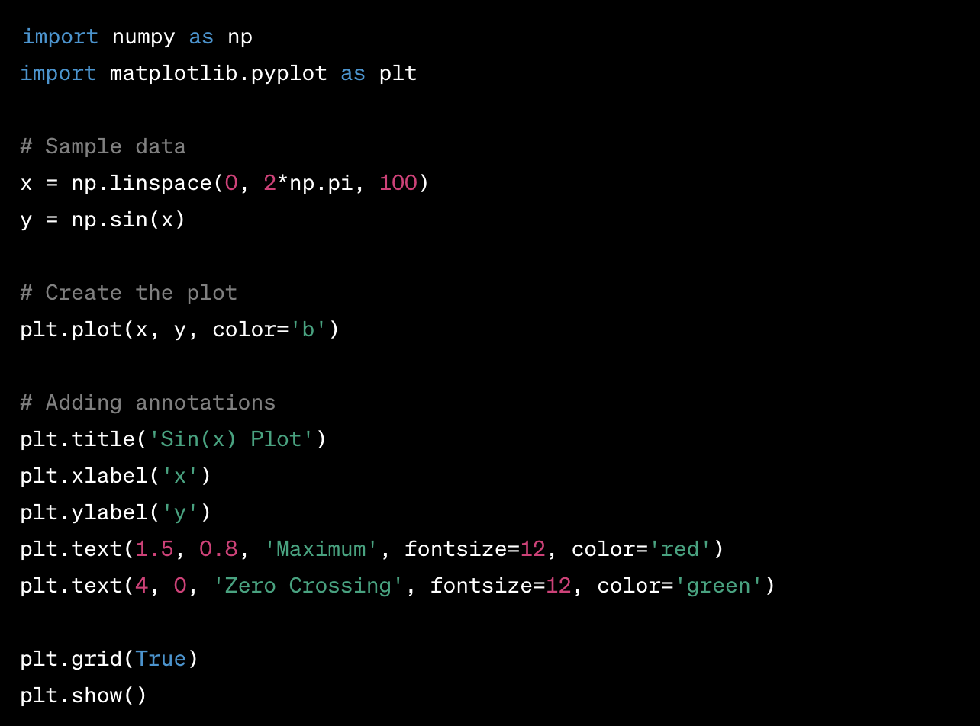
Sample Code

Slide 23
Customizing the Appearance
Customization of Plots
Matplotlib allows extensive customization of plot appearance for improved visual appeal.
Adjust fonts, colors, line styles, markers, and other visual elements.
Customizing Fonts and Styles
Use plt.rcParams to set global parameters for fonts and styles.
Modify properties like font.family, font.size, axes.grid, axes.linewidth, etc.
Customizing Colors
Customize colors of lines, markers, and backgrounds.
Use named colors ('blue', 'green') or hexadecimal color codes ('#FF5733’).
Using Matplotlib Style Sheets
Style sheets provide pre-defined sets of parameters to change plot appearances.
Choose from available style sheets or create custom ones to apply a consistent theme.

Slide 24
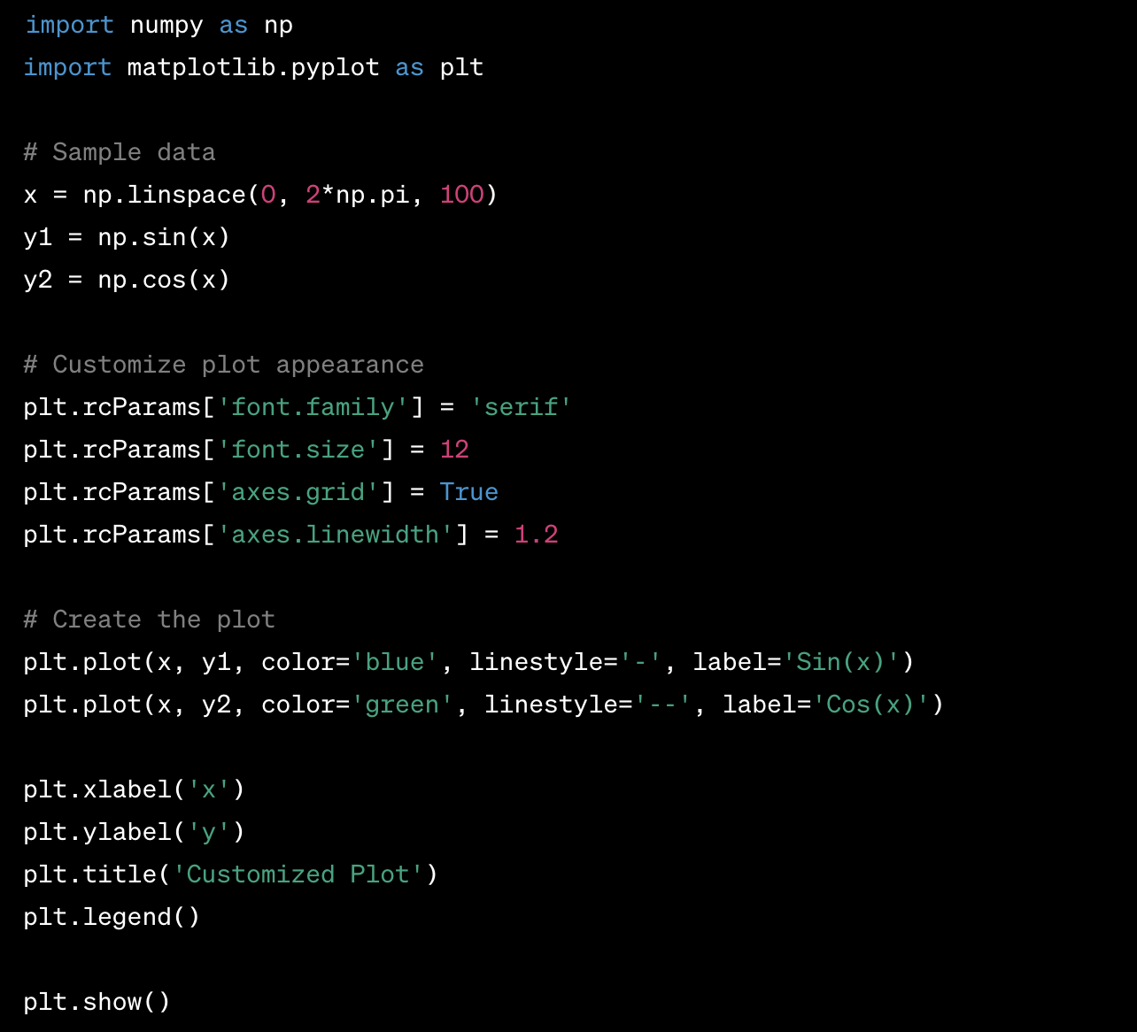
Sample Code

Slide 25
Saving and Exporting Plots
Saving Plots with plt.savefig()
Use plt.savefig() to save plots to various file formats such as PNG, PDF, SVG, JPEG, etc.
Specify the desired file name and format as arguments to plt.savefig().
Exporting to Different Formats
Choose the appropriate file format based on your requirements.
PNG (Portable Network Graphics) for web use, PDF (Portable Document Format) for documents, and SVG (Scalable Vector Graphics) for vector-based graphics.
Publication-Quality Visualizations
Matplotlib is widely used to create high-quality visualizations for research papers, presentations, and publications.
Pay attention to font sizes, axis labels, titles, and overall aesthetics to produce visually appealing plots.

Slide 26
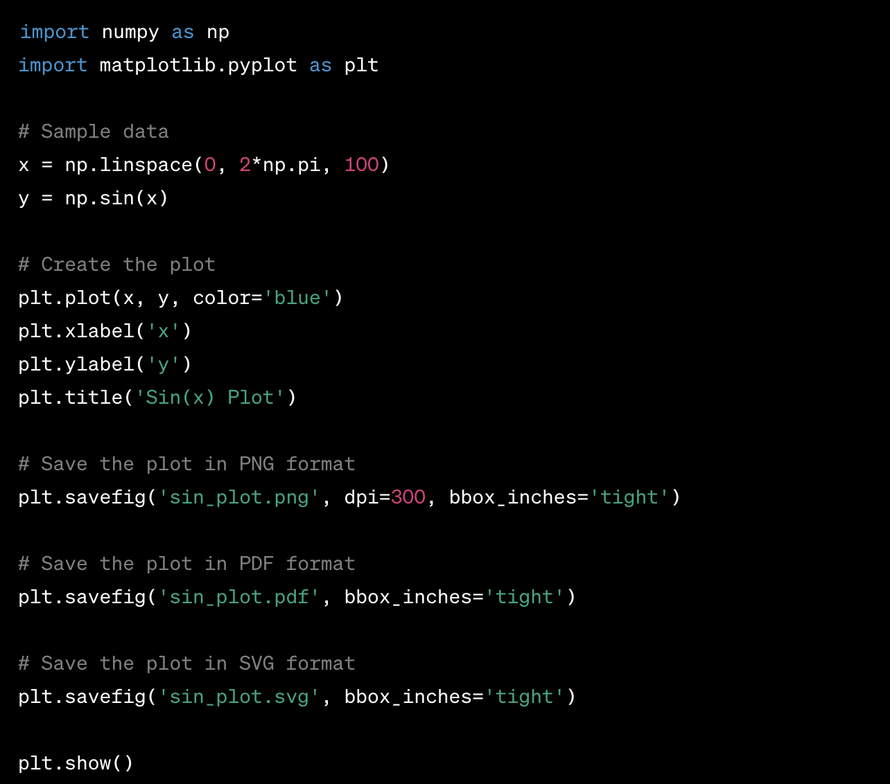
Sample Code

Slide 27
Advanced Plot Types (Optional)
Exploring Advanced Plot Types
Matplotlib offers a wide range of advanced plot types beyond basic line, scatter, and bar plots.
These advanced plot types cater to specific data visualization needs and add depth to data analysis.
3D Plots
Use mpl_toolkits.mplot3d to create 3D plots in Matplotlib.
Visualize data in three dimensions with surface plots, scatter plots, and wireframes.
Contour Plots
plt.contour() and plt.contourf() create contour plots for visualizing 3D data on a 2D plane.
Contour plots are useful for displaying data with continuous variation, such as topographic maps and heatmaps.

Slide 28
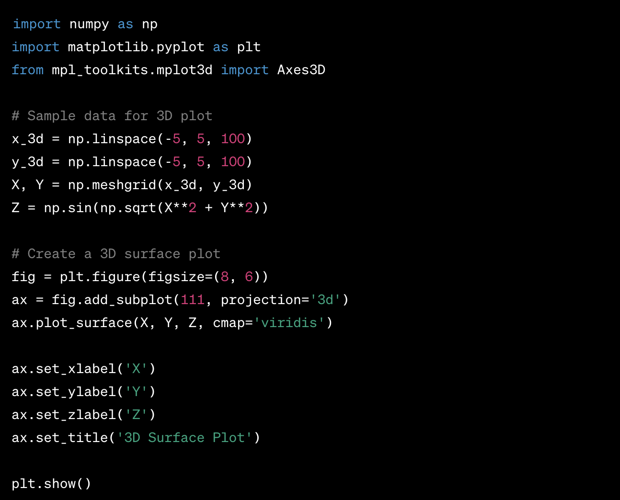
Sample Code

Slide 29
More Resources
User Guide
https://matplotlib.org/stable/users/index.html
Reference
https://matplotlib.org/stable/api/index.html
Tutorials
https://matplotlib.org/stable/tutorials/index.html
Examples
https://matplotlib.org/stable/gallery/index.html

Slide 30
Questions?

Slide 31
Thank You

