Slide 1
Keyboard brief

Slide 2
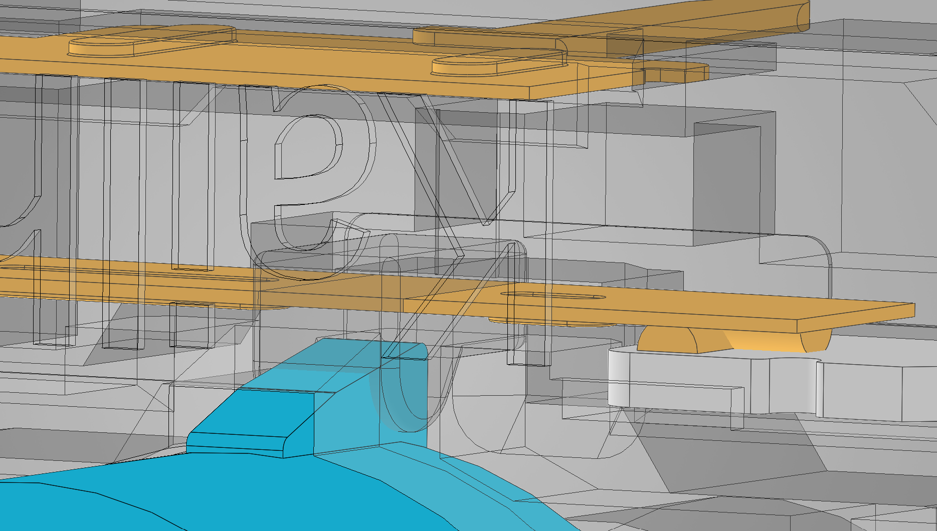
Keyswitch operation
Spring returned plastic stem pushes a leaf spring which makes contact between the two pins, seen on the right.
“Clicky” switches have a paperclip like spring to make a sound, seen on the left

Slide 3
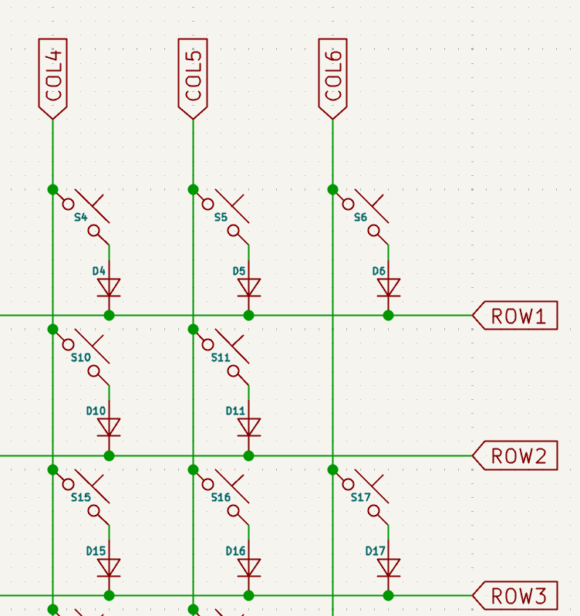
Key matrix
Key presses utilise a matrix, like LED arrays, to reduce the GPIO pins required.
One dimension is scanned using MCU output and another receives using MCU input.
Diodes are used to stop ghosting, like how LED arrays ghost
Two min video if you want

Slide 4
Keyboard subsystems
Multiple subsystems with interfacing considerations. In design order:
MCU: STM32
Keyswitch Array PCB
Peripheral Board (Optional OLED display and volume encoder)
Chassis and keycaps

Slide 5
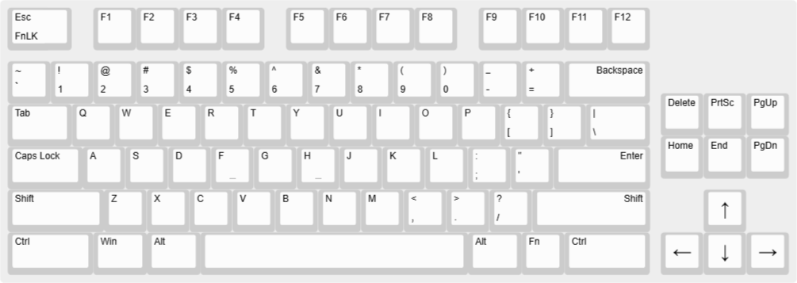
Interfacing
Due to sizing requirements, the MCU is designed first, which will be made to fit onto keyboard PCB.
Upgradeable MCU utilising a daughterboard
Prioritise low profile design
Idea is to have the MCU under the OLED display

Slide 6
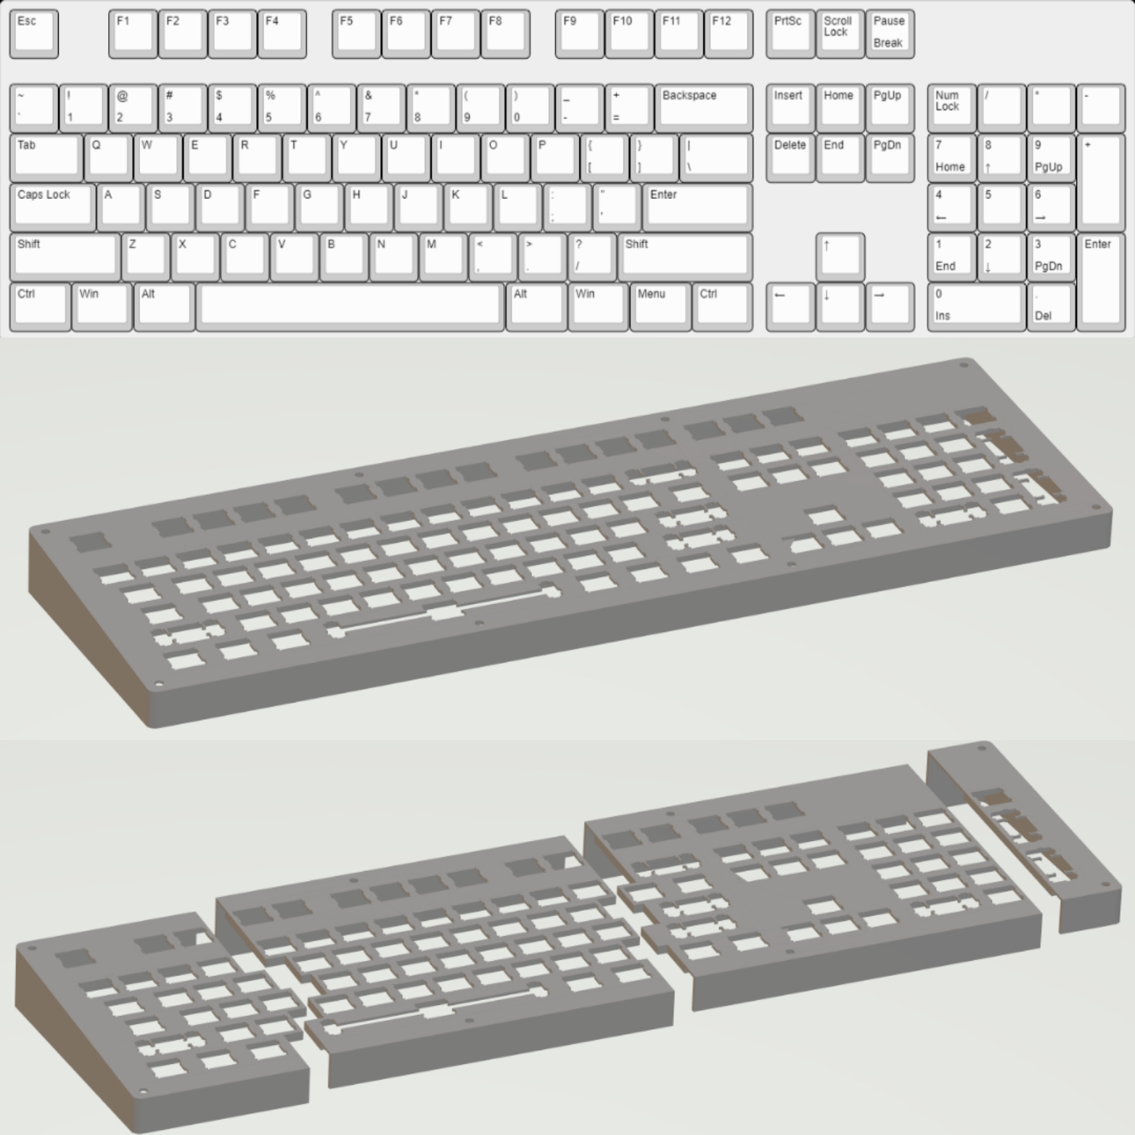
Chassis
Eventual plan for CNC Aluminium, able to create a working model using PLA or other FDM 3D printing material.
Grounding and isolation considerations with using metal chassis
Use of PLA sheets to electrically isolate PCB from chassis
Star point grounding directly to MCU’s USB TVS diodes
Mock-up on right

Slide 7
Firmware
Utilise QMK (Quantum Mechanical Keyboard) firmware
Runs on many MCUs, preference for ARM Cortex M series
USB consideration, some MCUs are funny with it
Use MCU that others have used
Refer to QMK recommended MCU list
https://docs.qmk.fm/compatible_microcontrollers

Slide 8
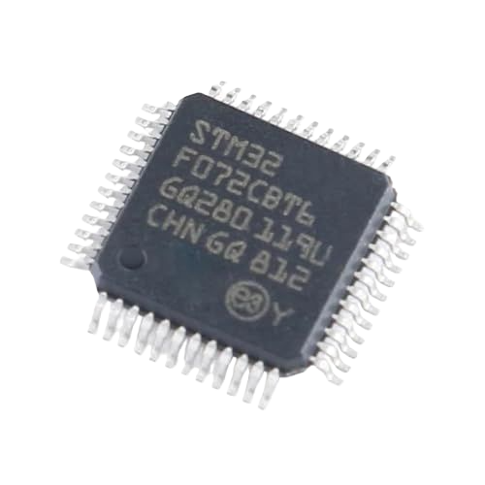
MCU
STM32F072CBT6 chosen, large amount of flash and very well supported for QMK applications, more than enough GPIO, crystal-less USB 2.0.
Turns out a YT tutorial also chose this
USB C interface, emphasis on ESD protection and signal integrity
Route USB as differential pairs
Good application specific TVS (Transient Voltage Supressing) diode chip
USBLC6-2
Minimised footprint

Slide 9
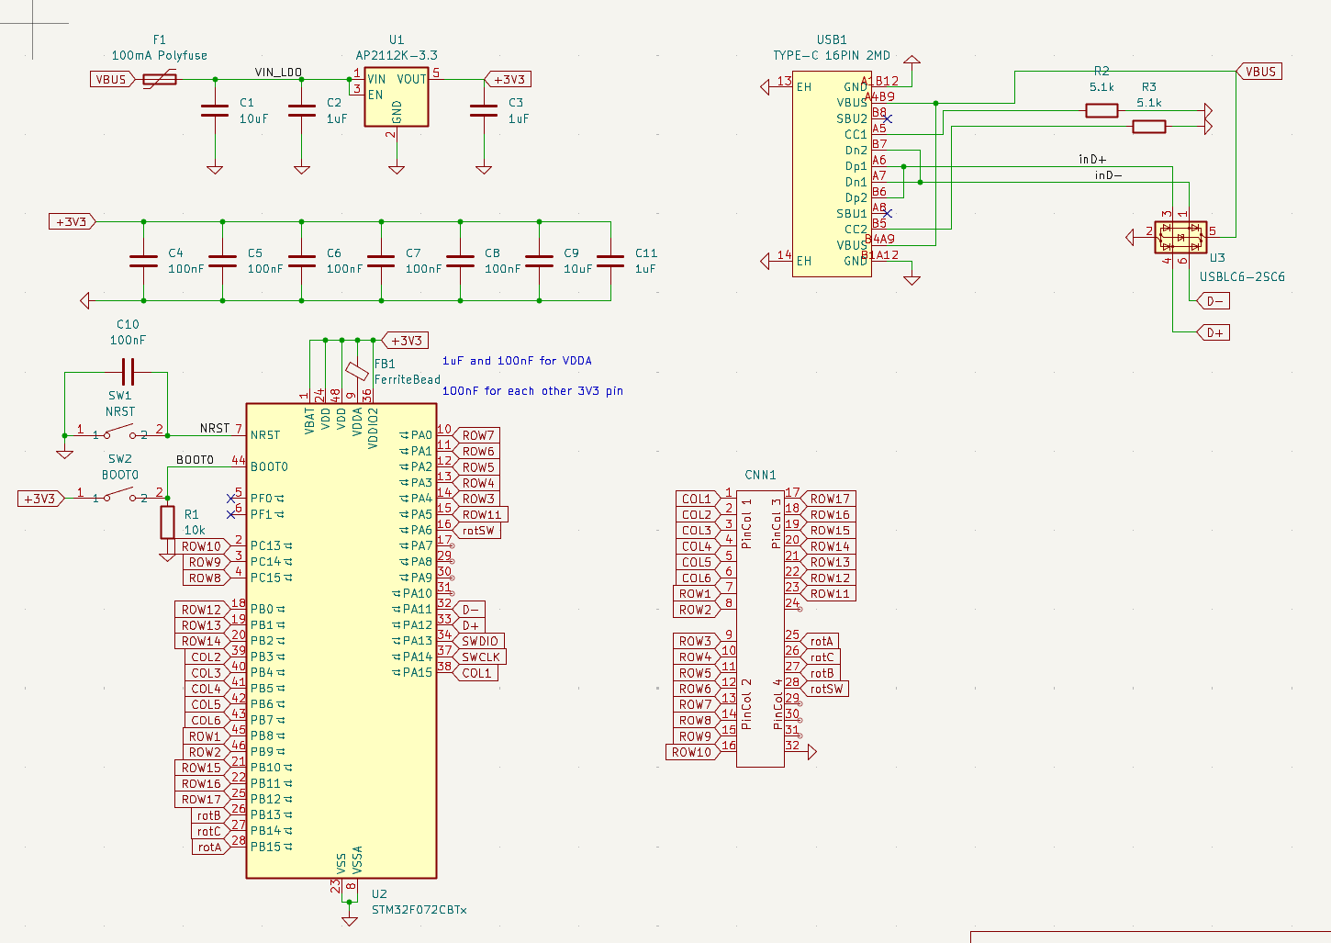
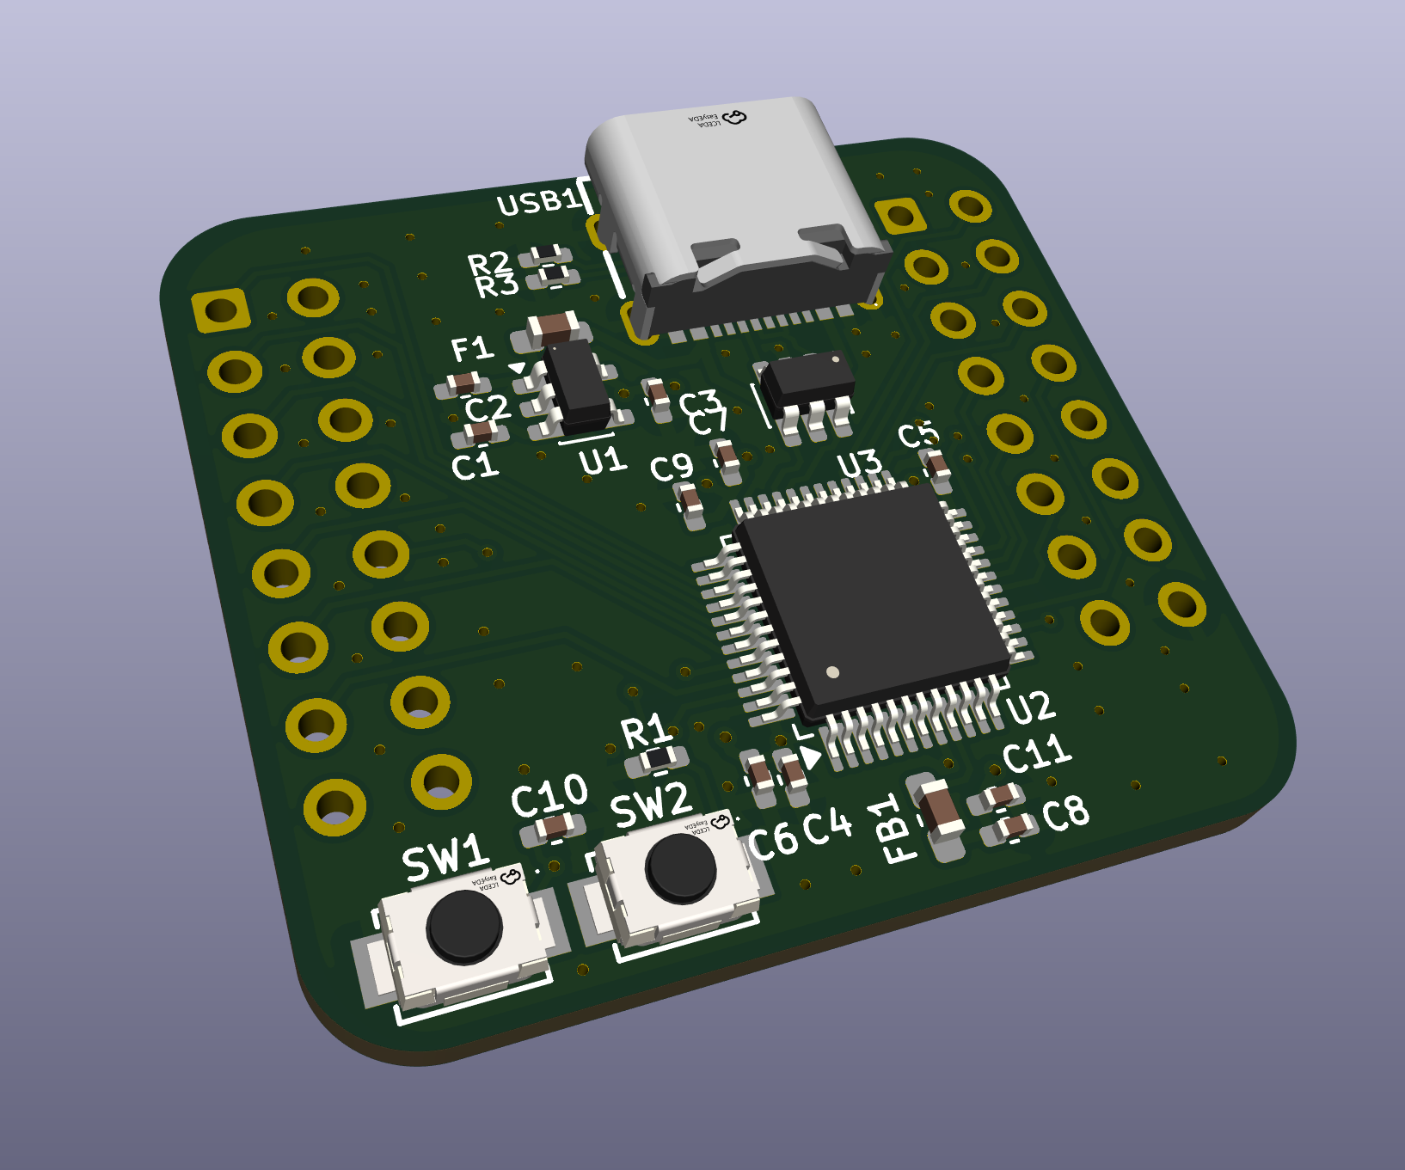
MCU So far

Slide 10
Thanks

