Slide 1



CAPSTONE PROJECT
Smart Resume Screener & Job Recommendation Portal
Flask + NLP + TF-IDF + Random Forest
CAPSTONE PROJECT PRESENTED BY
SUPERVISION & INSTITUTION
Chithira CV, Aswin George, Anandhakrishnan S, Nandagopal K
Tutor: Sneha Institute: RP2
SLIDE 1 OF 30

Slide 2


Agenda
01. Introduction
08. Dataset
15. Application Workflow
02. Problem Statement
09. Data Preprocessing (Jupyter)
16. Screenshots
03. Objectives
10. Feature Engineering
17. Advantages
04. Existing System
11. Model Building (Jupyter)
18. Limitations
05. Proposed System
12. Model Comparison
19. Conclusion
06. Architecture
13. Model Saving
20. References
07. Technology Stack
14. Flask Web Application
SLIDE 2 OF 30

Slide 3

Introduction
The aim of this project is to build an intelligent and user-friendly web application that automatically analyzes uploaded resumes using NLP-driven Machine Learning models and identifies the most suitable job roles for each candidate.
Along with predicting role fit, the system recommends relevant job openings from the database and highlights key strengths and skill gaps, helping users improve their career readiness.
SLIDE 3 OF 30

Slide 4

Problem Statement
Manual resume screening is:
→
Time-consuming
Automation Shift
→
Error-prone
This project automates resume analysis using Machine Learning and NLP to recommend suitable job roles and predict the most appropriate job category.
→
Costly
→
Difficult for recruiters
SLIDE 4 OF 30

Slide 5
Project Objectives
Automate resume screening: Remove administrative delays.
Extract text from uploaded resumes: Seamless system parsing.
Predict job category: High accuracy NLP classification.
Recommend matching job roles: Data-driven career mapping.
Display required skills: Immediate gap analysis.
Show education requirements: Validate minimum credentials.
Generate downloadable PDF report: Export system-generated records.
Reduce recruiter workload: Maximize corporate pipeline throughput.
SLIDE 5 OF 30

Slide 6

Existing System
Existing System Workflow
System Limitations
→
Manual resume verification.
→
Slow process
→
Time-consuming recruitment process.
→
Low efficiency
→
Human bias during screening.
→
High manual effort
→
No automatic job recommendation.
SLIDE 6 OF 30

Slide 7


Proposed System
Key Features
• Upload PDF, DOCX or TXT resume
• Resume text extraction
The application extracts resume text, predicts the job category, recommends matching jobs, and generates a PDF report.
• NLP preprocessing
• TF-IDF feature extraction
• Machine Learning prediction
• Job recommendation
• PDF report generation
• User-friendly Flask interface
SLIDE 7 OF 30

Slide 8









Architecture
Resume Upload
Text Extraction
Text Cleaning
TF-IDF Vectorization
Random Forest Model
Category Prediction
Job Recommendation
Result Page
PDF Report
SLIDE 8 OF 30

Slide 9

Technology Stack
Frontend
Backend
Machine Learning
Libraries
▪ HTML
▪ Python Flask
▪ Scikit-Learn
▪ Pandas
▪ CSS
▪ TF-IDF
▪ NumPy
▪ Bootstrap
▪ Random Forest
▪ PyPDF2
▪ JavaScript
▪ python-docx
▪ ReportLab
SLIDE 9 OF 30

Slide 10

Dataset
Dataset contains
→
Job Title
Used for:
→
Category
→
Experience Years
→
Model Training
→
Required Skills
→
Job Recommendation
→
Education Requirement
→
Salary Range
SLIDE 10 OF 30

Slide 11

Dataset Structure
Job Title | Category | Education Requirement | Experience Years | Required Skills | Salary Range
Software Engineer | Technology | Bachelor's in Computer Science|Bachelor's in E... | 2 | Python|Java|C++|Git|Software Design|Problem So... | 80-150K
Full Stack Developer | Technology | Diploma in IT|Bachelor's in Computer Science | 2 | JavaScript|React|Node.js|HTML/CSS|Database|Git | 75-140K
Frontend Developer | Technology | Diploma in IT|Bachelor's in Computer Science | 1 | JavaScript|React|Vue.js|CSS|HTML|UI/UX Design | 70-130K
Backend Developer | Technology | Bachelor's in Computer Science | 2 | Python|Java|Node.js|Database Design|API Develo... | 75-135K
DevOps Engineer | Technology | Bachelor's in Computer Science|IT Certification | 3 | Docker|Kubernetes|AWS|Linux|CI/CD|Scripting | 85-150K
SLIDE 11 OF 30

Slide 12
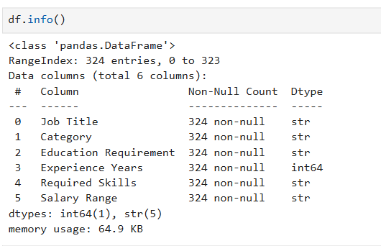
Dataset Info
SLIDE 12 OF 30

Slide 13

Data Preprocessing
Note: All model development was done in Jupyter Notebook.
Core Preprocessing Steps
NLP Pipeline Cleaning
→
Load Dataset
→
Text Cleaning
→
Handle Missing Values
→
Lowercase Conversion
→
Remove Duplicates
→
Remove Stopwords
→
Tokenization
SLIDE 13 OF 30

Slide 14

Feature Engineering
Key Benefits
TF-IDF Mapping
→
Converts text into machine-readable format
Text is converted into numerical vectors using TF-IDF Vectorizer
→
Removes unimportant words
→
Improves prediction accuracy
SLIDE 14 OF 30

Slide 15

Feature Engineering Details
Preprocessing Step | Used? | Explanation
Lowercase Conversion | Yes (automatic) | TfidfVectorizer converts text to lowercase by default (lowercase=True).
Remove Stopwords | Yes | Because you used stop_words='english'.
Tokenization | Yes (automatic) | TfidfVectorizer automatically splits text into words (tokens) before creating TF-IDF features.
SLIDE 15 OF 30

Slide 16






Model Building
Models trained
Dataset Split
Model Evaluation
KNN Logistic Regression Random Forest
Training : 80% Testing : 20%
Accuracy Precision Recall F1-score
SLIDE 16 OF 30

Slide 17


Model Comparison
Key Observation
Random Forest achieved the highest accuracy and was selected for deployment.
SLIDE 17 OF 30

Slide 18

Random Forest Observation
Model Performance Details
97%
• Overall Accuracy : 97%
• Weighted F1-score : 96%
• Macro F1-score : 90%
• Most categories achieved perfect classification.
MODEL ACCURACY
• Technology category obtained 100% accuracy.
• Few categories with limited samples showed lower performance.
SLIDE 18 OF 30

Slide 19

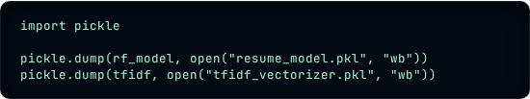
Model Saving
After training in Jupyter Notebook
Saved Files:
resume_model.pkl
tfidf_vectorizer.pkl
SLIDE 19 OF 30

Slide 20
Flask Web Application
Deployment Loads
Application Workflow
→
resume_model.pkl
→
Resume Upload
→
tfidf_vectorizer.pkl
→
Prediction
→
job_roles.csv
→
Job Recommendation
→
Download PDF
SLIDE 20 OF 30

Slide 21
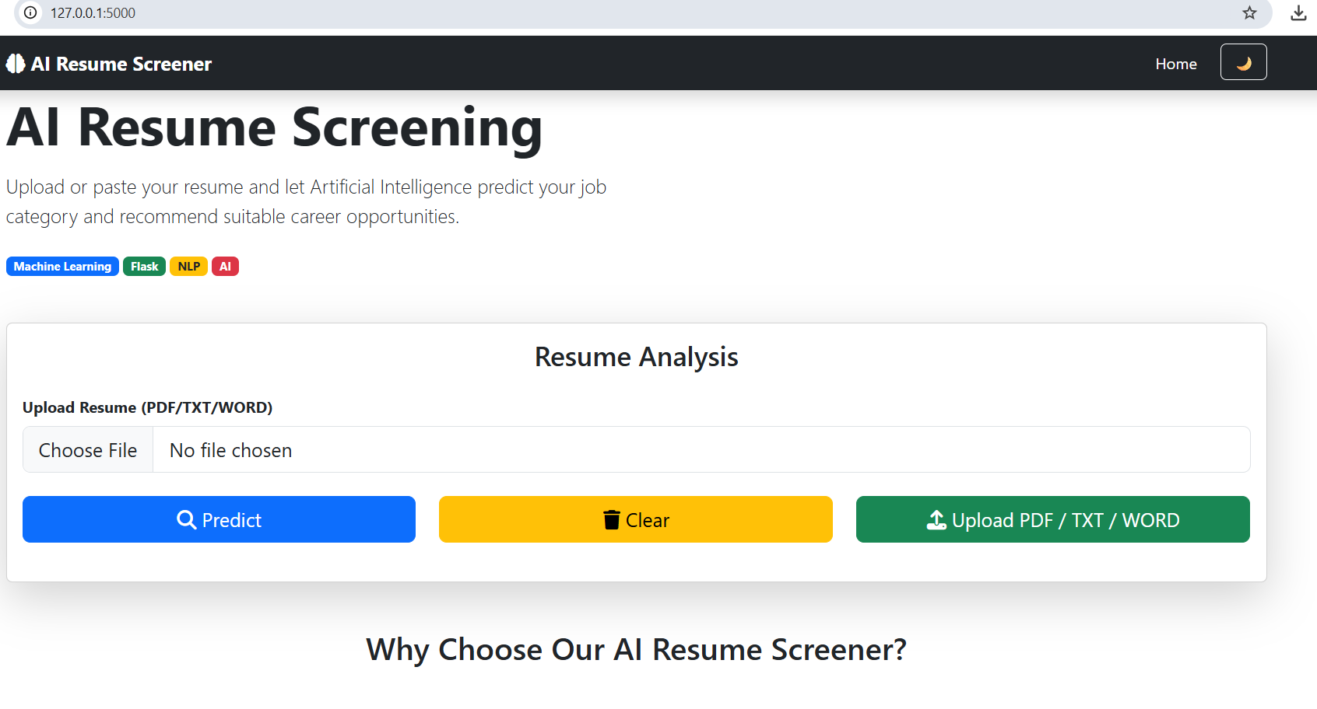
Screenshots - Home
127.0.0.1:5000
Upload or paste your resume and let Artificial Intelligenceredict your job category.
SMART SCREENER AI
SLIDE 22 OF 30

Slide 22
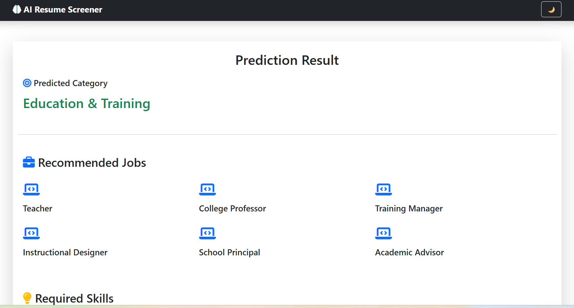
Screenshots - Result Page
SLIDE 23 OF 30

Slide 23
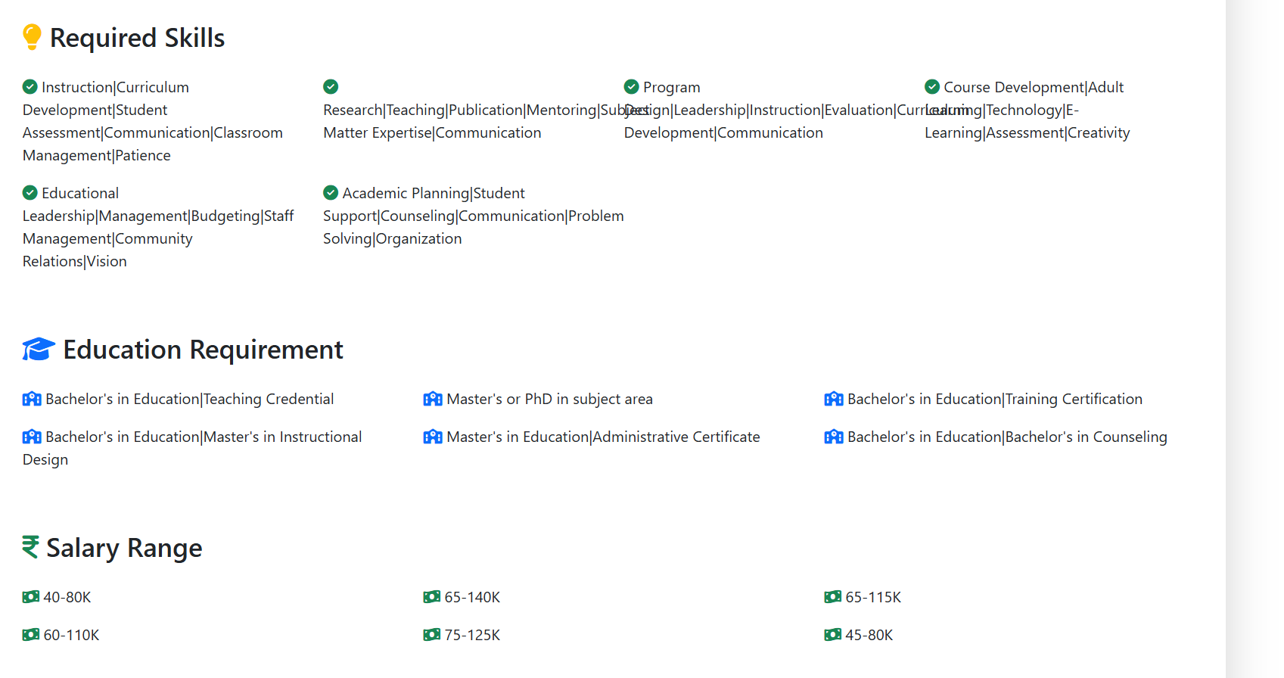


Screenshots
127.0.0.1:5000/predict#details
Required Skills
✔ Instruction|Curriculum Development|Student Assessment
✔ Program Design|Leadership|Instruction|Evaluation
✔ Educational Leadership|Management|Budgeting
✔ Academic Planning|Student Support|Counseling
Education Requirement
🎓 Bachelor's in Education|Teaching Credential
🎓 Master's or PhD in subject area
🎓 Bachelor's in Education|Training Certification
🎓 Master's in Education|Administrative Certificate
Salary Range
💵 40-80K
💵 65-140K
💵 65-115K
SMART SCREENER AI
SLIDE 24 OF 30

Slide 24
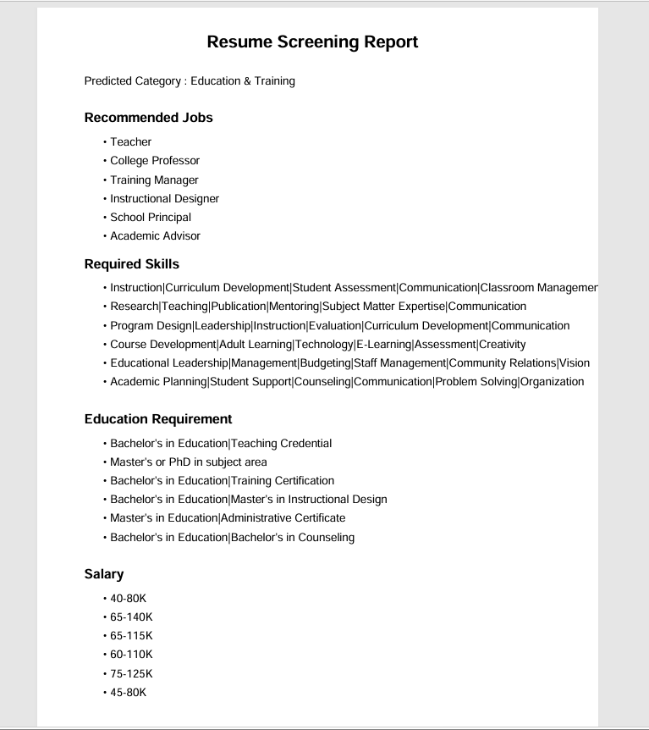
Screenshots - Result PDF
System Generated Report.pdf
Resume Screening Report
Confidence Score : 41.5 %
Recommended Jobs
•
•
College Profesor
•
Training Managr
Required Skills
• Instruction|Curriculum Development|Student Assessment|Patience
SLIDE 25 OF 30

Slide 25


Advantages
Fast
The deployed Flask application loads the saved Random Forest model, TF-IDF vectorizer, and job dataset, extracts text from uploaded PDF, DOCX, or TXT resumes, predicts the job category, recommends matching jobs, and allows downloading the screening result as a PDF.
Accurate
Easy to use
Predicts job category
Recommends relevant jobs
Generates downloadable PDF reports
SLIDE 26 OF 30

Slide 26

Limitations
Dataset dependent
Limited categories
Classification capabilities and mapping structures are rigidly tied to the coverage of the training records.
Predictions are restricted to the pre-configured categories present inside the trained taxonomic dataset.
SLIDE 27 OF 30

Slide 27
Conclusion
Successfully automated resume screening, shifting from administrative pipelines to algorithmic speeds.
Reduced manual effort in recruitment, enabling streamlined high-throughput standard HR operations.
Achieved 96.92% accuracy using Random Forest, validating the efficacy of the selected classification architecture.
Recommended suitable job roles based on resume content, leveraging the statistical weight of vectorized competency keys.
Built a complete end-to-end solution using Jupyter Notebook for model development and Flask for web deployment.
SLIDE 28 OF 30

Slide 28

References
Kaggle
Resume and Job datasets.
https://www.kaggle.com/
SLIDE 29 OF 30

Slide 29
Thank You
SLIDE 30 OF 30

