Slide 1
Z
ZOMATO RESTAURANT
ANALYTICS DASHBOARD
Capstone Project | Power BI Analytics | 2026
Presented by
Chithra P R
PGDA Batch - 45
Notes:
SPEAKER NOTES — SLIDE 1: "Good [morning/afternoon]. My name is Chithra P R from PGDA Batch 45. Today I will present my capstone project — a Power BI analytics dashboard built on Zomato's global restaurant dataset. This project covers the complete data analytics pipeline — from raw data to a fully interactive dashboard with real business insights. I will walk you through the problem statement, data architecture, cleaning steps, DAX measures, and the key findings from the dashboard."

Slide 2
PRESENTATION AGENDA
2
01
Problem Statement
05
Data Cleaning
What problem is being solved and why it matters
Power Query transformations and outlier fixes
02
Project Overview
06
DAX Measures
Objective, data source, tools used
20 calculated measures across 3 tables
03
Dataset & EDA
07
Dashboard Walkthrough
Understanding the raw data structure and distributions
Page 1 & Page 2 interactive dashboard explanation
04
Data Architecture
08
Key Insights & Conclusion
3-table Star Schema and relationship design
Business findings and project summary
Notes:
SPEAKER NOTES — SLIDE 2 (AGENDA): "Let me quickly walk you through the agenda. We have 8 sections today — starting from the problem statement, then data, cleaning, measures, and ending with insights and conclusion. The entire presentation is designed to follow the standard data analytics workflow — from problem to solution."

Slide 3
PROBLEM STATEMENT
3
Core Problem
Zomato collects vast amounts of restaurant data across 15 countries, but this data exists as a raw, unstructured CSV file with no analytical framework. Business stakeholders cannot derive meaningful insights about restaurant performance, customer satisfaction, pricing trends, or delivery impact without a structured analytical tool.
❓ Business Problem
📂 Data Problem
🎯 Solution Needed
No way to identify which restaurants perform well and why
Raw CSV with 9,551 rows — no relationships or structure
Clean & model data into a 3-table Star Schema
Cannot compare delivery vs non-delivery restaurant quality
Outliers distorting averages (₹8,00,000 single cost entry)
Build 20 DAX measures for accurate KPI calculation
No visibility into cuisine popularity or pricing vs rating trends
2,148 restaurants unrated, skewing rating calculations
Create interactive Power BI dashboard with drill-down filters
Notes:
SPEAKER NOTES — SLIDE 3 (PROBLEM STATEMENT): "The problem this project addresses is very clear — Zomato generates enormous amounts of restaurant data every day, but raw data alone is useless without structure and analysis. There are three layers to this problem: First, the business problem — stakeholders have no tool to understand performance patterns. Second, the data problem — a flat CSV with outliers and missing values cannot be analyzed directly. Third, the solution we needed — a structured data model with calculated measures and an interactive dashboard. My project solves all three."

Slide 4
PROJECT OVERVIEW
4
Objective
Data Source
Tools Used
Build an interactive Power BI dashboard to analyze global restaurant performance, customer ratings, and delivery trends across 15 countries.
Zomato public dataset — 9,551 restaurants, 15 countries, 6 continents, 21 columns covering cuisine, cost, ratings, delivery and table booking.
Microsoft Power BI Desktop for visualization, DAX for 20 calculated measures, Power Query for data modeling with a 3-table Star Schema.
Dashboard Pages
Page 1 — Restaurant Performance & Customer Rating Analysis Main dashboard: 6 KPI cards, 8 interactive charts, 4 slicers — cuisines, rating distribution, delivery impact, price analysis, world map. Page 2 — Performance Deep Dive Analysis Continent-level: avg rating, avg cost, price distribution, rating completion by country, restaurant share.
Notes:
SPEAKER NOTES — SLIDE 4 (PROJECT OVERVIEW): "The objective of this project was to convert a flat, unanalyzed CSV file into a fully interactive Power BI dashboard. The dataset comes from Zomato's public restaurant data — covering 9,551 restaurants across 15 countries and 6 continents. I used Power BI Desktop as my main tool, Power Query for data cleaning, and DAX for writing 20 calculated measures. The final output is a 2-page dashboard — Page 1 for overall performance analysis, Page 2 for continent and country-level deep dive."

Slide 5
DATASET OVERVIEW & EXPLORATORY DATA ANALYSIS
5
📂 Dataset Facts
🔍 Key EDA Findings
Source
Zomato Public Dataset
🇮🇳 India has 8,652 restaurants = 90.6% of dataset
File Format
Single CSV File
⭐ Average rating = 3.44 (after removing 0-rated entries)
Total Rows
9,551 Restaurants
🍽️ North Indian cuisine is most common with 936 restaurants
Total Columns
21 Columns
🛵 Only 25.7% of restaurants offer online delivery
Countries
15 Countries
📋 Only 12.1% have table booking — low adoption
Continents
6 Continents
💰 46.5% restaurants are budget (Price Range 1)
Rating Range
0.0 to 5.0 Stars
⚠️ 2,148 restaurants (22.5%) have never been rated
Cost Range
₹0 to ₹8,00,000 (outlier)
🌍 Africa has best avg rating (4.21) despite fewest entries
Cuisine Types
1,500+ unique combinations
Notes:
SPEAKER NOTES — SLIDE 5 (DATASET & EDA): "Before building the dashboard, I first explored the dataset to understand its structure. The data has 9,551 rows and 21 columns — all in a single flat CSV file. During exploratory analysis, I discovered several important patterns: India dominates with 90.6% of all restaurants. North Indian cuisine is the most common. Only 25.7% of restaurants offer online delivery and just 12.1% have table booking. Critically, 2,148 restaurants are completely unrated — which I had to handle carefully in my DAX measures. These EDA findings directly shaped both my data cleaning approach and dashboard design."

Slide 6
DATA ARCHITECTURE — STAR SCHEMA
6
Restaurant_Dim
Performance_Fact
Country_Dim
DIMENSION TABLE
FACT TABLE — CENTER
DIMENSION TABLE
🔑 Restaurant ID (KEY)
🔑 Restaurant ID (KEY)
🔑 Country Code (KEY)
Restaurant Name
Average Cost For Two
Country Name
Has Online Delivery
City
Continent
Restaurant ID
Has Table Booking
Country Code
Country Code
Aggregate Rating
Cuisines
Rating Text
Latitude / Longitude
Votes
Country
Price Range
Currency
Continent
Notes:
SPEAKER NOTES — SLIDE 6 (DATA ARCHITECTURE): "Rather than working with a single flat table, I designed a 3-table Star Schema — which is the industry-standard approach for analytical data models. The center of the schema is the Performance_Fact table, which holds all the measurable data — ratings, cost, votes, delivery status. This connects to Restaurant_Dim via Restaurant ID — which gives us location and cuisine information. It also connects to Country_Dim via Country Code — which enables continent-level filtering. A critical setting was changing the Cross Filter Direction to BOTH on all relationships. Without this, continent and country filters were not working correctly on the charts."

Slide 7
DAX MEASURES
8
#
Measure Name
DAX Function Used
Result
Table
1
Total Restaurants
COUNTROWS(Performance_Fact)
9,551
Fact
2
Total Votes
SUM([Votes])
1,498,645
Fact
3
Online Delivery %
FILTER + DIVIDE
25.7%
Fact
4
Table Booking %
FILTER + DIVIDE
12.1%
Fact
5
Weighted Avg Rating
CALCULATE + AVERAGE > 0
3.44
Fact
6
Avg Cost Cleaned
CALCULATE + AVERAGE (filtered)
₹583
Fact
7
Excellent %
FILTER Rating Text + DIVIDE
3.15%
Fact
8
High Performer %
FILTER Rating >= 4 + DIVIDE
varies
Fact
9
Rating Completion %
FILTER <> Not Rated + DIVIDE
77.5%
Fact
10
Delivery Rating Uplift
VAR Yes/No … RETURN diff
+0.78
Fact
11
Budget Restaurants
CALCULATE Price Range = 1
4,444
Fact
12
Luxury Restaurants
CALCULATE Price Range = 4
586
Fact
13
Avg Votes/Restaurant
SUM(Votes) / COUNTROWS
157
Fact
14
Total Countries
DISTINCTCOUNT(Country Code)
15
Rest_Dim
15
Total Cities
DISTINCTCOUNT(City)
varies
Rest_Dim
16
Total Cuisines
DISTINCTCOUNT(Cuisines)
varies
Rest_Dim
17
North Indian Count
CALCULATE cuisine filter
936
Rest_Dim
18
Dynamic Title
IF + ISFILTERED + SELECTEDVALUE
text
Rest_Dim
19
India Share %
CALCULATE country filter / total
90.6%
Country
20
Asia Count
CALCULATE continent filter
8,815
Country
Notes:
SPEAKER NOTES — SLIDE 8 (DAX MEASURES): "I wrote 20 DAX measures spread across the 3 tables. The most important ones are: Weighted Avg Rating — which uses CALCULATE with a filter to exclude zero-rated restaurants. Delivery Rating Uplift — which uses VAR to compute the difference in rating between delivery and non-delivery restaurants. India Share % — which uses a cross-table CALCULATE to compare India's count against the total. All percentage measures use the DIVIDE function to safely handle division by zero. The measures are what power all the KPI cards and chart calculations in the dashboard."

Slide 8
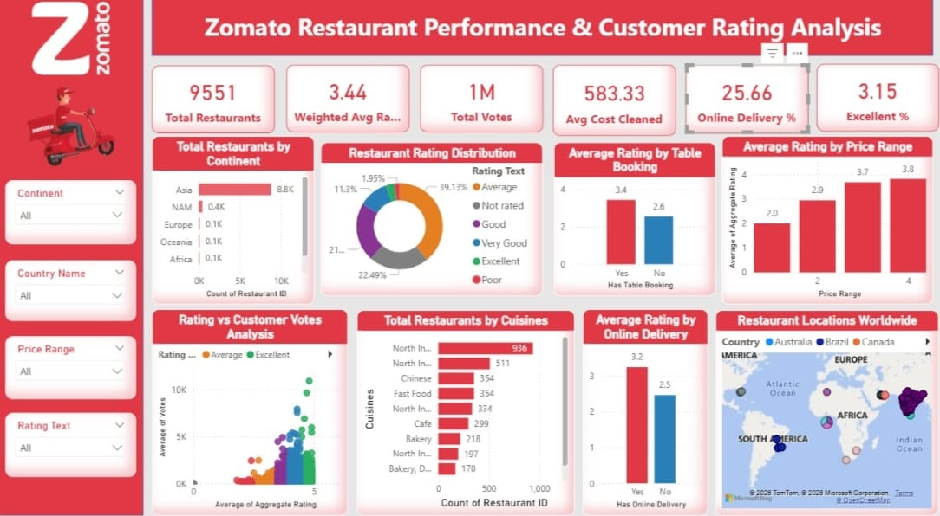
DASHBOARD PAGE 1
9
📊 Live Dashboard — Page 1: Restaurant Performance & Customer Rating Analysis
Notes:
SPEAKER NOTES — SLIDE 9 (DASHBOARD PAGE 1): "This is Page 1 of my Power BI dashboard — the main performance analysis page. At the top you can see 6 KPI cards showing the headline numbers — 9,551 restaurants, 3.44 average rating, 1 million votes, ₹583 average cost, 25.7% online delivery, and 3.15% excellent ratings. Below that are 8 interactive charts. The cuisines bar chart shows North Indian is most popular with 936 restaurants. The rating distribution donut shows that Average is the most common rating at 39%. The most interesting chart is the delivery vs rating comparison — restaurants with delivery are rated 0.78 points higher on average. All 8 charts respond dynamically to the 4 slicers on the left — Continent, Country, Price Range, and Rating Text."

Slide 9
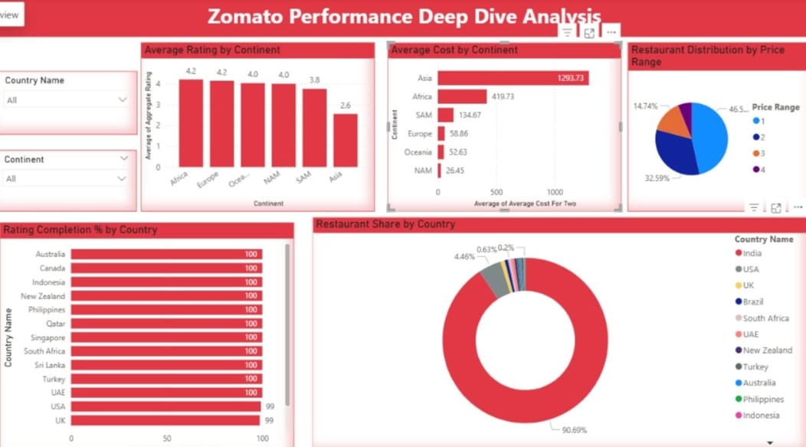
DASHBOARD PAGE 2
10
📊 Live Dashboard — Page 2: Performance Deep Dive Analysis
Notes:
SPEAKER NOTES — SLIDE 10 (DASHBOARD PAGE 2): "Page 2 is the deep dive analysis page — focused on continent and country level comparisons. The first chart shows average rating by continent — and surprisingly, Africa has the highest average rating at 4.21, followed by Europe at 4.19. Asia, despite having the most restaurants, has the lowest average at 3.37. The second chart shows average cost by continent — Asia appears highest at ₹1,293 because it includes expensive restaurants from Singapore, UAE and Philippines alongside cheaper Indian restaurants. The restaurant share donut clearly shows India's 90.7% dominance in this dataset. Both slicers — Country Name and Continent — make all 5 charts update dynamically, allowing targeted country-by-country comparison."

Slide 10
KEY PERFORMANCE INDICATORS
11
PAGE 1 — RESTAURANT PERFORMANCE
PAGE 2 — DEEP DIVE HIGHLIGHTS
9,551
3.44
1M
₹583
Best Avg Rating (Continent)
Africa 4.21 ⭐
Total Restaurants
Weighted Avg Rating
Total Votes
Avg Cost For Two
Most Restaurants (Continent)
Asia 8,815
India's Share of Dataset
25.7%
12.1%
3.15%
77.5%
90.6%
Delivery Rating Uplift
Online Delivery %
Table Booking %
Excellent %
Rating Completion
+0.78 pts
Price Range 1 (Budget) Count
4,444 (46.5%)
Notes:
SPEAKER NOTES — SLIDE 11 (KPIs): "These are the key performance indicators from both dashboard pages. On the left — Page 1 KPIs: 9,551 total restaurants, weighted average rating of 3.44, 1 million total votes, average cost of ₹583, 25.7% online delivery adoption, and 3.15% achieving Excellent rating. On the right — Page 2 deep dive highlights: Africa leads in rating quality at 4.21, Asia has the most restaurants at 8,815, India accounts for 90.6% of the dataset, delivery restaurants have a 0.78 rating advantage, and nearly half of all restaurants are in the budget price range. All these values are calculated using DAX measures — not simple aggregations."

Slide 11
KEY INSIGHTS & FINDINGS
12
01
02
03
🇮🇳 India Dominates
🛵 Delivery Boosts Rating
💰 Price Drives Quality
90.6%
+0.78 pts
3.82 vs 2.0
of all restaurants
delivery rating uplift
Luxury vs Budget rating
8,652 of 9,551 restaurants are from India. All global trends in this dataset are heavily shaped by Indian market patterns.
Restaurants with online delivery average 3.25 stars vs 2.47 without — suggesting higher investment in quality.
Luxury restaurants (Price Range 4) are rated nearly double Budget at 2.0 — higher price tiers attract better reviews.
04
05
06
🏆 Excellence Drives Votes
⚠️ 22.5% Are Unrated
🌍 Africa Leads Rating Quality
18x
2,148
4.21
more votes than Average
restaurants with no ratings
Africa's avg rating
Excellent restaurants get ~852 avg votes vs ~48 for Average. Quality creates a viral cycle of engagement.
Over 2,000 restaurants have never been rated — a major business opportunity for Zomato to drive engagement.
Despite very few restaurants, Africa tops continent ratings at 4.21. Asia with 8,815 restaurants has lowest at 3.37.
Notes:
SPEAKER NOTES — SLIDE 12 (KEY INSIGHTS): "These are the 6 most important business insights I extracted from the dashboard. Insight 1: India accounts for 90.6% of the dataset — so all trends are India-centric. Insight 2: Online delivery restaurants are rated 0.78 points higher — this is a strong finding for Zomato's business strategy. Insight 3: Luxury restaurants are rated almost double budget restaurants — price and quality are strongly correlated. Insight 4: Excellent restaurants receive 18 times more votes than Average-rated ones — showing quality drives viral engagement. Insight 5: 22.5% of restaurants have never been rated — this is a major opportunity for Zomato to drive first-review campaigns. Insight 6: Africa has the best rating quality despite the smallest presence — suggesting very selective listing standards."

Slide 12
RECOMMENDATIONS
13
1
STRATEGY
With delivery restaurants consistently rated 0.78 pts higher, Zomato should actively incentivize non-delivery restaurants to join the delivery platform — especially in underserved regions.
🛵 Promote Online Delivery Adoption
2
ENGAGEMENT
2,148 restaurants have zero reviews. A targeted push notification or discount campaign encouraging first-time reviewers would significantly improve data completeness and restaurant visibility.
⭐ Launch First-Review Campaigns
3
QUALITY
Since luxury restaurants (Price Range 4) have the highest ratings at 3.82, a 'Premium Quality' badge could help customers quickly identify high-value restaurants and improve conversions.
💰 Introduce Premium Restaurant Badging
4
EXPANSION
Africa and Europe show the highest average ratings (4.21 and 4.19) despite low restaurant counts. These markets represent a high-quality growth opportunity for Zomato's global expansion.
🌍 Invest in International Market Growth
Notes:
SPEAKER NOTES — SLIDE 13 (RECOMMENDATIONS): "Based on the insights from my analysis, I have 4 business recommendations for Zomato: First — promote online delivery adoption. Since delivery restaurants have consistently higher ratings, converting non-delivery restaurants could significantly improve overall platform quality scores. Second — launch first-review campaigns targeting the 2,148 unrated restaurants. These represent a massive untapped engagement opportunity. Third — introduce a Premium Quality badge for Price Range 4 restaurants since they consistently achieve the highest ratings. Fourth — expand internationally into Africa and Europe where quality standards appear highest. These recommendations are directly derived from the data, which makes them actionable and credible."

Slide 13
Z
CONCLUSION
This Power BI capstone project transforms raw Zomato data into actionable business intelligence. By building a 3-table Star Schema, writing 20 DAX measures, and designing 2 interactive dashboard pages, I uncovered key patterns in global restaurant performance, pricing, delivery impact, and customer engagement.
Thank You | Chithra P R | PGDA Batch-45 |
Notes:
SPEAKER NOTES — SLIDE 14 (CONCLUSION): "To summarize — this project took a raw, unstructured Zomato dataset with 9,551 restaurants and transformed it into a fully analytical Power BI solution. I built a 3-table Star Schema to properly model the data, wrote 20 DAX measures to calculate accurate KPIs, and created 2 interactive dashboard pages with drill-down capability. The key findings are: India dominates the dataset, delivery restaurants are rated higher, luxury restaurants attract better reviews, and there's a significant opportunity in the 22.5% unrated restaurants. This project demonstrates the complete data analytics workflow — from raw data, through cleaning, modeling, visualization, and finally to actionable business insights. Thank you. I'm happy to answer any questions."

