Slide 1
GESTURE RECOGNITION FOR CONTROLLING VLC MEDIA PLAYER
CHITHRA 21
SINDOORA 57
KRISHNA PRABHA 70

Slide 2
Average colour detection
The hand is shown in front of the camera in the region as requested.
Eliminating the border, the average of each region is found out.
Then the scalar wise median is found out.

Slide 3
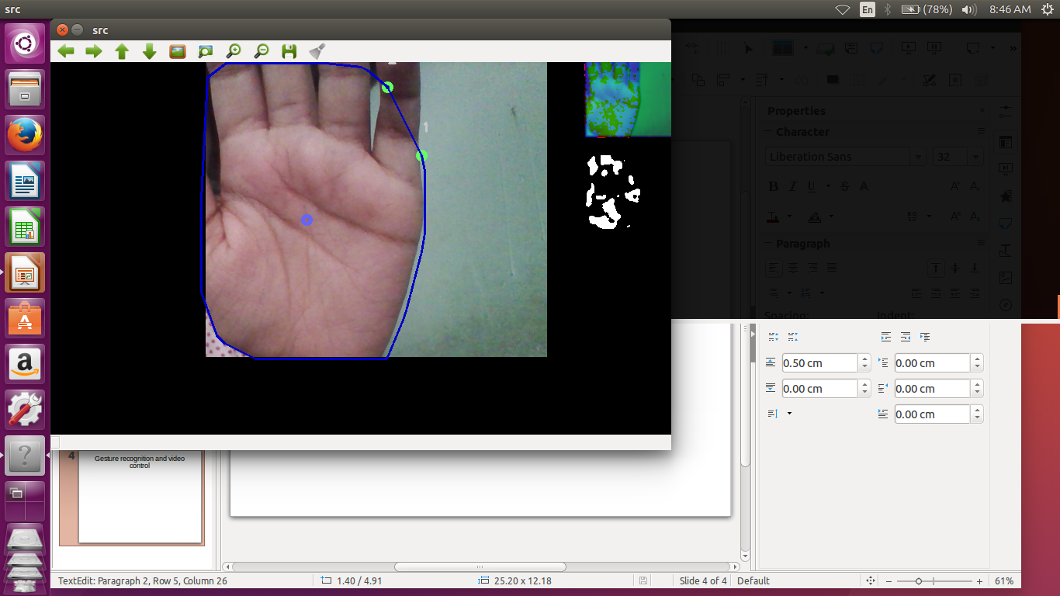

Slide 4
Filtering
With the calculated average, an upper and lower bound is finalised.
The value within both the upper and lower is made to be 1 and others to be 0.
Thus the threshold matrix is obtained

Slide 5
Contour and fingertips
With the help of the threshold matrix, the contours are found out.
Convexity hull technique and convexity defect technique are used here.
Also a vector of fingertips are also defined and kept track.

Slide 6
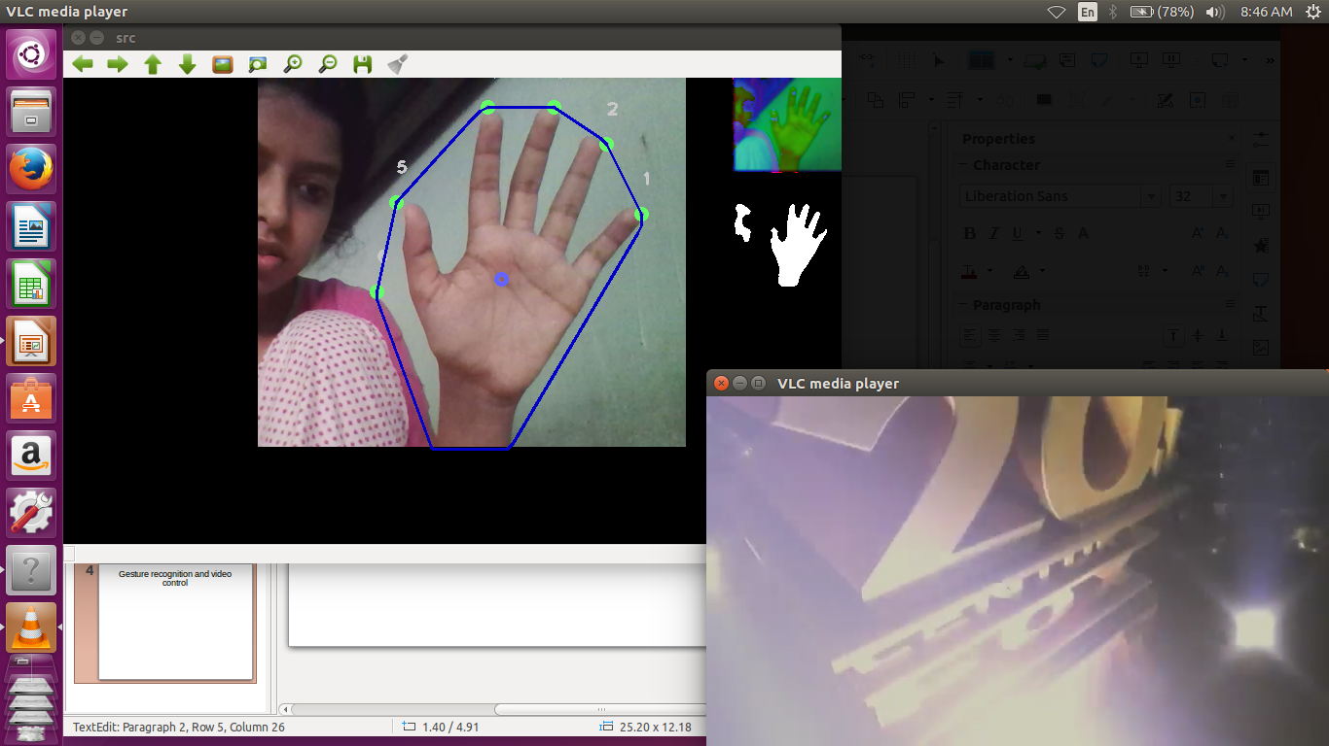
screenshots

Slide 7
Gesture recognition and video control
With the help of the fingertips and centroid, each gesture is mapped with an appropriate control option.
The control option is executed if the shown gesture matches with that

Slide 8
Future Enhancement
Implement more commands
Control other various applications
Make gesture recognition more accurate

