Slide 1
Introduction to Oracle
IT3031 – DSDA

Slide 2
Installation and Support Items
Oracle database 11g Express Edition Software.
Downloadd Oracle database 11g release 2 exprss edition
Oracle Database Software Downloads
Database Express Edition Installation Guide:
Oracle Database Express Edition Documentation, 11g Release 2 (11.2)
Accessed Oracle Documentation.
Documentation
For Online Usage – Oracle Live SQL

Slide 3
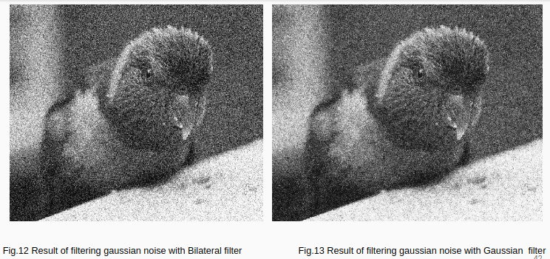
Install and start using Oracle 11g Release 2 Express Edition.

Slide 4

Thank You!

Slide 5
Project Speed Cycles Sri Lanka
Hero Experience Agency

Slide 6





Our Team

Slide 7
Purpose - to find out issues with the current website and - to provide recommendations in order to rebuild the website to increase sales through the website

Slide 8

There is cats

