Slide 1


Interior Design | Design and construction | Furniture making
Construction Architecture | Kitchen utensil manufacturing
best
Winner vn
Waterproofing liquid production and distribution

Slide 2
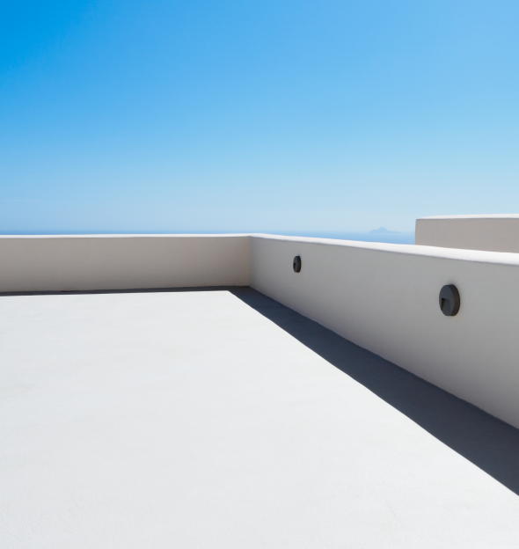
K1 Special Ultra-Strong Waterproof Coating
Eco-Friendly · Waterproof · Mortar ·
Flooring Material
best
Winner vn
K1 Waterproofing Products Overview
Our Vision and Mission
K1 Waterproofing Product Certifications
Product Specifications and Volume
Uses and Features
Installation and Construction Manual Construction Case Studies in Korea Global Distributors and Nationwide Dealer Network
03
04
06
07
08
09
11
13

Slide 3
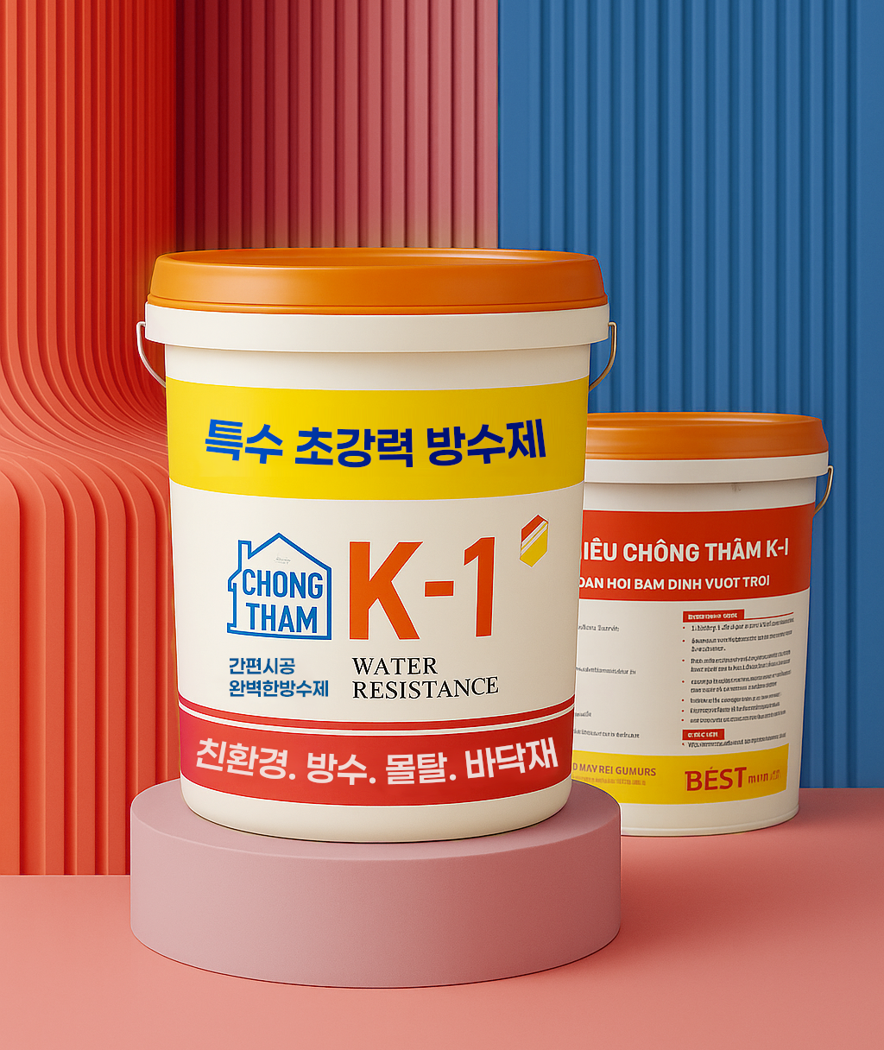
best
Winner vn
K1 K1 Waterproofing Products Overview
K1 is a versatile interior/exterior waterproofing solution featuring elastic waterproof compound technology. Its thermal energy reflection and waterproofing capabilities deliver significant energy savings during summer months. Utilizing specialized pigments to prevent indoor temperature rise, K1 offers superior waterproofing and freeze resistance while strengthening building structures through enhanced durability and adhesion.
Unlike competitors who use two-part systems requiring separate mixing of base and hardener, K1 products feature convenient single-component formulation with all ingredients pre-mixed in one package. Additionally, K1 is an environmentally friendly solution.
The product's core competitive advantage is its exceptional elasticity - capable of covering large cracks and demonstrating up to 300% elongation capacity.

Slide 4
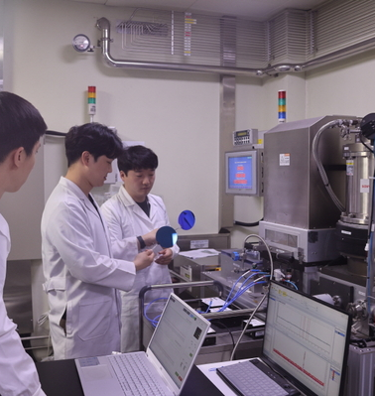
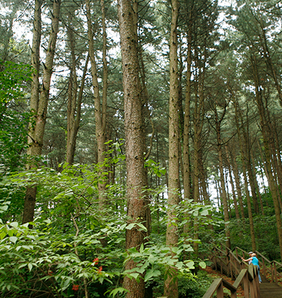

K1 Special Ultra-Powerful Waterproof Sealant
100% Waterproof Barrier - Not Even a Drop Gets Through 10-Year Safety Guarantee with Advanced Waterproofing Technology
Our Vision and Mission
10-Year Protection Guaranteed Safeguarding Your Space with Specialized Technology
Green Product
Imported Korean Raw Materials
We are building a future of harmony with nature through sustainable technology
We build global supply networks to ensure both stable raw material supply and consistent quality.

Slide 5
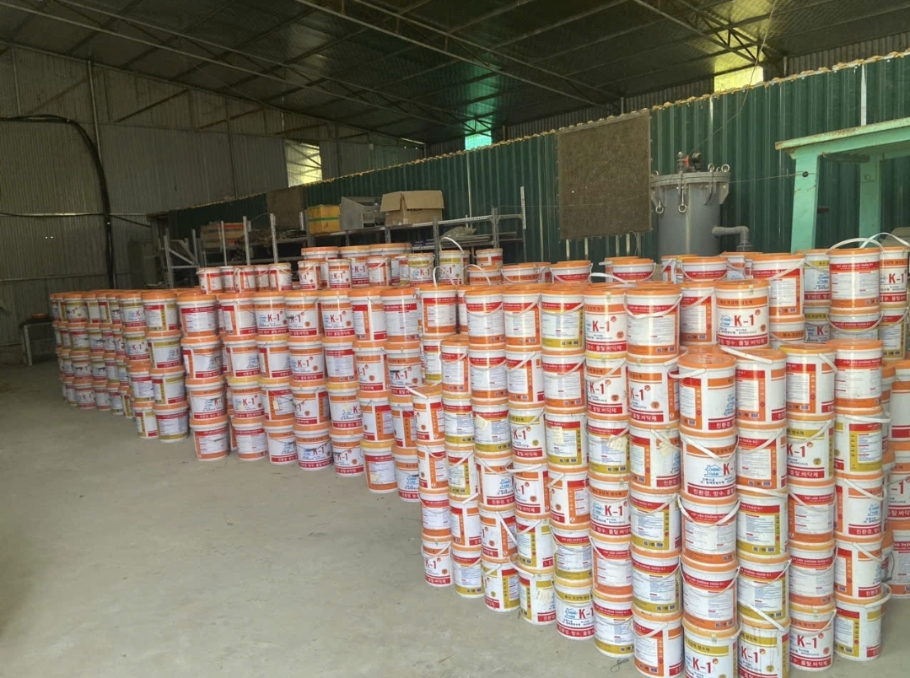

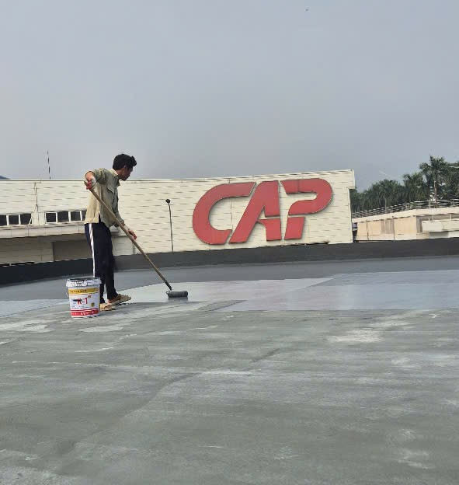
K1 Special Ultra-Powerful Waterproof Sealant
100% Waterproof Barrier - Not Even a Drop Gets Through 10-Year Safety Guarantee with Advanced Waterproofing Technology
Our Vision and Mission
Exclusive Vietnam Production
20 Years of Korean Market Experience
Single-Component Waterproofing Solution
Direct manufacturing in Vietnam allows us to guarantee quality, ethical production, and sustainability
20 years of market-proven expertise
in Korea. We promise the same
unwavering trust moving forward.
With single-component technology, anyone can easily deliver superior waterproofing performance.

Slide 6
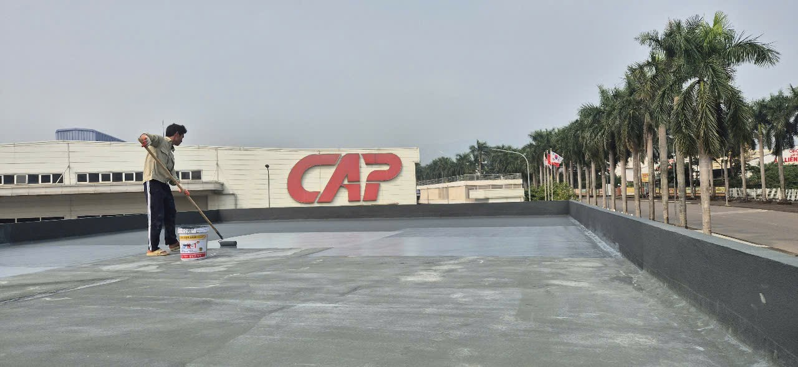
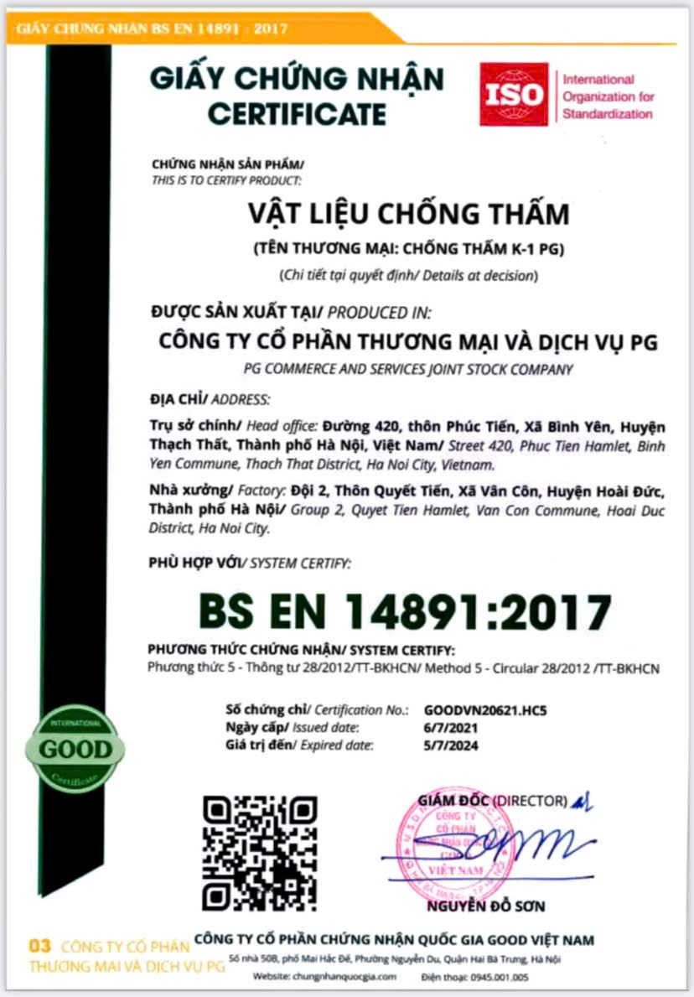
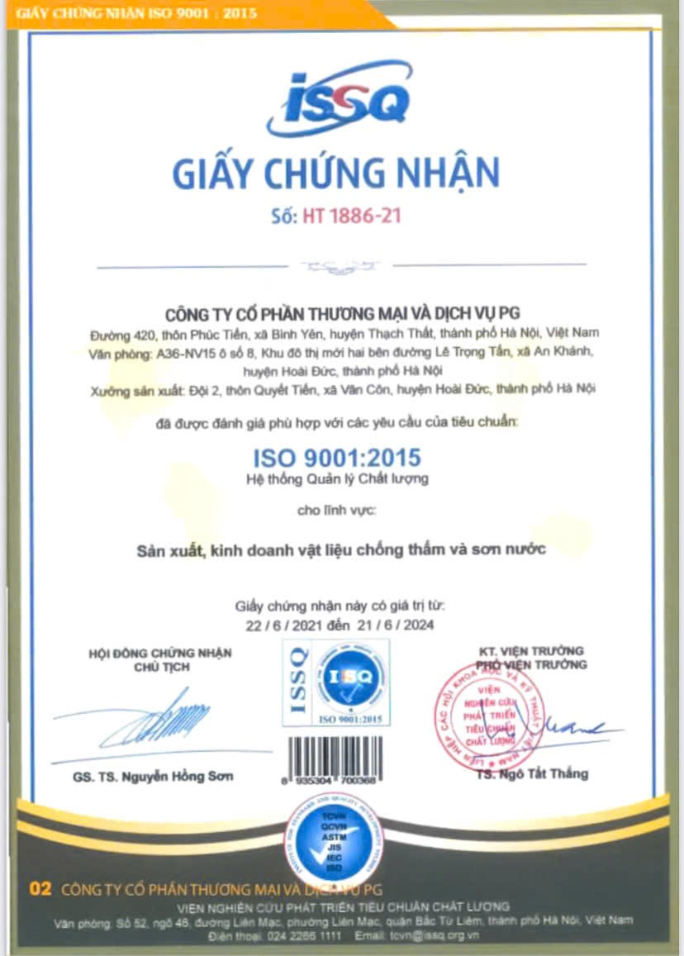
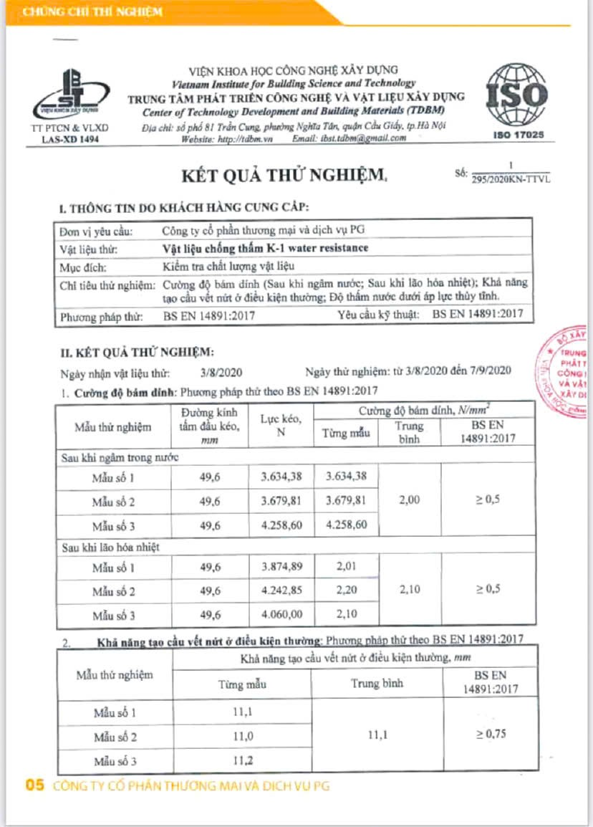
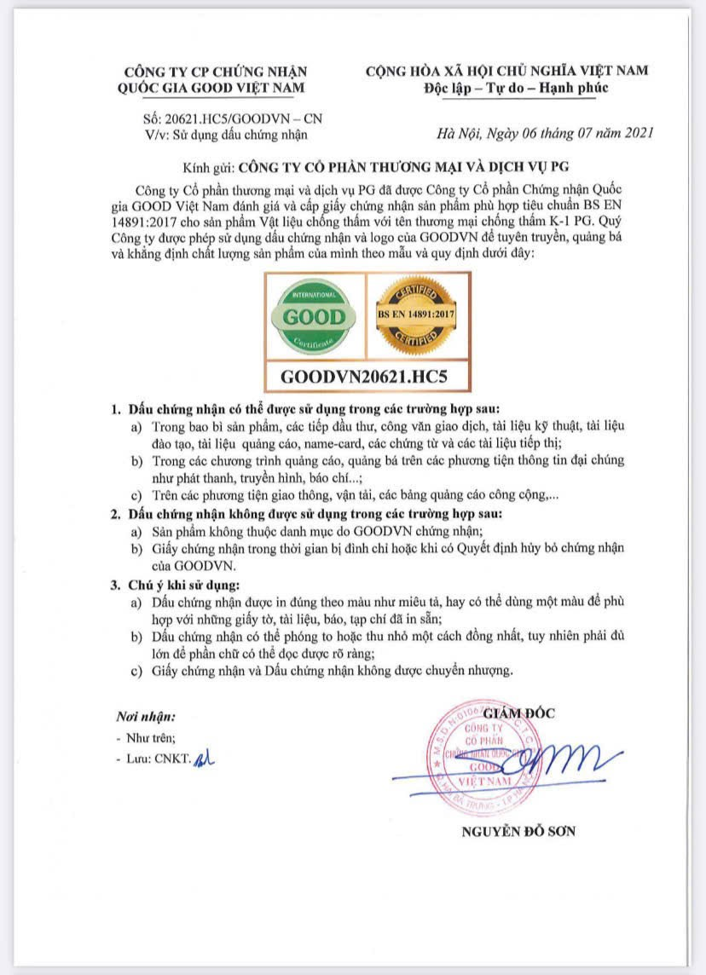
K1 Waterproofing Product Certifications
Our product has received quality and safety certifications from recognized domestic and international organizations. Certification documents can be provided upon request.
ISSQ Certification
Experimental Results Report
Vietnam National Certification
ISO Certification

Slide 7
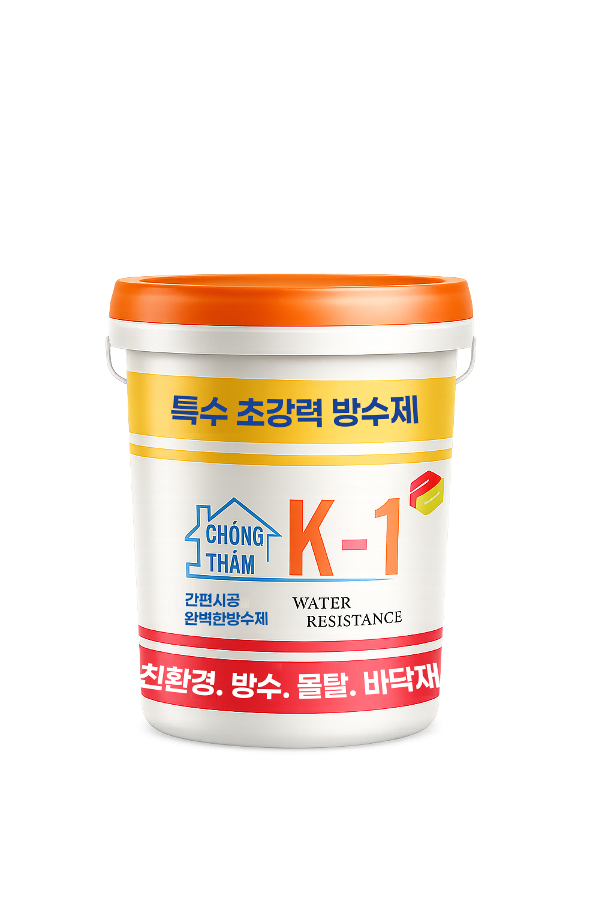
Product Specifications and Volume
K1 Special Ultra-Powerful Waterproof Sealant
18L
10L
5L
1L
K-1 (CT-18)
K-1 (CT-10)
K-1 (CT-05)
K-1 (CT-01)
1 Primer | 144 m²
2 Mid Coat | 72 m²
1 Primer | 80 m²
2 Mid Coat | 40 m²
1 Primer | 40 m²
2 Mid Coat | 20 m²
1 Primer | 8 m²
2 Mid Coat | 4 m²

Slide 8
K1 Special Ultra-Powerful Waterproof Sealant
Uses and Features
Top Coat Application and Recoatable over Existing Coatings
Eco-friendly Non-toxic Waterproof Material
Single-component Waterproof Material - Easy Application
Produced with Imported Korean Raw Materials
Unlike conventional water repellents, it allows for subsequent coating with water-based paint after application.
K-1 products are manufactured using eco-friendly materials. They are made with ingredients that are harmless to the human body, resulting in odorless and non-toxic products that can be used with confidence.
Designed for convenient DIY waterproofing, this single-component formula enables easy waterproof application anywhere you need it. Easy application with brush or roller!
Taking advantage of Southeast Asia's hot and humid climate characteristics, we have established direct production in Vietnam based on extensive research teams and experience gained in Korea.

Slide 9
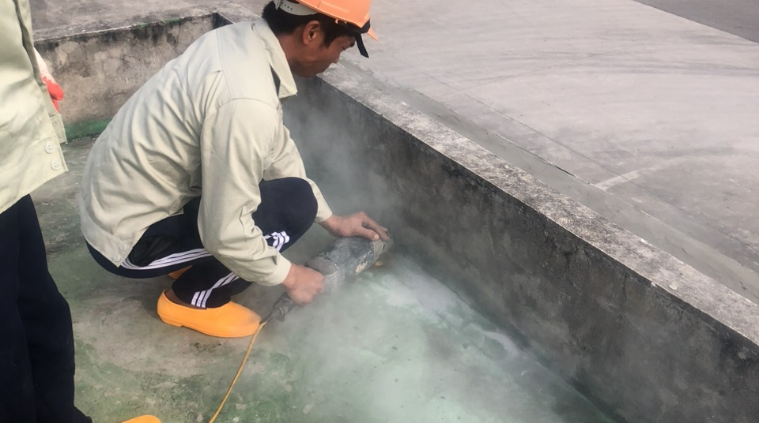
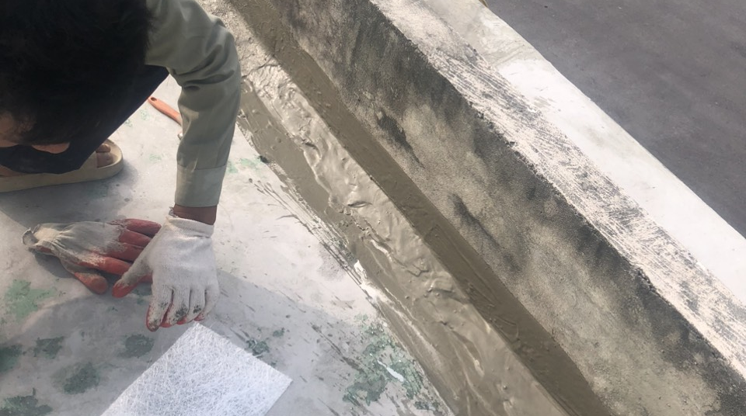
BEST WINNER VN
Installation and Construction Manual
Surface Preparation
Clean the work area of dust, foreign matter, oil, and other contaminants. Using a high-pressure washer or sponge is effective.
01
Surface Evaluation
02
Check the surface for cracks or holes and repair any found defects. Cracks should be filled with silicone or waterproof sealant.

Slide 10
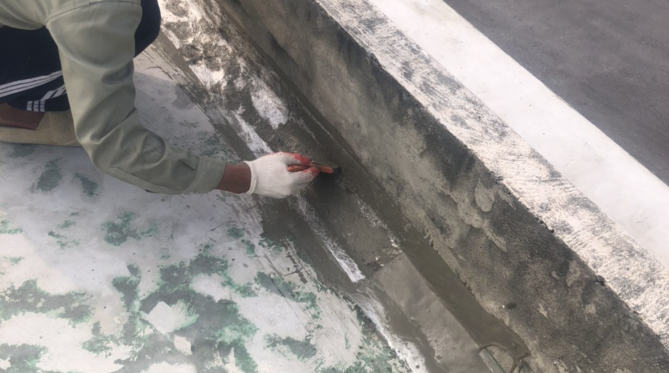
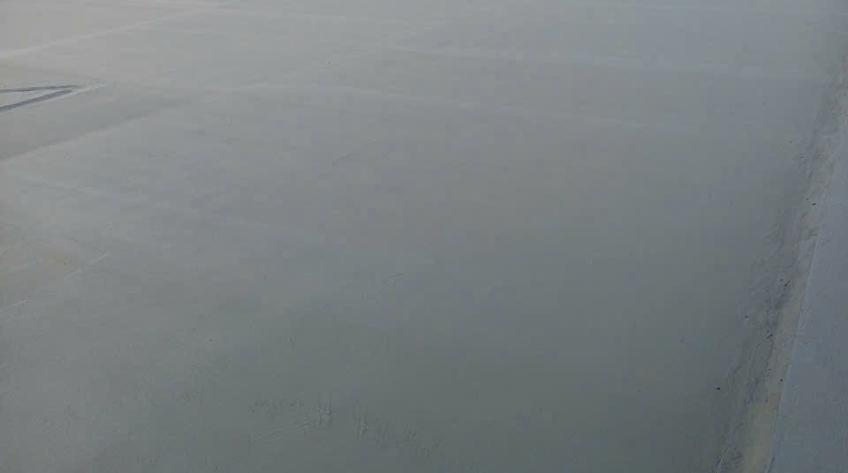
Primer Application
Apply primer evenly to the cleaned surface using a roller or brush. This step is important for improving the adhesion of the waterproofing material.
03
K1 Waterproofing Treatment
Once the primer is dry, apply K1 waterproofing agent to the proper thickness. Typically, 2-3 applications are recommended, ensuring each coat is applied only after the previous coat has fully dried.
04
Absolute water barrier technology that blocks every single drop - Specialized waterproofing ensures 10 years of reliable protection..

Slide 11


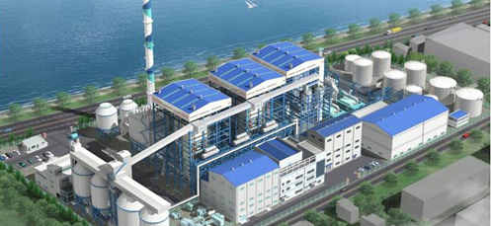
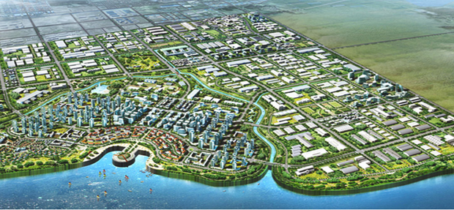
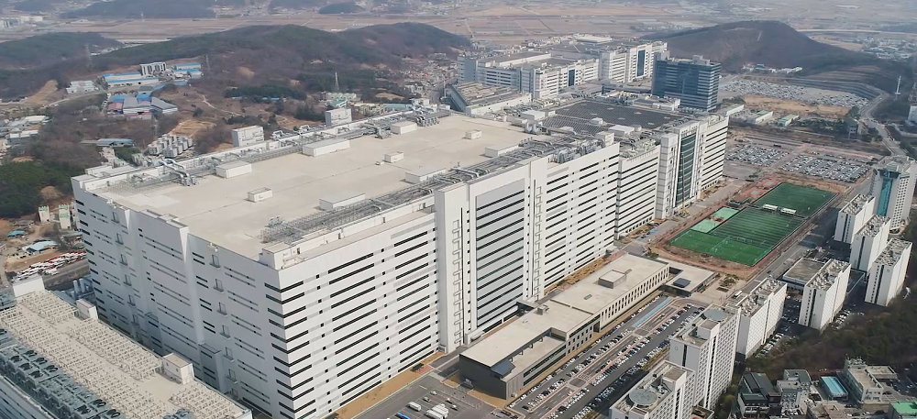
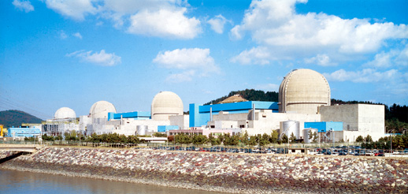
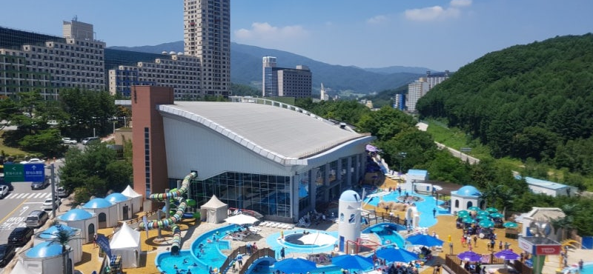
K1 Special Ultra-Strong Waterproofing Agent –
Korean Construction Case Studies
OCI, Kunjang Energy, Saemangeum Group, LG Display (Paju), Yeonggwang Nuclear Power Plant, Haewon Water Park

Slide 12

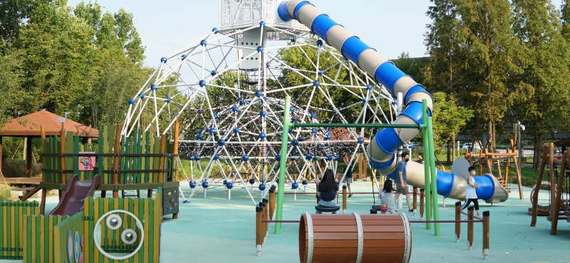
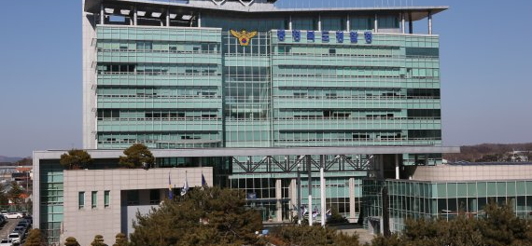
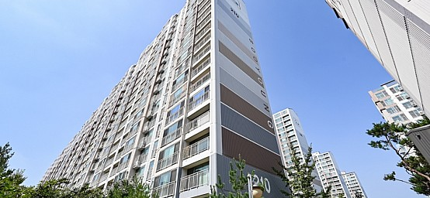
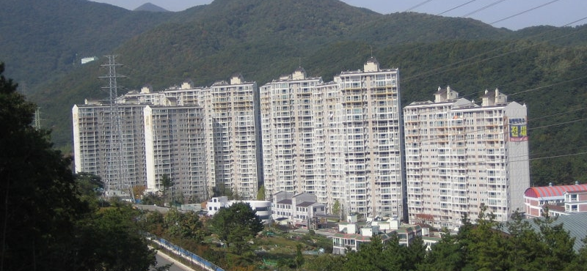
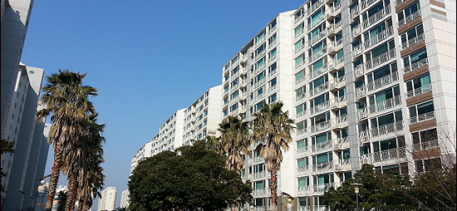
K1 Special Ultra-Strong
Waterproofing Agent –
Korean Construction Case Studies
Dasan Hangang Renaissance, Saeterol Park (Iksan), Cheongju Technical Police Agency, Sinchang Booyoung 2nd Phase, Cheondong Benecia, Jeju Daeyu Daelim

Slide 13
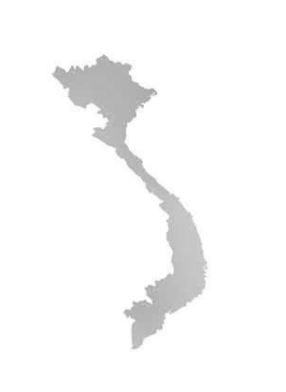
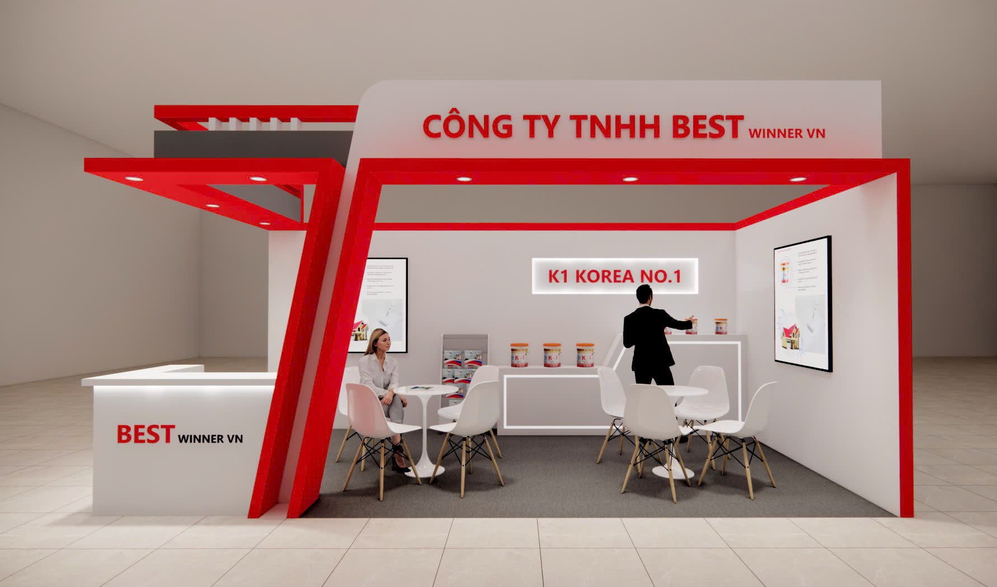
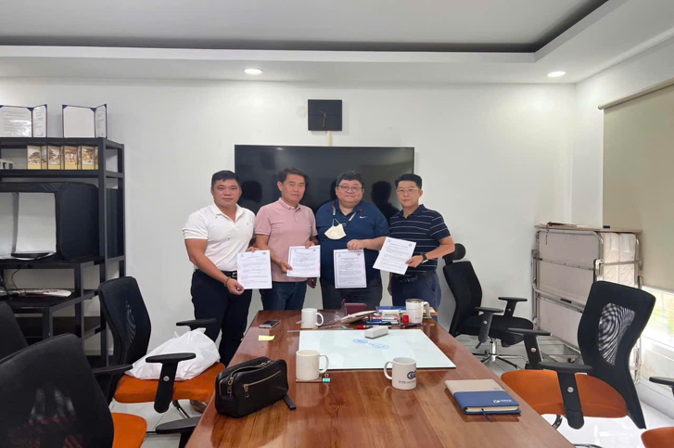
BEST WINNER VN
Overseas General Distributors Nationwide Dealerships
Headquarter
Factory
BESTWINNER
Hanoi Vietnam
PG COMMERCE
Hanoi Vietnam
Central Region
KBINVIET
Nghe An Vietnam
Cambodia
SHINYOUNG INDUSTRIAL CO., LTD
Southern Region
Indonesia
ETTE REACT
HO Chi Minh Vietnam
SHINYOUNG INDUSTRIAL CO., LTD

Slide 14
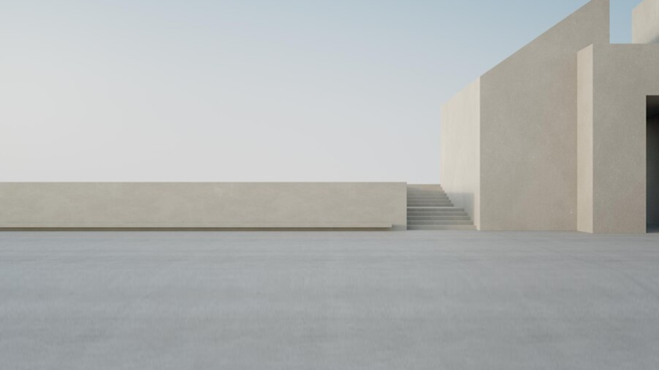

Thank you
Best Winner vn
086 945 2114(VN) 010 4435 1336(KR)
Banknetwork@hanmail.net
http://bestwinnervn.com/
44 Đại Mỗ, Phường Đại Mỗ, Quận Nam Từ Liêm, Hà Nội

