Slide 1
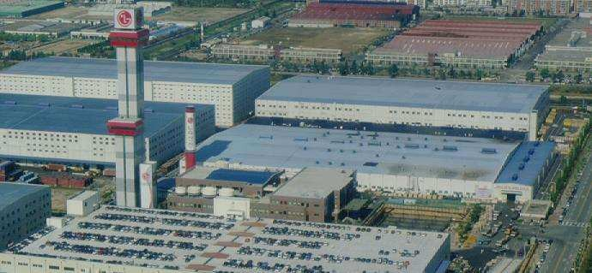
Global LGS Member’s Projects (involved)
LGIS Elevator Factory year of 1998 in Korea.

Slide 2
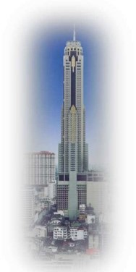
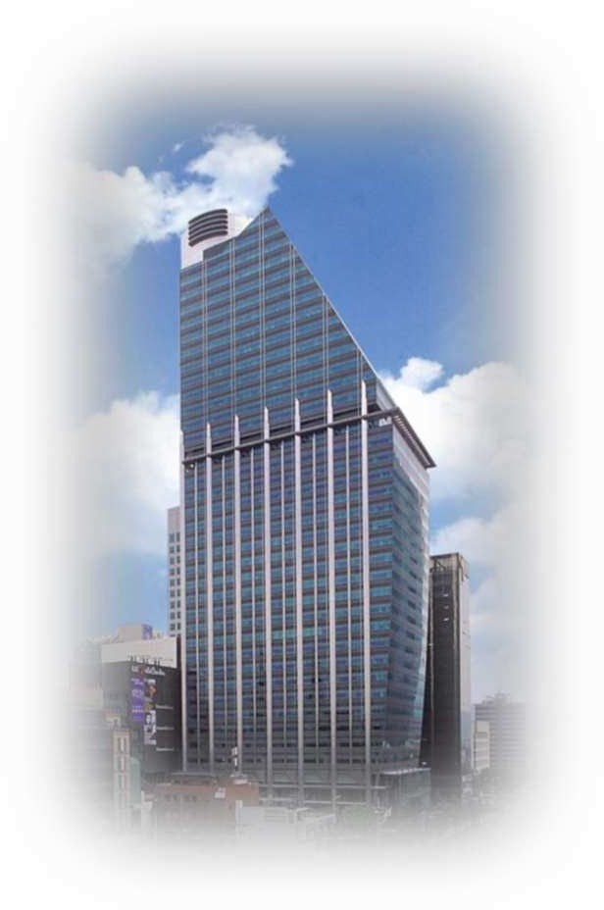
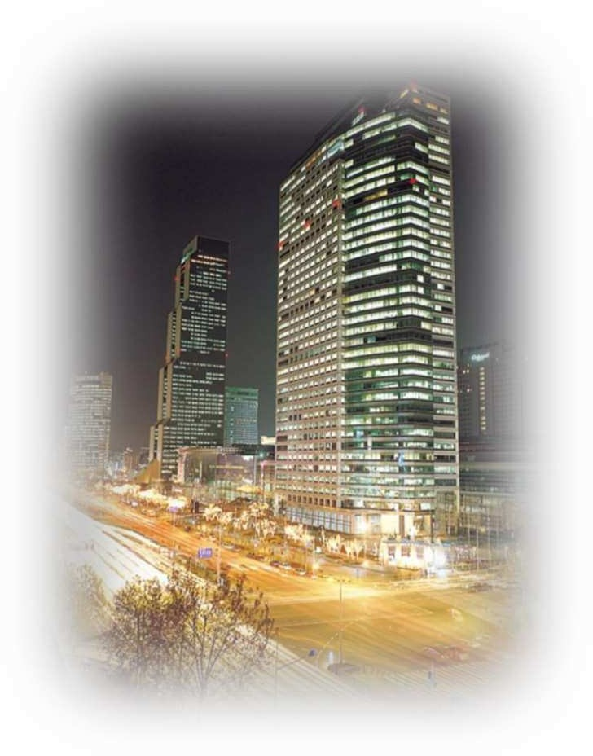
LGS Member’s Projects (Involved)
High Spee Elevator
360 m/min (6 m/sec)
420 m/min (7 m/sec)
240 m/min (4 m/sec)
Baiyoke Sky Tower / Th
ailand
LG Group Tower / Korea
ASEM Tower / Korea

Slide 3
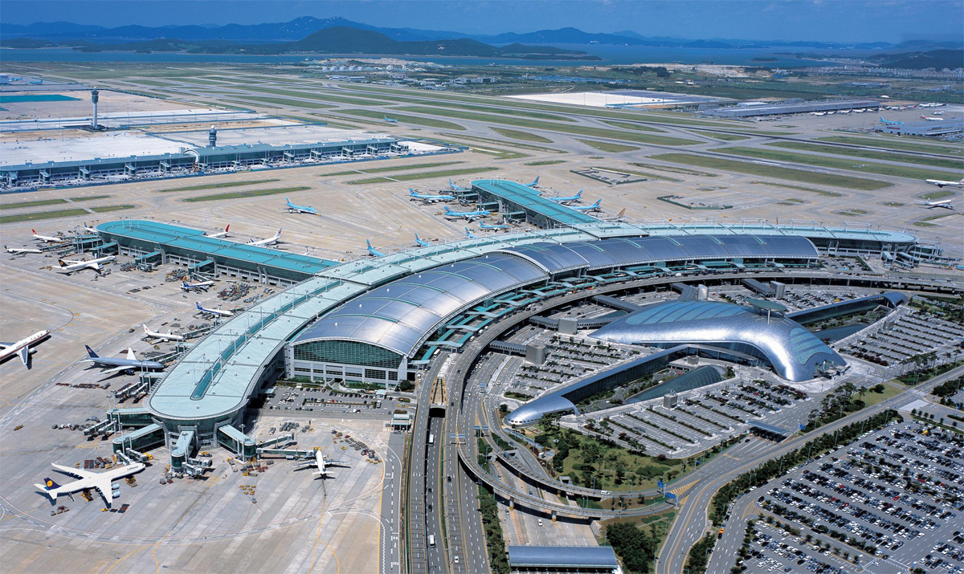
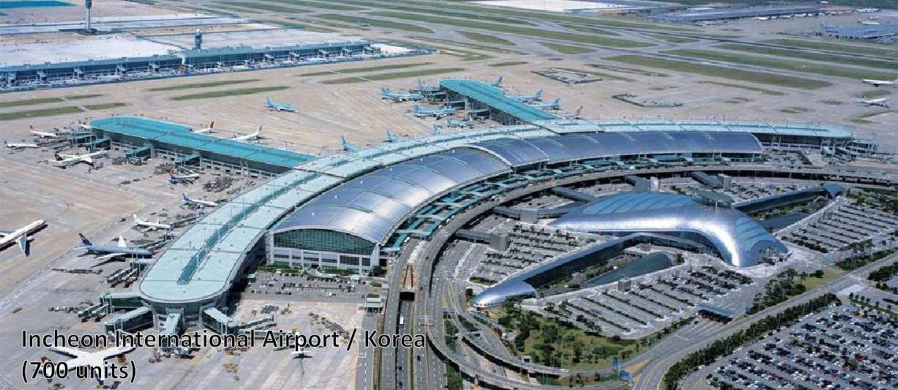
LGS Member’s Projects (Involved)
INCHEON INTERNATIONAL AIRPORT / KOREA (700 UNITS)

Slide 4
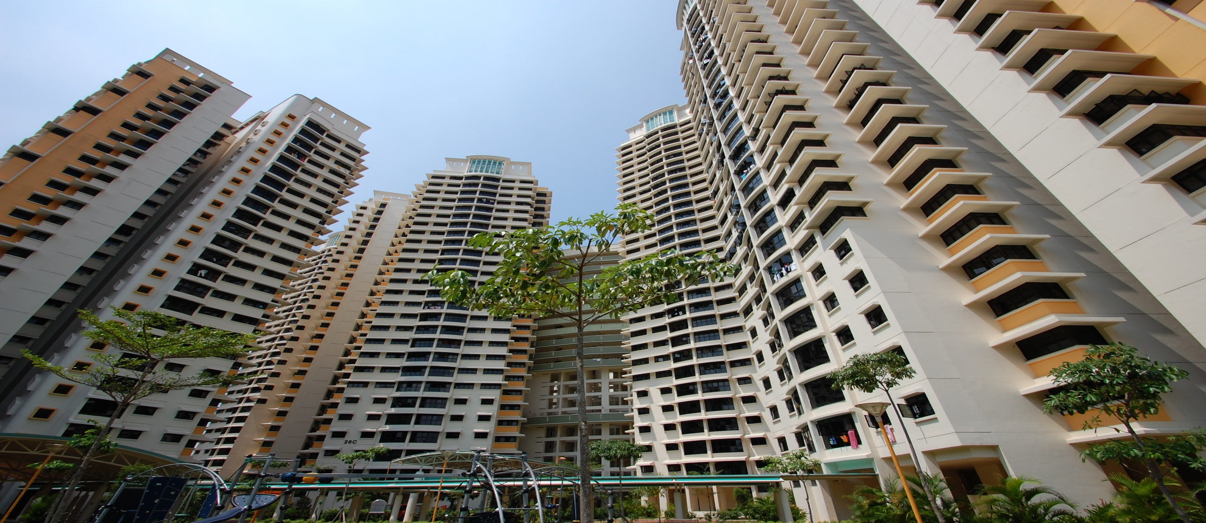
LGS Member’s Projects (Involved)
HDB (HOUSING DEVELOPMENT BOARD) / SINGAPORE HDB 9TH, 5TH LUP, 12TH LUP (3,000 UNITS)

Slide 5
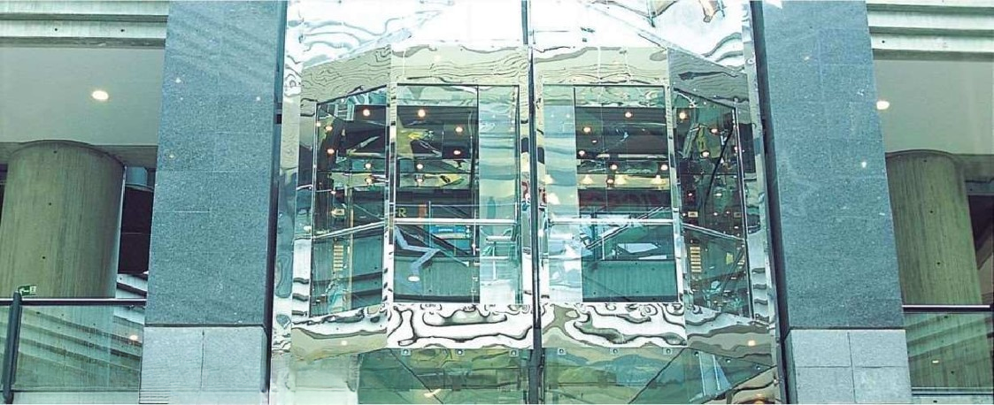
LGS Member’s Projects (Involved)
SAMBIL / VENEZUELA (50 UNITS)

Slide 6
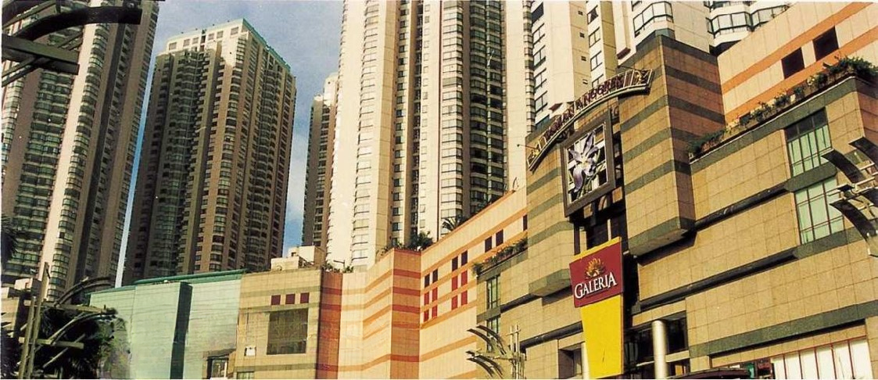
LGS Member’s Projects (Involved)
TAMAN ANGGREK / INDONESIA (50 UNITS)

Slide 7
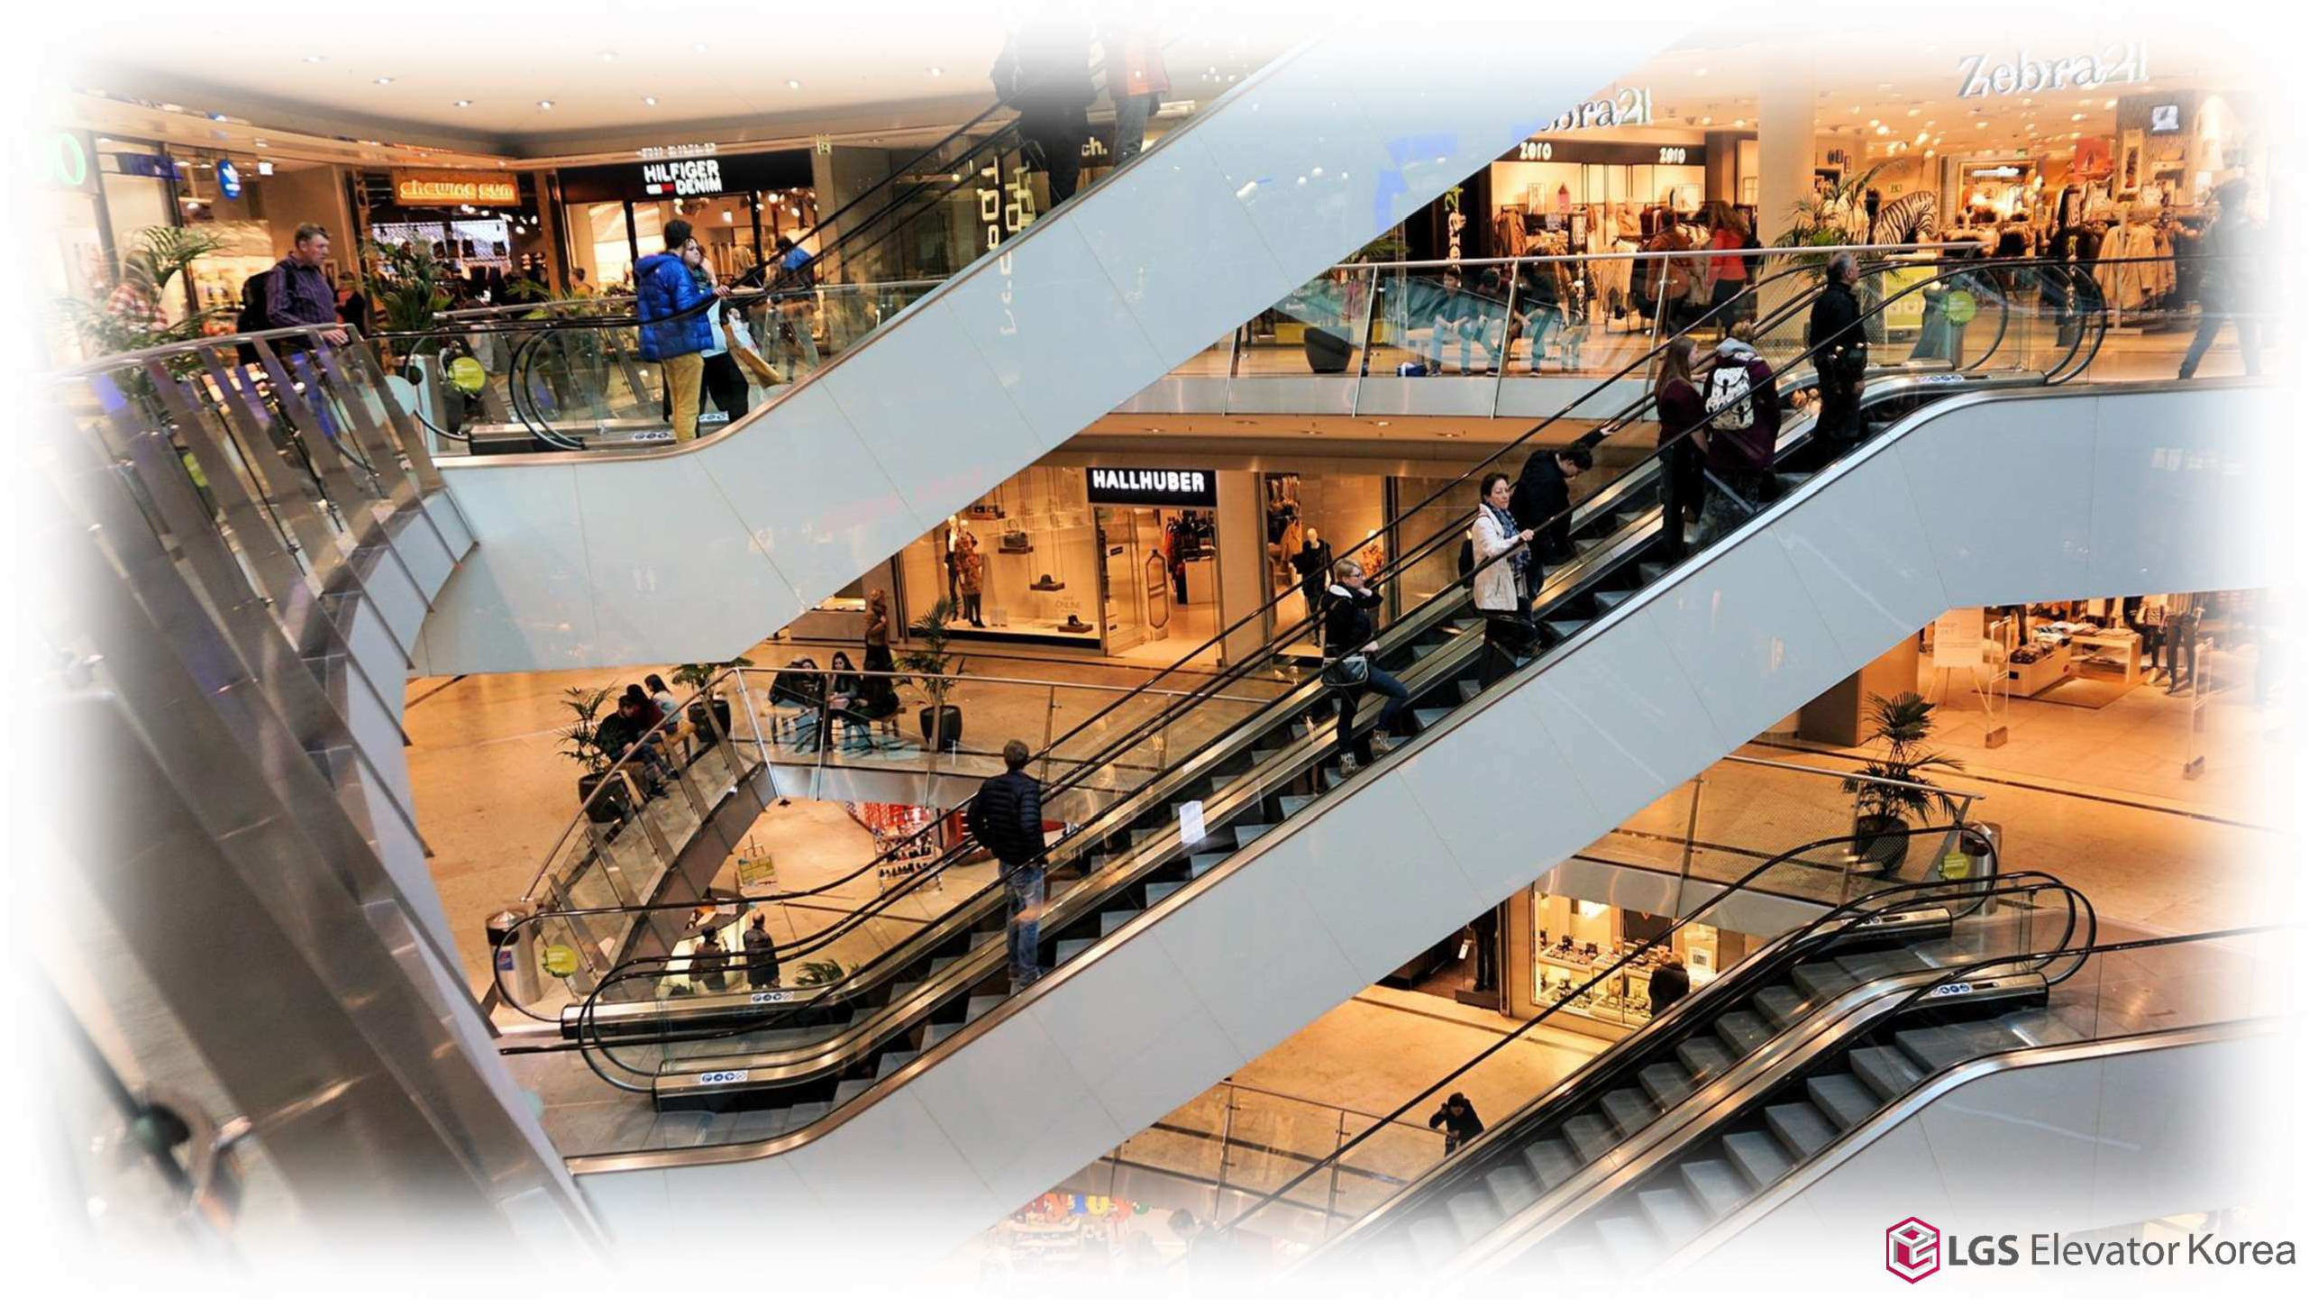
LGS Elevator Korea Signature Projects

Slide 8
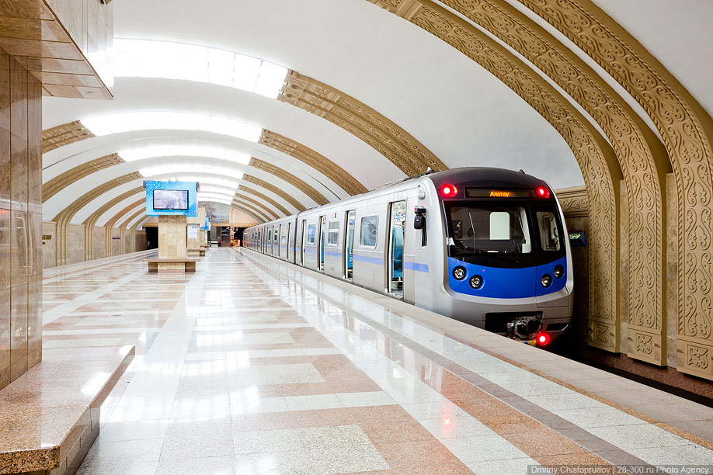
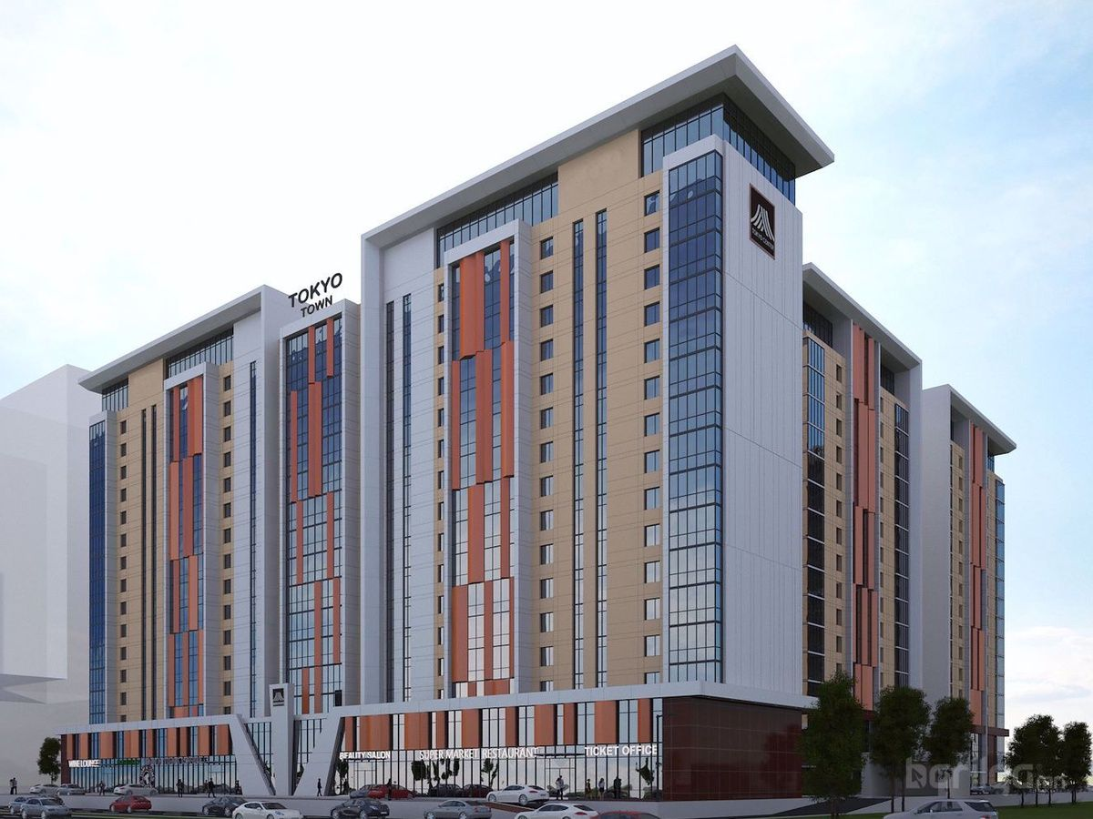
LGS Elevator Signature Projects
TOKYO TOWN / MONGOLIA
(30 UNITS)

Slide 9
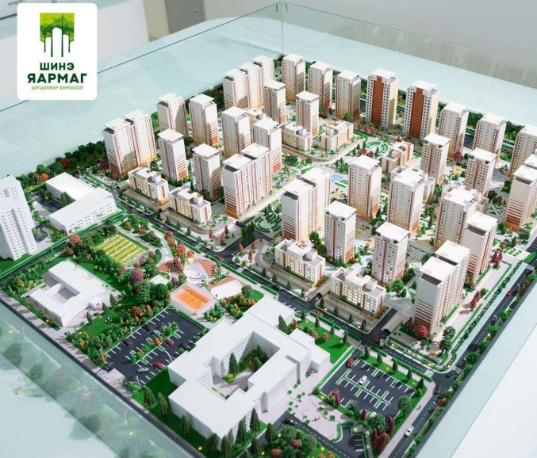
LGS Elevator Signature Projects
LGS Elevator Signature Projects
NEW YARMAG / MONGOLIA
(44 UNITS)

Slide 10
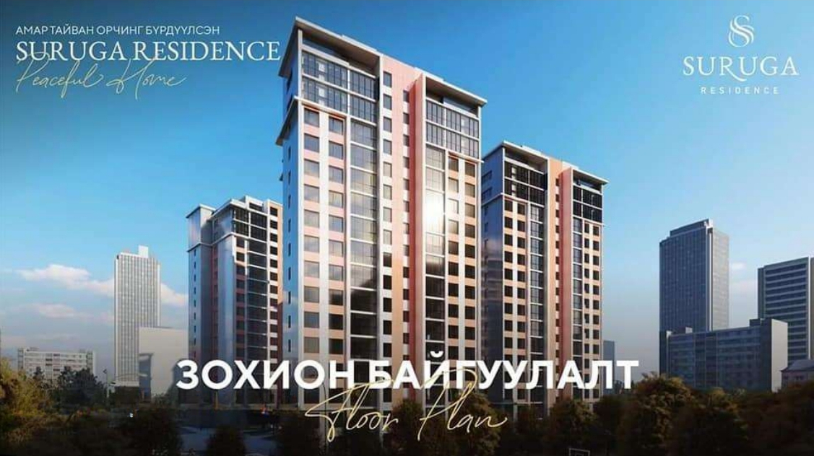
LGS Elevator Signature Projects
LGS Elevator Signature Projects
SURUGA RESIDENCE / MONGOLIA
(8 UNITS)

Slide 11
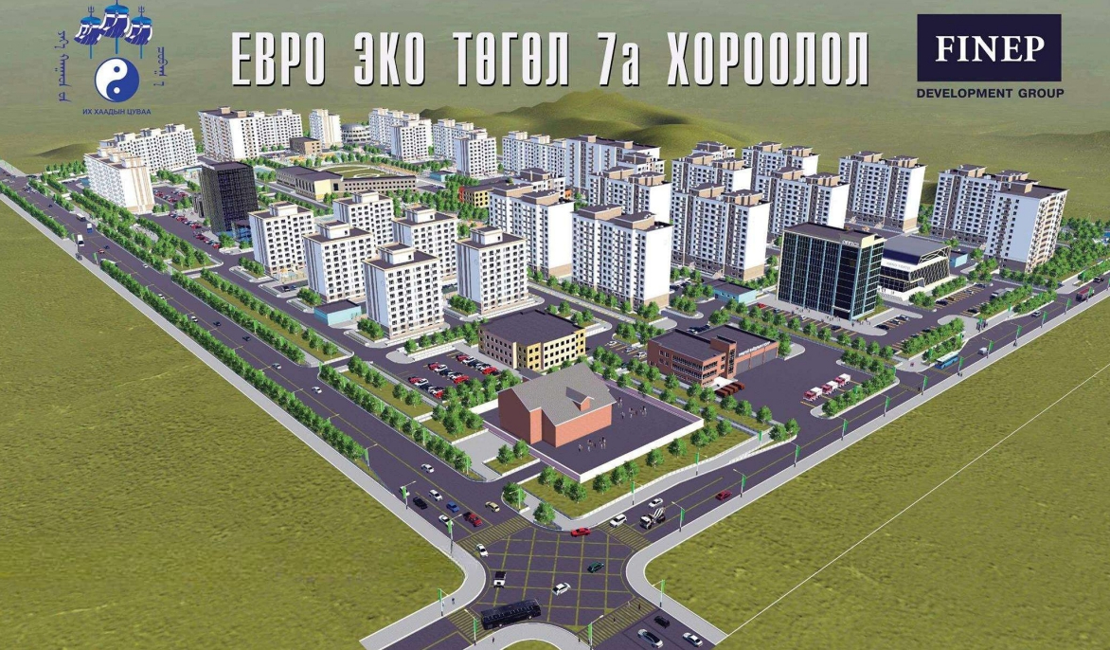
LGS Elevator Signature Projects
LGS Elevator Signature Projects
MASTER ENGINEERING / MONGOLIA
(8 UNITS)

Slide 12
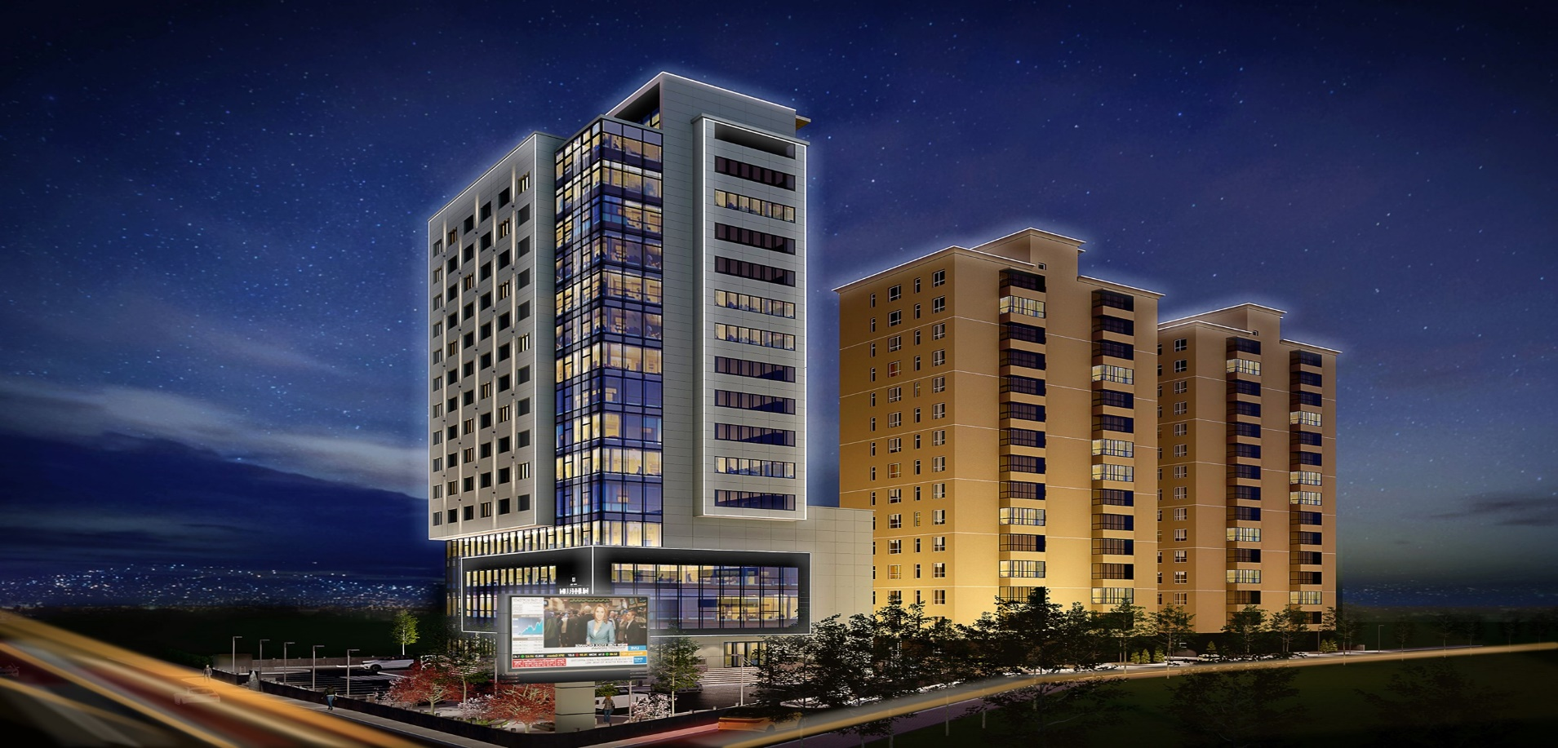
LGS Elevator Signature Projects
LGS Elevator Signature Projects
MILLENIUM TOWER / MONGOLIA
(6 UNITS)

Slide 13
LGS Elevator Signature Projects
LGS Elevator Signature Projects
ALMATY METRO STATIONS / KAZAKHSTAN
(32 UNITS)

Slide 14
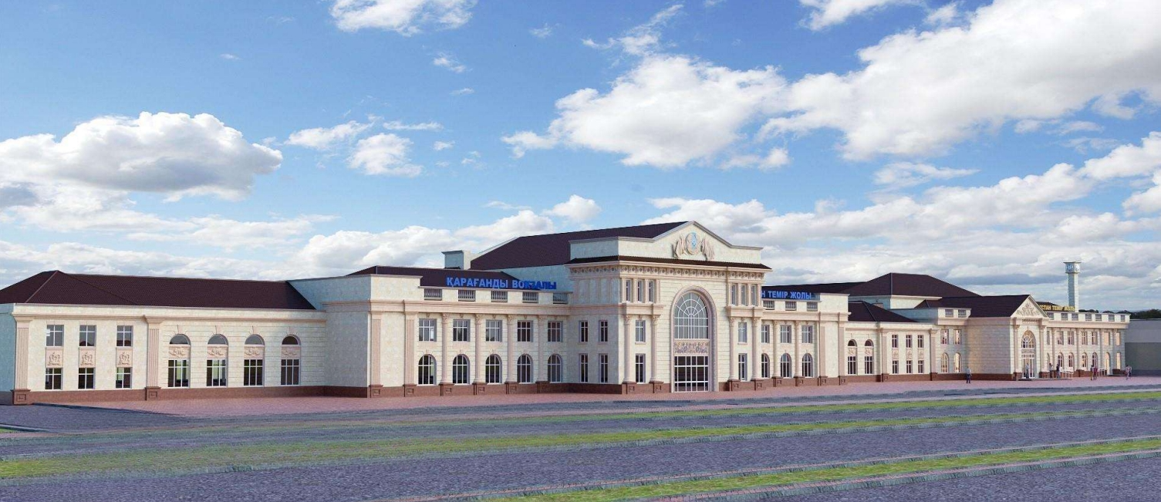
LGS Elevator Signature Projects
LGS Elevator Signature Projects
KARAGANDA TRAIN STATION / KAZAKHSTAN
(10 UNITS)

Slide 15
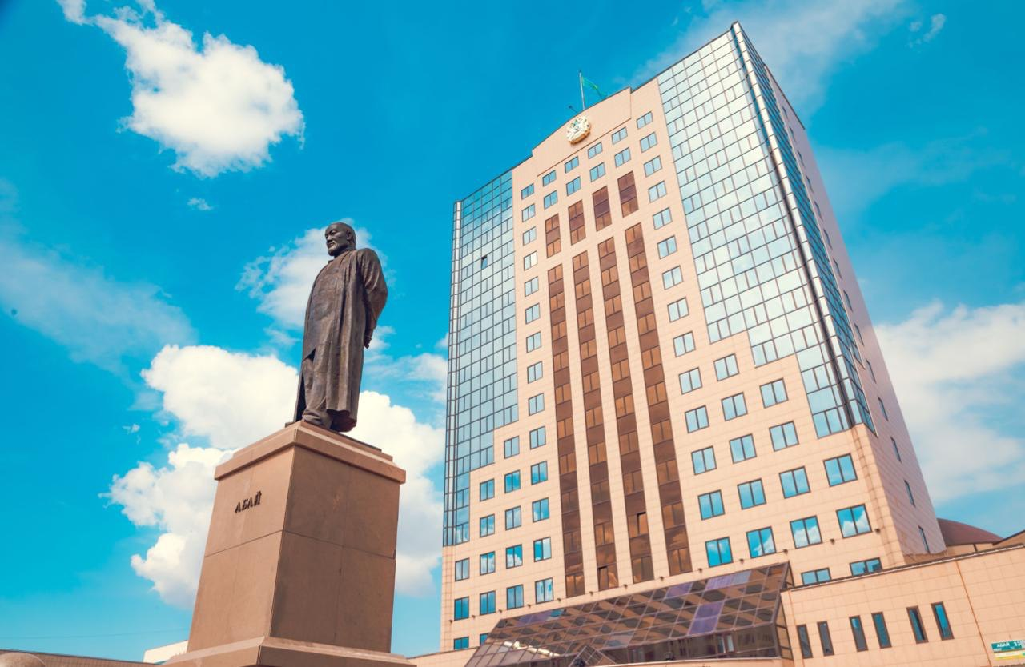
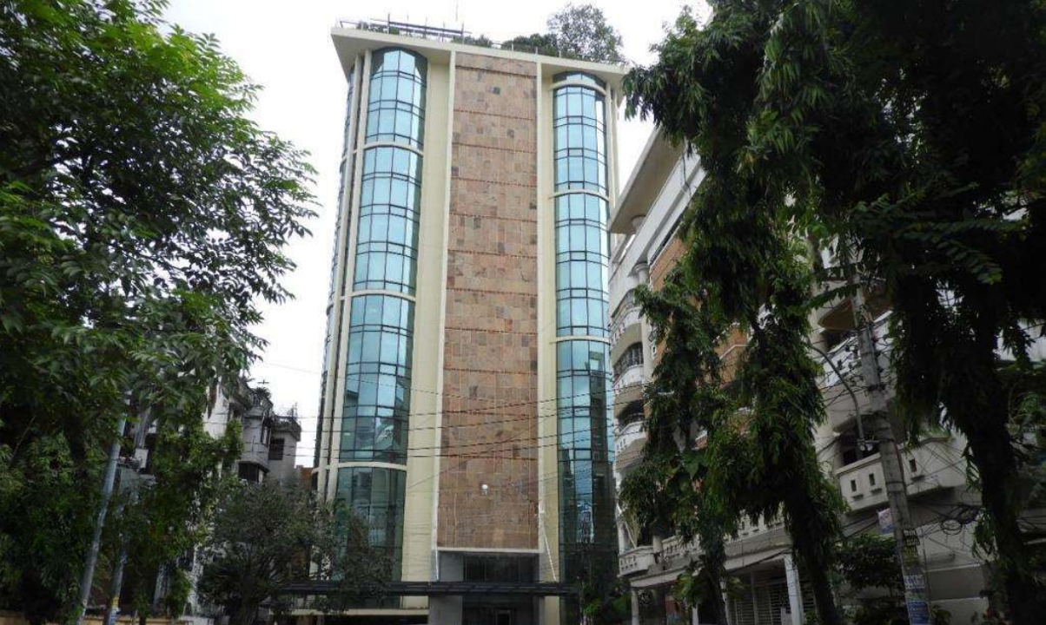
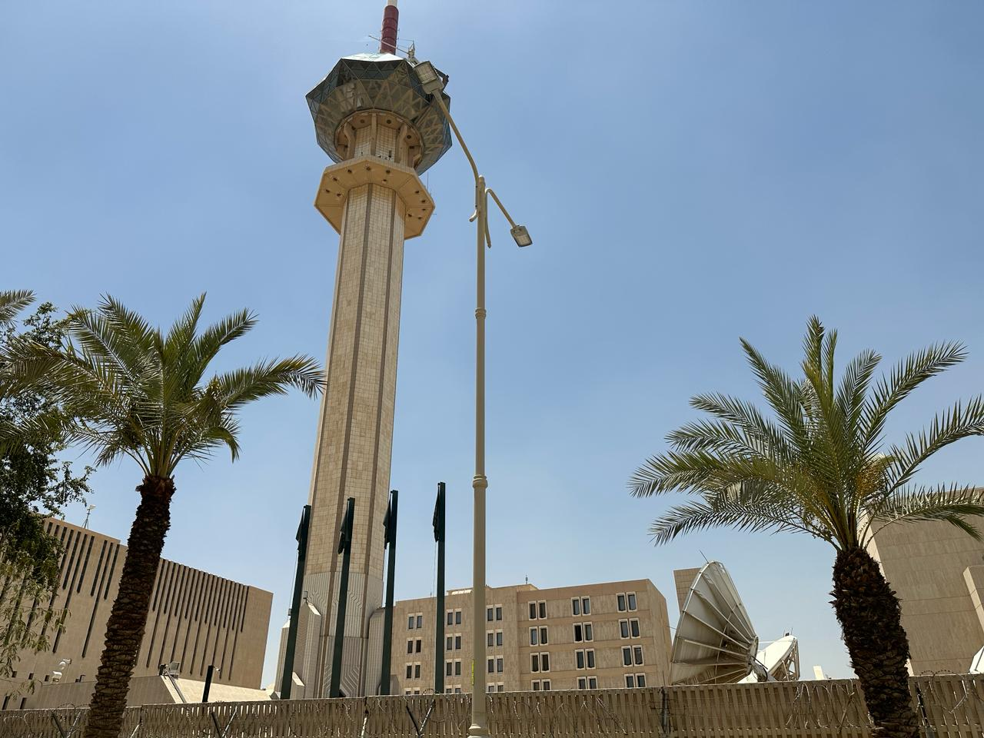
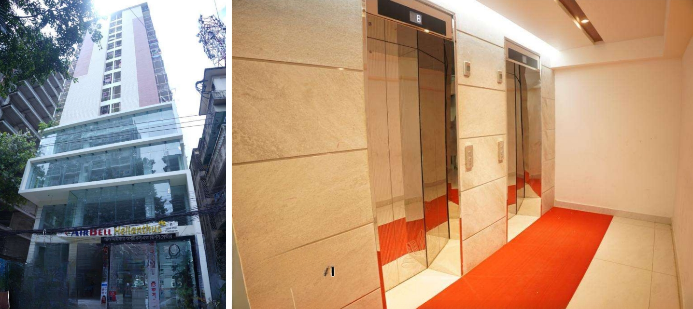
LGS Elevator Signature Projects
LGS Elevator Signature Projects
KSA TV TOWER / SAUDI ARABIA
(6 UNITS)

Slide 16
LGS Elevator Signature Projects
LGS Elevator Signature Projects
ACADEMY OF PULIC ADMINISTRATION / KAZAKHSTAN
(4 UNITS)

Slide 17
LGS Elevator Signature Projects
LGS Elevator Signature Projects
AIRBELL HELIANTHUS / BANGLADESH
(4 UNITS)

Slide 18
LGS Elevator Signature Projects
LGS Elevator Signature Projects
BEXIMCO PHARMACEUTICALS LTD / BANGLADESH
(4 UNITS)

Slide 19
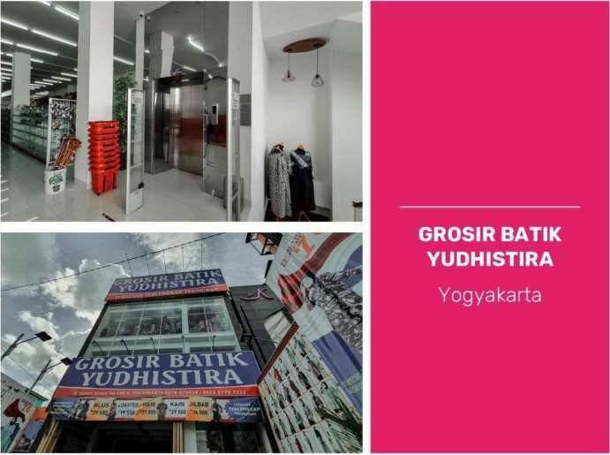
LGS Elevator Signature Projects

Slide 20
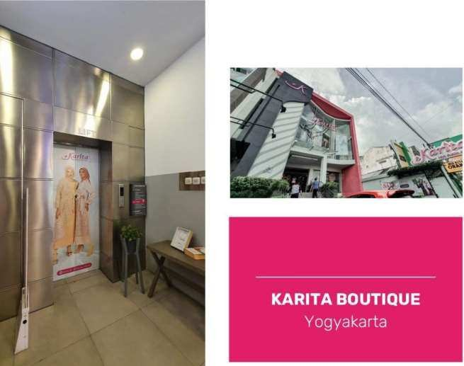
LGS Elevator Signature Projects

Slide 21
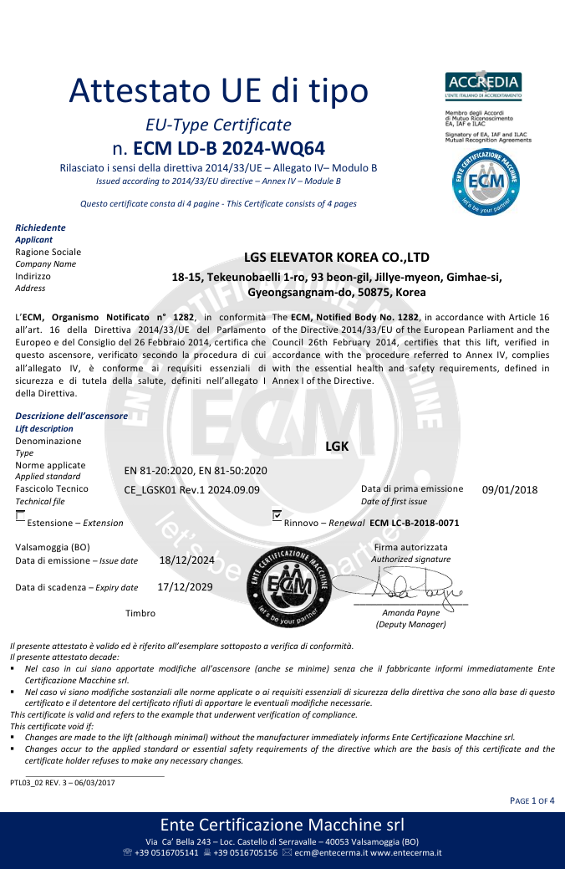
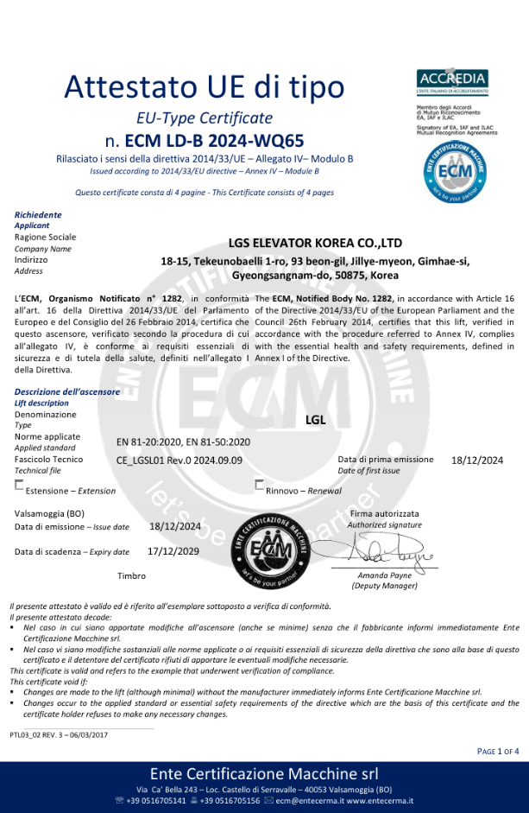
LGS Elevators’ Certificates
Elevator system CE Certificate (European Certification MMR_LGK)
Elevator system CE Certificate (European Certification MRL_LGL)

Slide 22
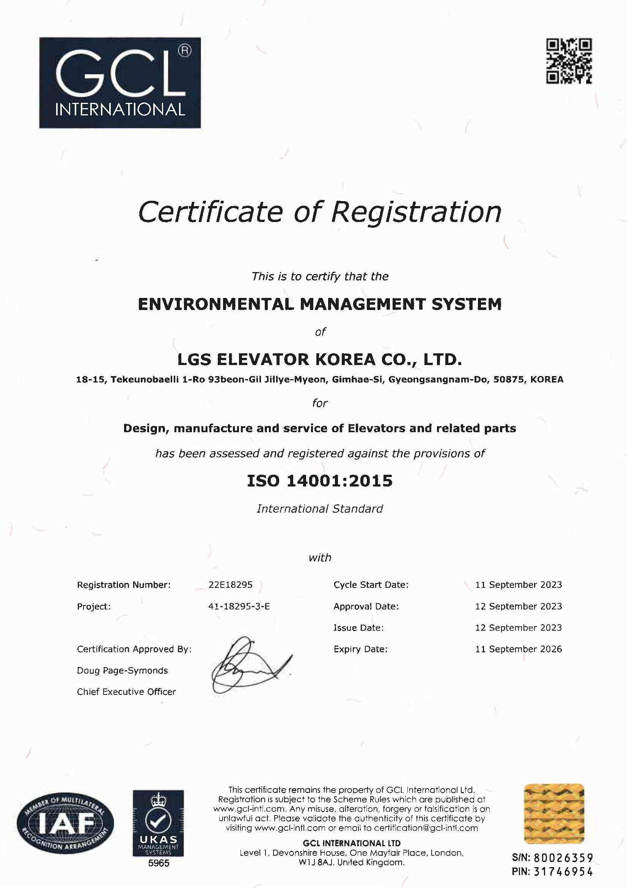
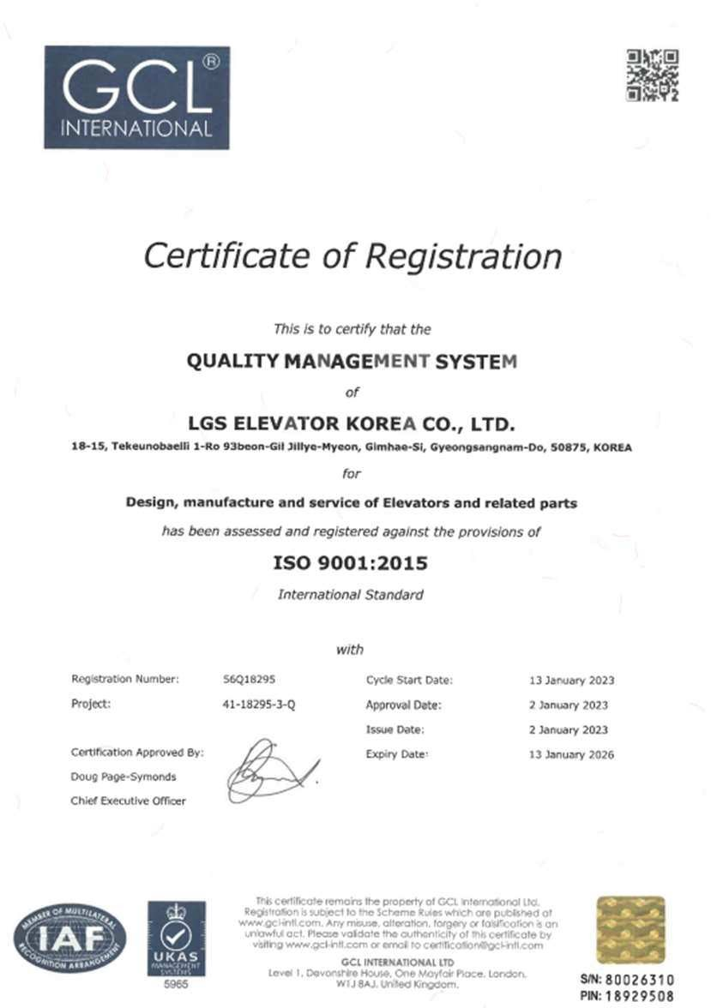
LGS Elevators’ Certificates
ISO14001
ISO9001

Slide 23
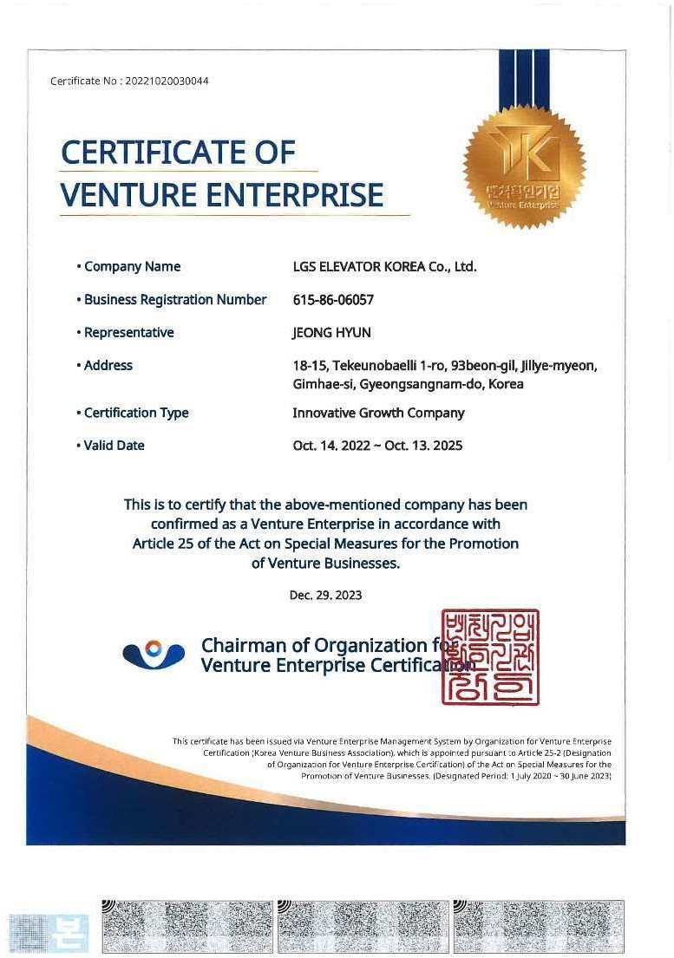
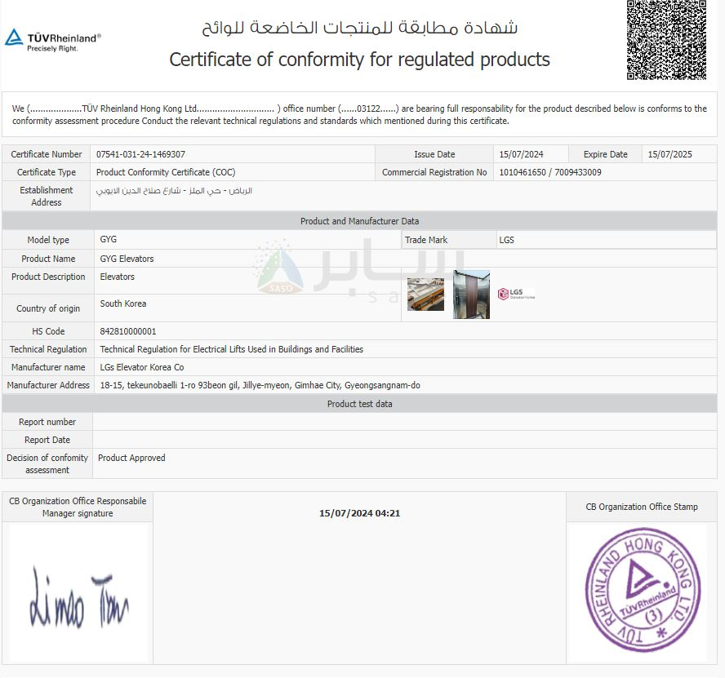
LGS Elevators’ Certificates
Certification of Venture Enterprise
Certificate of Conformity

Slide 24
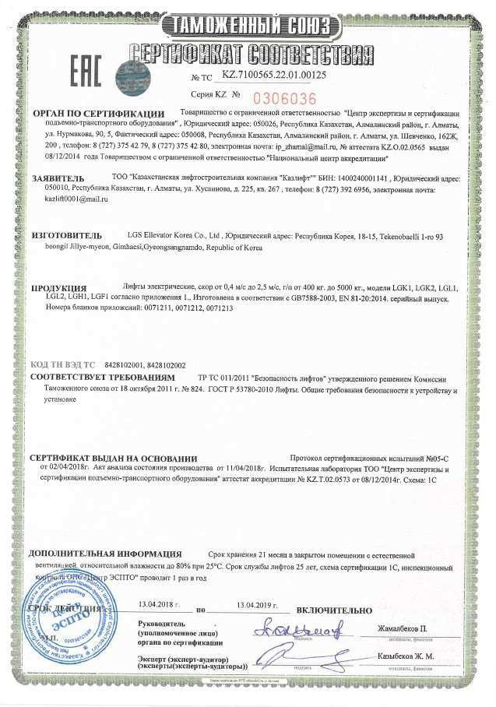
LGS Elevators’ Certificates
Elevator system CU Certificate (Russian Certification)

