Slide 1
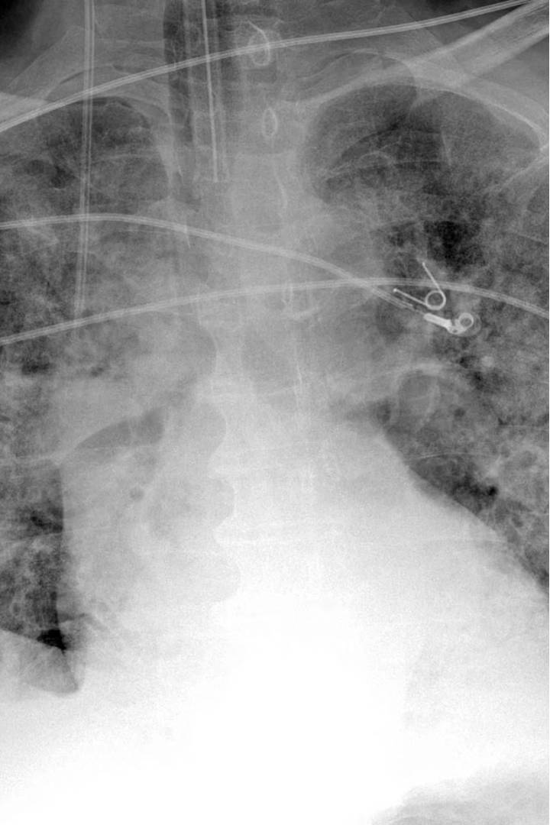



Classification of COVID-19 Using Chest X-ray Images with CNNs
The COVID-19 pandemic has highlighted the need for rapid and accurate diagnostic tools. This presentation explores the use of convolutional neural networks (CNNs) to classify COVID-19 from chest X-ray images, a crucial step in early detection and effective treatment.
by CHITRA JOSHI

Slide 2
Overview of Chest X-ray Imaging for COVID-19 Diagnosis
Noninvasive Imaging
Lung Abnormalities
Early Detection
Chest X-rays are a widely available, affordable, and noninvasive imaging technique that can provide crucial insights into COVID-19 infection.
COVID-19 can cause characteristic lung abnormalities visible on X-ray images, such as ground-glass opacities and consolidation.
Chest X-rays can aid in the early detection of COVID-19, enabling timely medical intervention and limiting disease spread.

Slide 3
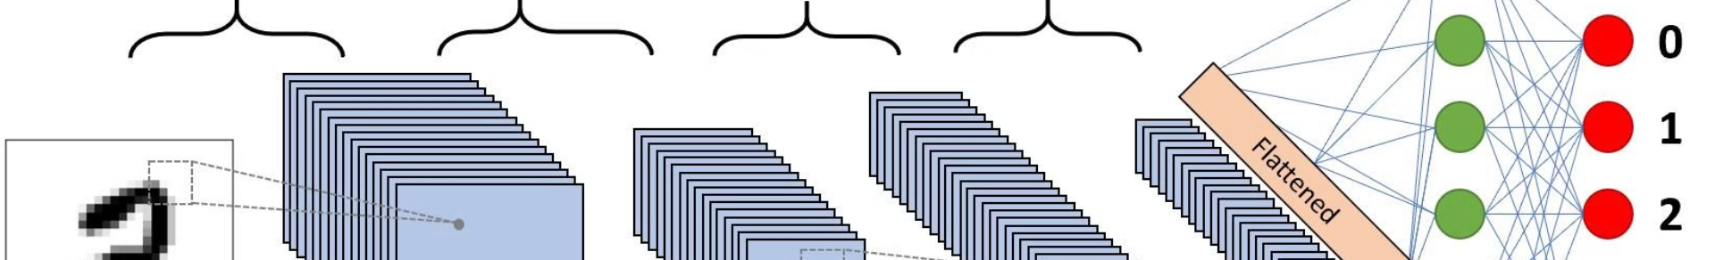
Convolutional Neural Networks (CNNs) for Image Classification
Feature Extraction
1
CNNs automatically extract relevant visual features from the X-ray images, such as patterns and textures.
2
Classification
The CNN model learns to classify the X-ray images into COVID-19 positive or negative based on the extracted features.
Accuracy Optimization
3
Through iterative training, the CNN model's performance is optimized to achieve high accuracy in COVID-19 detection.

Slide 4
Dataset Preparation and Preprocessing
1
Image Collection
2
Data Augmentation
Gathering a diverse dataset of chest X-ray images, both COVID-19 positive and negative cases.
Applying techniques like rotation, flipping, and noise addition to increase the dataset size and diversity.
3
Normalization
4
Train-Test Split
Normalizing the pixel values and dimensions of the X-ray images for consistent model input.
Dividing the dataset into training and testing sets to assess the model's generalization performance.

Slide 5
CNN Model Architecture and Training
Convolutional Layers
Fully Connected Layers
Extracting visual features from the X-ray images through a series of convolutional and pooling layers.
Classifying the images into COVID-19 positive or negative using dense, fully connected layers.
Optimization
Regularization
Training the CNN model using techniques like backpropagation and gradient descent to minimize the classification error.
Applying techniques like dropout and L2 regularization to prevent overfitting and improve generalization.

Slide 6




Evaluation Metrics and Performance Analysis
Accuracy
Precision
Recall
F1-Score
Percentage of correct predictions among all samples.
Percentage of true positives among all positive predictions.
Percentage of true positives among all actual positive samples.
Harmonic mean of precision and recall, providing a balanced evaluation.

Slide 7



Challenges and Limitations
Limited Data
Variability in Imaging
Generalization
Difficulty in obtaining a large, diverse dataset of COVID-19 chest X-ray images.
Variations in X-ray equipment, patient positioning, and image quality can impact model performance.
Ensuring the CNN model can generalize to unseen data and real-world scenarios.

Slide 8
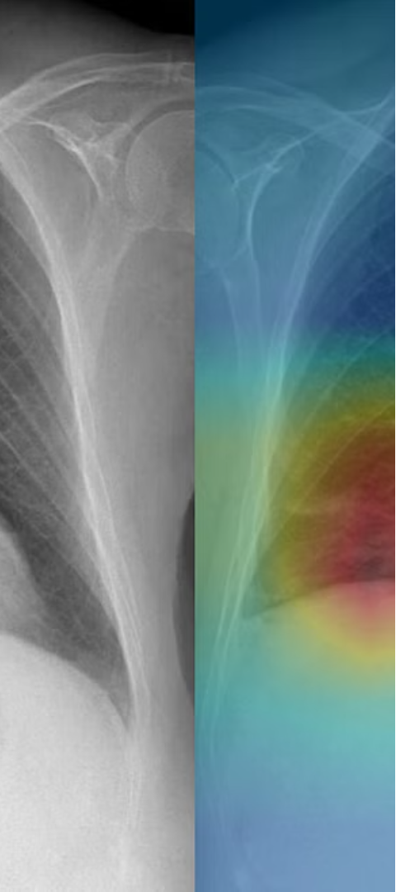
Conclusion and Future Research Directions
1
Promising Results
The CNN-based approach has shown promising results in accurately classifying COVID-19 from chest X-ray images.
2
Ongoing Refinement
Continued research to address challenges, such as larger datasets and improved model architectures.
3
Clinical Integration
Integrating the CNN-based COVID-19 detection system into clinical workflows for rapid diagnosis and triage.

