Slide 1
Nonnegative Matrix Factorization (+ Intro Optimization)
Uthsav Chitra
Johns Hopkins University
September 10, 2026

Slide 2
Today
Recap: PCA
Nonnegative matrix factorization (NMF)
  Definition and gene programs (what W and H mean)
  Objective functions: Frobenius and KL
Algorithms
  Multiplicative updates (Lee & Seung)
  Alternating least squares / HALS
  Initialization, local minima, choosing K
NMF in single-cell analysis
  cNMF — consensus gene programs; LIGER / iNMF — data integration

Slide 3
Dimensionality reduction
Reduce dimension (number of features) of high-dimensional data
makes it easier to visualize data, train ML models, etc.
G features (e.g. genes)
G’ << G features
N samples (e.g. cells)
Y
Y’
N samples (e.g. cells)

Slide 4
Principal Components Analysis (PCA)
Intuition: find linear combinations of features that are most “informative” (have highest variance)
Called principal components, or PCs
Principal component (PC) 1 =
2 * Feature A + 3 * Feature B
Feature A
Feature B
Samples (e.g. cells)
Samples (e.g. cells)

Slide 5
Linear comb. of features = direction in space, e.g. 2 * (Feature 1) + 3 * (Feature 2) represented by vector <2,3>
Slide from Smita Krishnaswamy et al: https://krishnaswamylab.org/workshop

Slide 6
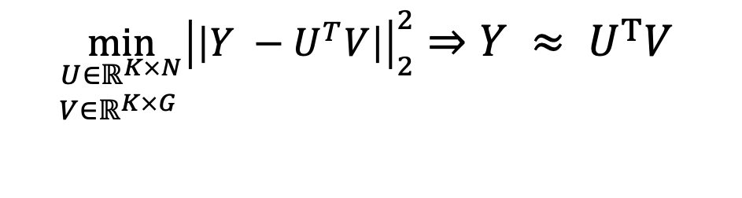
Alternative view: PCA as a matrix factorization
Last class: the top-K PCs give the best rank-K approximation of the data:
Y
U^{T}
V
≈
V (K × G)
$$\min_{\begin{aligned}U∈ℝ^{K×N} \\ V∈ℝ^{K×G} \end{aligned}}{{\left|\left|Y −U^{T}V\right|\right|}_{2}^{2}⇒Y ≈ U^{T}V }$$
Y (cells × genes)
U^{T} (N × K)
where U, V are unconstrained — entries can be positive or negative.
Each row is a PC
Each column is a “loading”
The catch: interpretability
PCs mix genes with positive and negative weights.
Opposing contributions cancel out.
A PC is hard to read as “a set of genes acting together.”

Slide 7
Challenge: Why signed PCs can be hard to interpret
15
7.2
-3
4
…
-2
Example PC
…
Gene
1
Gene
2
Gene
3
Gene
4
…
Gene
G
Ideally each PC corresponds to a related group of genes
e.g. a gene pathway (genes w/ related functions)
But oftentimes, most genes have a non-zero value (positive or negative)
-> PCs not directly interpretable
Goal: constrain the factors to be additive, nonnegative “parts” of the data.

Slide 8
15
7.2
-3
4
…
-2
Example PC
Gene
1
Gene
2
Gene
3
Gene
4
…
Gene
G
PCA: hard to interpret
What we would like ideally
Gene
1
Gene
2
Gene
4
Gene
1
Gene
2
Gene
3
Gene
4
Gene
5
Gene
6
Gene
3
Gene
5
Genes 1, 3, 5, … are all related
Zero value for genes 2,4

Slide 9
Key idea: nonnegativity gives parts-based factors
1. Gene expression counts Y are nonnegative (eg you cannot measure −3 transcripts)
2. If PCs (factors) and loadings are forced ≥ 0, data can only be built by adding parts, not subtracting.
Y
Always nonnegative
≈
Y (genes × cells)
Restrict to be nonnegative!
W = program definitions (gene loadings). H = program usages per cell. K = number of programs.
On faces, the parts are noses, eyes, mouths.
On single-cell data, the parts are gene expression programs — and each cell is a nonnegative mixture of them:
$$cell = 0.7 w_{A} + 0.2 w_{B} + 0.1 w_{C} + ⋯$$
(identity program A, cell-cycle program B, stress program C, …)
Lee & Seung, Nature 401:788–791 (1999).

Slide 10
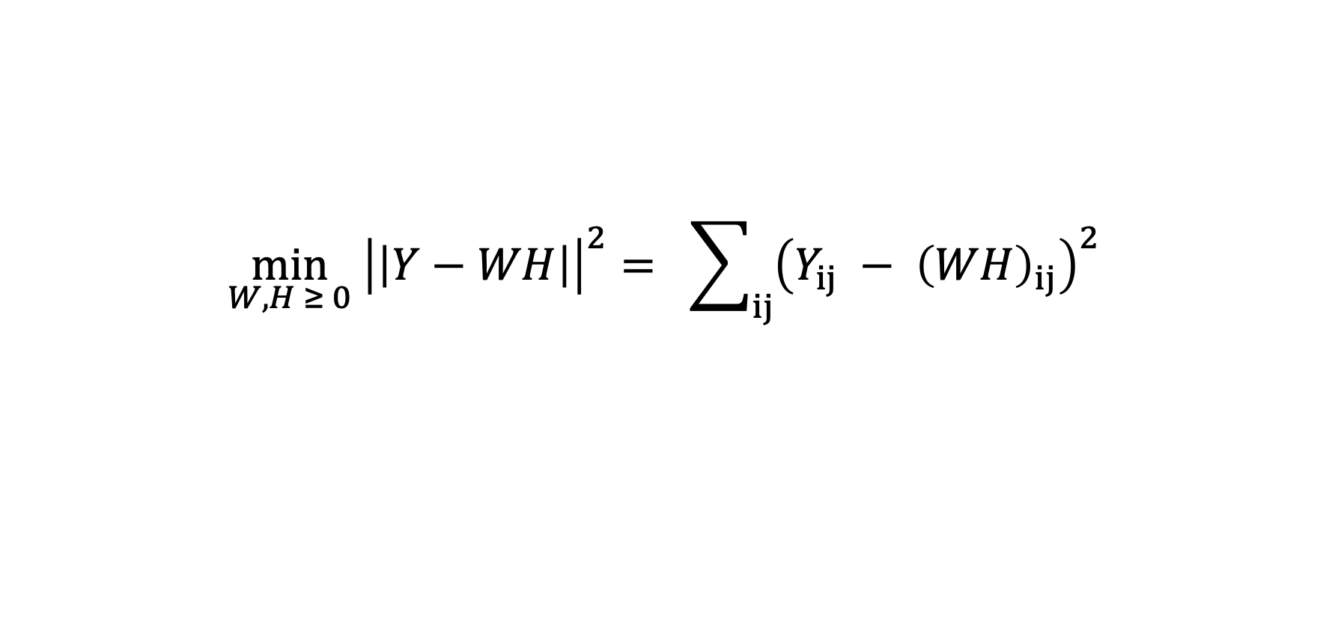
Nonnegative matrix factorization (NMF)
Given nonnegative data Y ≥ 0 (genes × cells), find W ≥ 0 and H ≥ 0 with
$$\min_{W,H ≥ 0} {\left|\left|Y−WH\right|\right|}^{2}= \sum_{ij}{{\left(Y_{ij} − {\left(WH\right)}_{ij}\right)}^{2}}$$
Y
W
H
≈
H (K × G)
Y (cells × genes)
W (N × K)
W = program definitions (gene loadings). H = program usages per cell.

Slide 11
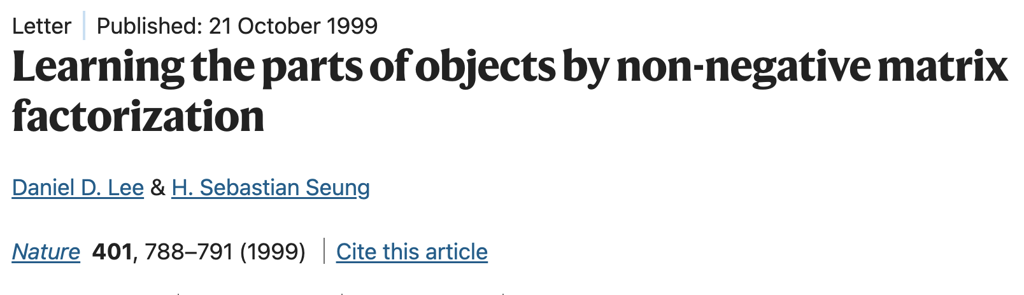
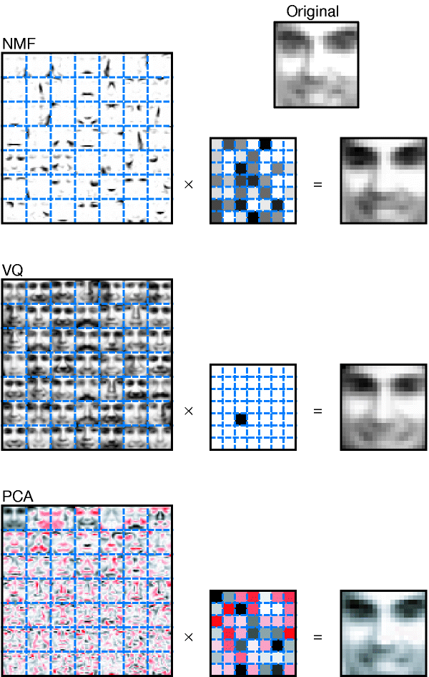
Lee and Seung (Nature 1999)

Slide 12
Slide from https://perso.telecom-paristech.fr/rioul/liesse/2015telecomups/SE-slides.pdf

Slide 13
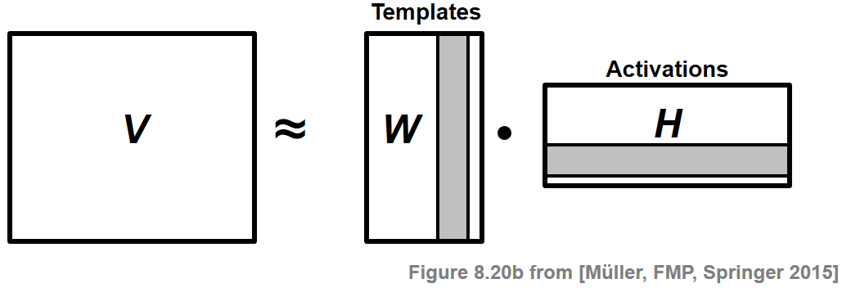
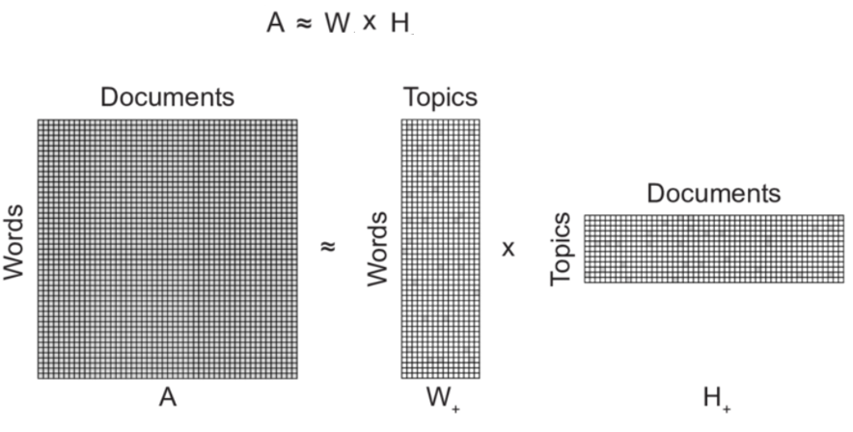
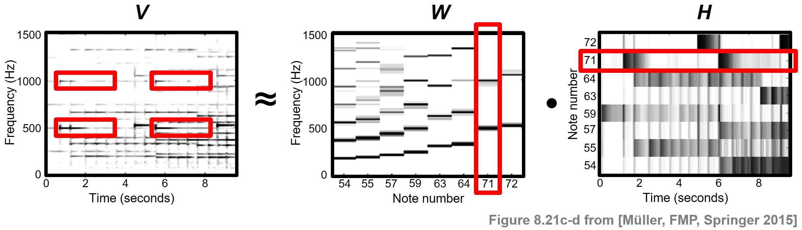
NMF used in many fields (pre-AI)
Audio analysis
Topic modeling
From https://medium.com/@sophiamsac/understanding-nmf-for-simple-topic-modelling-b3d7bc4f3fc2
From https://www.audiolabs-erlangen.de/resources/MIR/FMP/C8/C8S3_NMFbasic.html

Slide 14
What W and H mean in single-cell data
Y
W
H
≈
H (K × G)
Y (N × G)
W (N × K)
W — program usages
Non-negative values in a column indicate related genes
Related genes sometimes called “gene programs”, “metagenes”, …
H — "gene programs" / “metagenes"
Each cell’s column = how much of each program it expresses.
Usages are soft and additive — a cell can use several programs at once.

Slide 15
NMF vs. PCA
PCA / SVD
NMF
constraint
orthogonal, signed (±)
nonnegative (≥ 0)
factors
directions of max variance
additive parts / programs
combination
add and subtract
add only
solution
unique, closed-form (SVD)
non-unique, iterative
interpretability
often hard (cancellation)
parts-based, readable
best for
denoising, compression, viz
discovering gene programs

Slide 16
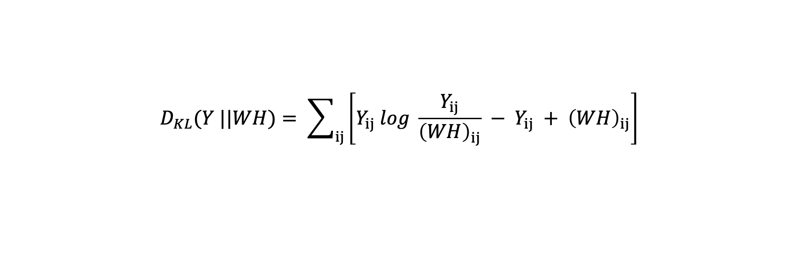
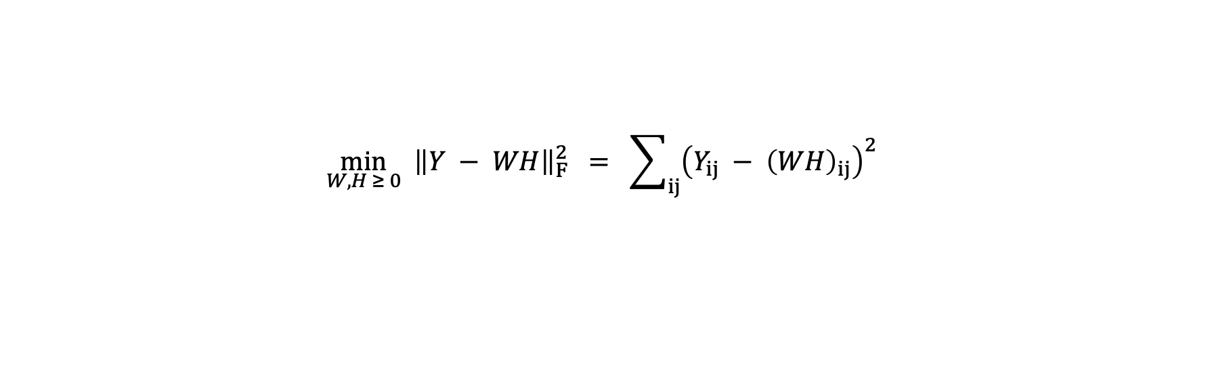
Objective: how good is the approximation?
Choose W, H ≥ 0 to minimize the reconstruction error. Two standard choices:
1. Frobenius (squared error)
$$\min_{W,H ≥ 0} {\left\|Y − WH\right\|}_{F}^{2} = \sum_{ij}{{\left(Y_{ij} − {\left(WH\right)}_{ij}\right)}^{2}}$$
2. KL (Poisson) divergence
$$D_{KL}(Y ||WH)= \sum_{ij}{\left[Y_{ij} log \frac{Y_{ij}}{{\left(WH\right)}_{ij}} − Y_{ij} + {\left(WH\right)}_{ij}\right]}$$
Frobenius is faster and standard once data are normalized (default in scikit-learn and cNMF)
Dont mention Poisson until later

Slide 17
Brief introduction: convex optimization / gradient descent (board)

Slide 18
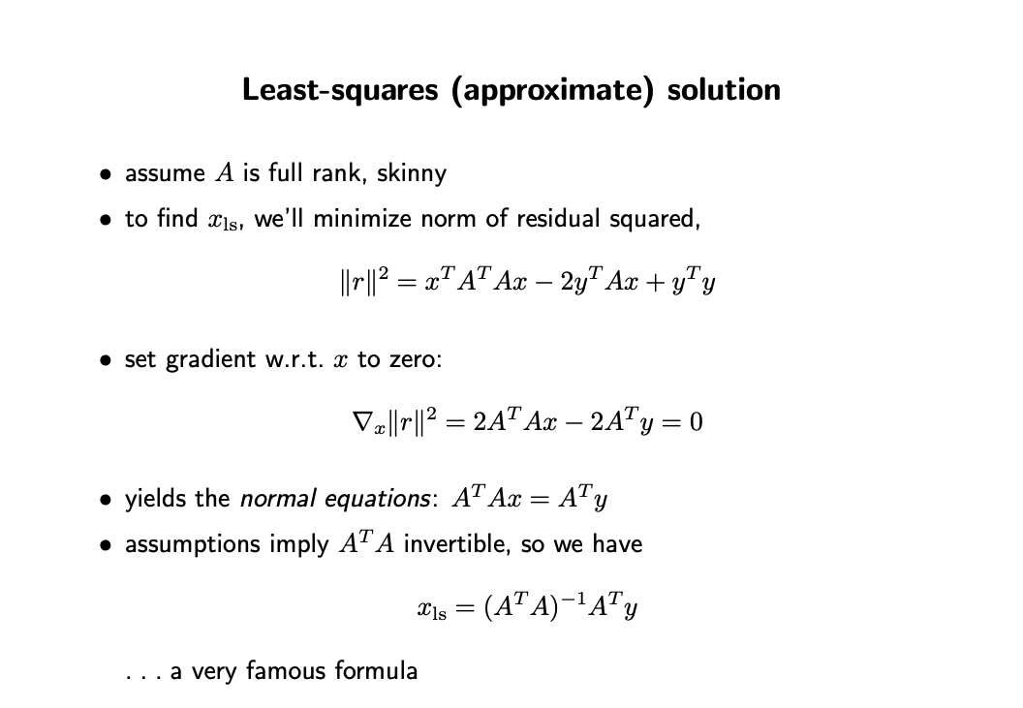


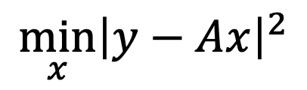
Brief introduction: least squares (board)
$$\min_{x}{{\left|y−Ax\right|}^{2}}$$
From https://see.stanford.edu/materials/lsoeldsee263/05-ls.pdf

Slide 19
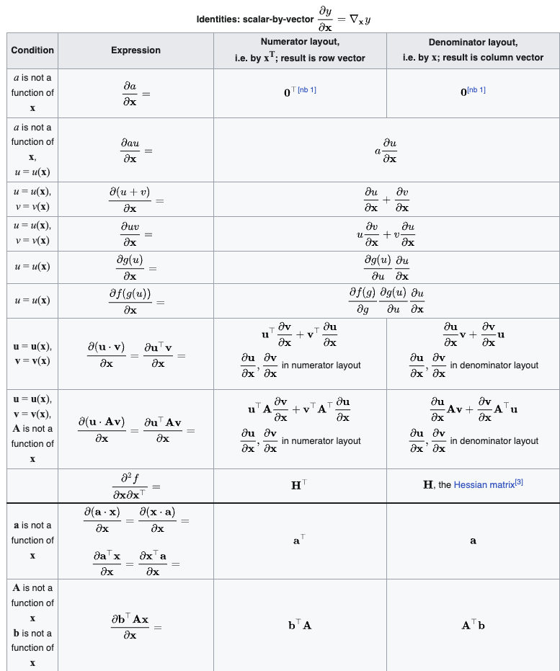
Brief introduction: least squares (board)
Wikipedia article for matrix calculus
From https://see.stanford.edu/materials/lsoeldsee263/05-ls.pdf

Slide 20
NMF: how to solve?
Given nonnegative data Y ≥ 0, find W ≥ 0 and H ≥ 0 with
$$\min_{W,H ≥ 0} {\left|\left|Y−WH\right|\right|}^{2}= \sum_{ij}{{\left(Y_{ij} − {\left(WH\right)}_{ij}\right)}^{2}}$$
Unfortunately, this problem is hard [board]
No unique solution
non-convex!
In general cannot find optimal W, H
[Interestingly, PCA does solve a non-convex optimization problem]
Y
W
H
≈
H (K × G)
Y (cells × genes)
W (N × K)
W = program definitions (gene loadings). H = program usages per cell.

Slide 21
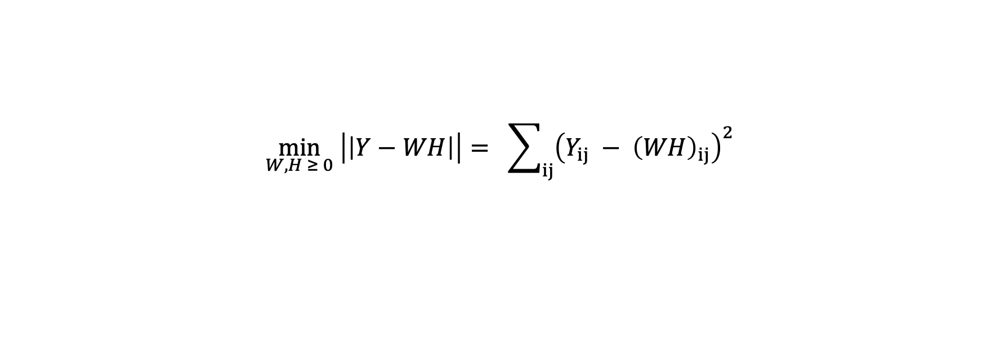
Optimization: non-convex, but biconvex
Given nonnegative data Y ≥ 0, find W ≥ 0 and H ≥ 0 with
$$\min_{W,H ≥ 0} \left|\left|Y−WH\right|\right|= \sum_{ij}{{\left(Y_{ij} − {\left(WH\right)}_{ij}\right)}^{2}}$$
The bad news
objective is not jointly convex in (W, H); NMF is NP-hard in general.
The good news
objective is biconvex: convex in W for fixed H, and convex in H for fixed W.
Strategy: alternate
fix one factor, update the other; repeat
fix W → update H
fix H → update W
repeat to convergence

Slide 22
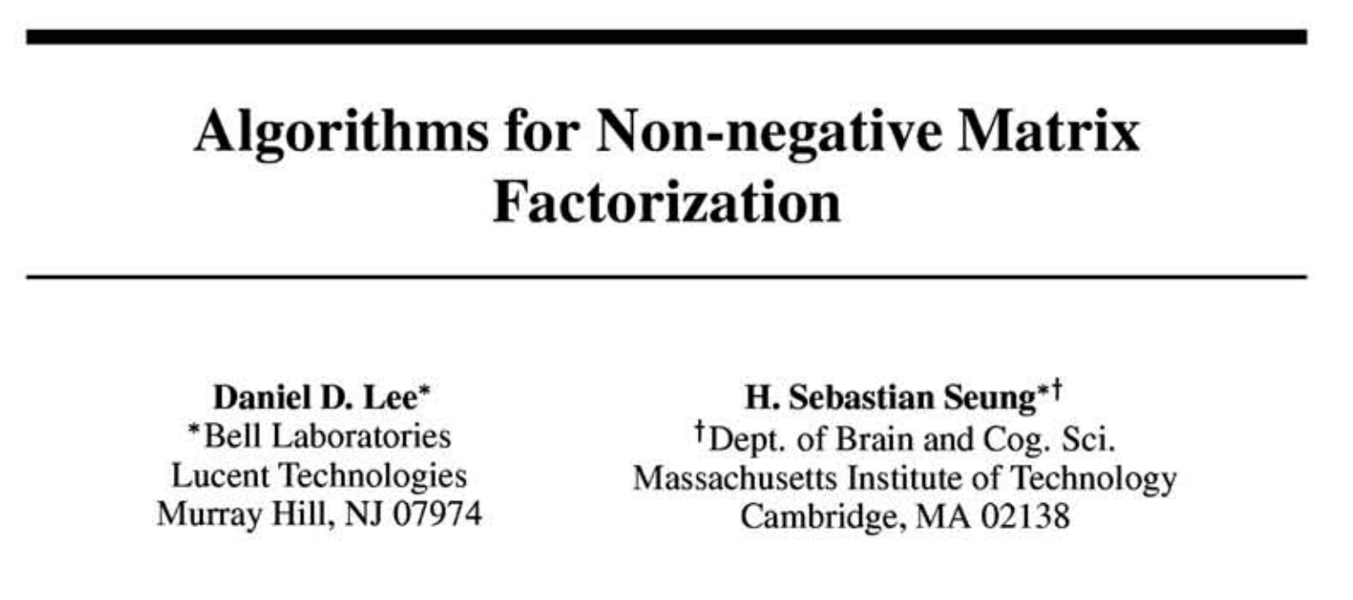


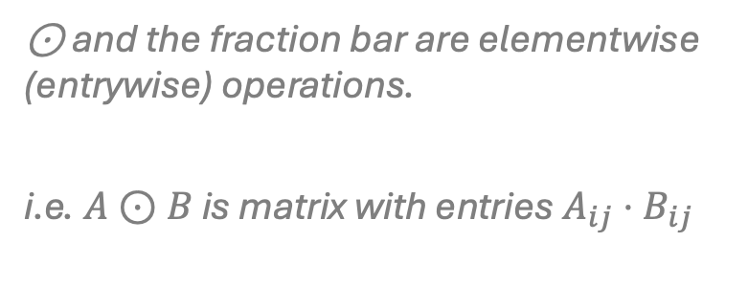
Algorithm 1: multiplicative updates
Classic NMF algorithm by Lee and Seung (Nature 1999, NIPS 2000). Alternate:
$$H ← H ⊙ \frac{W^{T}Y}{W^{T}WH}$$
⊙ and the fraction bar are elementwise (entrywise) operations.
i.e. $A⊙B$ is matrix with entries $A_{ij}⋅B_{ij}$
$$W ← W ⊙ \frac{YH^{T}}{WHH^{T}}$$
Two key properties:
Nonnegativity preserved in each update — nonnegative number times a ratio of nonnegative numbers stays ≥ 0
Monotone descent — each update provably never increases the objective

Slide 23




Where does multiplicative update rule come from? Interpretation 1
$$H ← H ⊙ \frac{W^{T}Y}{W^{T}WH}$$
Define $L\left(H\right)={\left|\left|Y−WH\right|\right|}^{2}$ as the loss for a fixed W. Its gradient is given by
$$∇_{H} {\left\|Y − WH\right\|}^{2} = 2 \left(W^{T}WH − W^{T}Y\right)$$
Gradient descent on H with step size $η$ has the form:
$$H ←H −η{⋅(∇}_{H} {\left\|Y − WH\right\|}^{2})$$
Set adaptive step size $η=\frac{1}{2}\frac{H}{W^{T}WH}:$
[write on board]
The adaptive step keeps entries ≥ 0 and vanishes at a stationary point (gradient = 0 ⇒ ratio = 1).
Simple and robust, but convergence can be slow near the optimum — motivating faster solvers.
makes the negative terms cancel and recovers the multiplicative update exactly.
$$η = \frac{H}{W^{T}WH}$$
A gradient step H ← H − η ∇ with the per-entry step size

Slide 24

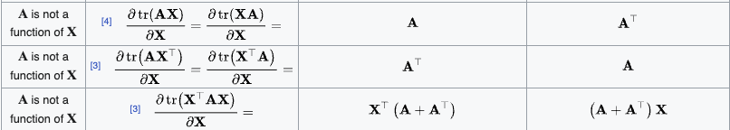
Matrix calculus…

Slide 25
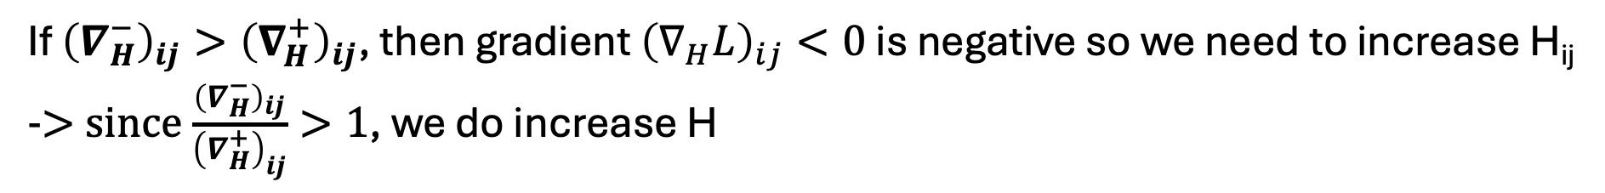
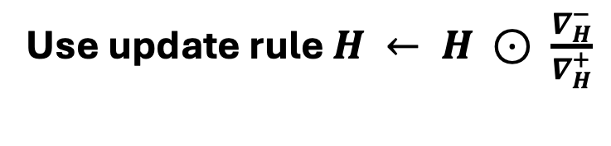
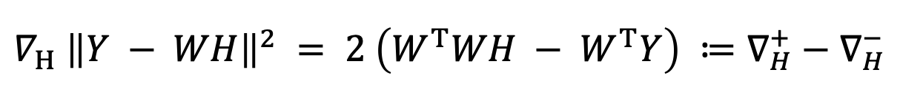
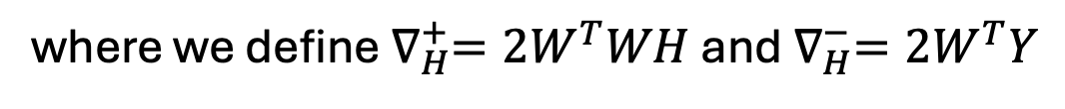

Where does multiplicative update rule come from? (Interpretation 2)
$$H ← H ⊙ \frac{W^{T}Y}{W^{T}WH}$$
Define $L\left(H\right)={\left|\left|Y−WH\right|\right|}^{2}$ as the loss for a fixed W. Its gradient is given by
$$∇_{H} {\left\|Y − WH\right\|}^{2} = 2 \left(W^{T}WH − W^{T}Y\right) ≔∇_{H}^{+}−∇_{H}^{−}$$
where we define $∇_{H}^{+}=2W^{T}WH$ and $∇_{H}^{−}=2W^{T}Y$
Use update rule $H ← H ⊙ \frac{∇_{H}^{−}}{∇_{H}^{+}}$
Why?
If ${\left(∇_{H}^{−}\right)}_{ij}>{\left(∇_{H}^{+}\right)}_{ij}$, then gradient ${\left(∇_{H}L\right)}_{ij}<0$ is negative so we need to increase H_{ij}
-> since $\frac{{\left(∇_{H}^{−}\right)}_{ij}}{{\left(∇_{H}^{+}\right)}_{ij}}>1$, we do increase H
The adaptive step keeps entries ≥ 0 and vanishes at a stationary point (gradient = 0 ⇒ ratio = 1).
Simple and robust, but convergence can be slow near the optimum — motivating faster solvers.
makes the negative terms cancel and recovers the multiplicative update exactly.
$$η = \frac{H}{W^{T}WH}$$
A gradient step H ← H − η ∇ with the per-entry step size

Slide 26
Algorithm 1: multiplicative updates
Classic NMF algorithm by Lee and Seung (Nature 1999, NIPS 2000). Alternate:
$$H ← H ⊙ \frac{W^{T}Y}{W^{T}WH}$$
⊙ and the fraction bar are elementwise (entrywise) operations.
i.e. $A⊙B$ is matrix with entries $A_{ij}⋅B_{ij}$
$$W ← W ⊙ \frac{YH^{T}}{WHH^{T}}$$
Downside: for large datasets, convergence is slow near the optimal solution

Slide 27


Where does multiplicative update rule come from?
Where do they come from? Start from the gradient in H (W fixed):
$$∇_{H} {\left\|Y − WH\right\|}^{2} = 2 \left(W^{T}WH − W^{T}Y\right)$$
A gradient step H ← H − η ∇ with the per-entry step size
$$η = \frac{H}{W^{T}WH}$$
makes the negative terms cancel and recovers the multiplicative update exactly.
The adaptive step keeps entries ≥ 0 and vanishes at a stationary point (gradient = 0 ⇒ ratio = 1).
Simple and robust, but convergence can be slow near the optimum — motivating faster solvers.

Slide 28
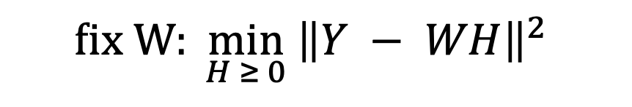

Algorithm 2: alternating non-negative least squares (ANLS)
$$fix W: \min_{H ≥ 0} {\left\|Y − WH\right\|}^{2}$$
Consider the subproblem:
Alternating nonnegative least squares (ANLS) updates one column of H at a time
y_{j}
h
Y
W
H
$$\min_{h ≥ 0} {\left\|y_{j} − Wh\right\|}^{2}$$
≈
H (K × G)
Y (cells × genes)
W (N × K)
Usually converges faster than multiplicative updates and avoids “stuck-at-zero” entries.
Default solver in many libraries (scikit-learn NMF; LIGER uses block-coordinate ANLS).
$$w_{k} ← {\left[w_{k} + residual\right]}_{+} , {\left[·\right]}_{+} = max(·, 0)$$

Slide 29

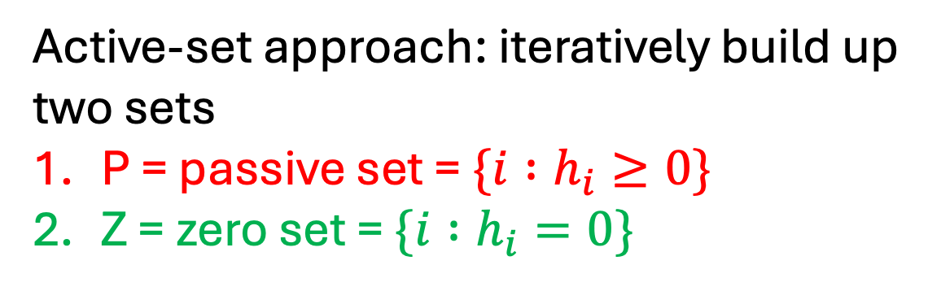
How to solve non-negative least squares (NNLS)?
$$\min_{h ≥ 0} {\left\|y − Wh\right\|}^{2}$$
Active-set approach: iteratively build up two sets
P = passive set = $\{i :h_{i}≥0\}$
Z = zero set = $\{i :h_{i}=0\}$
y
h
P
=
Z
W (N × K)

Slide 30

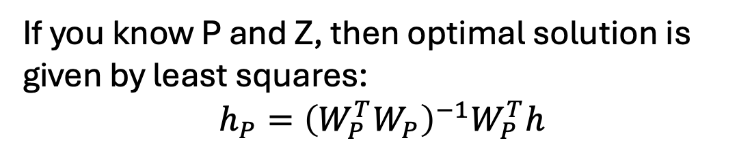
How to solve non-negative least squares (NNLS)?
$$\min_{h ≥ 0} {\left\|y − Wh\right\|}^{2}$$
Active-set approach: iteratively build up two sets
P = passive set = $\{i :h_{i}≥0\}$
Z = zero set = $\{i :h_{i}=0\}$
y
h
$$W_{P}$$
P
=
Z
If you know P and Z, then optimal solution is given by least squares:
$$h_{P}={\left(W_{P}^{T}W_{P}\right)}^{−1}W_{P}^{T}h$$
W (N × K)
(Slight adjustments needed if entries of $h_{P}$ are negative)

Slide 31

How to solve non-negative least squares (NNLS)?
$$\min_{h ≥ 0} {\left\|y − Wh\right\|}^{2}$$
Active-set approach: iteratively build up two sets
P = passive set = $\{i :h_{i}≥0\}$
Z = zero set = $\{i :h_{i}=0\}$
y
h
$$W_{P}$$
P
=
Z
Start with $P=∅$ and $Z=\{1,…,K\}$
Find index k that, when added to P, makes loss decrease most
Add k to P
Stop when no index makes loss decrease
W (N × K)

Slide 32

Initialization & local minima
NMF result depends on where you start.
Sometimes you may want to seed W, H using the SVD of Y (clip negatives) or from prior knowledge
Initialization 2
Initialization 1
$${\left\|Y − WH\right\|}^{2}$$
inferred solution 2
inferred solution 1
NMF parameters W,H
different seeds settle in different minima

Slide 33
Preprocessing single-cell data for NMF
NMF needs a nonnegative input — so the usual PCA pipeline changes.
Keep data nonnegative — use raw counts or library-size–normalized counts (CP10k / TPM); do NOT mean-center (that creates negatives).
Select informative genes — restrict to highly variable / over-dispersed genes (~1–2k) to focus programs and cut compute.
Scale carefully — you cannot z-score (centering breaks nonnegativity); cNMF scales each gene by its std-dev only.
Log or not — Frobenius-NMF often skips the log to preserve additivity; KL-NMF can run directly on counts.
Conventions follow Kotliar et al. (2019) and Scanpy/Seurat.

Slide 34

How to choose K (number of NMF factors)?
No nice “variance explained” interpretation unlike PCA
reconstruction error
$$\min_{W,H ≥ 0} {\left\|Y − WH\right\|}^{2}$$
Common heuristic: “elbow” of loss curve
K for which error does not decrease much afterwards
Packages like “kneedle” to systematically find such K
K

Slide 35
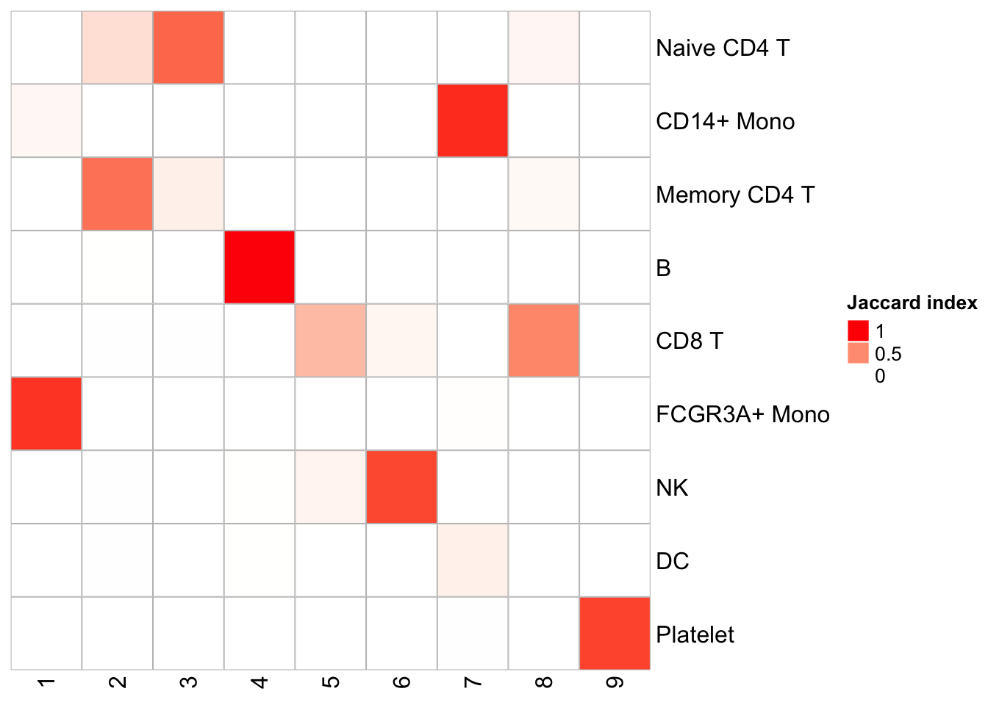
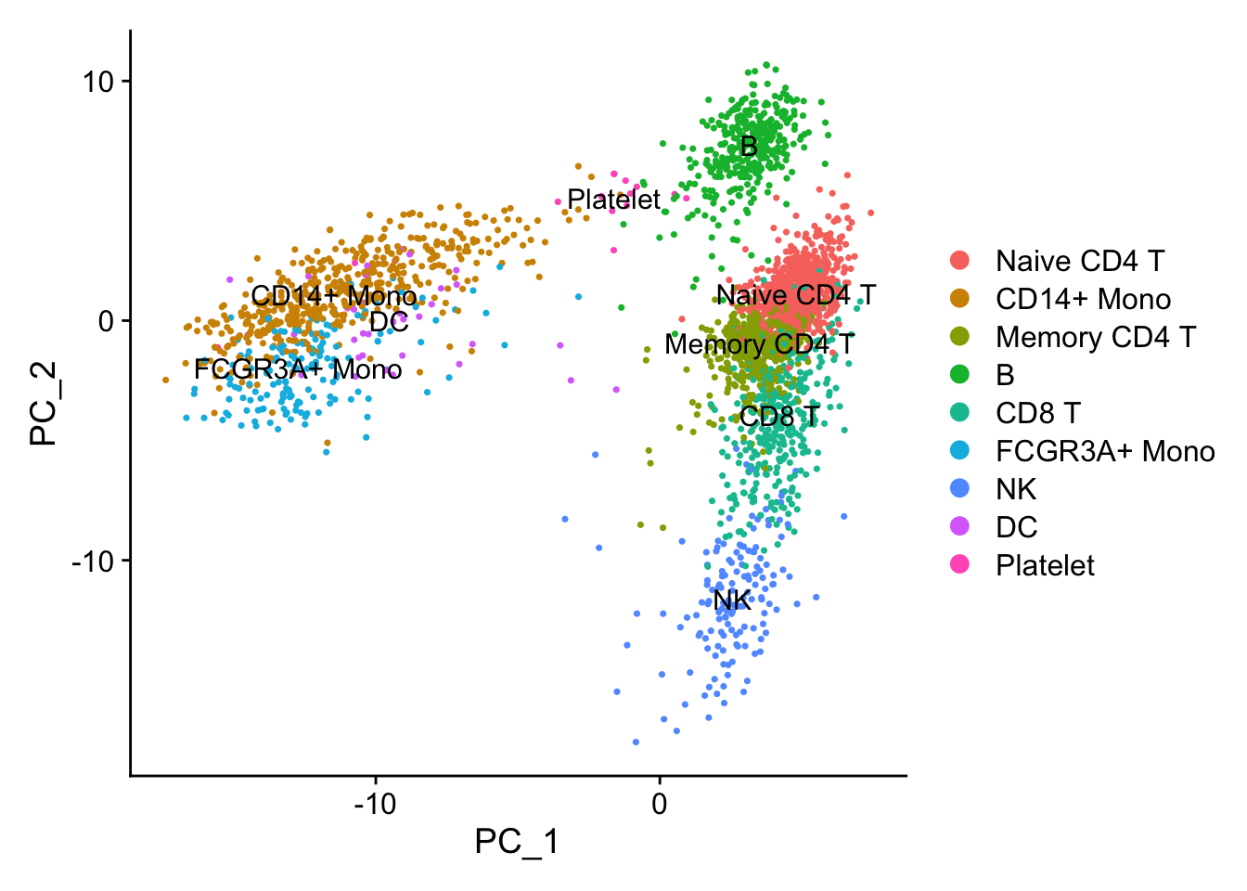
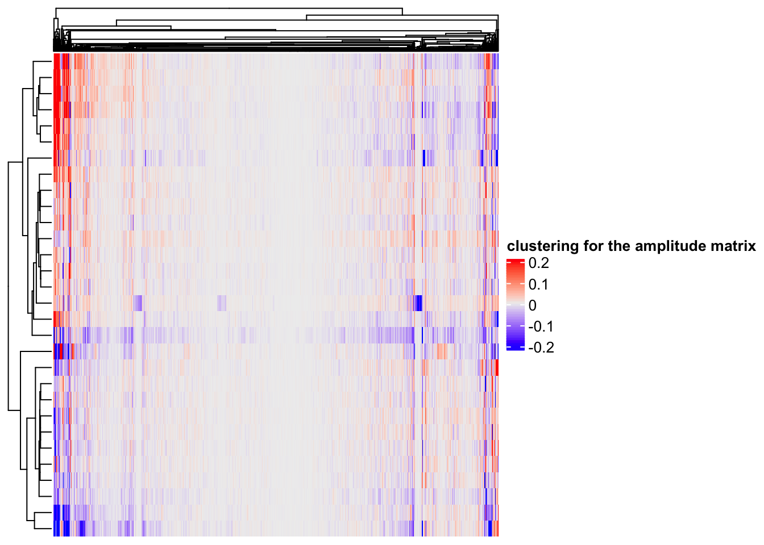
https://divingintogeneticsandgenomics.com/post/matrix-factorization-for-single-cell-rnaseq-data/
Example of NMF
3k PBMC (blood) data
PCA visualization
Apply NMF
G genes
N cells
Y
Loadings
W
H
Gene clustering using the factor matrix
Gene
NMF
H (K × G)
Factors
W (N × K)
Loadings
Gene

Slide 36
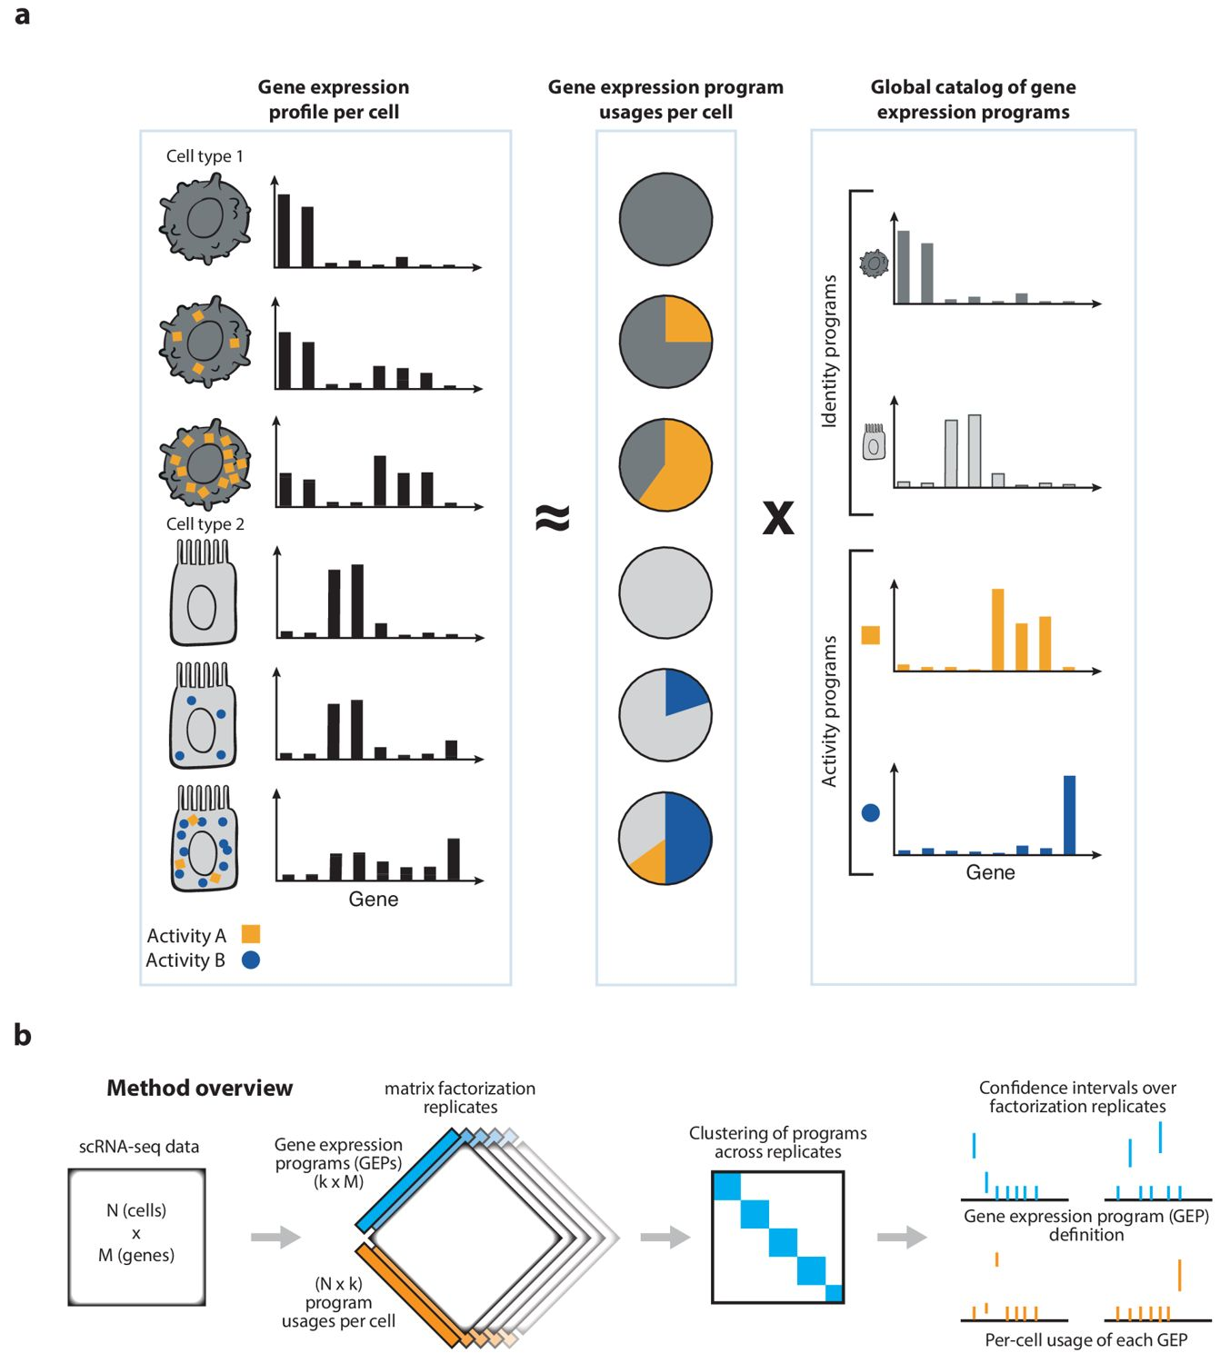
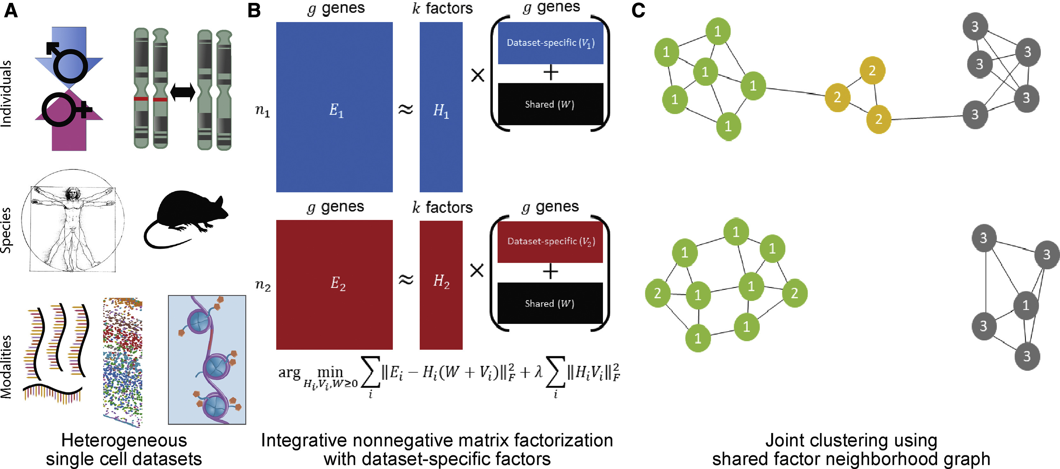
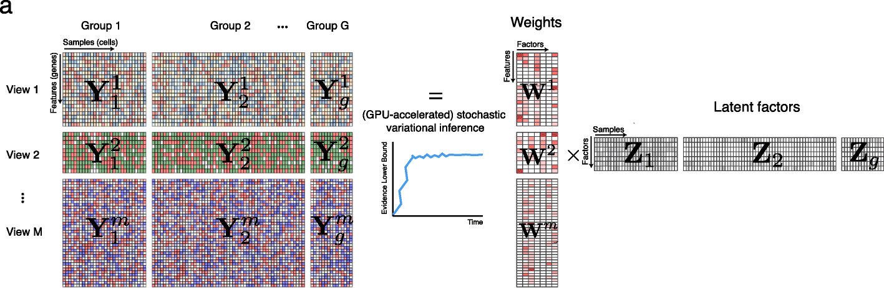
Many different (non-negative) matrix factorization variants used in practice
Consensus NMF (averaging over different initializations)
NMF for data integration (LIGER, scINSIGHT)
Probabilistic matrix factorization

Slide 37
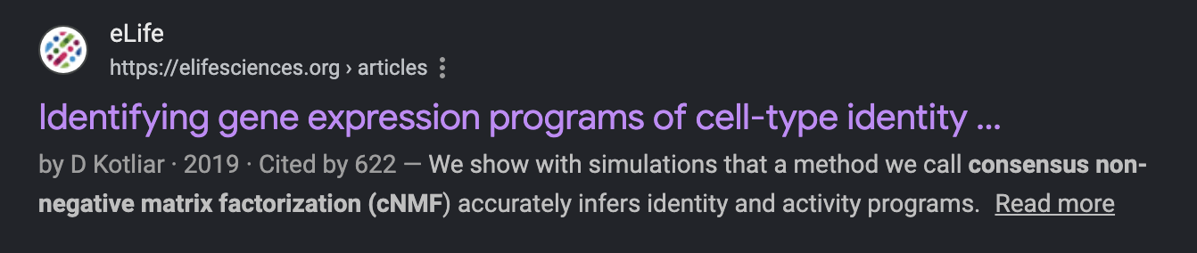
Variant 1: consensus NMF (cNMF)
Problem: one NMF run is seed-dependent. Idea: run NMF many times and keep the programs that recur.
1. Normalize
TPM + over-dispersed genes
2. Run NMF × R
R random seeds (≈100–200)
3. Pool & cluster
group the R·K programs into K
4. Filter
drop outlier components
5. Consensus
median of each cluster → W*
6. Refit
NNLS usages H given W*
Output: K consensus gene expression programs (GEPs) reproducible across seeds, plus per-cell usages. It adds robustness, not a new objective.
This turns an unstable algorithm into a dependable tool — the de-facto standard for finding programs in scRNA-seq.
Kotliar, Veres, Nagy, Tabrizi, Hodgin, Eggan, Regev, eLife 8:e43803 (2019).

Slide 38
Variant 1: consensus NMF (cNMF)
Run NMF many times
….. Clustering …..
Compute NMF across many different initializations and cluster the results
Kotliar, Veres, Nagy, Tabrizi, Hodgin, Eggan, Regev, eLife 8:e43803 (2019).

Slide 39
cNMF: identity vs. activity programs
A key biological payoff: cNMF separates two kinds of programs.
Identity programs
define a cell type (T cell, neuron).
each cell expresses essentially one.
roughly what clustering recovers.
Activity programs
transient, shared across cell types.
e.g. cell cycle, hypoxia, IFN response.
a cell can run several at once.
Why additivity matters: clustering would split a cycling T cell from a resting T cell (or fold cell cycle into “identity”).
NMF’s additive usages let one cell = identity program + cell-cycle program — disentangling type from state.
Kotliar et al., eLife (2019).

Slide 40

Welch et al, Cell 2019
Variant 2: LIGER (NMF for data integration)
The K x G matrix (factors) is split into two components:
one shared by all datasets,
one dataset-specific (absorbs dataset-specific features, e.g. “batch effects”)

Slide 41
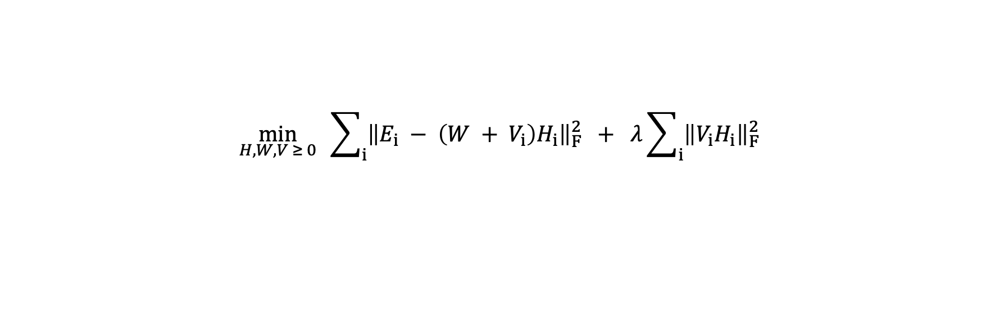
Variant 2: LIGER (NMF for data integration)
Different problem: combine multiple datasets (batches, technologies, species, modalities) into one shared space.
$$\min_{H,W,V ≥ 0} \sum_{i}{{\left\|E_{i} − \left(W + V_{i}\right)H_{i}\right\|}_{F}^{2}} + λ\sum_{i}{{\left\|V_{i}H_{i}\right\|}_{F}^{2}}$$
Eᵢ — dataset i (genes × cells), nonnegative input.
W — shared metagenes: programs common to every dataset (the “glue” that aligns them).
Vᵢ — dataset-specific metagenes: what is unique to dataset i.
Hᵢ — cell loadings in the shared space; λ tunes how much dataset-specific variation is allowed.
Welch, Kozareva, Ferreira, Vanderburg, Martin, Macosko, Cell 177:1873–1887 (2019).

Slide 42
Why the shared/specific split integrates data
Dataset 1
Because every dataset shares the same W,
cells from different batches land on the same factor axes (the Hᵢ share a coordinate system).
Vᵢ absorbs batch-specific effects, so they don’t contaminate the shared programs.
LIGER then quantile-normalizes the Hᵢ and builds a joint neighbor graph for clustering.
Large λ → less mixing; small λ → more aggressive integration.
E₁
W
V₁
≈
+
same W
Dataset 2
E₂
W
V₂
≈
+
Welch et al., Cell (2019); rliger documentation.

Slide 43
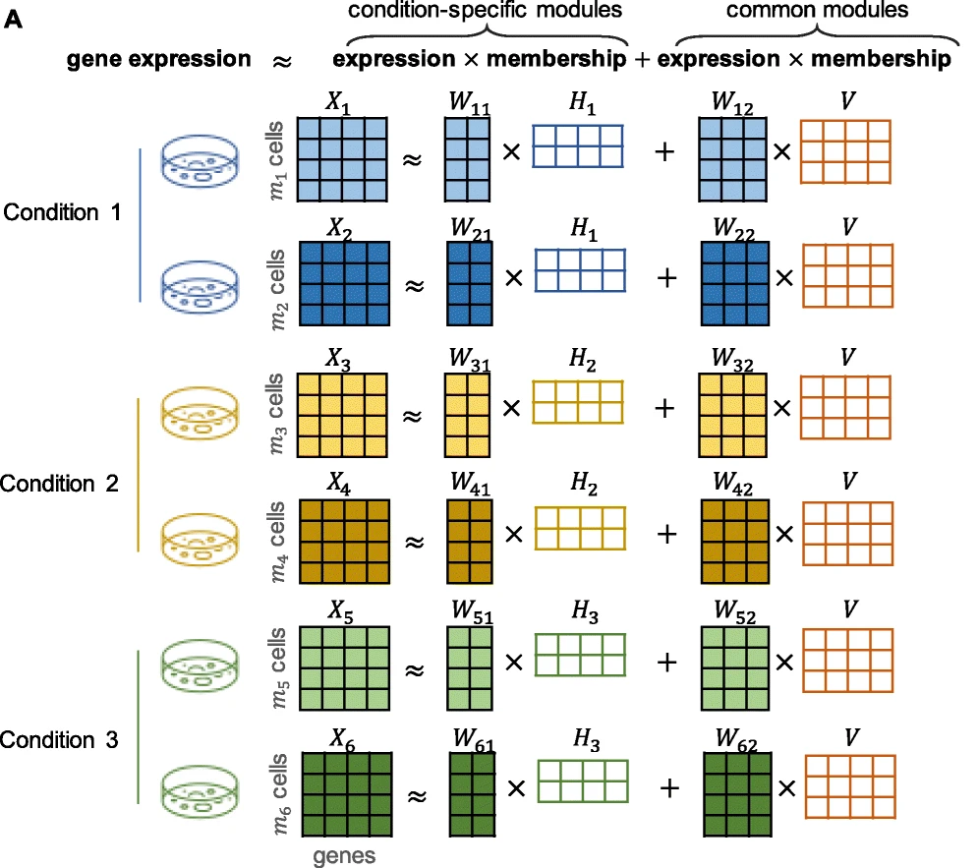
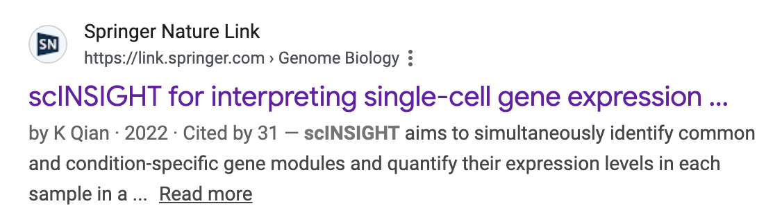
Variant 3: scINSIGHT

Slide 44
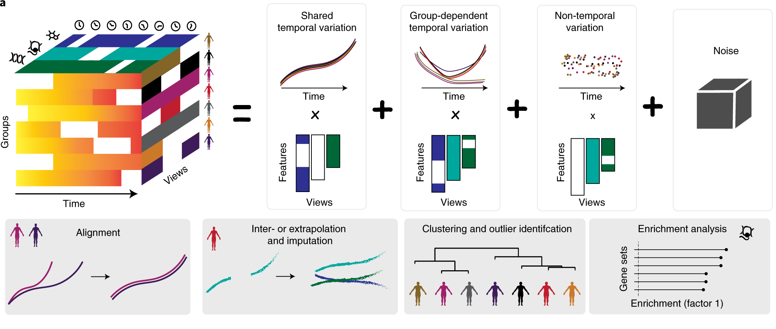
Variants 4/5: MOFA+ and MEFISTO
MOFA+ (Argelaguet et al, Genome Biol 2022)
Idea: use factor analysis (matrix factorization + probability)
MEFISTO (Velten et al, Nature Methods 2022)

Slide 45
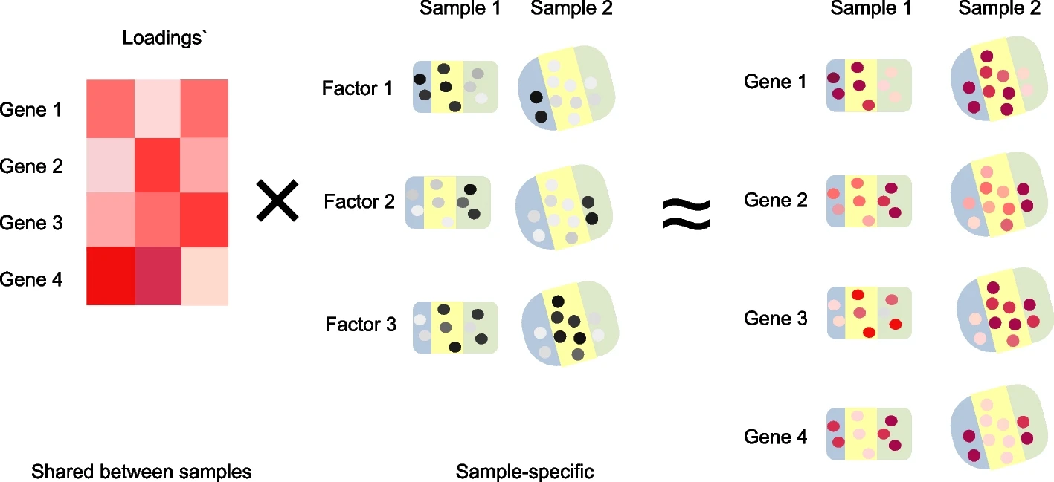
Non-negative spatial factorization (NSF)
Idea: Impose spatial coherence on factors
Will briefly discuss next class
NSF: Townes and Engelhardt, Nature Methods 2023
mNSF: Wang et al, Genome Biol 2025

Slide 46
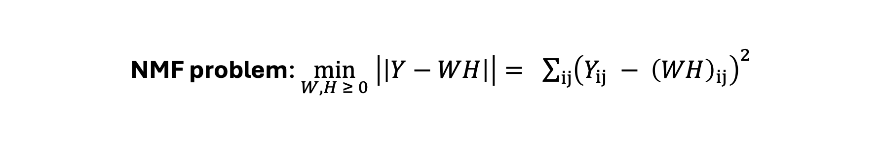
Non-negative matrix factorization (NMF) summary
NMF problem: $\min_{W,H ≥ 0} \left|\left|Y−WH\right|\right|= \sum_{ij}{{\left(Y_{ij} − {\left(WH\right)}_{ij}\right)}^{2}}$
Difficult to solve: No unique soln, nonconvex
Algorithms: (1) multiplicative updates (simple, monotone) and (2) alternating non-negative least squares (faster)
  Often want to use many initializations
Many variants used in practice!
  consensus (cNMF; many initializations); multiple samples/data modalities (LIGER, scINSIGHT, …)
Y
W
H
≈
H (K × G)
Y (cells × genes)
W (N × K)
NMF factorizes Y ≈ WH with W, H ≥ 0 — additive, parts-based, interpretable gene programs.
Objective: Frobenius or KL — same nonnegativity, different noise model.
Algorithms — multiplicative updates (simple, monotone) and ANLS / HALS (faster); alternating, non-convex.
Initialization & K matter — seed-dependent → use NNDSVD and consensus; choose K by stability.
cNMF — robust programs; separates cell-type identity from cellular activity.
LIGER / iNMF — shared + dataset-specific factors integrate batches, species, and modalities.
Big picture — NMF is one constrained factor model — a gateway to factor analysis and GLM-PCA.

