Slide 1
Probabilistic Matrix Factorization Models
+ In-class lab
Uthsav Chitra
Johns Hopkins University
September 15, 2026

Slide 2
Last class: Non-negative matrix factorization (NMF)
NMF problem: $\min_{W,H ≥ 0} \left|\left|Y−WH\right|\right|= \sum_{ij}{{\left(Y_{ij} − {\left(WH\right)}_{ij}\right)}^{2}}$
Difficult to solve: No unique soln, nonconvex
Algorithms: (1) multiplicative updates (simple, monotone) and (2) alternating non-negative least squares (faster)
  Often want to use many initializations
Many variants used in practice!
  consensus (cNMF; many initializations); multiple samples/data modalities (LIGER, scINSIGHT, …)
Y
W
H
≈
H (K × G)
Y (cells × genes)
W (N × K)
NMF factorizes Y ≈ WH with W, H ≥ 0 — additive, parts-based, interpretable gene programs.
Objective: Frobenius or KL — same nonnegativity, different noise model.
Algorithms — multiplicative updates (simple, monotone) and ANLS / HALS (faster); alternating, non-convex.
Initialization & K matter — seed-dependent → use NNDSVD and consensus; choose K by stability.
cNMF — robust programs; separates cell-type identity from cellular activity.
LIGER / iNMF — shared + dataset-specific factors integrate batches, species, and modalities.
Big picture — NMF is one constrained factor model — a gateway to factor analysis and GLM-PCA.

Slide 3
Typical single cell workflow
Original data matrix
J genes
N cells
y_{ij}
Entry y_{ij} = number of transcripts (“UMI count”) of gene j in cell i

Slide 4
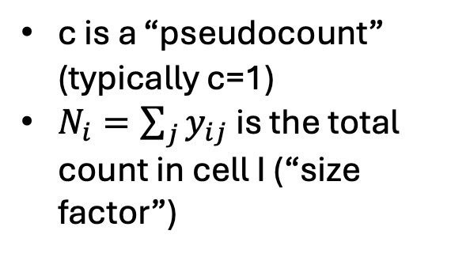


Typical single cell workflow
Original data matrix
Normalization
J genes
J genes
N cells
N cells
y_{ij}
$$z_{ij}$$
$$z_{ij}=log{(c+ \frac{y_{ij}}{N_{i}}×{10}^{6})}$$
Entry y_{ij} = number of transcripts (“UMI count”) of gene j in cell i
c is a “pseudocount” (typically c=1)
$N_{i}=\sum_{j}{y_{ij}}$ is the total count in cell I (“size factor”)

Slide 5
Typical single cell workflow
Highly variable gene selection
Original data matrix
Normalization
J genes
J genes
J’<J genes
N cells
N cells
N cells
y_{ij}
$$z_{ij}$$
$$z_{ij}=log{(c+ \frac{y_{ij}}{N_{i}}×{10}^{6})}$$
Entry y_{ij} = number of transcripts (“UMI count”) of gene j in cell i
Typically select top J’=1000-2000 genes according to some metric (e.g. variance)
c is a “pseudocount” (typically c=1)
$N_{i}=\sum_{j}{y_{ij}}$ is the total count in cell I (“size factor”)

Slide 6
Typical single cell workflow
Principal component analysis
Highly variable gene selection
Original data matrix
Normalization
J genes
J genes
J’<J genes
10-20 PCs
N cells
N cells
N cells
N cells
y_{ij}
$$z_{ij}$$
$$z_{ij}=log{(c+ \frac{y_{ij}}{N_{i}}×{10}^{6})}$$
Entry y_{ij} = number of transcripts (“UMI count”) of gene j in cell i
Typically select top J’=1000-2000 genes according to some metric (e.g. variance)
c is a “pseudocount” (typically c=1)
$N_{i}=\sum_{j}{y_{ij}}$ is the total count in cell I (“size factor”)

Slide 7
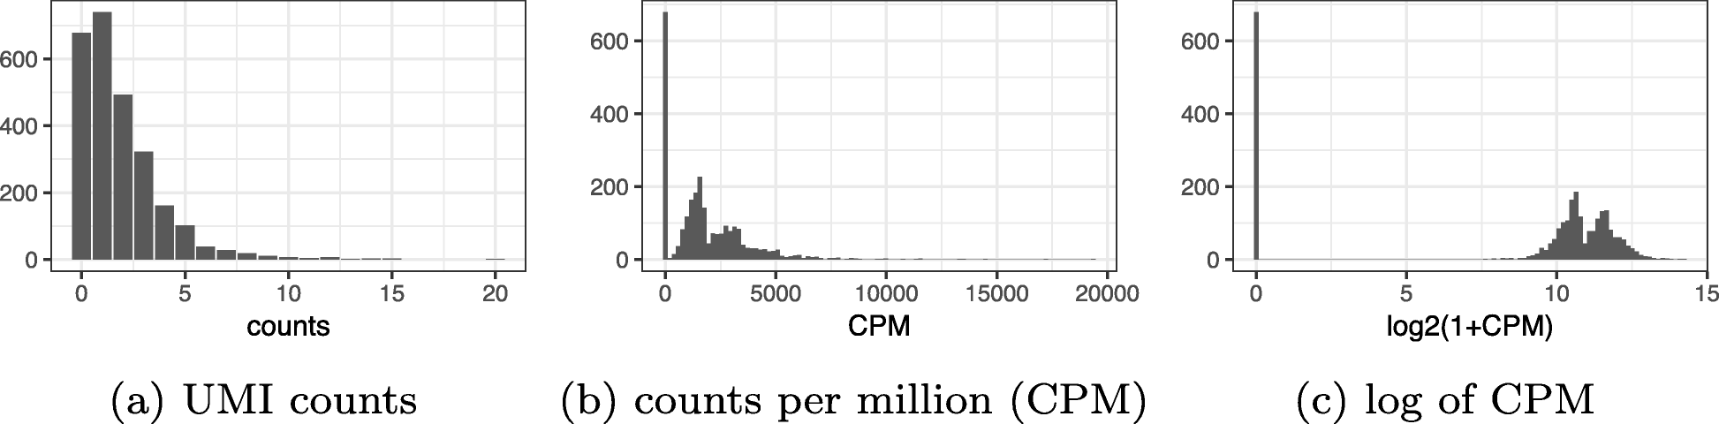

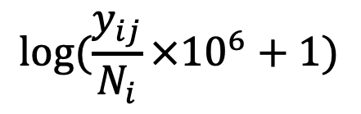
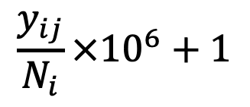

Issues with typical single cell workflow
Original data matrix
Normalization
J genes
J genes
N cells
N cells
Distorts counts – makes zeros much smaller than non-zeros!
y_{ij}
$$z_{ij}$$
$$z_{ij}=log{(c+ \frac{y_{ij}}{N_{i}}×{10}^{6})}$$
$$y_{ij}$$
$$\frac{y_{ij}}{N_{i}}×{10}^{6}+1$$
$$log⁡(\frac{y_{ij}}{N_{i}}×{10}^{6}+1)$$

Slide 8
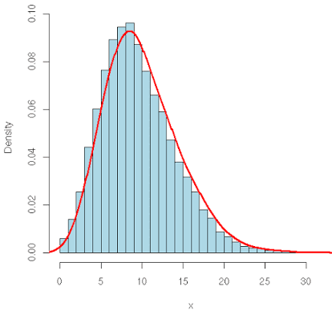
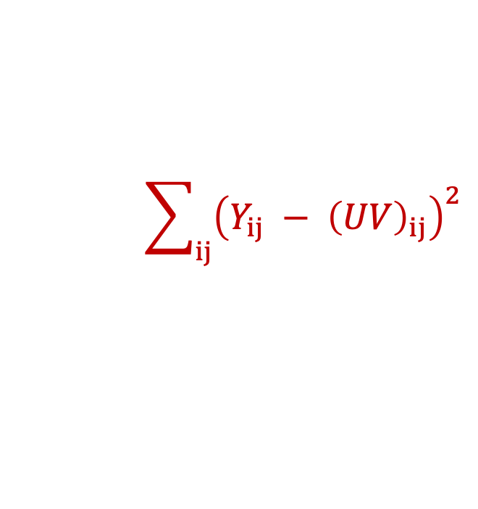
Issues with typical single cell workflow
Principal component analysis
Highly variable gene selection
Original data matrix
Normalization
J genes
J genes
J’<J genes
10-20 PCs
N cells
N cells
N cells
N cells
y_{ij}
PCA loss implicitly assumes data is continuous – but UMI counts are discrete!
$$\sum_{ij}{{\left(Y_{ij} − {\left(UV\right)}_{ij}\right)}^{2}}$$

Slide 9
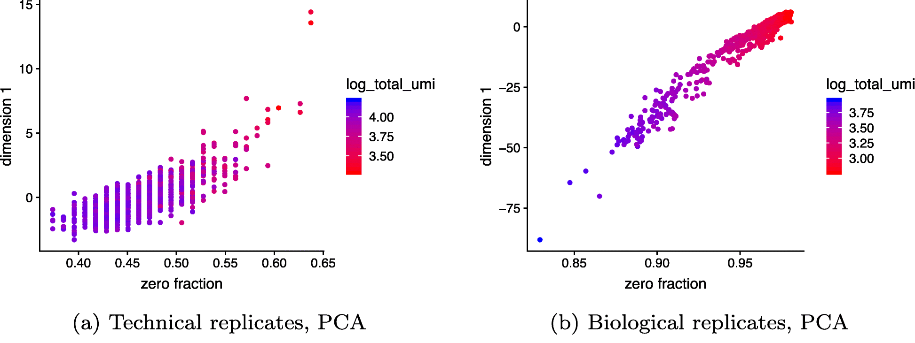

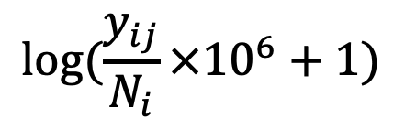
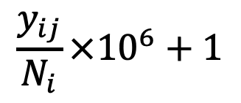
Top PC confounded by technical artifacts (fraction of zeros in cell)
$$y_{ij}$$
$$\frac{y_{ij}}{N_{i}}×{10}^{6}+1$$
$$log⁡(\frac{y_{ij}}{N_{i}}×{10}^{6}+1)$$
Top PC captures zero fraction
(No cells inside droplets)
All cells are identical

Slide 10
Today
Probabilistic methods that model distribution of single cell UMI counts
Multinomial/Poisson model -> negative binomial
GLM-PCA / analytic Pearson residuals
Extensions
  MOFA+
  Non-negative spatial factorization
-> In-class lab!

Slide 11
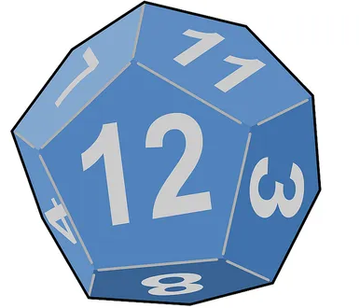
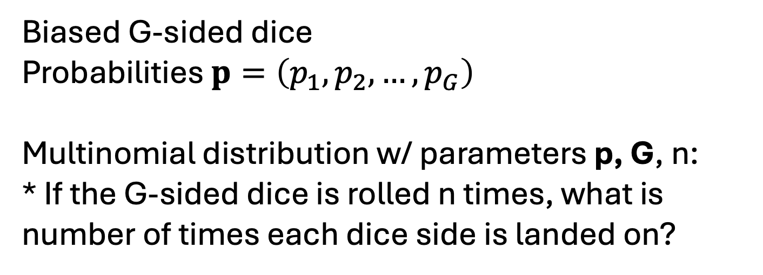
Multinomial distribution
Biased G-sided dice
Probabilities $p=\left(p_{1},p_{2}, …, p_{G}\right)$
Multinomial distribution w/ parameters p, G, n:
* If the G-sided dice is rolled n times, what is number of times each dice side is landed on?
Suppose:
G=2
p=(1/4,3/4) (biased coin flip)
n=10
Multinomial distribution describes # heads if you flip coin n=10 times

Slide 12
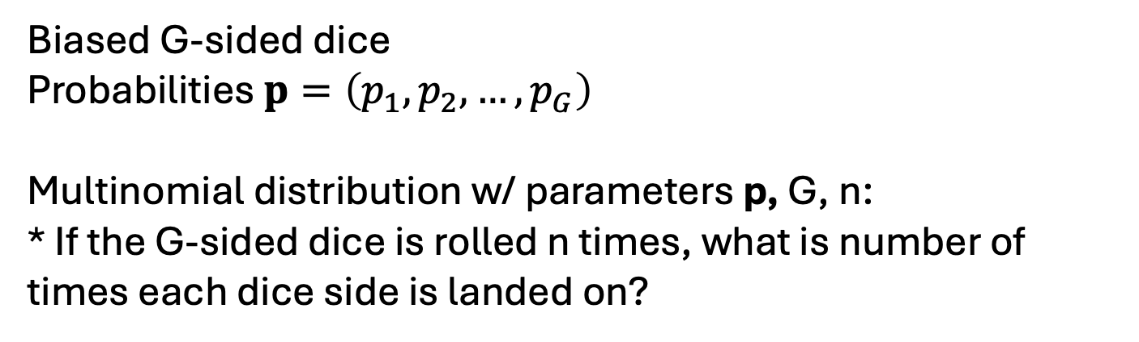
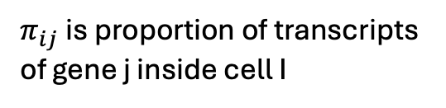


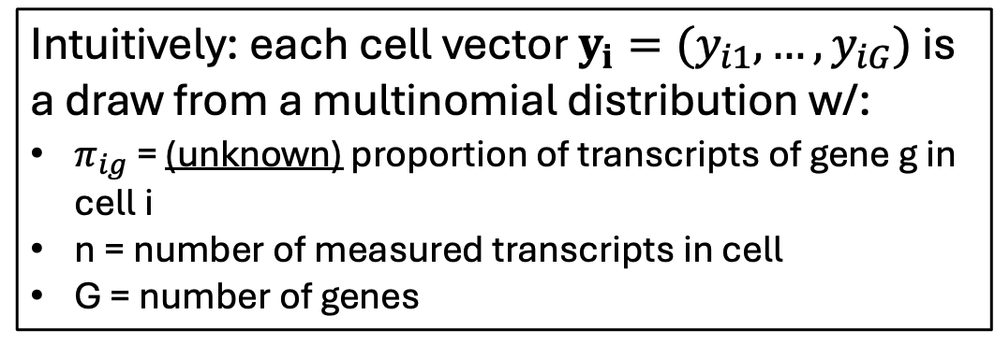
Multinomial distribution + single-cell
gene C
gene B
gene A
Biased G-sided dice
Probabilities $p=\left(p_{1},p_{2}, …, p_{G}\right)$
Multinomial distribution w/ parameters p, G, n:
* If the G-sided dice is rolled n times, what is number of times each dice side is landed on?
Intuitively: each cell vector $y_{i}=(y_{i1}, …, y_{iG})$ is a draw from a multinomial distribution w/:
$π_{ig}$ = (unknown) proportion of transcripts of gene g in cell i
n = number of measured transcripts in cell
G = number of genes
G genes
J genes
N cells
$$π_{1}=(π_{11}, …, π_{1G})$$
N cells
y_{i}
…
$$π_{N}=(π_{N1}, …, π_{NG})$$
$π_{ij}$is proportion of transcripts of gene j inside cell I

Slide 13
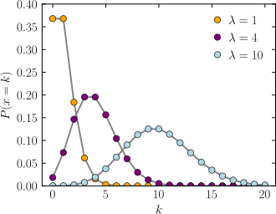
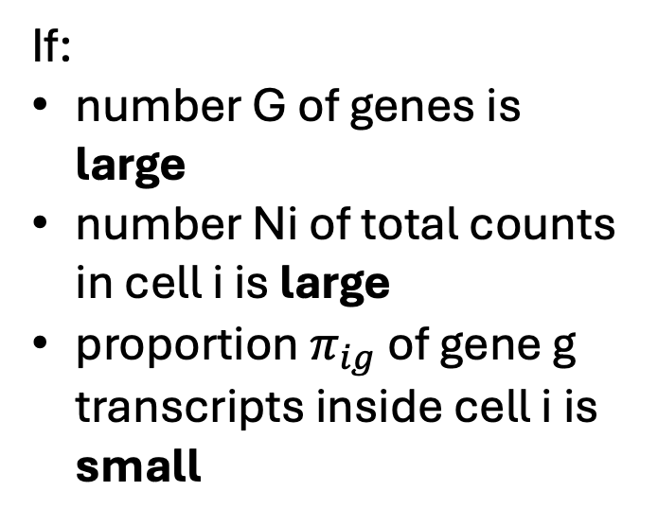


Multinomial $≈$ independent Poissons
If:
number G of genes is large
number Ni of total counts in cell i is large
proportion $π_{ig}$ of gene g transcripts inside cell i is small
Each gene expression count y_{ij} is independent and approximately distributed as
Can prove
$$y_{ig}\sim Poisson(N_{i}π_{ig})$$

Slide 14
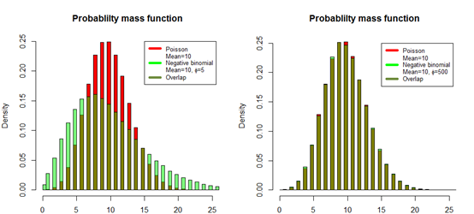


In practice data may be “overdispersed” (variance > mean)
-> Negative binomial distribution
Poisson distribution assumes mean = variance
i.e. if $X \sim Pois(λ)$, then $E\left[X\right]=Var\left[X\right]=λ$
Negative binomial allows for overdispersion: $Var\left[X\right]≥E[X]$.
$X \sim NB(μ, θ)$ has PDF
$$P\left(X=x\right)= \frac{Γ\left(x+θ\right)}{Γ\left(θ\right)x!}{\left(\frac{θ}{θ+μ}\right)}^{θ}{\left(\frac{μ}{θ+μ}\right)}^{x}$$
Mean: $E\left[X\right]=μ$
Variance: $Var\left[X\right]=μ+ \frac{μ^{2}}{θ}$

Slide 15
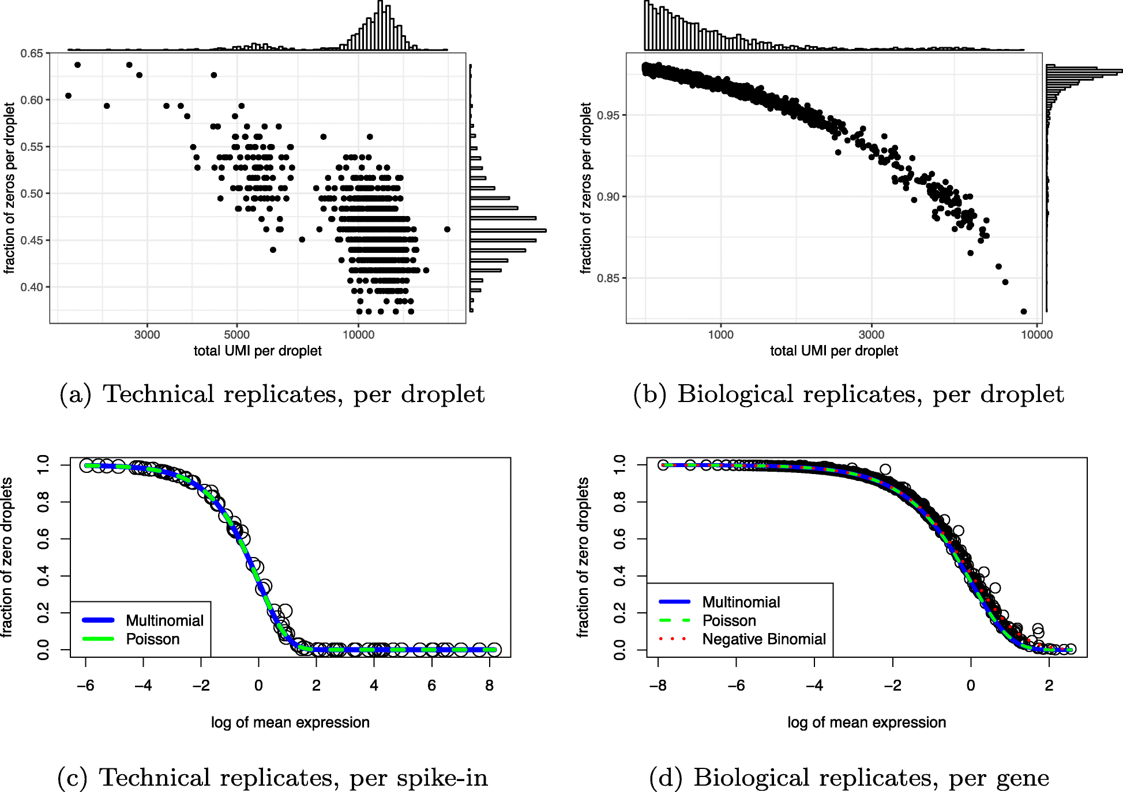
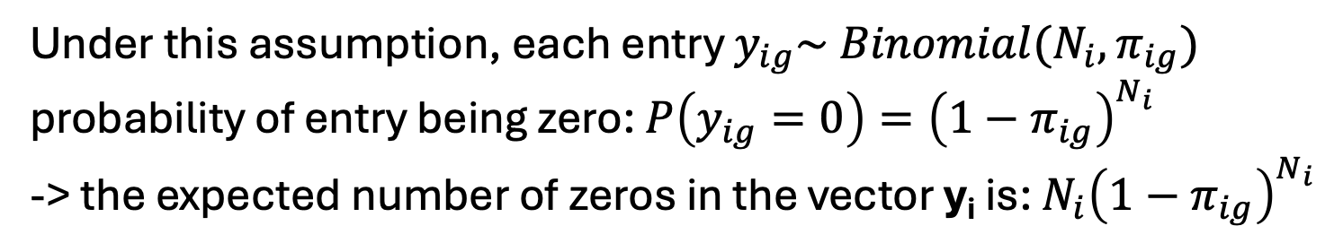
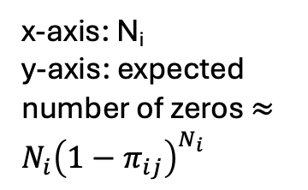
Empirically testing multinomial/Poisson models
Assumption: each gene expression vector $y_{i}=(y_{i1}, …, y_{iG})$ for cell i is sampled independently from Multinomial($π_{i}$, G, N_{i})
Under this assumption, each entry $y_{ig}\sim Binomial(N_{i}, π_{ig})$
probability of entry being zero: $P\left(y_{ig}=0\right)={\left(1−π_{ig}\right)}^{N_{i}}$
-> the expected number of zeros in the vector y_{i} is: $N_{i}{\left(1−π_{ig}\right)}^{N_{i}}$
x-axis: N_{i}
y-axis: expected number of zeros $≈N_{i}{\left(1−π_{ij}\right)}^{N_{i}}$

Slide 16

Empirically testing multinomial/Poisson models
Assumption: each gene expression vector $y_{i}=(y_{i1}, …, y_{iG})$ for cell i is sampled independently from Multinomial($π_{i}$, G, N_{i})
Each gene expression count y_{ig} is independent and approximately distributed as
$$y_{ig}\sim Poisson(N_{i}π_{ig})$$

Slide 17

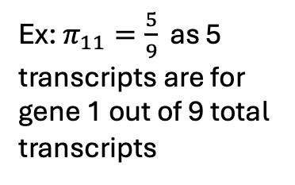

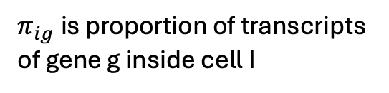
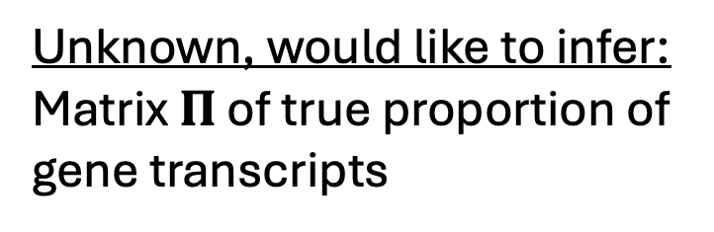

Setup
Unknown, would like to infer: Matrix $Π$ of true proportion of gene transcripts
Observed data: UMI count matrix Y (gene expression matrix)
gene 3
gene 2
gene 1
J genes
J genes
y₁
N cells
$$π_{1}=(π_{11}, …, π_{1G})$$
Ex: $π_{11}=\frac{5}{9}$ as 5 transcripts are for gene 1 out of 9 total transcripts
N cells
$$π_{2}=(π_{21}, …, π_{2G})$$
y₂
…
y_{N}
$$π_{N}=(π_{N1}, …, π_{NG})$$
$π_{ig}$is proportion of transcripts of gene g inside cell I
Problem: Given Y with rows y_{i} ~ Multinomial($π_{i}$, G, N_{i}), estimate the proportion matrix $Π$.

Slide 18



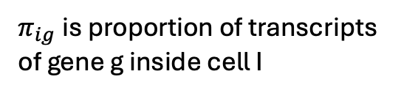

Poisson-PCA problem (GLM-PCA)
(Townes et al, Genome Biol 2019)
UMI count matrix Y (gene expression matrix)
Matrix $Π$ of true proportion of gene transcripts (unknown)
Assume $Π$ is low rank
J genes
G genes
y₁
$$π_{1}=(π_{11}, …, π_{1G})$$
N cells
N cells
V
y₂
$$π_{2}=(π_{21}, …, π_{2G})$$
=
…
U
y_{N}
$$π_{N}=(π_{N1}, …, π_{NG})$$
$π_{ig}$is proportion of transcripts of gene g inside cell I
(Different than PCA, which directly assumes Y is low rank)
Problem: Given Y with rows y_{i} ~ Multinomial($π_{i}$, G, N_{i}) (or $y_{ig} \sim Poisson(N_{i}π_{ig})$ ) estimate U, V such that $Π≈UV$.

Slide 19
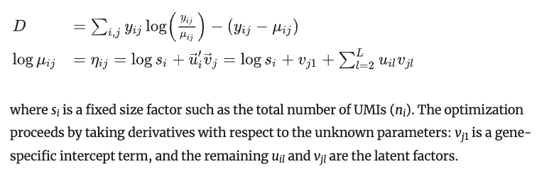
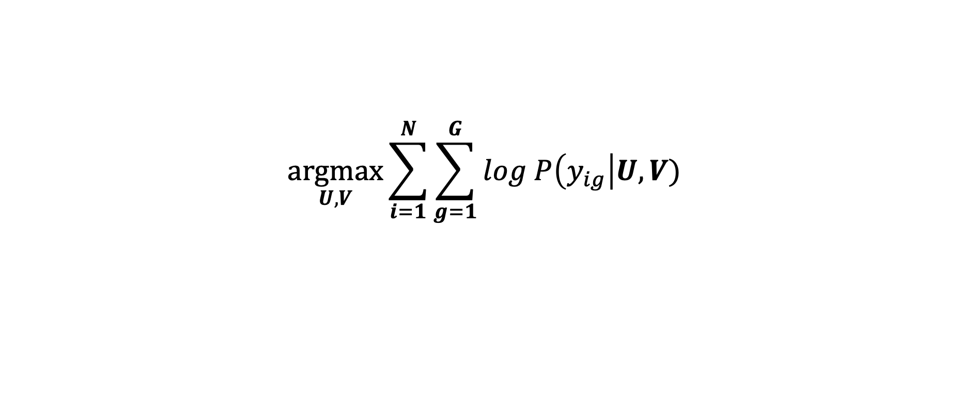

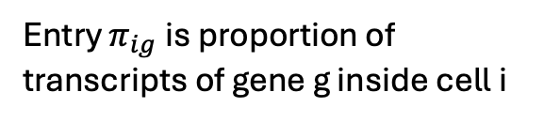
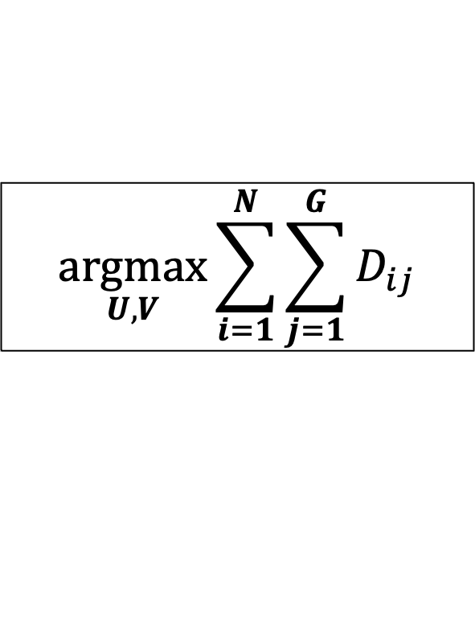
where D_ij is “deviance”:
Problem: Given Y with $y_{ig} \sim Poisson(N_{i}π_{ig})$ estimate U, V such that $Π≈UV$.
Maximum Likelihood Estimation (MLE): find U, V, that maximize likelihood of observed data
$$\underset{U, V}{argmax}{\sum_{i=1}^{N}{\sum_{g=1}^{G}{log P\left(y_{ig}\right|U, V)} }}$$
G genes
N cells
V
=
$$Π$$
U
Entry $π_{ig}$is proportion of transcripts of gene g inside cell i
$$\underset{U, V}{argmax}{\sum_{i=1}^{N}{\sum_{j=1}^{G}{D_{ij}}}}$$

Slide 20
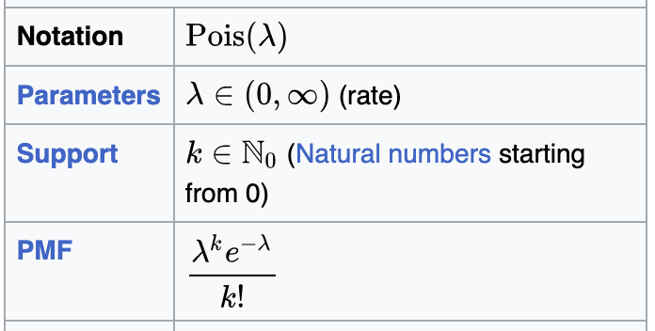

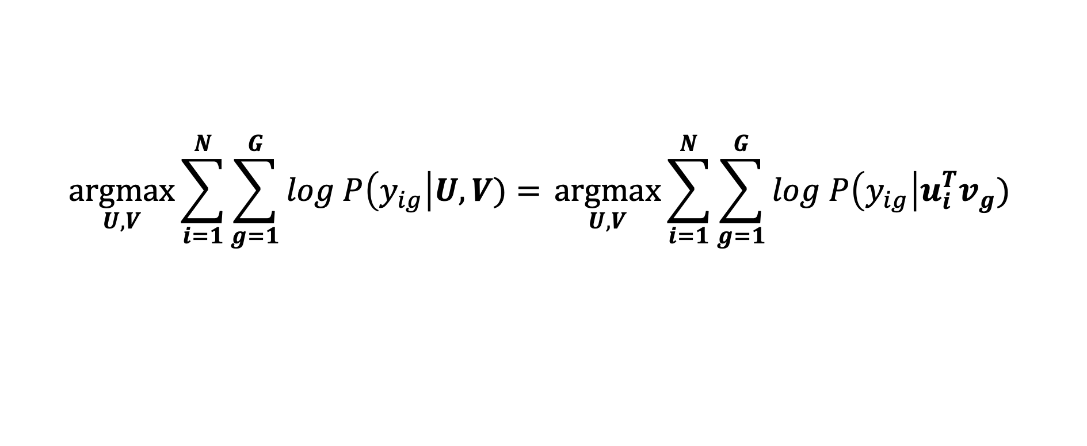
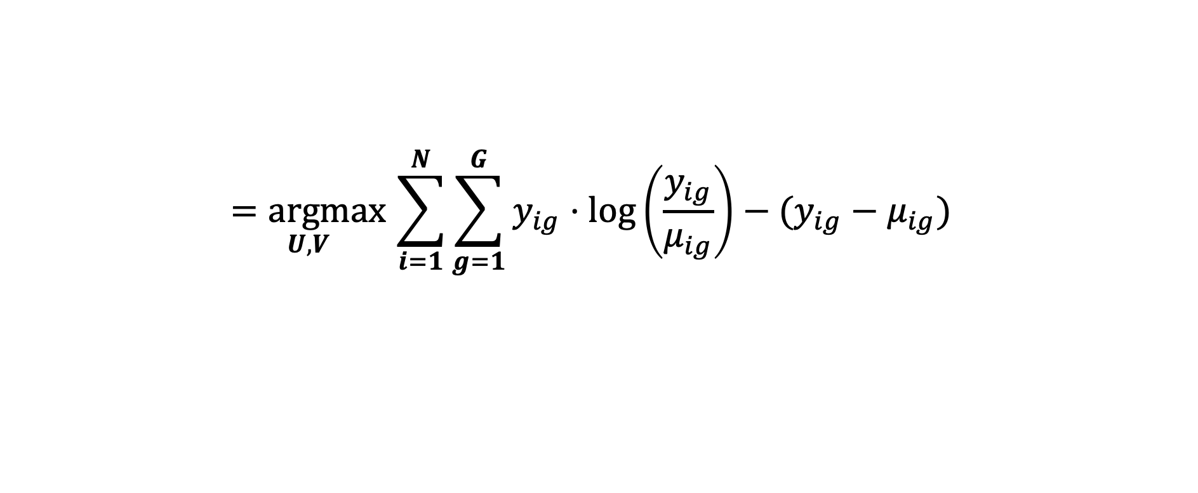
where D_ij is “deviance”:
Problem: Given Y with $y_{ig} \sim Poisson(N_{i}π_{ig})$ estimate U, V such that $Π≈UV$.
Maximum Likelihood Estimation (MLE): find U, V, that maximize likelihood of observed data
$$\underset{U, V}{argmax}{\sum_{i=1}^{N}{\sum_{g=1}^{G}{log P\left(y_{ig}\right|U, V)}= }\underset{U, V}{argmax}\sum_{i=1}^{N}{\sum_{g=1}^{G}{log P\left(y_{ig}\right|u_{i}^{T}v_{g})} }}$$
$$\underset{U, V}{=argmax}\sum_{i=1}^{N}{\sum_{g=1}^{G}{y_{ig}⋅\log\left(\frac{y_{ig}}{μ_{ig}}\right)−(y_{ig}−μ_{ig}) } }$$
Plug in Poisson PDF:
where $μ_{ig}=exp⁡(N_{i}+u_{i}^{T}v_{g})$
[Expand on board]
$$\underset{U, V}{argmax}{\sum_{i=1}^{N}{\sum_{j=1}^{G}{D_{ij}}}}$$

Slide 21
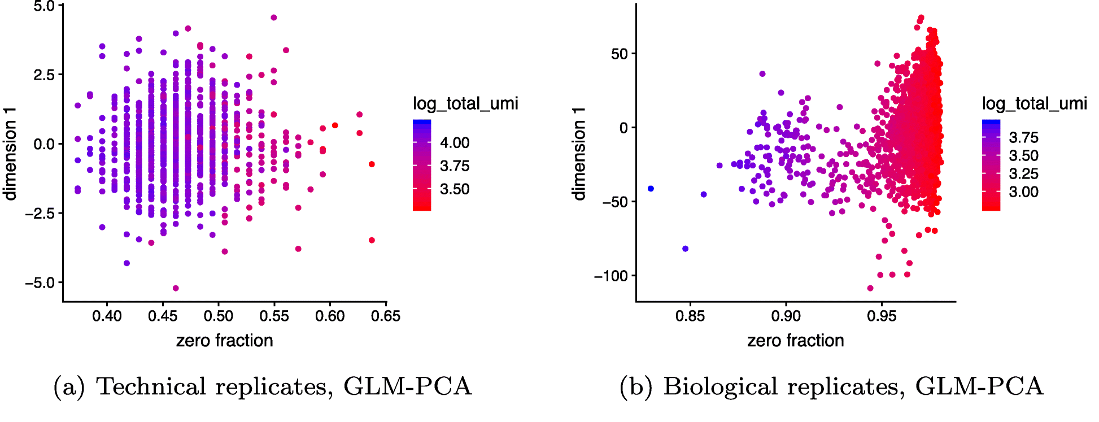
(No cells inside droplets)
All cells are identical
(Townes et al, Genome Biol 2019)

Slide 22
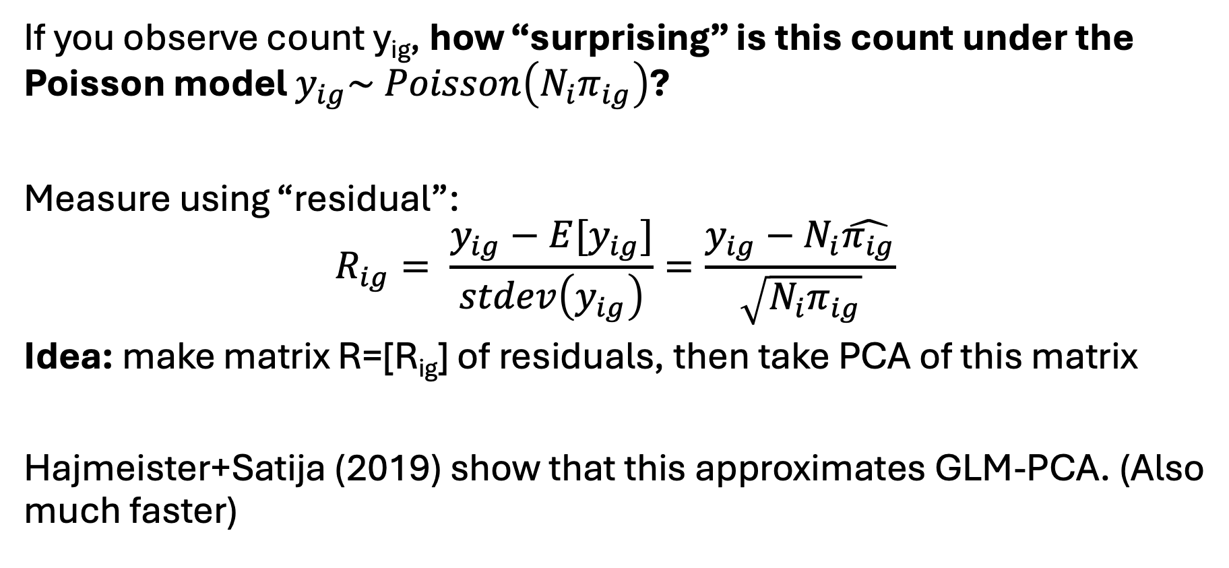
Analytic Pearson residuals (Hafemeister and Satija, 2019)
If you observe count y_{ig}, how “surprising” is this count under the Poisson model $y_{ig}\sim Poisson\left(N_{i}π_{ig}\right)$?
Measure using “residual”:
$$R_{ig}= \frac{y_{ig}−E[y_{ig}]}{stdev\left(y_{ig}\right)}=\frac{y_{ig}−N_{i}\hat{π_{ig}}}{\sqrt{N_{i}π_{ig}}}$$
Idea: make matrix R=[R_{ig}] of residuals, then take PCA of this matrix
Hajmeister+Satija (2019) show that this approximates GLM-PCA. (Also much faster)

Slide 23
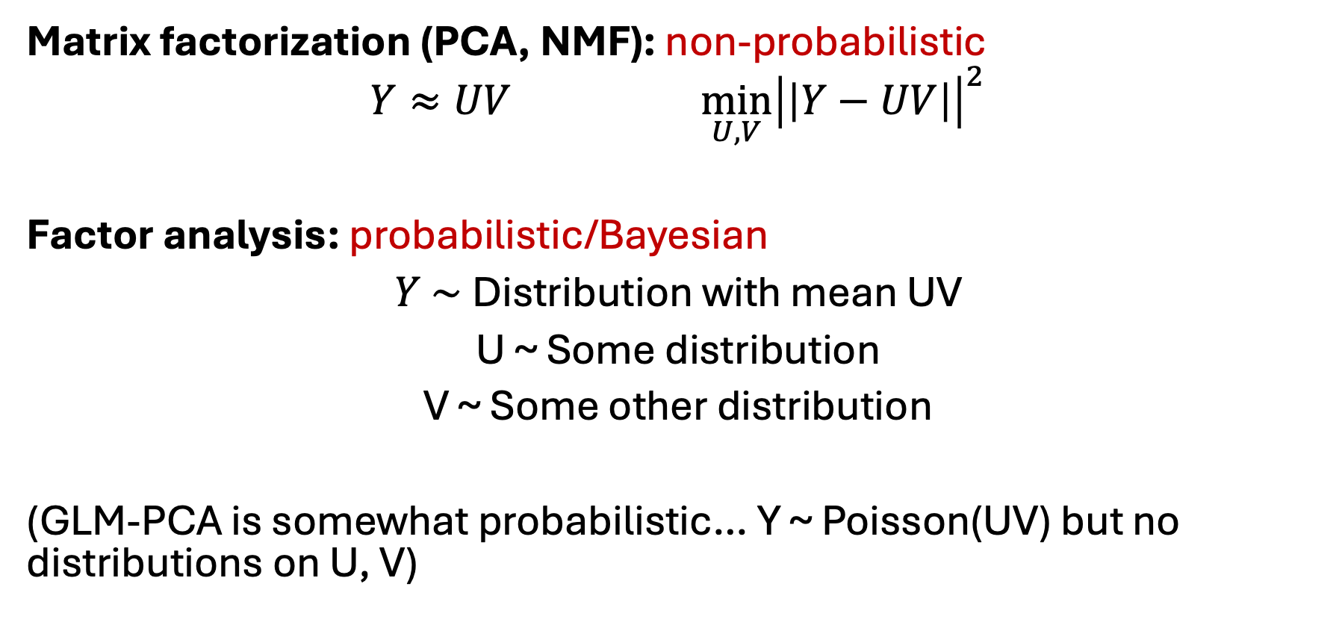
Factor analysis
Matrix factorization (PCA, NMF): non-probabilistic
$$Y≈UV \min_{U,V}{{\left|\left|Y−UV\right|\right|}^{2}}$$
Factor analysis: probabilistic/Bayesian
$Y \sim$Distribution with mean UV
U ~ Some distribution
V ~ Some other distribution
(GLM-PCA is somewhat probabilistic… Y ~ Poisson(UV) but no distributions on U, V)

Slide 24
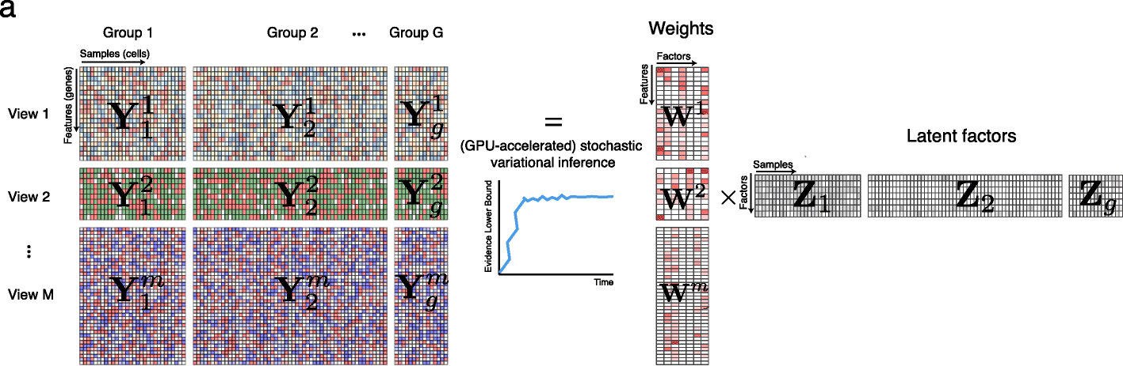
MOFA+: matrix factorization across multiple modalities/samples
Supports multiple distributions on data matrix Y: Gaussian (continuous), Poisson/negative binomial (discrete)
Useful for multimodal data (views) where different modalities have different distributions; e.g. protein expression different from gene expression
MOFA+ (Argelaguet et al, Genome Biol 2022)

Slide 25
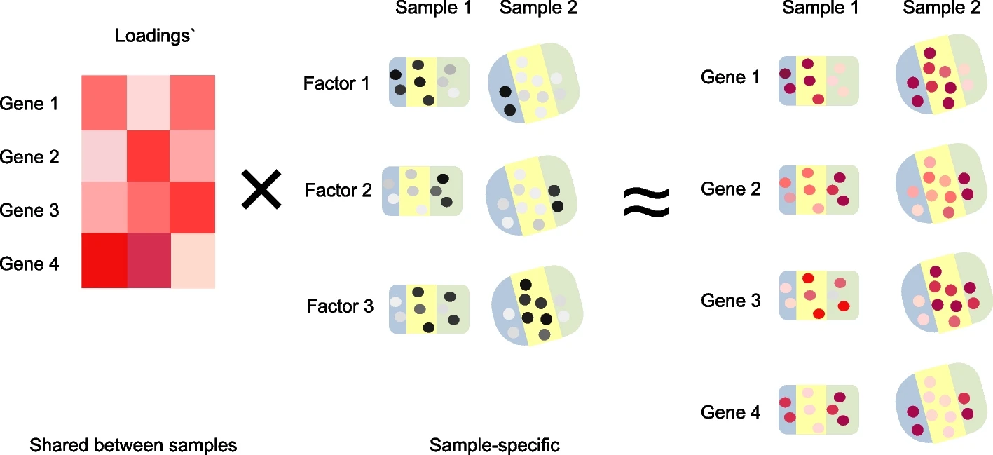
Non-negative spatial factorization (NSF)
Loadings V
Factors U
Uses a “Gaussian Process prior” – a distribution over functions in space
NSF: Townes and Engelhardt, Nature Methods 2023; mNSF: Wang et al, Genome Biol 2025

Slide 26
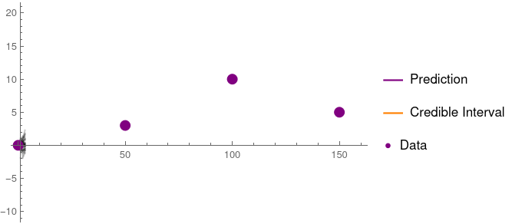
Illustrations of Gaussian processes
Think of these as distributions over functions f(x) or f(x,y).
Each line is a “sample” from your distribution over functions f(x)
[For spatial transcriptomics, imagine this idea but in 2-D]

Slide 27
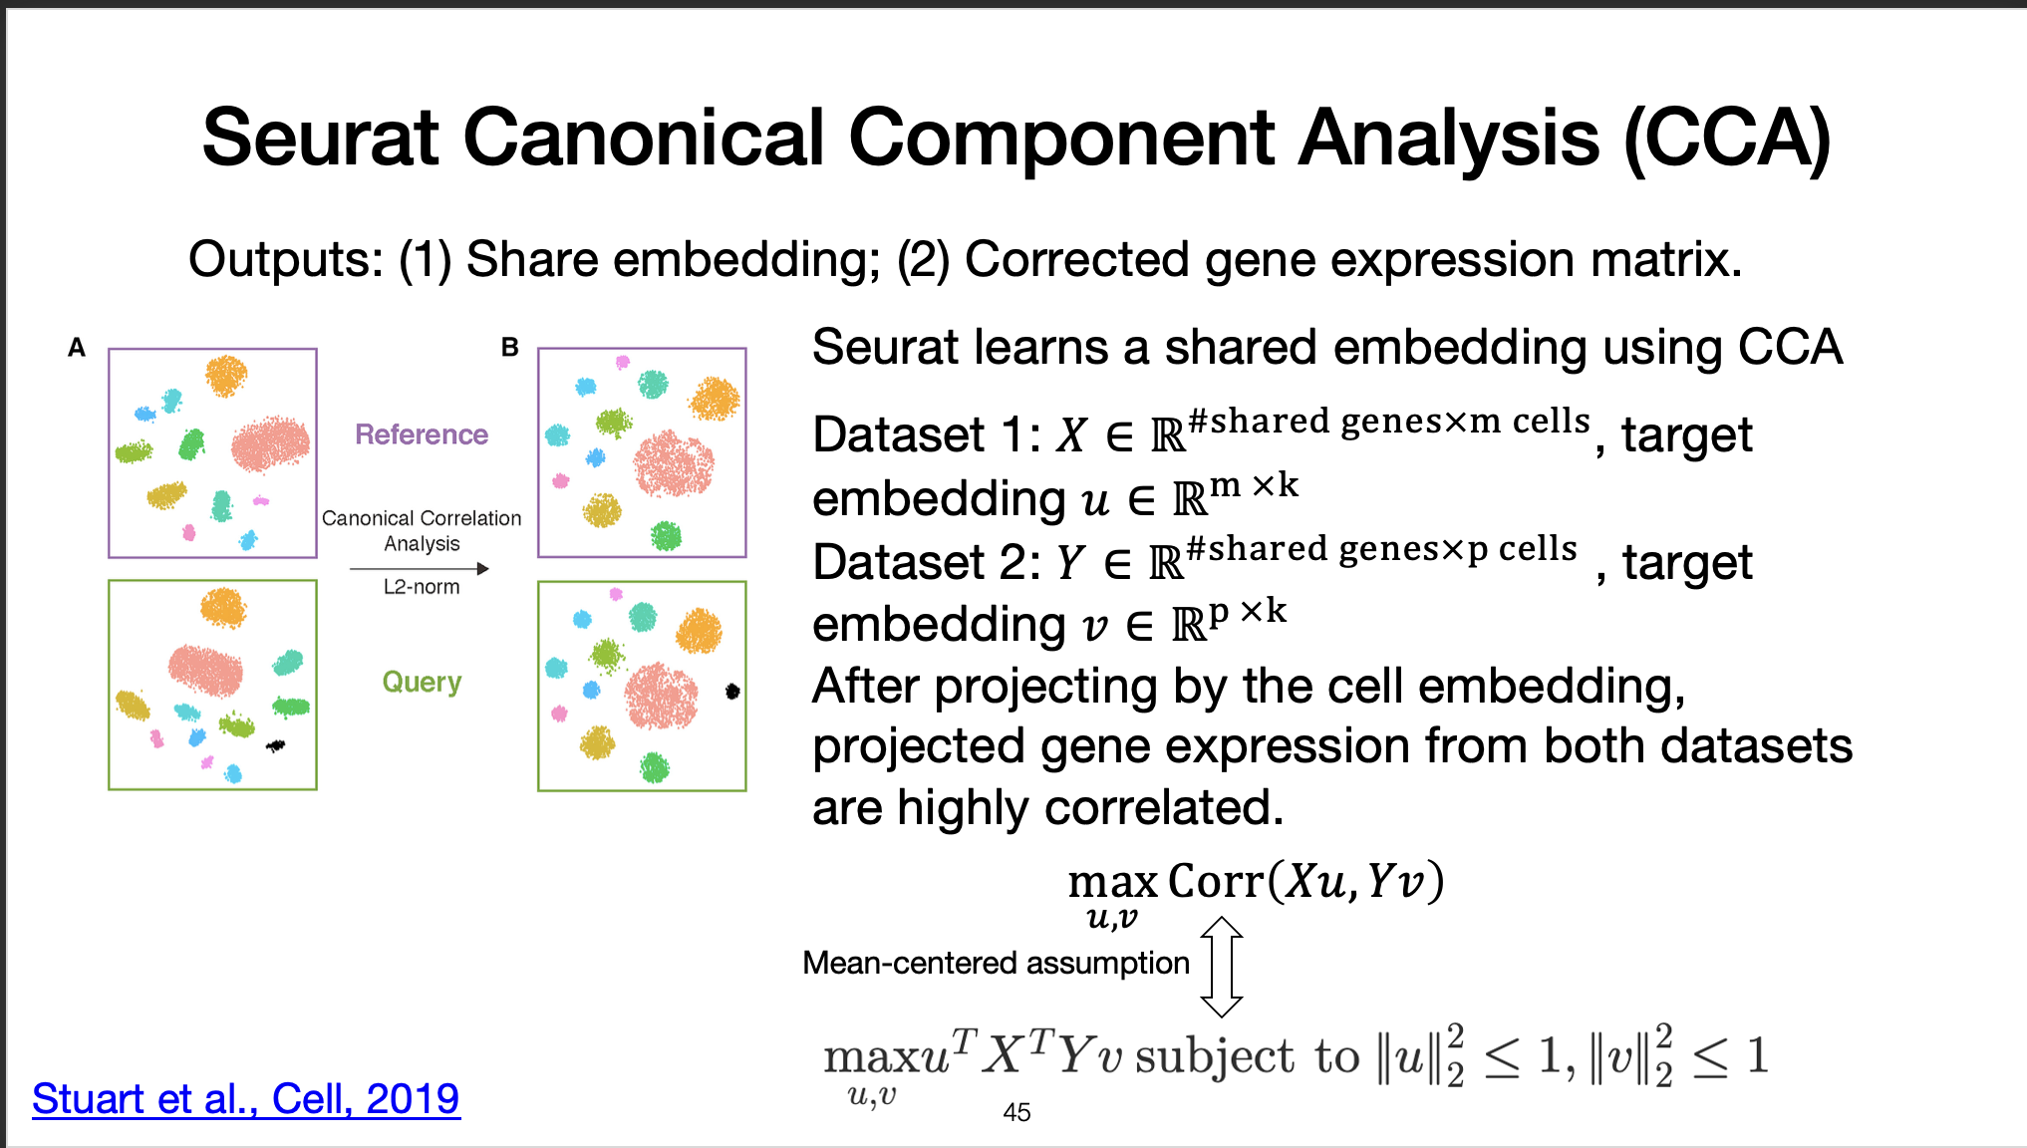

Slide 28
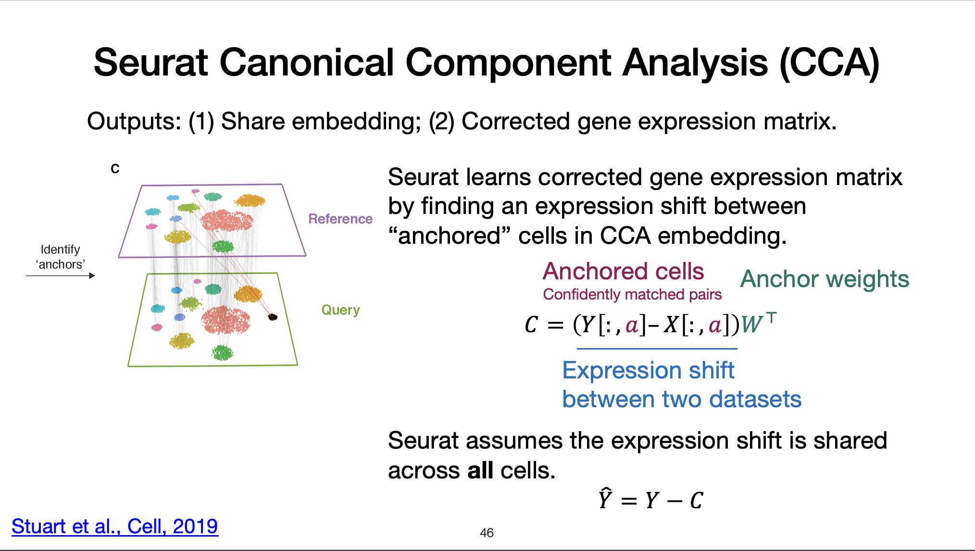

Slide 29
Summary
Standard single cell workflow: normalization -> HVG selection -> PCA
Normalization / PCA implicitly make assumptions that data is continuous. Not true for count data
GLM-PCA is a count-aware PCA using Poisson distributions
  Analytic Pearson residuals provide fast approximation
Factor analysis is a purely probabilistic formulation of matrix factorization.
  MOFA - integration of multiple modalities/samples
  Non-negative spatial factorization (NSF)
Canonical Correlation Analysis: find correlated directions across datasets; used by popular package Seurat. See homework!

Slide 30
In-class lab!

