Slide 1
Machine Learning for Single-Cell and Spatial Biology
Prof. Uthsav Chitra
Johns Hopkins University
September 1, 2026

Slide 2
Today
Welcome!
Course logistics
Introduction to single-cell and spatial sequencing

Slide 3
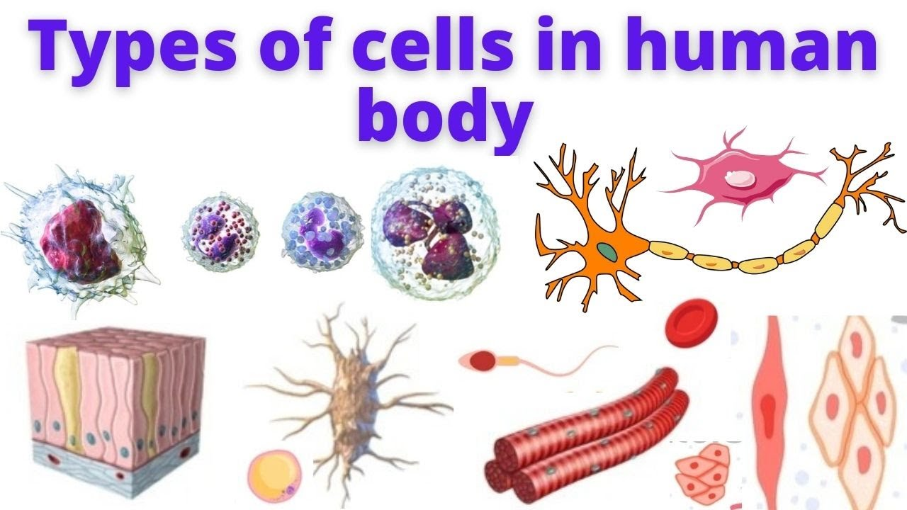
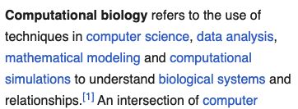
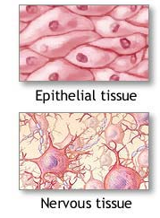
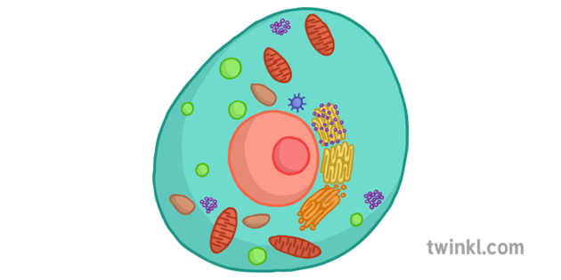
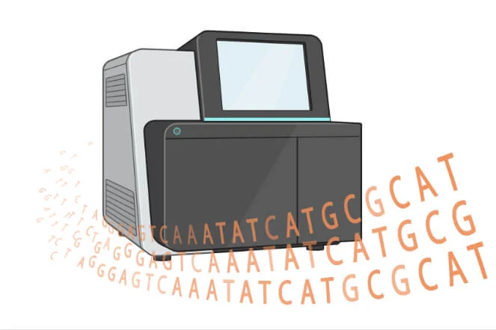
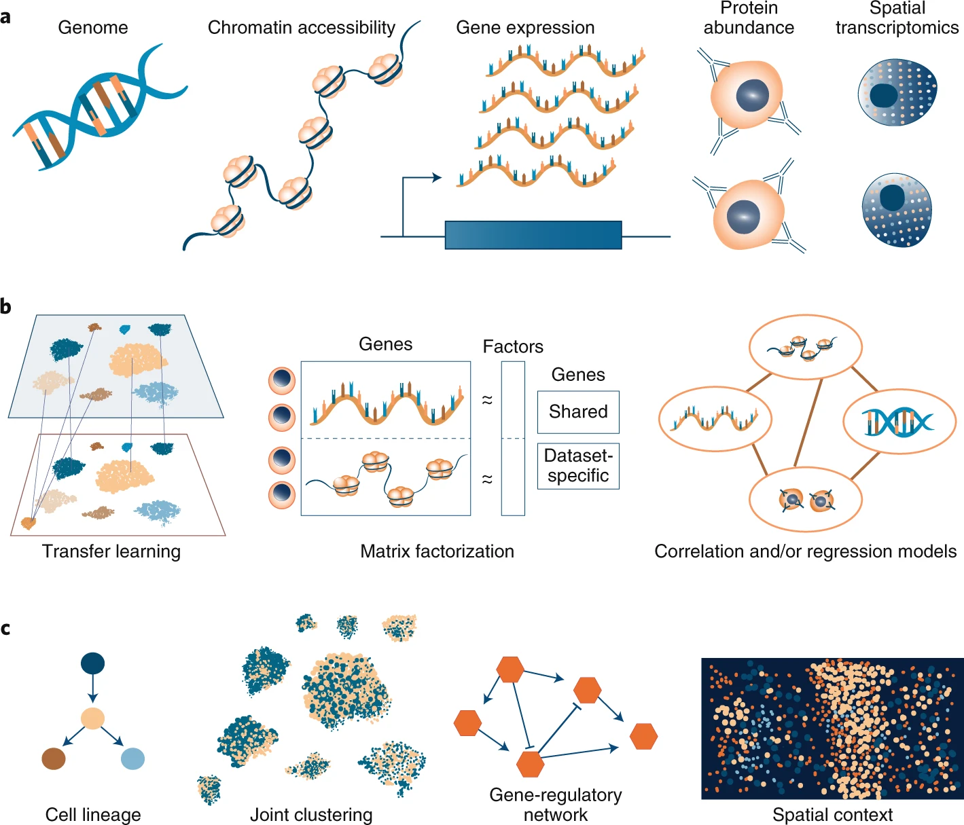
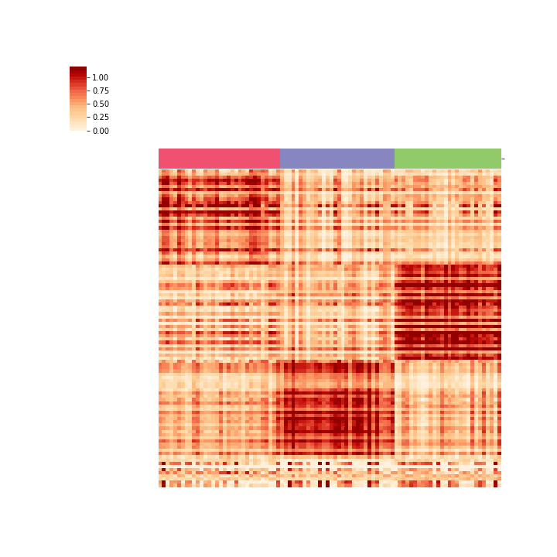
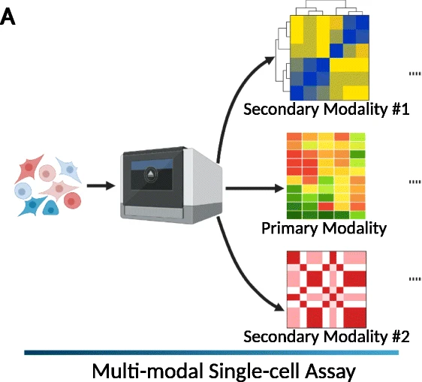
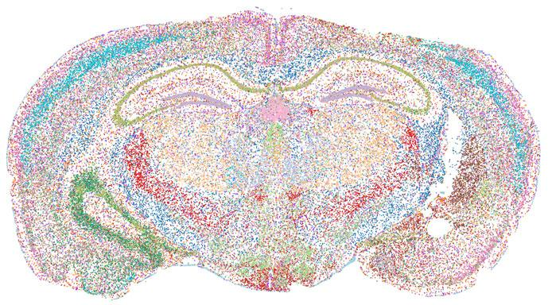
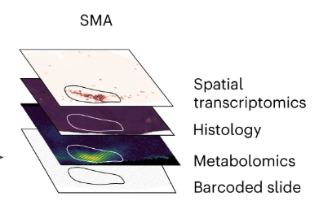
This class: ML methods to understanding cells/tissues in our body
Multi-modal, single-cell / spatial data
Different types of cells and tissues
machine learning
Sequencing / imaging machine
Genomic features (RNA, DNA, protein, …)
Wikipedia
Cells
…
Large data – need sophisticated ML methods to analyze and understand it!
Many datasets!

Slide 4
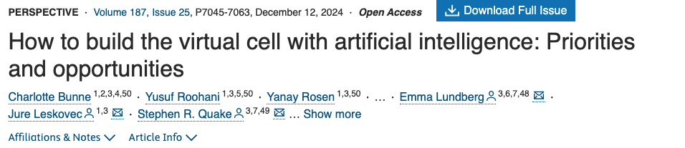
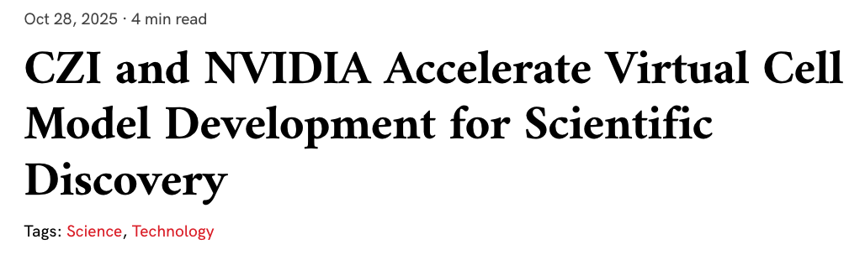
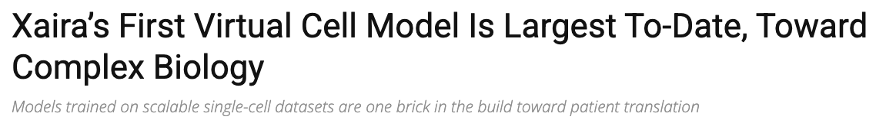
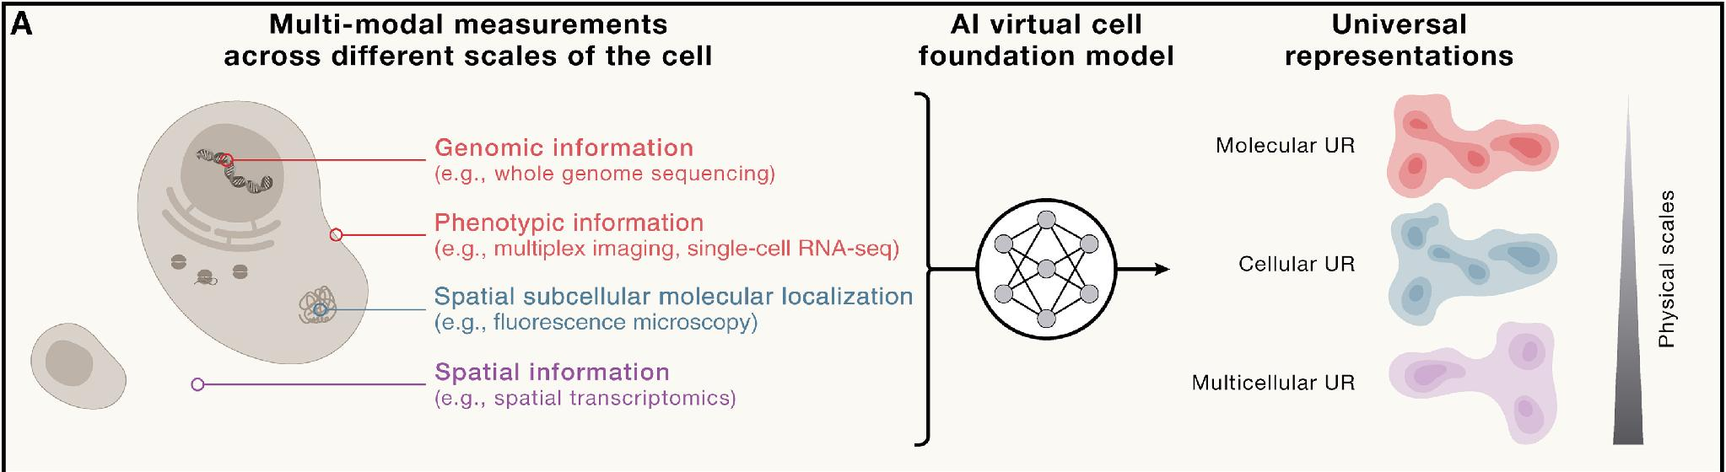
Recent news: AI/ML-powered “virtual cells”
But… what is a virtual cell?

Slide 5
Objectives
Learn fundamental methodology (ML/stats) for single-cell/spatial analysis
Understand state-of-the-art single cell and spatial analysis algorithms
Develop scientific communication and presentation skills
Gain hands-on experience analyzing genomic data
Our goal is for you to leave this course with the ML know-how to improve and expedite your own single cell/spatial research
(And maybe learn what a virtual cell is)

Slide 6
Instructor + teaching assistant
Add pic of Uthsav, sai, …

Slide 7
Logistics: canvas

Slide 8
Logistics: grading

Slide 9
Homeworks

Slide 10
Exams

Slide 11
Final project

Slide 12
Logistics: prerequisites

Slide 13
Class focus [update from Alexis]
This class will
Teach applications of ML and stats to genomics including current common data types
Cover designing and selecting good approaches for current major problems in genomics
Teach you to think critically about assumptions, caveats, and confounders in biological data analysis
This class will not
Provide theoretical background on specific ML methods, or substitute for an Intro ML course
Substitute for a genetics class

Slide 14
Introduction to single cell/spatial -omics data

Slide 15
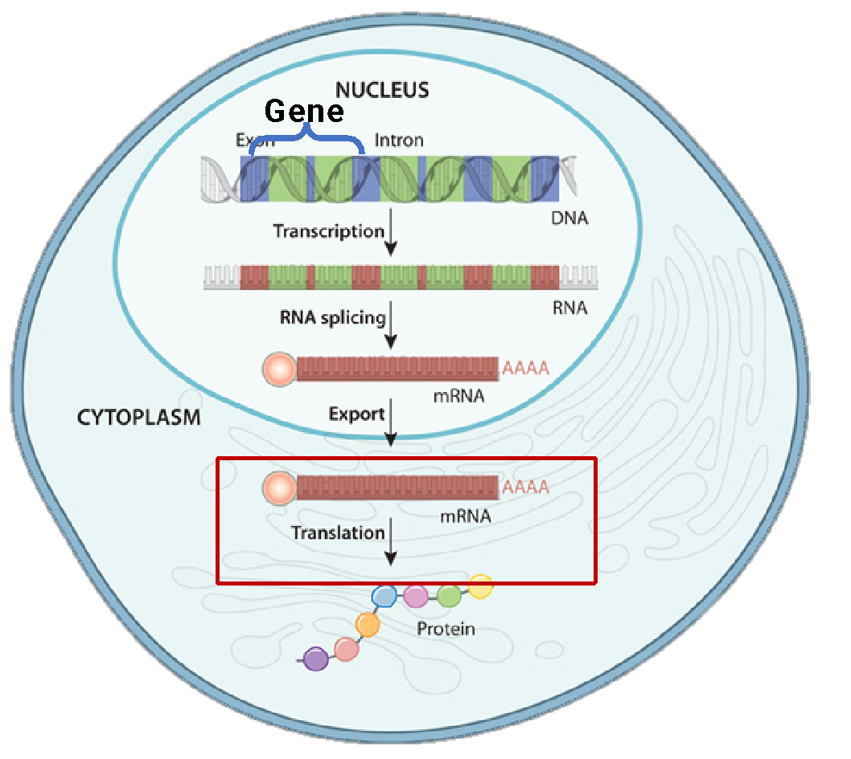
Gene expression determines cell type and function
mRNA transcript
gene C
gene A
gene B
gene C
gene B
gene A
Gene expression = number of mRNA transcripts
Notes:
Before we delve any deeper into this topic I will first briefly review gene expression and RNA sequencing.
Gene expression is the quantity and relative proportions of mRNA transcripts in a cell. These mRNA transcripts are transcribed from genes within the genome and then translated into proteins, so in this way the gene expression, or the expression of mRNA transcripts, determines cell type and function

Slide 16
Gene expression determines cell type and function
mRNA transcript
Microarray/RNA-seq
gene C
gene A
gene B
Neuron
High expression of gene B
Oligodendrocyte
gene C
gene B
gene A
High expression of gene A
Gene expression = number of mRNA transcripts
Notes:
In this toy example we have two different brain cell types, a neuron and an oligodendrocyte, which have different gene expression.
The neuron has high expression of gene B and the oligodendrocyte has high expression of gene A.

Slide 17
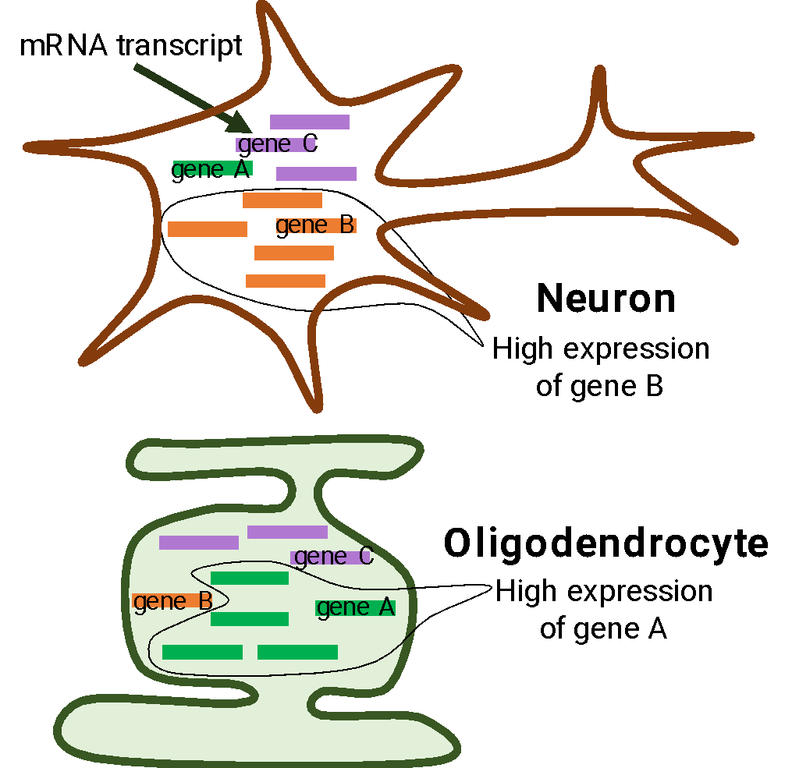
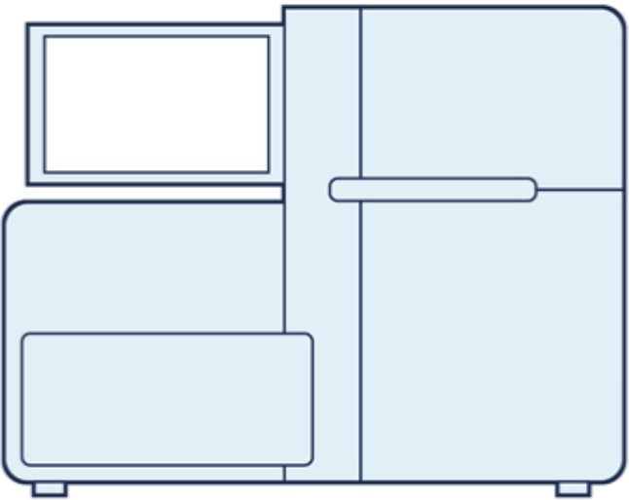
Single cell RNA-sequencing (scRNA-seq) measures gene expression in individual cells
Cell 1
Cells
gene B
Sequencing machine
count = high
Transcript count matrix
Genes
count = 0
gene A
Cell types!
Cell 2
Notes:
The newer technologies are called droplet-based single cell sequencing are more commonly used due to their ability to sequence many more cells. These include drop-seq, inDrops, and 10X Genomics. 10X Genomics droplet based technology is by far the most commonly used currently. With droplet based methods, cells are encapsulated in tiny droplets of oil, where each droplet contains a bead covered in barcodes unique to that droplet. With this technology we can now sequence from 1000 to up to 100,000 cells on a single sequencing run. However this comes at the cost of sequencing only about 70 thousand reads per cell instead of 1 million using plate-based methods.
This ability to assign barcoded reads to cells allows us to retain cell type information and investigate cellular heterogeneity within a single sample.

Slide 18
Single cell RNA-sequencing (scRNA-seq) measures gene expression in individual cells
Cell 1
Cells
gene B
Sequencing machine
count = high
Genes
count = 0
gene A
i-th column = transcript counts for cell i
Cell types!
Cell 2
Notes:
The newer technologies are called droplet-based single cell sequencing are more commonly used due to their ability to sequence many more cells. These include drop-seq, inDrops, and 10X Genomics. 10X Genomics droplet based technology is by far the most commonly used currently. With droplet based methods, cells are encapsulated in tiny droplets of oil, where each droplet contains a bead covered in barcodes unique to that droplet. With this technology we can now sequence from 1000 to up to 100,000 cells on a single sequencing run. However this comes at the cost of sequencing only about 70 thousand reads per cell instead of 1 million using plate-based methods.
This ability to assign barcoded reads to cells allows us to retain cell type information and investigate cellular heterogeneity within a single sample.

Slide 19
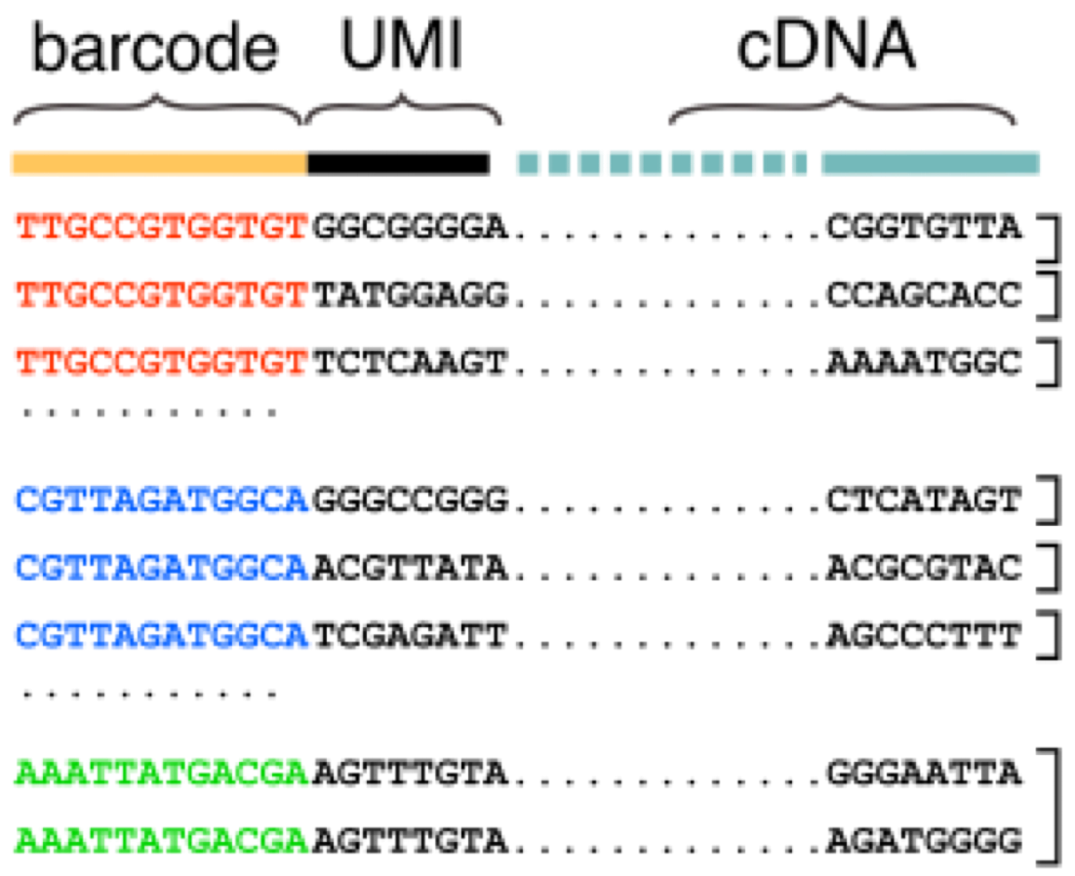
Single-cell sequencing
RNA sequencing
Gene 1
transcript count 3
Source: https://www.tbmcore.cnrs.fr/onecell/?lang=en (if GIF doesn’t work)
Gene 2
transcript count 3
(UMI = unique molecular identifier)
Gene 3
transcript count 2
…
…

Slide 20
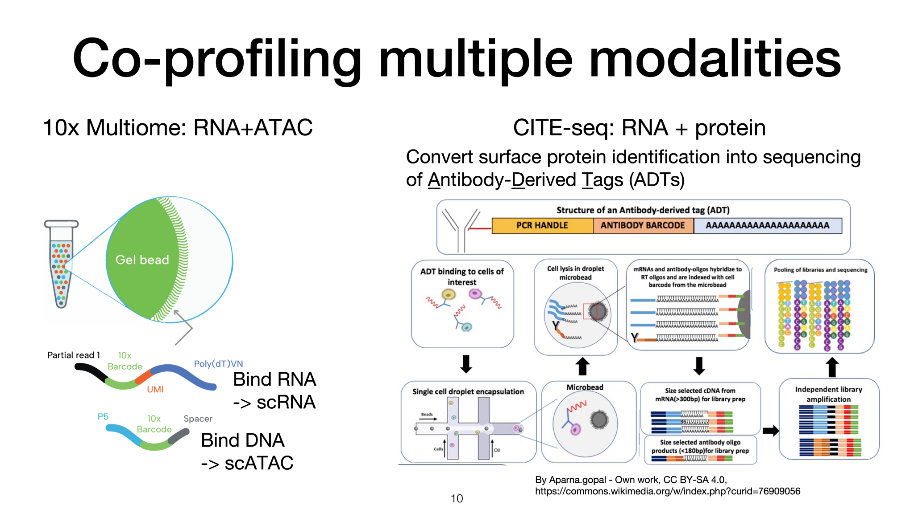

Slide 21
Multi-omics
TODO…

Slide 22
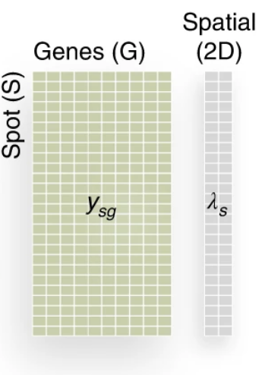


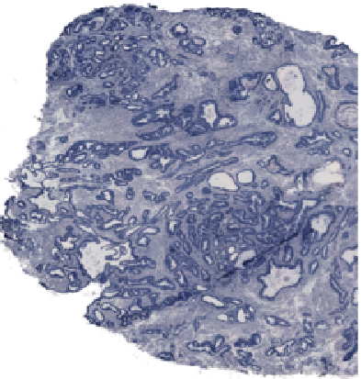
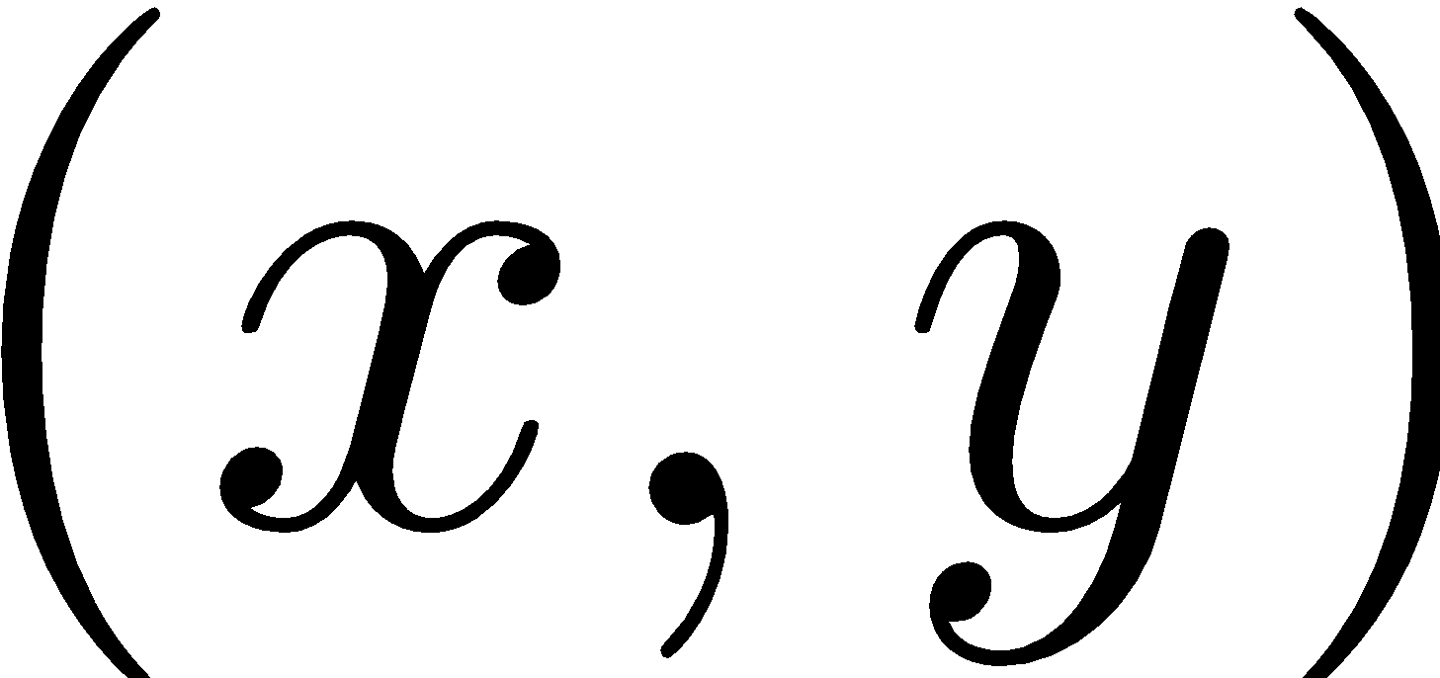
Spatial transcriptomics (spatial sequencing)
Gene expression matrix + spatial coordinates
Spatial (2D)
Genes (features)
2-D tissue
Spatial coordinate of spot
Spots (samples)
Genes
…
Gene expression vector
High-dimensional data:
1,000-20,000 genes (“features”)
1,000s - 1,000,000s spots (“samples”)
Spots may contain <1 cell, 1 cell, or multiple cells
Computational opportunities (and challenges): modeling spatial structure
Notes:
Emphasize that it’s high-dim, multi-modal
How to explain what expression is?
Single cell

Slide 23
Show different spatial sequencing technologies: Visium, Xenium, …

Slide 24
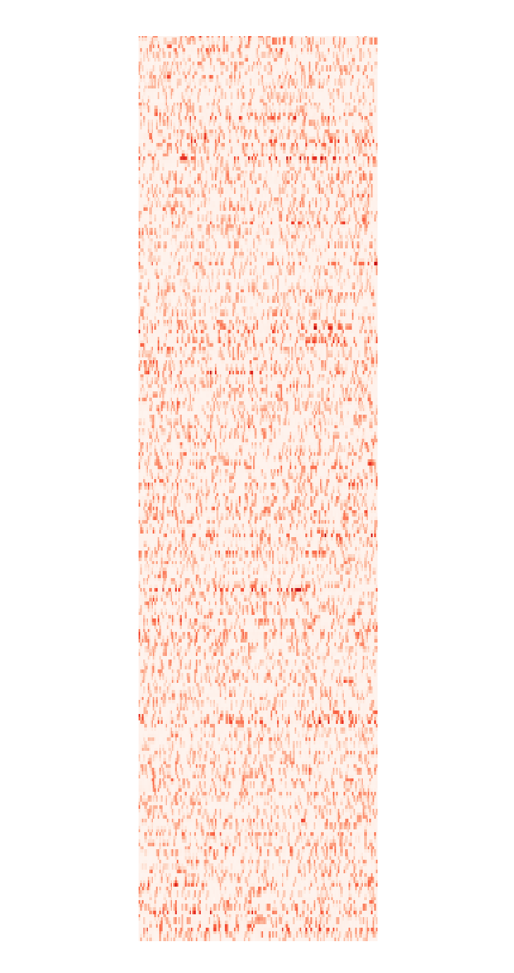
Technical challenges: sparsity and batch effects
Spatial (2D)
Genes (features)
Batch effects:
even if you measure exact same dataset, there will be (large, unknown) differences in measurements
Spots (samples)
Genes
Genes
Cells
Cells
Dataset A measured on Tuesday
Dataset A measured on Wednesday
70-90% zeros!
(or by different people, or with different machine, or …)

Slide 25
Biological challenges: biological structure is subtle and “low dimensional”

Slide 26
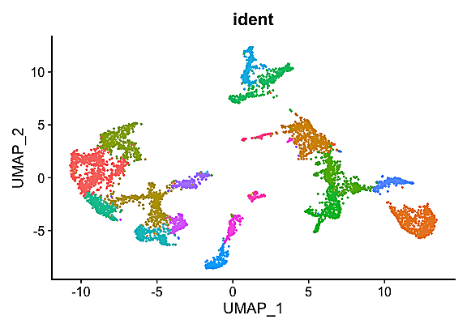
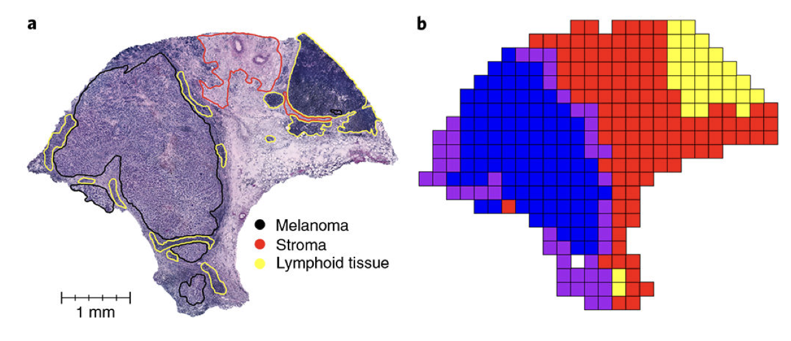
Problems
Dimensionality reduction + data visualization
(Spatial) clustering
Genes
Melanoma
Cells/spots
Single-cell
Zhao et al., Nat. Biotech. (2021)
Data: Thrane, et al. Cancer Res. (2018)
(dot=cell, color = cell types)

Slide 27
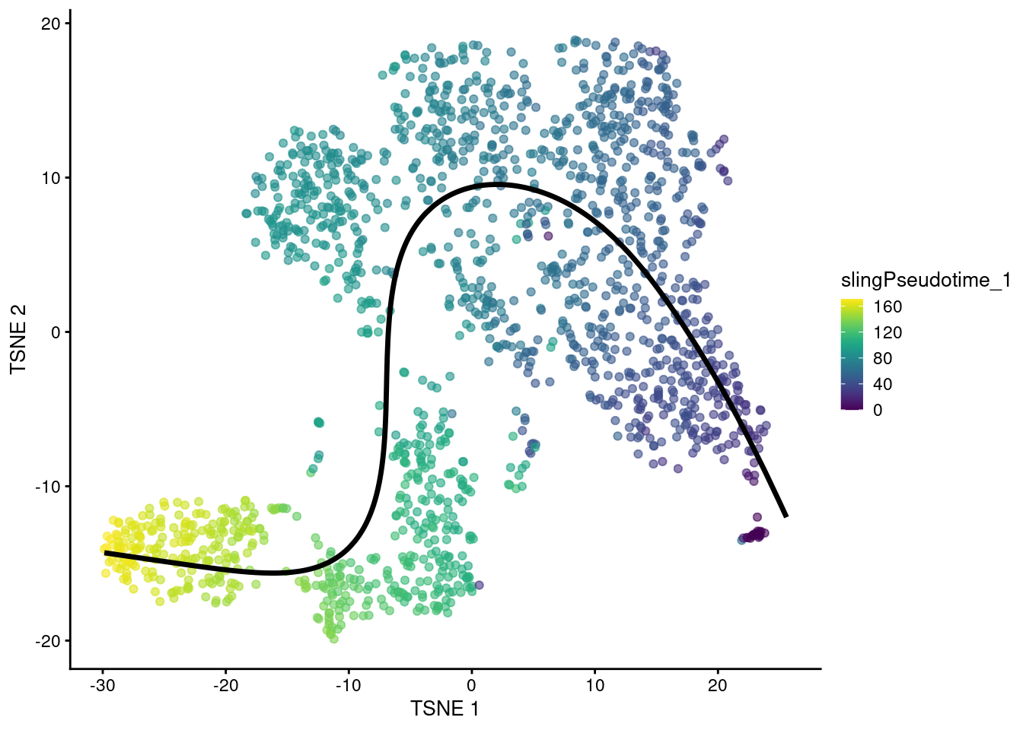
Problems
Trajectory inference
Data integration/differential analysis
Healthy
Diseased
Genes (features)
Genes (features)
Cells/spots
Cells/spots
Data=single snapshot but cells are at different stages
can you infer “pseudo” time ordering of cells?
Cell type disappeared!

Slide 28
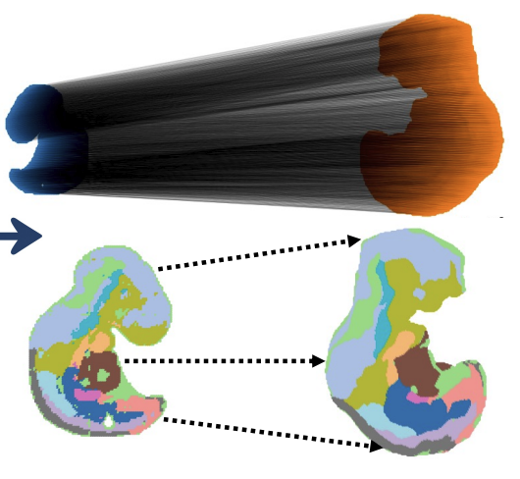
Problems
(Spatio)temporal time series
optimal transport, diffusion, …
Trajectory inference
Data=single snapshot but cells are at different stages
can you infer “pseudo” time ordering of cells?
Mouse embryo E10.5 -> E9.5
Halmos et al, bioRxiv 2025

Slide 29
Add some more applications: segmentation, multi-omics / gene regulatory inference, histology + ST, spatial gradients, foundation models……
Organize applications better

Slide 30
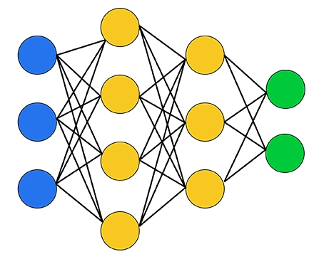
Applications
Foundation models
How to learn insights from large volume of datasets?
Multi-modal data
Genes
Metabolites
DNA
Cells
…

Slide 31
Tentative course roadmap
Part 1: dimensionality reduction
PCA, NMF, factor analysis
Part 2: graphs and manifold learning
Neighborhood graphs, random walks, diffusion, clustering, trajectories
Part 3: optimal transport and flow matching
Next class: refresher on ML/stats

