Slide 1
Probabilistic Matrix Factorization Models
GLM-PCA, factor analysis, and integration
Prof. Uthsav Chitra
Johns Hopkins University
September 15, 2026

Slide 2
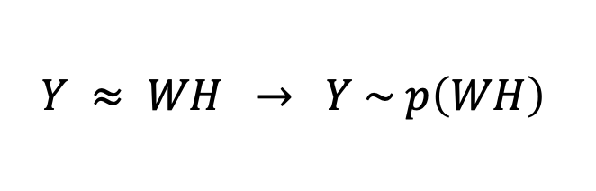
Recap: NMF and the noise-model idea
Last class — nonnegative matrix factorization:
Y ≈ WH with W, H ≥ 0 → additive, interpretable gene programs.
Objective = Frobenius (squared error) or KL divergence.
Key idea for today:
every matrix factorization implicitly assumes a noise model.
Frobenius ⇒ Gaussian noise; KL ⇒ Poisson (count) noise.
Today we make that probabilistic model explicit.
$$Y ≈ WH → Y \sim p\left(WH\right)$$
“factorize the parameters of a distribution”

Slide 3
Today: probabilistic matrix factorization
GLM-PCA — count-aware dimensionality reduction
the problem: normalization + the Gaussian assumption
the fix: a generalized linear model on the counts
Probabilistic factor analysis → MOFA+ (multi-omics)
Nonnegative spatial factorization — a spatial prior on the factors
Integration: CCA and Seurat
In-class lab

Slide 4
Typical single cell workflow
Original data matrix
J genes
N cells
y_{ij}
Entry y_{ij} = number of transcripts (“UMI count”) of gene j in cell i

Slide 5
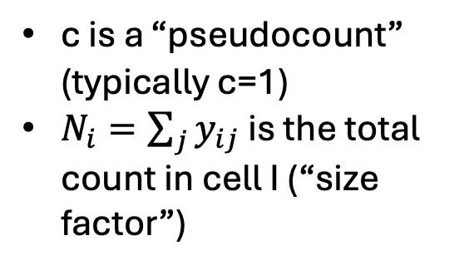


Typical single cell workflow
Original data matrix
Normalization
J genes
J genes
N cells
N cells
y_{ij}
$$z_{ij}$$
$$z_{ij}=log{(c+ \frac{y_{ij}}{N_{i}}×{10}^{6})}$$
Entry y_{ij} = number of transcripts (“UMI count”) of gene j in cell i
c is a “pseudocount” (typically c=1)
$N_{i}=\sum_{j}{y_{ij}}$ is the total count in cell I (“size factor”)

Slide 6
Typical single cell workflow
Highly variable gene selection
Original data matrix
Normalization
J genes
J genes
J’<J genes
N cells
N cells
N cells
y_{ij}
$$z_{ij}$$
$$z_{ij}=log{(c+ \frac{y_{ij}}{N_{i}}×{10}^{6})}$$
Entry y_{ij} = number of transcripts (“UMI count”) of gene j in cell i
Typically select top J’=1000-2000 genes according to some metric (e.g. variance)
c is a “pseudocount” (typically c=1)
$N_{i}=\sum_{j}{y_{ij}}$ is the total count in cell I (“size factor”)

Slide 7
Typical single cell workflow
Principal component analysis
Highly variable gene selection
Original data matrix
Normalization
J genes
J genes
J’<J genes
10-20 PCs
N cells
N cells
N cells
N cells
y_{ij}
$$z_{ij}$$
$$z_{ij}=log{(c+ \frac{y_{ij}}{N_{i}}×{10}^{6})}$$
Entry y_{ij} = number of transcripts (“UMI count”) of gene j in cell i
Typically select top J’=1000-2000 genes according to some metric (e.g. variance)
c is a “pseudocount” (typically c=1)
$N_{i}=\sum_{j}{y_{ij}}$ is the total count in cell I (“size factor”)

Slide 8
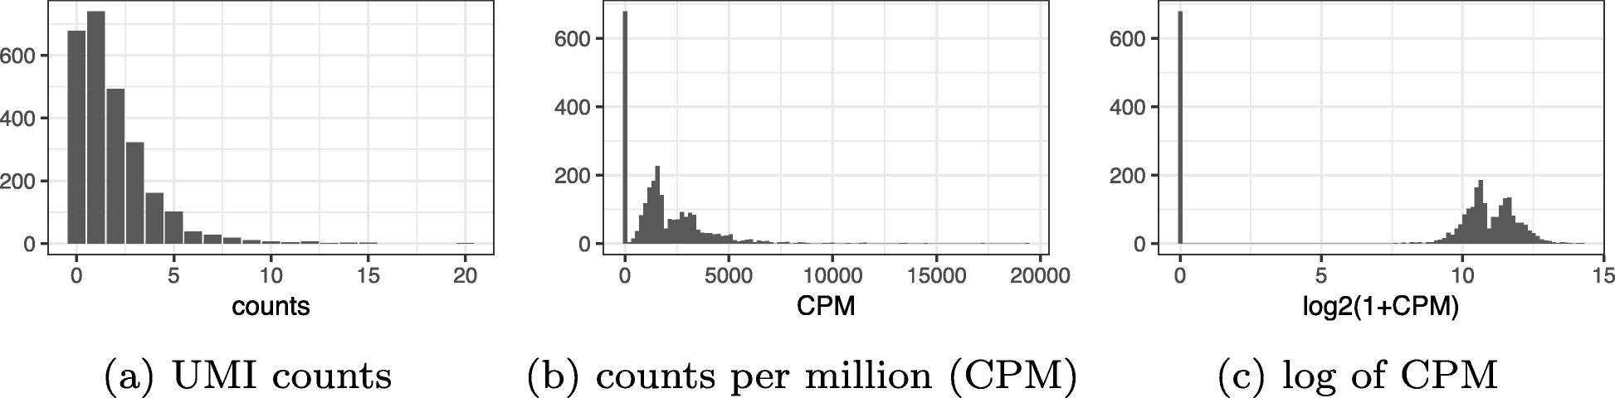

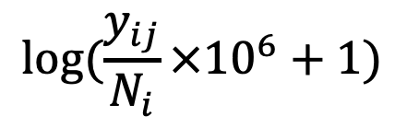
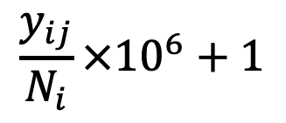

Issues with typical single cell workflow
Original data matrix
Normalization
J genes
J genes
N cells
N cells
Distorts counts – makes zeros much smaller than non-zeros!
y_{ij}
$$z_{ij}$$
$$z_{ij}=log{(c+ \frac{y_{ij}}{N_{i}}×{10}^{6})}$$
$$y_{ij}$$
$$\frac{y_{ij}}{N_{i}}×{10}^{6}+1$$
$$log⁡(\frac{y_{ij}}{N_{i}}×{10}^{6}+1)$$

Slide 9
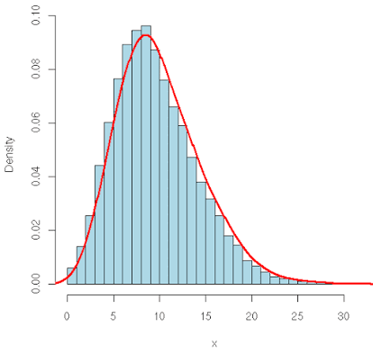
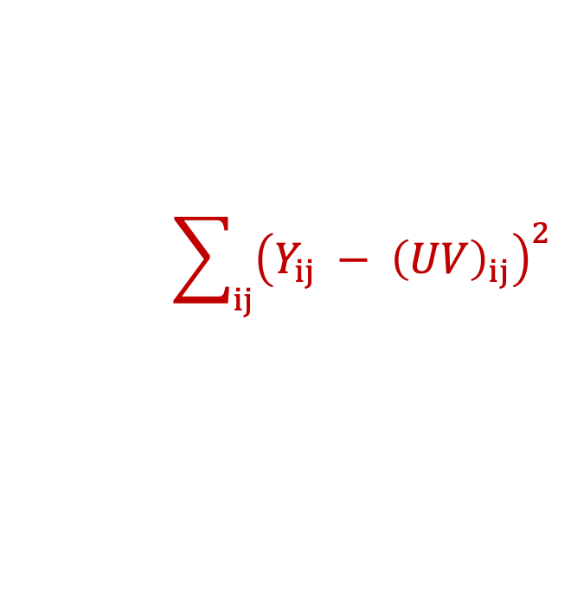
Issues with typical single cell workflow
Principal component analysis
Highly variable gene selection
Original data matrix
Normalization
J genes
J genes
J’<J genes
10-20 PCs
N cells
N cells
N cells
N cells
y_{ij}
PCA loss implicitly assumes data is continuous – but UMI counts are discrete!
$$\sum_{ij}{{\left(Y_{ij} − {\left(UV\right)}_{ij}\right)}^{2}}$$

Slide 10
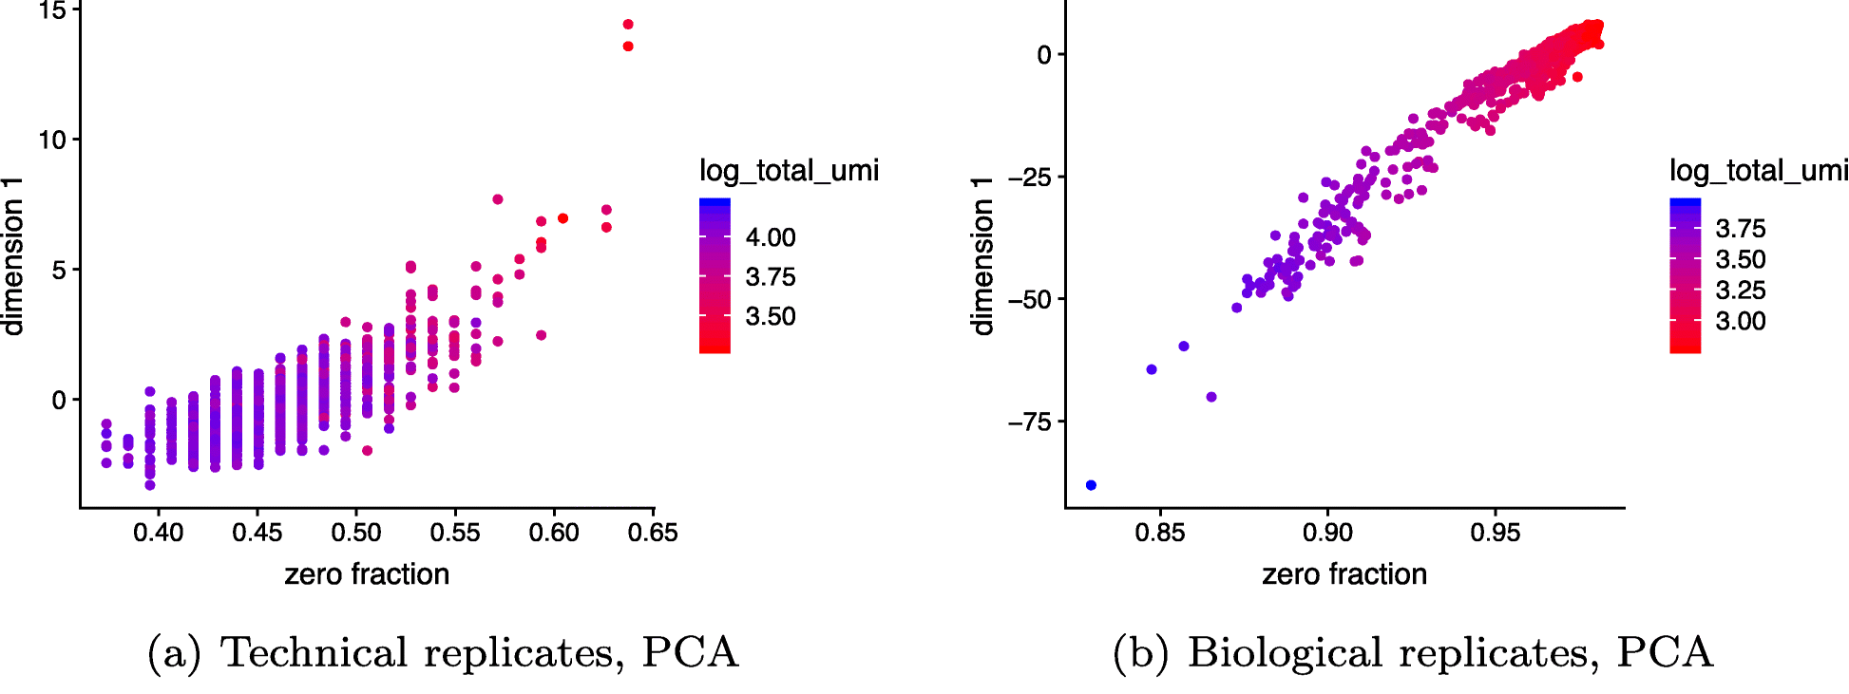

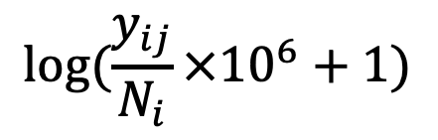
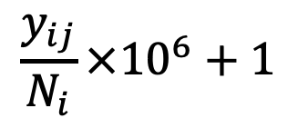
Top PC confounded by technical artifacts (fraction of zeros in cell)
$$y_{ij}$$
$$\frac{y_{ij}}{N_{i}}×{10}^{6}+1$$
$$log⁡(\frac{y_{ij}}{N_{i}}×{10}^{6}+1)$$
Top PC captures zero fraction
(No cells inside droplets)
All cells are identical

Slide 11
Today
Probabilistic methods that model distribution of single cell UMI counts
Multinomial/Poisson model -> negative binomial
GLM-PCA / analytic Pearson residuals
Extensions
MOFA+
Non-negative spatial factorization
-> In-class lab!

Slide 12
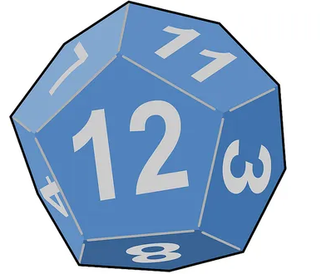
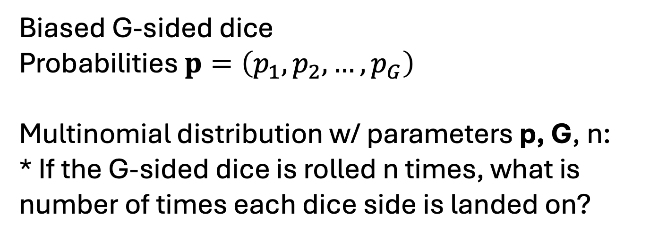
Multinomial distribution
Biased G-sided dice
Probabilities $p=\left(p_{1},p_{2}, …, p_{G}\right)$
Multinomial distribution w/ parameters p, G, n:
* If the G-sided dice is rolled n times, what is number of times each dice side is landed on?
Suppose:
G=2
p=(1/4,3/4) (biased coin flip)
n=10
Multinomial distribution describes # heads if you flip coin n=10 times

Slide 13
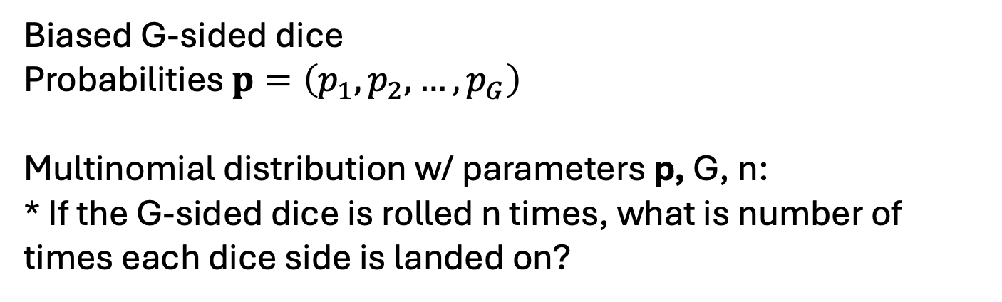
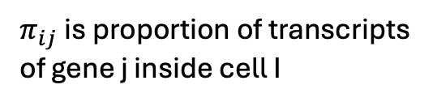


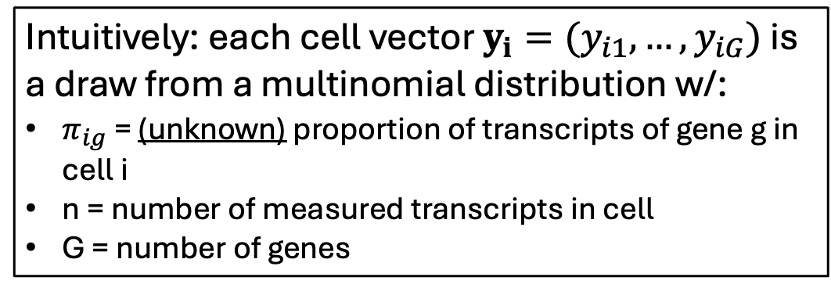
Multinomial distribution + single-cell
gene C
gene B
gene A
Biased G-sided dice
Probabilities $p=\left(p_{1},p_{2}, …, p_{G}\right)$
Multinomial distribution w/ parameters p, G, n:
* If the G-sided dice is rolled n times, what is number of times each dice side is landed on?
Intuitively: each cell vector $y_{i}=(y_{i1}, …, y_{iG})$ is a draw from a multinomial distribution w/:
$π_{ig}$ = (unknown) proportion of transcripts of gene g in cell i
n = number of measured transcripts in cell
G = number of genes
G genes
J genes
N cells
$$π_{1}=(π_{11}, …, π_{1G})$$
N cells
y_{i}
…
$$π_{N}=(π_{N1}, …, π_{NG})$$
$π_{ij}$is proportion of transcripts of gene j inside cell I

Slide 14
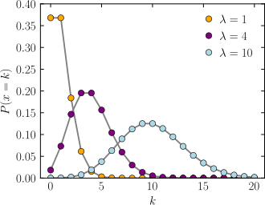
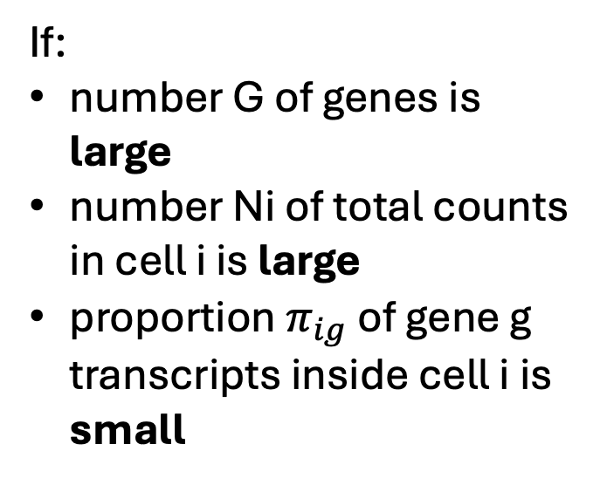


Multinomial $≈$ independent Poissons
If:
number G of genes is large
number Ni of total counts in cell i is large
proportion $π_{ig}$ of gene g transcripts inside cell i is small
Each gene expression count y_{ij} is independent and approximately distributed as
Can prove
$$y_{ig}\sim Poisson(N_{i}π_{ig})$$

Slide 15
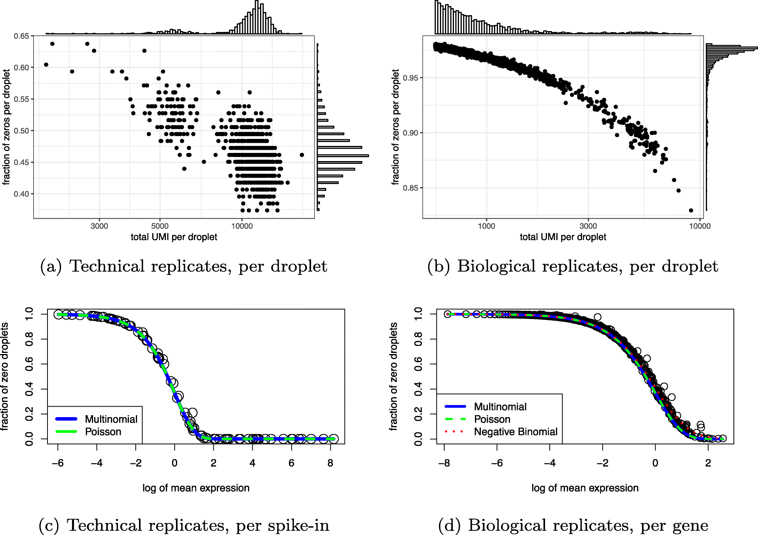
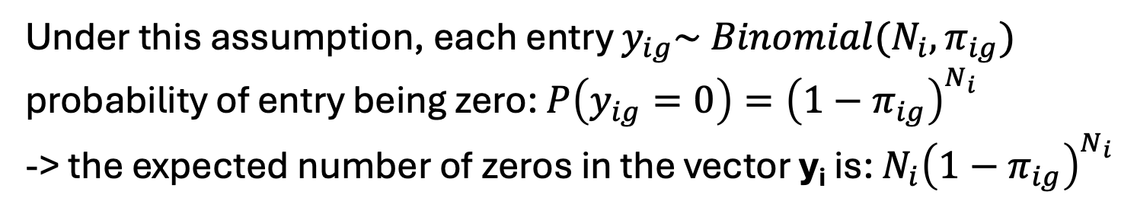
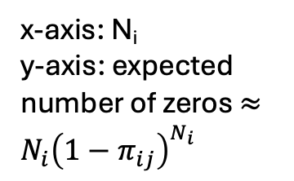
Empirically testing multinomial/Poisson models
Assumption: each gene expression vector $y_{i}=(y_{i1}, …, y_{iG})$ for cell i is sampled independently from Multinomial($π_{i}$, G, N_{i})
Under this assumption, each entry $y_{ig}\sim Binomial(N_{i}, π_{ig})$
probability of entry being zero: $P\left(y_{ig}=0\right)={\left(1−π_{ig}\right)}^{N_{i}}$
-> the expected number of zeros in the vector y_{i} is: $N_{i}{\left(1−π_{ig}\right)}^{N_{i}}$
x-axis: N_{i}
y-axis: expected number of zeros $≈N_{i}{\left(1−π_{ij}\right)}^{N_{i}}$

Slide 16

Empirically testing multinomial/Poisson models
Assumption: each gene expression vector $y_{i}=(y_{i1}, …, y_{iG})$ for cell i is sampled independently from Multinomial($π_{i}$, G, N_{i})
Each gene expression count y_{ig} is independent and approximately distributed as
$$y_{ig}\sim Poisson(N_{i}π_{ig})$$

Slide 17

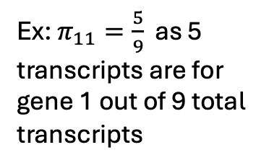

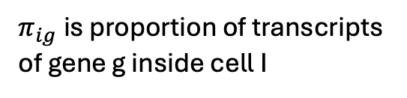
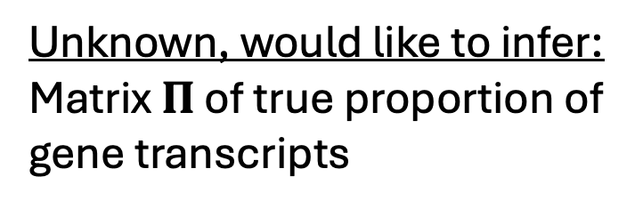

Setup
Unknown, would like to infer: Matrix $Π$ of true proportion of gene transcripts
Observed data: UMI count matrix Y (gene expression matrix)
gene 3
gene 2
gene 1
J genes
J genes
y₁
N cells
$$π_{1}=(π_{11}, …, π_{1G})$$
Ex: $π_{11}=\frac{5}{9}$ as 5 transcripts are for gene 1 out of 9 total transcripts
N cells
$$π_{2}=(π_{21}, …, π_{2G})$$
y₂
…
y_{N}
$$π_{N}=(π_{N1}, …, π_{NG})$$
$π_{ig}$is proportion of transcripts of gene g inside cell I
Problem: Given Y with rows y_{i} ~ Multinomial($π_{i}$, G, N_{i}), estimate the proportion matrix $Π$.

Slide 18



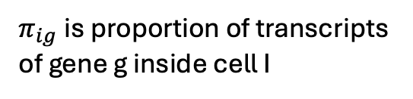

Poisson-PCA problem (GLM-PCA)
(Townes et al, Genome Biol 2019)
UMI count matrix Y (gene expression matrix)
Matrix $Π$ of true proportion of gene transcripts (unknown)
Assume $Π$ is low rank
J genes
G genes
y₁
$$π_{1}=(π_{11}, …, π_{1G})$$
N cells
N cells
V
y₂
$$π_{2}=(π_{21}, …, π_{2G})$$
=
…
U
y_{N}
$$π_{N}=(π_{N1}, …, π_{NG})$$
$π_{ig}$is proportion of transcripts of gene g inside cell I
(Different than PCA, which directly assumes Y is low rank)
Problem: Given Y with rows y_{i} ~ Multinomial($π_{i}$, G, N_{i}) (or $y_{ig} \sim Poisson(N_{i}π_{ig})$ ) estimate U, V such that $Π≈UV$.

Slide 19
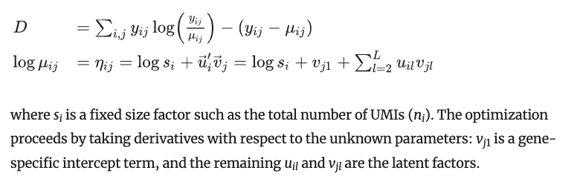
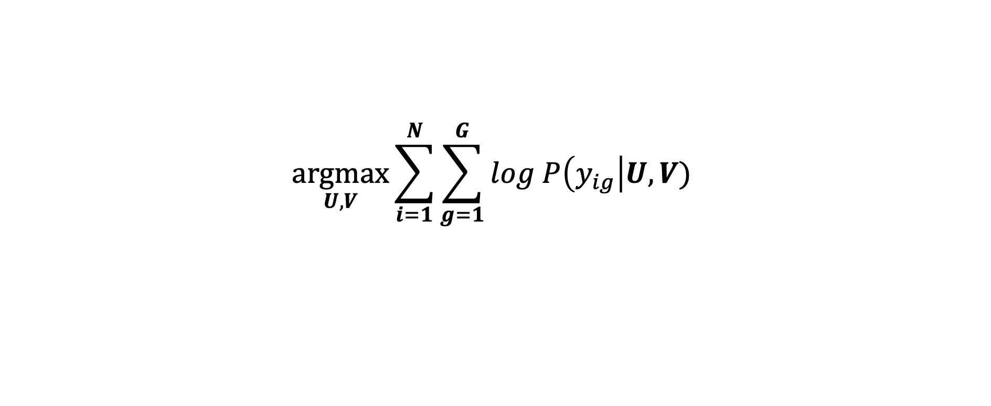

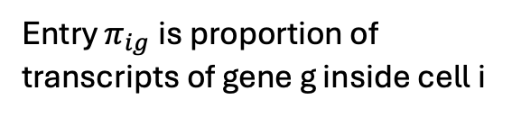
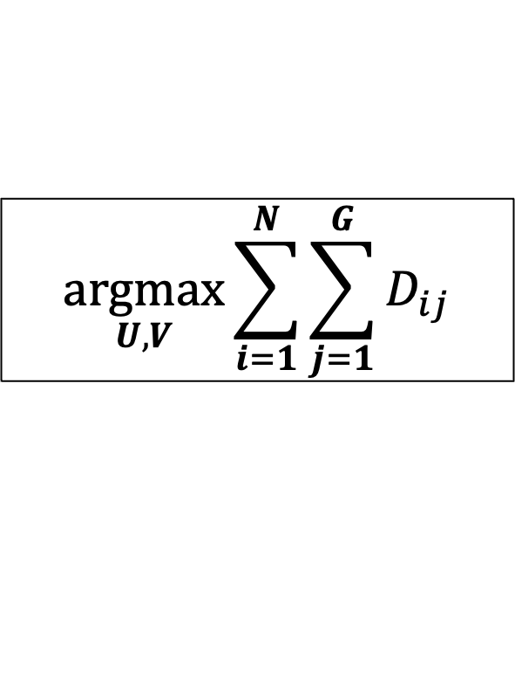
where D_ij is “deviance”:
Problem: Given Y with $y_{ig} \sim Poisson(N_{i}π_{ig})$ estimate U, V such that $Π≈UV$.
Maximum Likelihood Estimation (MLE): find U, V, that maximize likelihood of observed data
$$\underset{U, V}{argmax}{\sum_{i=1}^{N}{\sum_{g=1}^{G}{log P\left(y_{ig}\right|U, V)} }}$$
G genes
N cells
V
=
$$Π$$
U
Entry $π_{ig}$is proportion of transcripts of gene g inside cell i
$$\underset{U, V}{argmax}{\sum_{i=1}^{N}{\sum_{j=1}^{G}{D_{ij}}}}$$

Slide 20
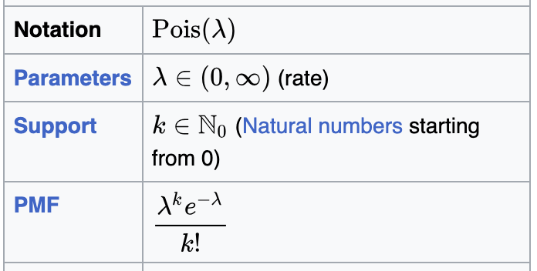

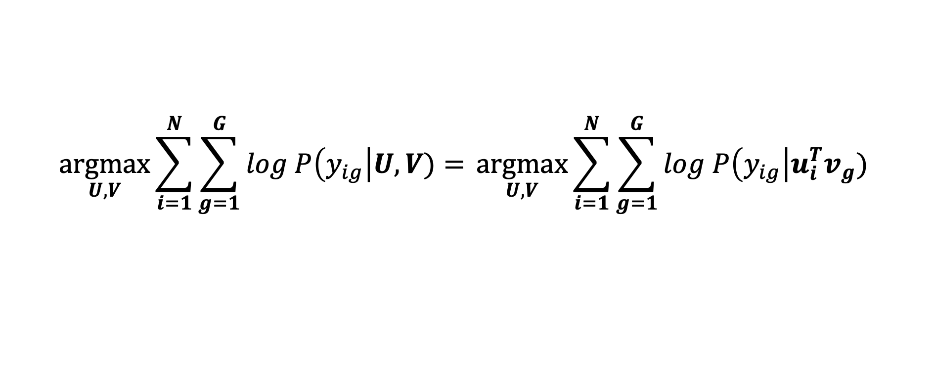
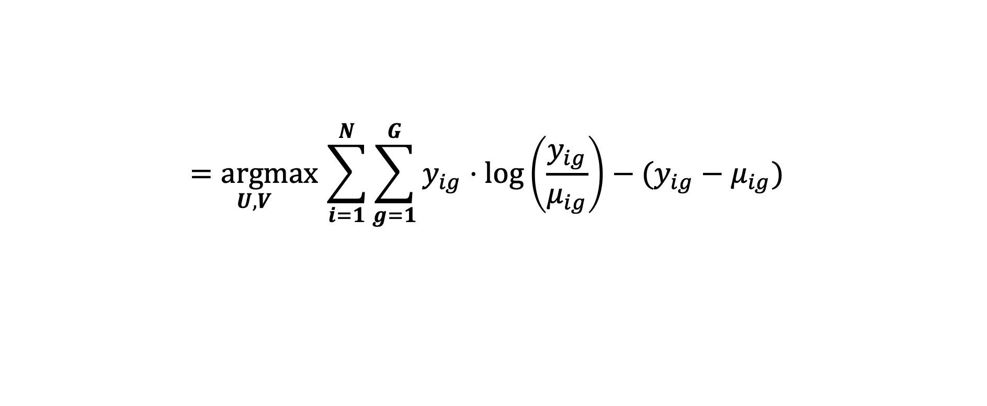
where D_ij is “deviance”:
Problem: Given Y with $y_{ig} \sim Poisson(N_{i}π_{ig})$ estimate U, V such that $Π≈UV$.
Maximum Likelihood Estimation (MLE): find U, V, that maximize likelihood of observed data
$$\underset{U, V}{argmax}{\sum_{i=1}^{N}{\sum_{g=1}^{G}{log P\left(y_{ig}\right|U, V)}= }\underset{U, V}{argmax}\sum_{i=1}^{N}{\sum_{g=1}^{G}{log P\left(y_{ig}\right|u_{i}^{T}v_{g})} }}$$
$$\underset{U, V}{=argmax}\sum_{i=1}^{N}{\sum_{g=1}^{G}{y_{ig}⋅\log\left(\frac{y_{ig}}{μ_{ig}}\right)−(y_{ig}−μ_{ig}) } }$$
Plug in Poisson PDF:
where $μ_{ig}=exp⁡(N_{i}+u_{i}^{T}v_{g})$
[Expand on board]
$$\underset{U, V}{argmax}{\sum_{i=1}^{N}{\sum_{j=1}^{G}{D_{ij}}}}$$

Slide 21
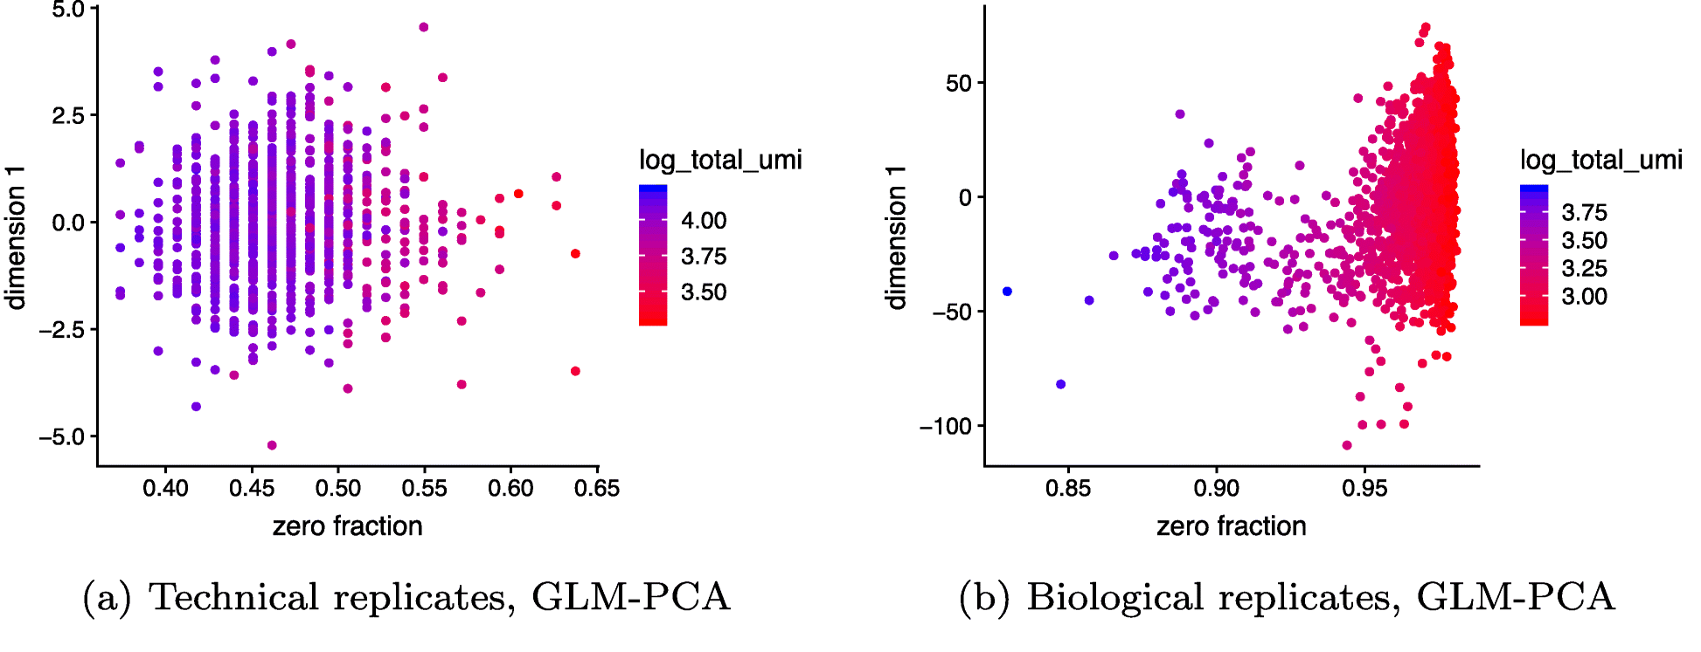
(No cells inside droplets)
All cells are identical
(Townes et al, Genome Biol 2019)

Slide 22
Factor analysis
…

Slide 23
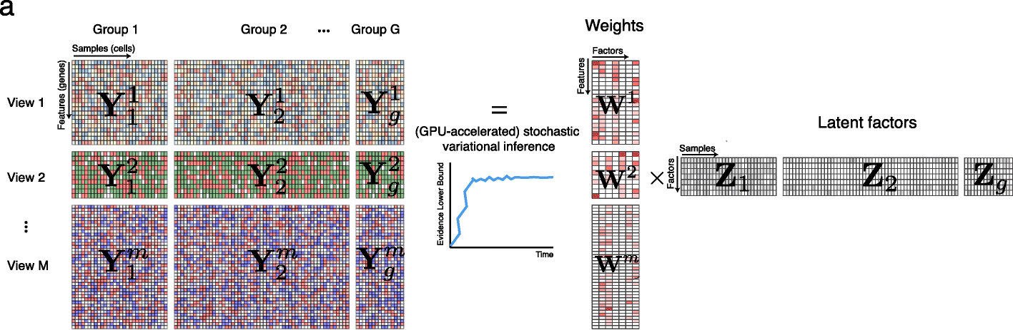
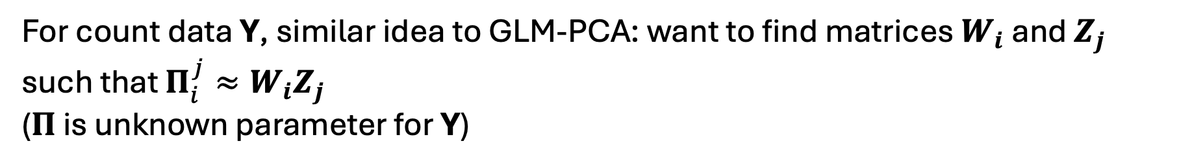
MOFA+: matrix factorization across multiple modalities/samples
For count data Y, similar idea to GLM-PCA: want to find matrices $W_{i}$ and $Z_{j}$ such that $Π_{i}^{j}≈W_{i}Z_{j}$
($Π$ is unknown parameter for Y)
MOFA+ (Argelaguet et al, Genome Biol 2022)

Slide 24
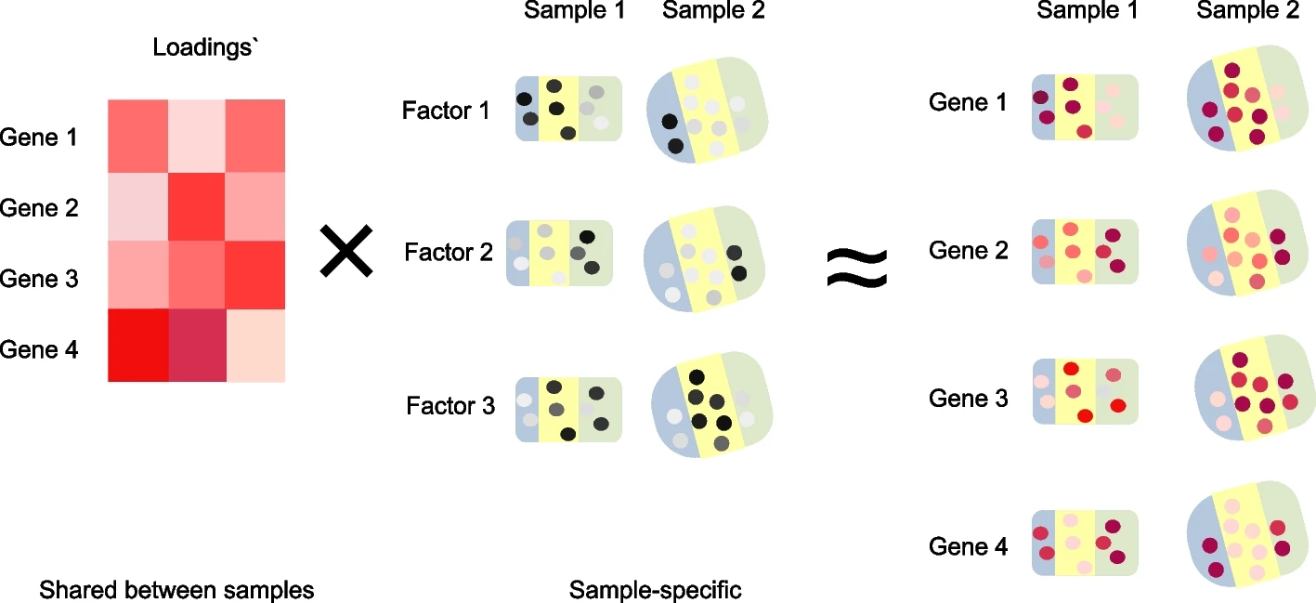
Non-negative spatial factorization (NSF)
Idea: Impose spatial coherence on factors
Will briefly discuss next class
NSF: Townes and Engelhardt, Nature Methods 2023
mNSF: Wang et al, Genome Biol 2025

Slide 26
Probabilistic factor analysis
GLM-PCA replaced the noise model. Factor analysis adds an explicit latent-variable prior on the factors.
$$z_{n} \sim 𝒩\left(0, I\right) , y_{n} = Wz_{n} + μ + ε_{n} , ε_{n} \sim 𝒩\left(0, Ψ\right)$$
z_{n} = latent factors (low-dim embedding of cell n); W = factor loadings; Ψ diagonal = per-feature noise.
Ψ = σ²I recovers (probabilistic) PCA; a general Ψ models heteroskedastic noise.
Put sparsity priors on W → interpretable factors. Extend to non-Gaussian likelihoods → counts, binary.
Extend to multiple data modalities → MOFA+.

Slide 27
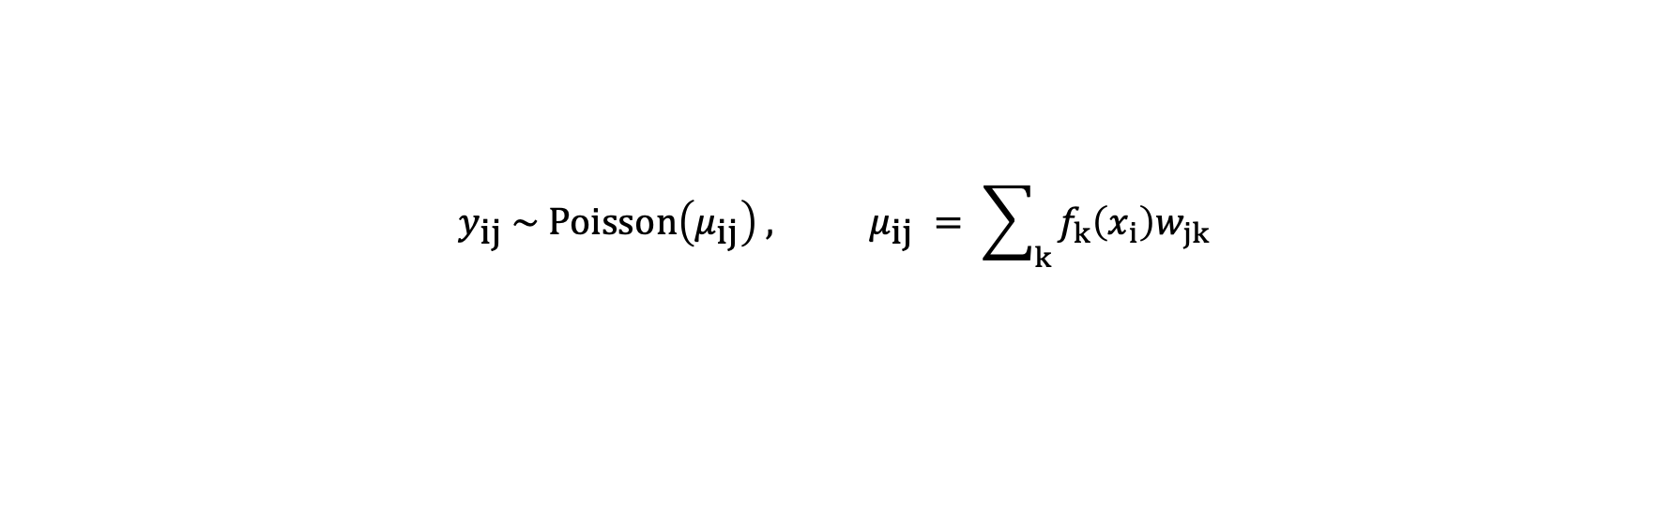
Nonnegative spatial factorization (NSF)
Spatial transcriptomics: each spot i has counts and a 2-D coordinate x_{i}. NSF makes the factors functions of space.
$$y_{ij} \sim Poisson\left(μ_{ij}\right) , μ_{ij} = \sum_{k}{f_{k}\left(x_{i}\right)w_{jk}}$$
Each spatial factor f_{k}(·) gets a Gaussian-process prior over the coordinates: f_{k} ~ GP(0, kernel) → spatially smooth factors.
Loadings and factors are constrained nonnegative → interpretable, additive spatial gene programs.
NSF = GLM-PCA (Poisson, count-aware) + NMF (nonnegative parts) + a spatial GP prior on the factors.
A hybrid (NSFH) mixes spatial and non-spatial factors, separating spatial from intrinsic variation.
Townes & Engelhardt, Nonnegative spatial factorization applied to spatial genomics, Nature Methods 20 (2023).

Slide 28
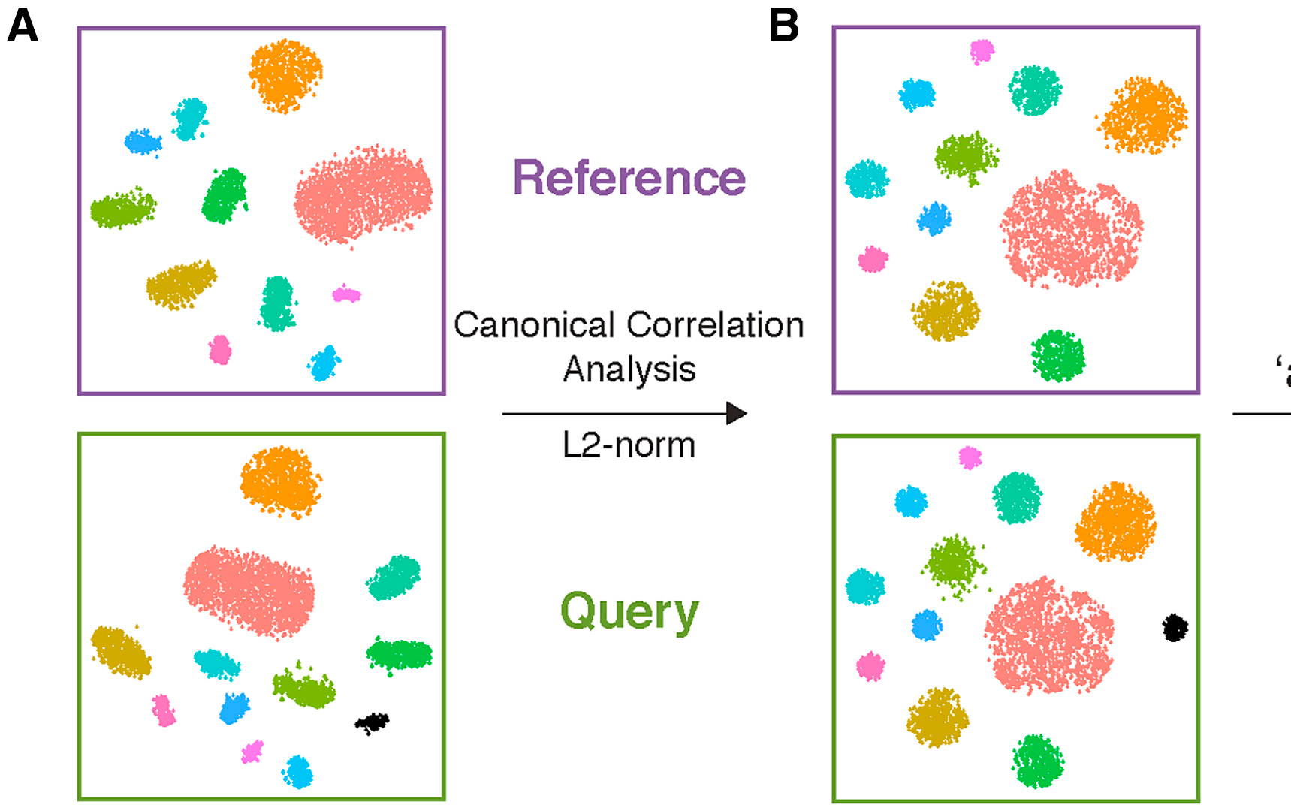

Integration: canonical correlation analysis (CCA)
To integrate two datasets, find directions that are maximally correlated across them.
Given X (cells × genes) and Y from two datasets, find loadings a, b maximizing:
$$\max_{a,b} \frac{a^{T}X^{T}Yb}{\sqrt{a^{T}X^{T}Xa} \sqrt{b^{T}Y^{T}Yb}}$$
The canonical vectors define a shared space capturing variation common to both datasets.
Unlike PCA (max variance within one dataset), CCA maximizes correlation between two.
CCA + L2-norm align the two datasets
Figure: Stuart et al., Cell (2019), from guest_Bioinf545_singlecell deck.

Slide 29
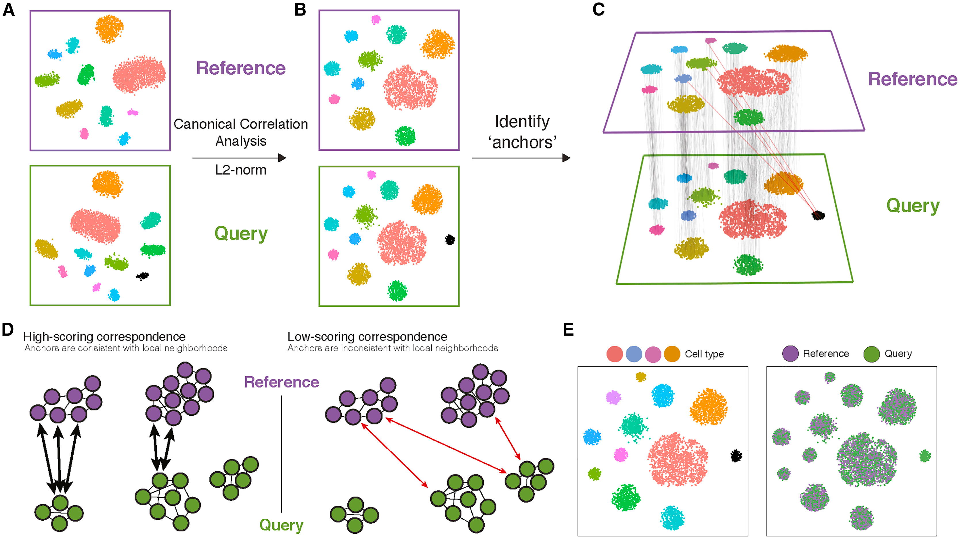
Seurat: anchor-based integration with CCA
Seurat (Stuart et al., 2019) integrates datasets in three steps:
CCA → a shared embedding of the two datasets (assumes shared variation; mean-centered).
Anchors → pairs of cells that are mutual nearest neighbors across datasets in the CCA space (confidently matched states).
Correction → use anchor pairs to compute an expression shift and align one dataset onto the other.
Output: an integrated embedding + a batch-corrected expression matrix.
Reference + Query → CCA → anchors → correspondence scoring → integrated
Figure: Stuart et al., Comprehensive Integration of Single-Cell Data, Cell 177 (2019); from guest_Bioinf545 deck.

Slide 30
Summary
Normalization + PCA make hidden assumptions — they distort counts and let the top PC track the zero fraction.
GLM-PCA — factorize the (log) mean of a Poisson — count-aware PCA; deviance for HVGs and residuals for speed.
Probabilistic factor analysis — a latent-variable model with priors; MOFA+ shares factors across modalities with sparsity.
Nonnegative spatial factorization — Poisson + nonnegativity + a Gaussian-process spatial prior on the factors.
Integration — CCA finds correlated directions across datasets; Seurat uses CCA anchors to align them.
Theme — choose the likelihood and the prior, then factorize — PCA, NMF, GLM-PCA, MOFA are all special cases.

Slide 31
In-class lab
[ placeholder — to be filled in ]
Suggested: run a standard PCA pipeline vs. GLM-PCA / deviance-residual PCA on a small scRNA-seq dataset; compare clustering (ARI) and inspect the zero-fraction artifact.

