Slide 1
(Graph) clustering
Uthsav Chitra

Slide 2
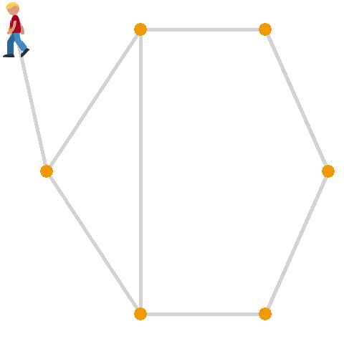
Past few classes: random walks on graph

Slide 3
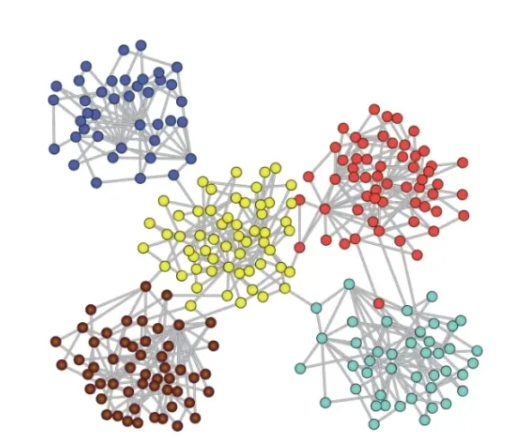
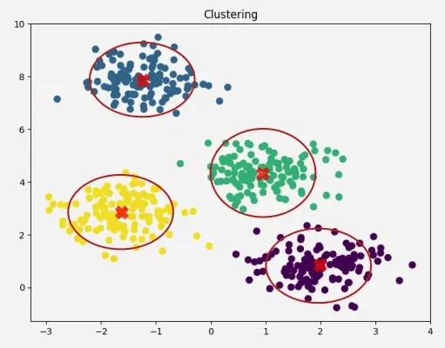
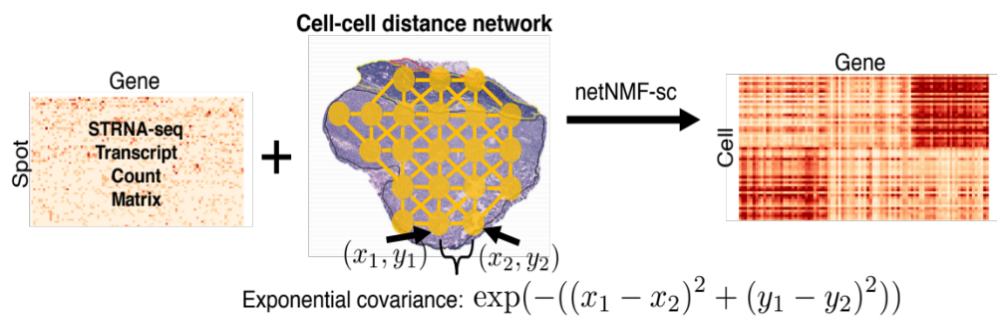
Today: (graph) clustering
Clustering: finding groups (clusters) of datapoints (cells) with similar features (gene expression)
Graph clustering: vertices the same group are more densely connected to each other than to other vertices
Genes
Feature 2 (e.g. gene 2, PC 2, …)
Cells
Feature 1 (e.g. gene 1, PC 1, …)

Slide 4
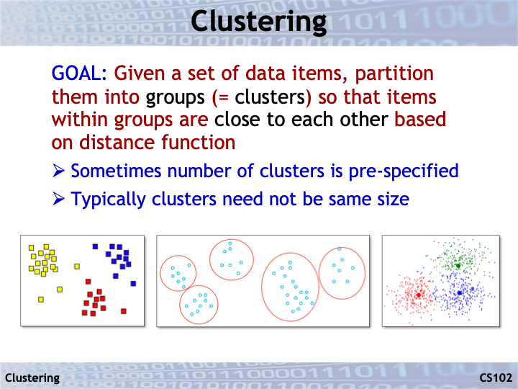
Slides from https://web.stanford.edu/class/cs102/lectureslides/ClusteringSlides.pdf

Slide 5
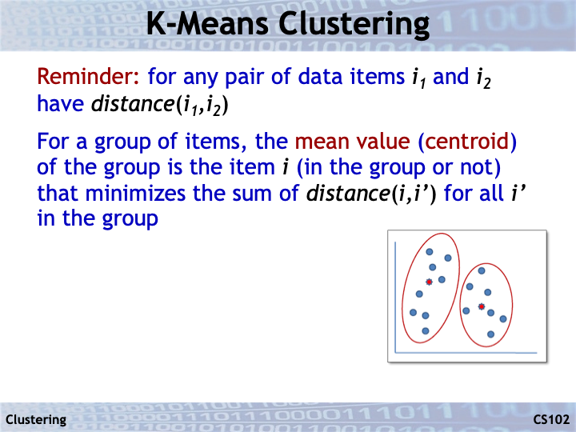

Slide 6
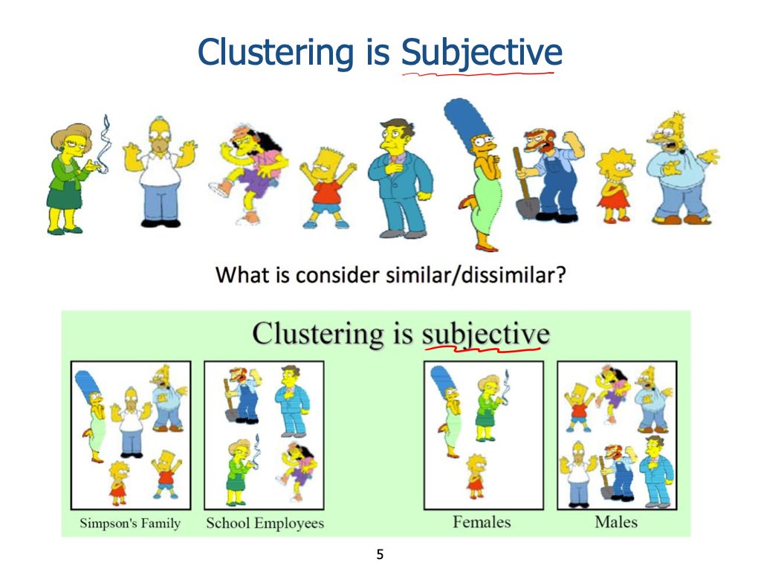

Slide 7
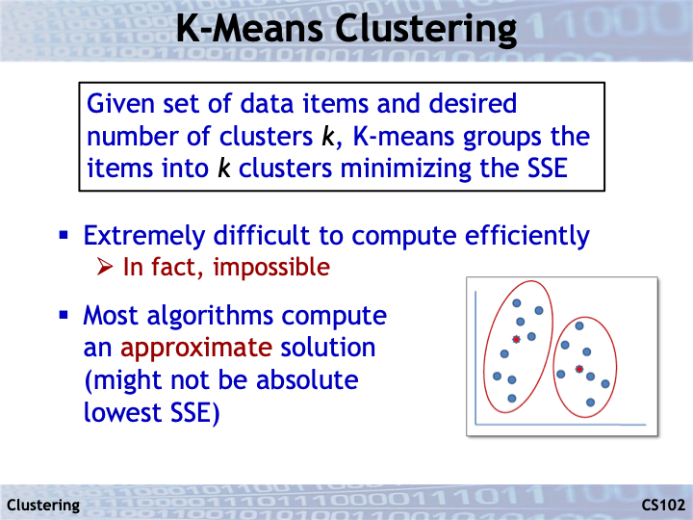
SSE = sum of squared errors (see next slide)
d(x,y) = ||x-y||²

Slide 8
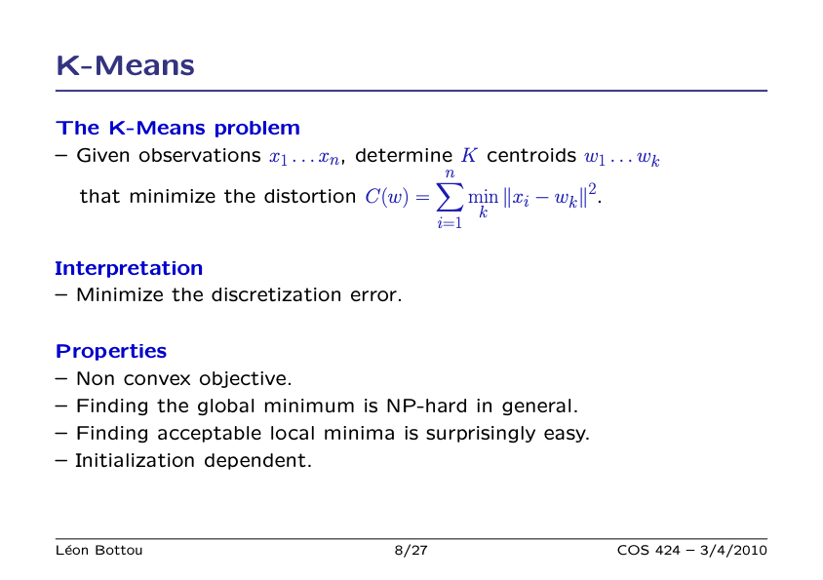
w₁
w₂

Slide 9
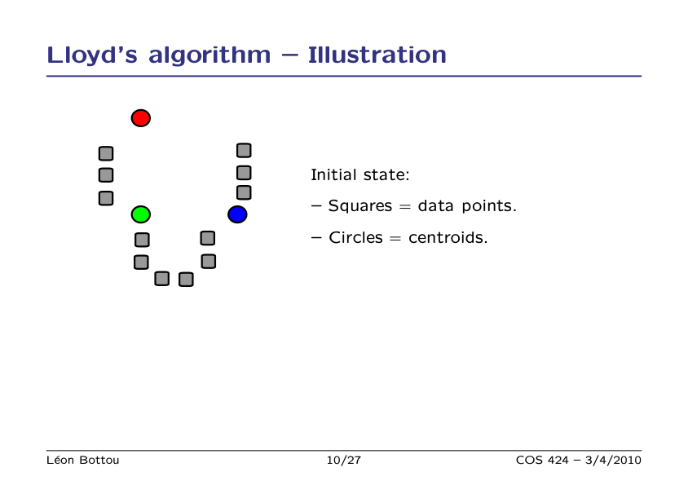

Slide 10
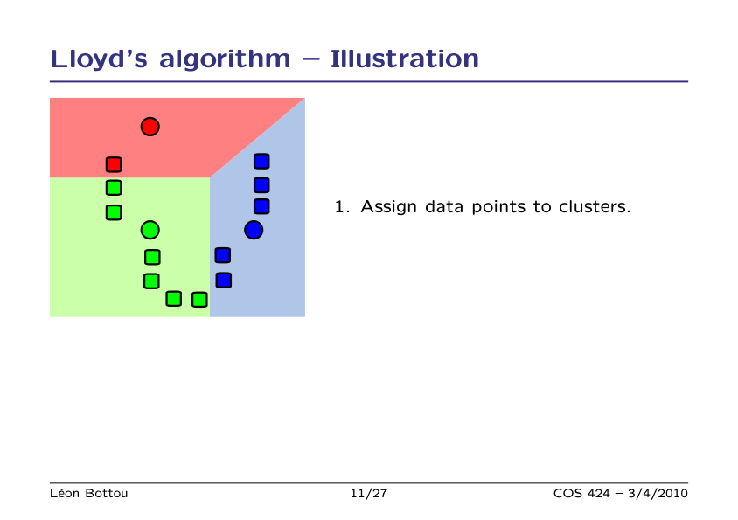

Slide 11
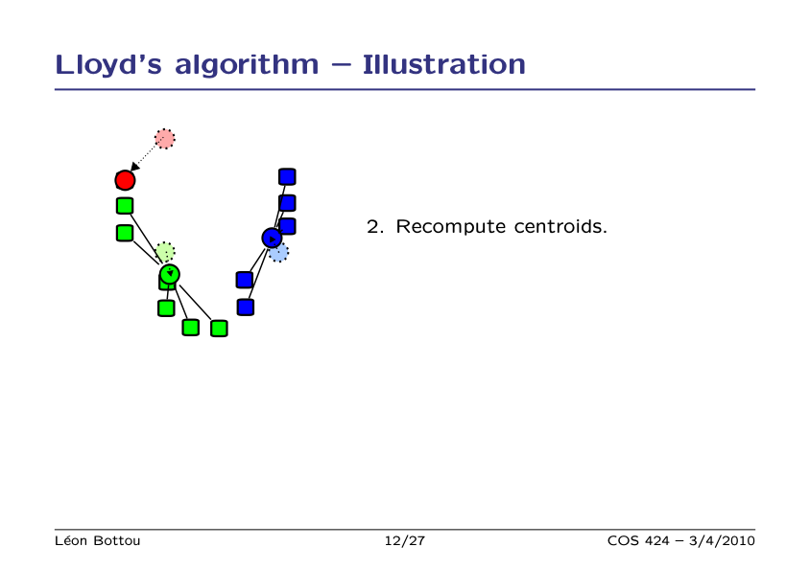

Slide 12
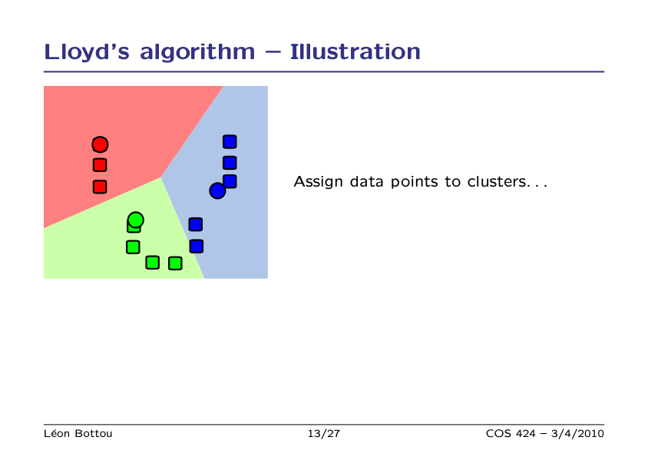

Slide 13
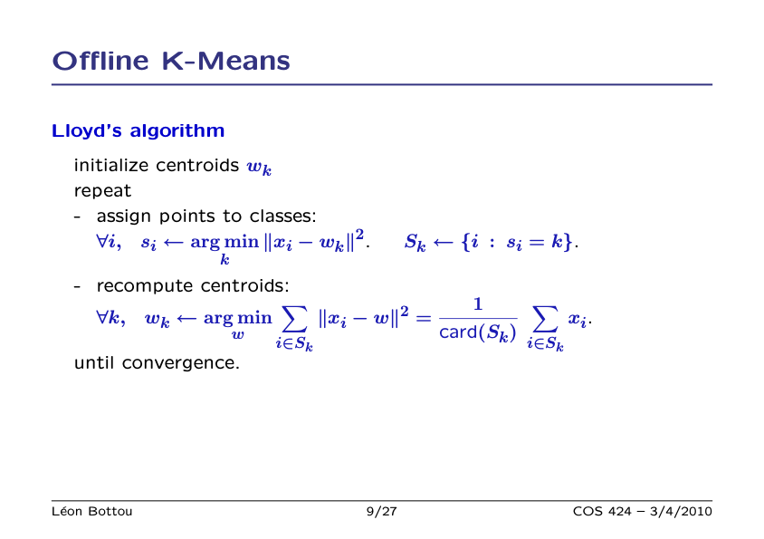

Slide 14
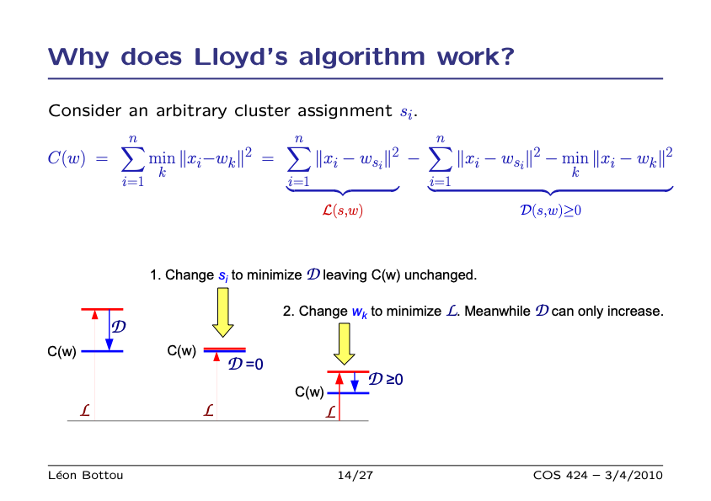

Slide 15
What’s used in practice?
Modern implementations follow Lloyd’s algorithm with specific to:
How to choose the number K of clusters?
How to initialize the cluster centroids w_{k}?
What about when your data is really large?

Slide 16
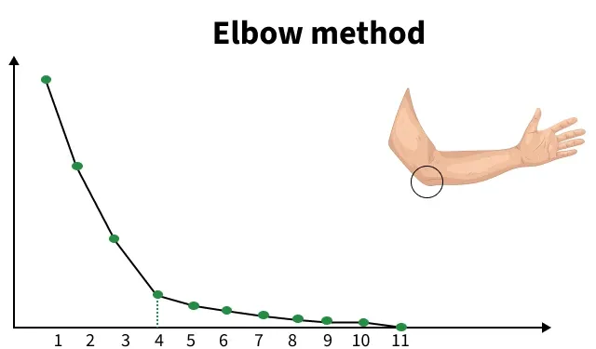
How to choose number K of clusters?
No rigorous way – choose K that maximizes/minimizes some quantity
Sum of squared errors
K
Elbow method: find a “elbow” where increasing K leads to diminishing returns

Slide 17
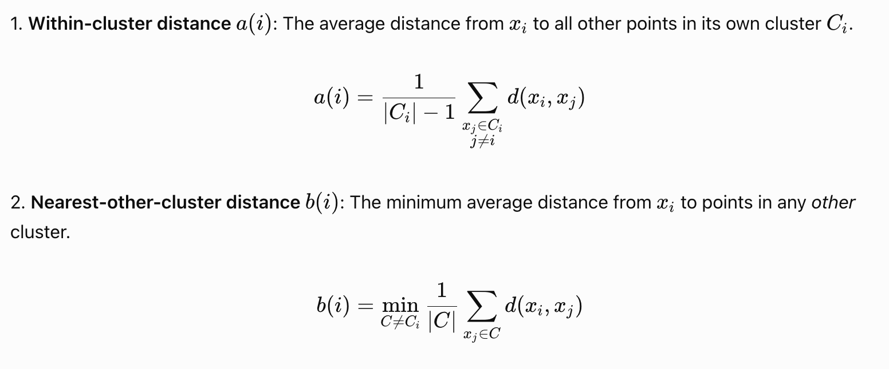
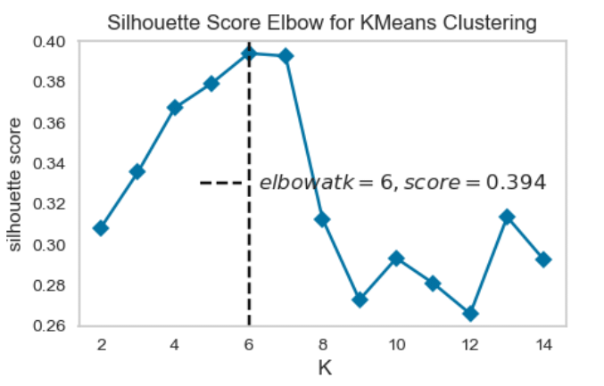
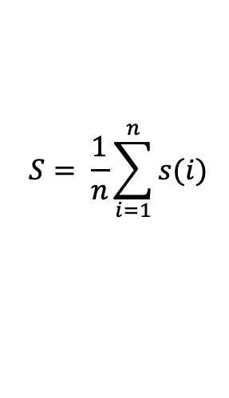
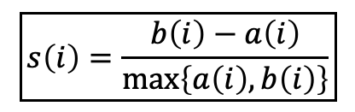
How to choose number K of clusters?
Silhouette score: find K that maximizes silhouette score
Intuition: want each vertex to be closer to vertices in same cluster, far from vertices in different clusters
Silhouette score for vertex i
Silhouette score averaged over vertices i
$$\boxed{s\left(i\right)=\frac{b\left(i\right)−a\left(i\right)}{\max\left\{a\left(i\right),b\left(i\right)\right\}}}$$
$$S= \frac{1}{n}\sum_{i=1}^{n}{s(i)}$$

Slide 18
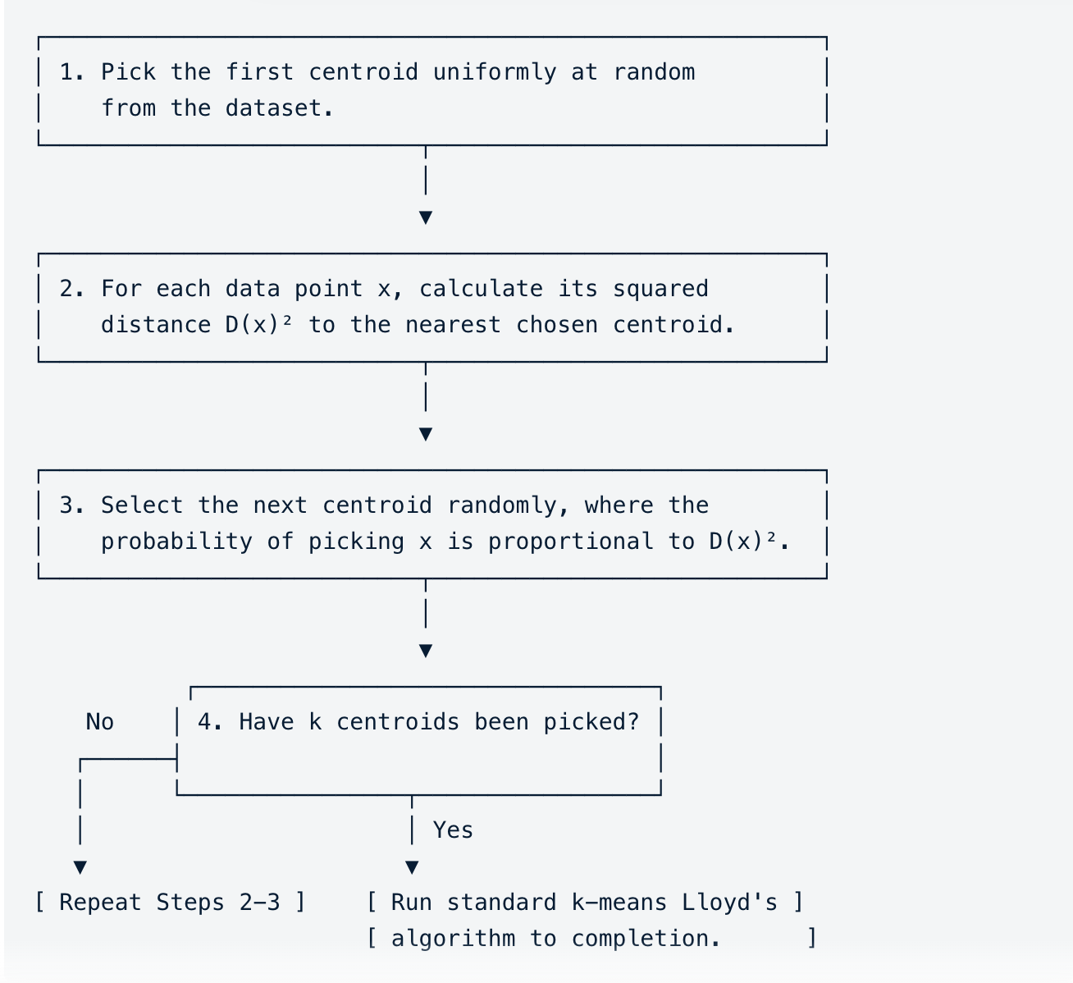
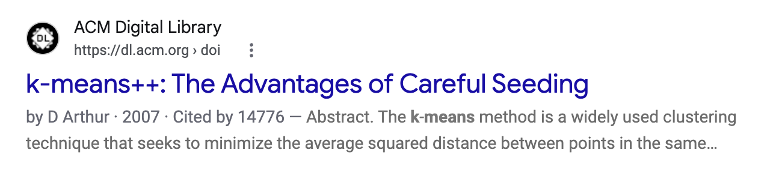
How to initialize cluster centroids w_{k}?
Initial k-means algorithm chose centroids uniformly at random from data
K-means++ instead chooses centroids that are most “spread out”

Slide 19
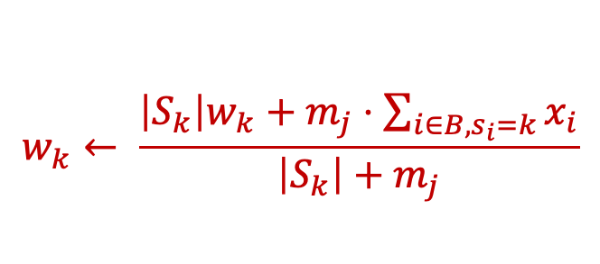
Mini-batch K-means updates parameters from random sample of datapoints (“mini-batch”)
mini-batch B
Don’t re-assign all points but only a small random sample of data points (“mini-batch”)
For datapoints i in B
Update centroids incrementally – running average
$$w_{k}← \frac{\left|S_{k}\right|w_{k}+m_{j}⋅\sum_{i∈B, s_{i}=k}{x_{i}}}{\left|S_{k}\right|+m_{j}}$$
(S_{k} is cluster k before processing current batch)

Slide 20
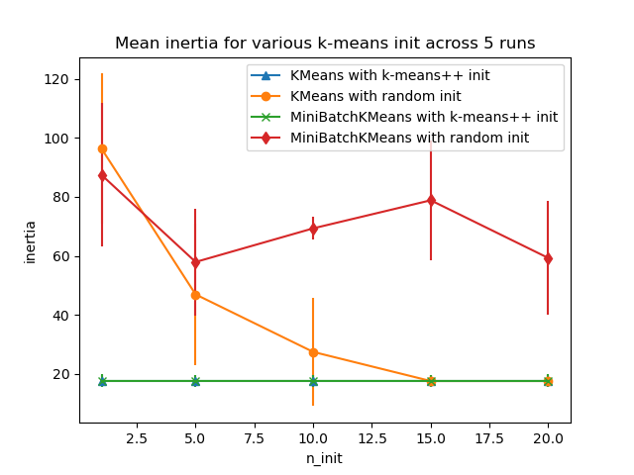
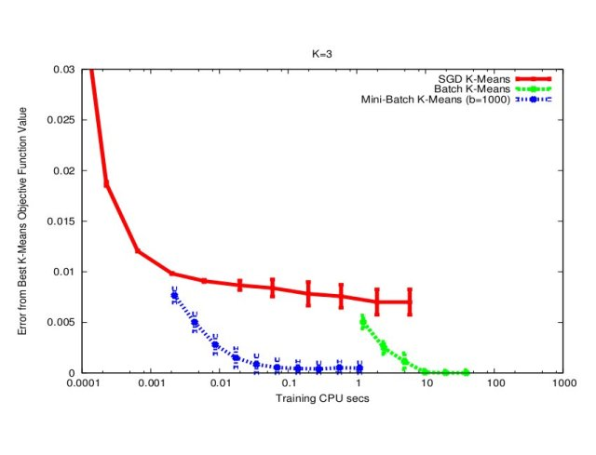
Runtime for k-means variants
(SSE)
From sklearn documentation
https://algorithmicthoughts.wordpress.com/2013/07/26/machine-learning-mini-batch-k-means/

Slide 21
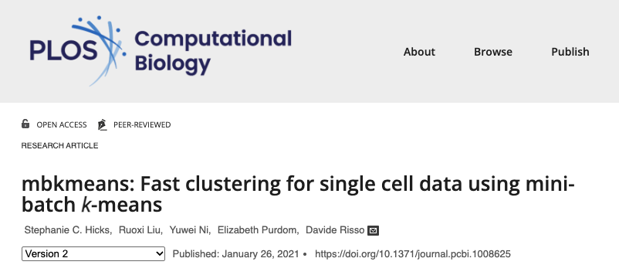
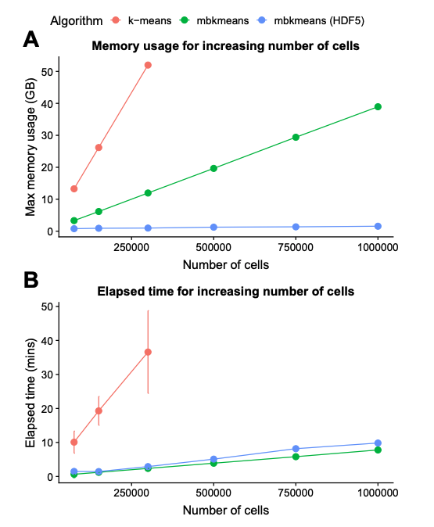
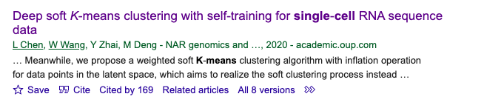
Efficient k-means variants used in single cell
(Stephanie is in BME/Biostats at JHU ☺ )

Slide 22
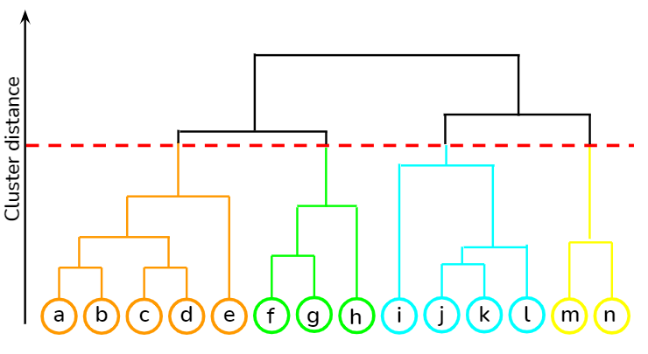
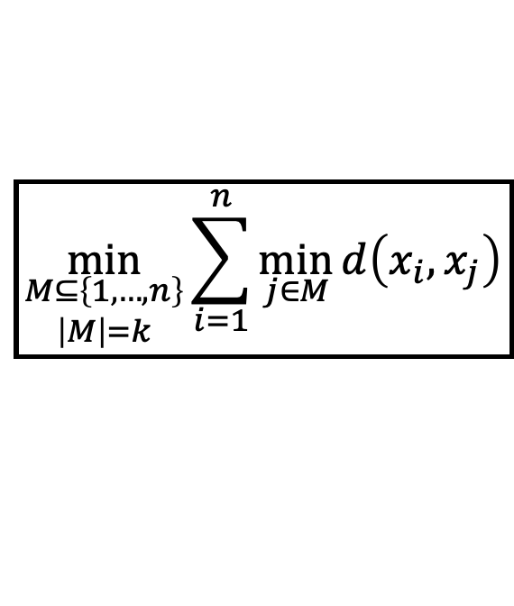
Many variants of k-means / clustering problems
K-medioids
Hierarchical clustering
$$\boxed{\min_{\begin{aligned}M⊆\left\{1,…,n\right\} \\ \left|M\right|=k\end{aligned}}{\sum_{i=1}^{n}{\min_{j∈M}{d\left(x_{i},x_{j}\right)}}}}$$
Generalize k-means to arbitrary dissimilarity function d(x,y)
(K-means is d(x,y) = ||x-y||²)
Learn a tree (hierarchy) of clusters

Slide 23
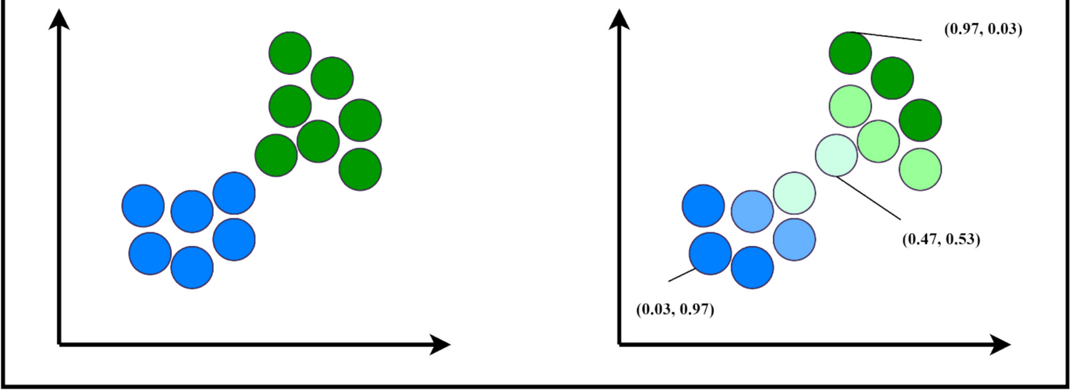
Hard versus soft clustering [see board]
Hard clustering: each datapoint assigned to exactly one cluster
Soft clustering: each datapoint can belong to >1 cluster with some probability
Soft clustering often better for points near cluster boundary

