Slide 1
(Graph) clustering, cont’d
Uthsav Chitra

Slide 2
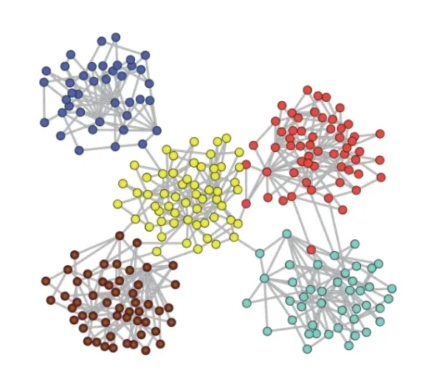
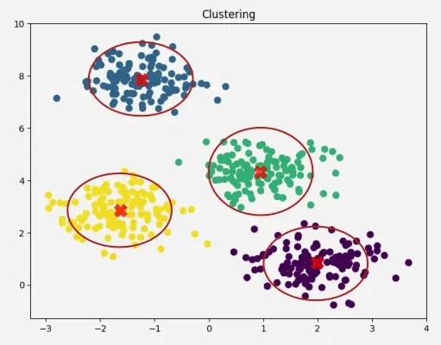
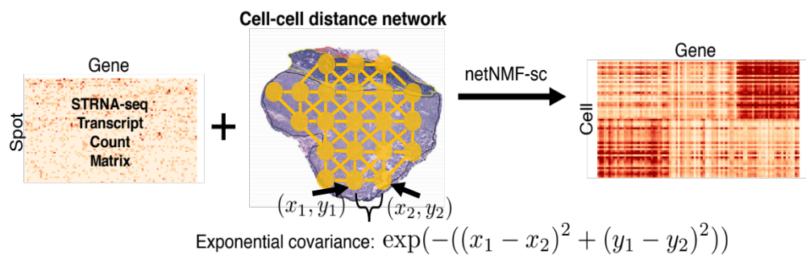
Today: (graph) clustering
Clustering: finding groups (clusters) of datapoints (cells) with similar features (gene expression)
Graph clustering: vertices the same group are more densely connected to each other than to other vertices
Genes
Feature 2 (e.g. gene 2, PC 2, …)
Cells
Feature 1 (e.g. gene 1, PC 1, …)

Slide 3
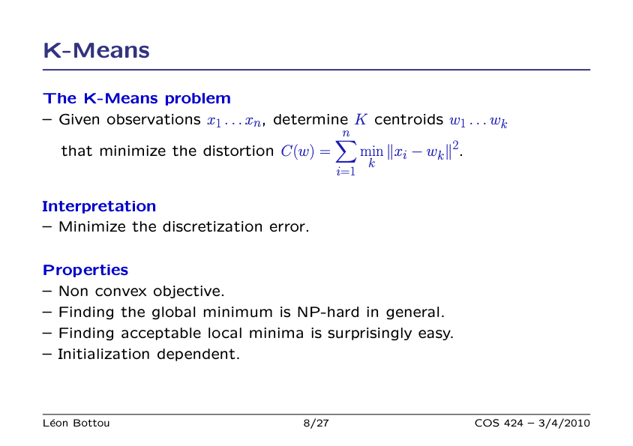
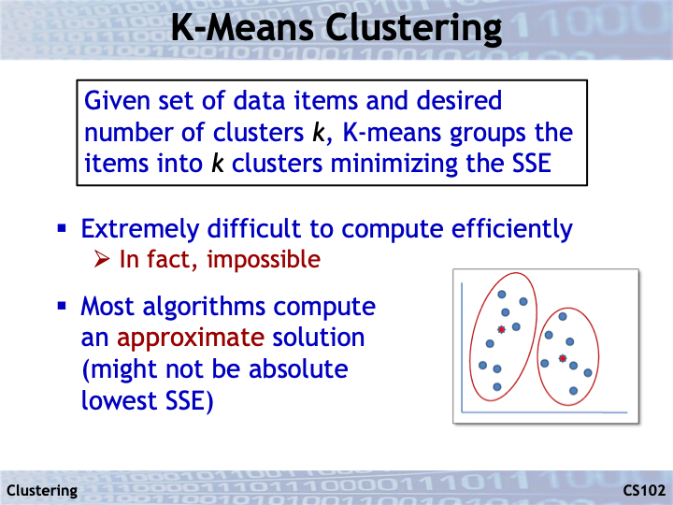
w₁
w₂

Slide 4
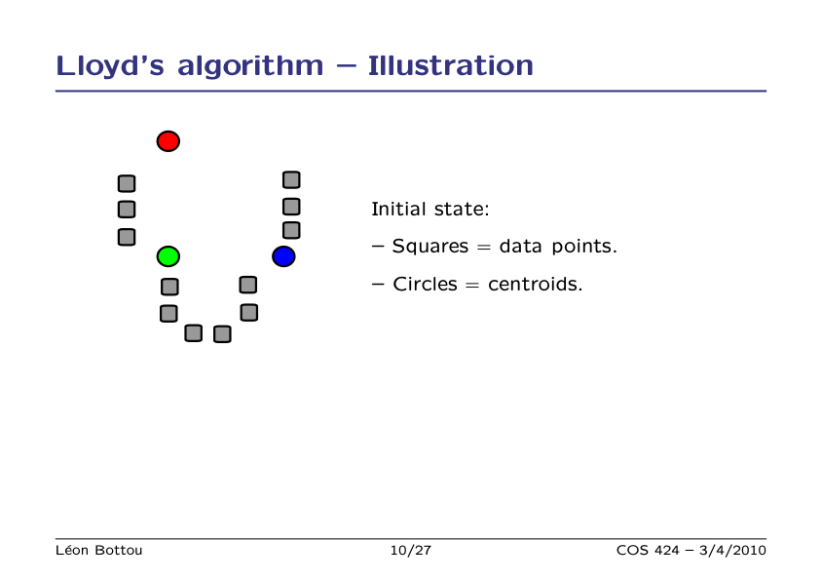

Slide 5
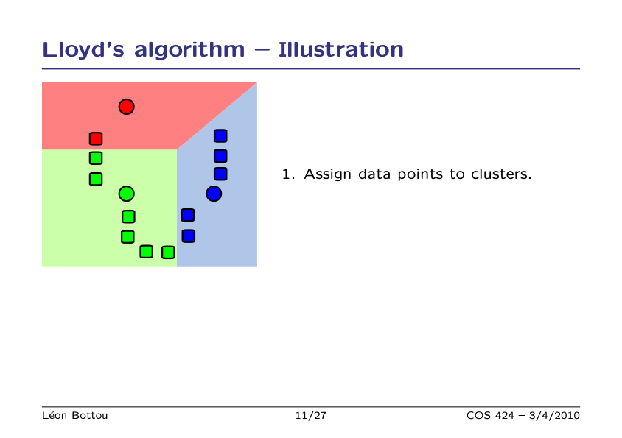

Slide 6
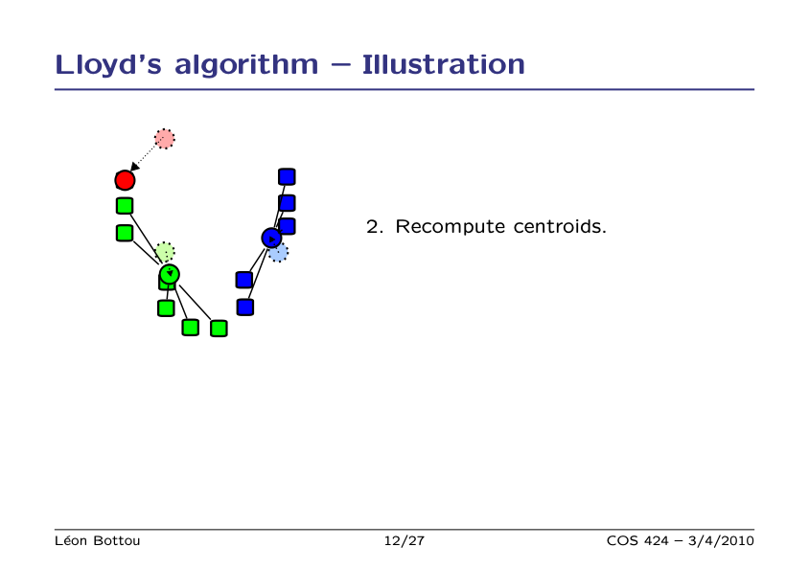

Slide 7
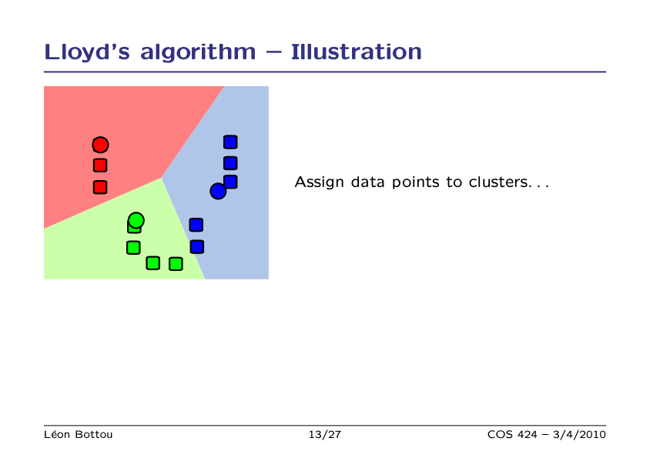

Slide 8
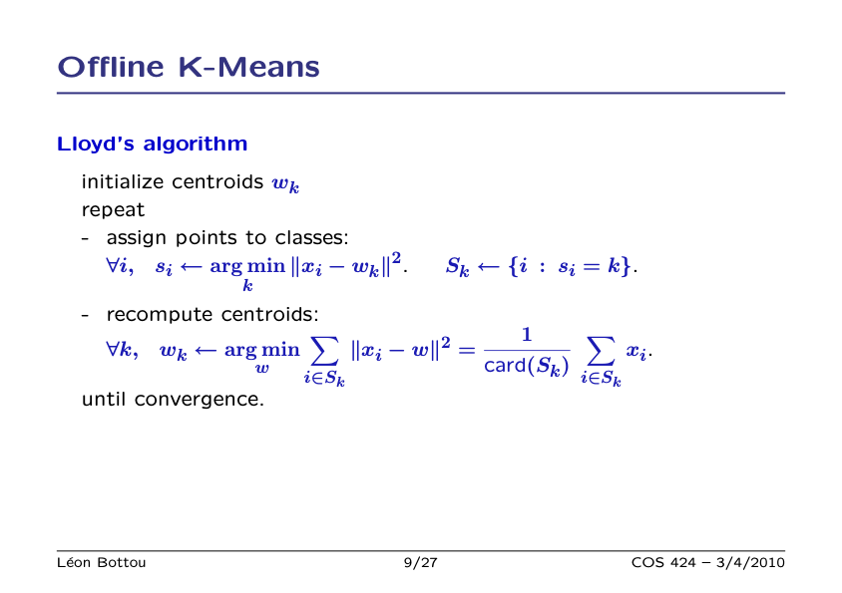

Slide 9
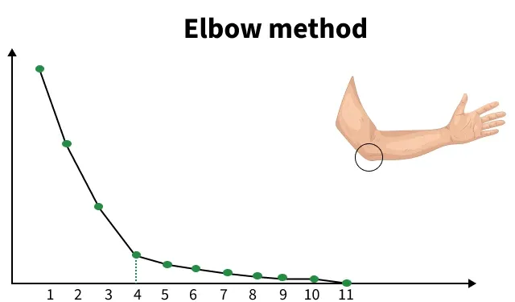
How to choose number K of clusters?
No rigorous way – choose K that maximizes/minimizes some quantity
Sum of squared errors
K
Elbow method: find a “elbow” where increasing K leads to diminishing returns

Slide 10
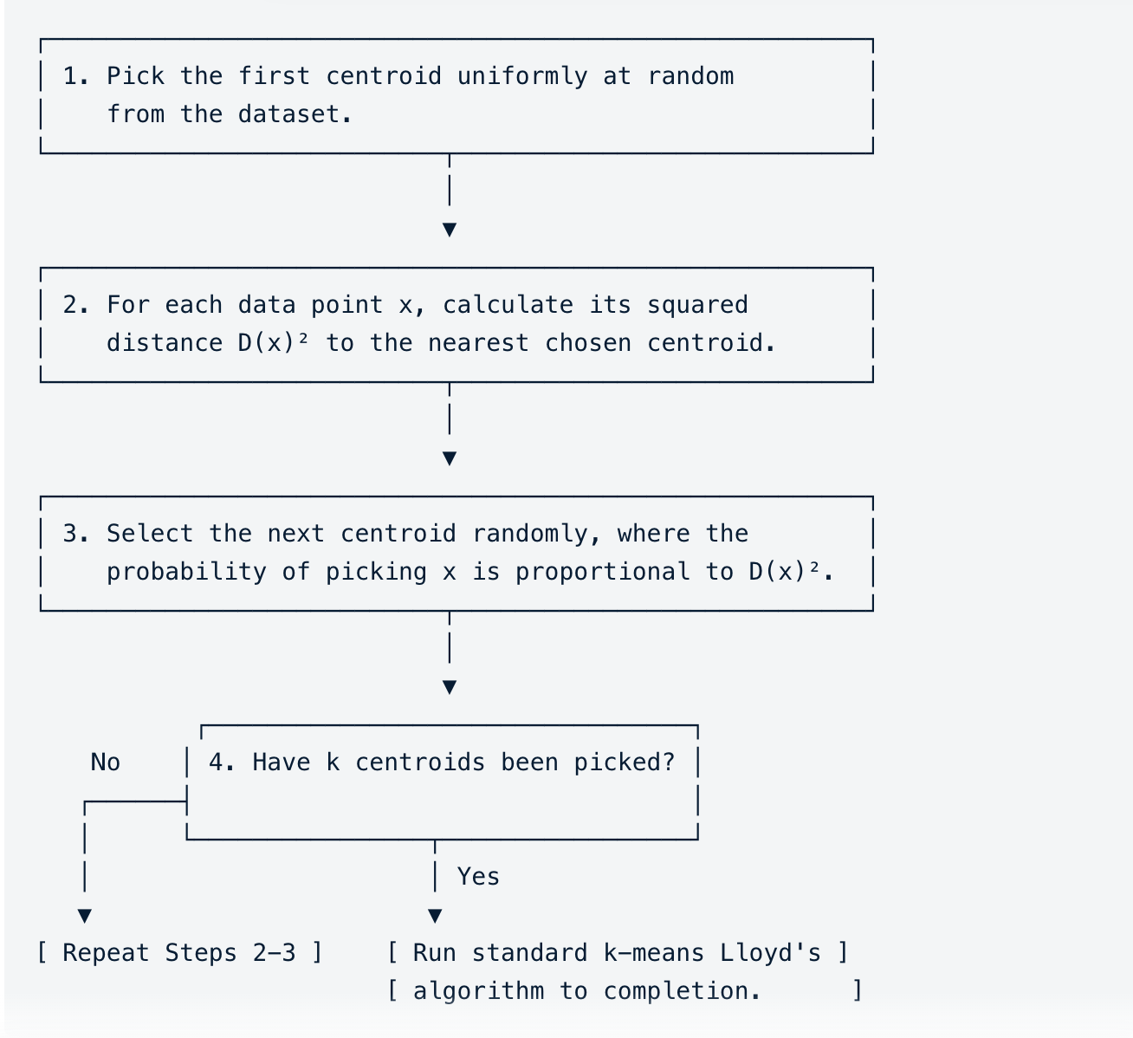
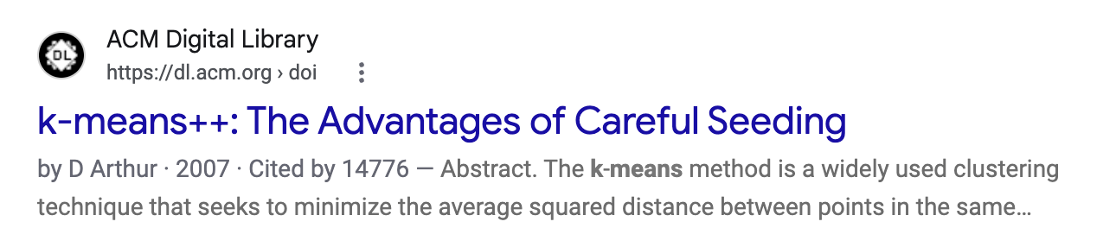
How to initialize cluster centroids w_{k}?
Initial k-means algorithm chose centroids uniformly at random from data
K-means++ instead chooses centroids that are most “spread out”

Slide 11
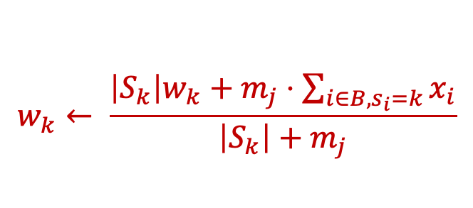
Mini-batch K-means updates parameters from random sample of datapoints (“mini-batch”)
mini-batch B
Don’t re-assign all points but only a small random sample of data points (“mini-batch”)
For datapoints i in B
Update centroids incrementally – running average
$$w_{k}← \frac{\left|S_{k}\right|w_{k}+m_{j}⋅\sum_{i∈B, s_{i}=k}{x_{i}}}{\left|S_{k}\right|+m_{j}}$$
(S_{k} is cluster k before processing current batch)

Slide 12
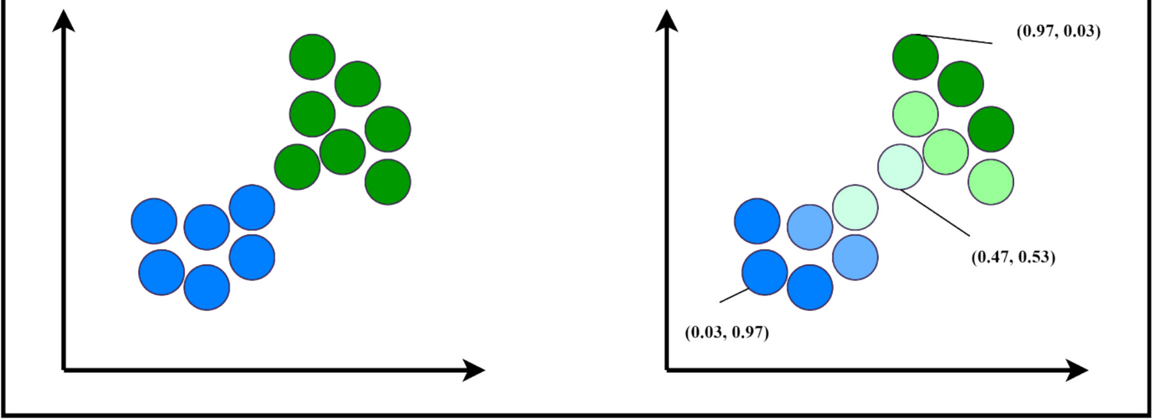
Hard versus soft clustering [see board]
Hard clustering: each datapoint assigned to exactly one cluster
Soft clustering: each datapoint can belong to >1 cluster with some probability
Soft clustering often better for points near cluster boundary

Slide 13
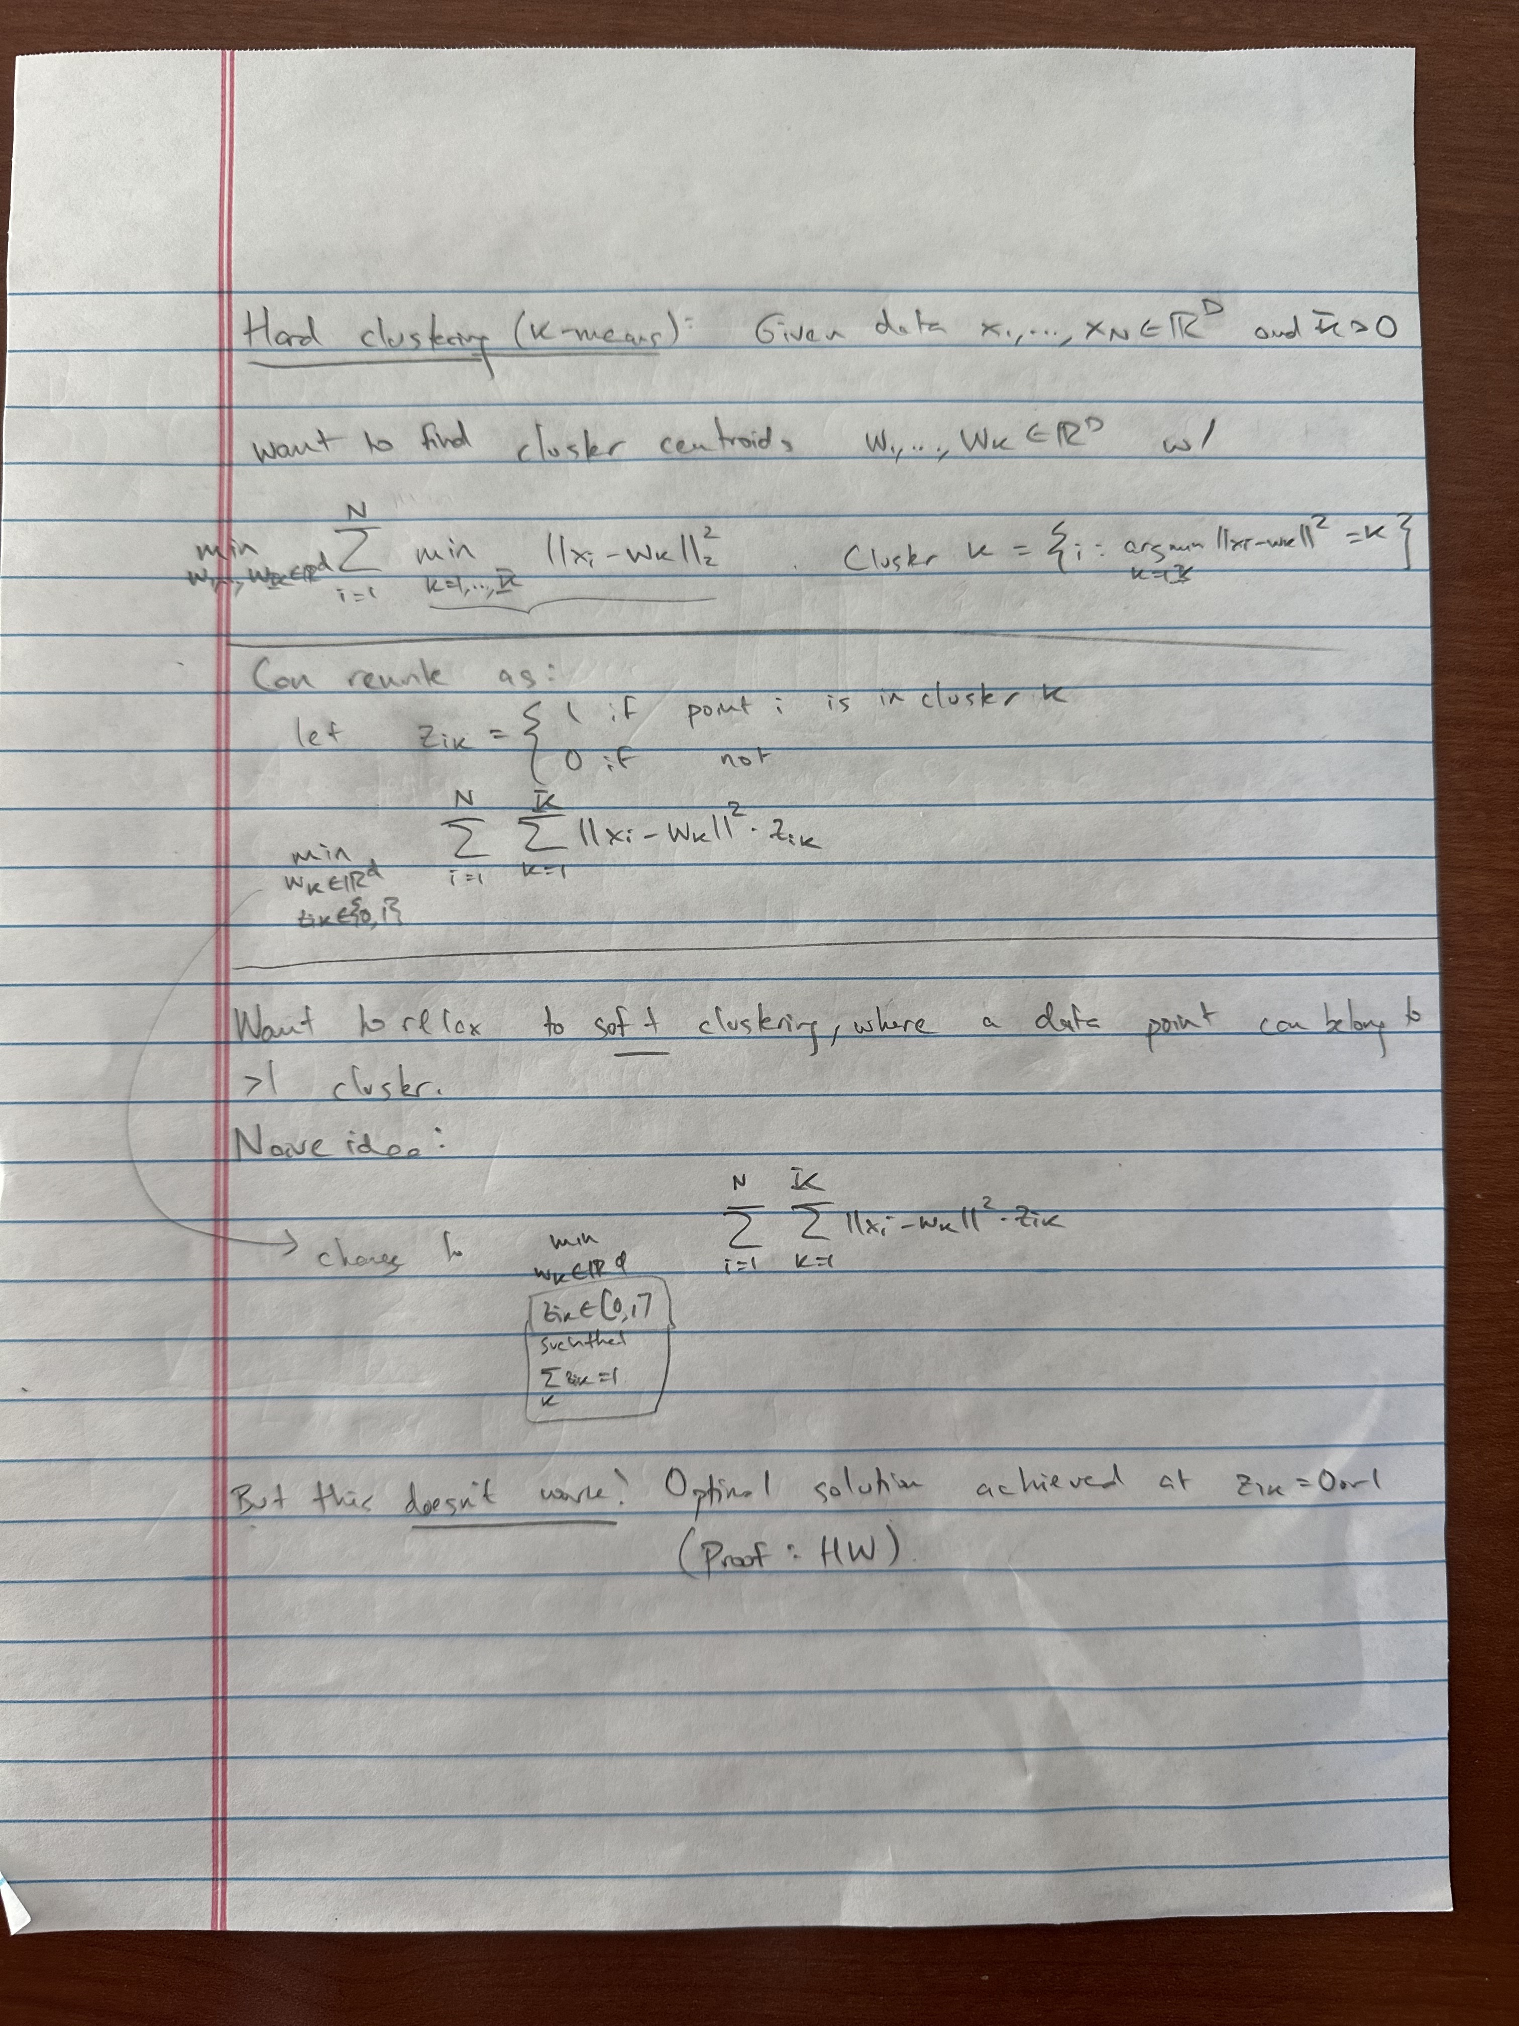

Slide 14
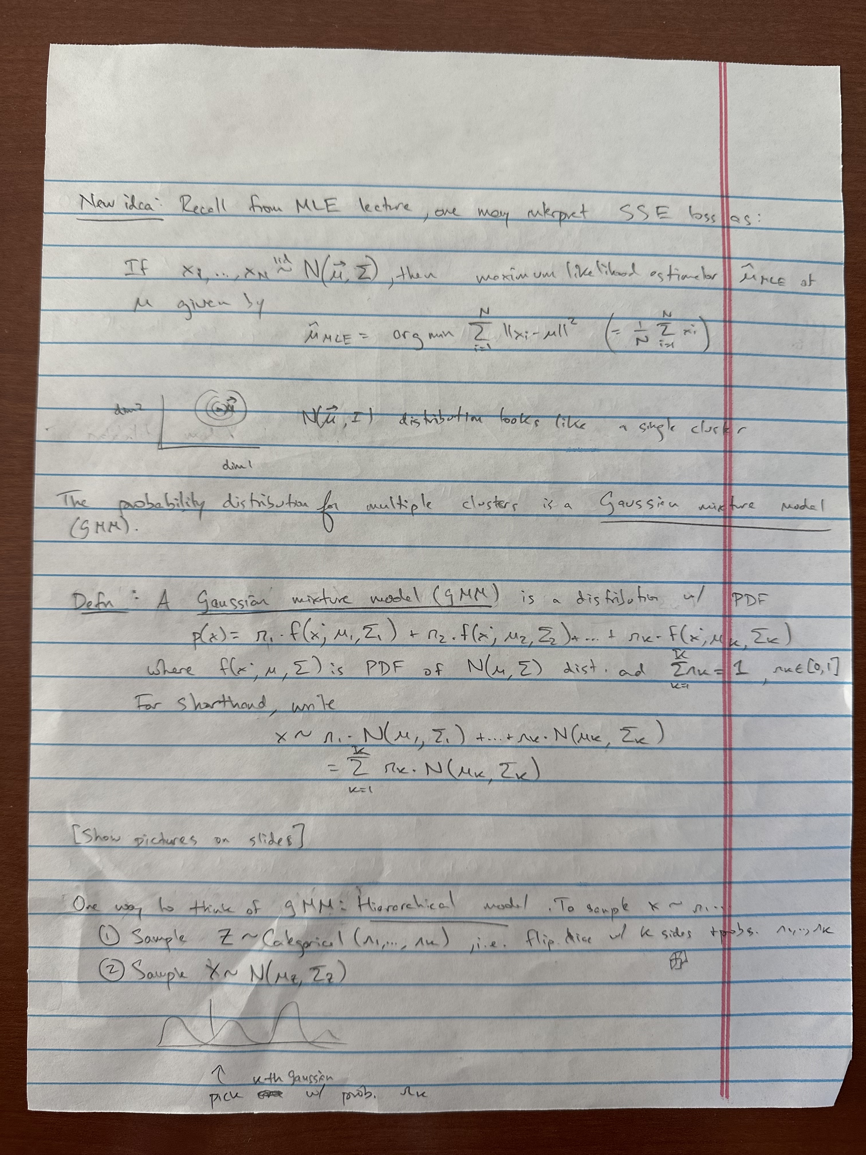
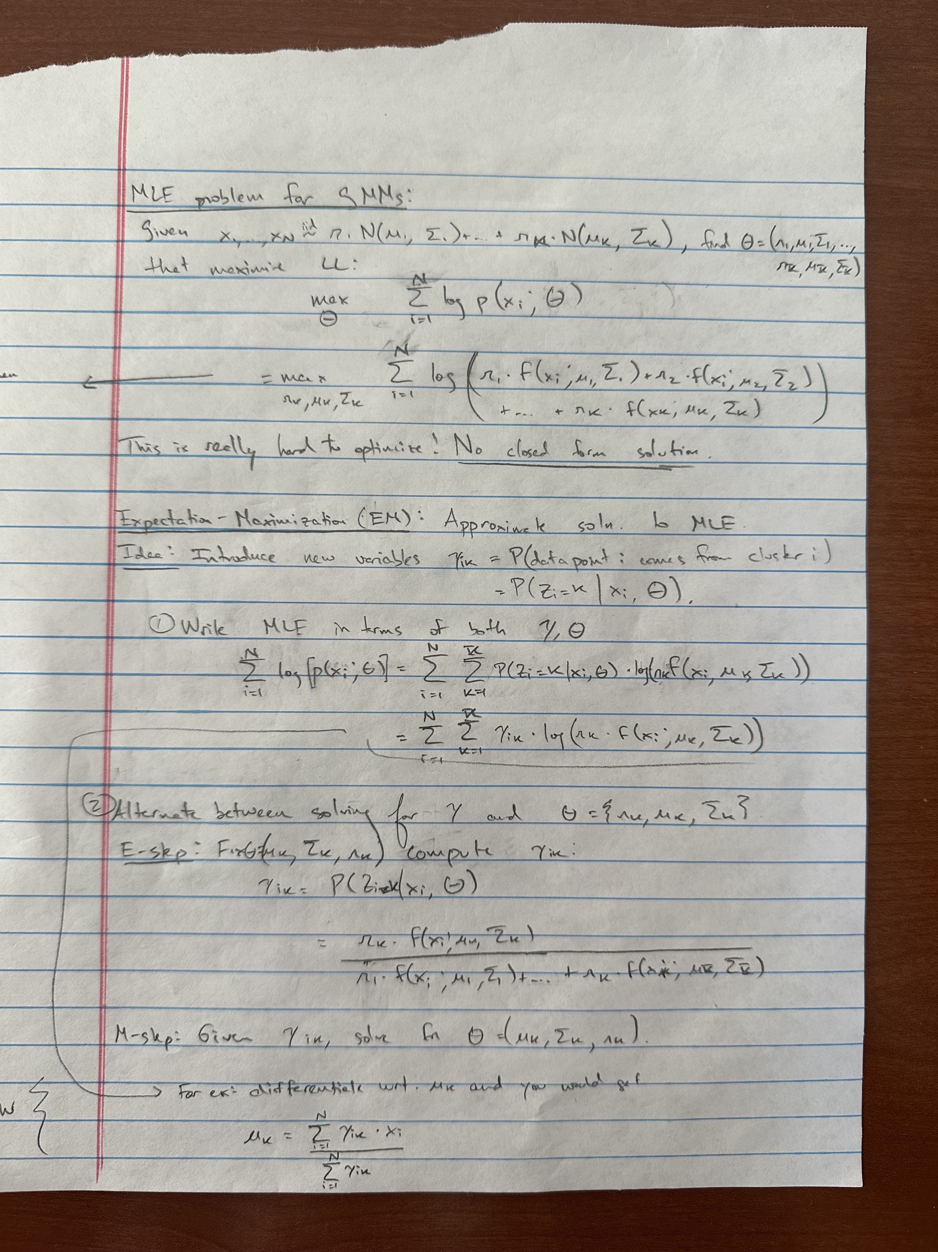

Slide 15
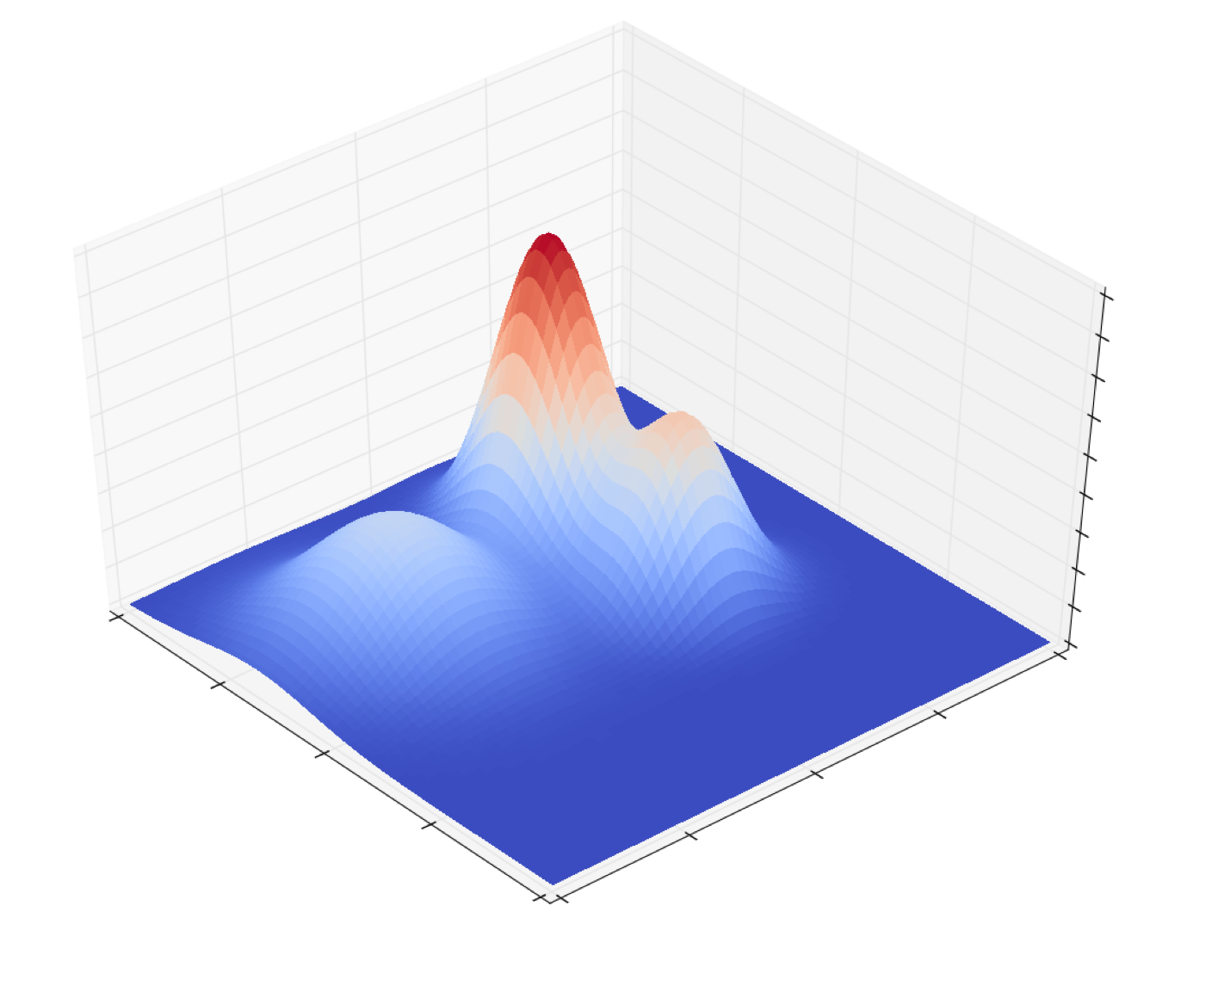
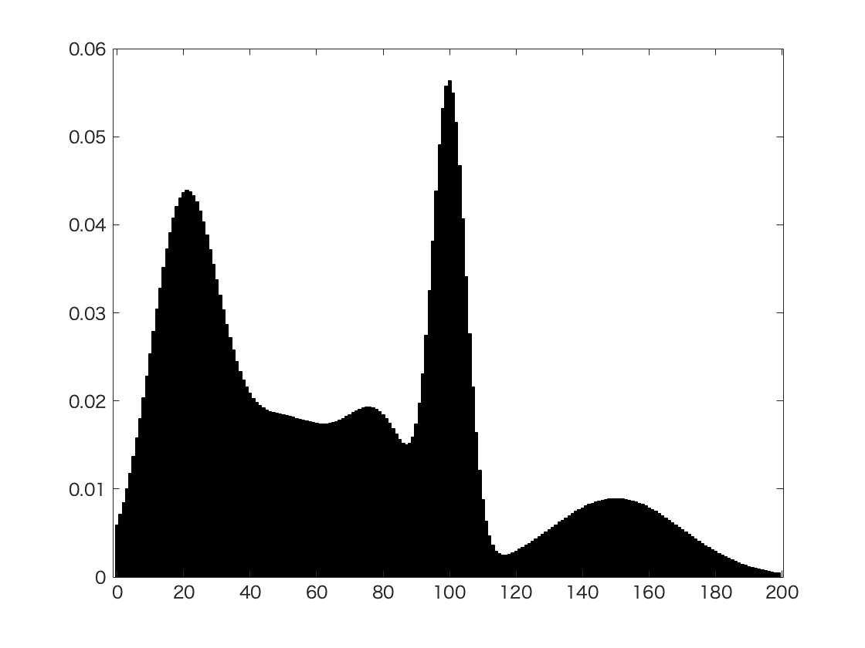
Gaussian mixture model examples
p(x)
p(x)
x₂
x₁
x
1-D GMM
2-D GMM

Slide 16
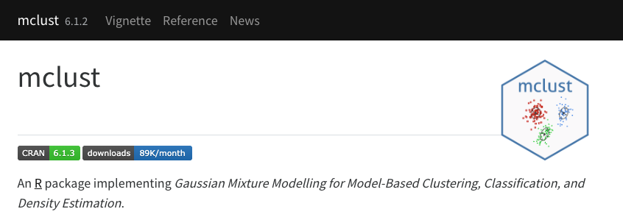
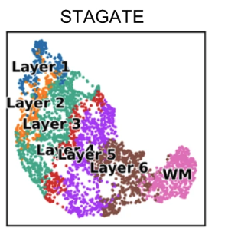
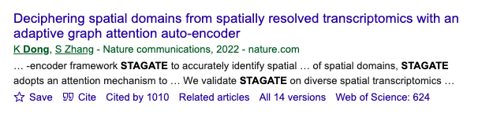
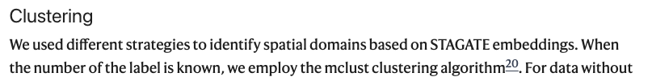
GMMs often used for clustering latent embeddings from neural networks

Slide 17
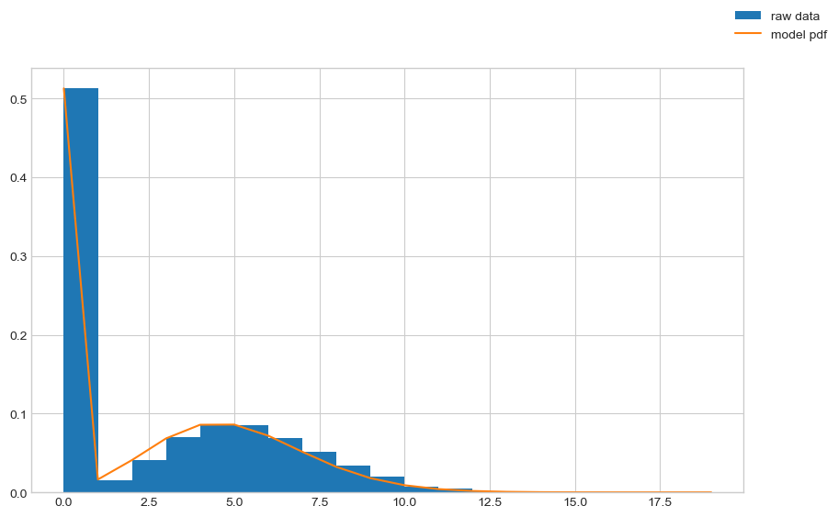
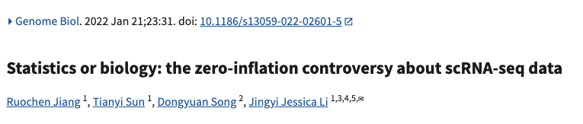
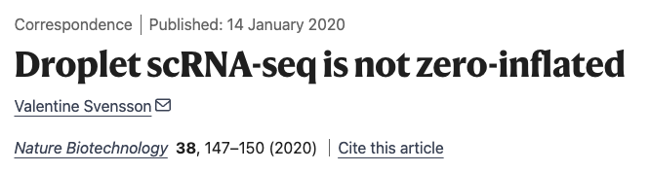
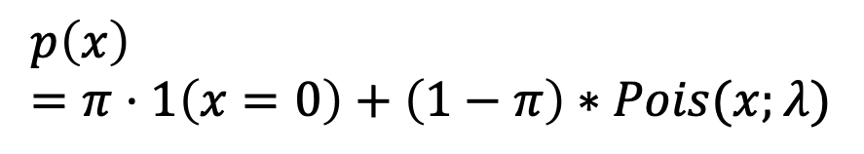
Applications of mixture models
Can formulate mixture models for other distributions (e.g. Poisson)
Used to be standard to model single cell data with a “zero inflated” distribution
= Mixture of a count distribution (eg Poisson, NB) with a “zero component”
$$p\left(x\right)=π⋅1\left(x=0\right)+\left(1−π\right)∗Pois(x;λ)$$
Technology dependent – for 10x single cell technologies (which are most common), zero component not needed

Slide 18
Hidden Markov Random Field (HMRF)
Extension where (hidden) cluster labels Z are not independent but follow a “graph structure”
x₄
x₇
Observed data X
x₂
x₉
x₅
x₆
x₈
x₁
x₃
z₄
z₇
z₂
z₉
z₅
z₈
z₁
Hidden variables Z
z₃
z₆

Slide 19
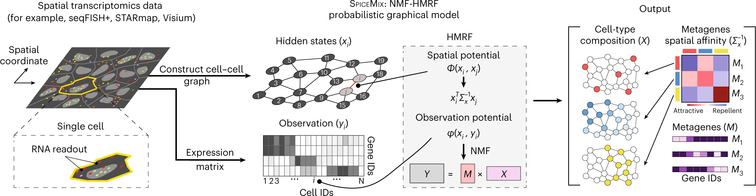
HMRFs used for spatial analysis
SpiceMix (Chidester et al, Nat Genet 2023)

Slide 20
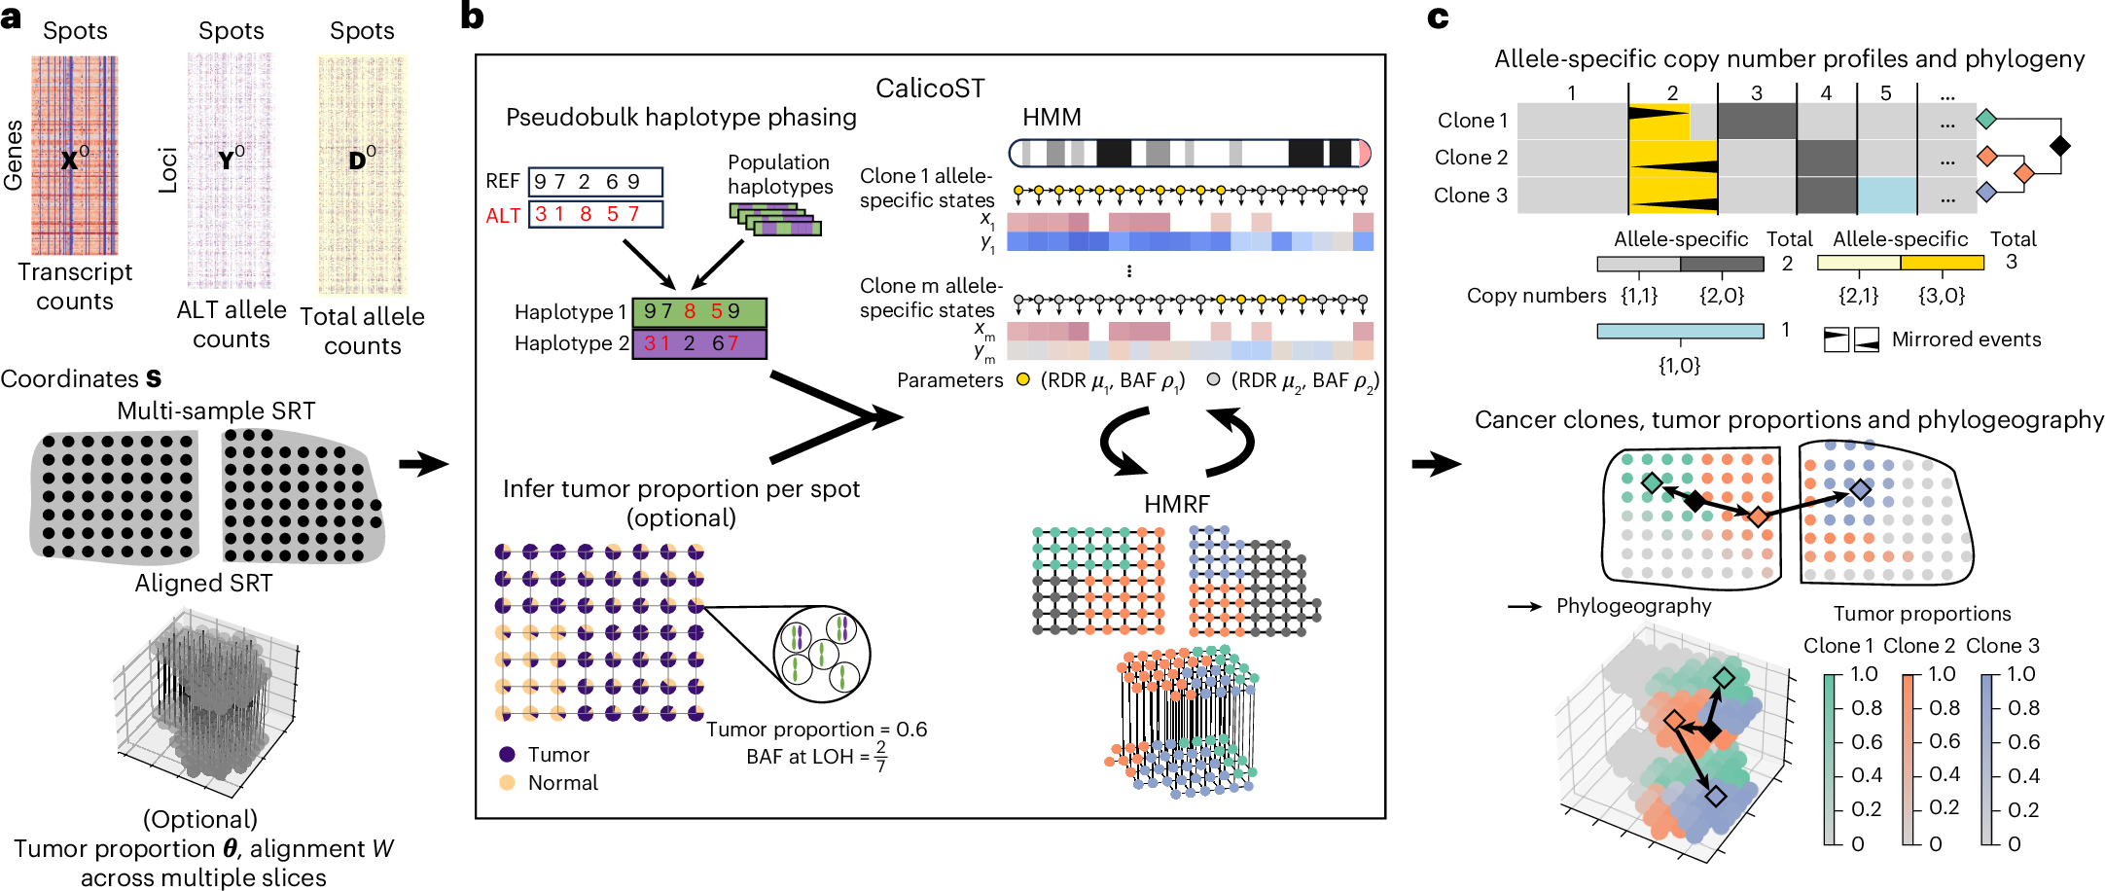
HMRFs used for spatial analysis
CalicoST (Ma et al, Nat Methods 2025)

Slide 21
Graph clustering
What if it’s hard to create distance function?
Or we want to represent underlying manifold? (e.g. for single cell data)
Can we find clusters in the graph?

