Slide 1
Machine Learning for Single-Cell and Spatial Biology
Uthsav Chitra
Johns Hopkins University
September 1, 2026

Slide 2
Today
Welcome!
Course logistics
Introduction to single-cell and spatial sequencing

Slide 3
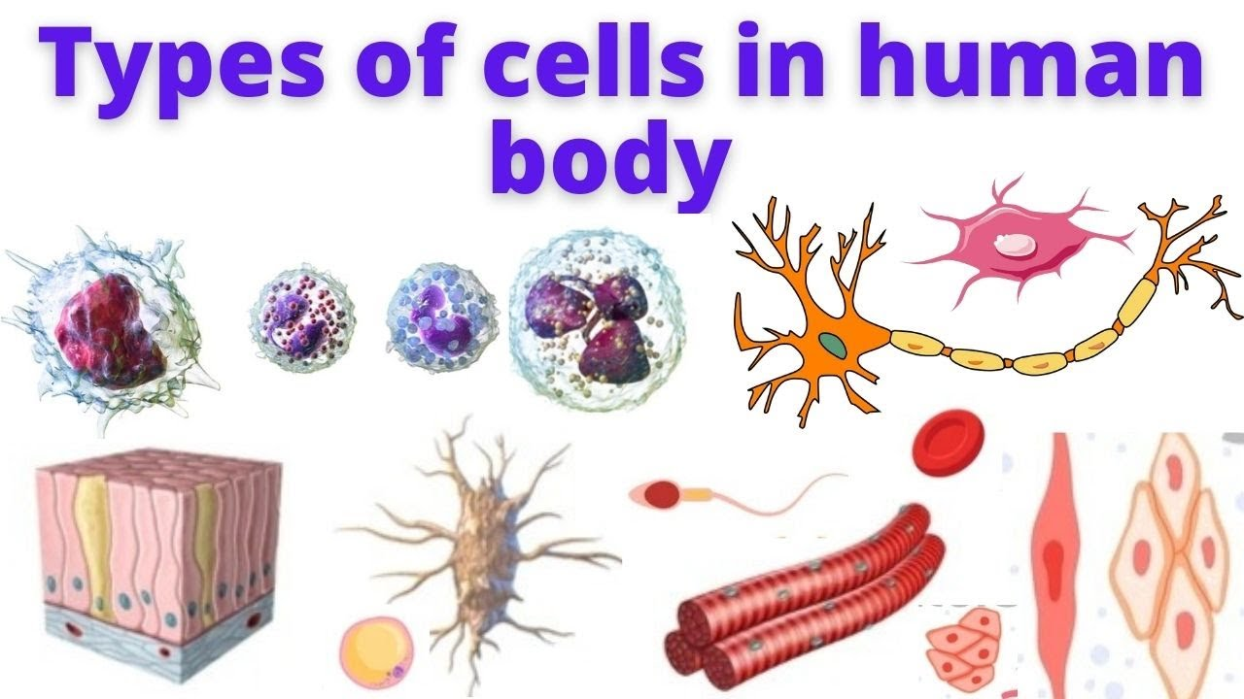
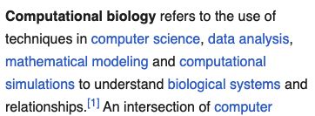
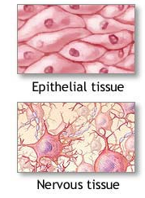
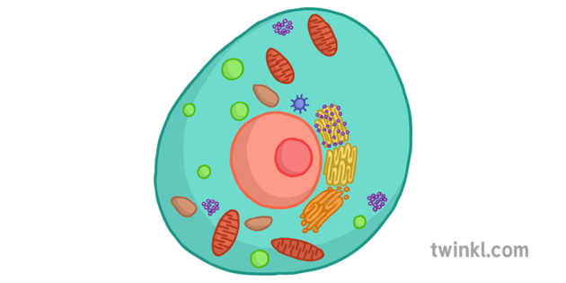
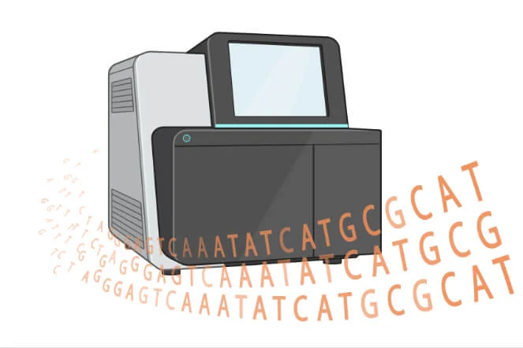
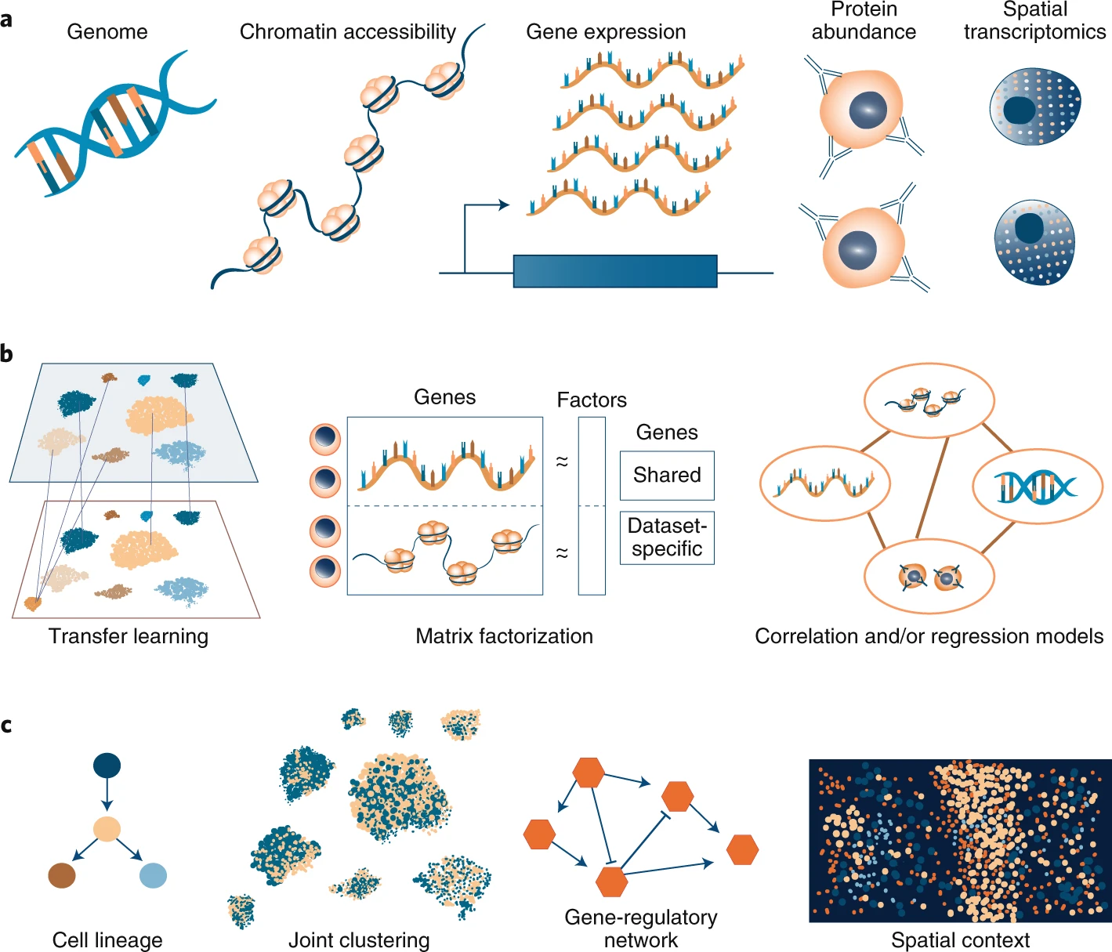
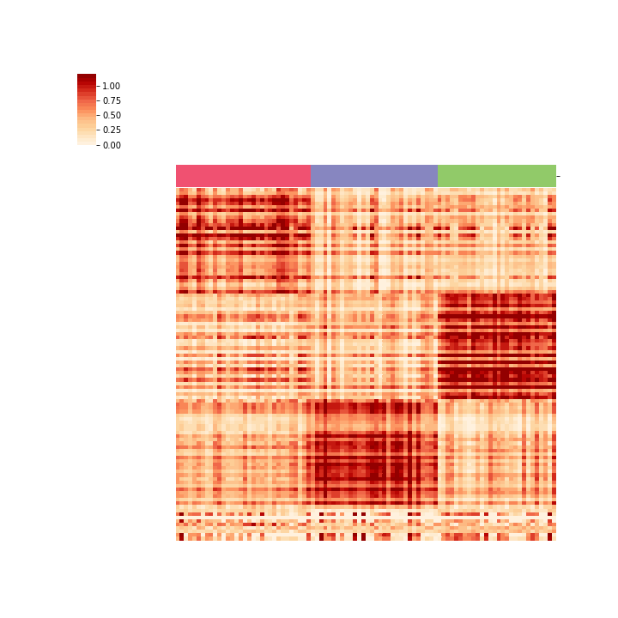
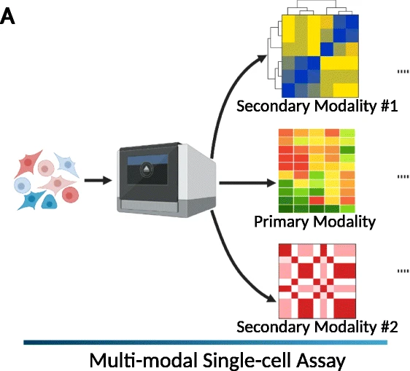
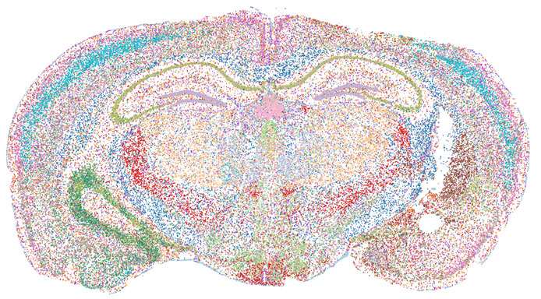
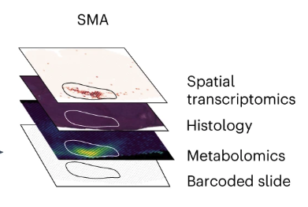
This class: ML methods to understanding cells/tissues in our body
Different types of tissues
Multi-modal, single-cell / spatial data
machine learning
Sequencing / imaging machine
Genomic features (RNA, DNA, protein, …)
Cells in body
Wikipedia
Cells
…
Large data – need sophisticated ML methods to analyze and understand it!
Many datasets!

Slide 4
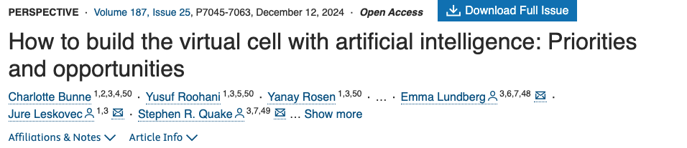
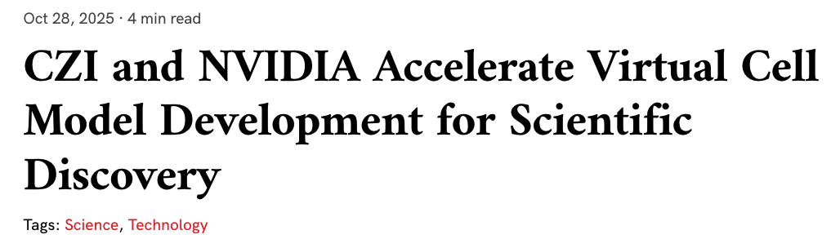
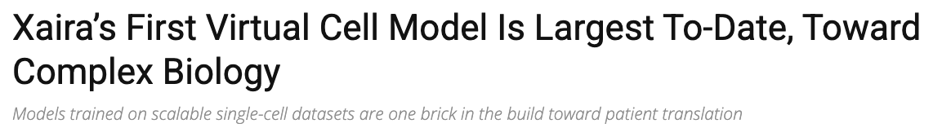
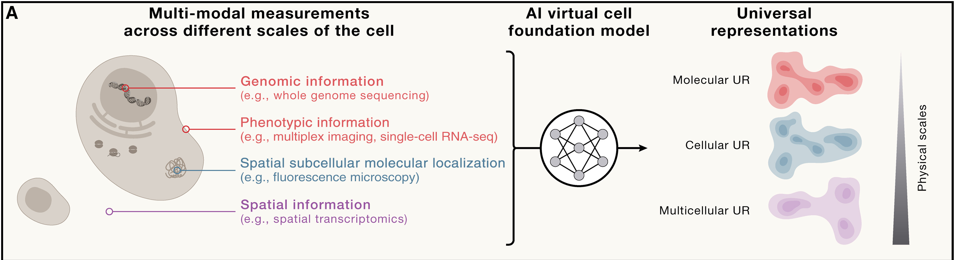
Recent news: AI/ML-powered “virtual cells”
But… what is a virtual cell?

Slide 5
Objectives
Learn fundamental methodology (ML/stats) for single-cell/spatial analysis
Understand state-of-the-art single cell and spatial analysis algorithms
Develop scientific communication and presentation skills
Gain hands-on experience analyzing genomic data
Our goal is for you to leave this course empowered to improve and expedite your own single cell/spatial research

Slide 6

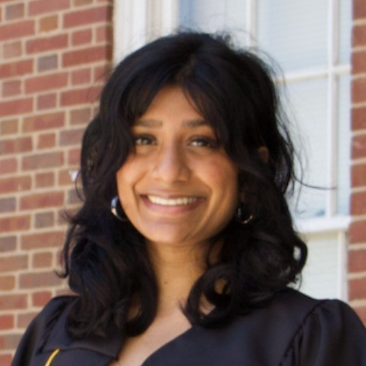
Instructors
Instructor: Uthsav Chitra
Assistant Professor in Department of Computer Science
TA: Sayuni (Sai) Dharmasena
PhD student in Computer Science
(previously undergrad in JHU BME)

Slide 7
Logistics
Course material will primarily be on Github (https://github.com/chitra-lab/ML-for-single-cell-and-spatial-genomics-fall-2026)
Will use Canvas for grading
Office hours: right after class 5:45-6:45
T (Sai, Malone 216) + Th (Uthsav, Malone 319)

Slide 8
Calendar (subject to change)
Unit 1: linear dimensionality reduction
Unit 2: deep learning / dimensionality reduction
Unit 3: manifold learning / graphs
Unit 4: graphs (cont’d) + spatial
Unit 5: Optimal transport
Rest of class: guest lectures, lab presentations

Slide 9
Assessments
Homework: 5 problem sets, one for each unit
In-class labs: one for each unit
In-class quizzes: ~20 minutes, after each unit
Mid-term oral exam: w/ either me or Sai
Final project + oral exam on project

Slide 10
Homeworks (10% of grade)
Problem sets to
reinforce core computational concepts and
teach how to apply concepts to realistic biological settings
AI use is not allowed to directly answer homework problems.
Since it’s impossible to monitor AI usage, HW make up a small % of grade
Homework problems might appear on exams! So encouraged to understand solutions

Slide 11
In-class labs (10% of grade)
Application of ML methods learned in class to real data
AI usage explicitly encouraged.
We will set up AI agents in pre-lab on the next class

Slide 12
In-class exams (25% of grade)
Multiple, short in-class exams
About ~20-30 minutes
Handwritten, no computer or notes allowed
Designed to test understanding of fundamental concepts taught in class – nothing tricky
Might include homework problem(s) to incentivize you to understand the homework
Lowest quiz grade will be dropped

Slide 13
Oral exam (25% of grade)
Oral exam
~middle of semester, anything covered beforehand is fair game
Dates TBD, will send out way to schedule with either me or Sai
~10-15 minutes. Will involve us giving one question and you working out the details.
Might be a homework problem to incentivize you to understand the homework
Designed to test understanding of fundamental concepts taught in class – nothing tricky

Slide 14
Final project (25% of grade)
Application of computational methods learned in class towards solving a real biological problem.
Examples:
novel application of ML method to a biological dataset
Must have some novelty, e.g. existing ML method applied to new datasets, or a new ML method on existing datasets
replicating analyses from a published paper with publicly available data
Theoretical analysis of existing/novel ML method

Slide 15
Final project (25% of grade)
Application of computational methods learned in class towards solving a real biological problem.
Work in groups of 1-4
Two evaluations
Final presentation to class
“Oral exam” where you explain final project to me or Sai

Slide 16
Grading
In-class assessments: 25% (5% each)
Oral exam: 25%
Final project and/or exam: 25%
Homework: 10%
Labs: 10%
Attendance and participation: 5%

Slide 17
Prerequisites
Linear algebra
Probability
(Will cover some basics next class)
Ideally: students have seen some machine learning already
Note: no prior biology knowledge is required

Slide 18
Class focus
This class will
Teach applications of ML and stats to genomics
Cover designing and selecting good approaches for current major problems in genomics
Teach you to think critically about assumptions, caveats, and confounders in biological data analysis
This class will not
Provide theoretical background on specific ML methods, or substitute for an Intro ML course
Substitute for a genomics class

Slide 19
Introduction to single cell/spatial data

Slide 20
Gene expression determines cell type and function
mRNA transcript
gene C
gene A
gene B
gene C
gene B
gene A
Gene expression = number of mRNA transcripts
Notes:
Before we delve any deeper into this topic I will first briefly review gene expression and RNA sequencing.
Gene expression is the quantity and relative proportions of mRNA transcripts in a cell. These mRNA transcripts are transcribed from genes within the genome and then translated into proteins, so in this way the gene expression, or the expression of mRNA transcripts, determines cell type and function

Slide 21
Gene expression determines cell type and function
mRNA transcript
Microarray/RNA-seq
gene C
gene A
gene B
Neuron
High expression of gene B
Oligodendrocyte
gene C
gene B
gene A
High expression of gene A
Gene expression = number of mRNA transcripts
Notes:
In this toy example we have two different brain cell types, a neuron and an oligodendrocyte, which have different gene expression.
The neuron has high expression of gene B and the oligodendrocyte has high expression of gene A.

Slide 22
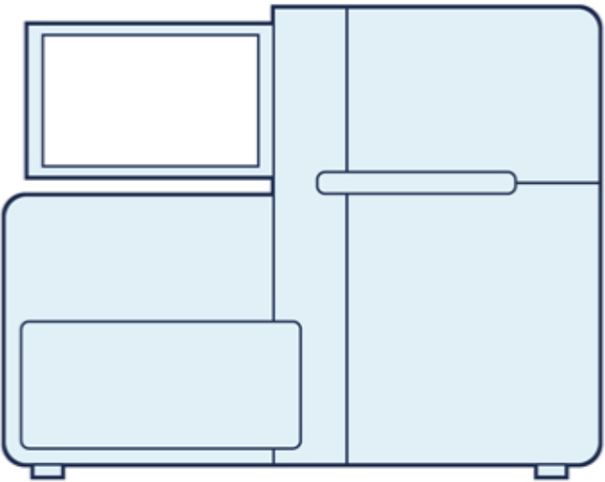
Single cell RNA-sequencing (scRNA-seq) measures gene expression in individual cells
Cell 1
Cells
Sequencing machine
Transcript count matrix
Genes
count = 0
Cell 2
Notes:
The newer technologies are called droplet-based single cell sequencing are more commonly used due to their ability to sequence many more cells. These include drop-seq, inDrops, and 10X Genomics. 10X Genomics droplet based technology is by far the most commonly used currently. With droplet based methods, cells are encapsulated in tiny droplets of oil, where each droplet contains a bead covered in barcodes unique to that droplet. With this technology we can now sequence from 1000 to up to 100,000 cells on a single sequencing run. However this comes at the cost of sequencing only about 70 thousand reads per cell instead of 1 million using plate-based methods.
This ability to assign barcoded reads to cells allows us to retain cell type information and investigate cellular heterogeneity within a single sample.

Slide 23
Single cell RNA-sequencing (scRNA-seq) measures gene expression in individual cells
Cell 1
Cells
gene B
Sequencing machine
count = high
Transcript count matrix
Genes
count = 0
gene A
Cell types!
Cell 2
Notes:
The newer technologies are called droplet-based single cell sequencing are more commonly used due to their ability to sequence many more cells. These include drop-seq, inDrops, and 10X Genomics. 10X Genomics droplet based technology is by far the most commonly used currently. With droplet based methods, cells are encapsulated in tiny droplets of oil, where each droplet contains a bead covered in barcodes unique to that droplet. With this technology we can now sequence from 1000 to up to 100,000 cells on a single sequencing run. However this comes at the cost of sequencing only about 70 thousand reads per cell instead of 1 million using plate-based methods.
This ability to assign barcoded reads to cells allows us to retain cell type information and investigate cellular heterogeneity within a single sample.

Slide 24
Single cell RNA-sequencing (scRNA-seq) measures gene expression in individual cells
Cell 1
Cells
gene B
Sequencing machine
count = high
Genes
count = 0
gene A
i-th column = transcript counts for cell i
Cell types!
Cell 2
Notes:
The newer technologies are called droplet-based single cell sequencing are more commonly used due to their ability to sequence many more cells. These include drop-seq, inDrops, and 10X Genomics. 10X Genomics droplet based technology is by far the most commonly used currently. With droplet based methods, cells are encapsulated in tiny droplets of oil, where each droplet contains a bead covered in barcodes unique to that droplet. With this technology we can now sequence from 1000 to up to 100,000 cells on a single sequencing run. However this comes at the cost of sequencing only about 70 thousand reads per cell instead of 1 million using plate-based methods.
This ability to assign barcoded reads to cells allows us to retain cell type information and investigate cellular heterogeneity within a single sample.

Slide 25
Single-cell sequencing
Source: https://www.tbmcore.cnrs.fr/onecell/?lang=en (if GIF doesn’t work)

Slide 26
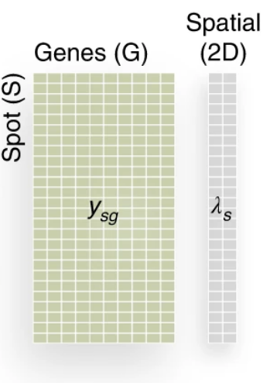
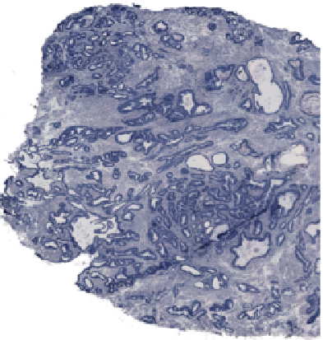
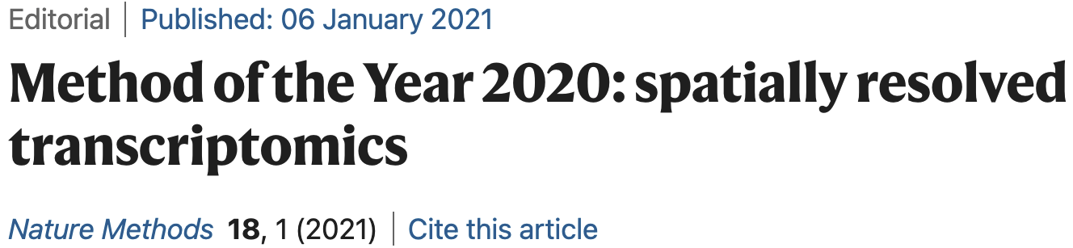
Spatial transcriptomics (spatial sequencing)
Gene expression matrix + spatial coordinates
Spatial (2D)
Genes (features)
Spatial coordinate of spot
2-D tissue
Spots (samples)
Genes
…
Gene expression vector
High-dimensional data:
1,000-20,000 genes (“features”)
1,000s - 1,000,000s spots (“samples”)
Computational opportunities (and challenges): modeling spatial structure
Notes:
Emphasize that it’s high-dim, multi-modal
How to explain what expression is?
Single cell

Slide 27
Challenges: sparsity and batch effects
Spatial (2D)
Genes (features)
Batch effects:
even if you measure exact same dataset, there will be (large, unknown) differences in measurements
Spots (samples)
Genes
Genes
Cells
Cells
Dataset A measured on Tuesday
Dataset A measured on Wednesday
70-90% zeros!
(or by different people, or with different machine, or …)

Slide 28
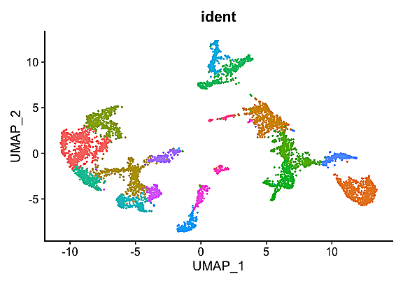
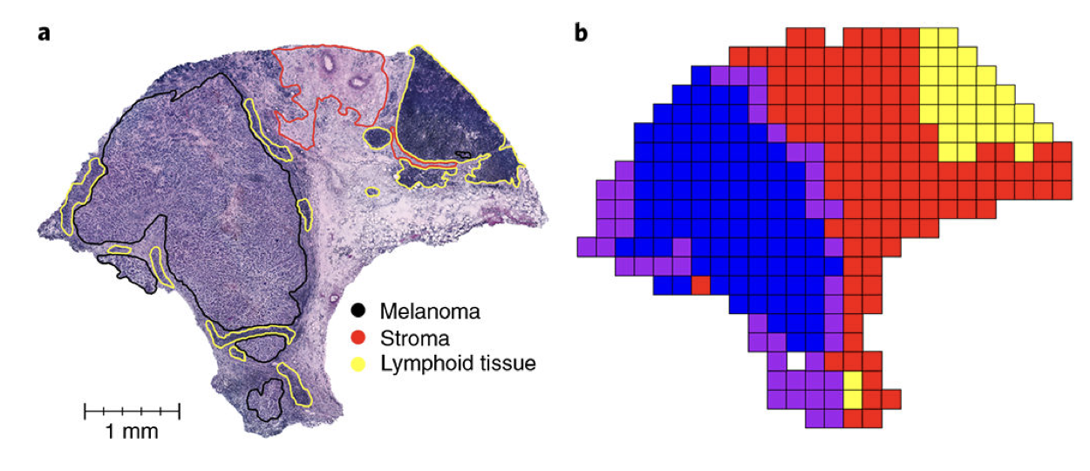
Application: dimensionality reduction + data visualization
Single-cell
Genes
Cells/spots
(dot=cell, color = cell types)
Melanoma
Data is very high dimensional! How to intuitively understand?
Spatial
Zhao et al., Nat. Biotech. (2021)
Data: Thrane, et al. Cancer Res. (2018)

Slide 29
Differential + multimodal data analysis
Multi-modal data
Differential analysis
Genes
Metabolites
DNA
Healthy
Diseased
Cells
…
Genes (features)
Genes (features)
Cells/spots
Cells/spots
Cell type disappeared!

Slide 30
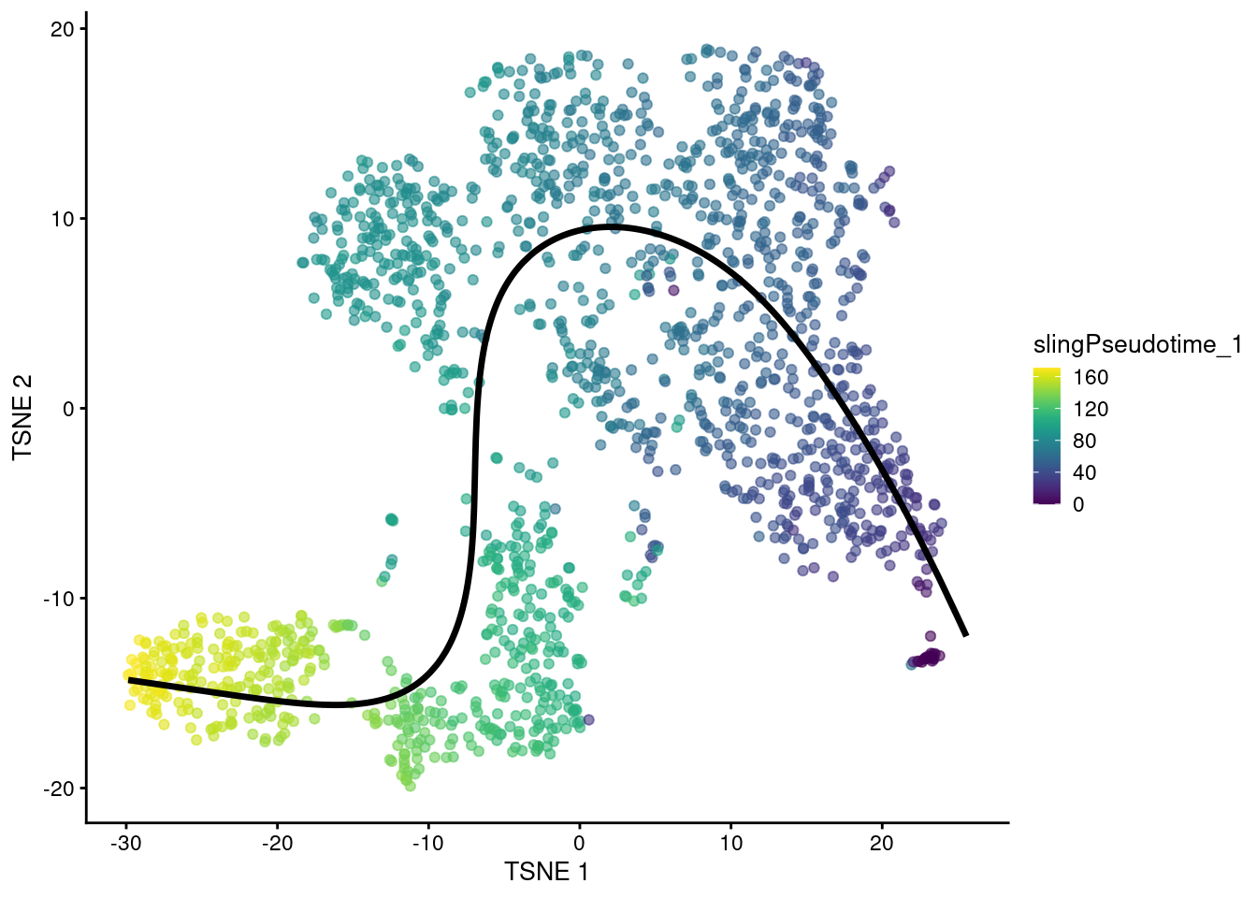
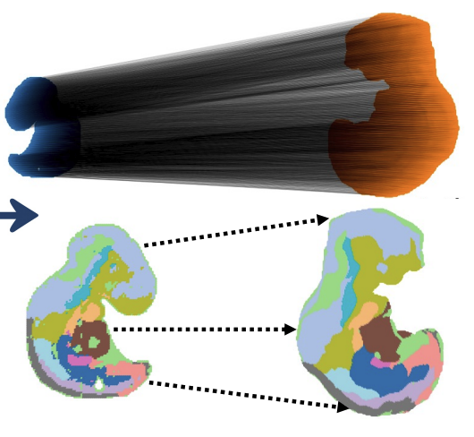
Trajectory inference
A single dataset
Time series data
optimal transport, diffusion, …
Data=single snapshot but cells are at different stages
can you infer “pseudotime” ordering of cells?
Mouse embryo E10.5 -> E9.5
Halmos et al, bioRxiv 2025

Slide 31
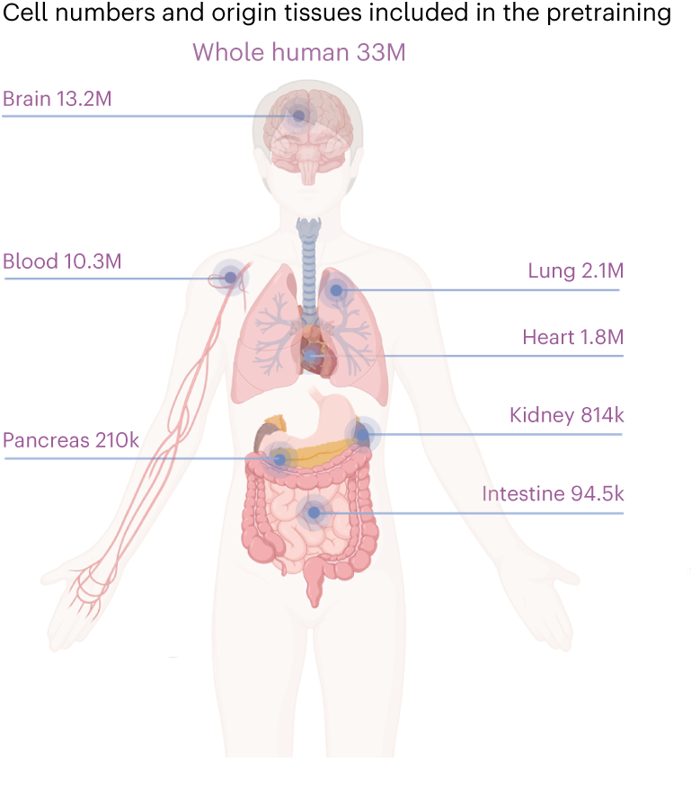
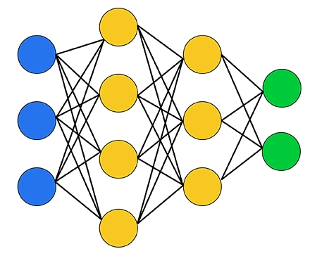
New: foundation models
Foundation models
How to learn insights from large volume of datasets?
scGPT (Cui et al, Nature Methods 2024)

Slide 32
Applications
Data integration/differential analysis
(Spatio)temporal time series
optimal transport, diffusion, …
Healthy
Diseased
Genes (features)
Genes (features)
Cells/spots
Cells/spots
Cell type disappeared!
Mouse embryo E10.5 -> E9.5
Halmos et al, bioRxiv 2025

Slide 33
Recap: course roadmap
Unit 1: linear dimensionality reduction
PCA, NMF, …
Unit 2: non-linear dimensionality reduction (deep learning)
Autoencoders, contrastive learning, foundation models
Unit 3: manifold learning + graphs
Random walks, diffusion, …
Unit 4: graphs (cont’d) + spatial methodologies
Unit 5: Optimal transport for integrating multiple datasets
Next class: refresher on ML/stats + pre-lab

