Slide 1
Representation learning: autoencoders, contrastive learning, and foundation models
Part 2
Uthsav Chitra

Slide 2
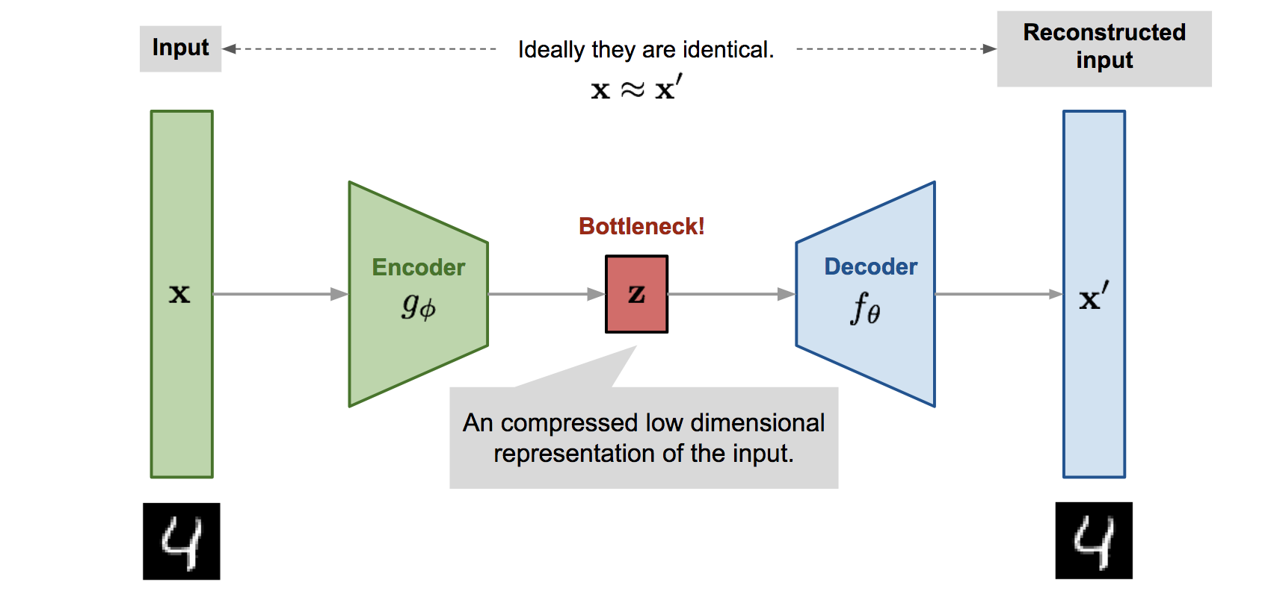
Last time: autoencoders
Given data x₁, …, x_{N}, solve:
Weights of neural networks
Notes:
fix

Slide 3
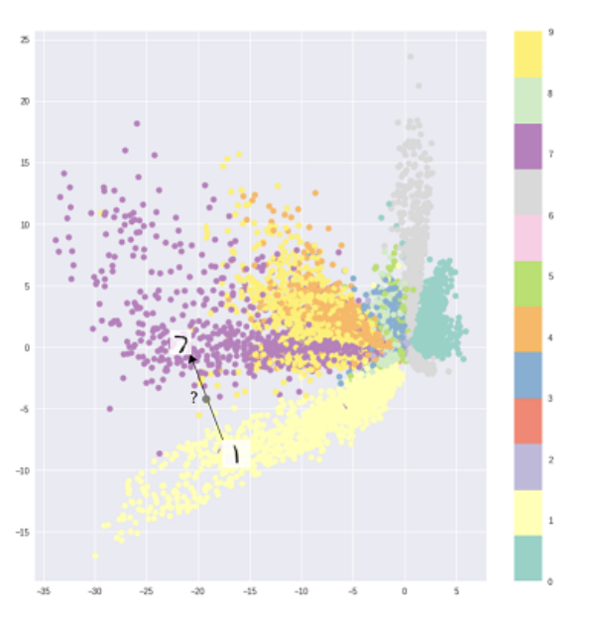
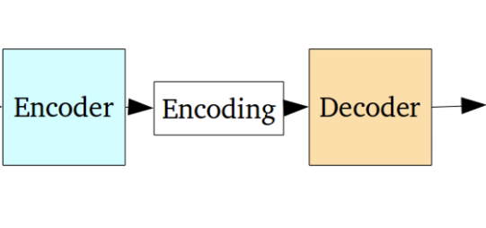

Autoencoder latent space is hard to interpret
Digits cluster together in the latent space
Lots of unused space – these do not map to real images
Plug into decoder
Autoencoder axis 2
Autoencoder axis 1

Slide 4
Autoencoder latent space is hard to interpret
Digits cluster together in the latent space
Lots of unused space – these do not map to real images
Cannot reasonably interpolate between two datapoints
Need structured latent space
Autoencoder axis 2
Autoencoder axis 1

Slide 5
RECAP

Slide 9
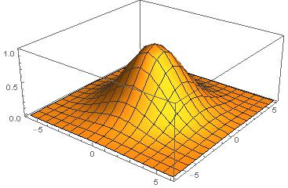
Variational autoencoder (VAE): a generative model
Key idea: Make latent variable z follow a distribution
Gaussian z ~ N(0, I)

Slide 10
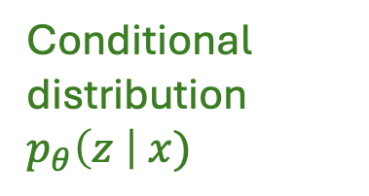
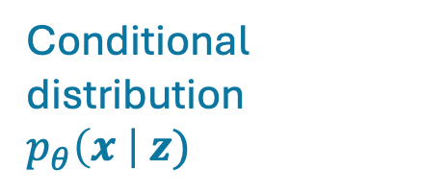
VAE intuition: encoder and decoder map points to distributions
z
Conditional distribution $p_{θ}\left(x \right| z)$
Conditional distribution $p_{θ}\left(z \right| x)$
“Decoder”
“Encoder”
Latent variable z
Data x

Slide 11
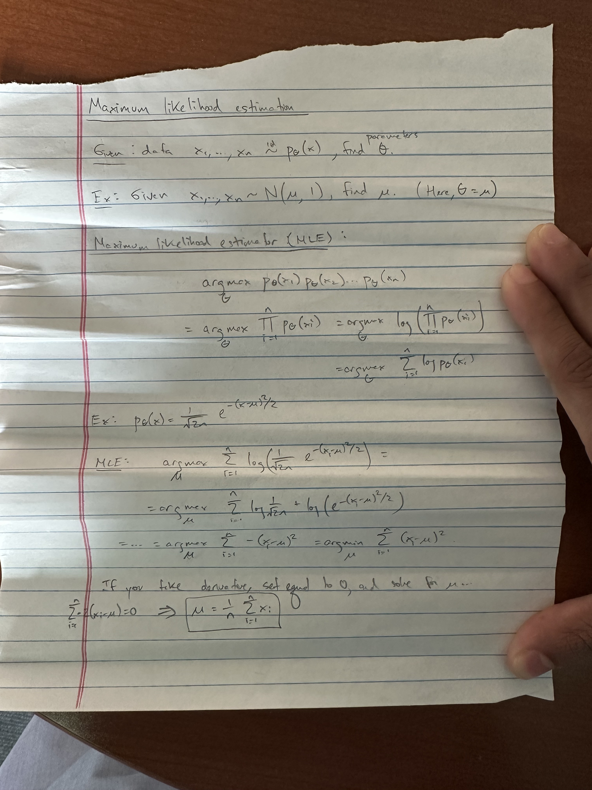
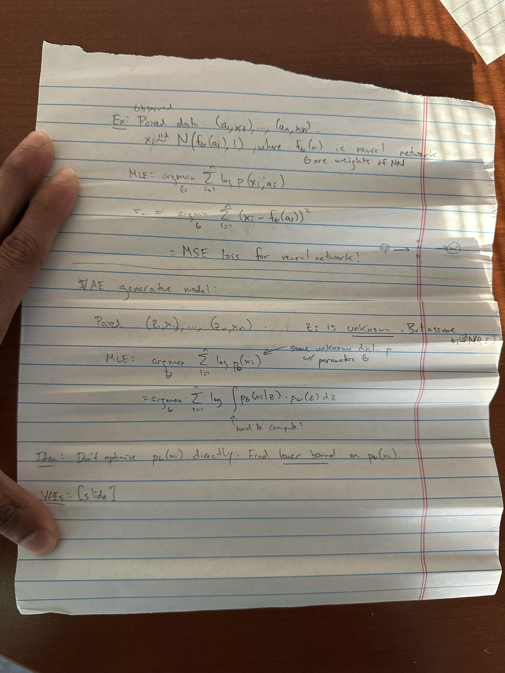
Maximum likelihood estimation [board]

Slide 12
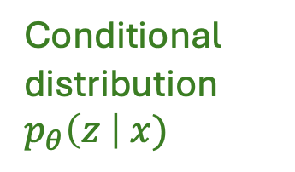

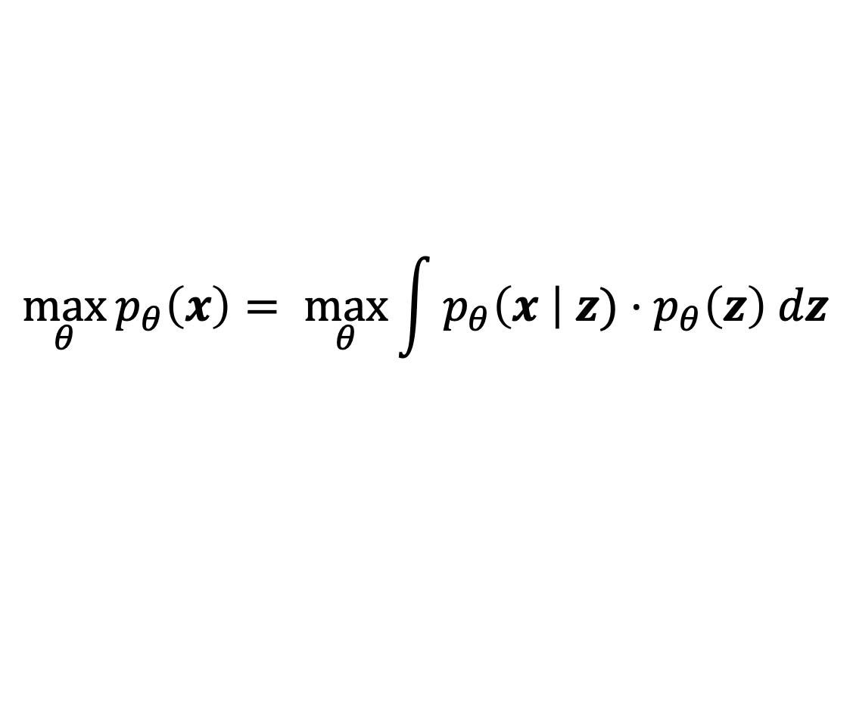
Maximum likelihood to learn parameters of VAE:
z
Conditional distribution $p_{θ}\left(x \right| z)$
Conditional distribution $p_{θ}\left(z \right| x)$
“Decoder”
“Encoder”
Latent variable z
Data x
Goal: find parameters $θ$ that maximize probability of seeing observed data:
$$\max_{θ}{p_{θ}\left(x\right)= \max_{θ}{\int{p_{θ}\left(x \right| z)⋅p_{θ}\left(z\right) dz}}}$$
ISSUE: computing integral is hard!!
can approximate with neural network
simple Gaussian

Slide 13
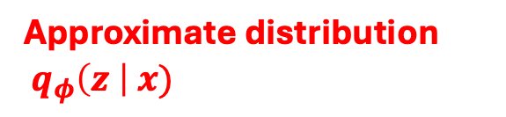
Solution: “variational” inference
z
Conditional distribution $p_{θ}\left(x \right| z)$
Conditional distribution $p_{θ}\left(z \right| x)$
“Decoder”
“Encoder”
Latent variable z
Approximate distribution
$q_{φ}\left(z \right| x)$
Data x

Slide 14
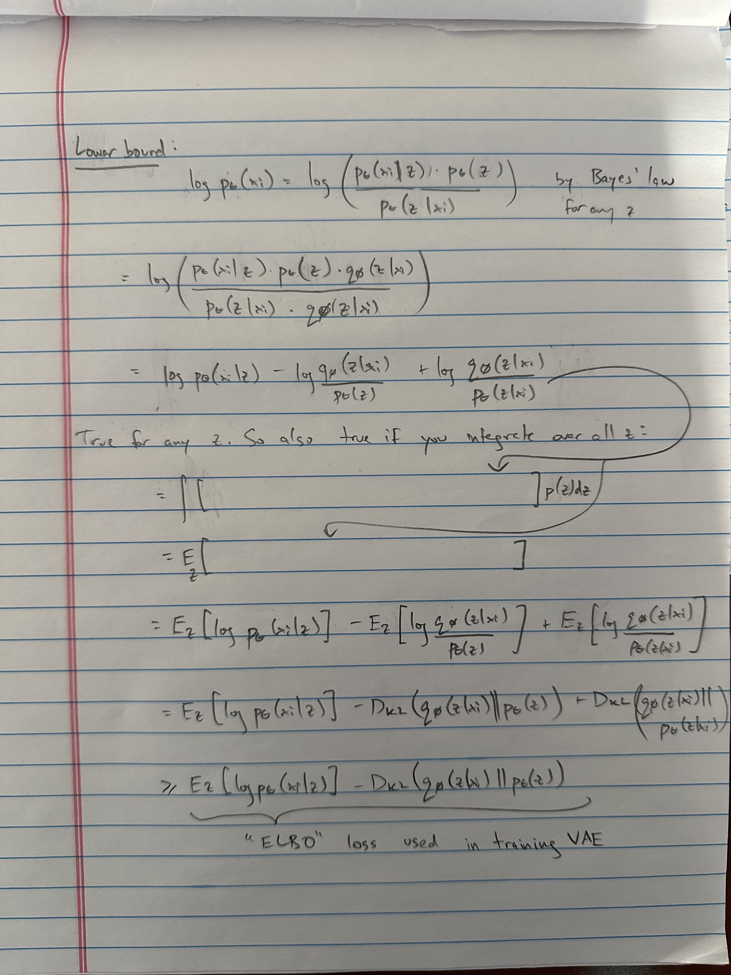
Deriving the variational loss [on board]

Slide 15
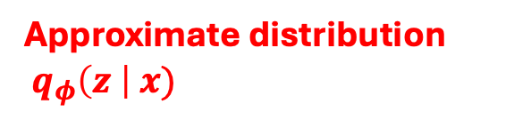
Deriving the variational loss [on board]
z
Conditional distribution $p_{θ}\left(x \right| z)$
Conditional distribution $p_{θ}\left(z \right| x)$
“Decoder”
“Encoder”
Latent variable z
Approximate distribution
$q_{φ}\left(z \right| x)$
Data x

Slide 16

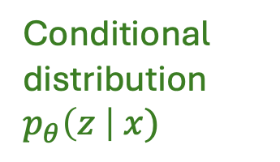

ELBO (Evidence lower bound objective) loss
z
Conditional distribution $p_{θ}\left(x \right| z)$
Conditional distribution $p_{θ}\left(z \right| x)$
“Decoder”
“Encoder”
Latent variable z
Approximate distribution
$q_{φ}\left(z \right| x)$
Data x
Prior distribution: z ~ N(0, I)
Find parameters $φ, θ$ of neural networks $q_{φ}\left(z \right| x)$, $p_{θ}\left(x \right| z)$ that maximize
Lower bound on true data likelihood (ELBO)

Slide 17

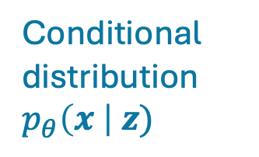


VAE architecture in practice: two networks trained jointly
Encoder
Decoder
$$μ_{φ}\left(x\right)$$
Conditional distribution $p_{θ}\left(x \right| z)$
Encoder network
z
$$σ_{φ}^{2}\left(x\right)$$
Latent variable z
Approximate distribution is Gaussian:
Data x
Homework: could be Gaussian, Poisson, …
$q_{φ}\left(z \right| x)=N(μ_{φ}\left(x\right), σ_{φ}^{2}\left(x\right))$
Loss:

Slide 18
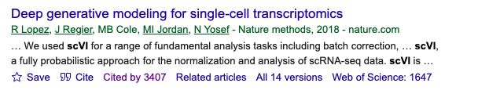
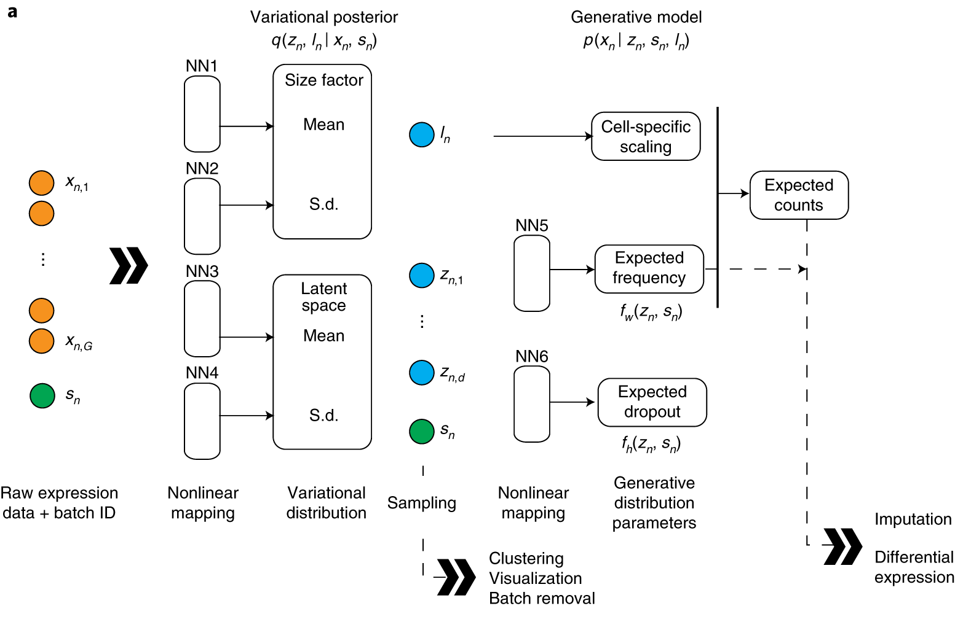
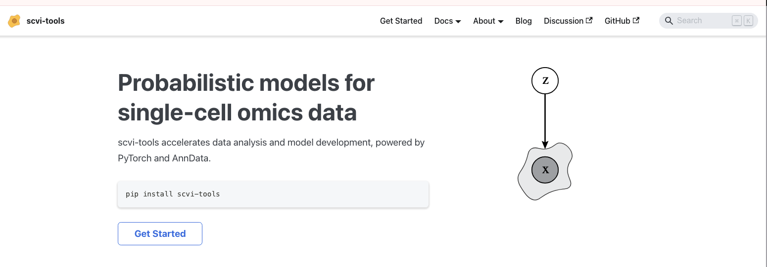
scVI is a widely-used VAE in single-cell biology
An entire ecosystem – scvi-tools – is based off of variational inference

Slide 19
Next: self-supervised learning
Generative models are great but now suppose you just want to learn representations
(i.e. you don’t care about generating new samples)
(e.g. single cell vectors)

Slide 20
Supervised learning
If you have labels, you can extract last (or intermediate) layer from an MLP
Training labels
(e.g. cell type)
(e.g. single cell vectors)

Slide 21
What if you don’t have labels?
e.g. only single cell vectors but no cell type labels
????
(e.g. single cell vectors)

Slide 22
Self-supervised learning
(e.g. single cell vectors)

Slide 23
Early(ish) self-supervised approaches: “pretext” tasks

Slide 24
Early(ish) self-supervised approaches: “pretext” tasks

Slide 25
Early(ish) self-supervised approaches: “pretext” tasks
Extract representation from last layer

Slide 26
Many other pretext tasks…

Slide 32
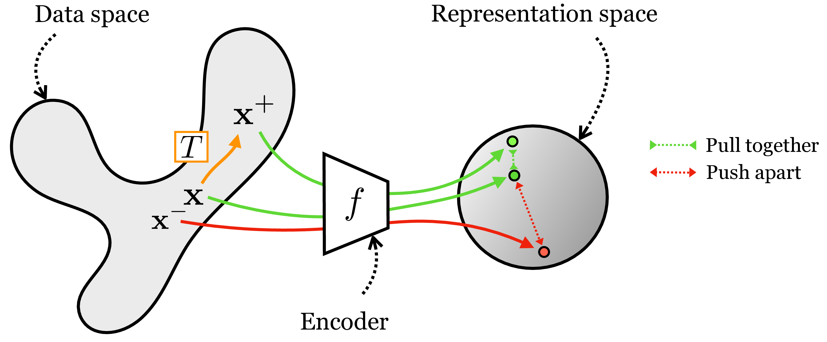
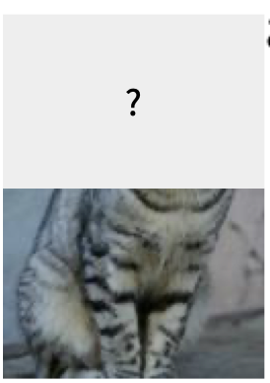
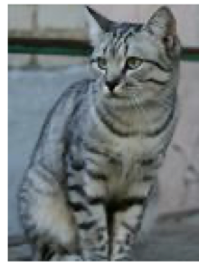
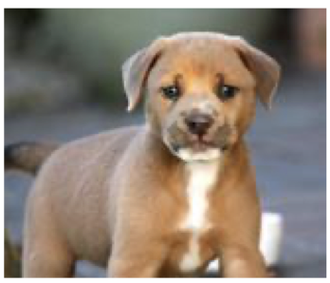
Contrastive learning
From https://visionbook.mit.edu/representation_learning.html#sec-representation_learning-contrastive_learning

Slide 36
Called the InfoNCE loss

Slide 37
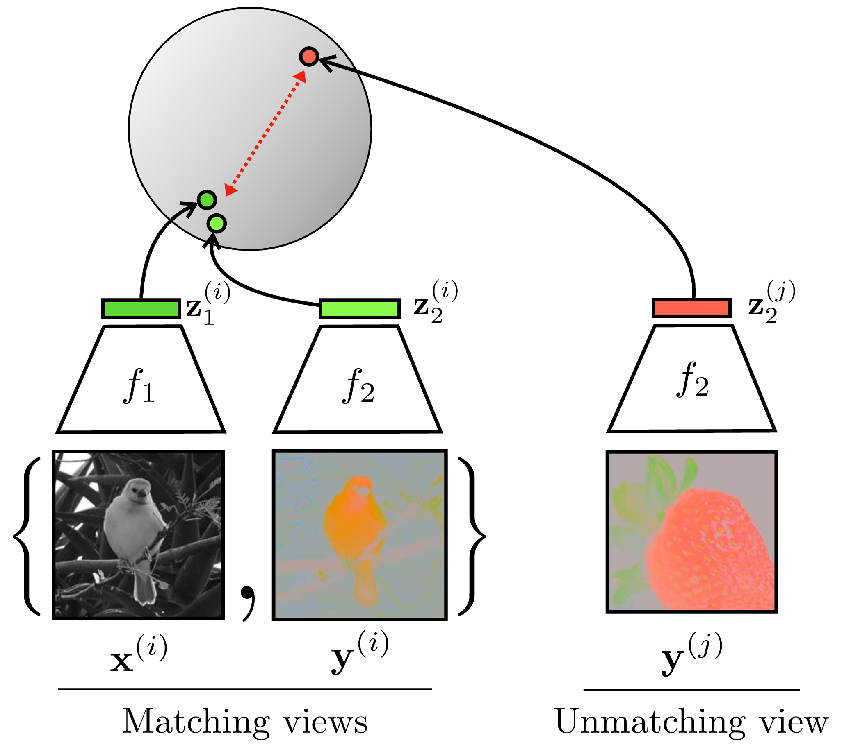
Wang and Isola (ICML 2020) show that InfoNCE loss encourages
Alignment (shown left)
Uniformity
  ie embeddings are spread out uniform across circle and not clustered together

Slide 42
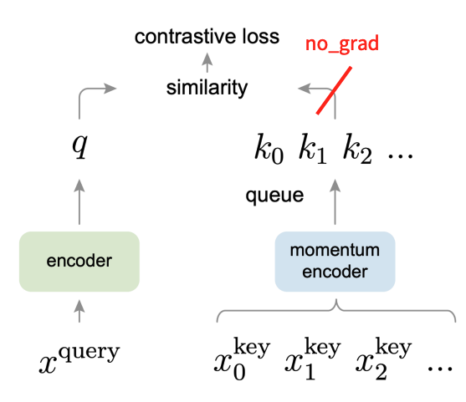
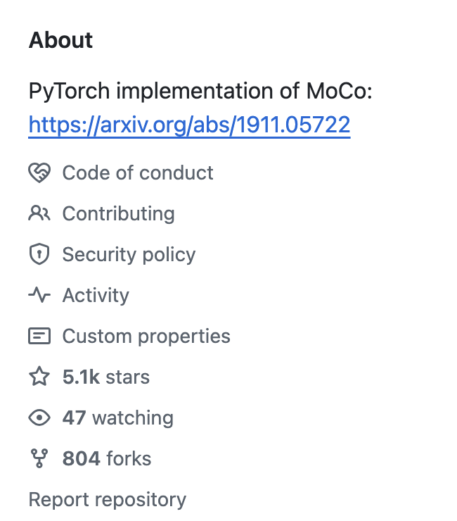
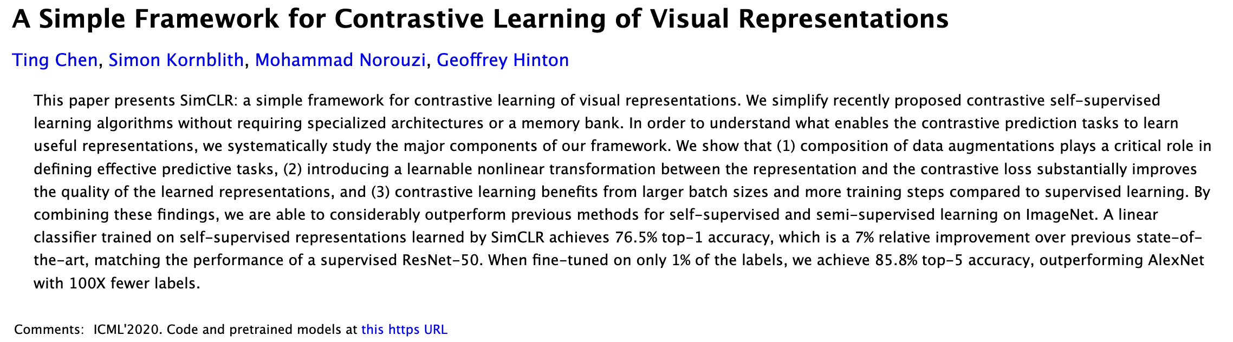
MoCo builds off of SimCLR by saving negative examples across iterations (batches)
Momentum Contrastive Learning (MoCo)
More sample efficient: priority queue to increase number of training samples in a batch
All are widely used (e.g. many citations, Github stars, …)
(30000+ citations!)

Slide 43
MoCo builds off of SimCLR
(30000+ citations!)
Momentum Contrastive Learning (MoCo)
More sample efficient: priority queue to increase number of training samples in a batch
All are widely used (e.g. many citations, Github stars, …)

Slide 45
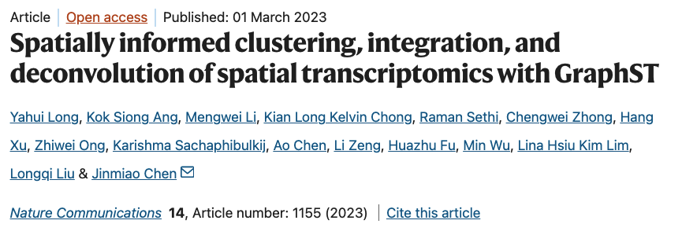
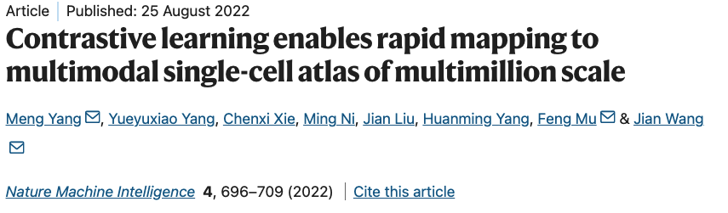
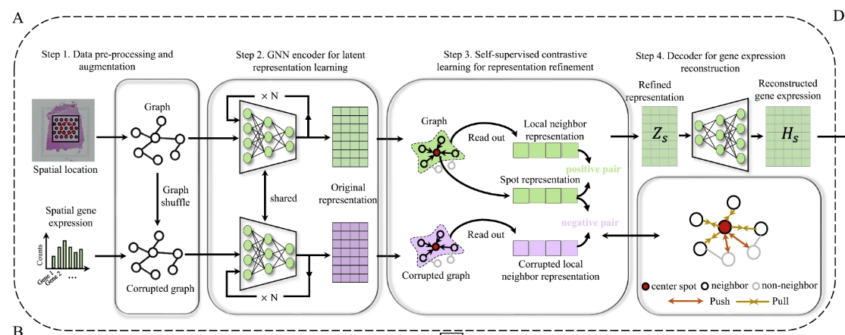
Contrastive learning in single cell/spatial analysis (especially popular for spatial biology)

Slide 46
Summary:
Maximum likelihood estimation (MLE)
Approximate MLE to get loss (“ELBO”) for a variational autoencoder
Contrastive learning -- no probabilistic model
Instead augment datapoints x with random transformations T(x)
train neural network to attract x with T(x) and repel x from x’

