Slide 1
Machine Learning for Single-Cell and Spatial Biology
Prof. Uthsav Chitra
Johns Hopkins University
September 8, 2026

Slide 2
Today
Dimensionality reduction / feature selection
Principal components analysis (PCA)
Derivation
Computing principal components (PCs)
Singular value decomposition (SVD)
Variance explained
Examples

Slide 3
20000 genes (features)
1000-1000000s of cells
Slide from Smita Krishnaswamy et al: https://krishnaswamylab.org/workshop

Slide 4
Features
Feature 1
Feature 2
…
Samples
Data matrix
Slide from Smita Krishnaswamy et al: https://krishnaswamylab.org/workshop

Slide 5
Slide from Smita Krishnaswamy et al: https://krishnaswamylab.org/workshop

Slide 6
Slide from Smita Krishnaswamy et al: https://krishnaswamylab.org/workshop

Slide 7
Slide from Smita Krishnaswamy et al: https://krishnaswamylab.org/workshop

Slide 8
Dimensionality reduction
Reduce dimension (number of features) of high-dimensional data
makes it easier to visualize data, train ML models, etc.
G features (e.g. genes)
G’ << G features
N samples (e.g. cells)
Y
Y’
N samples (e.g. cells)

Slide 9
Naïve approach: feature (gene) selection
Remove “uninformative” features
Features (e.g. genes)
Informative: has large “spread” (variance) across samples
2.1
0.0
2.1
-1.2
2.1
3.7
Samples (e.g. cells)
2.1
-4.2
2.1
-1.1
2.1
-20
2.1
15
Uninformative: constant across all samples
Source: Wikipedia

Slide 10
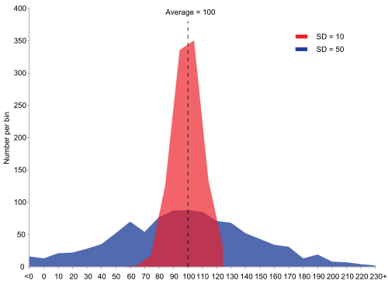
Naïve approach: feature (gene) selection
Remove “uninformative” features
Features (e.g. genes)
Informative: has large “spread” (variance) across samples
2.1
0.0
2.1
-1.2
Intuitively, quantify how feature “informativeness” through variance
2.1
3.7
Samples (e.g. cells)
2.1
-4.2
2.1
-1.1
2.1
-20
2.1
15
Uninformative: constant across all samples
Source: Wikipedia

Slide 11

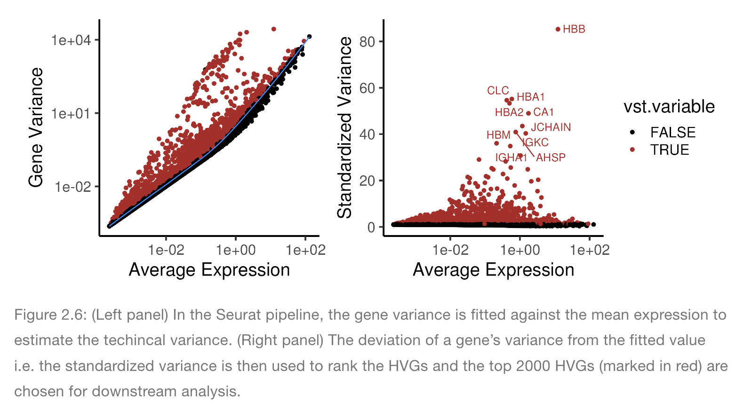
Data pre-processing step: Highly variable gene (HVG) selection
Find genes where:
variance > mean expression
(Recall that in Poisson distribution, mean = variance)
Source: https://ouyanglab.com/singlecell/basic.html
Seurat = standard R package for single cell analysis

Slide 12

Challenges with feature selection
Many genes are “highly variable”
E.g. in Seurat/Scanpy, one typically takes the top 1000-2000 HVGs
Features are often correlated or related. We would like to summarize these patterns
Feature A
Feature B
0.0
0.0
-2.4
-1.2
7.4
3.7
Feature A $≈2 ×$Feature B
Samples (e.g. cells)
0.0
-4.2
-2.2
-1.1
Keeping both Feature A and Feature B is redundant – we would like to keep only one
-40
-20
0.0
15

Slide 13
Principal Components Analysis (PCA)
Intuition: find linear combinations of features that are most “informative” (have highest variance)
Called principal components, or PCs
Principal component (PC) 1 = 2 * Feature A + 3 * Feature B
Feature A
Feature B
Samples (e.g. cells)
Samples (e.g. cells)

Slide 14
Slide from Smita Krishnaswamy et al: https://krishnaswamylab.org/workshop

Slide 15
Slide from Smita Krishnaswamy et al: https://krishnaswamylab.org/workshop

Slide 16
Slide from Smita Krishnaswamy et al: https://krishnaswamylab.org/workshop

Slide 17
Slide from Smita Krishnaswamy et al: https://krishnaswamylab.org/workshop

Slide 18
Slide from Smita Krishnaswamy et al: https://krishnaswamylab.org/workshop

Slide 19
Linear comb. of features = direction in space
Slide from Smita Krishnaswamy et al: https://krishnaswamylab.org/workshop

Slide 20
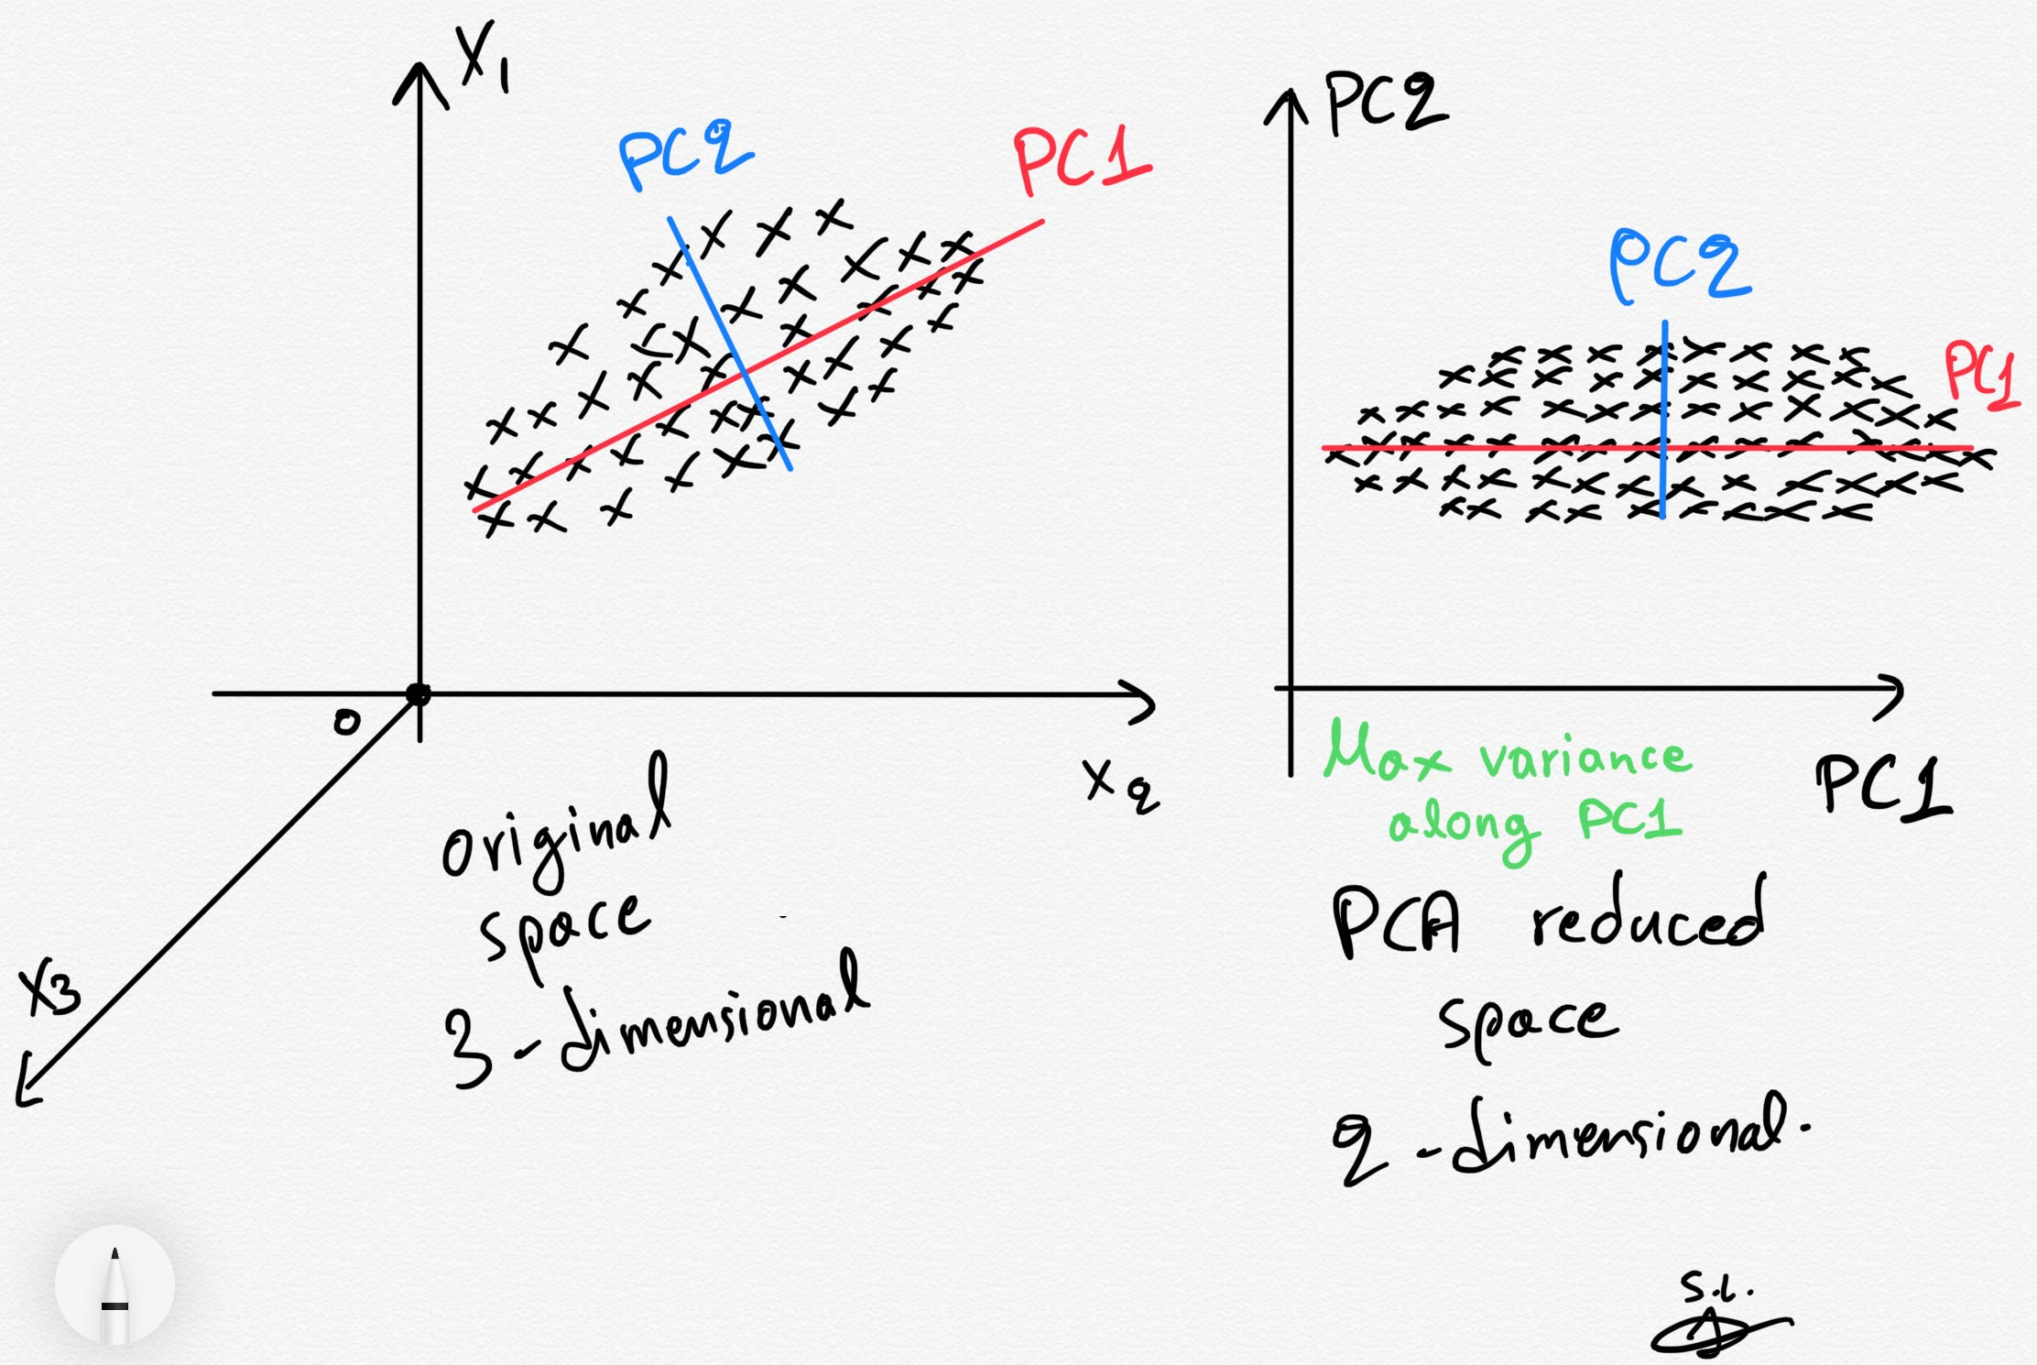
PCA: geometric intuition
Linear combination of features = direction in space
e.g. 2 * (Feature 1) + 3 * (Feature 2) is represented by vector <2,3>
PCs are orthogonal
PC1 = direction of largest variance
PC2 = direction orthogonal to PC1 of largest variance
PC3 = direction orthogonal to PC 1, PC2 of largest variance

Slide 21
Geometric interpretation of PCA: dimensionality reduction
Find directions in space that “explain the most variance in the data”
Linear comb. of features = direction in space, e.g. 2 * (Feature 1) + 3 * (Feature 2) represented by vector <2,3>

Slide 22
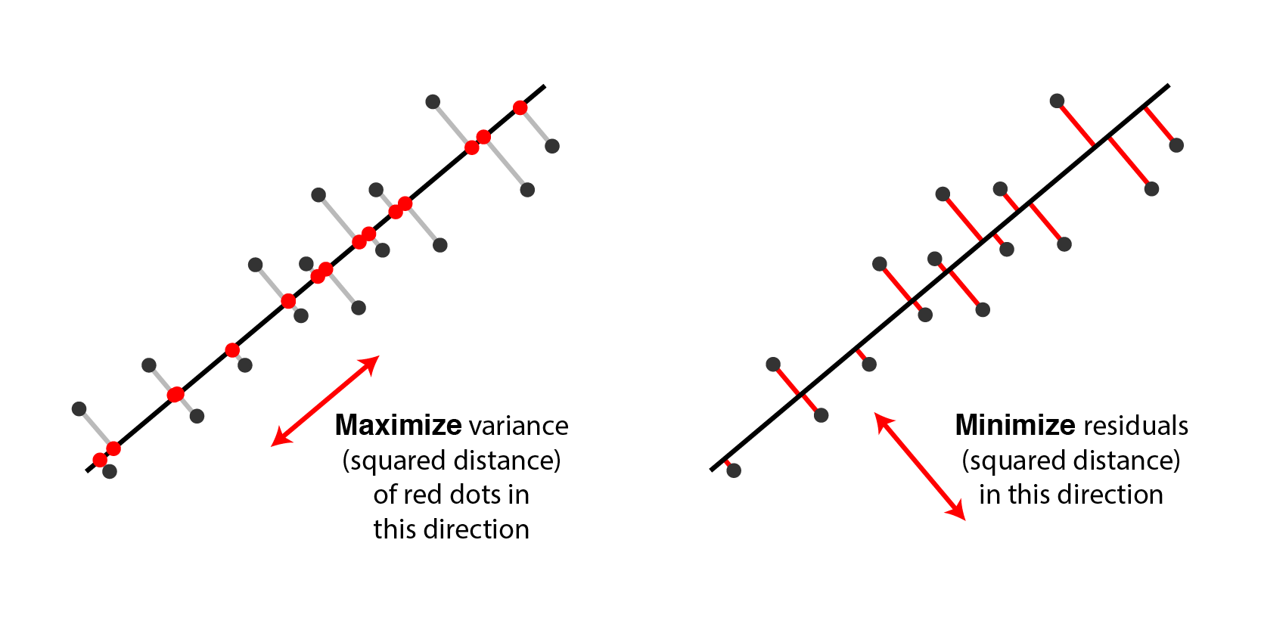
Alternative interpretation of PCA

Slide 23
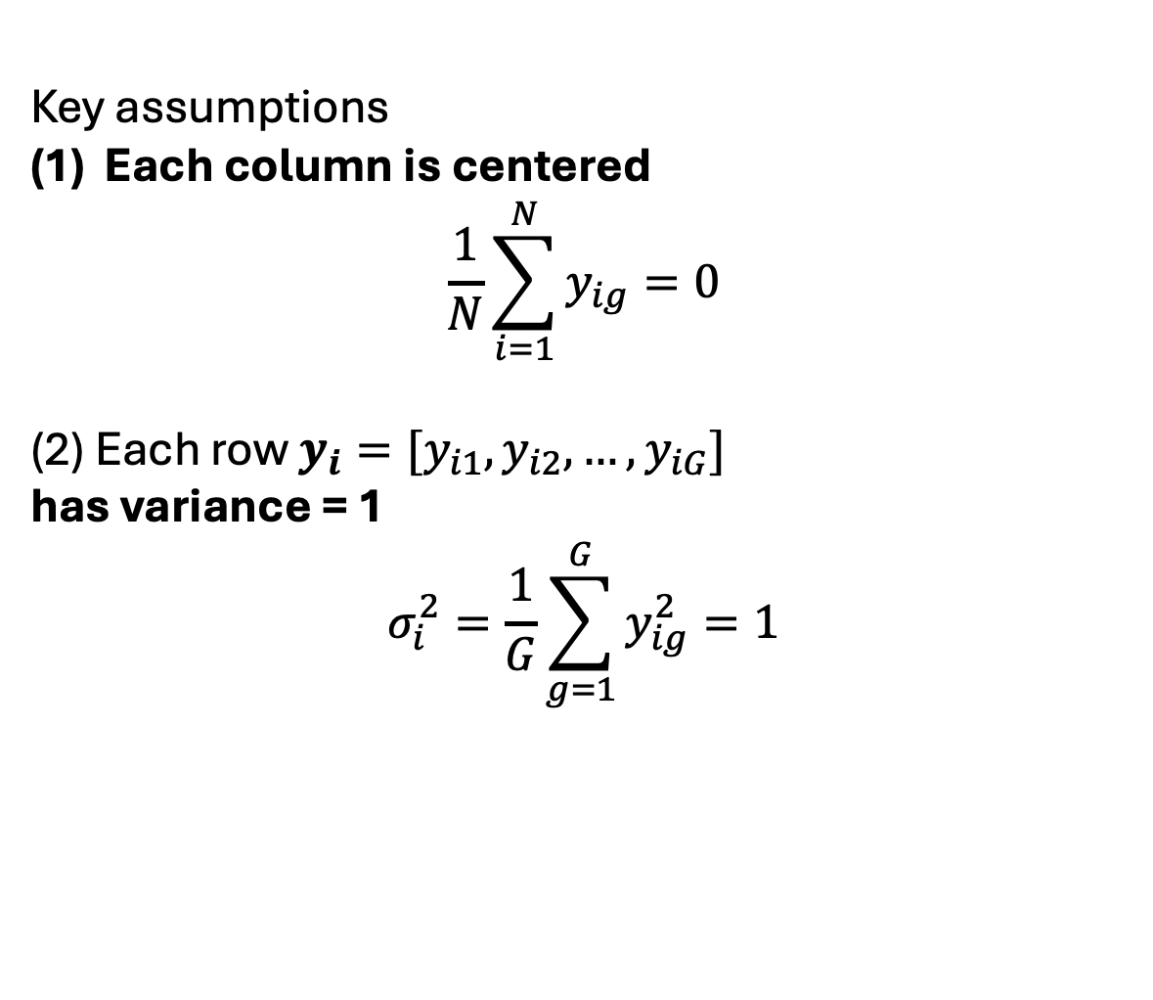

PCA: derivation
Key assumptions
Each column is centered
$$\frac{1}{N}\sum_{i=1}^{N}{y_{ig}=0}$$
(2) Each row $y_{i}=[y_{i1}, y_{i2}, …, y_{iG}]$
has variance = 1
$$σ_{i}^{2}=\frac{1}{G}\sum_{g=1}^{G}{y_{ig}^{2}}=1$$
G features
y₁
N samples
y₂
…
y_{N}
Y
PC 1: (length M – linear coefficients of M features)
$$v_{1}=\underset{\left|\left|w\right|\right|=1}{argmax}{Var\left(Yw\right)}$$

Slide 24
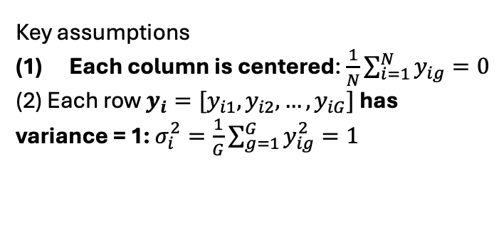
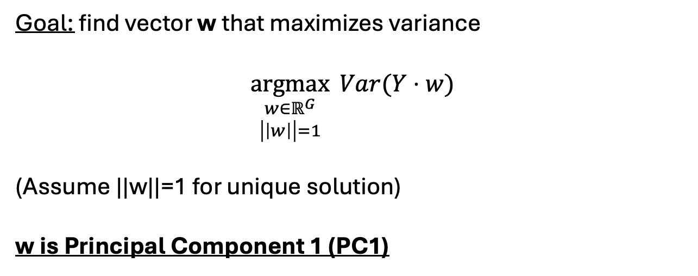
PCA: derivation
Goal: find vector w that maximizes variance
$$\underset{\begin{aligned}w∈ℝ^{G} \\ \left|\left|w\right|\right|=1\end{aligned}}{argmax}{Var(Y⋅w)}$$
(Assume ||w||=1 for unique solution)
w is Principal Component 1 (PC1)
G features
y₁
N samples
y₂
w
…
y_{N}
Y
Key assumptions
Each column is centered: $\frac{1}{N}\sum_{i=1}^{N}{y_{ig}=0}$
(2) Each row $y_{i}=[y_{i1}, y_{i2}, …, y_{iG}]$ has variance = 1: $σ_{i}^{2}=\frac{1}{G}\sum_{g=1}^{G}{y_{ig}^{2}}=1$
PC 1: (length M – linear coefficients of M features)
$$v_{1}=\underset{\left|\left|w\right|\right|=1}{argmax}{Var\left(Yw\right)}$$

Slide 25
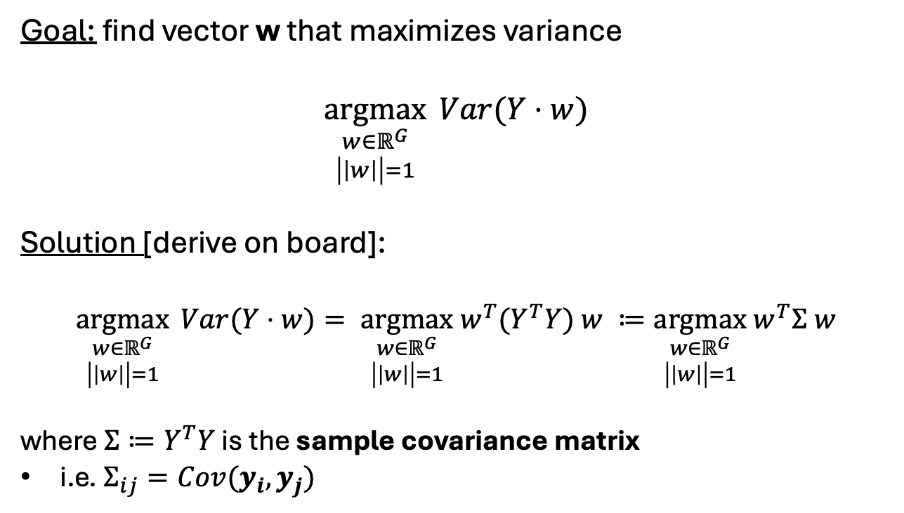
PCA: derivation
Goal: find vector w that maximizes variance
$$\underset{\begin{aligned}w∈ℝ^{G} \\ \left|\left|w\right|\right|=1\end{aligned}}{argmax}{Var(Y⋅w)}$$
Solution [derive on board]:
$$\underset{\begin{aligned}w∈ℝ^{G} \\ \left|\left|w\right|\right|=1\end{aligned}}{argmax}{Var(Y⋅w)}= \underset{\begin{aligned}w∈ℝ^{G} \\ \left|\left|w\right|\right|=1\end{aligned}}{argmax} w^{T}{(Y}^{T}Y) w ≔\underset{\begin{aligned}w∈ℝ^{G} \\ \left|\left|w\right|\right|=1\end{aligned}}{argmax} w^{T}Σ w$$
where $Σ≔Y^{T}Y$ is the sample covariance matrix
i.e. $Σ_{ij}=Cov(y_{i}, y_{j})$
G features
y₁
N samples
y₂
w
…
y_{N}
Y
Key assumptions
Each column is centered: $\frac{1}{N}\sum_{i=1}^{N}{y_{ig}=0}$
(2) Each row $y_{i}=[y_{i1}, y_{i2}, …, y_{iG}]$ has variance = 1: $σ_{i}^{2}=\frac{1}{G}\sum_{g=1}^{G}{y_{ig}^{2}}=1$
PC 1: (length M – linear coefficients of M features)
$$v_{1}=\underset{\left|\left|w\right|\right|=1}{argmax}{Var\left(Yw\right)}$$

Slide 26

PCA: derivation
Goal: find vector w that maximizes variance
$$\underset{\begin{aligned}w∈ℝ^{G} \\ \left|\left|w\right|\right|=1\end{aligned}}{argmax}{Var(Y⋅w)}$$
Solution [derive on board]:
$$\underset{\begin{aligned}w∈ℝ^{G} \\ \left|\left|w\right|\right|=1\end{aligned}}{argmax}{Var(Y⋅w)}= \underset{\begin{aligned}w∈ℝ^{G} \\ \left|\left|w\right|\right|=1\end{aligned}}{argmax} w^{T}{(Y}^{T}Y) w ≔\underset{\begin{aligned}w∈ℝ^{G} \\ \left|\left|w\right|\right|=1\end{aligned}}{argmax} w^{T}Σ w$$
where $Σ≔Y^{T}Y$ is the sample covariance matrix
i.e. $Σ_{ij}=Cov(y_{i}, y_{j})$
G features
y₁
N samples
y₂
w
…
y_{N}
Y
Key assumptions
Each column is centered: $\frac{1}{N}\sum_{i=1}^{N}{y_{ig}=0}$
(2) Each row $y_{i}=[y_{i1}, y_{i2}, …, y_{iG}]$ has variance = 1: $σ_{i}^{2}=\frac{1}{G}\sum_{g=1}^{G}{y_{ig}^{2}}=1$
This is the top eigenvector of $Σ$! (Why?)
i.e. eigenvector v with largest (absolute) eigenvalue
PC 1: (length M – linear coefficients of M features)
$$v_{1}=\underset{\left|\left|w\right|\right|=1}{argmax}{Var\left(Yw\right)}$$

Slide 27
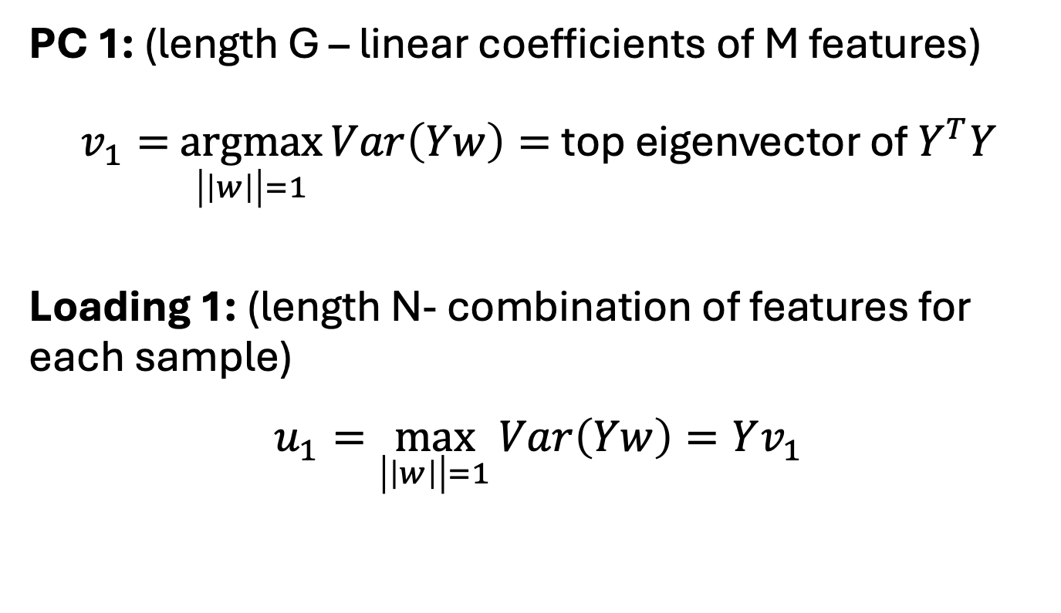

PCA: derivation 1
PC 1: (length G – linear coefficients of M features)
$v_{1}=$ $\underset{\left|\left|w\right|\right|=1}{argmax}{Var\left(Yw\right)}=$top eigenvector of $Y^{T}Y$
Loading 1: (length N- combination of features for each sample)
$$u_{1}=\max_{\left|\left|w\right|\right|=1}{Var\left(Yw\right)}=Yv_{1}$$
G features
N samples
Y
$$v_{1}^{T}$$
u₁
G features
N samples

Slide 28


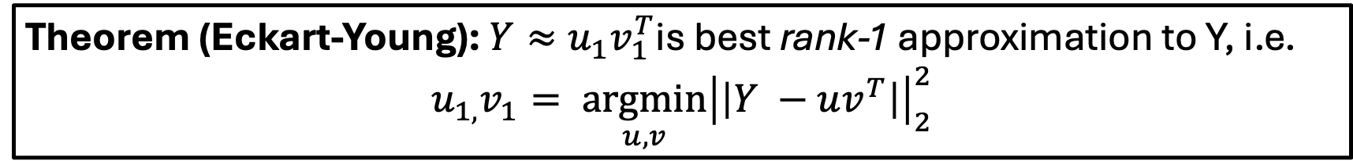
PCA: derivation 1
PC 1: $v_{1}=\max_{\left|\left|w\right|\right|=1}{Var\left(Yw\right)}$ Loading 1: $u_{1}=Yv_{1}$
Theorem (Eckart-Young): $Y≈u_{1}v_{1}^{T}$is best rank-1 approximation to Y, i.e.
$$u_{1,}v_{1}= \underset{u,v}{argmin}{{\left|\left|Y −uv^{T}\right|\right|}_{2}^{2}}$$
G features
v₁
$$≈$$
u₁
G features
N samples
N samples
Y
Intuition: PCA corresponds to computing the singular value decomposition (SVD) [will discuss soon] which produces best rank-k approximation to Y

Slide 29


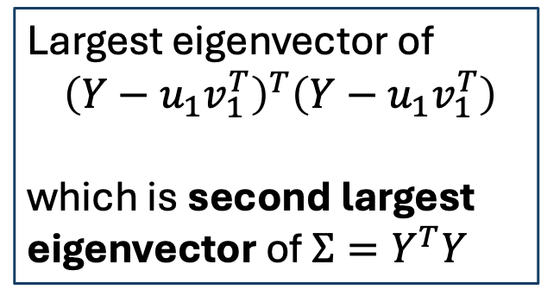
Deriving other PCs
PC 1: $v_{1}=\max_{\left|\left|w\right|\right|=1}{Var\left(Yw\right)}$ Loading 1: $u_{1}=Yv_{1}$
PC 2: (have to subtract off PC1)
$$v_{2}=\max_{\begin{aligned}\left|\left|w\right|\right|=1 \\ w⊥v_{1}\end{aligned}}{Var\left((Y−u_{1}v_{1}^{T})w\right)}$$
Loading 2: (since v₁, v₂ are orthogonal)
$$u_{2}=\left(Y−u_{1}v_{1}^{T}\right)v_{2}=Yv_{2}$$
Largest eigenvector of $${\left(Y−u_{1}v_{1}^{T}\right)}^{T}\left(Y−u_{1}v_{1}^{T}\right)$$
which is second largest eigenvector of $Σ=Y^{T}Y$

Slide 30


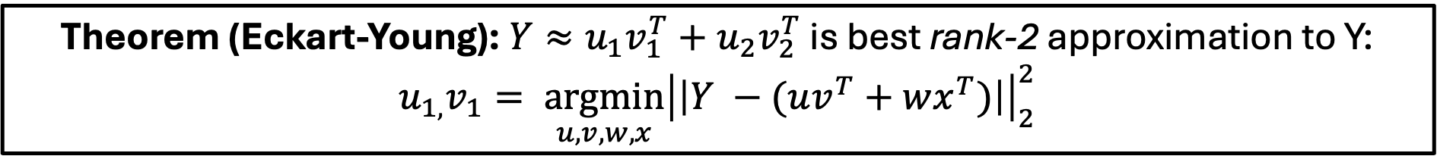
Deriving other PCs
PC 1: $v_{1}=$largest eigenvector of $Σ=Y^{T}Y$ Loading 1: $u_{1}=Yv_{1}$
PC 2: $v_{2}=$second-largest eigenvector of $Σ$ Loading 2: $u_{2}=Yv_{2}$
Theorem (Eckart-Young): $Y≈u_{1}v_{1}^{T}+u_{2}v_{2}^{T}$ is best rank-2 approximation to Y: $u_{1,}v_{1}= \underset{u,v,w,x}{argmin}{{\left|\left|Y −(uv^{T}+wx^{T})\right|\right|}_{2}^{2}}$
G features
v₁
v₂
$$≈$$
N samples
Y
u₁
+
u₂

Slide 31
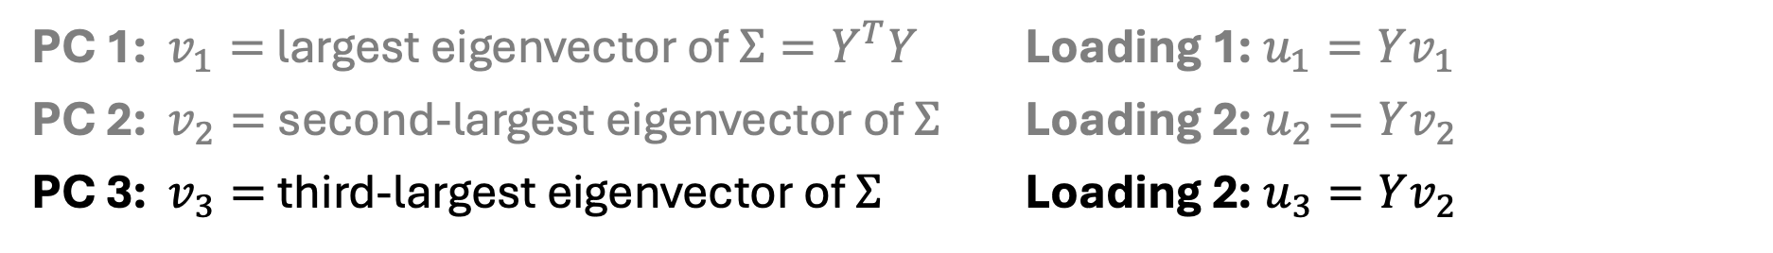
Deriving other PCs
PC 1: $v_{1}=$largest eigenvector of $Σ=Y^{T}Y$ Loading 1: $u_{1}=Yv_{1}$
PC 2: $v_{2}=$second-largest eigenvector of $Σ$ Loading 2: $u_{2}=Yv_{2}$
PC 3: $v_{3}=$third-largest eigenvector of $Σ$ Loading 2: $u_{3}=Yv_{2}$
…
G features
v₁
v₂
$$≈$$
N samples
Y
u₁
+
u₂
v₃
+
u₃
+ …

Slide 32


Alternative view of PCA: matrix factorization
G features
v₁
…
$$≈$$
v_{K}
N samples
Y
u₁
…
u_{K}
V (size K x G)
Y (size N x G)
U^{T} (size N x K)
Top-K PCs and loadings give best rank-K approximation:
$$\min_{\begin{aligned}U∈ℝ^{K×N} \\ V∈ℝ^{K×G} \end{aligned}}{{\left|\left|Y −U^{T}V\right|\right|}_{2}^{2}}$$

Slide 33
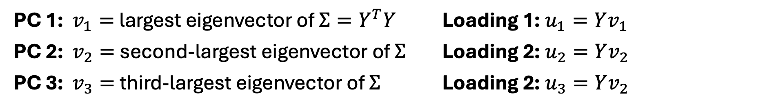

How to compute PCs?
PC 1: $v_{1}=$largest eigenvector of $Σ=Y^{T}Y$ Loading 1: $u_{1}=Yv_{1}$
PC 2: $v_{2}=$second-largest eigenvector of $Σ$ Loading 2: $u_{2}=Yv_{2}$
PC 3: $v_{3}=$third-largest eigenvector of $Σ$ Loading 2: $u_{3}=Yv_{2}$
Want: top eigenvectors of $Σ=Y^{T}Y$
Naïve approach: power method

Slide 34
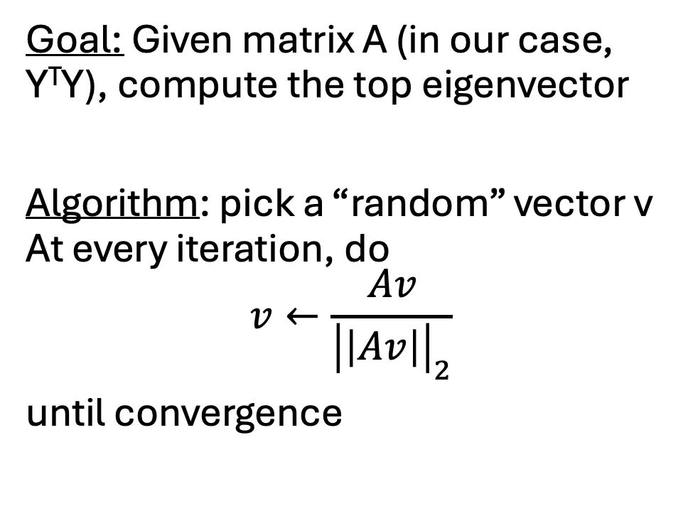
Power method
Goal: Given matrix A (in our case, Y^{T}Y), compute the top eigenvector
Algorithm: pick a “random” vector v At every iteration, do
$$v←\frac{Av}{{\left|\left|Av\right|\right|}_{2}}$$
until convergence

Slide 35
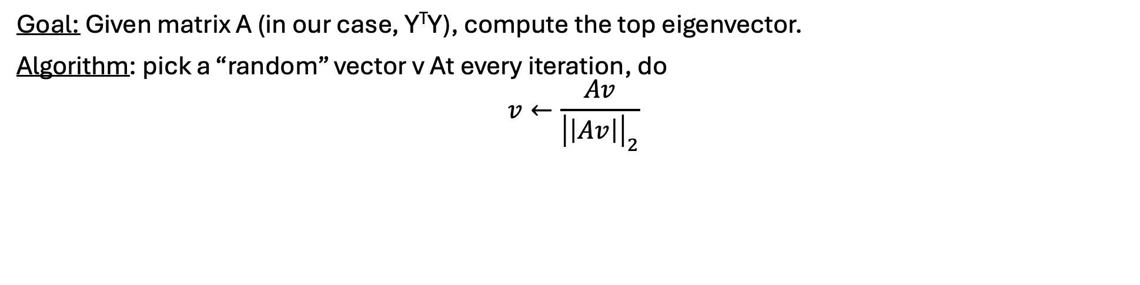
Power method
Goal: Given matrix A (in our case, Y^{T}Y), compute the top eigenvector.
Algorithm: pick a “random” vector v At every iteration, do
$$v←\frac{Av}{{\left|\left|Av\right|\right|}_{2}}$$
Why does this work? [see board]
Assume A is symmetric. Then eigenvectors v1, …, vN form orthonormal basos

Slide 36
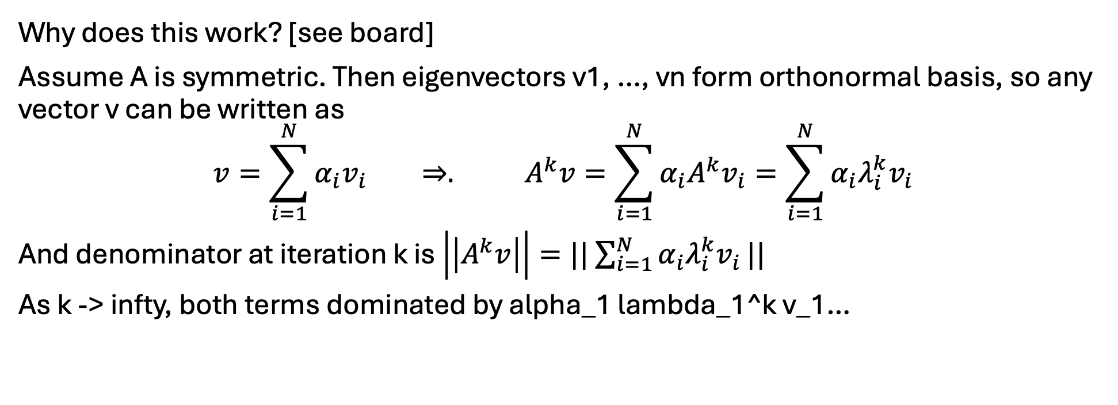
Power method
Goal: Given matrix A (in our case, Y^{T}Y), compute the top eigenvector.
Algorithm: pick a “random” vector v At every iteration, do
$$v←\frac{Av}{{\left|\left|Av\right|\right|}_{2}}$$
Why does this work? [see board]
Assume A is symmetric. Then eigenvectors v1, …, vn form orthonormal basis, so any vector v can be written as
$$v=\sum_{i=1}^{N}{α_{i}v_{i}} ⇒. A^{k}v=\sum_{i=1}^{N}{α_{i}{A^{k}v}_{i}=\sum_{i=1}^{N}{{α_{i}λ}_{i}^{k}v_{i}}}$$
And denominator at iteration k is $\left|\left|A^{k}v\right|\right|=||$ $\sum_{i=1}^{N}{{α_{i}λ}_{i}^{k}v_{i}}||$
As k -> infty, both terms dominated by alpha_1 lambda_1^k v_1…

Slide 37
Power method
Goal: Given matrix A (in our case, Y^{T}Y), compute the top eigenvector.
Algorithm: pick a “random” vector v At every iteration, do
$$v←\frac{Av}{{\left|\left|Av\right|\right|}_{2}}$$
Why does this work? [see board]
Assume A is symmetric. Then eigenvectors v1, …, vN form orthonormal basis
However in practice power method is too slow

Slide 38





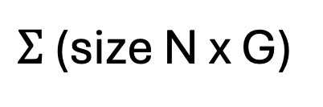
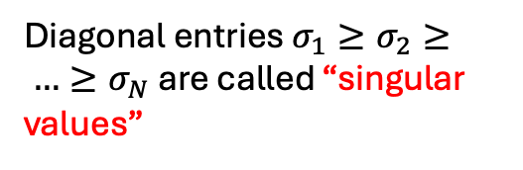

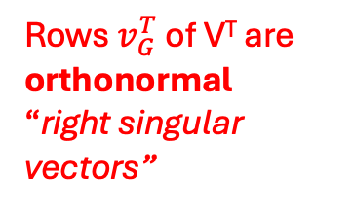
In practice: Singular value decomposition
G features
$$σ_{1}$$
$$v_{1}^{T}$$
$$σ_{2}$$
0
$$v_{2}^{T}$$
N samples
=
…
0
u₁
u₂
u_{N}
…
0
…
$$σ_{N}$$
Y (size NxG)
U (size N x N)
$Σ$ (size N x G)
$$v_{G}^{T}$$
V^{T} (size G x G)
Columns u_{i} of U are orthonormal
“left singular vectors”
Diagonal entries $σ_{1}≥σ_{2}≥ …≥σ_{N}$ are called “singular values”
Rows $v_{G}^{T}$ of V^{T} are orthonormal
“right singular vectors”
SVD always exists and singular values $σ_{i}$ are unique (up to re-ordering)

Slide 39







Why do we care?
G features
$$σ_{1}$$
$$v_{1}^{T}$$
$$σ_{2}$$
0
$$v_{2}^{T}$$
N samples
=
…
0
u₁
u₂
u_{N}
…
0
…
$$σ_{N}$$
Y (size NxG)
U (size N x N)
$Σ$ (size N x G)
$$v_{G}^{T}$$
V^{T} (size G x G)
Right singular values v_{j} are the eigenvectors of Y^{T}Y – i.e. the top principal components of Y
There are very efficient algorithms for computing SVD!

Slide 40
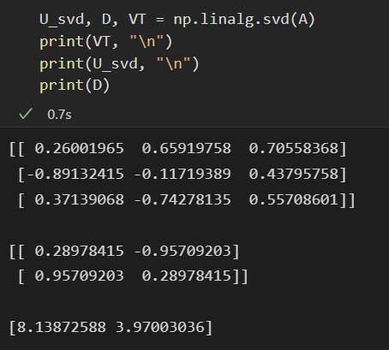
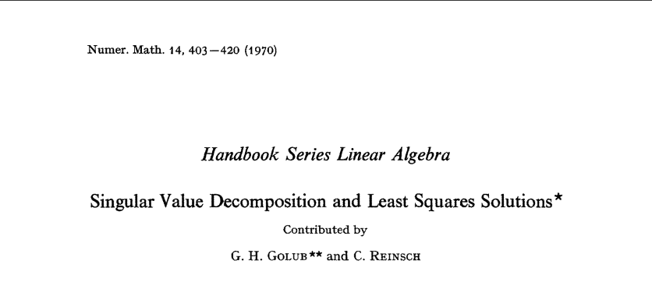
How to compute SVD?
Tons of numerical linear algebra research done on efficiently computing the SVD!

Slide 41
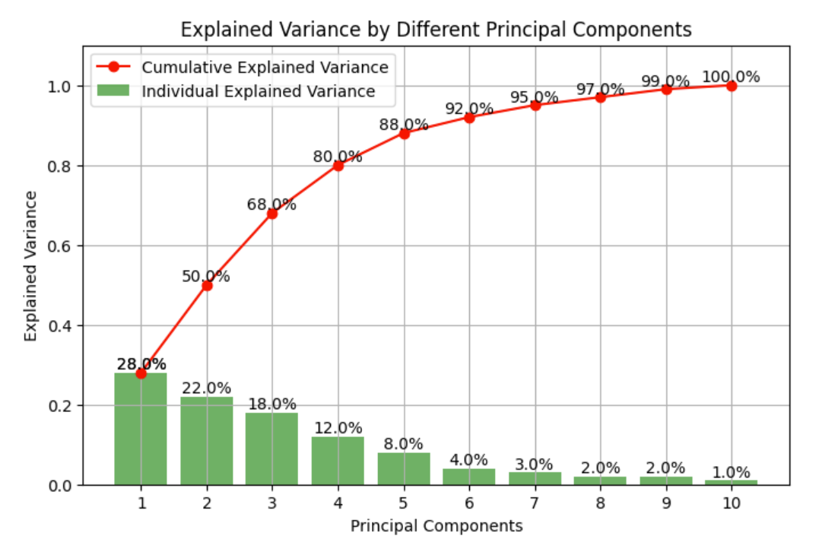
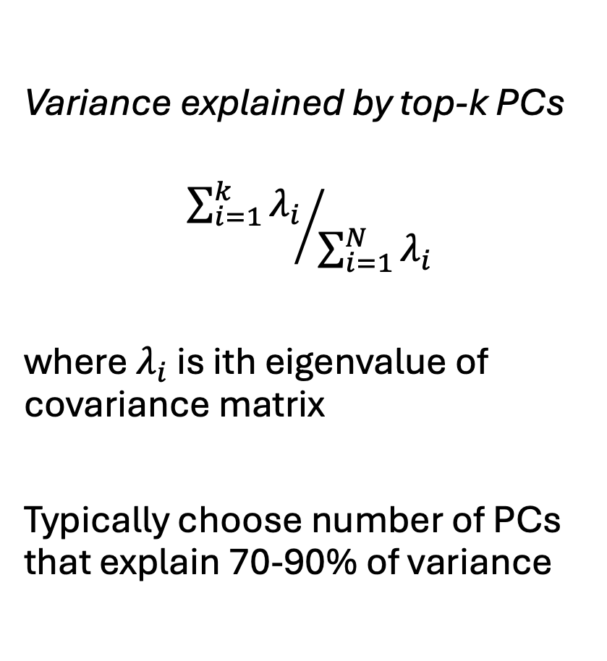
How to choose # PCs?
Variance explained by top-k PCs
$${\sum_{i=1}^{k}{λ_{i}}}/{\sum_{i=1}^{N}{λ_{i}}}$$
where $λ_{i}$ is ith eigenvalue of covariance matrix
Typically choose number of PCs that explain 70-90% of variance

Slide 42
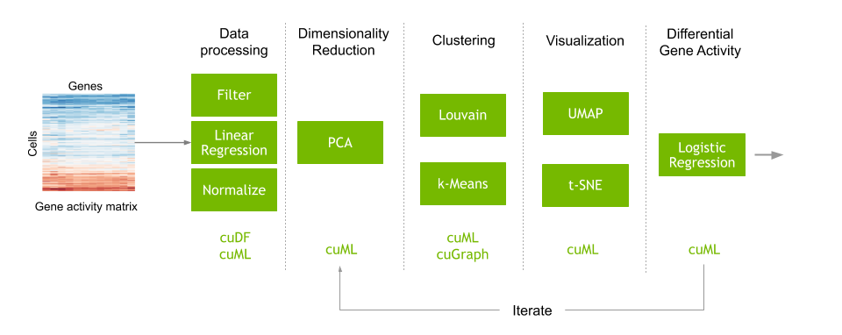
PCA is standard step in single cell pipeline
From https://developer.nvidia.com/blog/accelerating-single-cell-genomic-analysis-using-rapids/

Slide 43
PCA is standard step in single cell pipeline
This is a tricky step though… will come back to this soon
From https://developer.nvidia.com/blog/accelerating-single-cell-genomic-analysis-using-rapids/

Slide 44
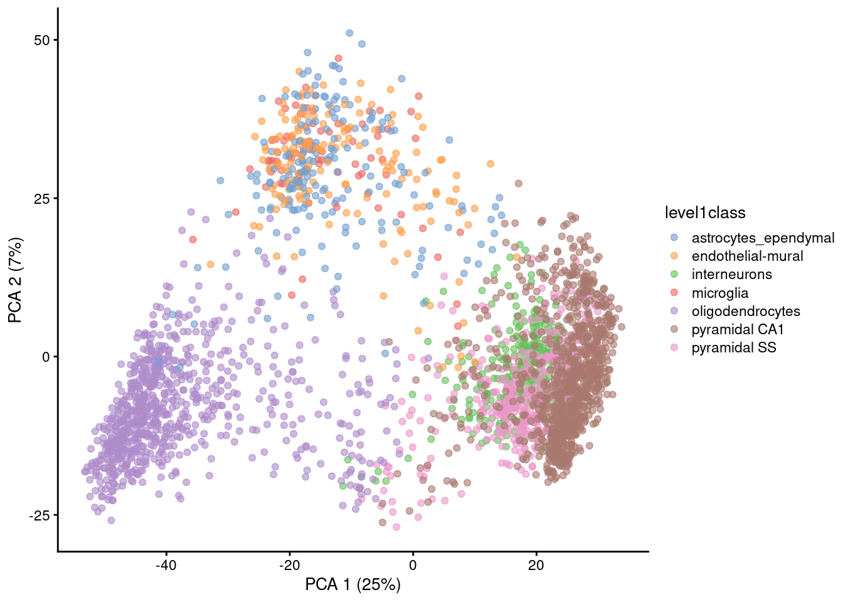
Using PCA to visualize single cell data
Caption: PCA plot of the first two PCs in the Zeisel brain data. Each point is a cell, coloured according to the annotation provided by the original authors.

Slide 45
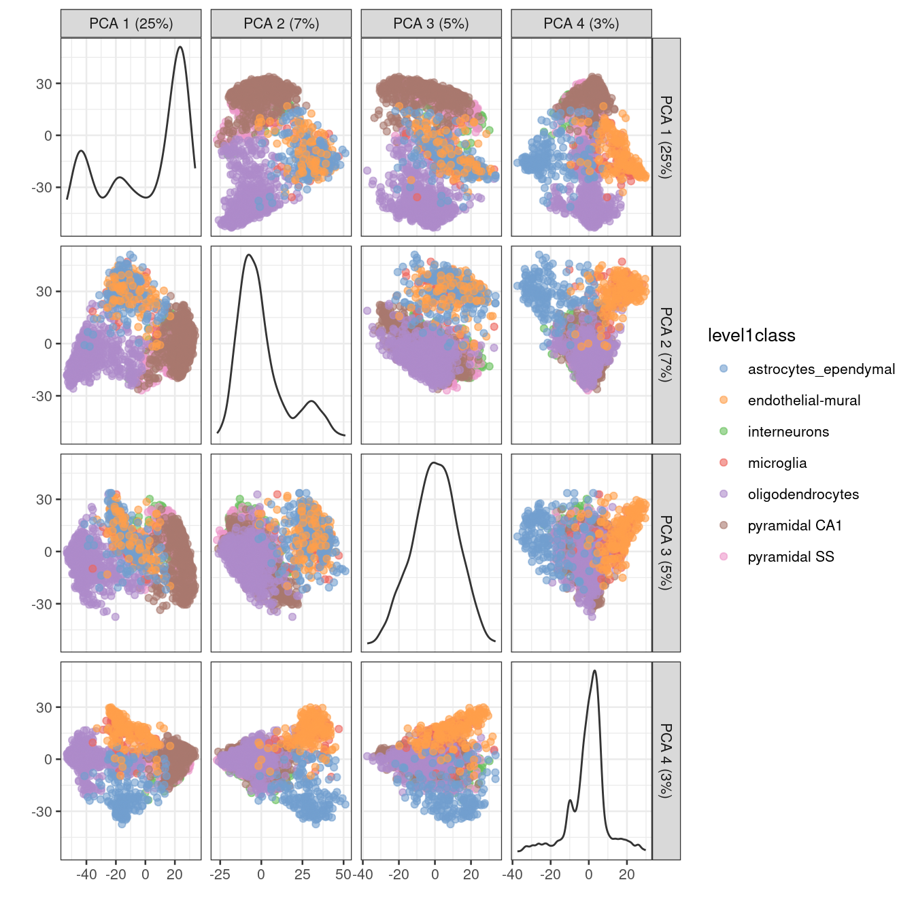
Visualizing more PCs

Slide 46
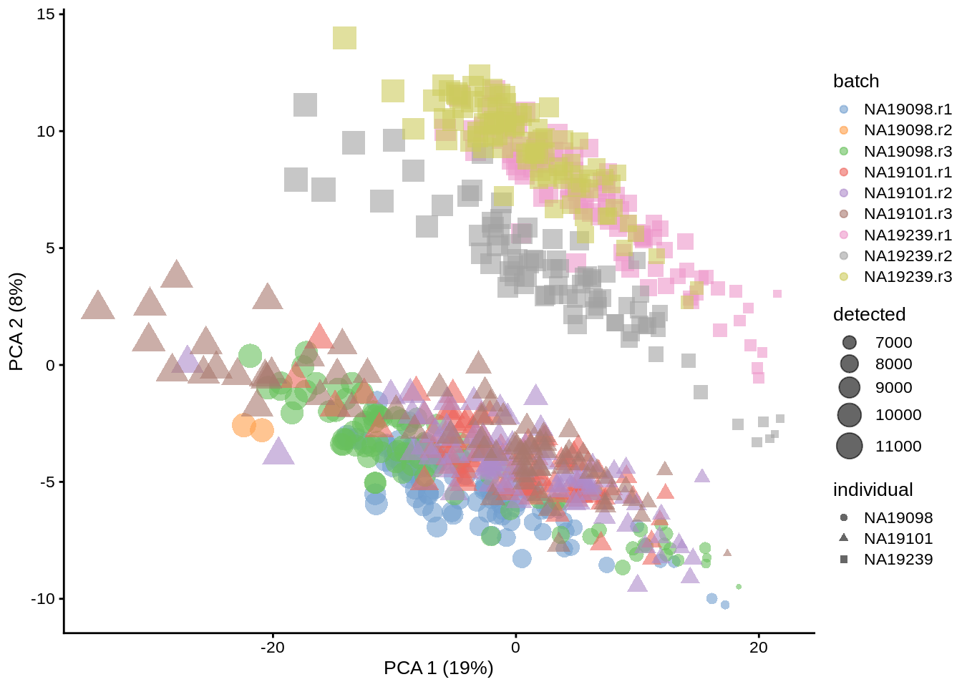
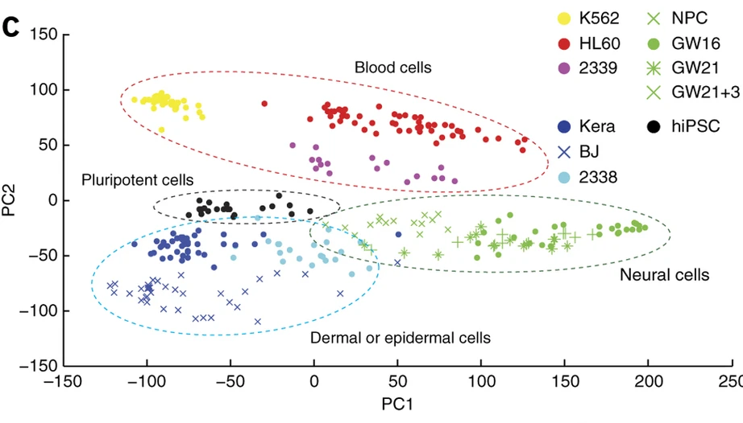
More examples of PCA
Different individuals are separated in PC space (“batch effect”)
PCs separate different cell types
(Pollen et al, Nat Biotech 2014)
https://www.singlecellcourse.org/basic-quality-control-qc-and-exploration-of-scrna-seq-datasets.html

Slide 47
Summary
Dimensionality reduction: take a large data matrix and reduce to fewer dimensions for easier visualization + analysis
Naïve approach: feature selection- keep features with high variance
Less naïve: Principal components analysis (PCA)
find linear combinations of features with high variance
Compute by finding eigenvectors of sample covariance matrix. Can do so using SVD.

Slide 48
Challenge 1: Interpretability
Ideally:
top PCs would group together genes with related functions
top loadings would group together cells of similar type
But not always due to negative values (genes can cancel each other out)…
how do you interpret a negative value?
2
2
0
0
Related genes???
Related genes???
Cells
Genes
0
0
-7
-7
15
…
…
PC1
Loading 1

Slide 49
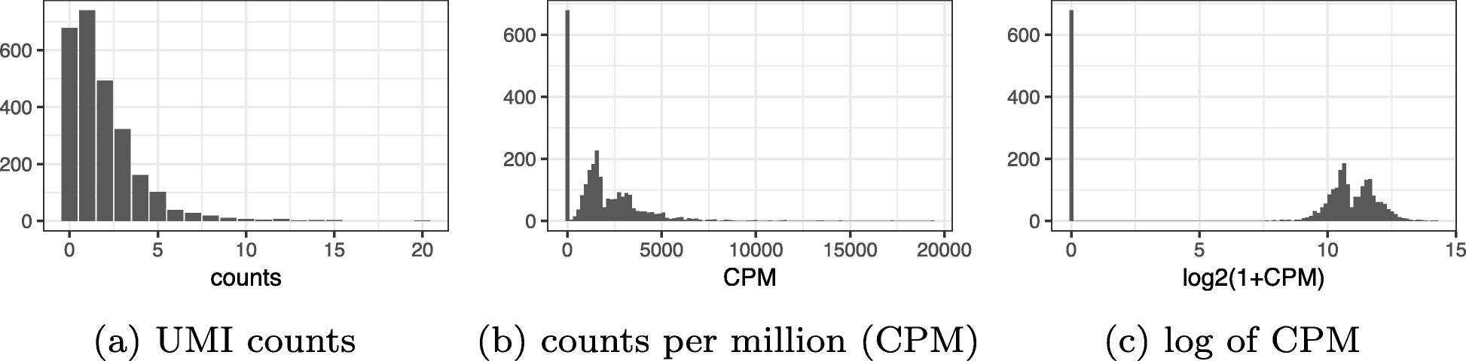
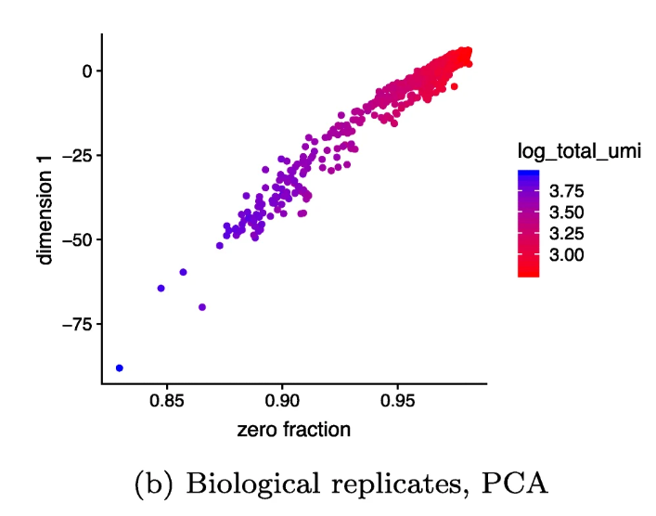
Challenge 2: normalization
Standard normalization
Top PC highly correlated with number of zeros in cell!
Townes et al 2019

Slide 50

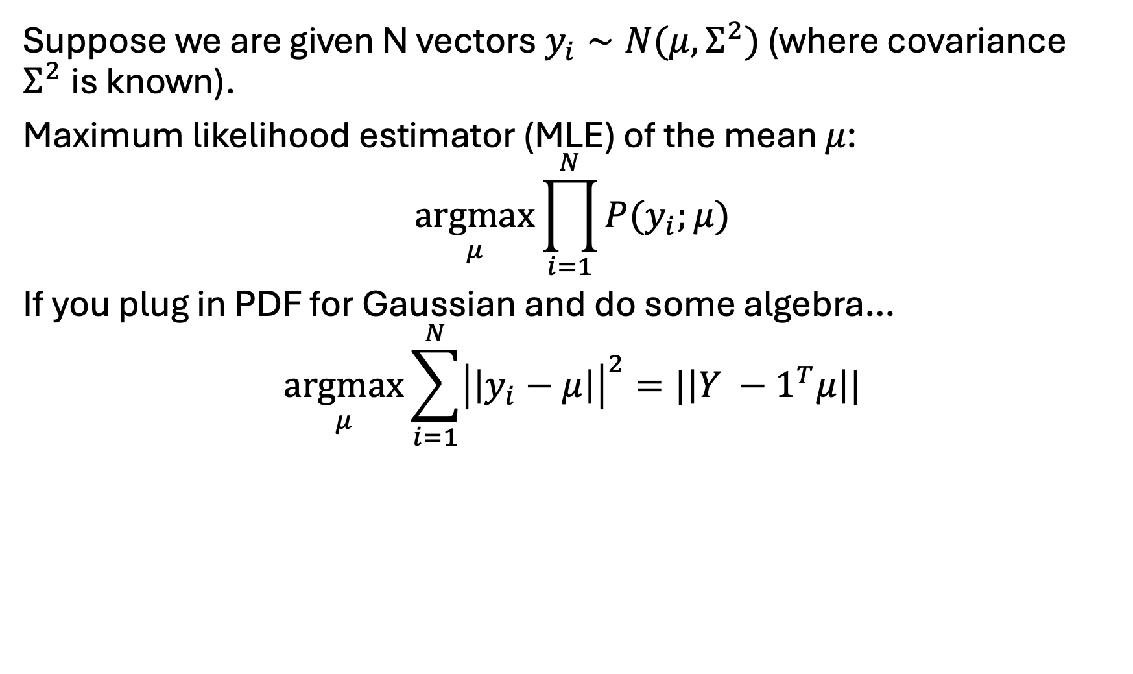
Maximum likelihood estimation under a Gaussian
Suppose we are given N vectors $y_{i}∼N(μ,Σ^{2})$ (where covariance $Σ^{2}$is known).
Maximum likelihood estimator (MLE) of the mean $μ$:
$$\underset{μ}{argmax}{\prod_{i=1}^{N}{P(y_{i};μ)}}$$
If you plug in PDF for Gaussian and do some algebra…
$$\underset{μ}{argmax}{\sum_{i=1}^{N}{{\left|\left|y_{i}−μ\right|\right|}^{2}=|\left|Y −1^{T}μ\right||}}$$
ADD SLIDES FOR: PCA $≈$ maximum likelihood of mean of a Gaussian (under appropriate model)

Slide 51
Next class(es): two solutions
Non-negative matrix factorization
For better interpretability of PCs
2. GLM-PCA (or more generally, factor analysis)
For issues with normalization

Slide 52
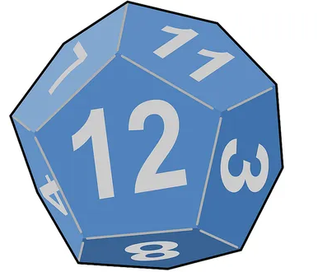
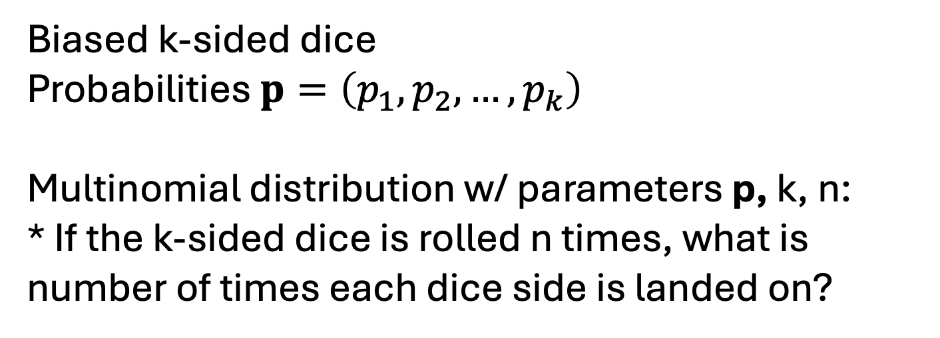
Multinomial distribution
Biased k-sided dice
Probabilities $p=\left(p_{1},p_{2}, …, p_{k}\right)$
Multinomial distribution w/ parameters p, k, n:
* If the k-sided dice is rolled n times, what is number of times each dice side is landed on?
Suppose:
k=2
p=(1/4,3/4) (biased coin flip)
n=10
Multinomial distribution describes # heads if you flip coin n=10 times

Slide 53
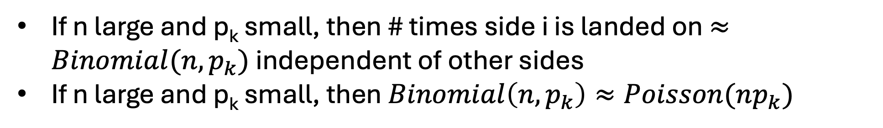
Approximating a multinomial distribution
Biased k-sided dice
Probabilities $p=\left(p_{1},p_{2}, …, p_{k}\right)$
Multinomial distribution w/ parameters p, k, n:
* If the k-sided dice is rolled n times, what is number of times each dice side is landed on?
If n large and p_{k} small, then # times side i is landed on $≈Binomial(n, p_{k})$ independent of other sides
If n large and p_{k} small, then $Binomial\left(n, p_{k}\right)≈Poisson(np_{k})$

