Slide 1
Manifold learning + graphs
Uthsav Chitra

Slide 2
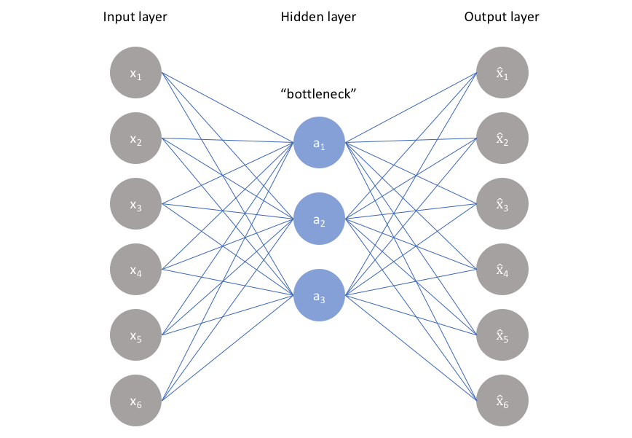
So far: dimensionality reduction methods to uncover “low-dimensional structure” in data
Linear dimensionality reduction
Non-linear dimensionality reduction

Slide 3
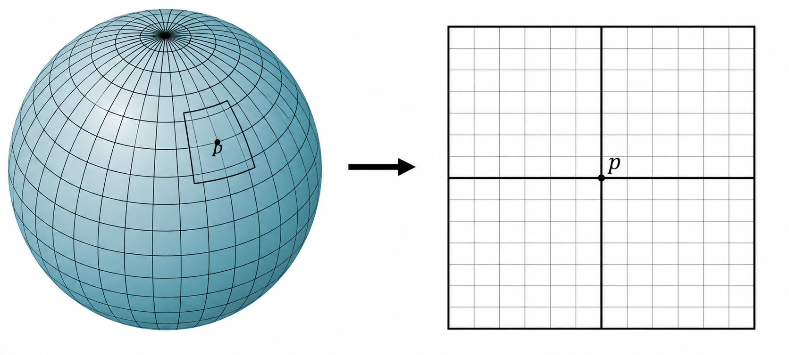
Manifolds: mathematical framework for modeling “low dimensional structure”
Informally: A manifold M is an object in a high-dimensional space that “locally” is low-dimensional
Example: a sphere (globe)
Lives in 3-D space
“locally” looks 2-D

Slide 4
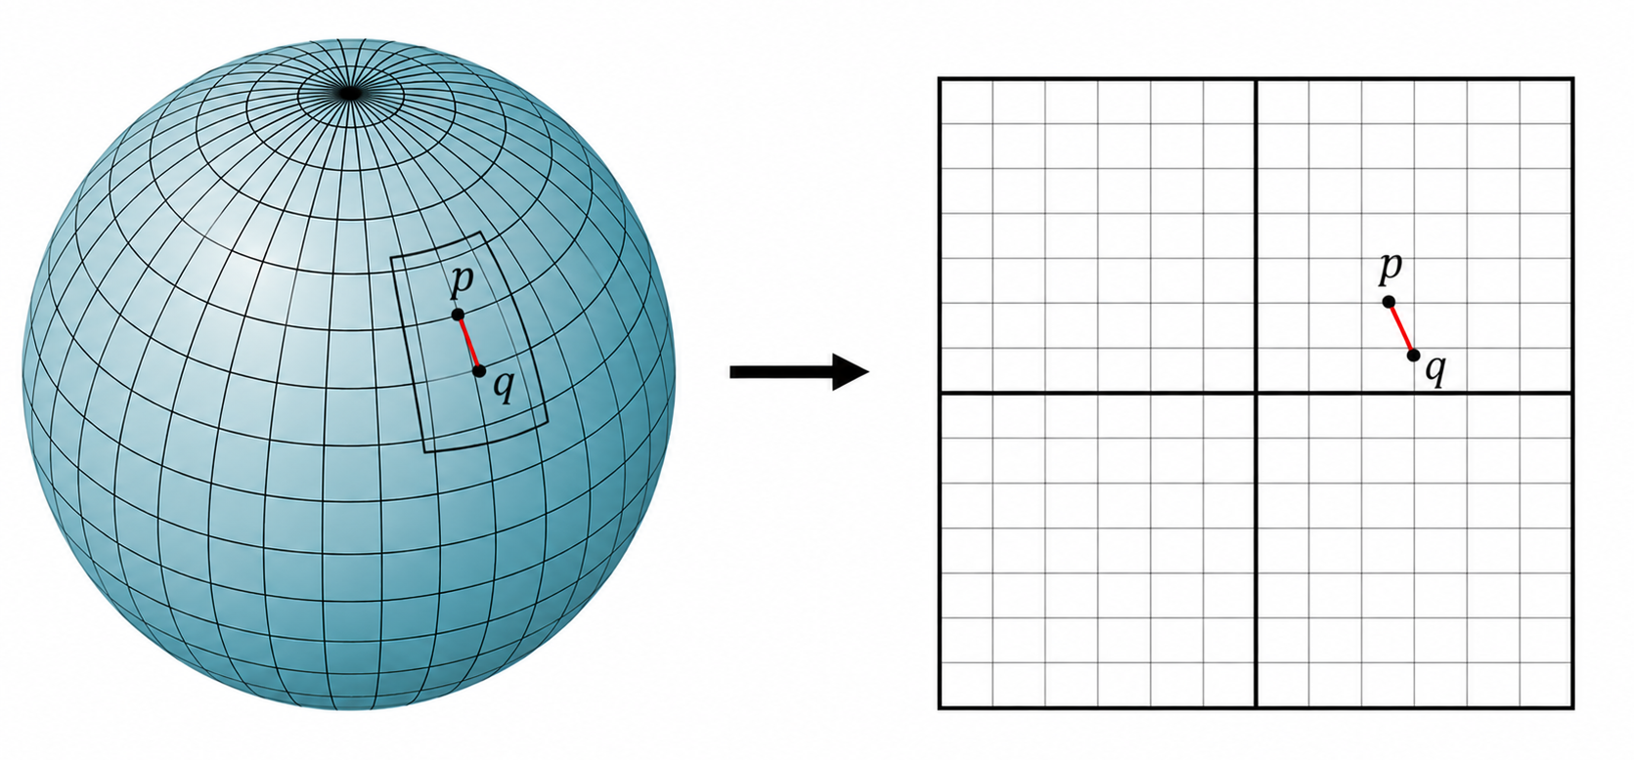
Distances are preserved “locally” in manifold
Manifold lives in 3-D space
“locally” looks 2-D
q
q
If points p, q are “close”, then the distance d_{M}(p,q) on manifold $≈$ “local” distance in 2-D space:
$$d_{M}\left(p,q\right)≈{\left|p−q\right|}_{2}^{2}$$

Slide 5
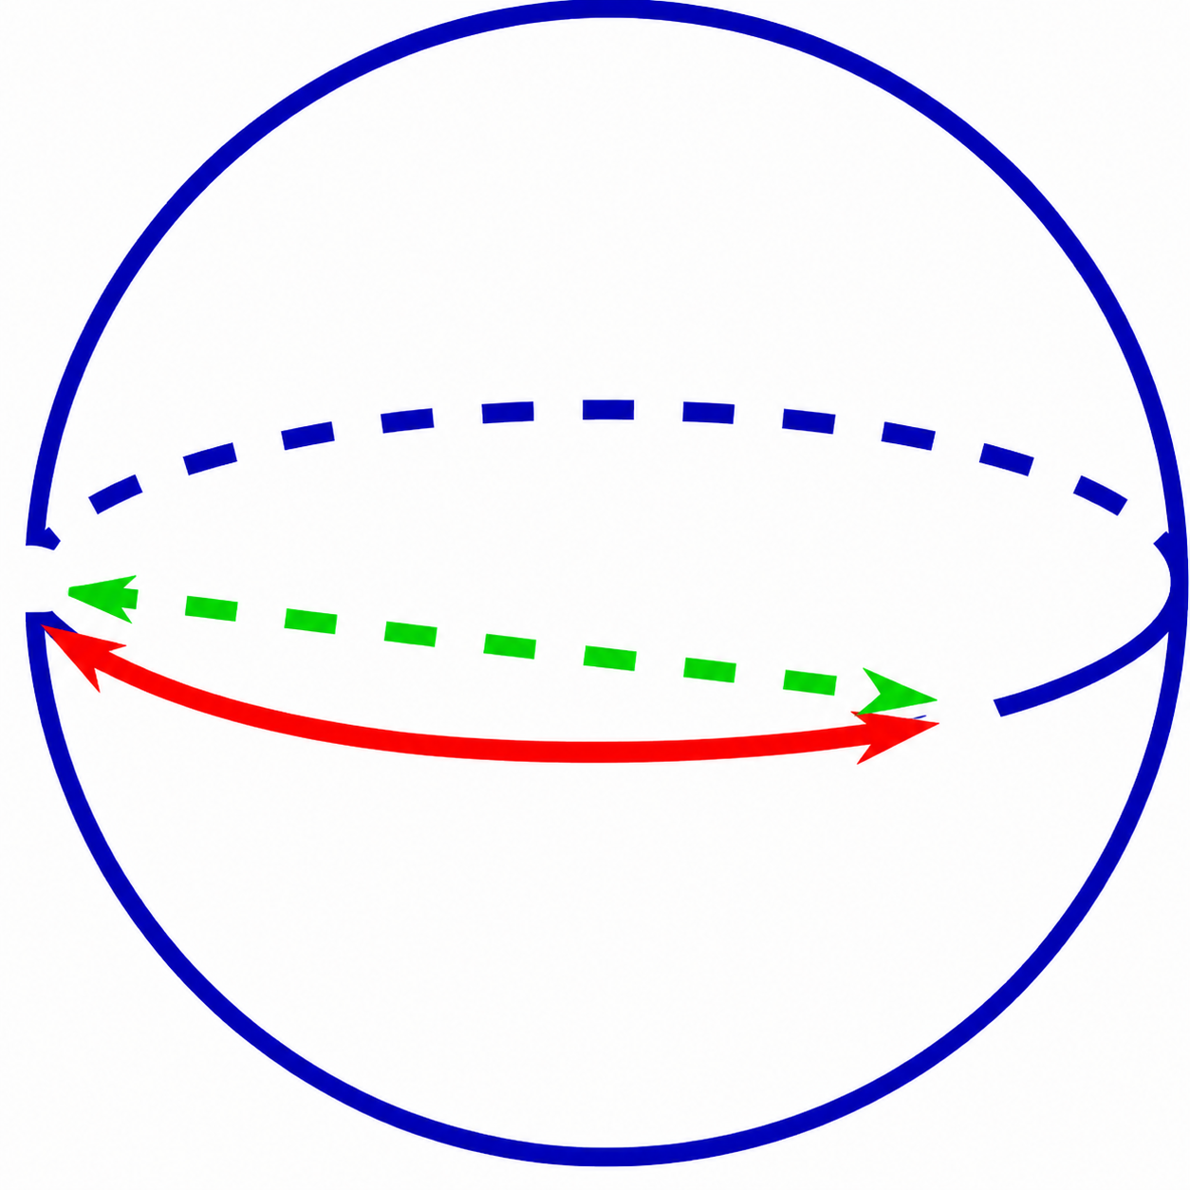
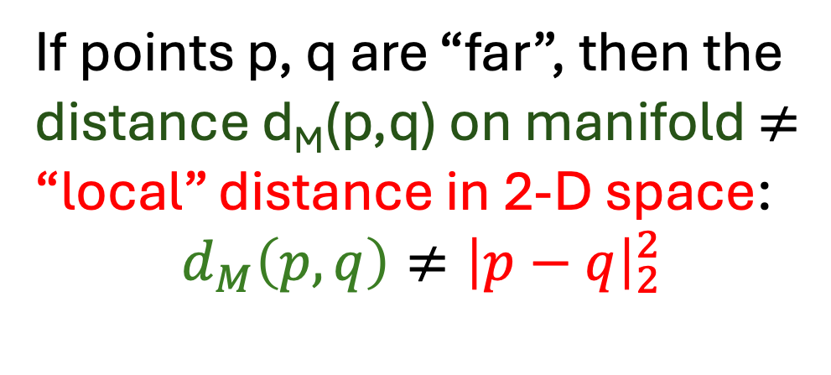

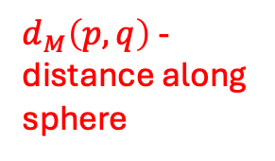
In a manifold, distances are not preserved globally
If points p, q are “far”, then the distance d_{M}(p,q) on manifold $≠$ “local” distance in 2-D space:
$$d_{M}\left(p,q\right)≠{\left|p−q\right|}_{2}^{2}$$
Euclidean dist. ${\left|p−q\right|}_{2}^{2}$
q
$d_{M}\left(p,q\right)$ - distance along sphere
p

Slide 6
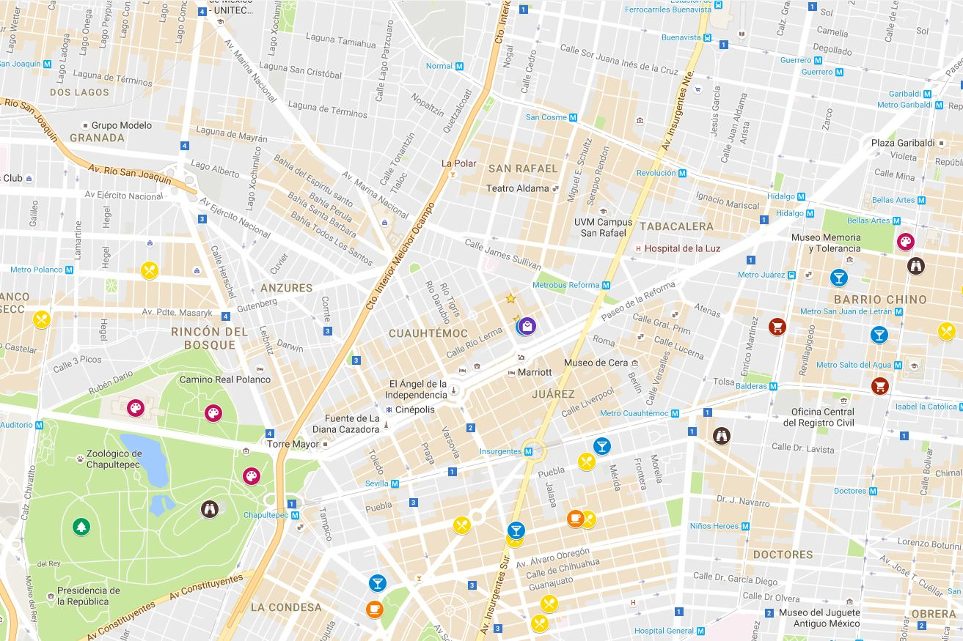
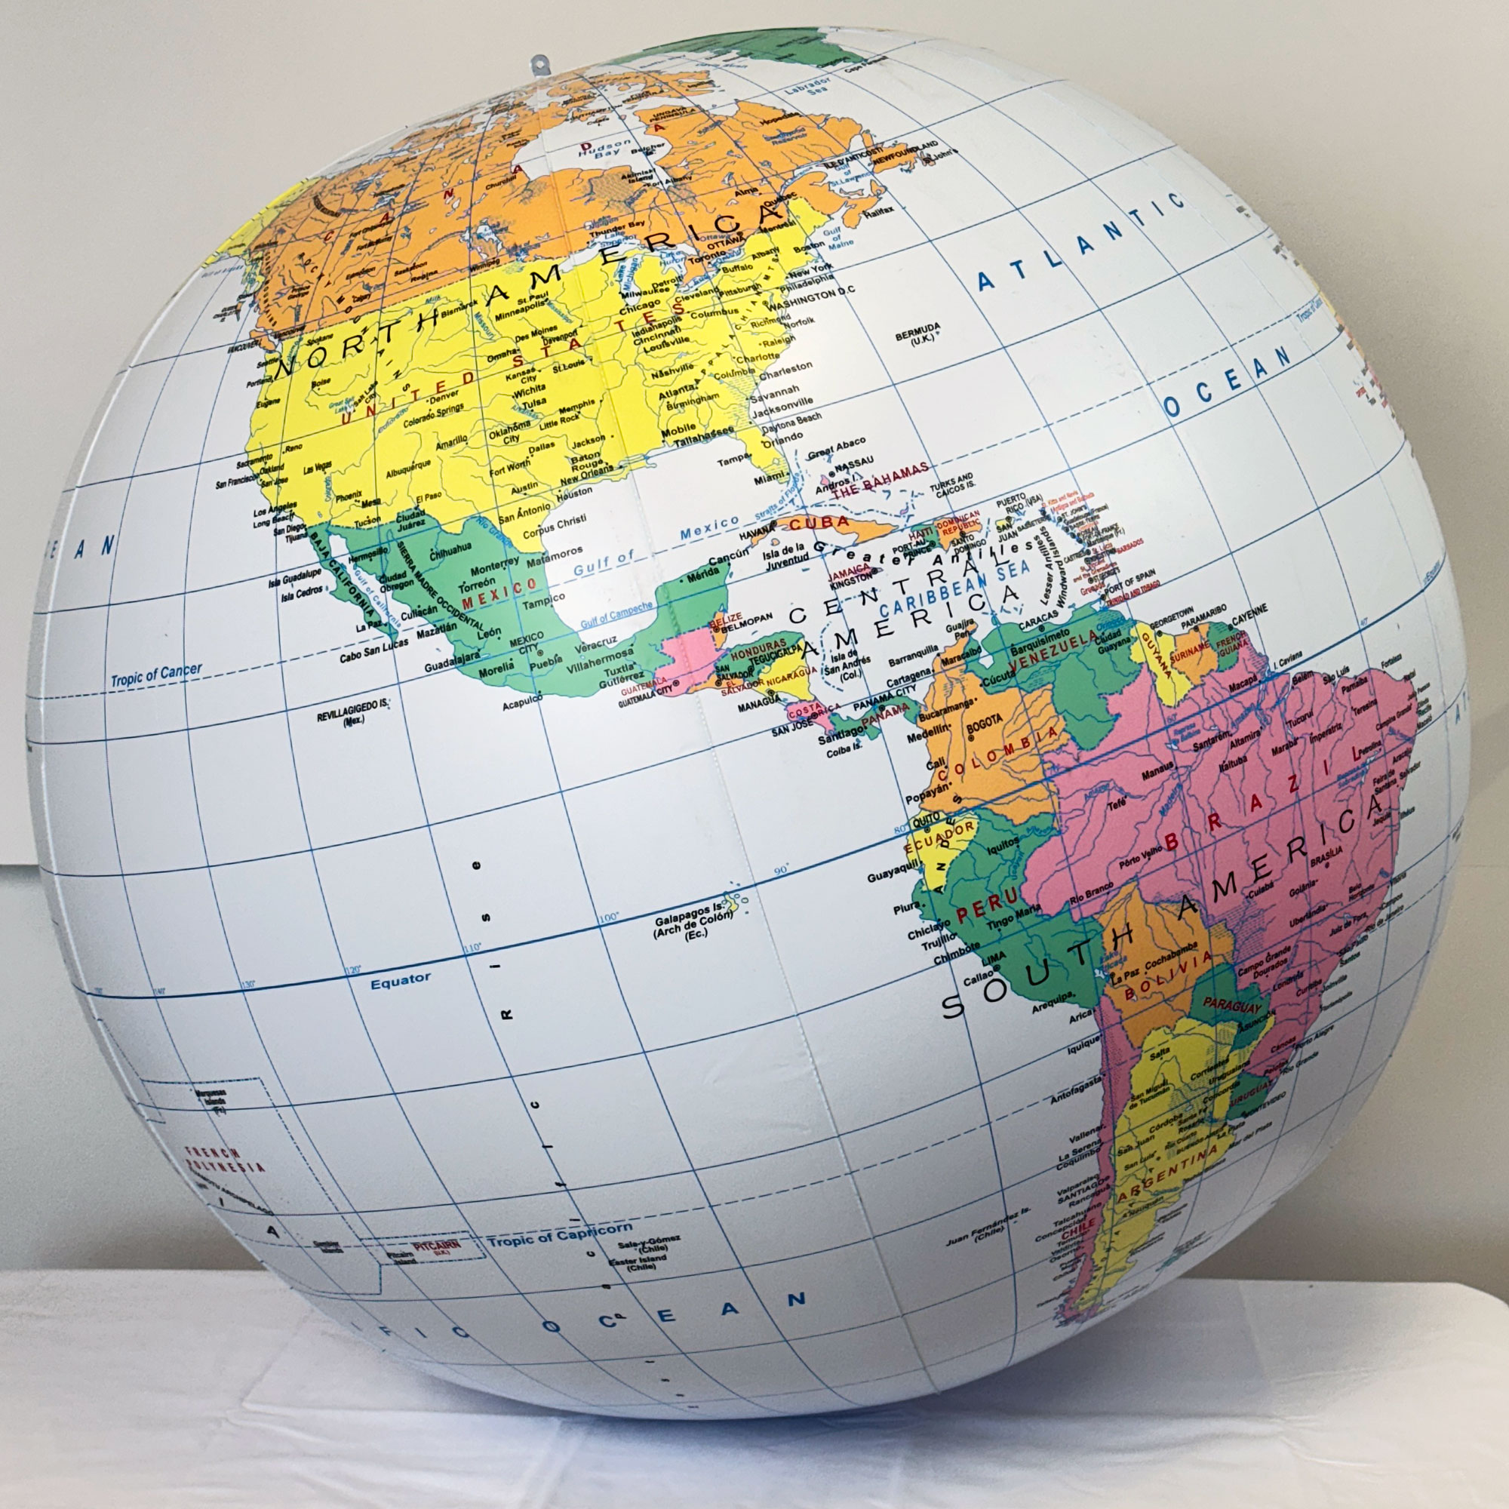
Another way to think about manifolds: maps
For small trips, we can approximate the distance on a globe with a 2-D map

Slide 7
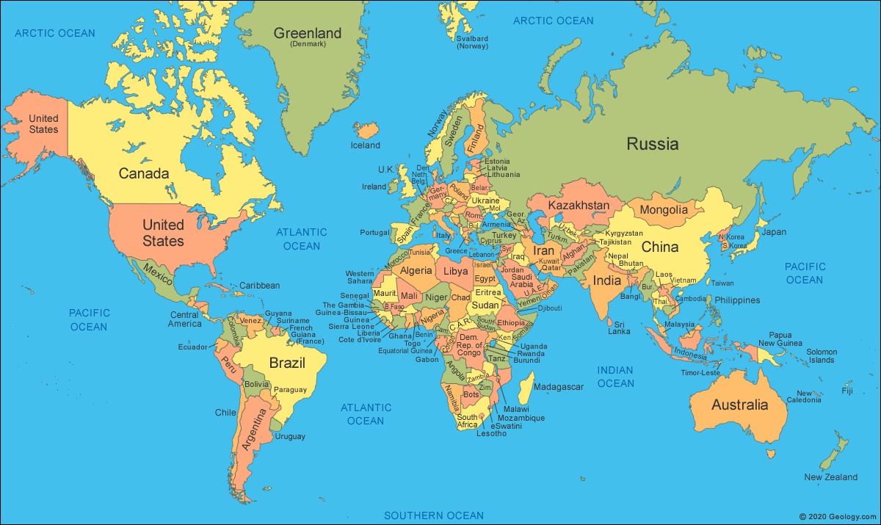
Another way to think about manifolds: maps
For long trips, 2-D map is not good for calculating distances

Slide 8
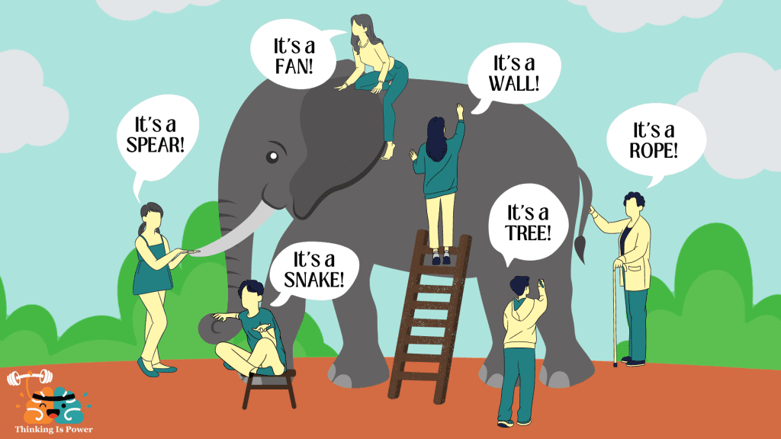

Slide 9

“Canonical” example: Swiss roll
2-D manifold in 3-D space
Data comes from points on manifold

Slide 10
https://ubc-cs.github.io/cpsc340/lectures/L27.pdf?raw=1

Slide 13
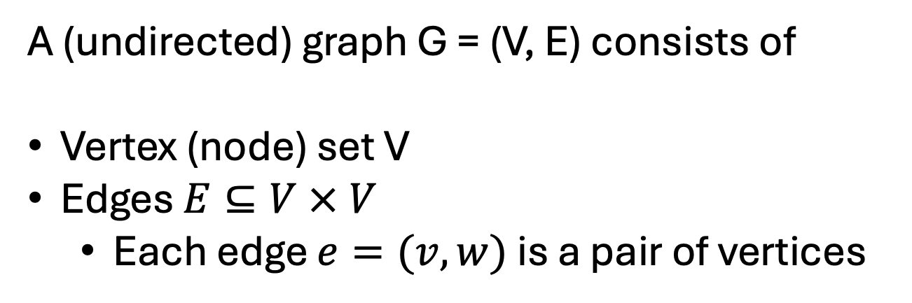
Graphs
A (undirected) graph G = (V, E) consists of
Vertex (node) set V
Edges $E⊆V × V$
  Each edge $e=(v,w)$ is a pair of vertices
5
6
4
3
2
Example graph with
Vertices V = {1,2,3,4,5,6}
Edges E = { (1,2), (1,3), (2,3), (3,4), (4,5), (4,6) }
1

Slide 14
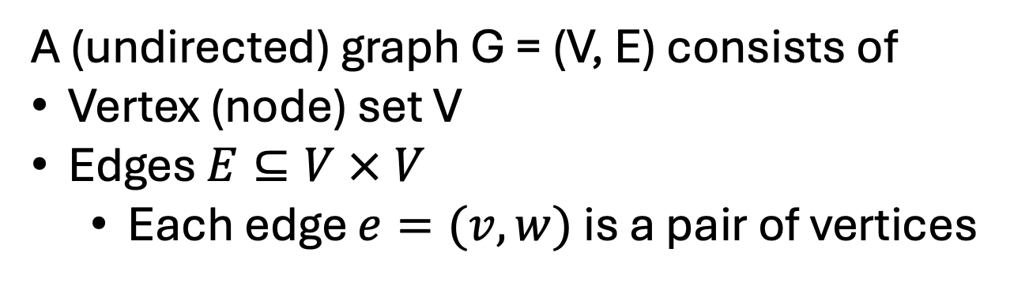
Useful definitions for graphs [see board]
5
6
4
A (undirected) graph G = (V, E) consists of
Vertex (node) set V
Edges $E⊆V × V$
  Each edge $e=(v,w)$ is a pair of vertices
3
2
[On board] define
Degree
Path
Adjacency/connected
Distance between nodes
Adjacency matrix <-> distance btwn nodes
Generalization to weighted graphs
1
Example graph with
Vertices V = {1,2,3,4,5,6}
Edges E = { (1,2), (1,3), (2,3), (3,4), (4,5), (4,6) }
The degree d_{v} of a vertex v = the number of edges that v is in
  e.g. d₁=2 and d₃=3 in graph

Slide 15
Graphs are used to represent manifold structure
Given data x₁, …, x_{N} lying on (unknown) manifold:
form graph G=(V,E) with vertices V={x₁, …, x_{N}} and edges connecting “nearby” points
Datapoints in original 3D space
Graph G formed by connecting “nearby” datapoints
For certain graph constructions, distances d_{G} in graph approximate distances d_{M} on manifold!

Slide 16
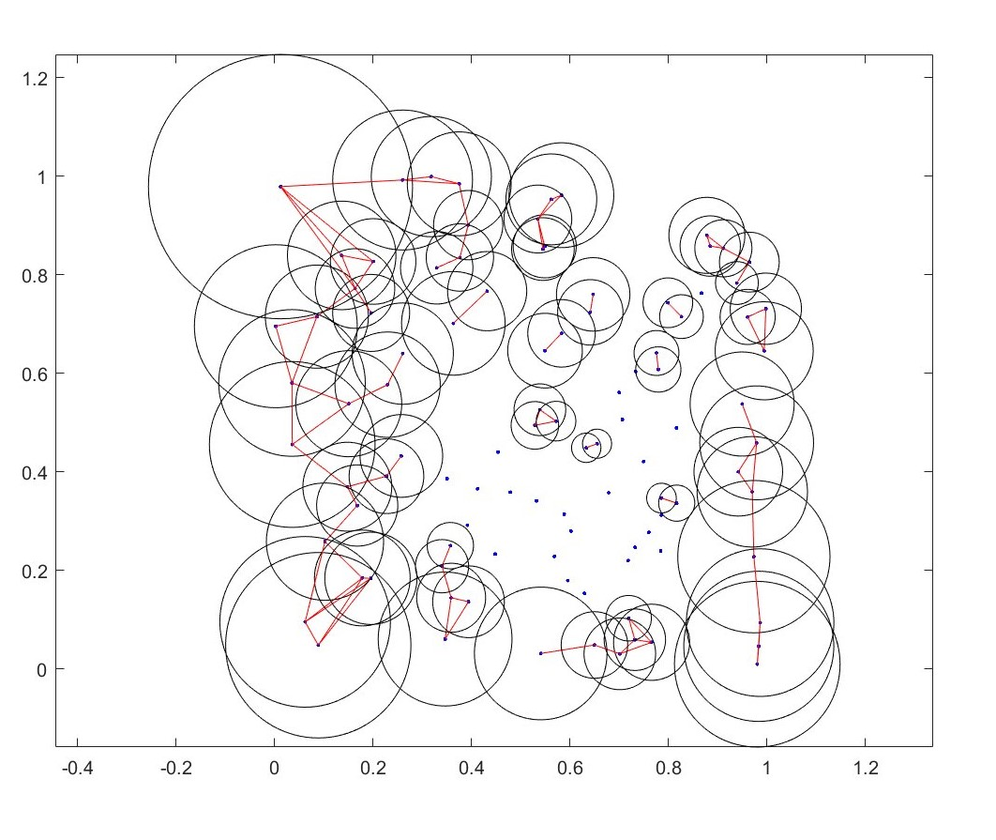
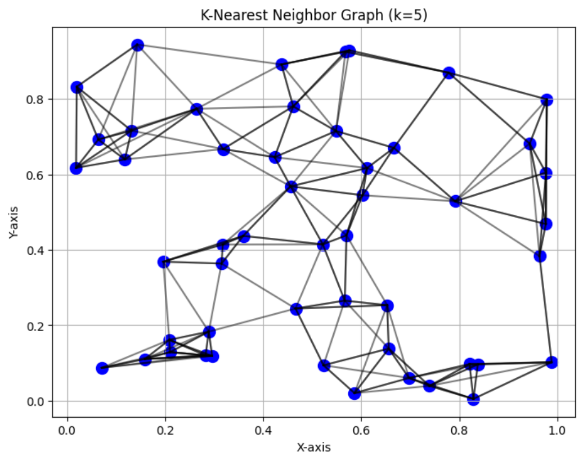
Common graph constructions
k-NN (k nearest neighbors) graph
Draw an edge between vertex v and its k nearest neighbors
ε-ball graph
Draw an edge between vertex v and all vertices w within distance ε
Should these graphs be weighted? Directed? …

Slide 17



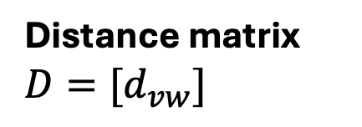

Multidimensional scaling (MDS)
Given distances $d_{vw}>0$ between every pair of datapoints v, w : find K-dimensional embeddings $z_{v}∈ℝ^{K}$ such that:
$$d_{vw}≈{\left|z_{v}−z_{w}\right|}_{2}$$
N observations
Distance matrix ${D=[d}_{vw}]$
N observations

Slide 18



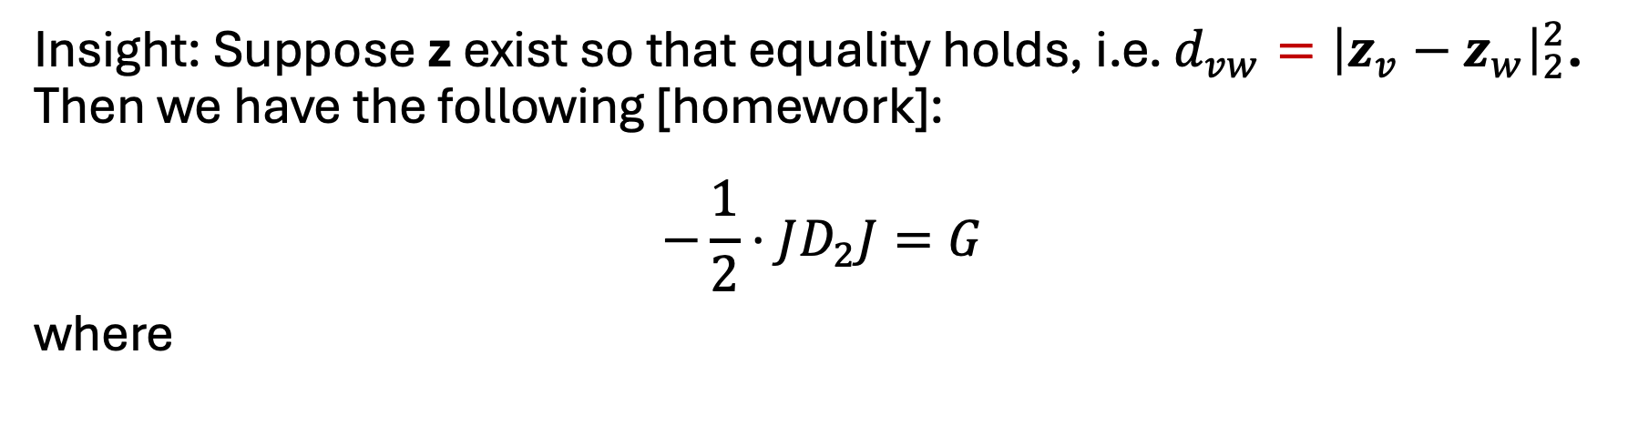
MDS: Given distances $d_{vw}>0$ find $z_{v}∈ℝ^{K}$ such that: $d_{vw}≈{\left|z_{v}−z_{w}\right|}_{2}^{2}$
Insight: Suppose z exist so that equality holds, i.e. $d_{vw}={\left|z_{v}−z_{w}\right|}_{2}^{2}$. Then we have the following [homework]:
$$−\frac{1}{2}⋅JD_{2}J=G$$
where
Squared distance matrix $D_{2}=[d_{vw}^{2}]$
Centering matrix $J=I −\frac{1}{n}1^{T}1$
Gram matrix $G=\left[g_{vw}\right]$ where $g_{vw}= z_{v}^{T}z_{w}$

Slide 19



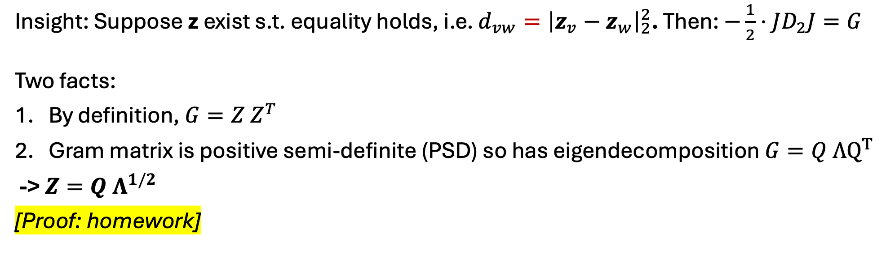
MDS: Given distances $d_{vw}>0$ find $z_{v}∈ℝ^{K}$ such that: $d_{vw}≈{\left|z_{v}−z_{w}\right|}_{2}^{2}$
Insight: Suppose z exist s.t. equality holds, i.e. $d_{vw}={\left|z_{v}−z_{w}\right|}_{2}^{2}$. Then: $−\frac{1}{2}⋅JD_{2}J=G$
Two facts:
By definition, $G=Z Z^{T}$
Gram matrix is positive semi-definite (PSD) so has eigendecomposition $G=Q ΛQ^{T}$
-> $Z=Q Λ^{1/2}$
[Proof: homework]
Squared distance matrix $D_{2}=[d_{vw}^{2}]$
Centering matrix $J=I −\frac{1}{n}1^{T}1$
Gram matrix $G=\left[g_{vw}\right]$ where $g_{vw}= z_{v}^{T}z_{w}$
Embedding matrix Z

Slide 20
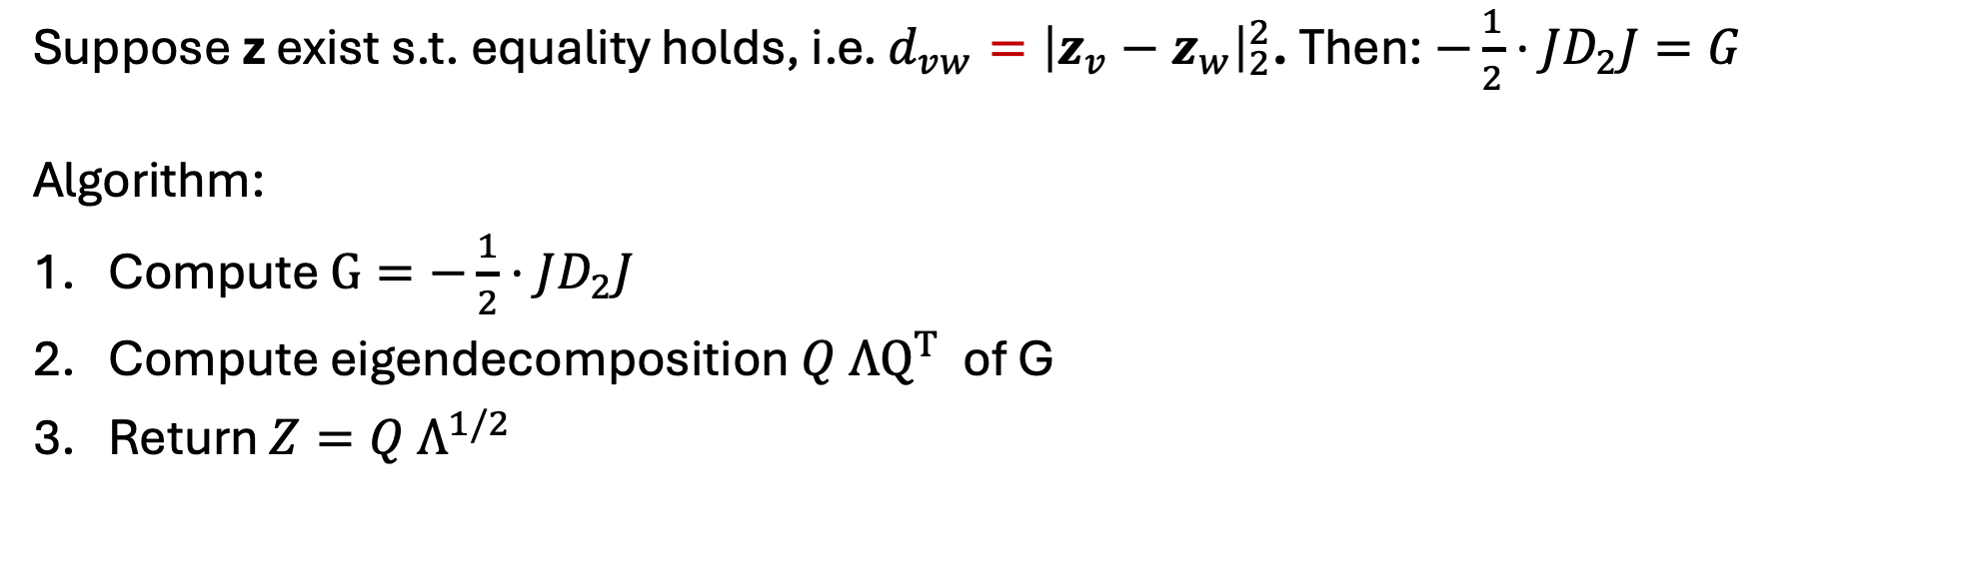
MDS: Given distances $d_{vw}>0$ find $z_{v}∈ℝ^{K}$ such that: $d_{vw}≈{\left|z_{v}−z_{w}\right|}_{2}^{2}$
Suppose z exist s.t. equality holds, i.e. $d_{vw}={\left|z_{v}−z_{w}\right|}_{2}^{2}$. Then: $−\frac{1}{2}⋅JD_{2}J=G$
Algorithm:
Compute $G=−\frac{1}{2}⋅JD_{2}J$
Compute eigendecomposition $Q ΛQ^{T}$ of G
Return $Z=Q Λ^{1/2}$
Squared distance matrix $D_{2}=[d_{vw}^{2}]$
Centering matrix $J=I −\frac{1}{n}1^{T}1$
Gram matrix $G=\left[g_{vw}\right]$ where $g_{vw}= z_{v}^{T}z_{w}$
Embedding matrix Z

Slide 21
MDS: Given distances $d_{vw}>0$ find $z_{v}∈ℝ^{K}$ such that: $d_{vw}≈{\left|z_{v}−z_{w}\right|}_{2}^{2}$
Suppose z exist s.t. equality holds, i.e. $d_{vw}={\left|z_{v}−z_{w}\right|}_{2}^{2}$. Then: $−\frac{1}{2}⋅JD_{2}J=G$
Algorithm:
Compute $G=−\frac{1}{2}⋅JD_{2}J$
Compute eigendecomposition $Q ΛQ^{T}$ of G
Return $Z=Q Λ^{1/2}$
What if this does not hold??
Squared distance matrix $D_{2}=[d_{vw}^{2}]$
Centering matrix $J=I −\frac{1}{n}1^{T}1$
Gram matrix $G=\left[g_{vw}\right]$ where $g_{vw}= z_{v}^{T}z_{w}$
Embedding matrix Z

Slide 22
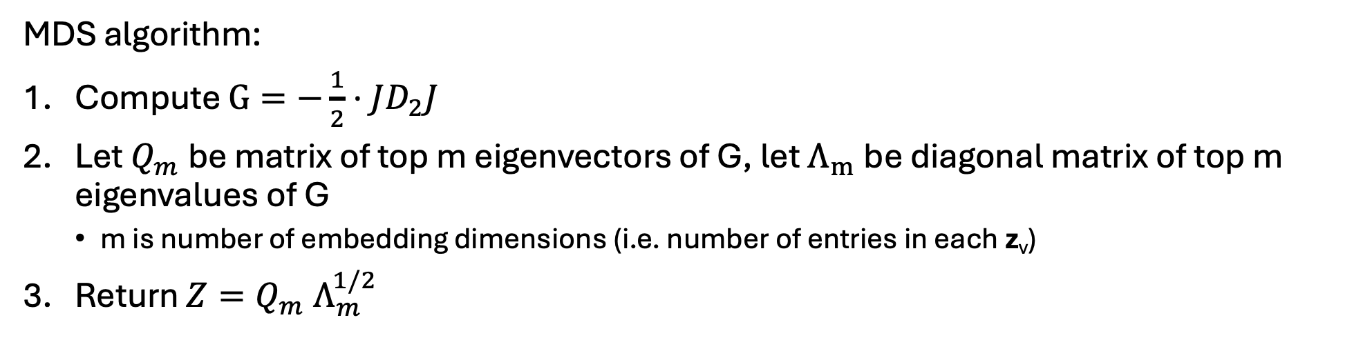
MDS: Given distances $d_{vw}>0$ find $z_{v}∈ℝ^{K}$ such that: $d_{vw}≈{\left|z_{v}−z_{w}\right|}_{2}^{2}$
MDS algorithm:
Compute $G=−\frac{1}{2}⋅JD_{2}J$
Let $Q_{m}$ be matrix of top m eigenvectors of G, let $Λ_{m}$ be diagonal matrix of top m eigenvalues of G
  m is number of embedding dimensions (i.e. number of entries in each z_{v})
Return $Z=Q_{m} Λ_{m}^{1/2}$
Number m of embedding dimensions is hyperparameter – chosen by user!
Squared distance matrix $D_{2}=[d_{vw}^{2}]$
Centering matrix $J=I −\frac{1}{n}1^{T}1$
Gram matrix $G=\left[g_{vw}\right]$ where $g_{vw}= z_{v}^{T}z_{w}$
Embedding matrix Z
Homework: MDS with Euclidean distances (i.e. $d_{vw}=|x_{v}−x_{w}|)$) = PCA

Slide 23
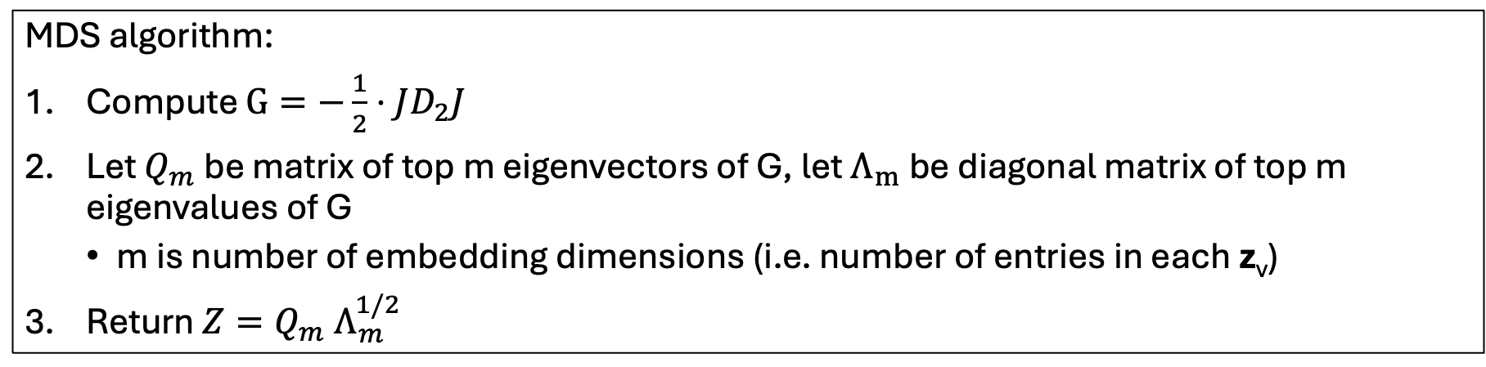

PCA is special case of MDS
PCA = MDS with Euclidean distances (i.e. $d_{vw}={\left|x_{v}−x_{w}\right|}^{2}$)
Why? $JD_{2}J =X^{T}X$, i.e. the matrix you take the top eigenvectors of in PCA
Proof: homework
MDS algorithm:
Compute $G=−\frac{1}{2}⋅JD_{2}J$
Let $Q_{m}$ be matrix of top m eigenvectors of G, let $Λ_{m}$ be diagonal matrix of top m eigenvalues of G
  m is number of embedding dimensions (i.e. number of entries in each z_{v})
Return $Z=Q_{m} Λ_{m}^{1/2}$

Slide 24
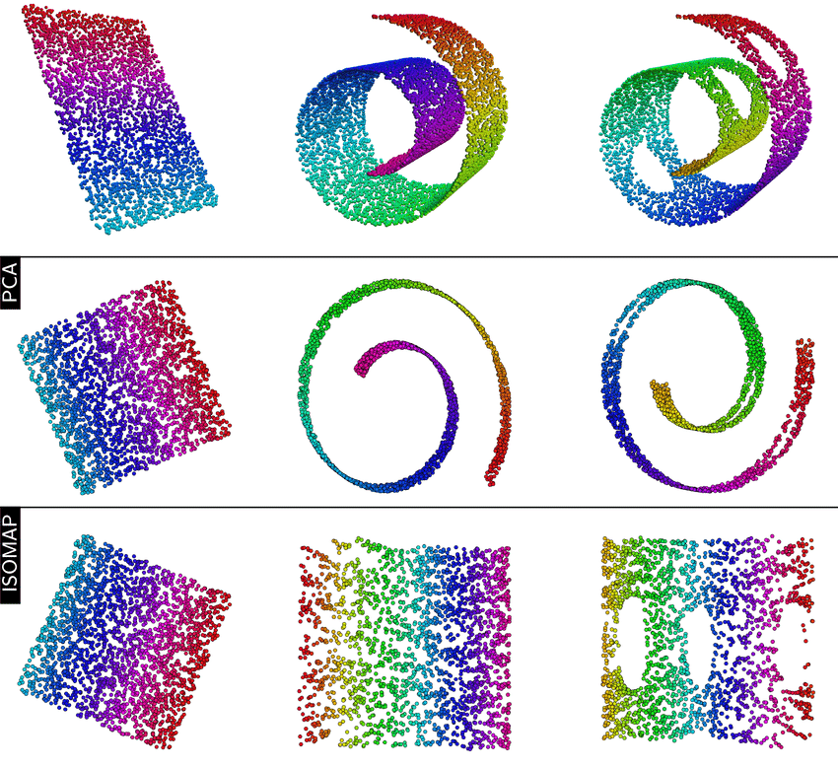
ISOMAP = MDS with graph-based distances
Original data
PCA 2-D projection
ISOMAP 2-D projection

Slide 25

















Major challenge of MDS
What if graph distances (shortest path distance) don’t show the full picture?
Case 1: A and B are connected… but likely not that related
Few paths from A -> B
Case 2: A and B are not connected… but likely related
Many paths from A -> B
B
A
B
A
Next time: using “random walks” instead

