Slide 1
Markov chains + trajectory inference
Uthsav Chitra

Slide 2












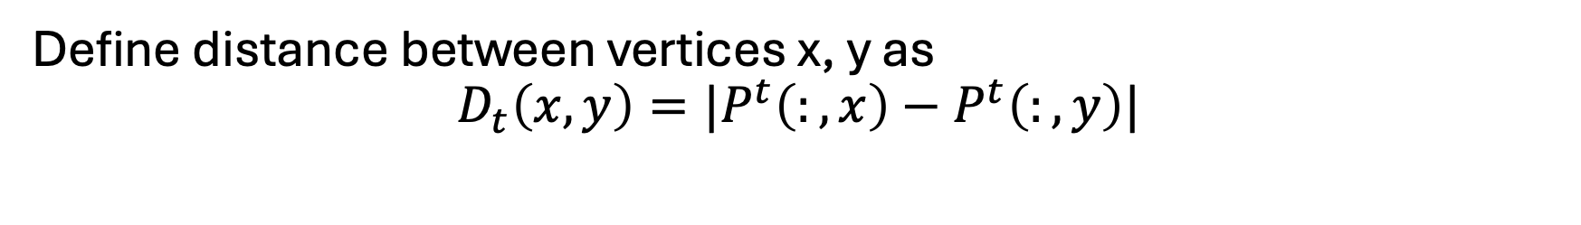
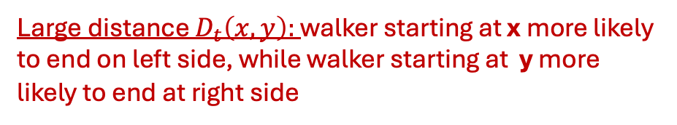



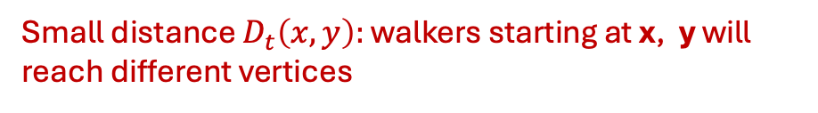



Last time: diffusion maps, a random walk based distance
Define distance between vertices x, y as
$$D_{t}\left(x,y\right)=|P^{t}\left(:,x\right)−P^{t}\left(:,y\right)|$$
Big idea: Probability transition matrix P^{t} models all length-t paths
Vertices x,y are close if a walker starting at either x or y will end up at same vertices in length-t path
Large distance $D_{t}\left(x,y\right):$ walker starting at x more likely to end on left side, while walker starting at y more likely to end at right side
Small distance $D_{t}\left(x,y\right):$ walker starting at x or y will likely end at middle vertex
x
y
x
y
Small distance $D_{t}\left(x,y\right):$ walkers starting at x, y will reach different vertices

Slide 3
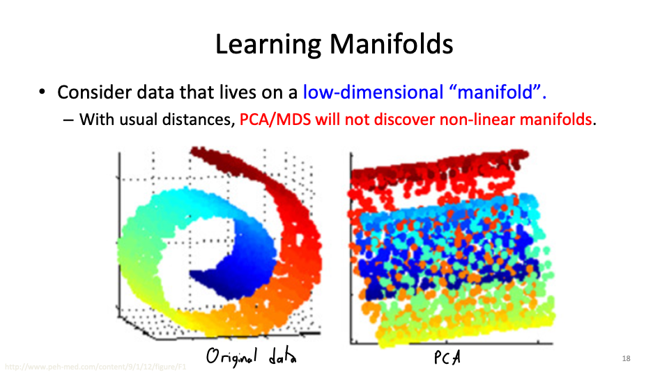
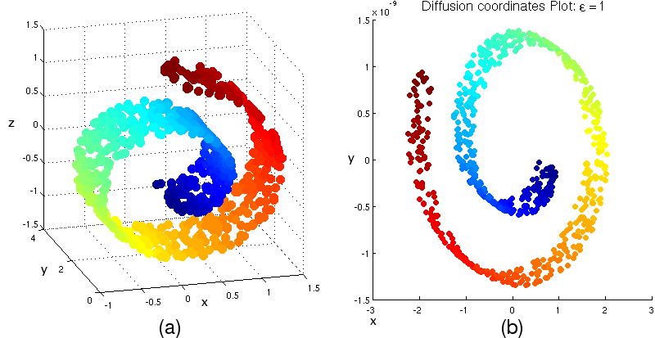




Last time: diffusion maps, a random walk based distance
Define distance between vertices x, y as
$$D_{t}\left(x,y\right)=|P^{t}\left(:,x\right)−P^{t}\left(:,y\right)|$$
If you define embedding $e(x)$ of each vertex x as
Diffusion maps first two components
Then $D_{t}\left(x,y\right)={\left| e_{t}\left(x\right)−e_{t}\left(y\right)\right|}^{2}$
Also suggests a natural way to embed vertices of graph!
$${\left(e_{t}\right)}_{1}$$
$${\left(e_{t}\right)}_{0}$$
Small distance $D_{t}\left(x,y\right):$ walkers starting at x, y will reach different vertices

Slide 4
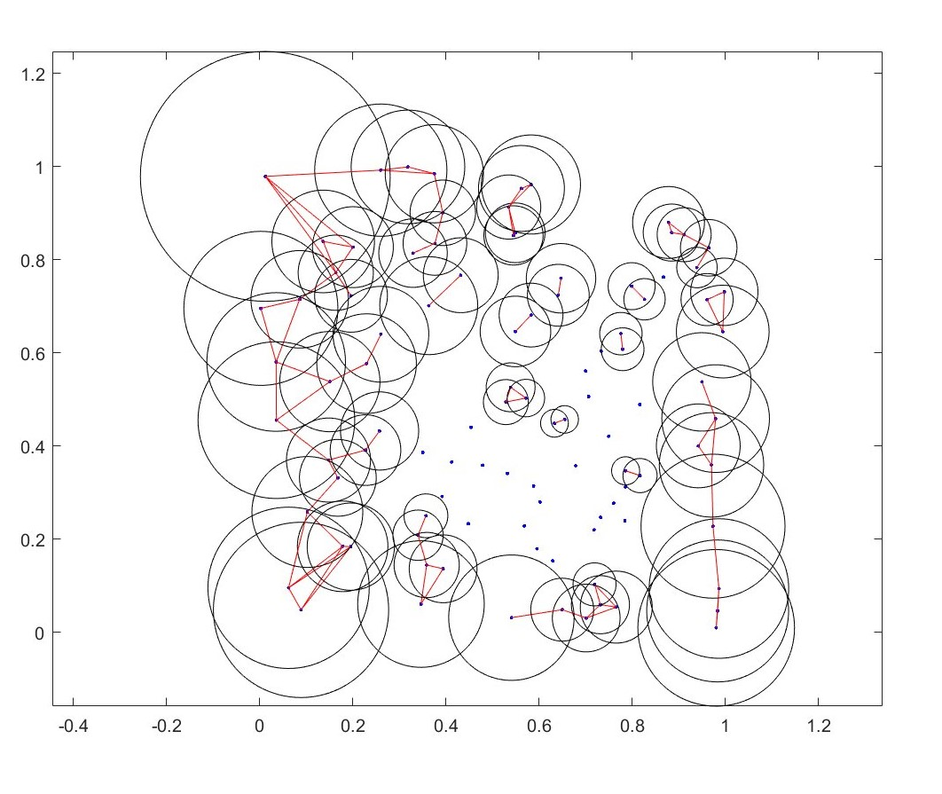
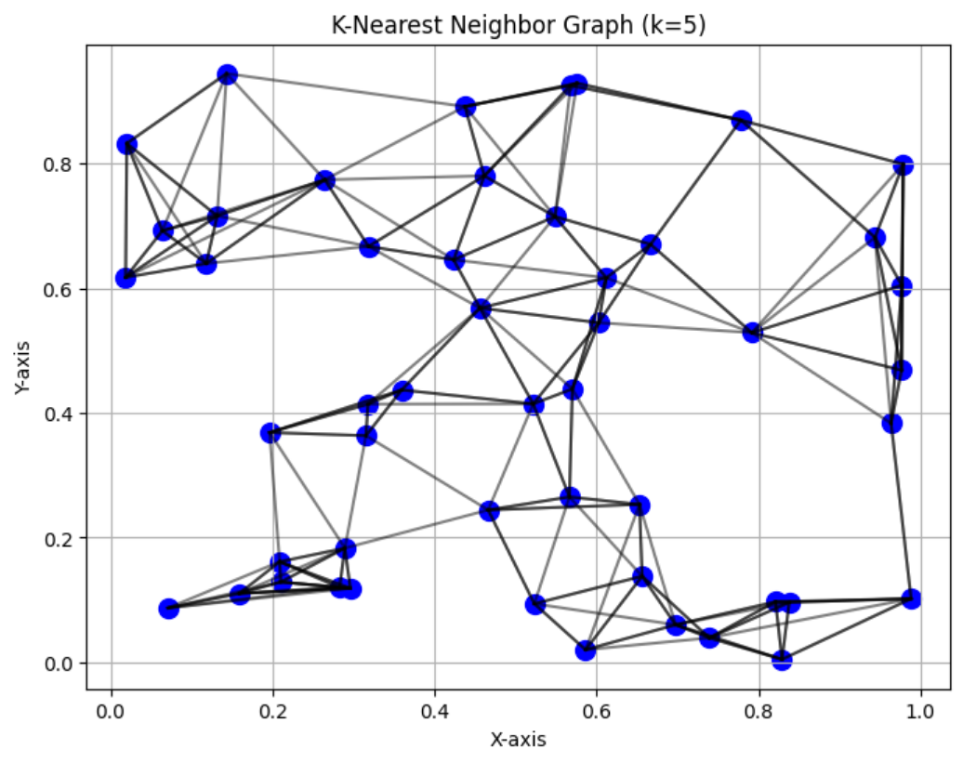
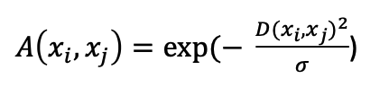
Last time: application to single cell data
ε-ball graph
Draw an edge between vertex v and all vertices w within distance ε
k-NN (k nearest neighbors) graph
Draw an edge between vertex v and its k nearest neighbors
For single cell data, distance btwn cells x_{i}, x_{j} typically defined using an “affinity function” / “similarity function”
e.g. Gaussian kernel function

Slide 5

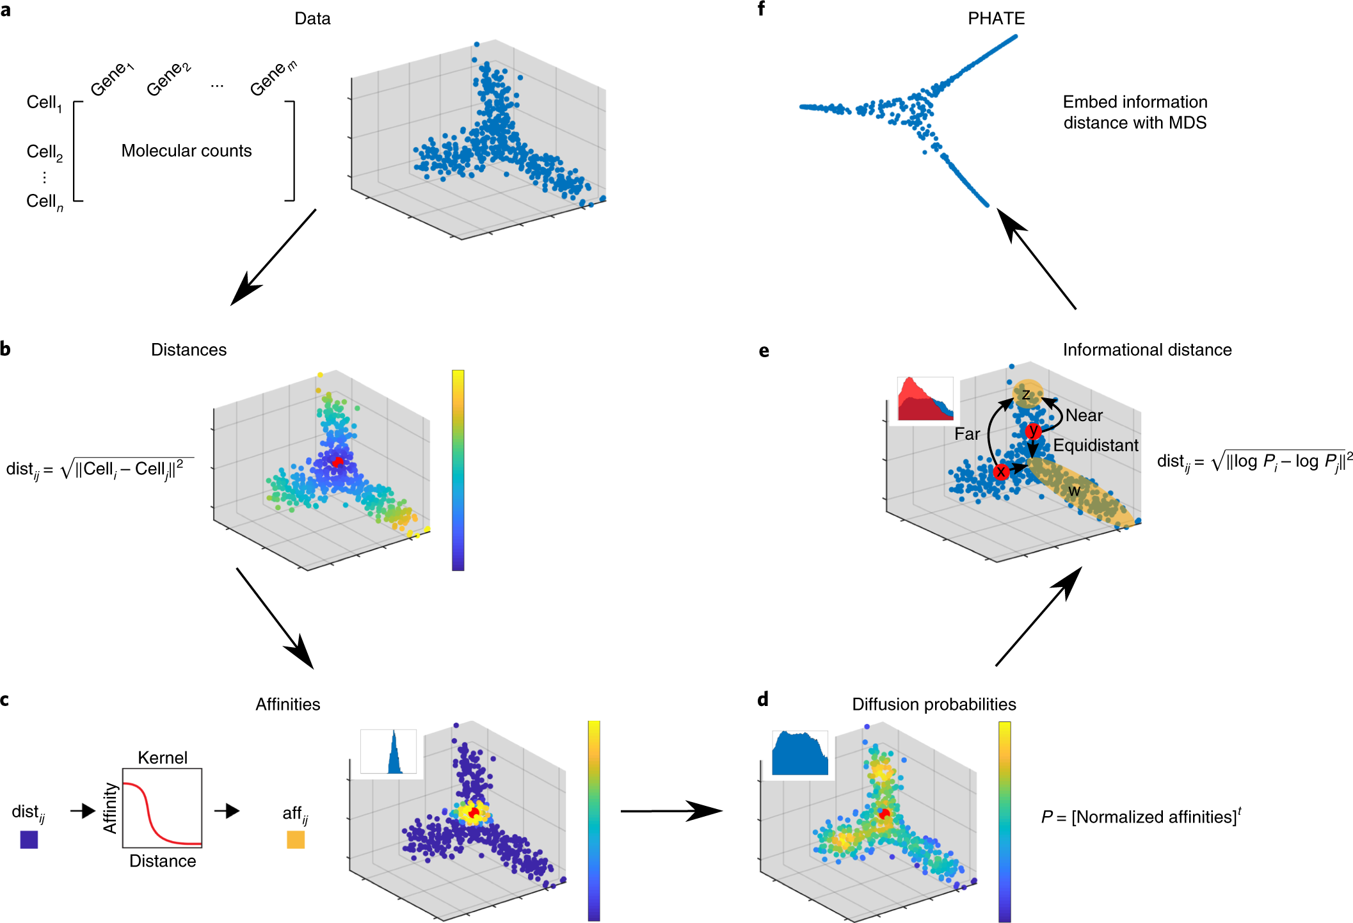
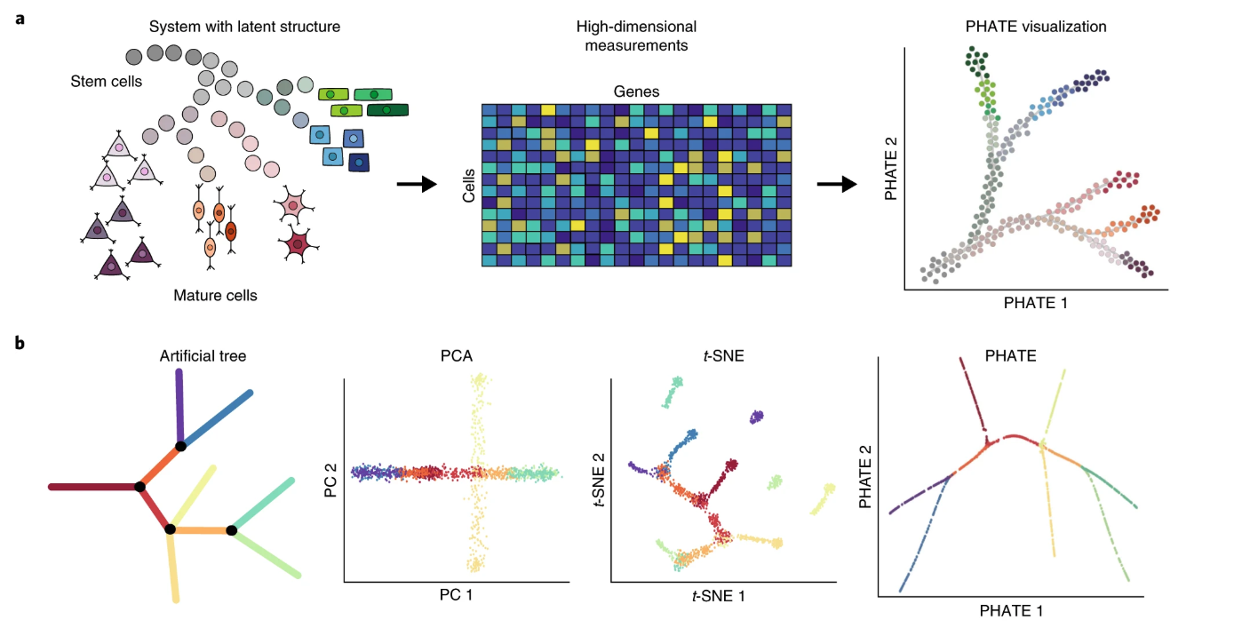
PHATE embedding method uses diffusion maps distance + MDS
Commonly used / highly cited method for dimensionality reduction

Slide 6
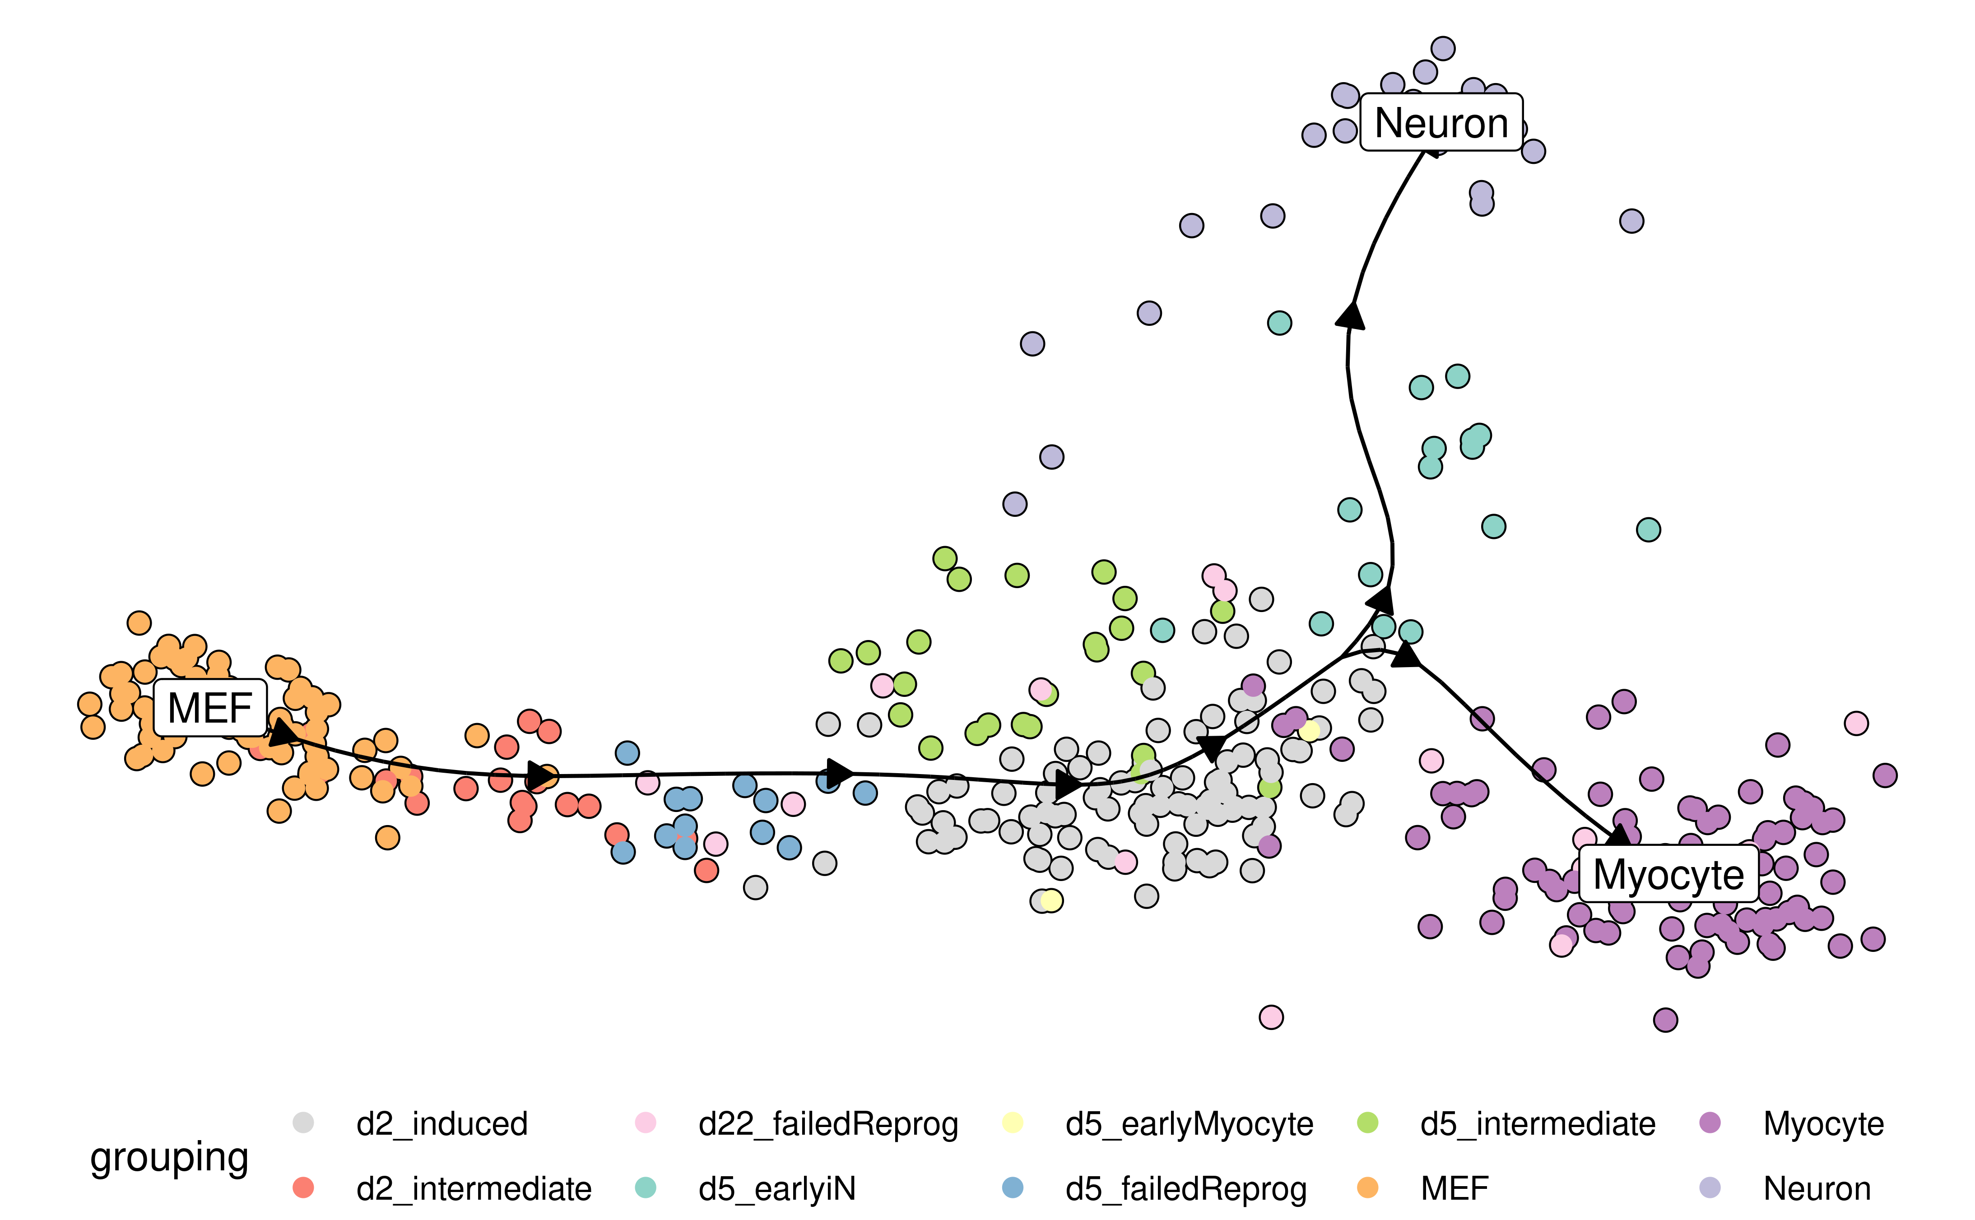
Last time: trajectory inference
Even though you measure cells at same time…
different cells may be at different developmental stages
Goal: reconstruct relative temporal ordering of cells

Slide 7
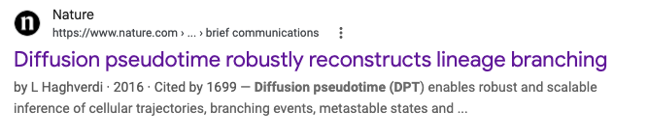
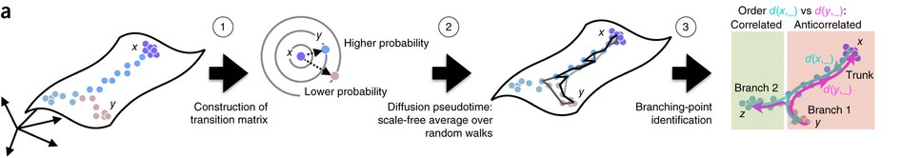
Popular TI methods use diffusion
Uses diffusion maps metric

Slide 8
Last time: t-SNE and UMAP

Slide 9
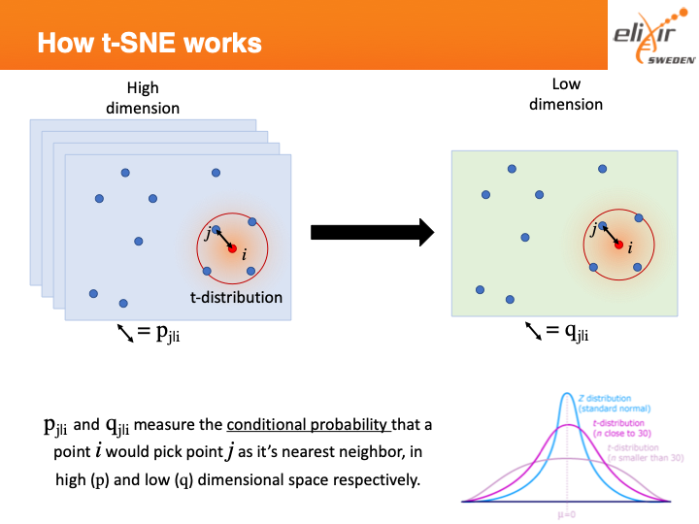
Last time:
Learned embedding
Original data
t-SNE tries to learn this map

Slide 10
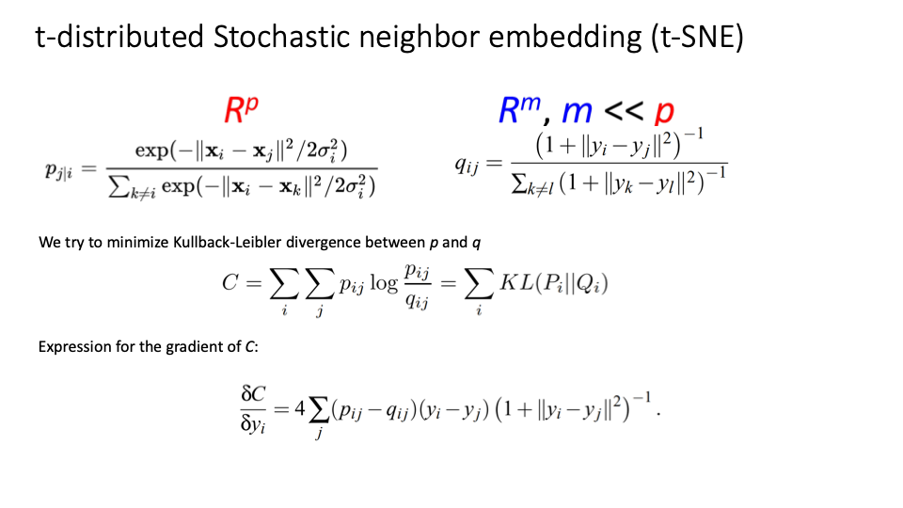
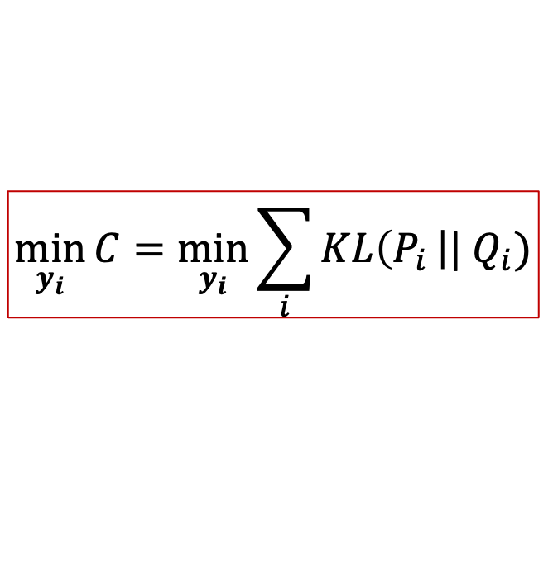
New, lower-dimensional data
Original data
$$\min_{y_{i}}{C=\min_{y_{i}}{\sum_{i}{KL\left(P_{i }\right||{ Q}_{i})}}}$$

Slide 11
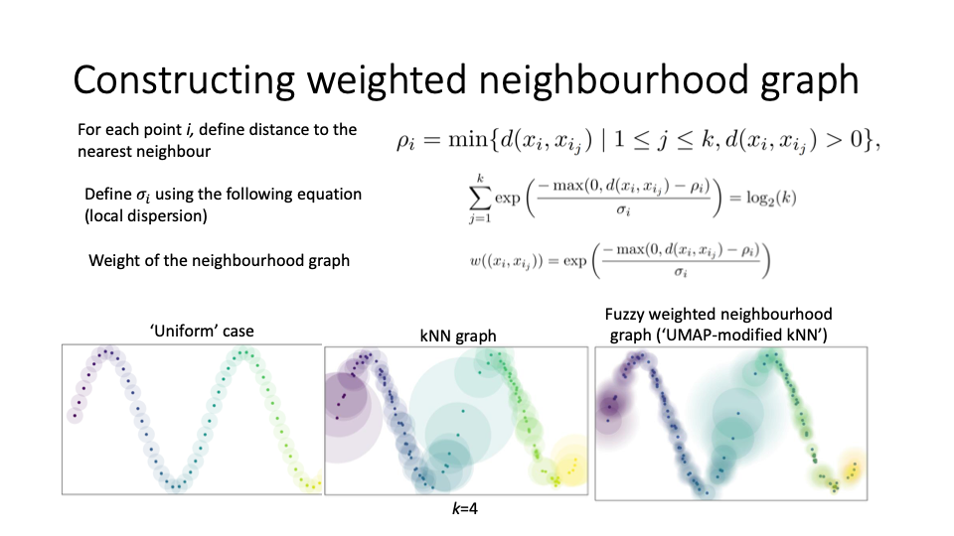
Last time: UMAP algorithm

Slide 12
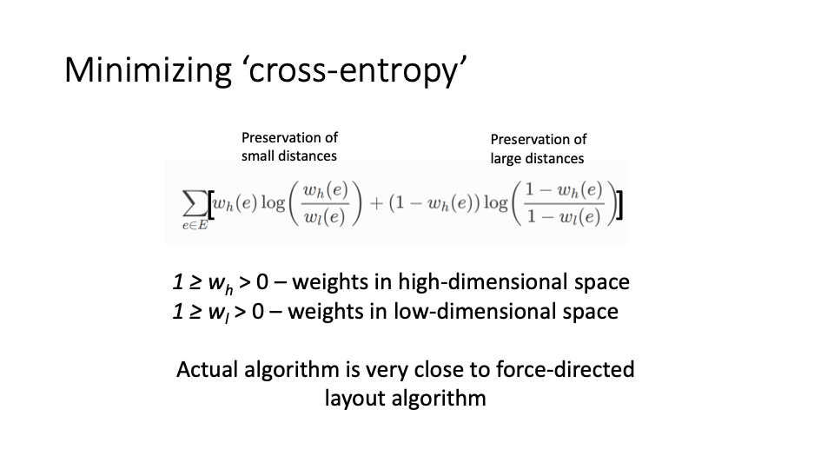
Last time: UMAP algorithm
UMAP problem: find low dimensional embedding y that minimizes cross-entropy between original-data-graph and reduced-dimension-graph
(t-SNE is similar in spirit, but “cross-entropy” is replaced w/ “KL divergence w/ nearest neighbors”)

Slide 13
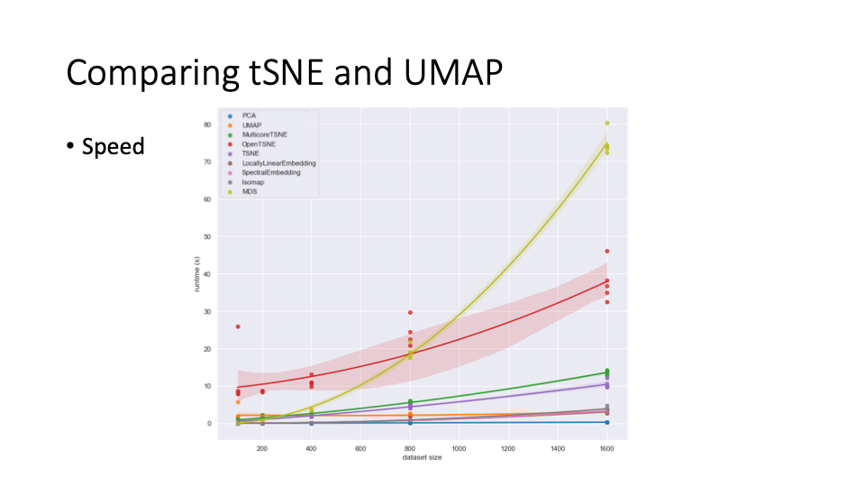
UMAP typically used more in single cell bio as it is faster

Slide 14
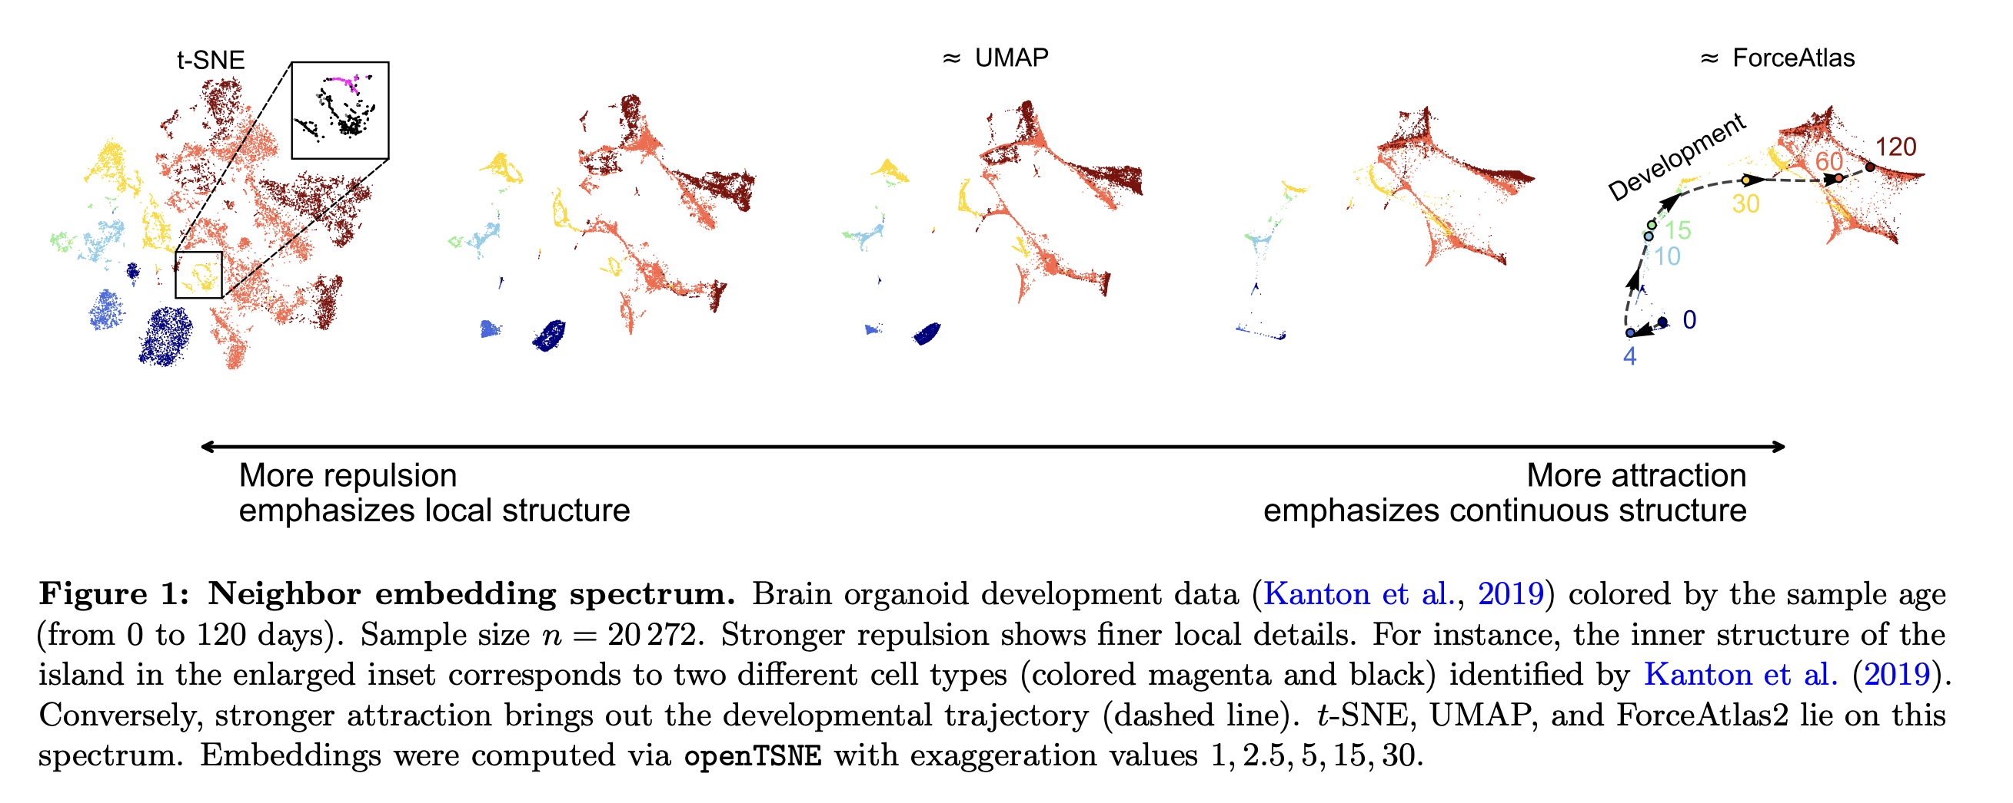
UMAP and t-SNE lie on attraction-repulsion spectrum
https://www.biorxiv.org/content/10.1101/2024.04.26.590867v1.full.pdf

Slide 15
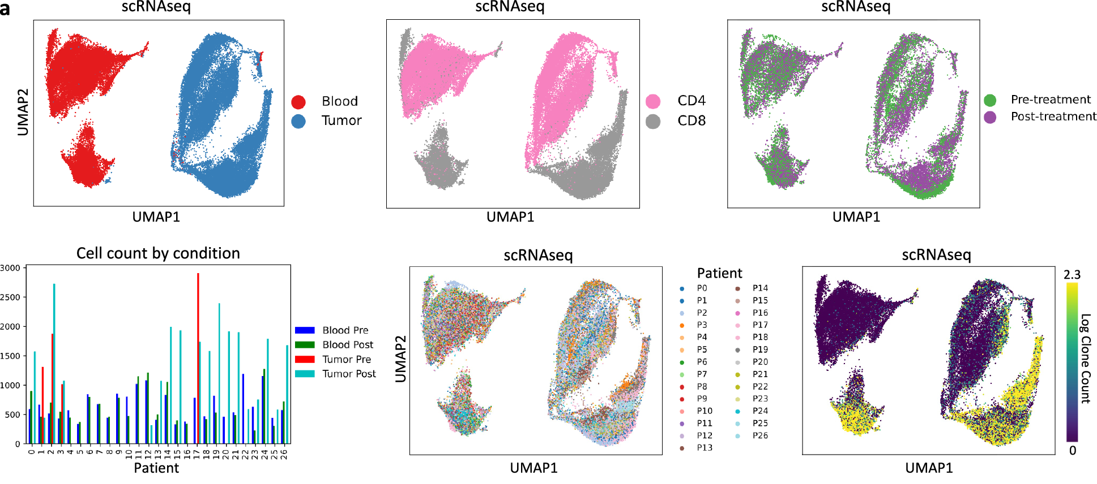
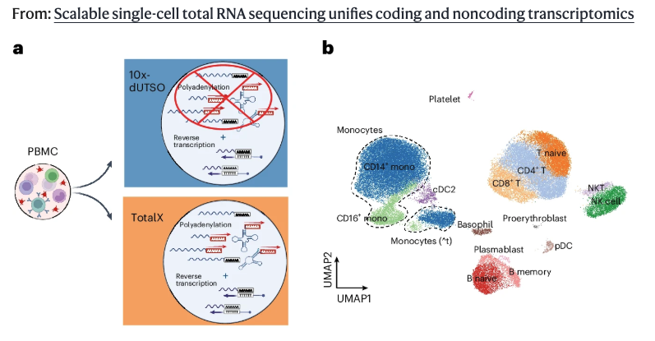
Example of typical UMAP plots in single cell
Single-cell RNA sequencing of T-cells across 20+ patients (He et al, Nat Comms 2026)
Isakova et al, Nat Biotech 2026

Slide 16

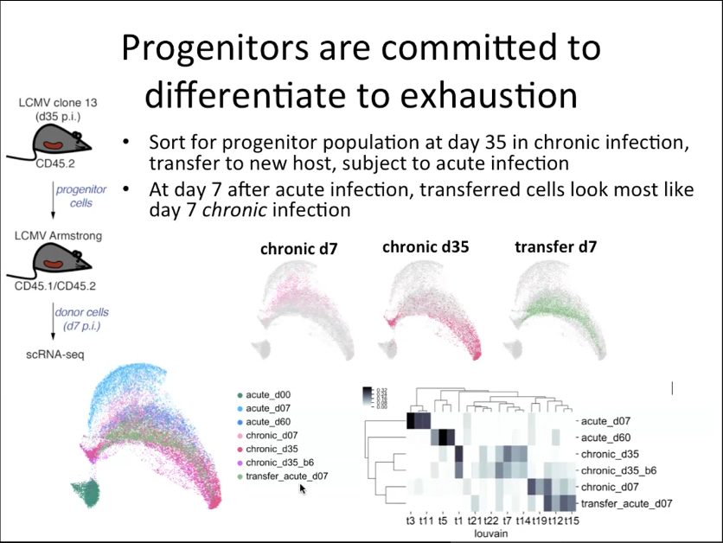
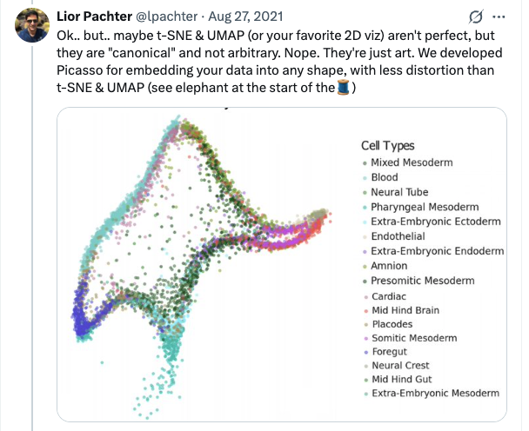
UMAP plots are often over-interpreted
Slide from https://network.febs.org/videos/talk15_christina_leslie

Slide 17
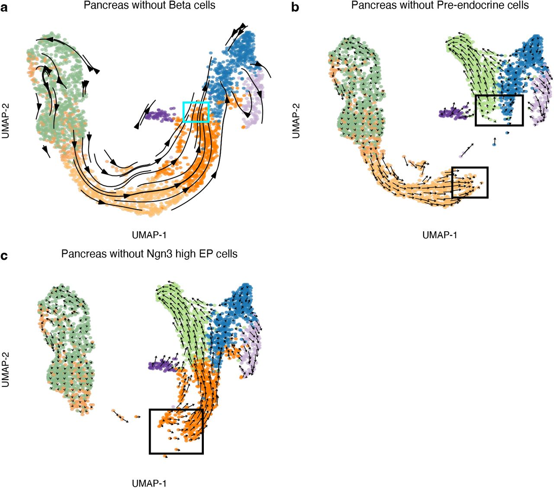
Figure from “Pumping the brakes on RNA velocity – understanding and interpreting RNA velocity estimates”
by Zheng et al (Kasper Hansen lab JHU biostats)

Slide 18

Random walks on directed graphs (Markov chains)
Vertex 1
Vertex 2
Vertex 3
Vertex 1
Vertex 2
Vertex 3
Vertex 1
1
0
1
Vertex 1
1/2
0
1/4
Vertices often called states
Vertex 2
1
0
3
Vertex 2
1/2
0
3/4
0
2
0
Vertex 3
0
1
0
Vertex 3
Adjacency matrix A
Entry a_{ij} = weight of edge j->i
Probability transition matrix P
Entry p_{ij} = probability of j->i
2
2
1
1/2
3
3/4
1
2
1
1
1
1
3
1/2
1/4
3

Slide 19
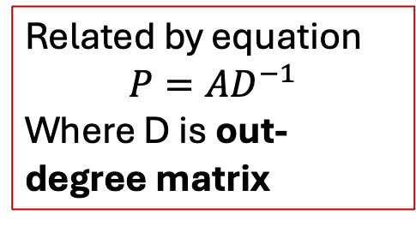
Random walks on directed graphs (Markov chains)
Vertex 1
Vertex 2
Vertex 3
Vertex 1
Vertex 2
Vertex 3
Vertex 1
1
0
1
Vertex 1
1/2
0
1/4
Related by equation
$$P=AD^{−1}$$
Where D is out-degree matrix
Vertex 2
1
0
3
Vertex 2
1/2
0
3/4
0
2
0
Vertex 3
0
1
0
Vertex 3
Adjacency matrix A
Entry a_{ij} = weight of edge j->i
Probability transition matrix P
Entry p_{ij} = probability of j->i
2
2
2
0
0
1
1/2
3
3/4
0
2
0
1
2
1
1
1
0
0
4
1
3
1/2
1/4
3
Outdegree matrix D

Slide 20

Random walks on directed graphs (Markov chains)
Vertex 1
Vertex 2
Vertex 3
Formula after t steps…
$$x_{t}=P^{t}x_{0}$$
Vertex 1
1/2
0
1/4
0
t
Vertex 2
1/2
3/4
Vertex 3
0
1
0
Probability transition matrix P
x_{t}
x₀
Probability transition matrix P
Entry p_{ij} = probability of j->i
2
1/2
where x₀ is initial probability distribution over vertices
3/4
1
1
1/2
1/4
3

Slide 21




Classification of states in Markov chain
Recurrent: if at vertex/state v, then you will always return to v
P(x_{t}=v for some t | x₀=v) = 1
Transient: if at vertex/state v, then there is a non-zero probability you never return to v again
P(x_{t}=v for some t | x₀=v) < 1

Slide 22

Classification of states in Markov chain
Recurrent: if at vertex/state v, then you will always return to v
P(x_{t}=v for some t | x₀=v) = 1
Transient: if at vertex/state v, then there is a non-zero probability you never return to v again
P(x_{t}=v for some t | x₀=v) < 1
Transient states
Recurrent state
Go over more examples on the board

Slide 23
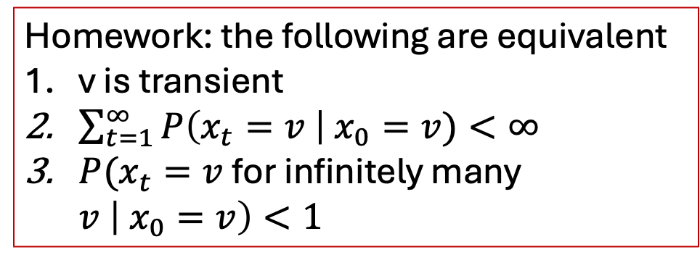
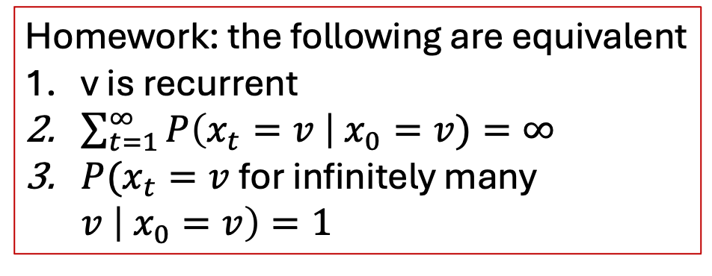
Classification of states in Markov chain
Recurrent: if at vertex/state v, then you will always return to v
P(x_{t}=v for some t | x₀=v) = 1
Transient: if at vertex/state v, then there is a non-zero probability you never return to v again
P(x_{t}=v for some t | x₀=v) < 1
Homework: the following are equivalent
v is recurrent
$\sum_{t=1}^{∞}{P\left(x_{t}=v \right| x_{0}=v)=∞}$
$P(x_{t}=v$for infinitely many $v \left| x_{0}=v\right)=1$
Homework: the following are equivalent
v is transient
$\sum_{t=1}^{∞}{P\left(x_{t}=v \right| x_{0}=v)<∞}$
$P(x_{t}=v$for infinitely many $v \left| x_{0}=v\right)<1$
For infinite-state MCs: there is also positive recurrent, where $E\left[x_{t}=v \right|{ x}_{0}=v]<∞$ vs. null recurrent, where $E\left[x_{t}=v \right|{ x}_{0}=v]=∞$ . That is, you can return to v with probability 1, but it takes infinite time to do so.

Slide 24
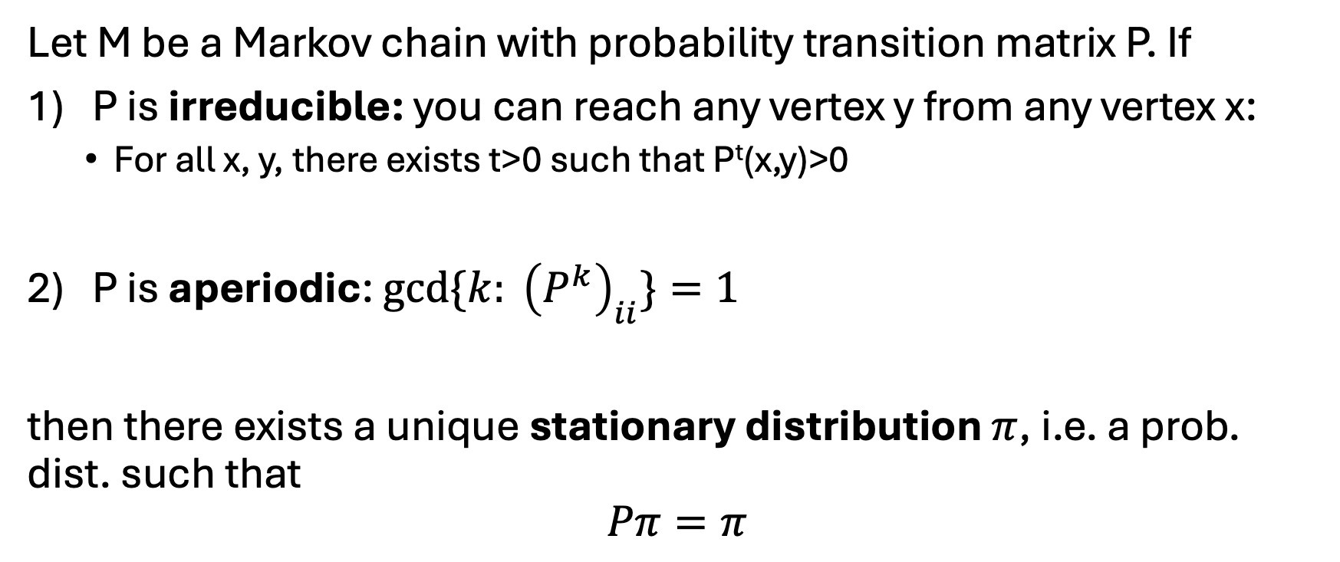
Fundamental theorem of Markov chains (existence/uniqueness of stationary distribution)
Let M be a Markov chain with probability transition matrix P. If
P is irreducible: you can reach any vertex y from any vertex x:
  For all x, y, there exists t>0 such that P^{t}(x,y)>0
2) P is aperiodic: ${gcd⁡\{k: \left(P^{k}\right)}_{ii}\}=1$
then there exists a unique stationary distribution $π$, i.e. a prob. dist. such that
$$Pπ=π$$

Slide 25
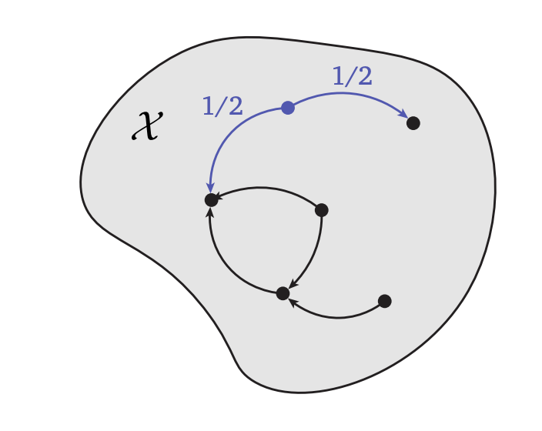




Examples of non-irreducible/aperiodic Markov chains
Not aperiodic: you always switch sides
Not irreducible:
If you start at v, you either get stuck in the left or right side
$${gcd⁡\{k: \left(P^{k}\right)}_{ii}>0\}=2$$
v

Slide 26



More general theorem of Markov chains
For a Markov chain, divide it into its “strongly connected components” (ie partitions where every node can reach every other node)
… get a directed acylic graph

Slide 27





More general theorem of Markov chains
For a Markov chain, divide it into its “strongly connected components” (ie partitions where every node can reach every other node)

Slide 28
More general theorem of Markov chains
For a Markov chain, divide it into its “strongly connected components” (ie partitions where every node can reach every other node)
Vertices in leaves are recurrent
  If a leaf has a single node, then it is an absorbing state (eg C₂)
Vertices in internal nodes are transient

Slide 29
More general theorem of Markov chains
For a Markov chain, divide it into its “strongly connected components” (ie partitions where every node can reach every other node)
Vertices in leaves are recurrent
Vertices in internal nodes are transient
Theorem: For each s.c.c. C, if C is aperiodic then there is a unique stationary distribution $π_{C}$ supported on C

Slide 30
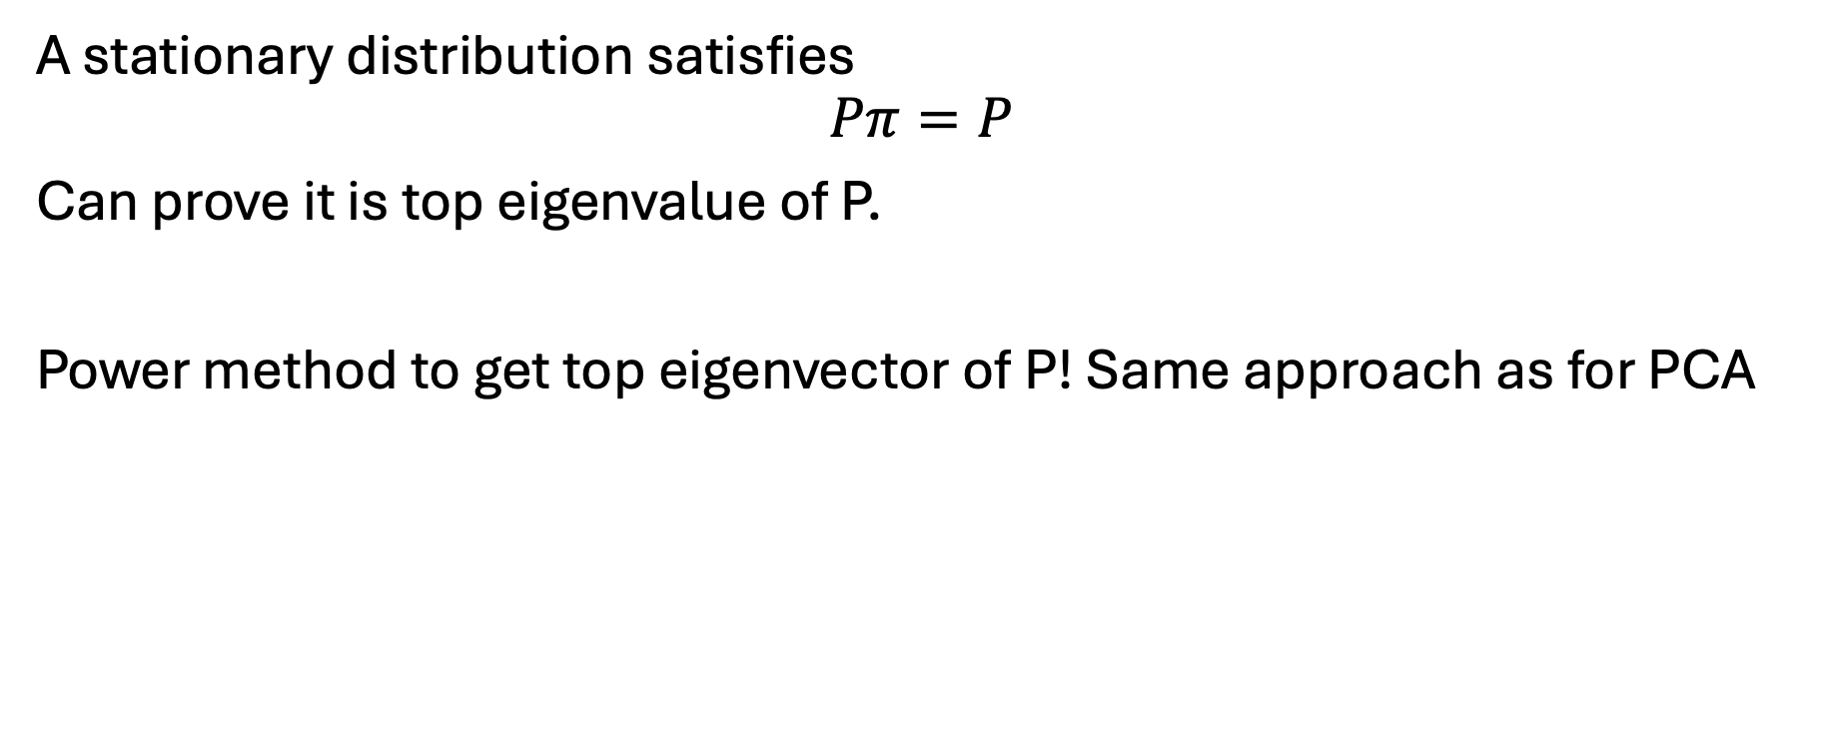
Computing stationary distribution(s)
A stationary distribution satisfies
$$Pπ=P$$
Can prove it is top eigenvalue of P.
Power method to get top eigenvector of P! Same approach as for PCA

Slide 31
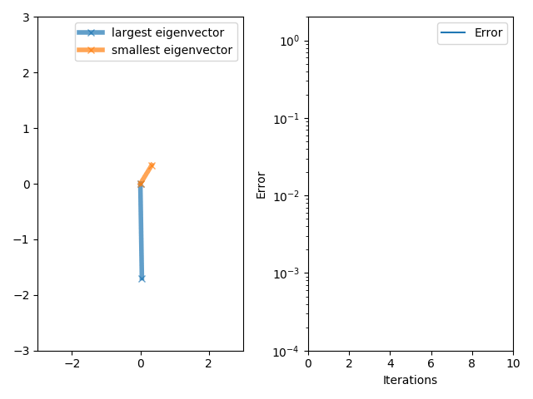
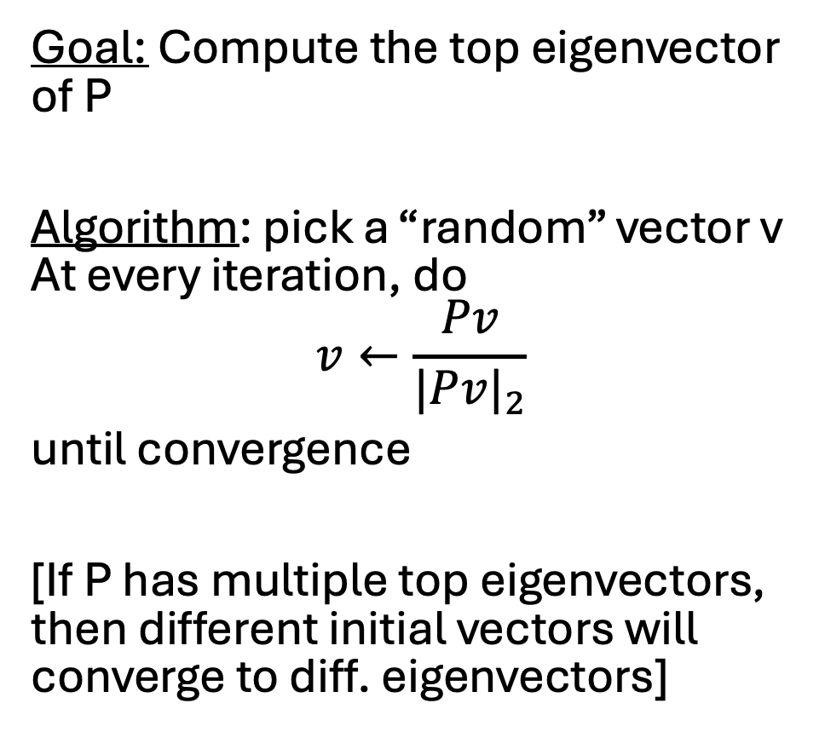
Power method
Goal: Compute the top eigenvector of P
Algorithm: pick a “random” vector v At every iteration, do
$$v←\frac{Pv}{{|Pv|}_{2}}$$
until convergence
[If P has multiple top eigenvectors, then different initial vectors will converge to diff. eigenvectors]

Slide 32








Absorbing Markov chains + absorption probabilities
Definition 1: An absorbing state is a recurrent s.c.c. with a single vertex
Definition 2: An absorbing Markov chain is a Markov chain where every recurrent s.c.c. has a single node (ie is an absorbing state)
Absorbing state
Absorbing state

Slide 33








Absorbing Markov chains + absorption probabilities
Definition 1: An absorbing state is a recurrent s.c.c. with a single vertex
  e.g. cell type A and cell type B2 below
Definition 1: An absorbing Markov chain is a Markov chain where every recurrent s.c.c. has a single node (ie is an absorbing state)
Oftentimes we want to calculate the probability of ending up in an absorbing state
Cell type A
Cell type B1
Cell type B2
Undifferentiated cell

Slide 34
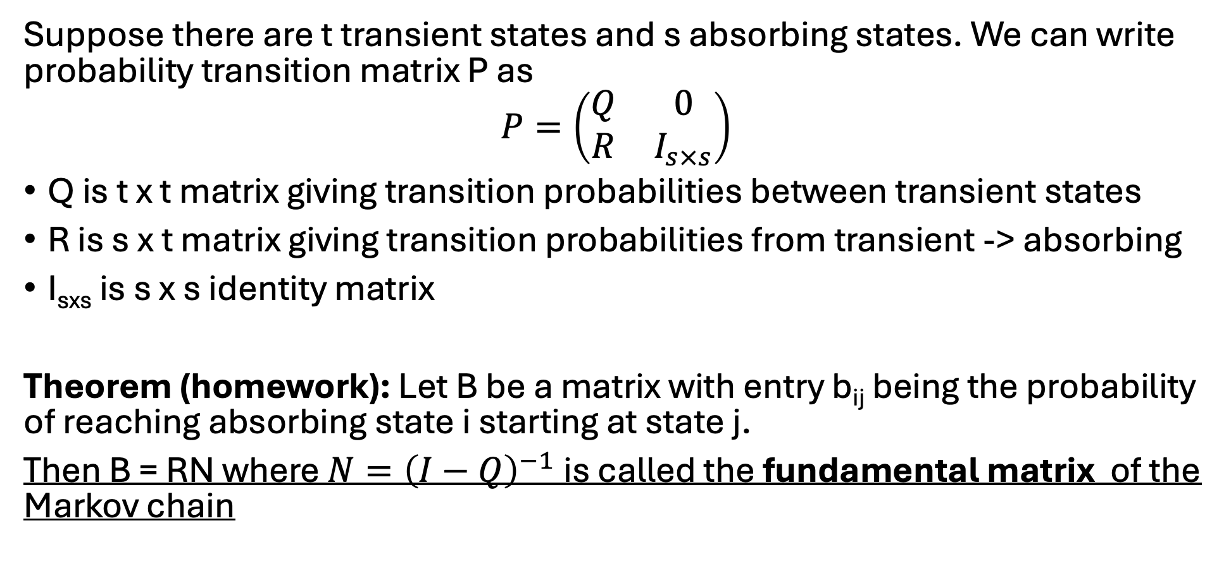
Absorbing Markov chains + absorption probabilities
Suppose there are t transient states and s absorbing states. We can write probability transition matrix P as
$$P=\left(\begin{matrix}Q & 0 \\ R & I_{s×s}\end{matrix}\right)$$
Q is t x t matrix giving transition probabilities between transient states
R is s x t matrix giving transition probabilities from transient -> absorbing
I_{sxs} is s x s identity matrix
Theorem (homework): Let B be a matrix with entry b_{ij} being the probability of reaching absorbing state i starting at state j.
Then B = RN where $N={\left(I−Q\right)}^{−1}$ is called the fundamental matrix of the Markov chain

Slide 35

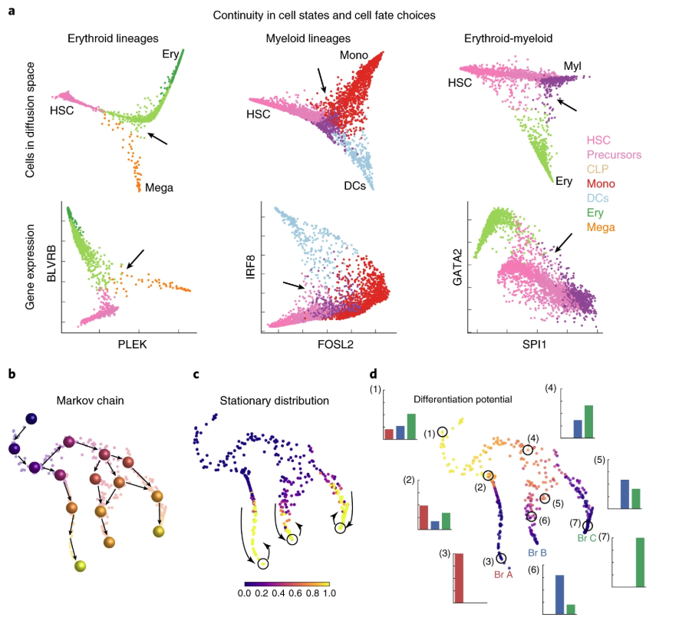
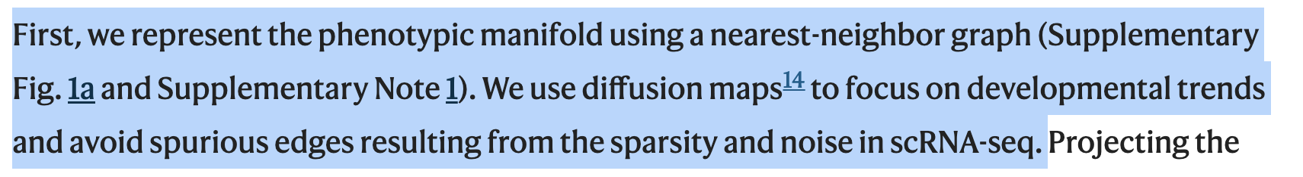
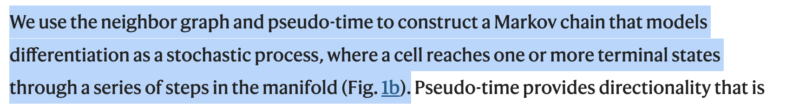
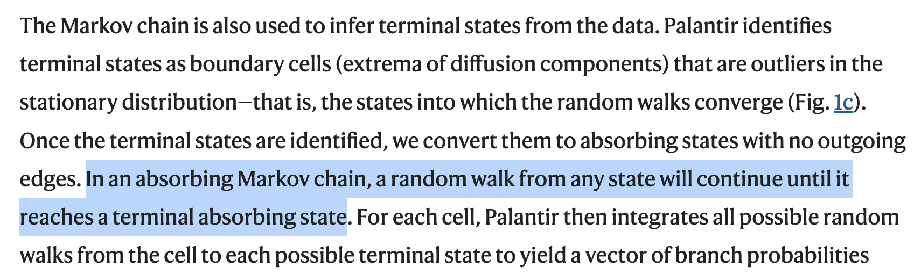
“Palantir” algorithm models cell differentiation w/ absorbing Markov chains

Slide 36
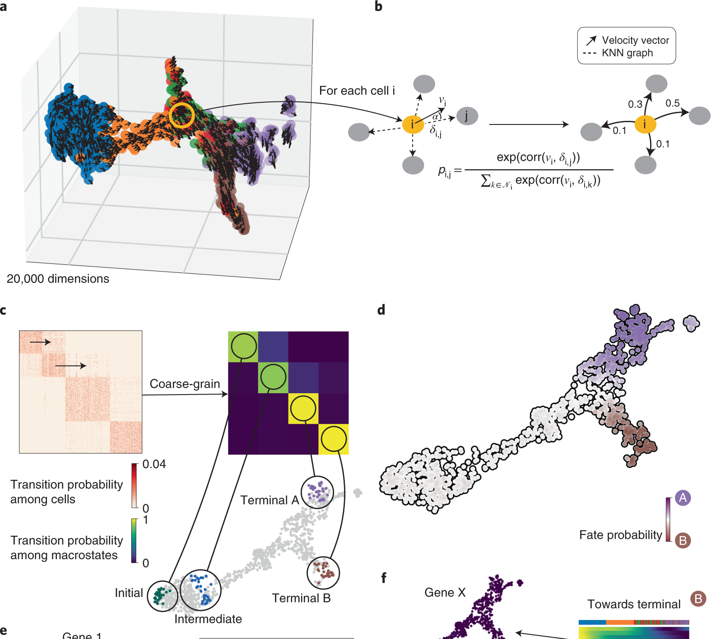
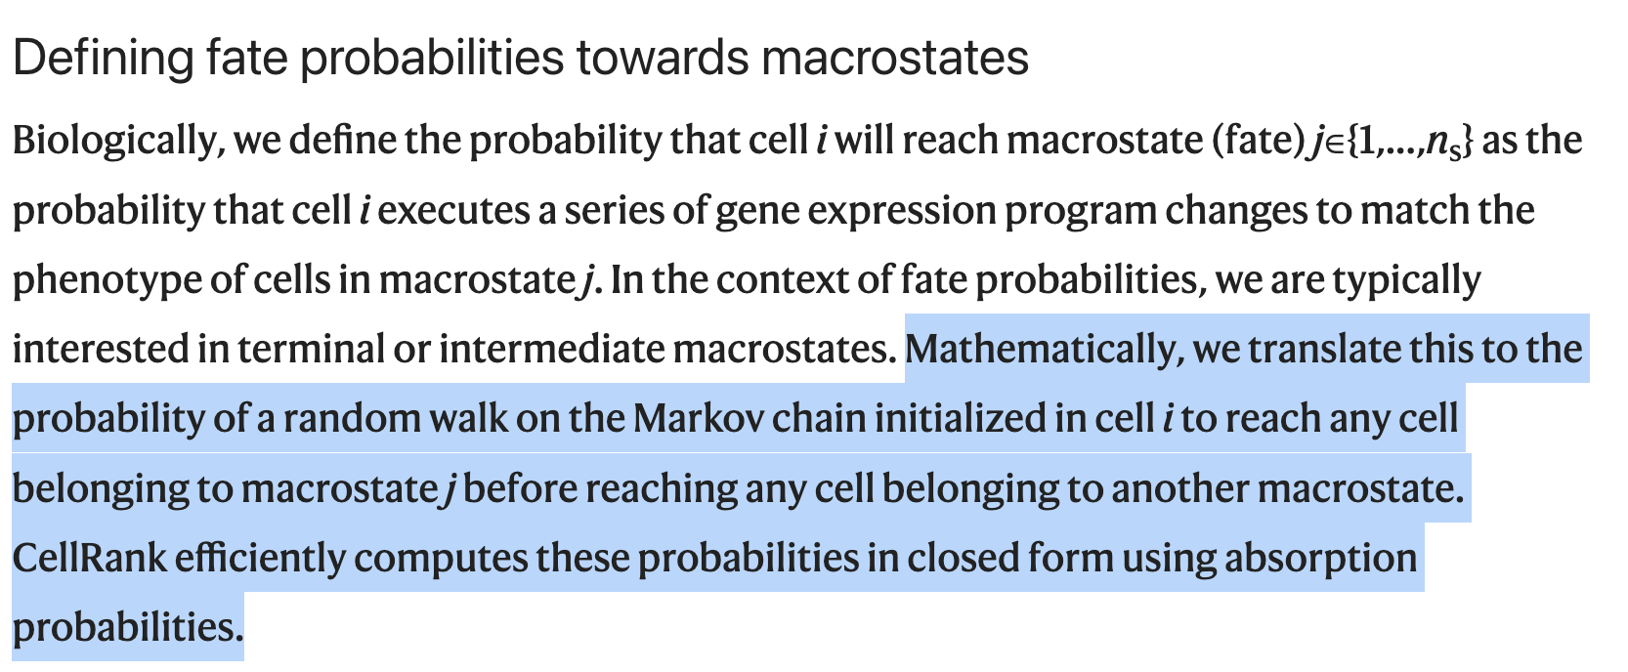

CellRank models cell differentiation using absorbing Markov chains

