Slide 1
Random walks on graphs
Uthsav Chitra

Slide 2
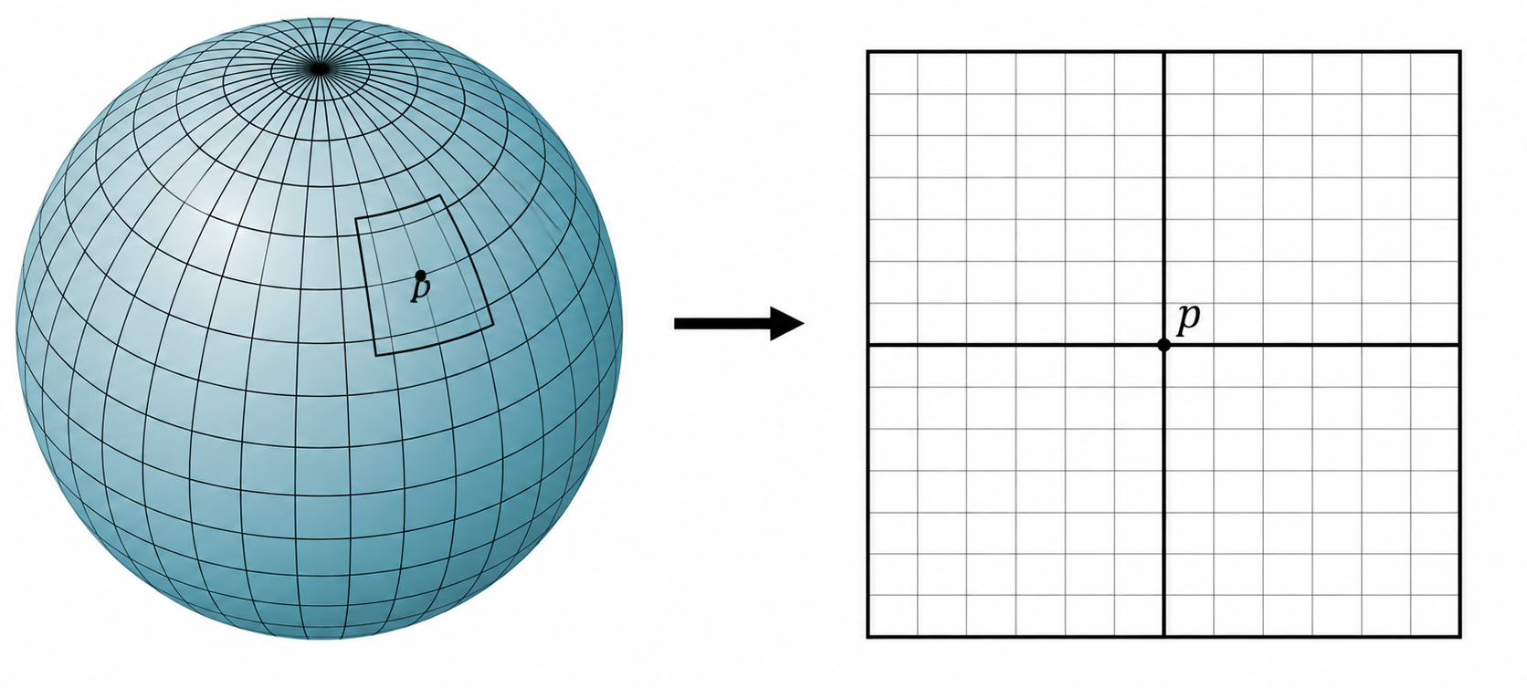
Last time: manifolds
Informally: A manifold M is an object in a high-dimensional space that “locally” is low-dimensional
Example: a sphere (globe)
Lives in 3-D space
“locally” looks 2-D

Slide 3
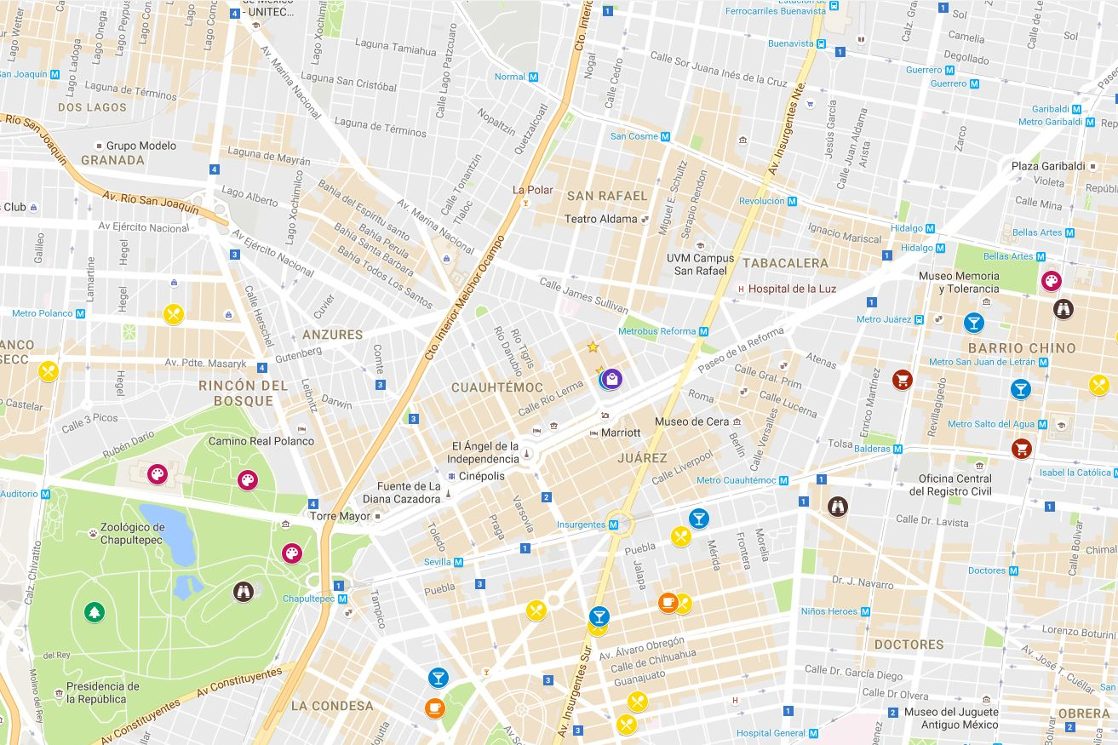
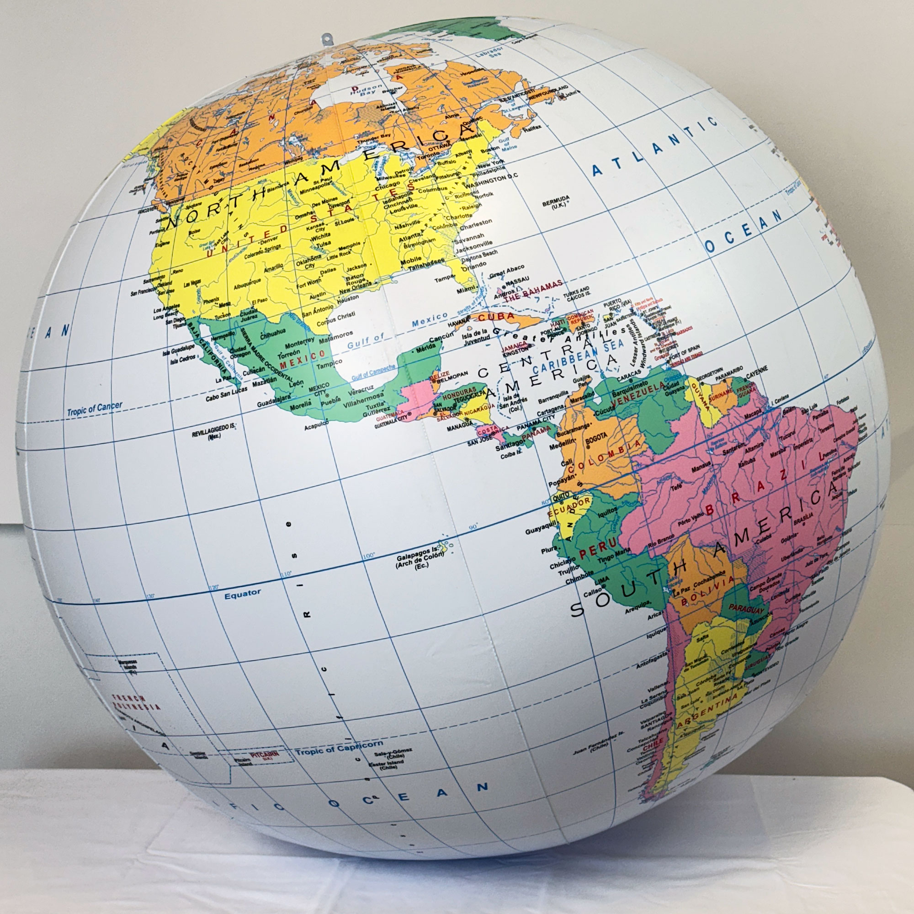
Another way to think about manifolds: maps
For small trips, we can approximate the distance on a globe with a 2-D map

Slide 4
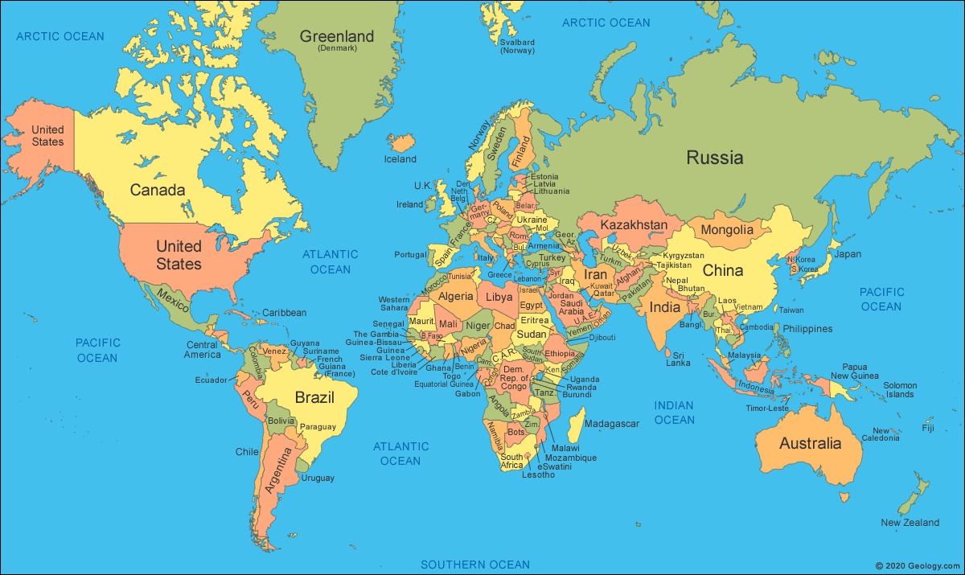
Another way to think about manifolds: maps
For long trips, 2-D map is not good for calculating distances

Slide 5
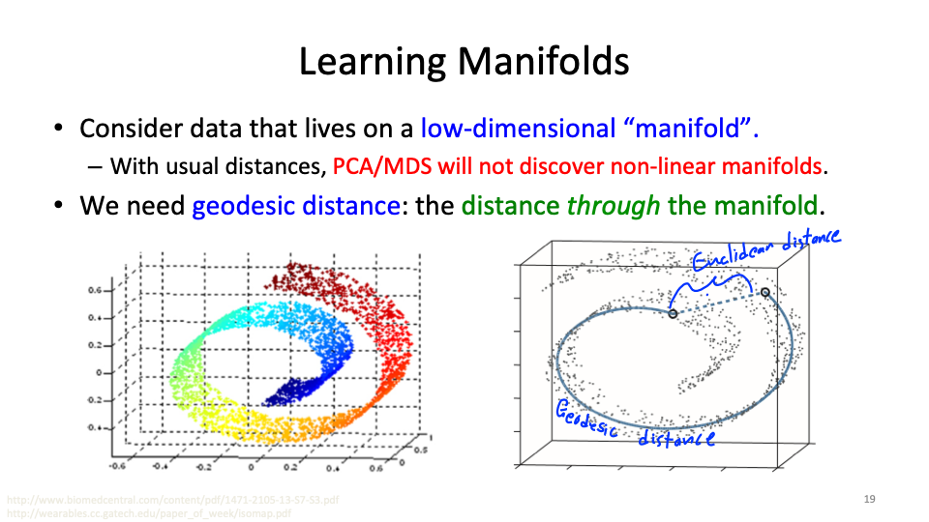
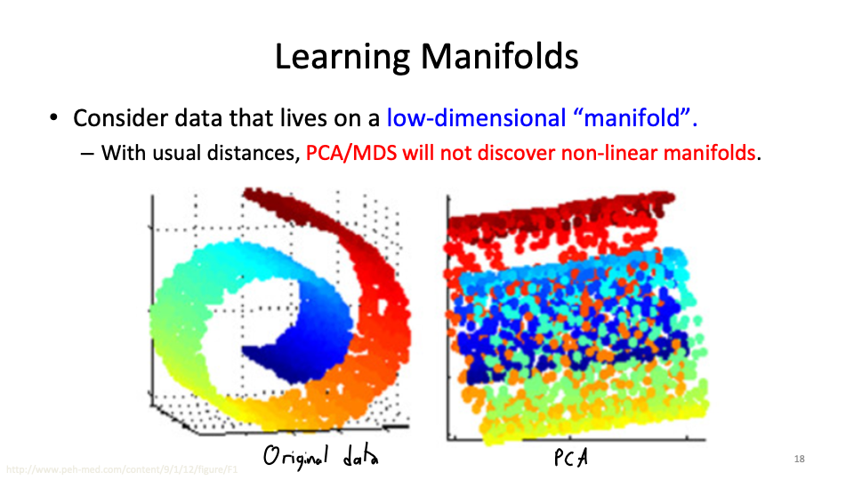
Last time: manifold structure obscured by PCA
We need geodesic distances

Slide 6
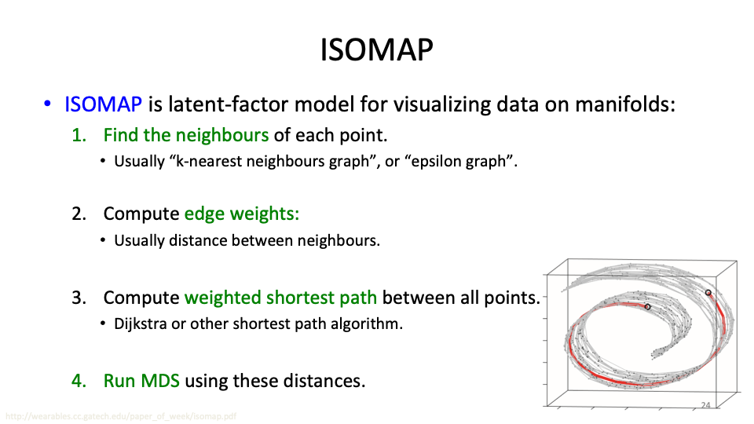
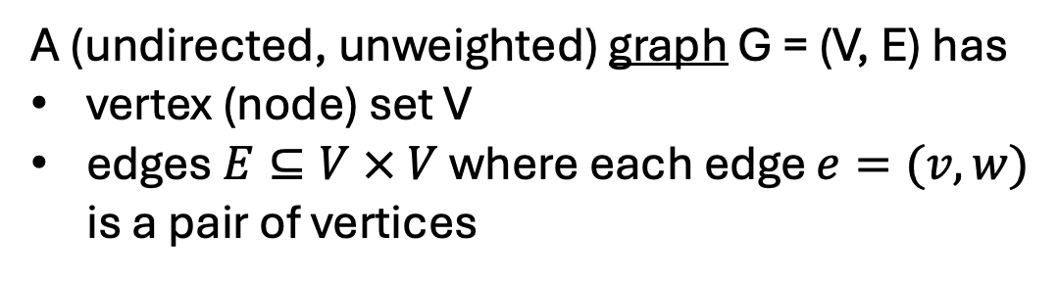
Last time: Graphs are used to represent manifold
A (undirected, unweighted) graph G = (V, E) has
vertex (node) set V
edges $E⊆V × V$ where each edge $e=(v,w)$ is a pair of vertices
Data points x₁, …, x_{N} in original 3D space
Graph G=(V,E) w/ vertices V={x₁, …, x_{N}} formed by connecting “nearby” datapoints x_{i}

Slide 7
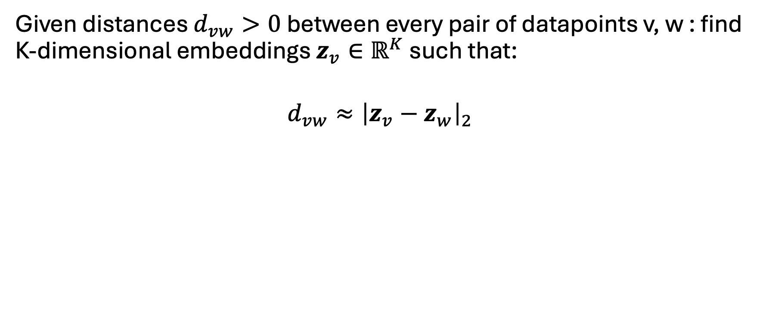


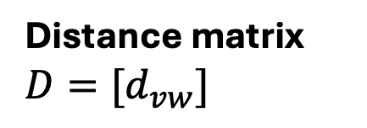
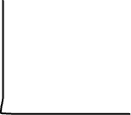
Last time: Multidimensional scaling (MDS)
Given distances $d_{vw}>0$ between every pair of datapoints v, w : find K-dimensional embeddings $z_{v}∈ℝ^{K}$ such that:
$$d_{vw}≈{\left|z_{v}−z_{w}\right|}_{2}$$
N observations
Distance matrix ${D=[d}_{vw}]$
N observations

Slide 8

















Major challenge of MDS
What if graph distances (shortest path distance) don’t show the full picture?
Case 1: A and B are connected… but likely not that related
Few paths from A -> B
Case 2: A and B are not connected… but likely related
Many paths from A -> B
B
A
B
A

Slide 9
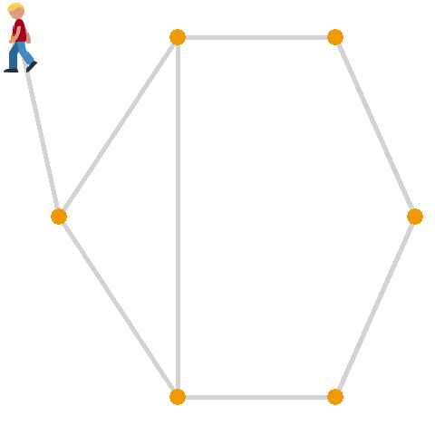


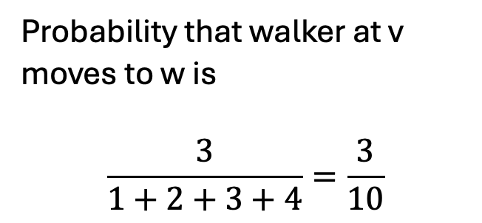
Today’s new idea: random walks on a graph
Imagine a “walker” moving between vertices
Step 0: walker at vertex v
Step 1: moves to vertex w with probability proportional to edge weight e_{vw}
Step 2: repeat…
Probability that walker at v moves to w is
$$\frac{3}{1+2+3+4}=\frac{3}{10}$$

Slide 10

Intuition: Random walks distinguish challenging cases for MDS
Case 1: A and B are connected… but likely not that related
Few paths from A -> B
Random walker at A has a low probability of moving to B
(If walker moves to somewhere in left cluster, they will be stuck there for a while)
A
B

Slide 11
Intuition: Random walks distinguish challenging cases for MDS
Case 2: A and B are not connected… but likely related
Many paths from A -> B
B
Random walker at A has a high probability of moving to B in 2 steps
A

Slide 12


Random walks on graph
Classical field in applied math, starting in ~1970s
1990-2000s: Random walks form basis of original Google search algorithm, social network recommendation systems (FB, IG…), …
In biology, random walks were used to study protein interactions (pre-AlphaFold)

Slide 13
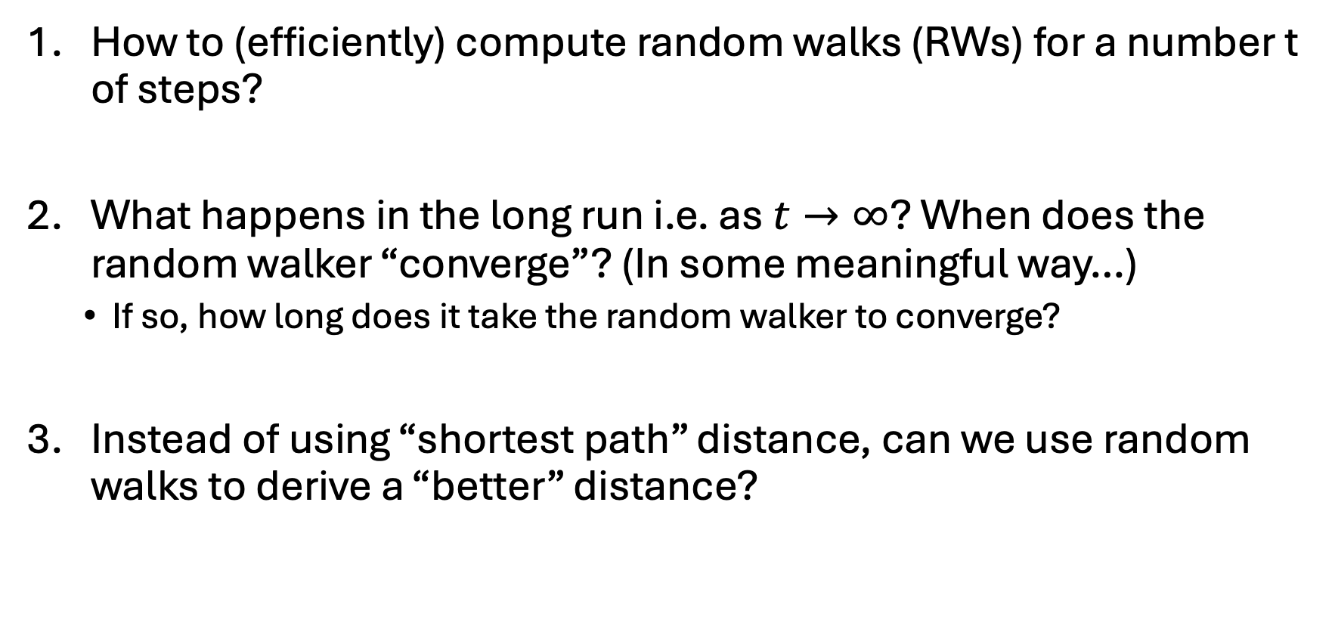
Some natural questions
How to (efficiently) compute random walks (RWs) for a number t of steps?
What happens in the long run i.e. as $t→∞$? When does the random walker “converge”? (In some meaningful way…)
  If so, how long does it take the random walker to converge?
Instead of using “shortest path” distance, can we use random walks to derive a “better” distance?

Slide 14
Example of random walk
0
1
1
0
1
0
1
2
1
1
0
0
0
2
0
0
Adjacency matrix A
2
2
1
4
1
1
1
3

Slide 15
What is a random walk
t=0
2
2
1
4
1
1
1
3

Slide 16
What is a random walk
t=0
t=1
2
2
2
2
1
1
4
4
1
1
1
1
1
3
1
3

Slide 17
What is a random walk
t=0
t=1
2
2
2
2
1
1
4
4
1
1
1
1
1
3
1
3
t=2
With probability 1/2
With probability 1/4
With probability 1/4
2
2
2
2
2
2
1
1
4
1
4
1
4
1
1
1
1
1
1
3
1
3
1
3

Slide 18

Definitions
Vertex 1
Vertex 2
Vertex 3
Vertex 4
0
1
1
0
Vertex 1
0
1/4
1/2
0
1
0
1
2
Vertex 2
1/2
0
1/2
1
1
1
0
0
Vertex 3
1/2
1/4
0
0
0
2
0
0
Vertex 4
0
2/4
0
0
Adjacency matrix A
Probability transition matrix P
2
2
Entry P_{ij} is probability of going from vertex j -> vertex i
1
4
1
1
1
3

Slide 19
Definitions
Vertex 1
Vertex 2
Vertex 3
Vertex 4
0
1
1
0
Vertex 1
0
1/4
1/2
0
1
0
1
2
Vertex 2
1/2
0
1/2
1
Probability of going from 2 -> 4
1
1
0
0
Vertex 3
1/2
1/4
0
0
0
2
0
0
Vertex 4
0
2/4
0
0
Adjacency matrix A
Probability transition matrix P
2
2
Entry P_{ij} is probability of going from vertex j -> vertex i
1
4
1
1
1
3
(You might ask, why not define P_{ij} as probability of i -> j? Will get back to that)

Slide 20
Definitions
Vertex 1
Vertex 2
Vertex 3
Vertex 4
0
1
1
0
Vertex 1
0
1/4
1/2
0
1
0
1
2
Vertex 2
1/2
0
1/2
1
Probability of going from 2 -> 4
1
1
0
0
Vertex 3
1/2
1/4
0
0
0
2
0
0
Vertex 4
0
2/4
0
0
Adjacency matrix A
Probability transition matrix P
2
2
Entry P_{ij} is probability of going from vertex j -> vertex i
1
4
1
1
1
3
(You might ask, why not define P_{ij} as probability of i -> j? Will get back to that)

Slide 21
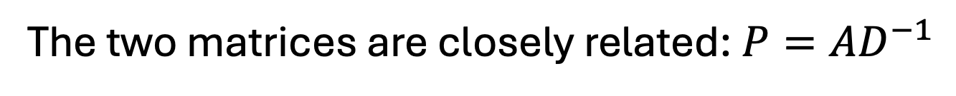
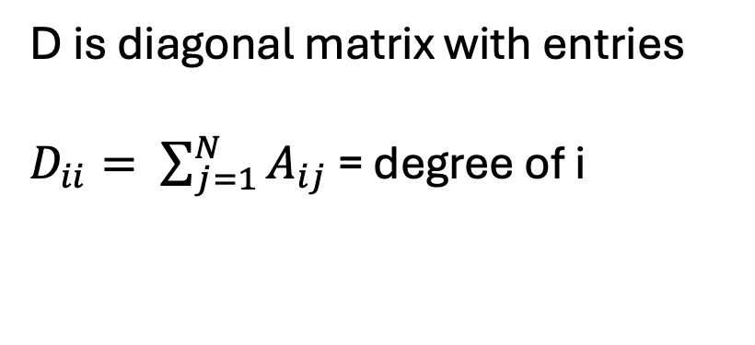
Relation between adjacency and probability transition matrix
2
2
The two matrices are closely related: $P=AD^{−1}$
1
4
1
1
D is diagonal matrix with entries
$D_{ii}= \sum_{j=1}^{N}{A_{ij}}$ = degree of i
1
3
-1
0
1/4
1/2
0
0
1
1
0
2
0
0
0
=
1
0
1
2
0
4
0
0
1/2
0
1/2
1
1
1
0
2
1/2
1/4
0
0
0
0
0
2
0
0
2/4
0
0
0
2
0
0
0
0
0
2
Adjacency matrix A
Degree matrix D
Probability transition matrix P
3

Slide 22
Random walks are efficiently modeled with probability transition matrix [derive on board]
2
2
1
4
1
1
x_{t}
Probability transition matrix P
x_{t-1}
1
3
x_{t+1}(i) = ∑_{j}(Probability of being at node j)*Pr(j->i) =∑_{j}x_{t}(j)*P(i,j) = P x_{t}
x_{t+1} = P*x_{t} = P*P*x_{t-1}= P*P*P*x_{t-2}= …=P^{t} x₀

Slide 23
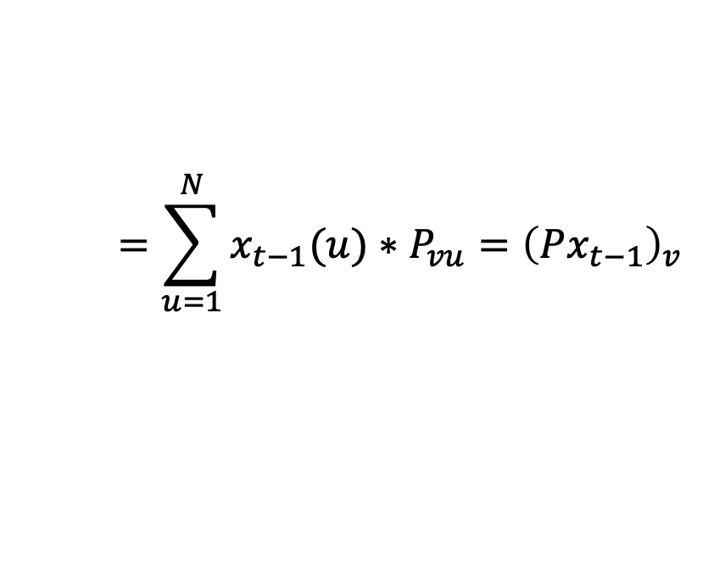
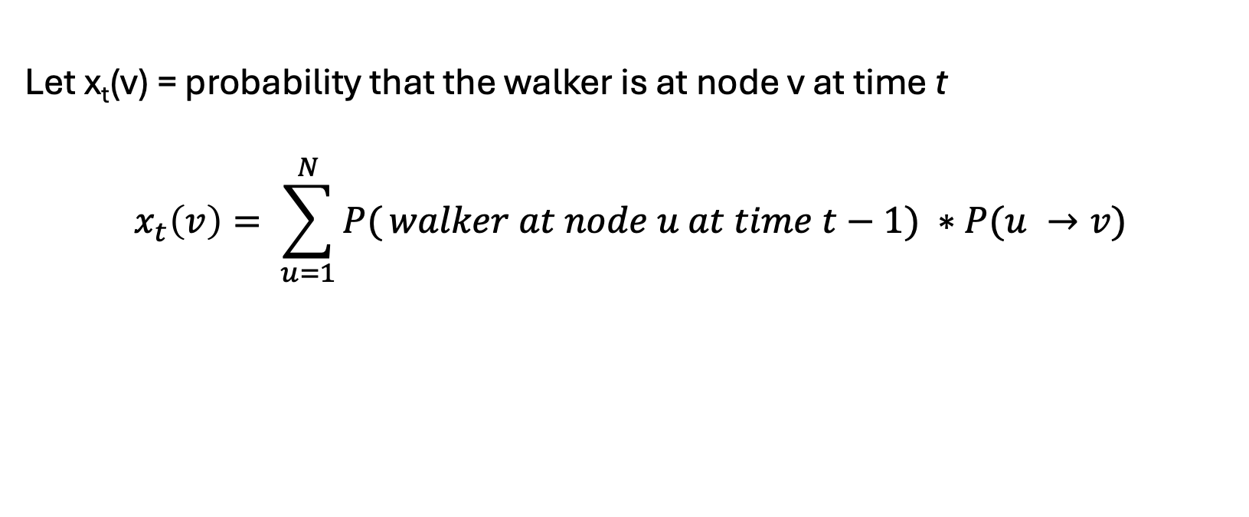

Random walks are efficiently modeled with probability transition matrix [derive on board]
Let x_{t}(v) = probability that the walker is at node v at time t
$$x_{t}\left(v\right)= \sum_{u=1}^{N}{P(}walker at node u at time t−1) ∗P(u →v)$$
$$=\sum_{u=1}^{N}{x_{t−1}(u)}∗P_{vu}={\left(Px_{t−1}\right)}_{v}$$
$$x_{t}=Px_{t−1}$$
2
2
1
4
1
1
=
Probability transition matrix P
x_{t}
x_{t-1}
1
3
x_{t+1}(i) = ∑_{j}(Probability of being at node j)*Pr(j->i) =∑_{j}x_{t}(j)*P(i,j) = P x_{t}
x_{t+1} = P*x_{t} = P*P*x_{t-1}= P*P*P*x_{t-2}= …=P^{t} x₀

Slide 24
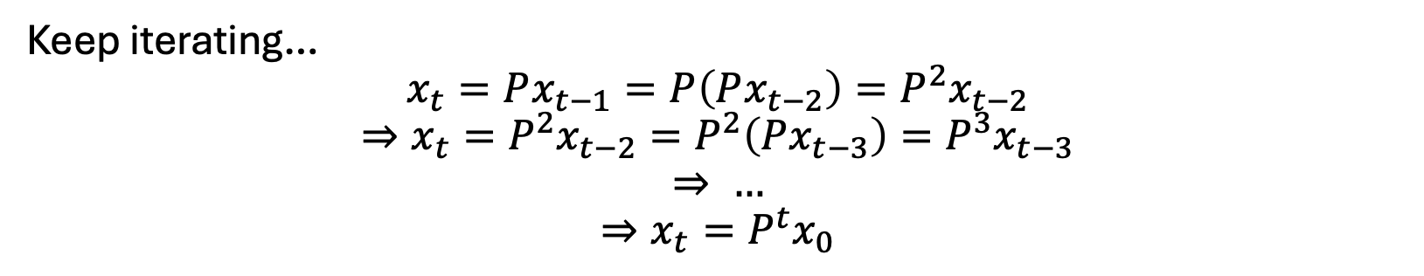
Random walks are efficiently modeled with probability transition matrix [derive on board]
Let x_{t}(v) = probability that the walker is at node v at time t
$$x_{t}\left(v\right)= \sum_{u=1}^{N}{P(}walker at node u at time t−1) ∗P(u →v)$$
$$=\sum_{u=1}^{N}{x_{t−1}(u)}∗P_{vu}={\left(Px_{t−1}\right)}_{v}$$
$$x_{t}=Px_{t−1}$$
Keep iterating…
$$x_{t}=Px_{t−1}=P\left(Px_{t−2}\right)=P^{2}x_{t−2}$$
$$⇒x_{t}=P^{2}x_{t−2}=P^{2}\left(Px_{t−3}\right)=P^{3}x_{t−3}$$
$$⇒ …$$
$$⇒x_{t}=P^{t}x_{0}$$
x0 is initial distribution of where walker starts
x_{t+1}(i) = ∑_{j}(Probability of being at node j)*Pr(j->i) =∑_{j}x_{t}(j)*P(i,j) = P x_{t}
x_{t+1} = P*x_{t} = P*P*x_{t-1}= P*P*P*x_{t-2}= …=P^{t} x₀

Slide 25
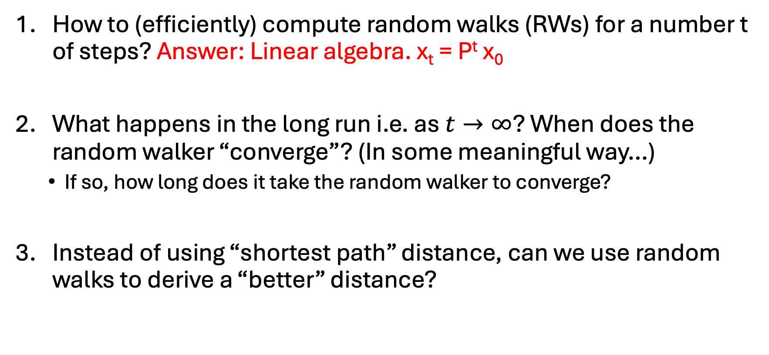
Some natural questions
How to (efficiently) compute random walks (RWs) for a number t of steps? Answer: Linear algebra. x_{t} = P^{t} x₀
What happens in the long run i.e. as $t→∞$? When does the random walker “converge”? (In some meaningful way…)
  If so, how long does it take the random walker to converge?
Instead of using “shortest path” distance, can we use random walks to derive a “better” distance?

Slide 26
Stationary Distribution [derive on board]
What happens when the surfer keeps walking for a long time?
When the surfer keeps walking for a long time
When the distribution does not change anymore
  i.e. x_{T+1} = x_{T}
For “well-behaved” graphs this does not depend on the start distribution!!

Slide 27
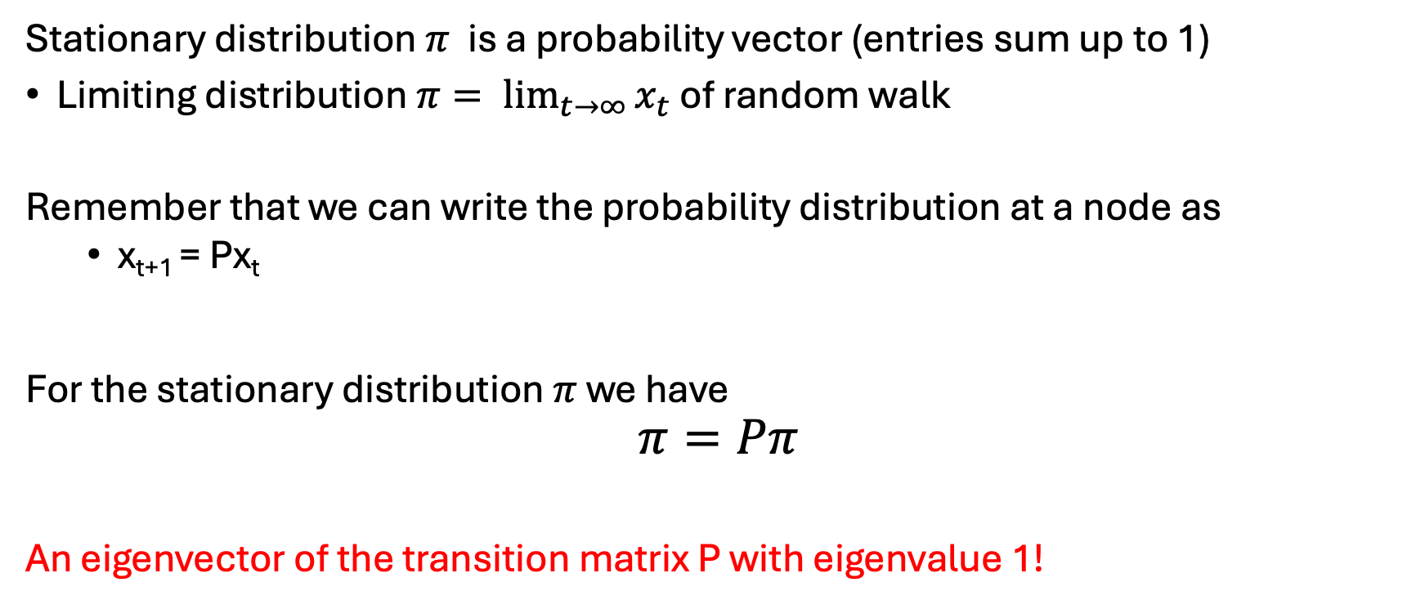
What is a stationary distribution?
Intuitively and Mathematically
Stationary distribution $π$ is a probability vector (entries sum up to 1)
Limiting distribution $π= \lim_{t→∞}{x_{t}}$ of random walk
Remember that we can write the probability distribution at a node as
  x_{t+1} = Px_{t}
For the stationary distribution $π$ we have
$$π=Pπ$$
An eigenvector of the transition matrix P with eigenvalue 1!

Slide 28

When does stationary distribution exist? Perron Frobenius theorem (special case)
Let M be a nonnegative, real, n x n matrix.
Suppose M is irreducible- you cannot permute rows/columns so M has form
where A is k x k submatrix; B is (n-k) x k, etc.
Add pictures

Slide 29
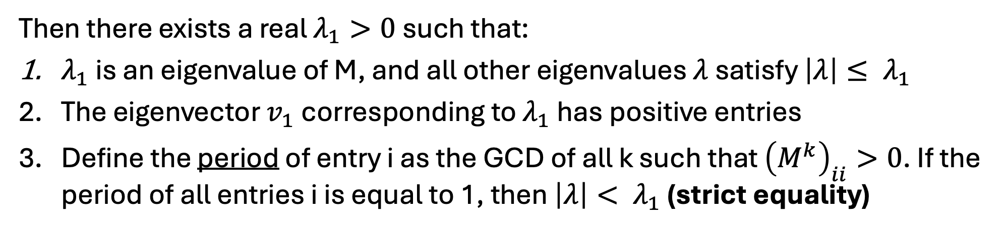
When does stationary distribution exist? Perron Frobenius theorem (special case)
Let M be a nonnegative, real, n x n matrix.
Suppose M is irreducible- you cannot permute rows/columns so M has form
where A is k x k submatrix; B is (n-k) x k, etc.
Add pictures
Then there exists a real $λ_{1}>0$ such that:
$λ_{1}$ is an eigenvalue of M, and all other eigenvalues $λ$ satisfy ${\left|λ\right|≤ λ}_{1}$
The eigenvector $v_{1}$ corresponding to $λ_{1}$ has positive entries
Define the period of entry i as the GCD of all k such that ${\left(M^{k}\right)}_{ii}>0$. If the period of all entries i is equal to 1, then ${\left|λ\right|< λ}_{1}$ (strict equality)

Slide 30
Existence of stationary distribution
Does a stationary distribution always exist? Is it unique?
  Yes, if the graph is…
Connected (i.e. P is irreducible)
Not bipartite (i.e. period of each node is 1)
2
2
Cannot divide up vertices into two groups with edges only between groups (no edges within groups)
4
4
1
1
3
3
✅
❌
Issue: stationary distribution depends on which component you start in
Issue: keep hopping between groups…
❌

Slide 31
Computing stationary distribution for graphs
Board…

Slide 32
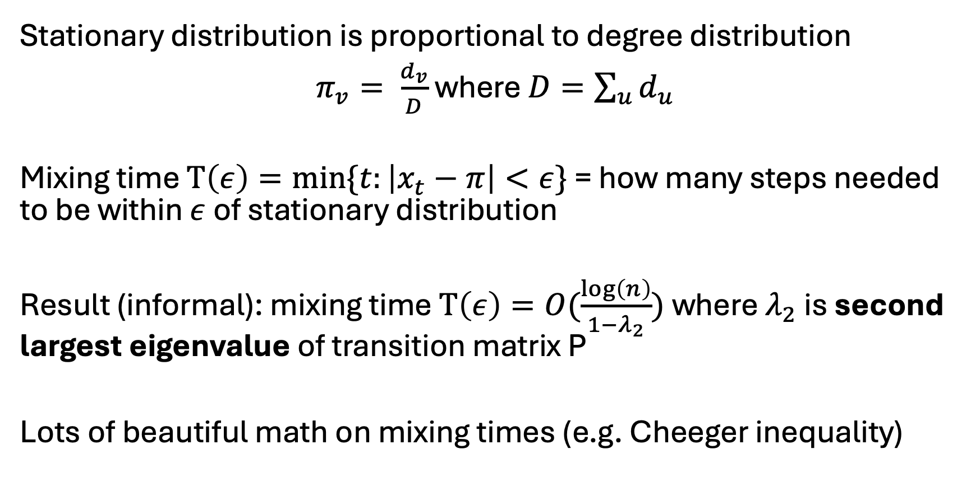
Computing stationary distribution [board]
Stationary distribution is proportional to degree distribution
$π_{v}= \frac{d_{v}}{D}$ where $D=\sum_{u}{d_{u}}$
Mixing time $T\left(ε\right)=min⁡\{t:\left|x_{t}−π\right|<ε\}$ = how many steps needed to be within $ε$of stationary distribution
Result (informal): mixing time $T\left(ε\right)=O(\frac{\log\left(n\right)}{1−λ_{2}})$ where $λ_{2}$ is second largest eigenvalue of transition matrix P
Lots of beautiful math on mixing times (e.g. Cheeger inequality)

Slide 33



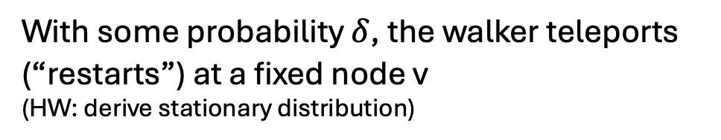






Variants of random walks
Random walk with restart
(Personalized PageRank)
Lazy random walk
With some probability $δ$ that a walker stays at the current node
(HW: a lazy RW always has period 1)
With some probability $δ$, the walker teleports (“restarts”) at a fixed node v
(HW: derive stationary distribution)
2
4
1
2
2
3
4
4
Prob $δ$
1
1
2
4
3
3
1
Prob $1−δ$
3
With probability
Prob $δ$

Slide 34

Random walks on directed graphs (Markov chains)
Vertex 1
Vertex 2
Vertex 3
Vertex 1
Vertex 2
Vertex 3
Vertex 1
1
0
1
Vertex 1
1/2
0
1/4
Vertex 2
1
0
3
Vertex 2
1/2
0
3/4
Will discuss more next class
0
2
0
Vertex 3
0
1
0
Vertex 3
Adjacency matrix A
Entry a_{ij} = weight of edge j->i
Probability transition matrix P
Entry p_{ij} = probability of j->i
2
2
1
1/2
3
3/4
1
2
1
1
1
1
3
1/2
1/4
3

Slide 35
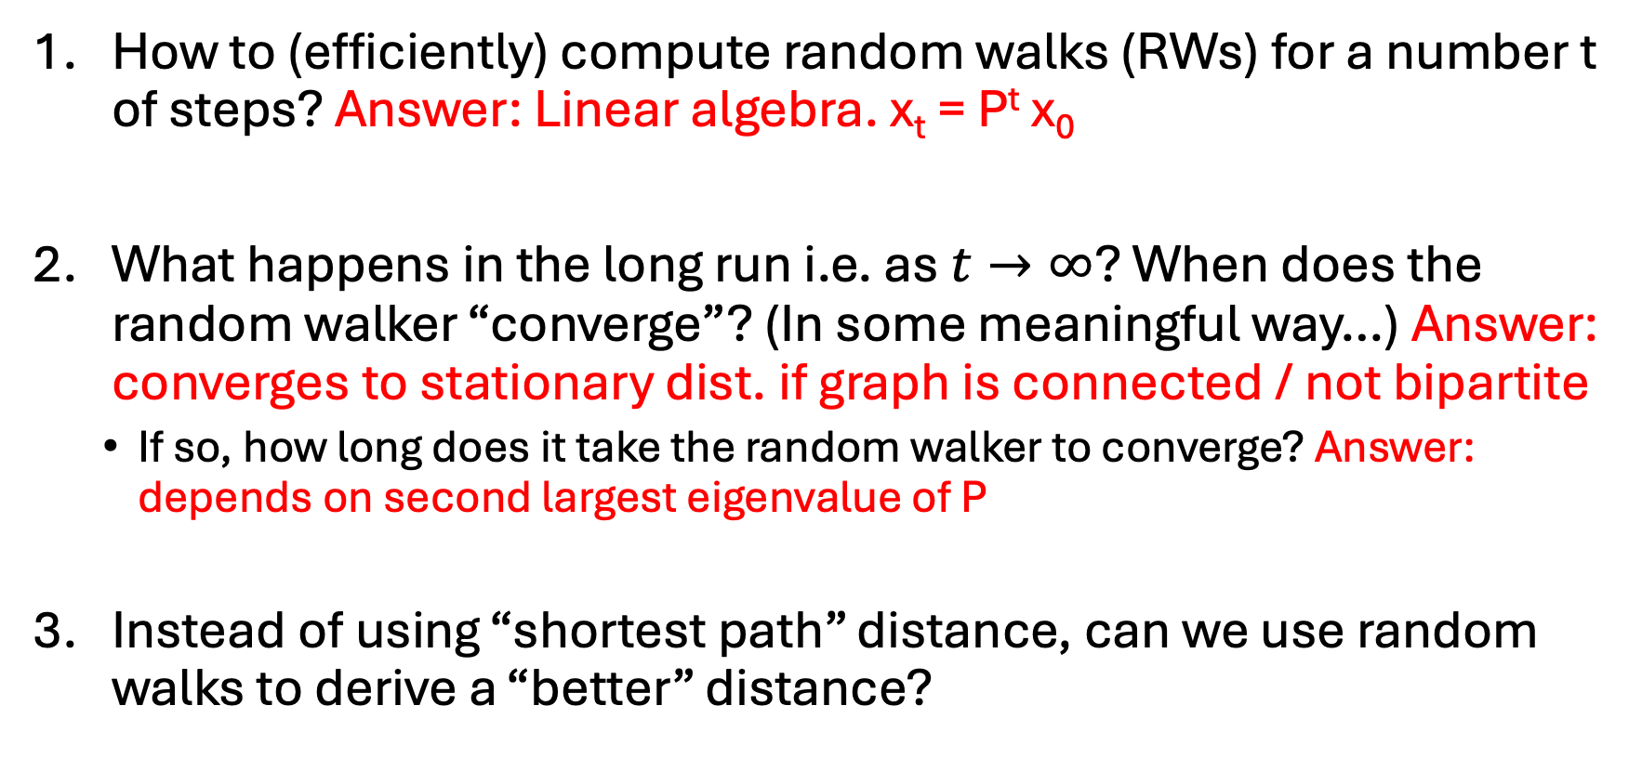
Some natural questions
How to (efficiently) compute random walks (RWs) for a number t of steps? Answer: Linear algebra. x_{t} = P^{t} x₀
What happens in the long run i.e. as $t→∞$? When does the random walker “converge”? (In some meaningful way…) Answer: converges to stationary dist. if graph is connected / not bipartite
  If so, how long does it take the random walker to converge? Answer: depends on second largest eigenvalue of P
Instead of using “shortest path” distance, can we use random walks to derive a “better” distance?

Slide 36

Deriving a random walk-based distance
If you start a random walk at A, after t steps you will likely be in the left side
A
B
Column of P^{t} corresponding to vertex A
Describes distribution of where walker is after t steps

Slide 37
Deriving a random walk-based distance
If you start a random walk at A, after t steps you will likely be in the left side
A
B
If you start a random walk at B, after t steps you will likely be in the right side
Column of P^{t} corresponding to vertex B
Column of P^{t} corresponding to vertex A

Slide 38
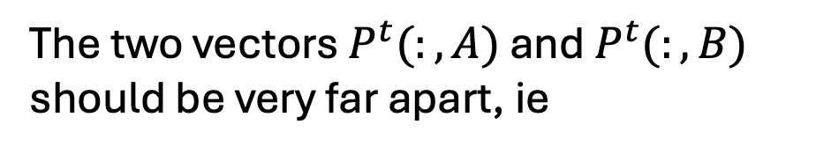

Deriving a random walk-based distance
If you start a random walk at A, after t steps you will likely be in the left side
A
B
If you start a random walk at A, after t steps you will likely be in the right side
The two vectors $P^{t}(:,A)$ and $P^{t}(:,B)$ should be very far apart, ie
$$\left| P^{t}\left(:,A\right)−P^{t}\left(:,B\right)\right|≫0$$

Slide 39
Deriving a random walk-based distance
If you start a random walk at A, after t steps you will likely be in the left side
A
B
If you start a random walk at A, after t steps you will likely be in the right side
The two vectors $P^{t}(:,A)$ and $P^{t}(:,B)$ should be very far apart, ie
$$\left| P^{t}\left(:,A\right)−P^{t}\left(:,B\right)\right|≫0$$

Slide 40
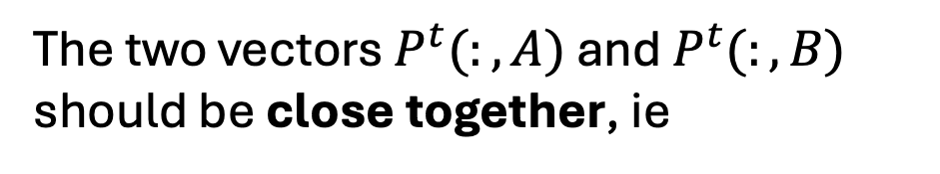

Deriving a random walk-based distance
B
A
If you start a random walk at A or B, after t steps you will likely be at the same vertices (middle)
This is because there are many paths between A <--> B
The two vectors $P^{t}(:,A)$ and $P^{t}(:,B)$ should be close together, ie
$$\left| P^{t}\left(:,A\right)−P^{t}\left(:,B\right)\right|≈0$$

Slide 41
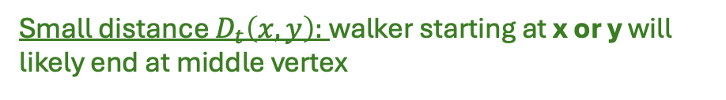
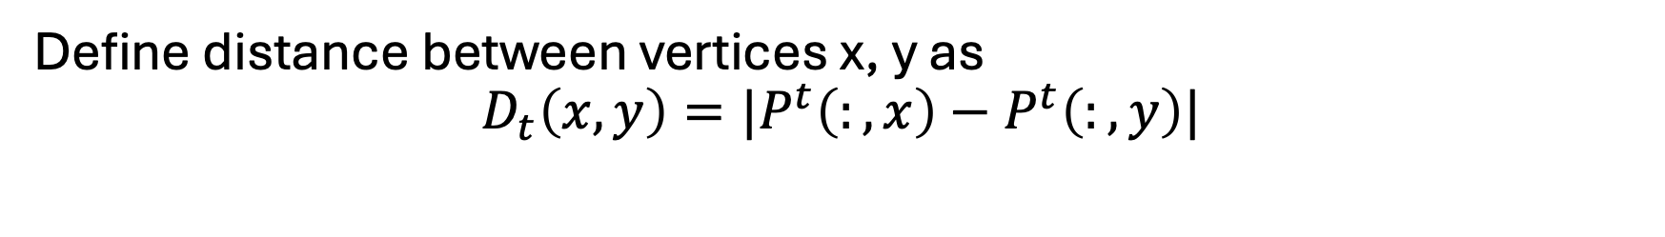
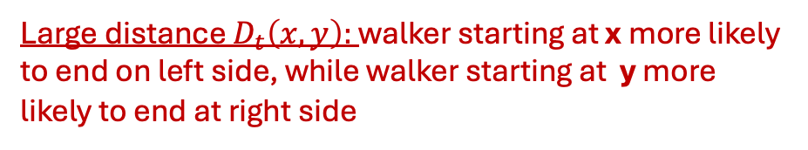
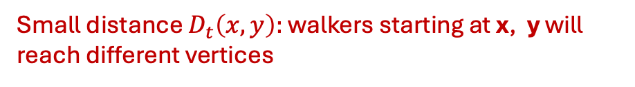
Diffusion maps: a random walk based distance
Define distance between vertices x, y as
$$D_{t}\left(x,y\right)=|P^{t}\left(:,x\right)−P^{t}\left(:,y\right)|$$
Big idea: Probability transition matrix P^{t} models all length-t paths
Vertices x,y are close if a walker starting at either x or y will end up at same vertices in length-t path
Large distance $D_{t}\left(x,y\right):$ walker starting at x more likely to end on left side, while walker starting at y more likely to end at right side
Small distance $D_{t}\left(x,y\right):$ walker starting at x or y will likely end at middle vertex
x
y
x
y
Small distance $D_{t}\left(x,y\right):$ walkers starting at x, y will reach different vertices

Slide 42
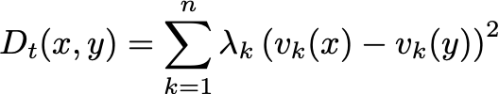

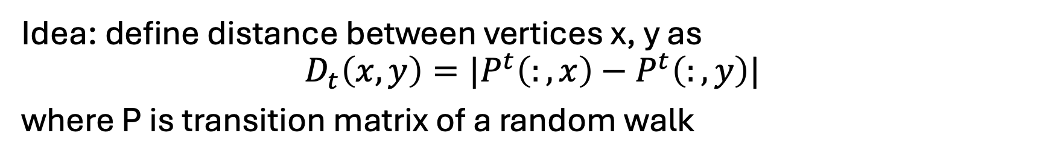

Diffusion maps
Idea: define distance between vertices x, y as
$$D_{t}\left(x,y\right)=|P^{t}\left(:,x\right)−P^{t}\left(:,y\right)|$$
where P is transition matrix of a random walk
It turns out [homework] that you can equivalently define the diffusion distance as
2t
where $λ_{k}, v_{k}$ are k-th eigenvalue, eigenvector (resp.) of P

Slide 43
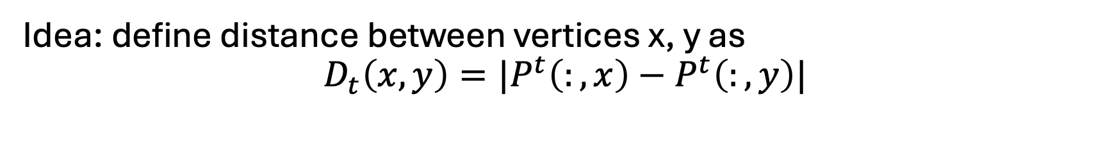
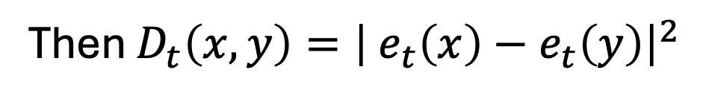
Diffusion maps
Idea: define distance between vertices x, y as
$$D_{t}\left(x,y\right)=|P^{t}\left(:,x\right)−P^{t}\left(:,y\right)|$$
If you define embedding $e(x)$ of each vertex x as
Then $D_{t}\left(x,y\right)={\left| e_{t}\left(x\right)−e_{t}\left(y\right)\right|}^{2}$
[Homework]
Also suggests a natural way to embed vertices of graph!

Slide 44
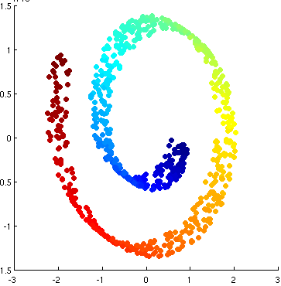


Diffusion maps embedding on “swiss roll”
Diffusion maps first two components
$${\left(e_{t}\right)}_{1}$$
$${\left(e_{t}\right)}_{0}$$

Slide 45
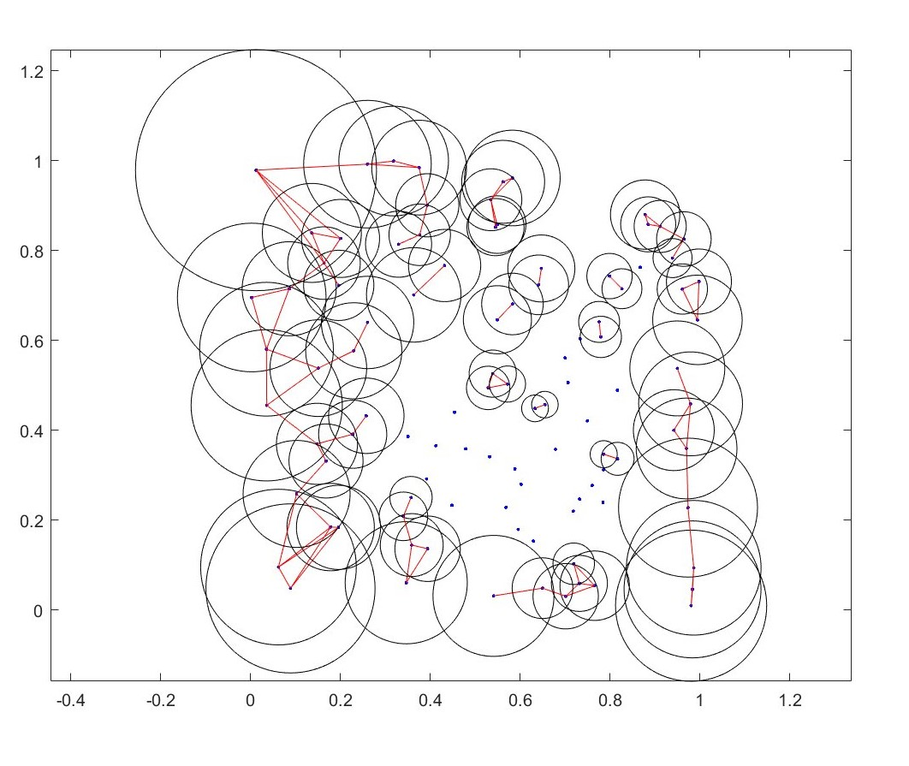
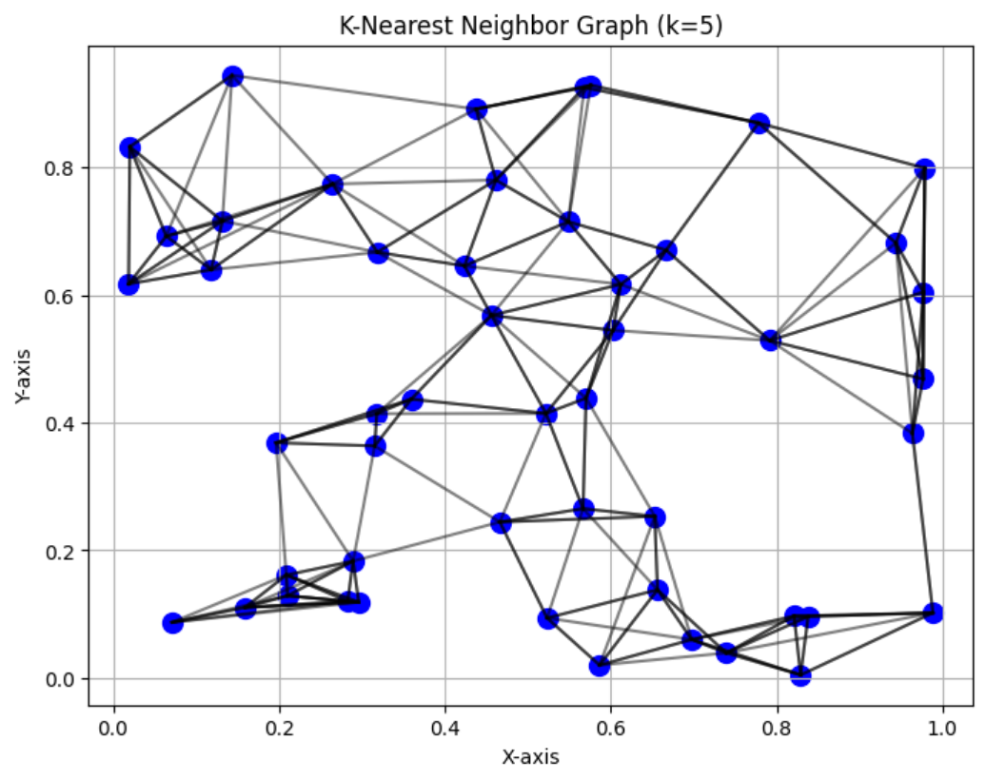
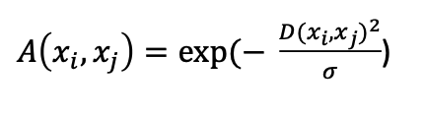
Now, how is this all useful for single cell data?
ε-ball graph
Draw an edge between vertex v and all vertices w within distance ε
k-NN (k nearest neighbors) graph
Draw an edge between vertex v and its k nearest neighbors
For single cell data, distance btwn cells x_{i}, x_{j} typically defined using an “affinity function” / “similarity function”
e.g. Gaussian kernel function

Slide 46
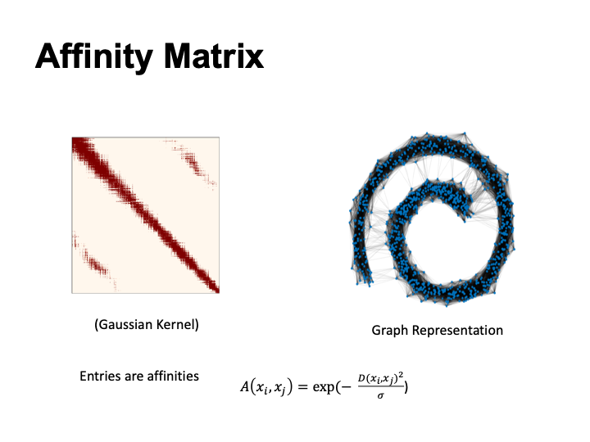

Slide 47

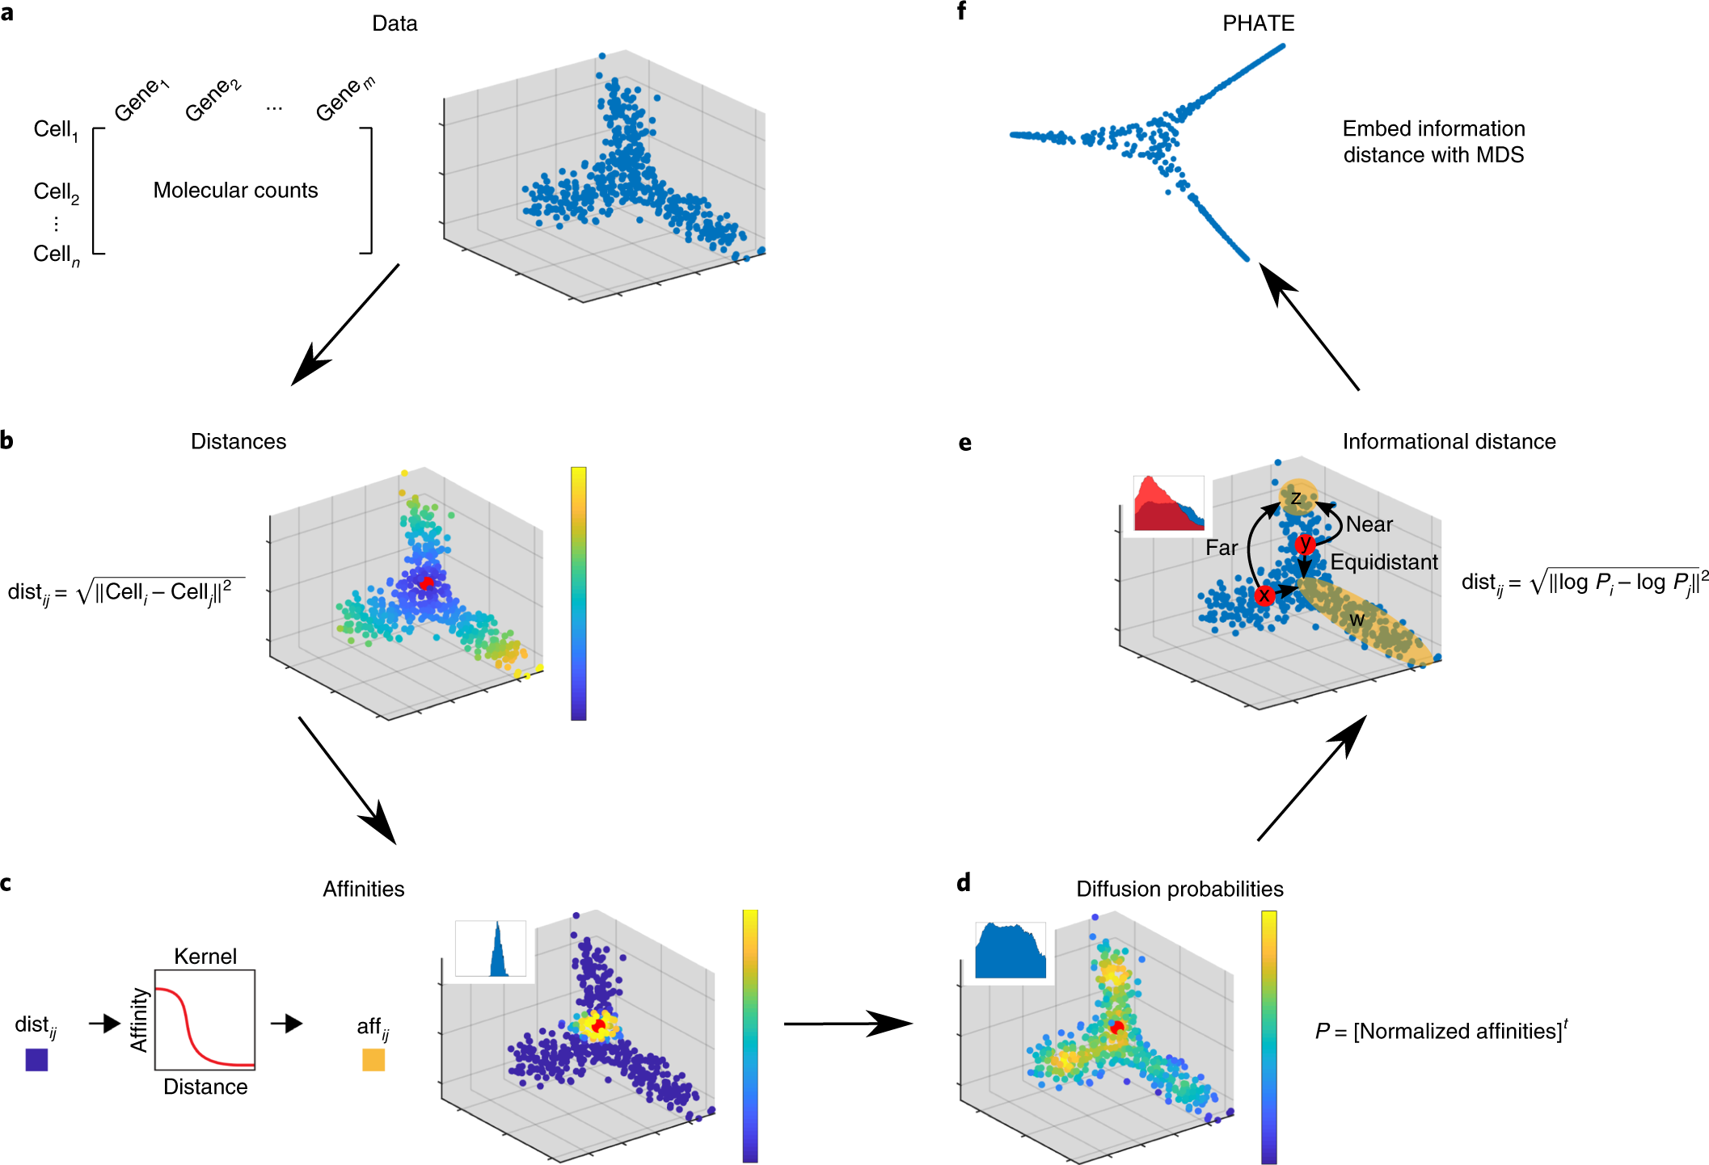
PHATE: uses diffusion maps distance + MDS
Commonly used / highly cited method for dimensionality reduction

Slide 48
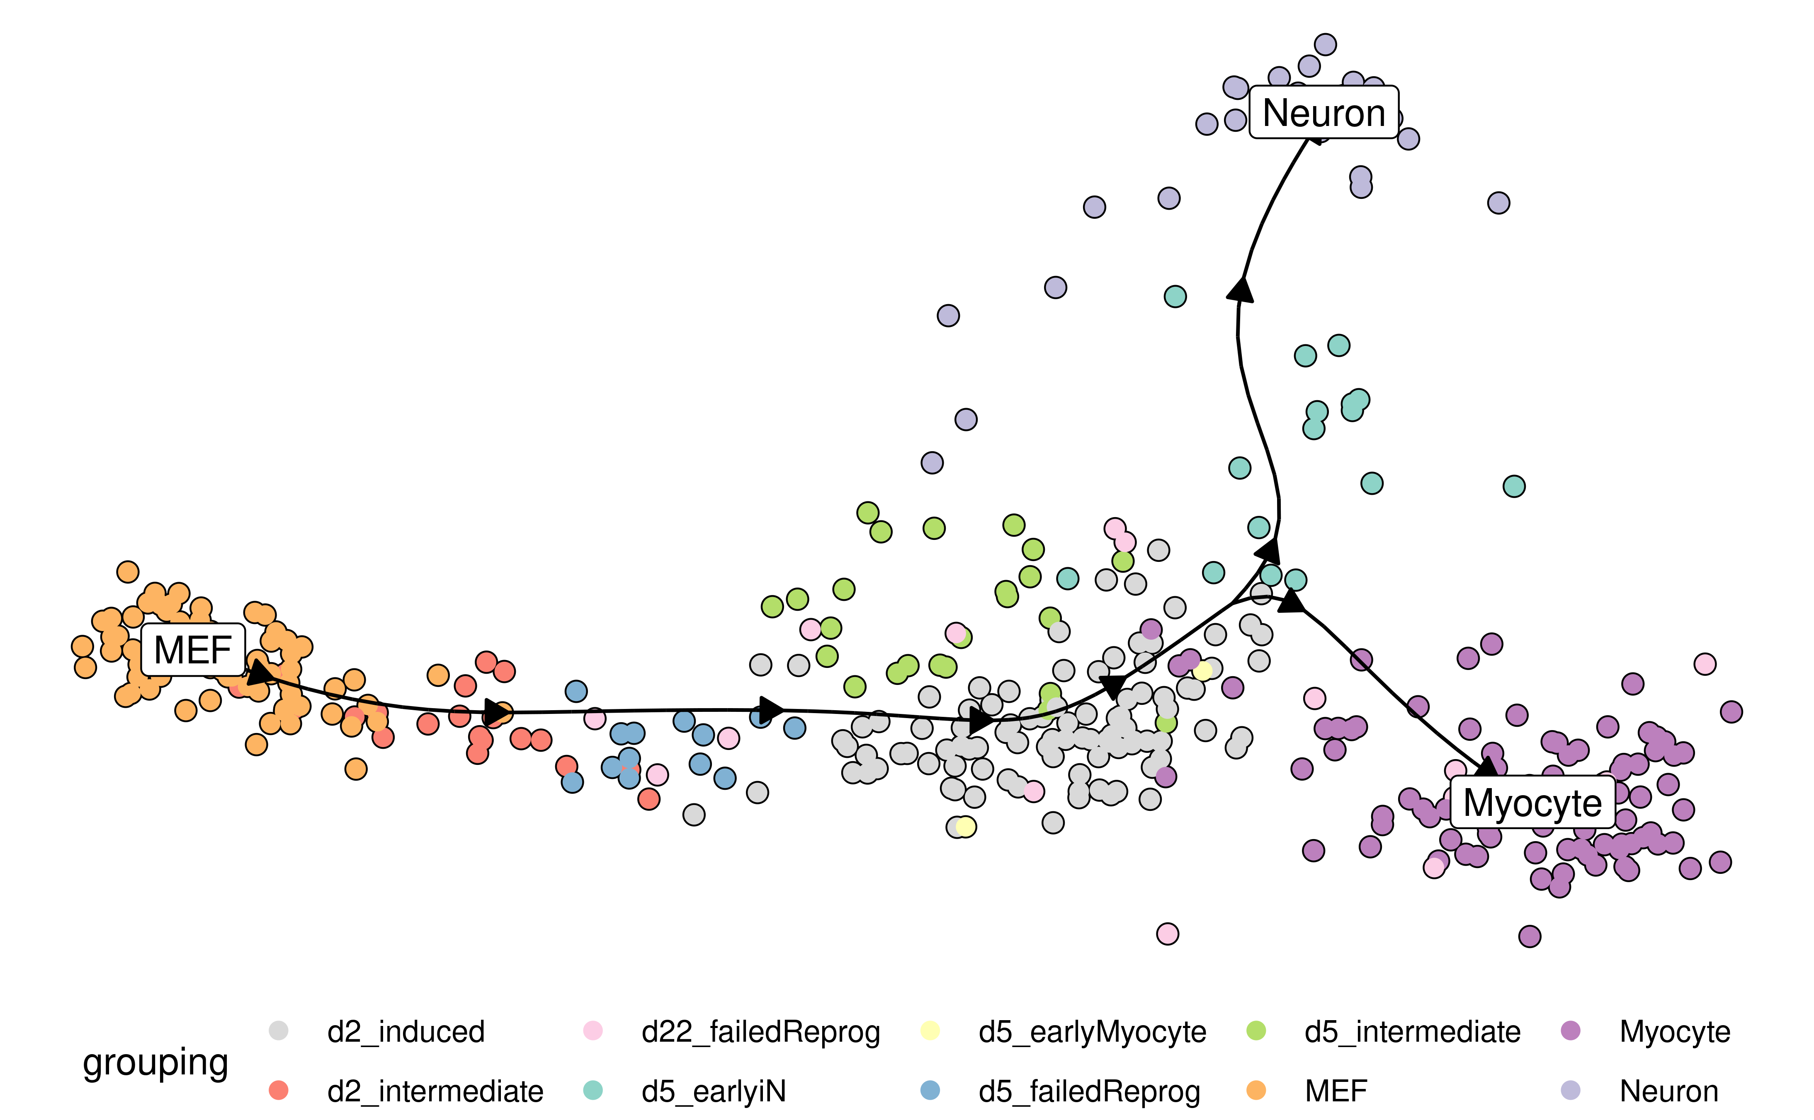
Trajectory inference: learning temporal ordering of cells in a single cell dataset
Even though you measure cells at same time…
different cells may be at different developmental stages
Goal: reconstruct relative temporal ordering of cells

Slide 49
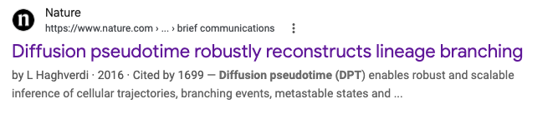
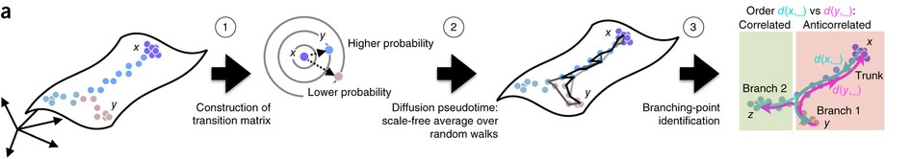
Popular TI methods use diffusion
Uses diffusion maps metric

Slide 50
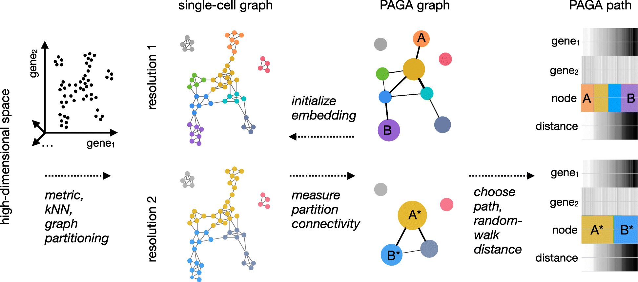

Popular TI methods use diffusion
Uses diffusion maps metric

Slide 51
PAGA (partition-based graph abstraction)

Slide 52
Next time
t-SNE/UMAP
Markov chains + more trajectory inference

