Slide 1
Data visualization + trajectory inference
Uthsav Chitra

Slide 2
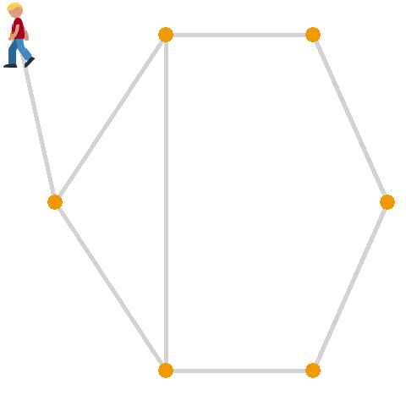


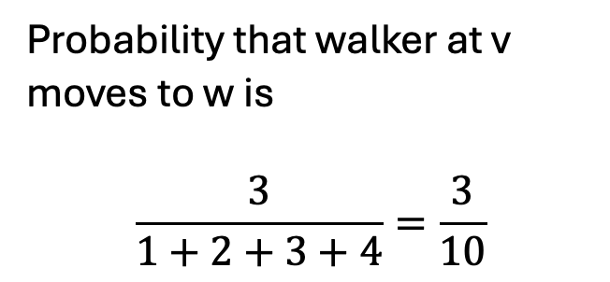
Last time: random walks on a graph
Imagine a “walker” moving between vertices
Step 0: walker at vertex v
Step 1: moves to vertex w with probability proportional to edge weight e_{vw}
Step 2: repeat…
Probability that walker at v moves to w is
$$\frac{3}{1+2+3+4}=\frac{3}{10}$$

Slide 3

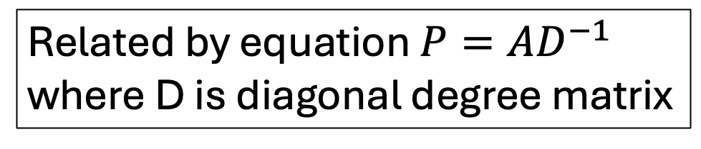
Definitions
Vertex 1
Vertex 2
Vertex 3
Vertex 4
0
1
1
0
Vertex 1
0
1/4
1/2
0
1
0
1
2
Vertex 2
1/2
0
1/2
1
Entry P_{ij} is probability of going from vertex j -> vertex i
1
1
0
0
Vertex 3
1/2
1/4
0
0
0
2
0
0
Vertex 4
0
2/4
0
0
Adjacency matrix A
Probability transition matrix P
2
2
Related by equation $P=AD^{−1}$
where D is diagonal degree matrix
1
4
1
1
1
3

Slide 4
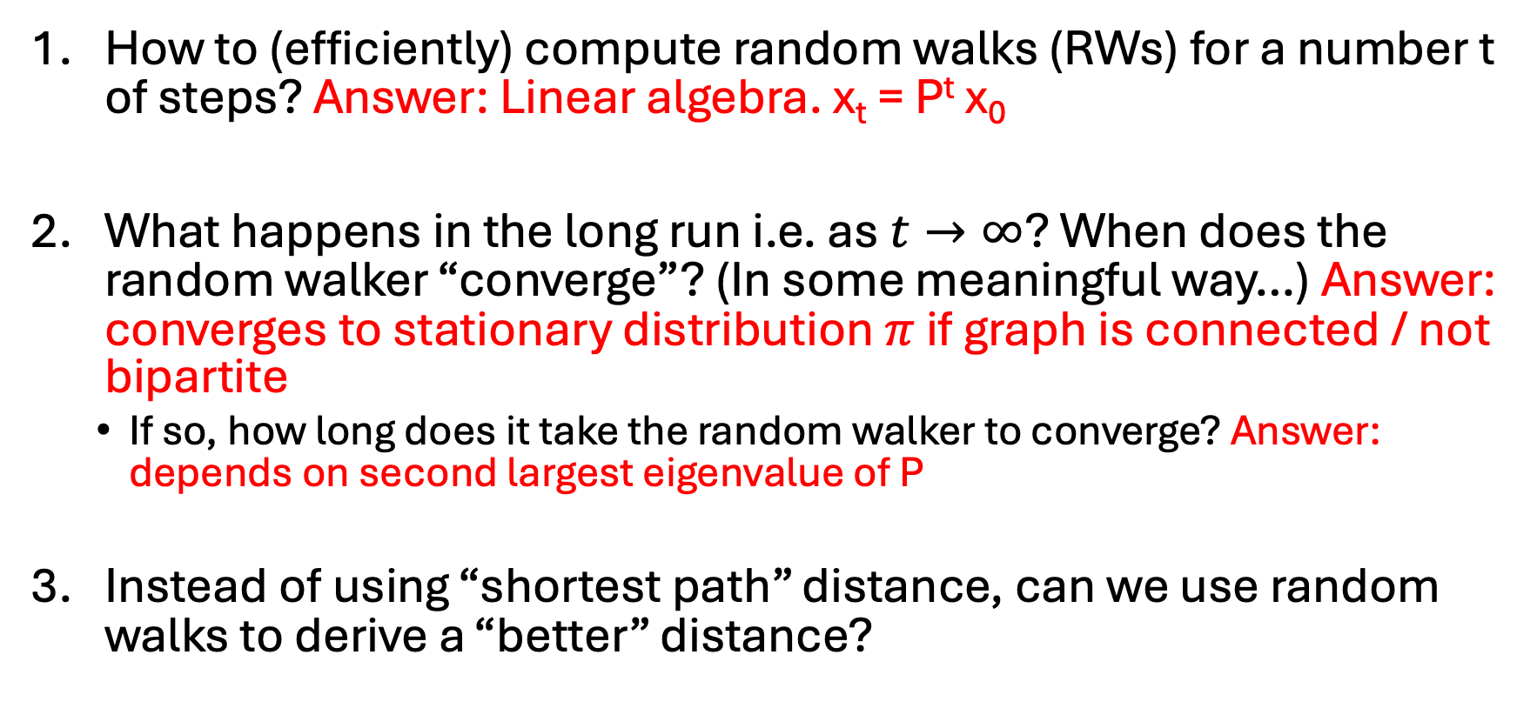
Some natural questions
How to (efficiently) compute random walks (RWs) for a number t of steps? Answer: Linear algebra. x_{t} = P^{t} x₀
What happens in the long run i.e. as $t→∞$? When does the random walker “converge”? (In some meaningful way…) Answer: converges to stationary distribution $π$ if graph is connected / not bipartite
  If so, how long does it take the random walker to converge? Answer: depends on second largest eigenvalue of P
Instead of using “shortest path” distance, can we use random walks to derive a “better” distance?

Slide 5
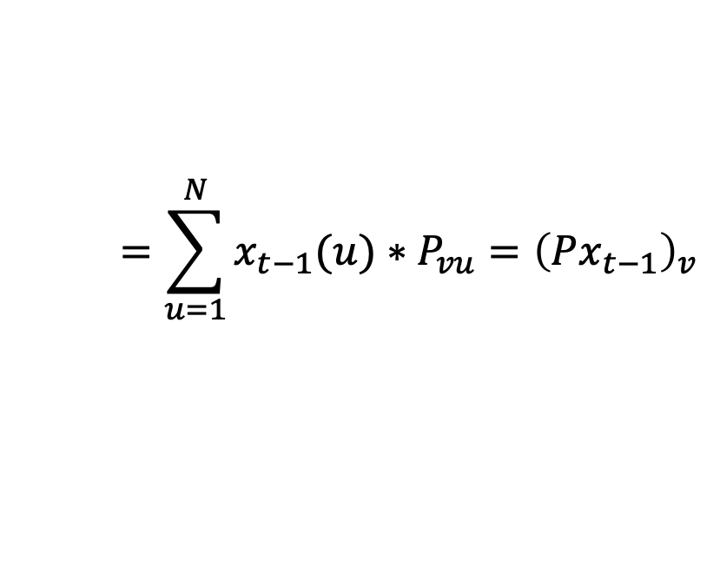
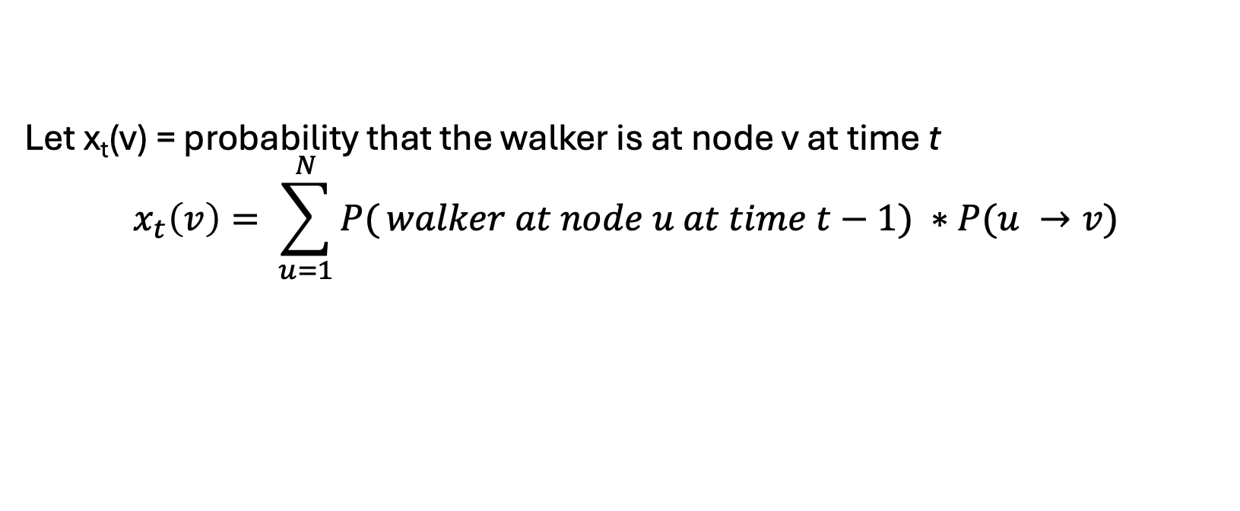


Random walks are efficiently modeled with probability transition matrix
Let x_{t}(v) = probability that the walker is at node v at time t
$$x_{t}\left(v\right)= \sum_{u=1}^{N}{P(}walker at node u at time t−1) ∗P(u →v)$$
x₀ is initial distribution of where walker starts
$$=\sum_{u=1}^{N}{x_{t−1}(u)}∗P_{vu}={\left(Px_{t−1}\right)}_{v}$$
$$x_{t}=Px_{t−1}$$
$$x_{t}=P^{t}x_{0}$$
t
Key idea: Probability transition matrix P^{t} models all possible paths of length t
not just shortest path
=
Probability transition matrix P
x_{t}
x₀
x_{t+1}(i) = ∑_{j}(Probability of being at node j)*Pr(j->i) =∑_{j}x_{t}(j)*P(i,j) = P x_{t}
x_{t+1} = P*x_{t} = P*P*x_{t-1}= P*P*P*x_{t-2}= …=P^{t} x₀

Slide 6
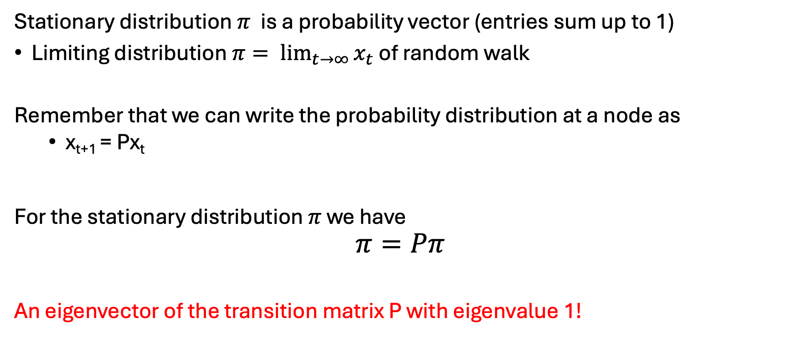
What is a stationary distribution?
Intuitively and Mathematically
Stationary distribution $π$ is a probability vector (entries sum up to 1)
Limiting distribution $π= \lim_{t→∞}{x_{t}}$ of random walk
Remember that we can write the probability distribution at a node as
  x_{t+1} = Px_{t}
For the stationary distribution $π$ we have
$$π=Pπ$$
An eigenvector of the transition matrix P with eigenvalue 1!

Slide 7
Existence of stationary distribution
Does a stationary distribution always exist? Is it unique?
  Yes, if the graph is…
Connected (i.e. P is irreducible)
Not bipartite (i.e. period of each node is 1)
2
2
Cannot divide up vertices into two groups with edges only between groups (no edges within groups)
4
4
1
1
3
3
✅
❌
Issue: stationary distribution depends on which component you start in
Issue: keep hopping between groups…
❌

Slide 8
Today / next class
Diffusion maps
Modern embedding methods: t-SNE/UMAP
Markov chains (random walks on directed graphs)
Trajectory inference

Slide 9











Deriving a random walk-based distance
If you start a random walk at A, after t steps you will likely be in the left side
A
B
Column of P^{t} corresponding to vertex A
Describes distribution of where walker is after t steps

Slide 10
Deriving a random walk-based distance
If you start a random walk at A, after t steps you will likely be in the left side
A
B
If you start a random walk at B, after t steps you will likely be in the right side
Column of P^{t} corresponding to vertex B
Column of P^{t} corresponding to vertex A

Slide 11
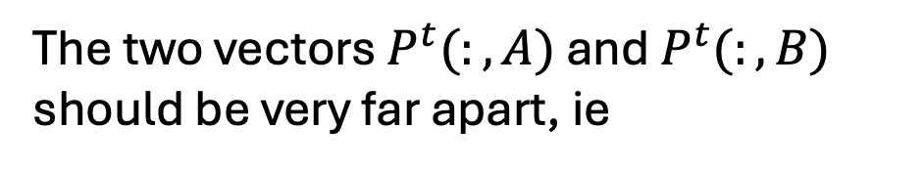

Deriving a random walk-based distance
If you start a random walk at A, after t steps you will likely be in the left side
A
B
If you start a random walk at A, after t steps you will likely be in the right side
The two vectors $P^{t}(:,A)$ and $P^{t}(:,B)$ should be very far apart, ie
$$\left| P^{t}\left(:,A\right)−P^{t}\left(:,B\right)\right|≫0$$

Slide 12
Deriving a random walk-based distance
If you start a random walk at A, after t steps you will likely be in the left side
A
B
If you start a random walk at A, after t steps you will likely be in the right side
The two vectors $P^{t}(:,A)$ and $P^{t}(:,B)$ should be very far apart, ie
$$\left| P^{t}\left(:,A\right)−P^{t}\left(:,B\right)\right|≫0$$

Slide 13


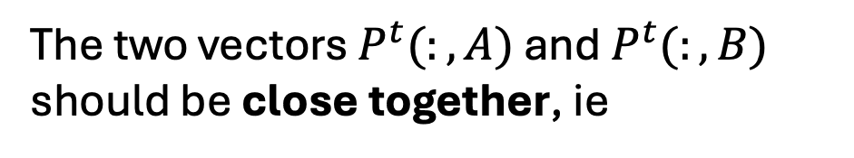







Deriving a random walk-based distance
B
A
If you start a random walk at A or B, after t steps you will likely be at the same vertices (middle)
This is because there are many paths between A <--> B
The two vectors $P^{t}(:,A)$ and $P^{t}(:,B)$ should be close together, ie
$$\left| P^{t}\left(:,A\right)−P^{t}\left(:,B\right)\right|≈0$$

Slide 14
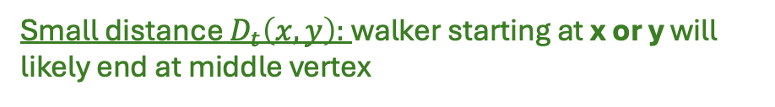
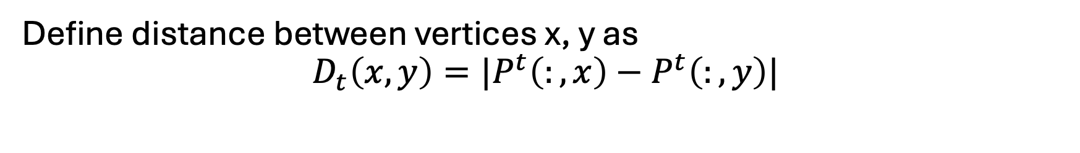
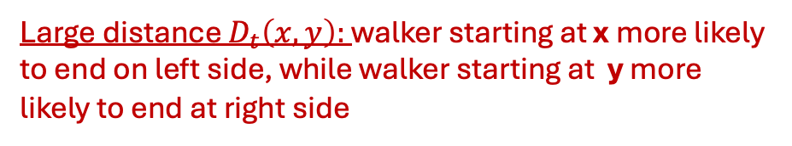
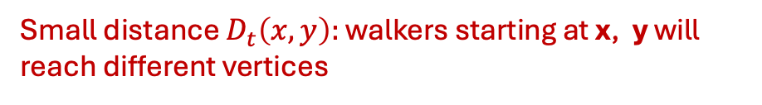
Diffusion maps: a random walk based distance
Define distance between vertices x, y as
$$D_{t}\left(x,y\right)=|P^{t}\left(:,x\right)−P^{t}\left(:,y\right)|$$
Big idea: Probability transition matrix P^{t} models all length-t paths
Vertices x,y are close if a walker starting at either x or y will end up at same vertices in length-t path
Large distance $D_{t}\left(x,y\right):$ walker starting at x more likely to end on left side, while walker starting at y more likely to end at right side
Small distance $D_{t}\left(x,y\right):$ walker starting at x or y will likely end at middle vertex
x
y
x
y
Small distance $D_{t}\left(x,y\right):$ walkers starting at x, y will reach different vertices

Slide 15
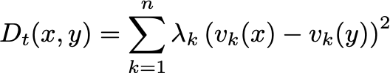

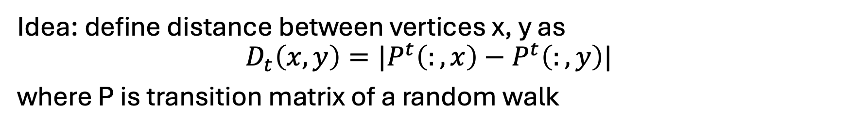

Diffusion maps
Idea: define distance between vertices x, y as
$$D_{t}\left(x,y\right)=|P^{t}\left(:,x\right)−P^{t}\left(:,y\right)|$$
where P is transition matrix of a random walk
It turns out [homework] that you can equivalently define the diffusion distance as
2t
where $λ_{k}, v_{k}$ are k-th eigenvalue, eigenvector (resp.) of P

Slide 16
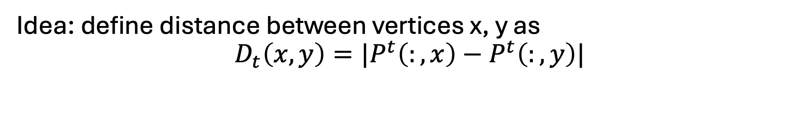
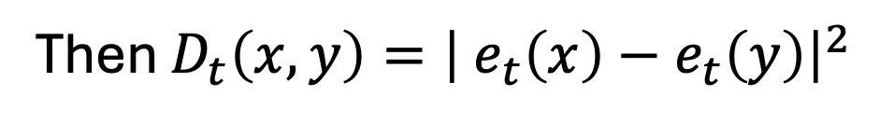
Diffusion maps
Idea: define distance between vertices x, y as
$$D_{t}\left(x,y\right)=|P^{t}\left(:,x\right)−P^{t}\left(:,y\right)|$$
If you define embedding $e(x)$ of each vertex x as
Then $D_{t}\left(x,y\right)={\left| e_{t}\left(x\right)−e_{t}\left(y\right)\right|}^{2}$
[Homework]
Also suggests a natural way to embed vertices of graph!

Slide 17
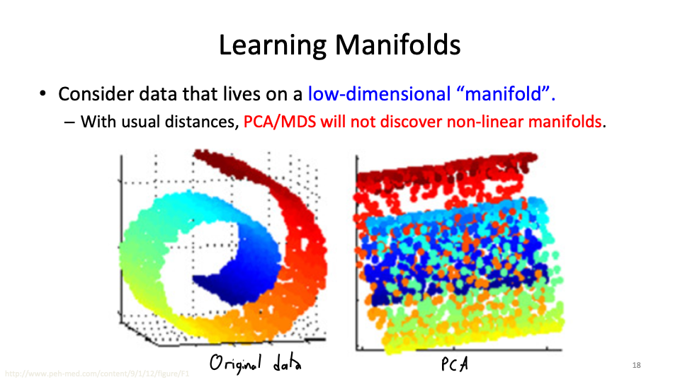
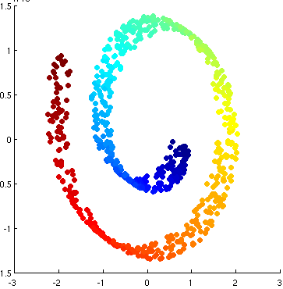


Diffusion maps embedding on “swiss roll”
Diffusion maps first two components
$${\left(e_{t}\right)}_{1}$$
$${\left(e_{t}\right)}_{0}$$

Slide 18
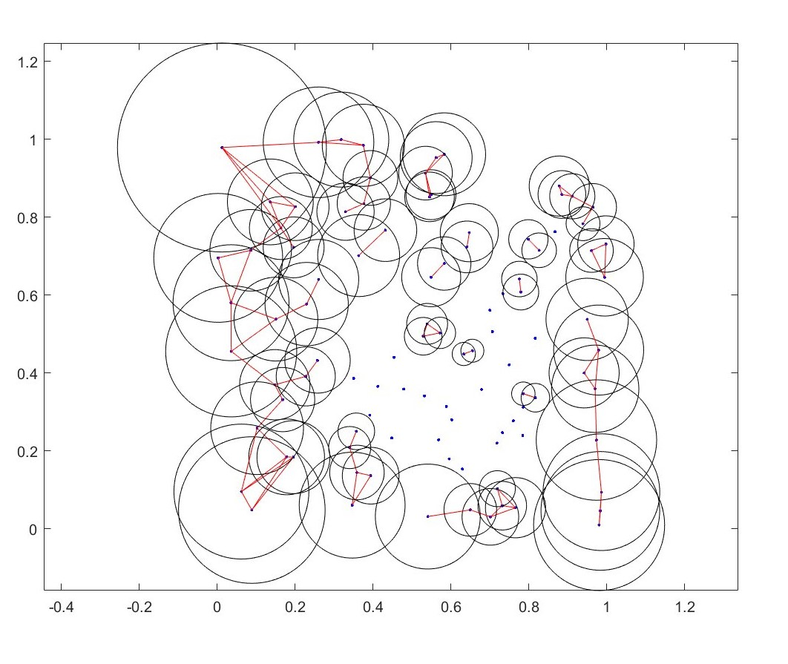
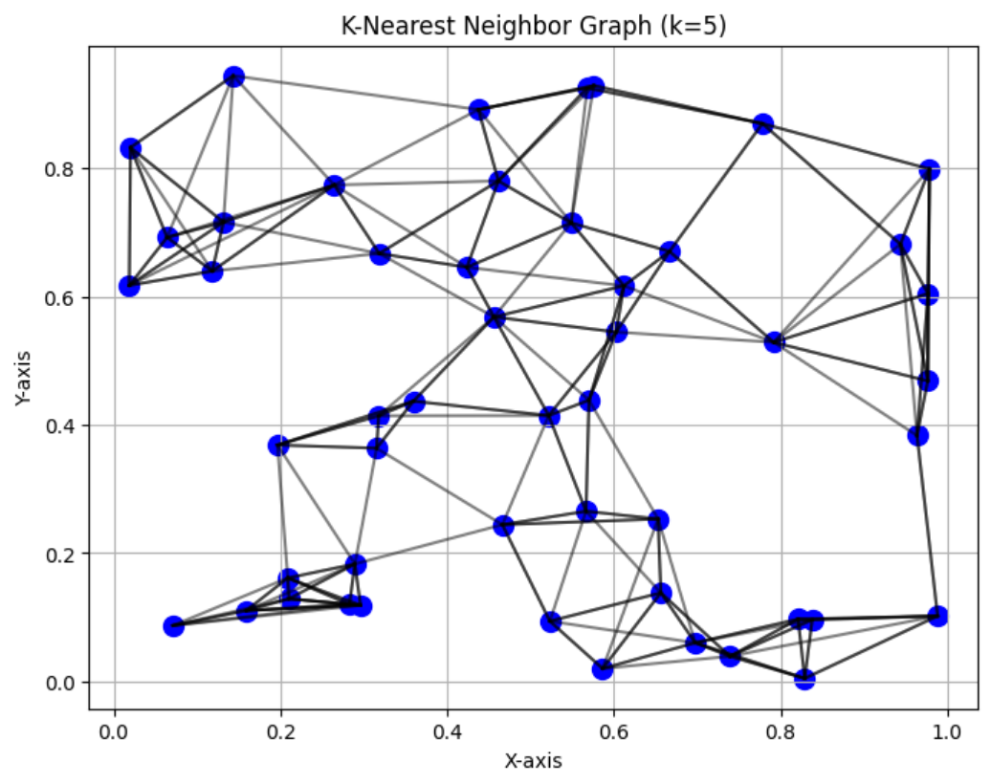
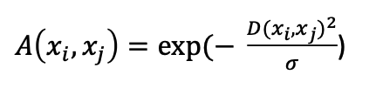
Now, how is this all useful for single cell data?
ε-ball graph
Draw an edge between vertex v and all vertices w within distance ε
k-NN (k nearest neighbors) graph
Draw an edge between vertex v and its k nearest neighbors
For single cell data, distance btwn cells x_{i}, x_{j} typically defined using an “affinity function” / “similarity function”
e.g. Gaussian kernel function

Slide 19
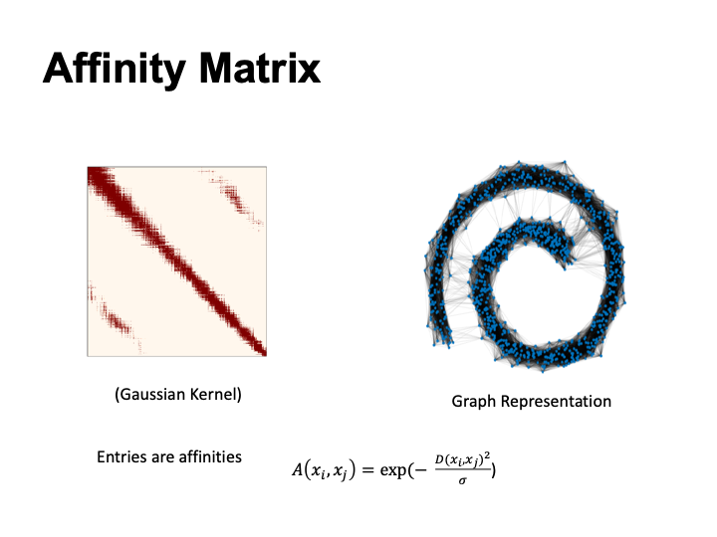

Slide 20

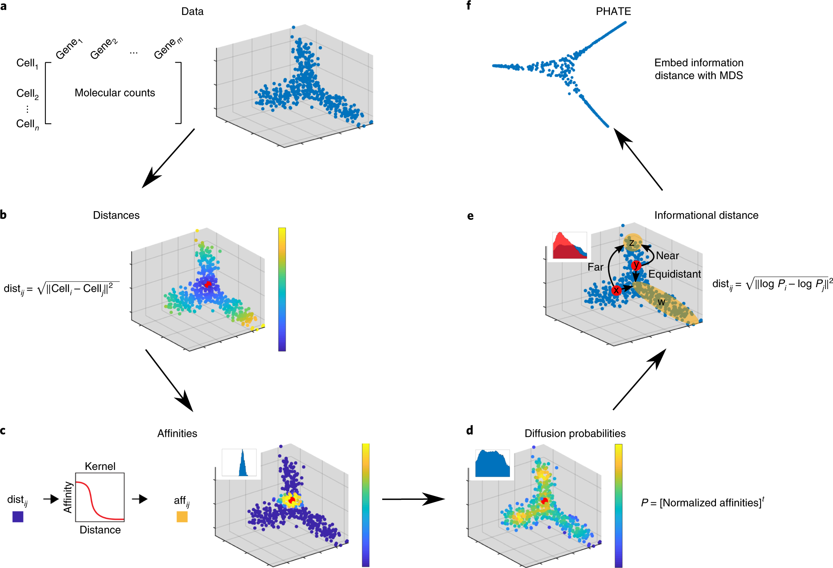
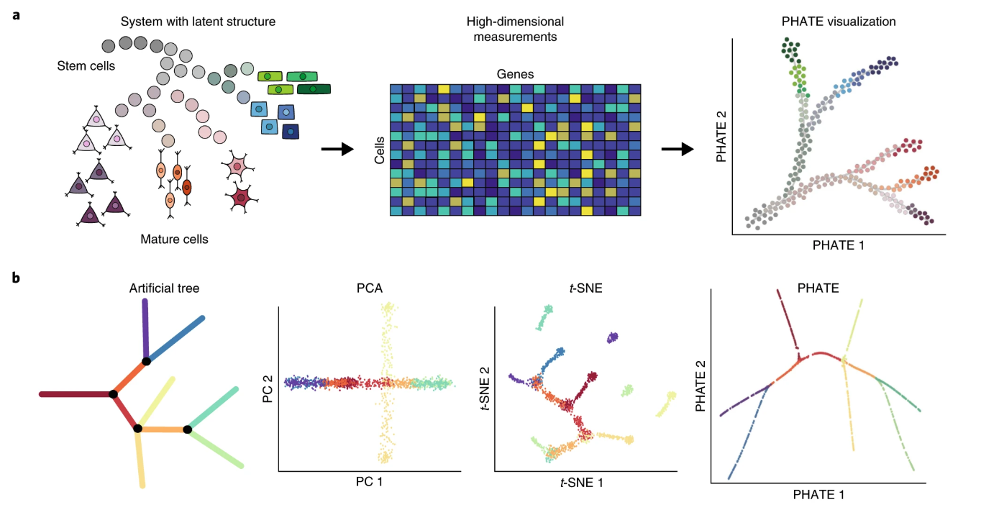
PHATE: uses diffusion maps distance + MDS
Commonly used / highly cited method for dimensionality reduction

Slide 21
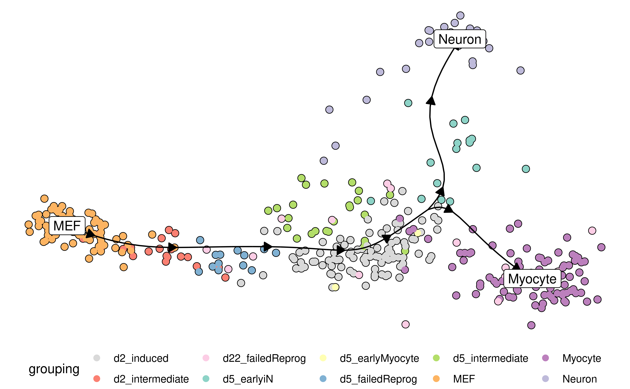
Trajectory inference: learning temporal ordering of cells in a single cell dataset
Even though you measure cells at same time…
different cells may be at different developmental stages
Goal: reconstruct relative temporal ordering of cells

Slide 22
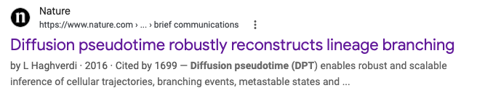
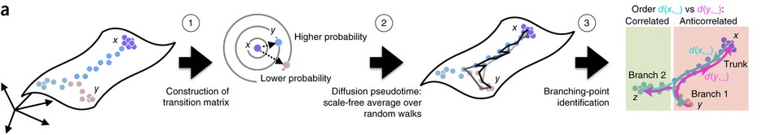
Popular TI methods use diffusion
Uses diffusion maps metric

Slide 23
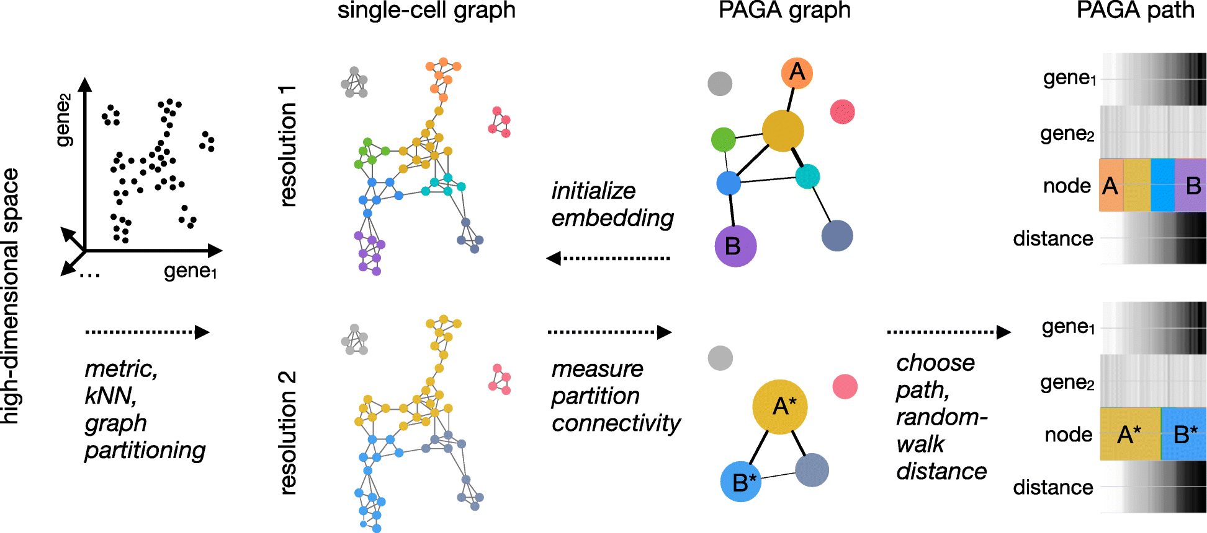

Popular TI methods use diffusion
Uses diffusion maps metric

Slide 24
PAGA (partition-based graph abstraction)

Slide 25


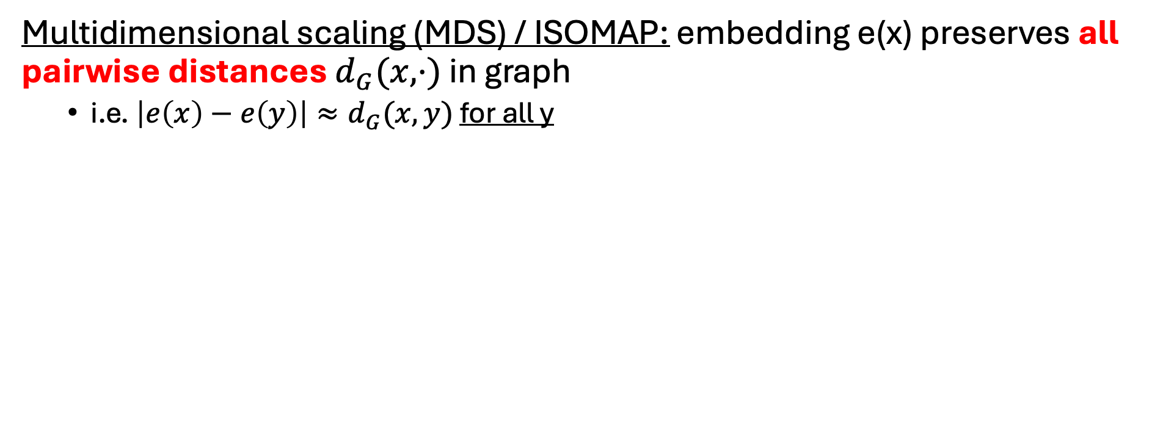


Next: modern embedding methods
x
Multidimensional scaling (MDS) / ISOMAP: embedding e(x) preserves all pairwise distances $d_{G}(x, ⋅)$ in graph
  i.e. $\left|e\left(x\right)−e\left(y\right)\right|≈d_{G}(x, y)$ for all y

Slide 26
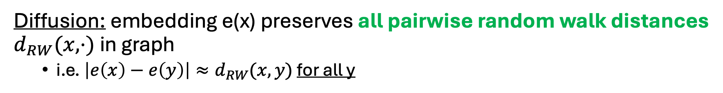
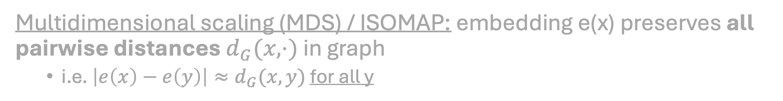




Next: modern embedding methods
x
Multidimensional scaling (MDS) / ISOMAP: embedding e(x) preserves all pairwise distances $d_{G}(x, ⋅)$ in graph
  i.e. $\left|e\left(x\right)−e\left(y\right)\right|≈d_{G}(x, y)$ for all y
Diffusion: embedding e(x) preserves all pairwise random walk distances $d_{RW}(x, ⋅)$ in graph
  i.e. $\left|e\left(x\right)−e\left(y\right)\right|≈d_{RW}(x, y)$ for all y

Slide 27
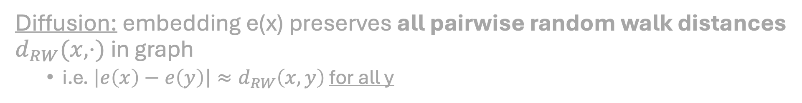
A new idea for embedding
x
Multidimensional scaling (MDS) / ISOMAP: embedding e(x) preserves all pairwise distances $d_{G}(x, ⋅)$ in graph
  i.e. $\left|e\left(x\right)−e\left(y\right)\right|≈d_{G}(x, y)$ for all y
Diffusion: embedding e(x) preserves all pairwise random walk distances $d_{RW}(x, ⋅)$ in graph
  i.e. $\left|e\left(x\right)−e\left(y\right)\right|≈d_{RW}\left(x, y\right)$ for all y
New idea: for visualization, we don’t need to preserve all distances?
We only care about “local neighborhood”

Slide 28
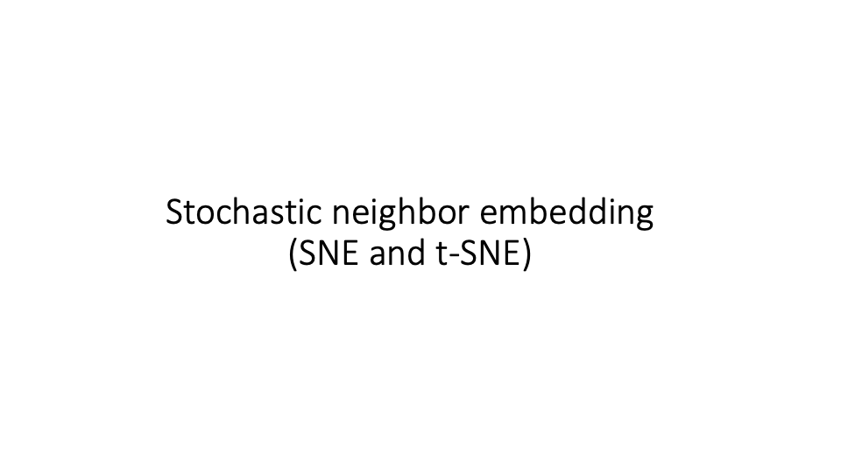
Many slides from Andrei Zinovyev

Slide 29
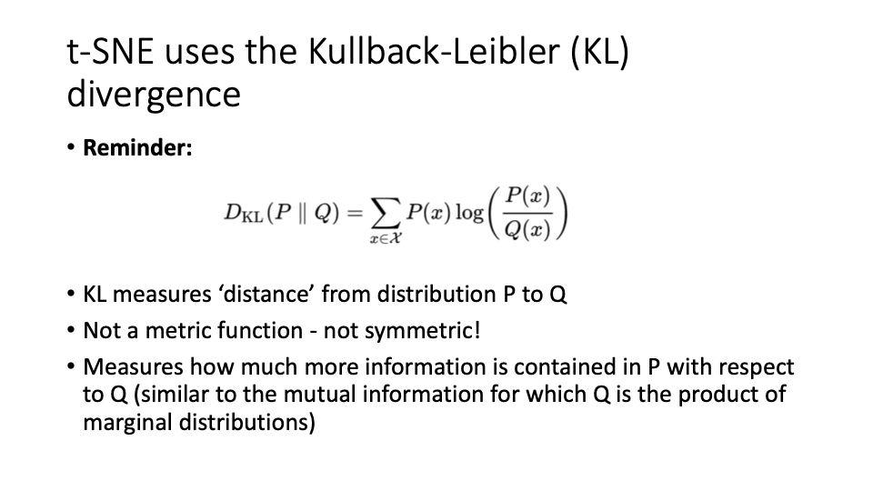

Slide 30
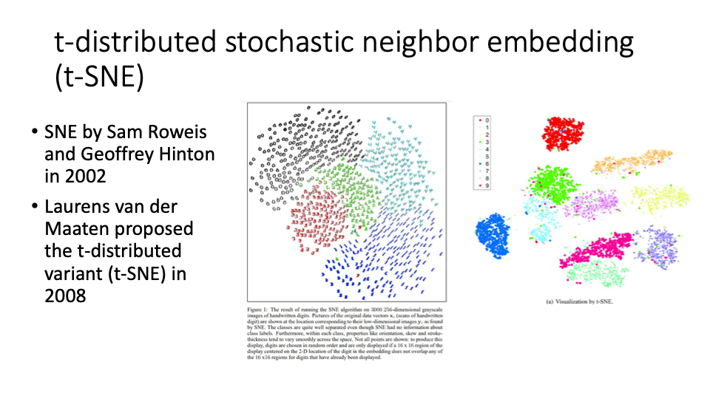

Slide 31
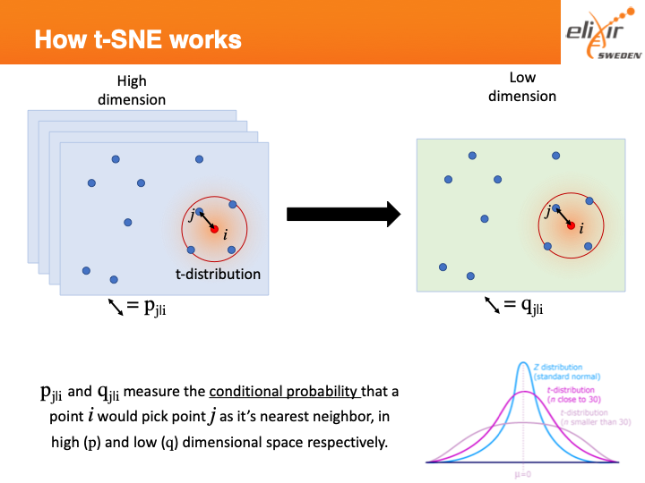
Learned embedding
Original data
t-SNE tries to learn this map

Slide 32
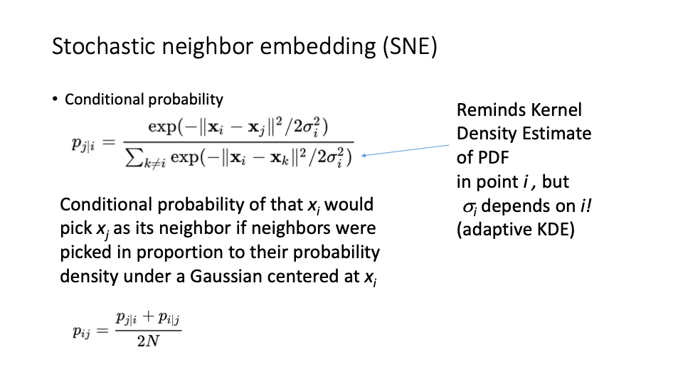

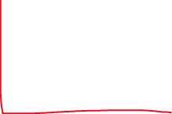


Slide 33
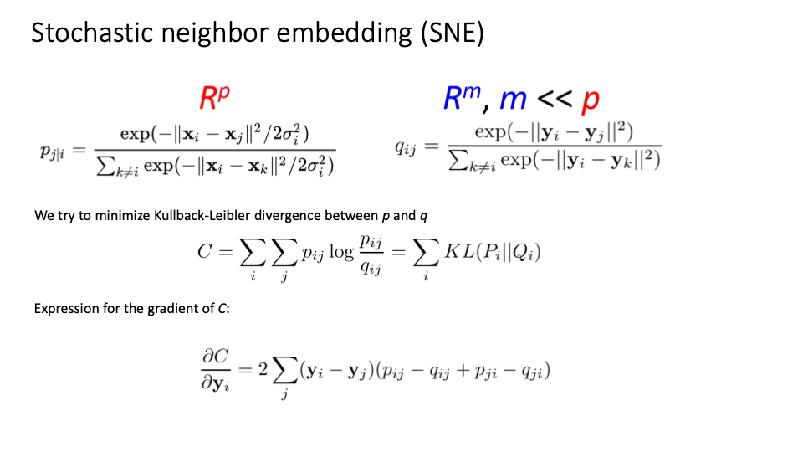
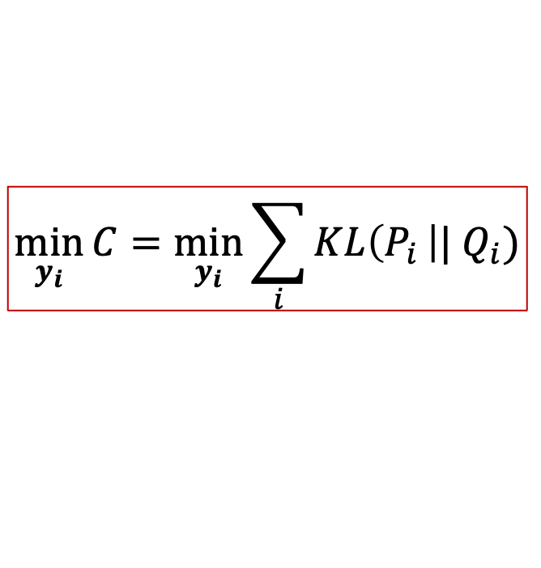
New, lower-dimensional data
Original data
$$\min_{y_{i}}{C=\min_{y_{i}}{\sum_{i}{KL\left(P_{i }\right||{ Q}_{i})}}}$$

Slide 34
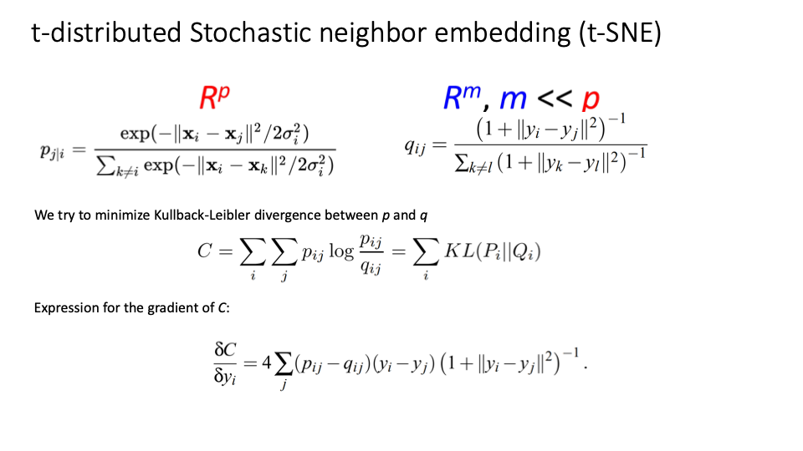

New, lower-dimensional data
Original data
$$\min_{y_{i}}{C=\min_{y_{i}}{\sum_{i}{KL\left(P_{i }\right||{ Q}_{i})}}}$$

Slide 35
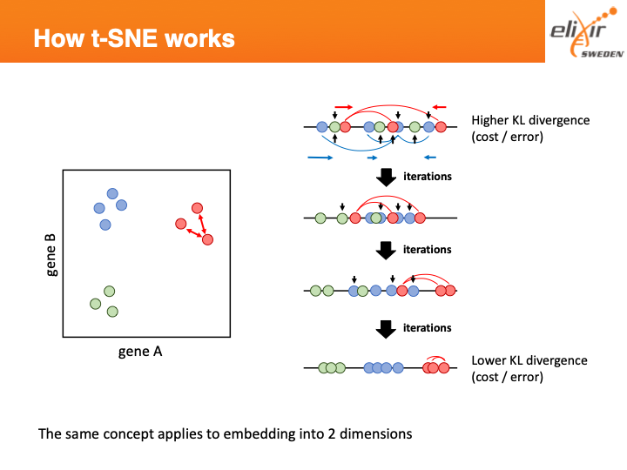
(embedding to one dimension)

Slide 36
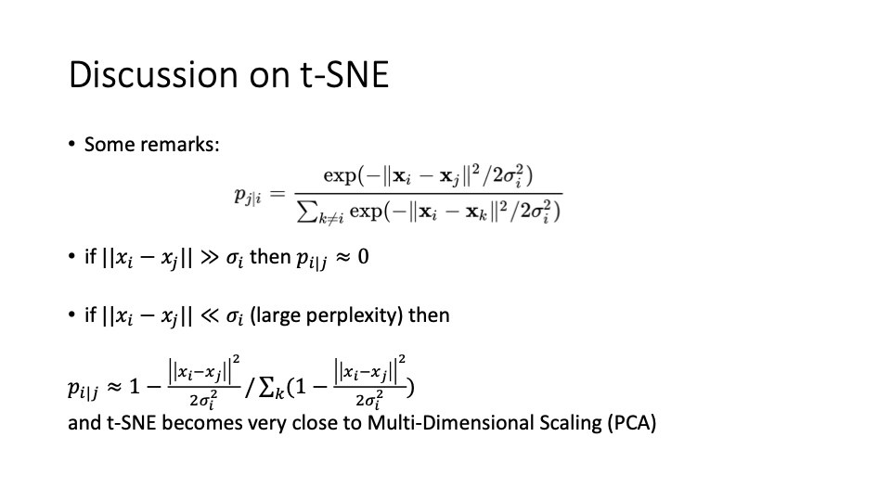
-> t-SNE only looks at local neighborhood of point j
[Homework]

Slide 37
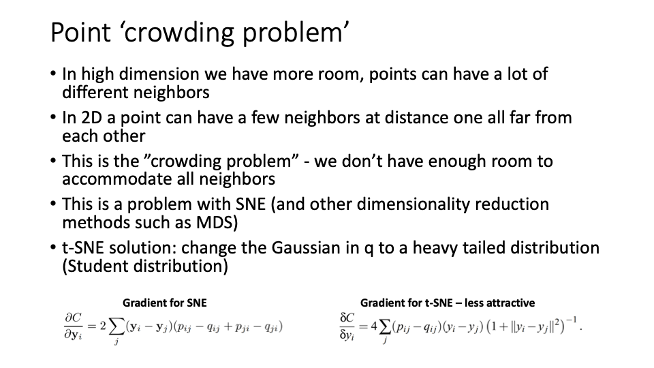

Slide 38


Slide 39
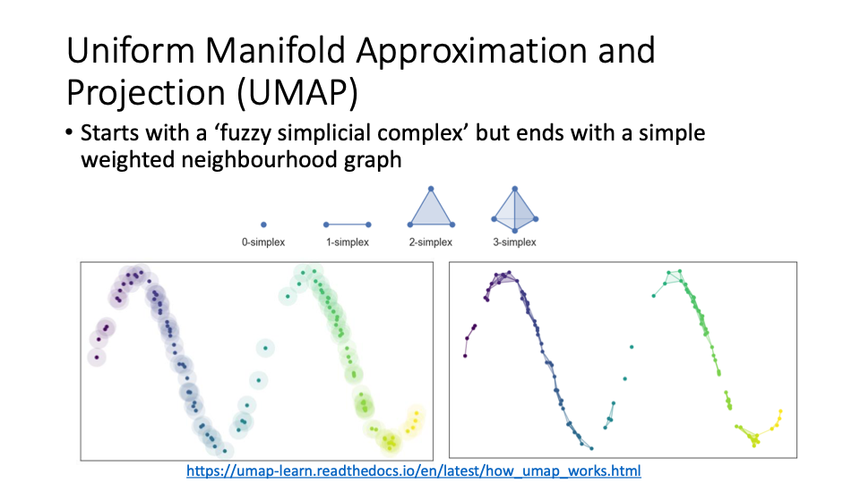

Slide 40
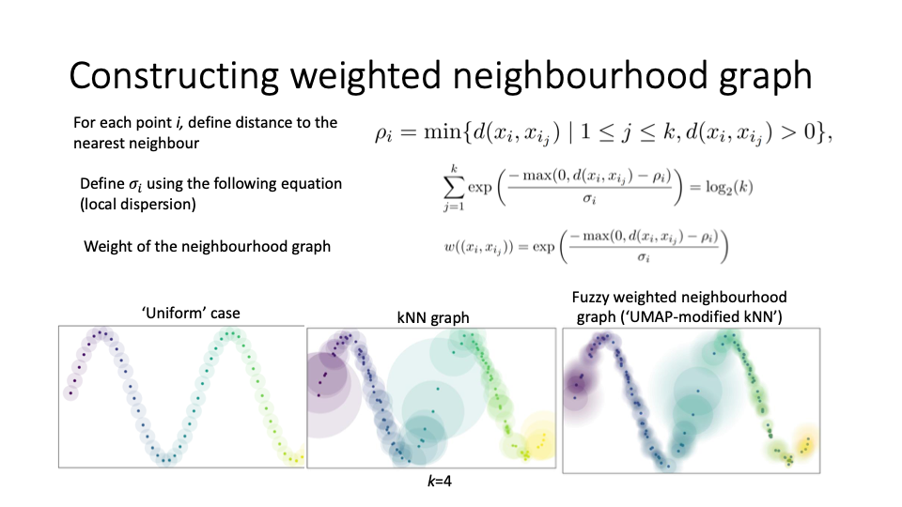

Slide 41
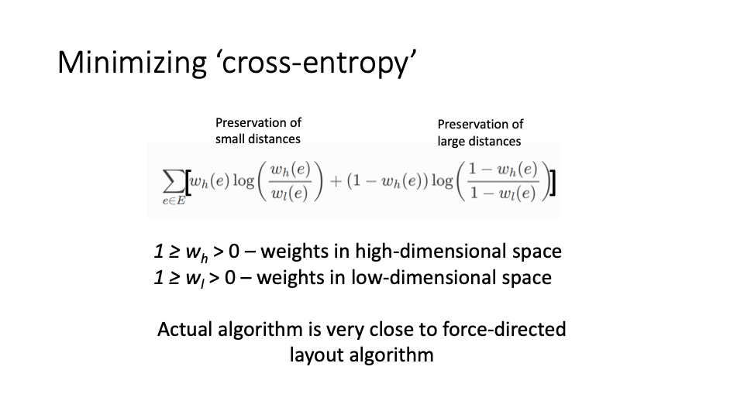
UMAP problem: find low dimensional embedding y that minimizes cross-entropy

Slide 42
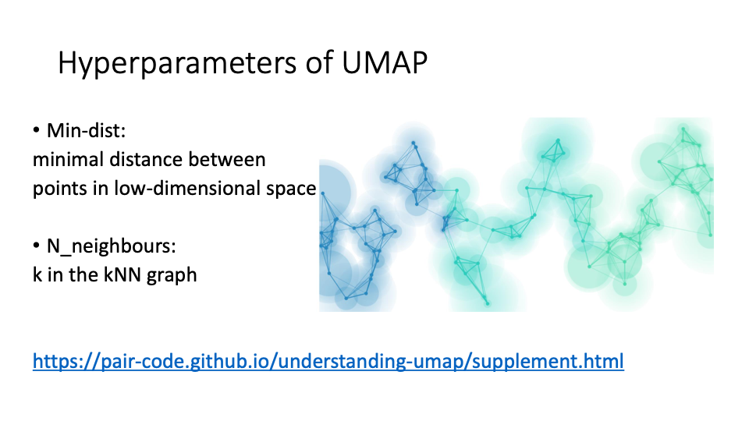

Slide 43
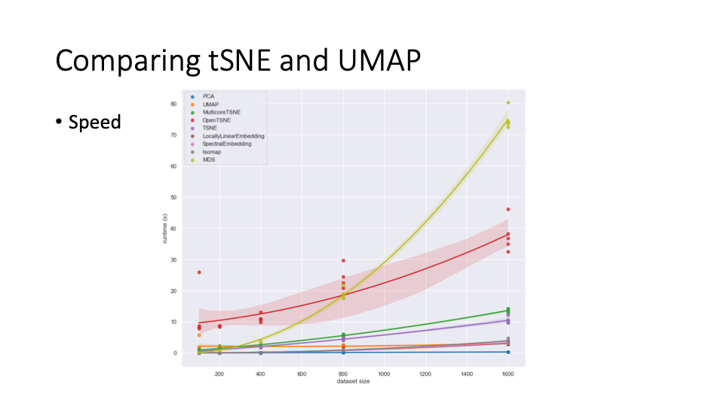
UMAP typically used more in single cell bio as it is faster

Slide 44

UMAP and t-SNE lie on attraction-repulsion spectrum
https://www.biorxiv.org/content/10.1101/2024.04.26.590867v1.full.pdf

Slide 45

Example of typical UMAP plots in single cell
Single-cell RNA sequencing of T-cells across 20+ patients (He et al, Nat Comms 2026)

Slide 46



UMAP plots are often over-interpreted
Slide from https://network.febs.org/videos/talk15_christina_leslie

Slide 47

Figure from “Pumping the brakes on RNA velocity – understanding and interpreting RNA velocity estimates”
by Zheng et al (Kasper Hansen lab JHU biostats)

Slide 48
Moving on: trajectory inference is built on Markov chains

Slide 49

Random walks on directed graphs (Markov chains)
Vertex 1
Vertex 2
Vertex 3
Vertex 1
Vertex 2
Vertex 3
Vertex 1
1
0
1
Vertex 1
1/2
0
1/4
Vertices often called states
Vertex 2
1
0
3
Vertex 2
1/2
0
3/4
0
2
0
Vertex 3
0
1
0
Vertex 3
Adjacency matrix A
Entry a_{ij} = weight of edge j->i
Probability transition matrix P
Entry p_{ij} = probability of j->i
2
2
1
1/2
3
3/4
1
2
1
1
1
1
3
1/2
1/4
3

Slide 50

Random walks on directed graphs (Markov chains)
Vertex 1
Vertex 2
Vertex 3
Vertex 1
Vertex 2
Vertex 3
Vertex 1
1
0
1
Vertex 1
1/2
0
1/4
Related by equation
$$P=AD^{−1}$$
Where D is out-degree matrix
Vertex 2
1
0
3
Vertex 2
1/2
0
3/4
0
2
0
Vertex 3
0
1
0
Vertex 3
Adjacency matrix A
Entry a_{ij} = weight of edge j->i
Probability transition matrix P
Entry p_{ij} = probability of j->i
2
2
2
0
0
1
1/2
3
3/4
0
2
0
1
2
1
1
1
0
0
4
1
3
1/2
1/4
3
Outdegree matrix D

Slide 51

Random walks on directed graphs (Markov chains)
Vertex 1
Vertex 2
Vertex 3
Formula after t steps…
$$x_{t}=P^{t}x_{0}$$
Vertex 1
1/2
0
1/4
0
t
Vertex 2
1/2
3/4
Vertex 3
0
1
0
Probability transition matrix P
x_{t}
x₀
Probability transition matrix P
Entry p_{ij} = probability of j->i
2
1/2
where x₀ is initial probability distribution over vertices
3/4
1
1
1/2
1/4
3

Slide 52




Classification of states in Markov chain
Recurrent: if at vertex/state v, then you will always return to v
P(x_{t}=v for some t | x₀=v) = 1
Transient: if at vertex/state v, then there is a non-zero probability you never return to v again
P(x_{t}=v for some t | x₀=v) < 1

Slide 53

Classification of states in Markov chain
Recurrent: if at vertex/state v, then you will always return to v
P(x_{t}=v for some t | x₀=v) = 1
Transient: if at vertex/state v, then there is a non-zero probability you never return to v again
P(x_{t}=v for some t | x₀=v) < 1
Transient states
Recurrent state
Go over more examples on the board

Slide 54


Classification of states in Markov chain
Recurrent: if at vertex/state v, then you will always return to v
P(x_{t}=v for some t | x₀=v) = 1
Transient: if at vertex/state v, then there is a non-zero probability you never return to v again
P(x_{t}=v for some t | x₀=v) < 1
Homework: the following are equivalent
v is recurrent
$\sum_{t=1}^{∞}{P\left(x_{t}=v \right| x_{0}=v)=∞}$
$P(x_{t}=v$for infinitely many $v \left| x_{0}=v\right)=1$
Homework: the following are equivalent
v is transient
$\sum_{t=1}^{∞}{P\left(x_{t}=v \right| x_{0}=v)<∞}$
$P(x_{t}=v$for infinitely many $v \left| x_{0}=v\right)<1$
For infinite-state MCs: there is also positive recurrent, where $E\left[x_{t}=v \right|{ x}_{0}=v]<∞$ vs. null recurrent, where $E\left[x_{t}=v \right|{ x}_{0}=v]=∞$ . That is, you can return to v with probability 1, but it takes infinite time to do so.

Slide 55

Fundamental theorem of Markov chains (existence/uniqueness of stationary distribution)
Let M be a Markov chain with probability transition matrix P. If M is:
P is irreducible, meaning you can reach any vertex y starting from any vertex x:
  For all x, y, there exists t>0 such that P^{t}(x,y)>0
2) P is aperiodic, that ${gcd⁡\{k: \left(P^{k}\right)}_{ii}\}>1$
then there exists a unique stationary distribution $π$, i.e. a prob. dist. such that
$$Pπ=π$$

Slide 56




Examples of non-irreducible/aperiodic Markov chains
Not irreducible:
If you start at v, you either get stuck in the left or right side
Not aperiodic: you always switch sides
v

Slide 57



More general theorem of Markov chains
For a Markov chain, divide it into its “strongly connected components” (ie partitions where every node can reach every other node)
… get a directed acylic graph

Slide 58





More general theorem of Markov chains
For a Markov chain, divide it into its “strongly connected components” (ie partitions where every node can reach every other node)

Slide 59
More general theorem of Markov chains
For a Markov chain, divide it into its “strongly connected components” (ie partitions where every node can reach every other node)
Vertices in leaves are recurrent
  If a leaf has a single node, then it is an absorbing state (eg C₂)
Vertices in internal nodes are transient

Slide 60
More general theorem of Markov chains
For a Markov chain, divide it into its “strongly connected components” (ie partitions where every node can reach every other node)
Vertices in leaves are recurrent
Vertices in internal nodes are transient
Theorem: For each s.c.c. C, if C is aperiodic then there is a unique stationary distribution $π_{C}$ supported on C

Slide 61

Computing stationary distribution(s)
A stationary distribution satisfies
$$Pπ=P$$
Can prove it is top eigenvalue of P.
Power method to get top eigenvector of P! Same approach as for PCA
Insert picture?

Slide 62








Absorbing Markov chains + absorption probabilities
An absorbing state is a recurrent strongly connected component with a single vertex
  e.g. cell type A and cell type B2 below
Defn: An absorbing Markov chain is a Markov chain where every recurrent s.c.c. has a single node (ie is an absorbing state)
Cell type A
Cell type B1
Cell type B2
Undifferentiated cell

Slide 63








Absorbing Markov chains + absorption probabilities
An absorbing state is a recurrent strongly connected component with a single vertex
  e.g. cell type A and cell type B2 below
Defn: An absorbing Markov chain is a Markov chain where every recurrent s.c.c. has a single node (ie is an absorbing state)
Oftentimes we want to calculate the probability of ending up in an absorbing state
Cell type A
Cell type B1
Cell type B2
Undifferentiated cell

Slide 64

Absorbing Markov chains + absorption probabilities
Suppose there are t transient states and s absorbing states. We can write probability transition matrix P as
$$P=\left(\begin{matrix}Q & 0 \\ R & I_{s×s}\end{matrix}\right)$$
Q is t x t matrix giving transition probabilities between transient states
R is s x t matrix giving transition probabilities from transient -> absorbing
I_{sxs} is s x s identity matrix
Theorem (homework): Let B be a matrix with entry b_{ij} being the probability of reaching absorbing state i starting at state j.
Then B = RN where $N={\left(I−Q\right)}^{−1}$ is called the fundamental matrix of the Markov chain

Slide 65




Palantir (Setty et al, Nat Bio 2019) models cell differentiation using absorbing Markov chains

Slide 66


CellRank (Lange et al, Nat Meth 2022) models cell differentiation using absorbing Markov chains

