Slide 1

Lending Club
Portfolio & Risk Assessment

Slide 2
Problem
Consumer Finance Company has to make a decision for loan approval based on the applicant’s profile
Risks associated with the decision are –
Loss of business
Financial Loss
Company needs help in understanding the driving factors behind loan defaults.

Slide 3
Data Available
Loan
The file has information about customer attributes and loan attributes
It has data about loans –
Fully paid
Charged-off
Current

Slide 4
Cleansing & Transformation
Removal of Columns and Rows not required for analysis
Columns with sparse data and fields not directly related to the analysis
Identify potential imputation logics for columns with less missing value %
Employee Length had few values. Missing value has been replaced with 0 in the code. Other options are replaced it with mode ( in this case it would have been 10+)
Identification and removal of outliers
Applicants with more than 90% percentile removed for the analysis
Derive additional metrics/attributes if any
segmentation for Interest Rate, Debt to Income, Charged Off % etc.

Slide 5
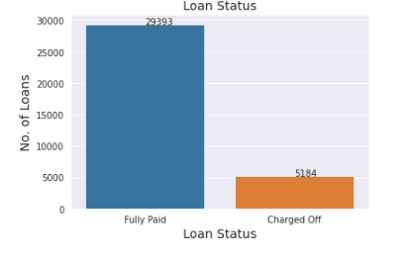
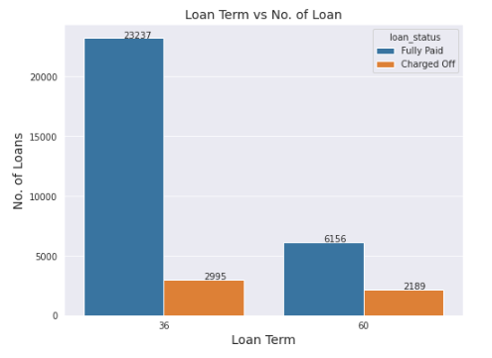
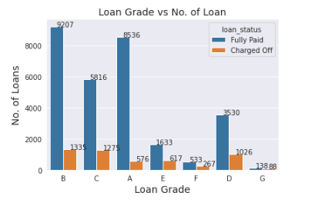
Univariate Analysis – Loan Insights
~15% loans were charged off
Significant no. of loans were issued with 36 months term
Ratio of default is higher in 60 months term
Loans falling under Grade B, C and D have higher charged off

Slide 6
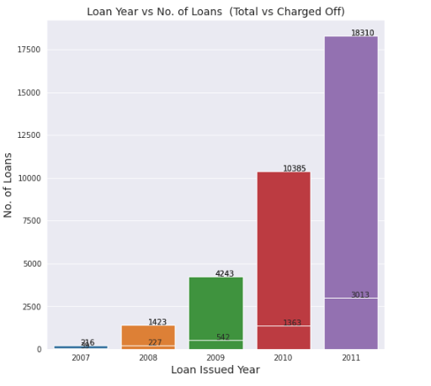
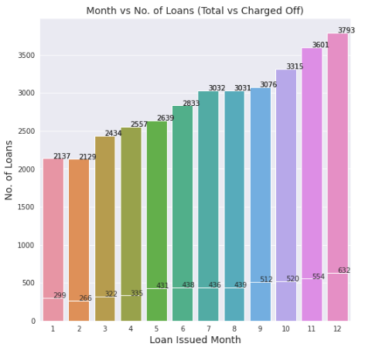
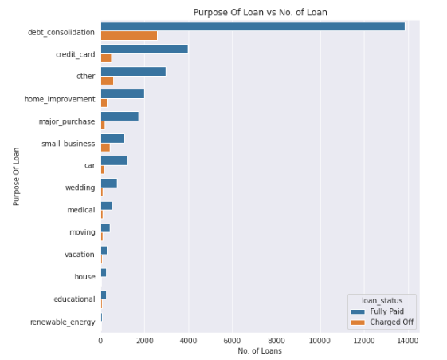
Univariate Analysis – Loan Insights
There is a significant increase in the no. of loans issued over the year and the defaulters too.
There is an increase in the no. of loans issued towards end of the year
Debt Consolidation, Credit Card and Other are the top 3 purpose behind the loans that were charged off.

Slide 7
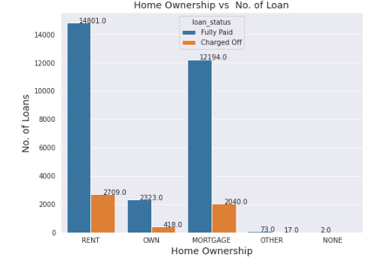
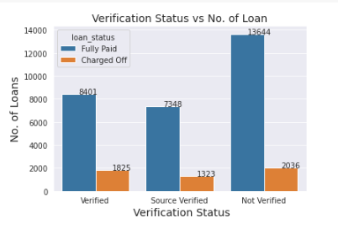
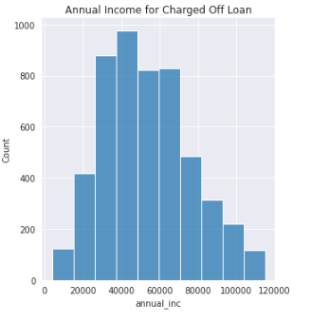
Univariate Analysis – Customer Insights
Applicants who fall under MORTGAGE and RENT have higher charged off loans compared to OWN
It doesn't look like Unverified has significantly higher defaulters compared the verified ones.
People with Annual Income around 40K have higher number of loans defaulted

Slide 8
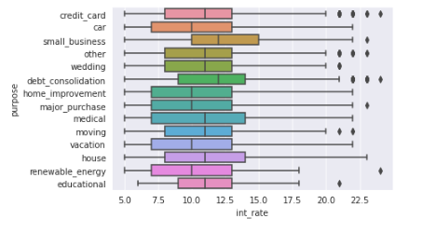
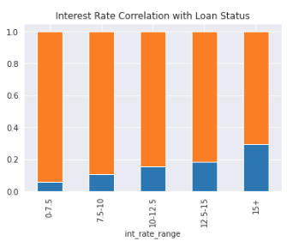
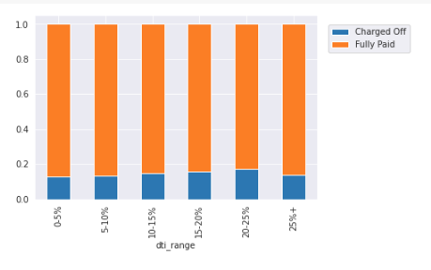
Bivariate Analysis - Insights
There is higher interest rate for the small business, debt consolidation ,medical & house.
Debt Consolidation have higher interest rate as well from previous graph they have higher charge off.
Defaulters are within 20% across all DTI Range
Defaulters increase as the Interest Rate increases

Slide 9
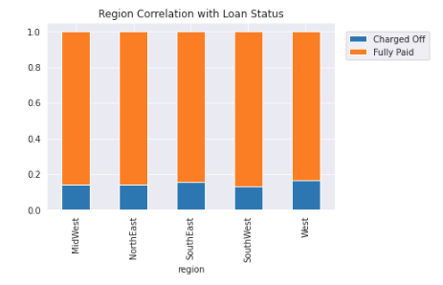
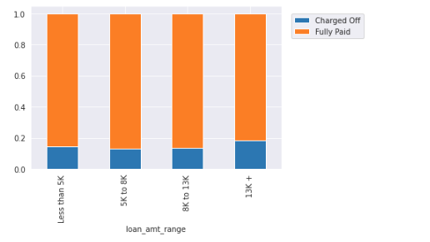
Bivariate Analysis - Insights
Charged Off percentage is within 20 % across all regions
Defaulters looks high in both of loan amount range i.e. lower (<5K) and higher end (>13K)

Slide 10
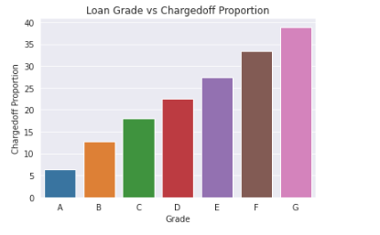
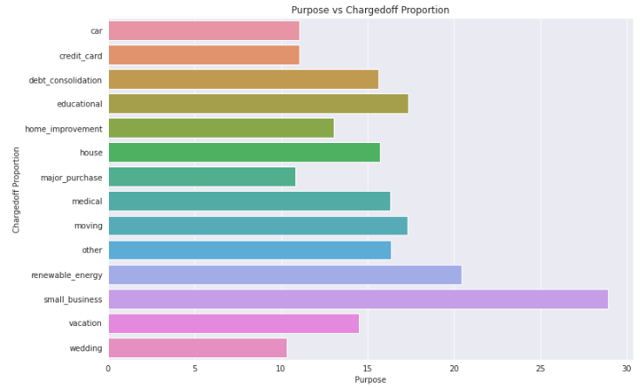
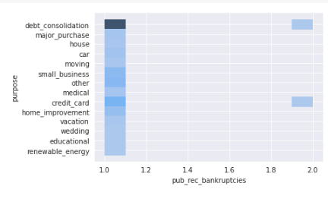
Bivariate Analysis - Insights
Grade G tops the Charged Off percentage
Small business has higher number of Charged Off loans and earlier we noticed this has higher interest rates as well.
People with bankruptcies majorly took loan for debt consolidation & credit card

Slide 11
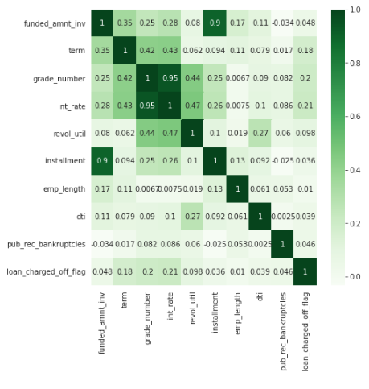
Multivariate Analysis
Loan charge off have slightly positive correlation with term & interest rate
Term have positive correlation with funded amount & interest rate
Grade has positive correlation with Interest Rate, Term and Loan Status
Revolving line utilization rate has positive correlation with Grade, Interest Rate and Debt to Income

Slide 12
Summary and Recommendations
Applicants with loan amount <5K and >13K have higher number of defaulting
Applicants seeking loan for small business, debt consolidation, credit card seems to defaulting.
High risk Grade G has higher number of defaulters.
Defaulter Percentage is high in the high interest rates
Recommendation -
Attributes like Loan Purpose, Interest Rate, Purpose, Loan Grade, Loan Amount, Loan Term, Revolving Utilization Rate and Public Bankruptcy Count have shown relationship with Charged Off

