Slide 1
Key logger and security
CAPSTONE PROJECT
Presented By:
Chitradevi.C JKKNCET BTECH-IT

Slide 2
OUTLINE
Problem Statement
Proposed System/Solution
System Development Approach
Algorithm & Deployment
Result
Conclusion
Future Scope
References

Slide 3
Problem Statement
project problem statement for keylogger Problem Statement: In today's digital age, where cybersecurity threats loom large, one of the significant concerns is the proliferation of keyloggers, stealthy software tools designed to monitor and record keystrokes on a user's computer without their knowledge. Keyloggers pose a severe threat to individuals and organizations as they can capture sensitive information such as passwords, credit card details, and other personal data, leading to identity theft, financial loss, and privacy breaches.

Slide 4
Proposed Solution
To combat the growing threat of keyloggers and protect individuals and organizations from the potential risks associated with these malicious tools, we propose the development of an advanced anti-keylogger system. This system will utilize innovative techniques and technologies to detect and prevent keylogging activities effectively.
Behavioral Analysis: Implement advanced behavioral analysis algorithms to monitor and analyze user typing patterns and behavior. By establishing a baseline of normal typing behavior, deviations indicative of keylogging activities can be detected in real-time.
Signature-Based Detection: Incorporate a signature-based detection mechanism to identify known keylogger patterns and signatures. This database will be regularly updated to stay current with emerging threats.

Slide 5
Encryption: Integrate robust encryption techniques to safeguard keystrokes and sensitive data transmitted between the keyboard and applications. This encryption layer will ensure that even if keyloggers intercept data, it remains unintelligible to them.
Sandbox Environment: Create a sandbox environment where potentially suspicious processes or applications are isolated and monitored closely for any keylogging behavior. This prevents keyloggers from accessing sensitive information or transmitting data to external sources.

Slide 6
Machine Learning Models: Employ machine learning models to continuously improve the system's ability to detect and adapt to evolving keylogger techniques. These models will learn from new data and user interactions to enhance detection accuracy and reduce false positives.
Real-Time Alerts: Implement a real-time alerting system to notify users or administrators immediately upon detecting suspicious keylogging activity. Alerts can be delivered through various channels such as email, SMS, or mobile applications, enabling swift response and mitigation.

Slide 7
benefits of the Solution:
Enhanced Security: The advanced anti-keylogger system offers robust protection against keylogging threats, safeguarding sensitive information and preventing unauthorized access.
Proactive Detection: By leveraging advanced detection techniques, the system can identify keyloggers in real-time, enabling prompt action to mitigate potential risks.
Adaptability: Machine learning algorithms ensure that the system remains adaptive and responsive to emerging threats, continually improving its detection capabilities over time.
User Empowerment: Through education and awareness initiatives, users are empowered to take proactive measures to protect themselves from keylogging attacks, fostering a culture of cybersecurity awareness and resilience.

Slide 8
System Approach
Requirement Analysis
Architecture Design
Component Selection
Development
Integration
Deployment
Monitoring and Maintenance
User Training and Support
Feedback and Iteration
Compliance and Regulation

Slide 9
Algorithm & Deployment
Behavioral Analysis Algorithm:
Define a baseline for normal typing behavior by analyzing factors such as typing speed, rhythm, and patterns.
Continuously monitor user typing behavior in real-time.
Compare current typing behavior to the established baseline.
Detect deviations from the baseline that may indicate potential keylogging activity.
Implement machine learning algorithms to adaptively update the baseline and improve detection accuracy over time.
Signature-Based Detection Algorithm:
Maintain a database of known keylogger signatures and patterns.
Regularly update the signature database to include new threats.
Monitor incoming keystrokes and compare them to the signature database.
Trigger an alert if a match with a known keylogger signature is detected.

Slide 10
Encryption Algorithm:
Utilize strong encryption algorithms such as AES (Advanced Encryption Standard) for encrypting keystrokes and sensitive data.
Generate unique encryption keys for each session or communication channel.
Implement secure key management practices to protect encryption keys from unauthorized access.
Machine Learning Models:
Train machine learning models using labeled datasets of normal and anomalous typing behavior.
Implement classification algorithms such as decision trees, random forests, or neural networks to classify incoming typing behavior as normal or potentially malicious.
Continuously update and refine the machine learning models using new data to improve detection accuracy.

Slide 11
On-Premises Deployment:
Install the anti-keylogger system on dedicated hardware within the organization's network infrastructure.
Configure the system to monitor all endpoints and network traffic for keylogging activity.
Integrate the system with existing security tools and infrastructure for seamless operation and centralized management.
Conduct thorough testing and validation before deploying the system into production to ensure compatibility and reliability.
Cloud-Based Deployment:
Deploy the anti-keylogger solution as a cloud service hosted on a reputable cloud platform such as AWS, Azure, or Google Cloud.
Provide clients with access to the anti-keylogger service through secure APIs or web interfaces.
Implement multi-tenancy support to serve multiple clients while maintaining isolation and security.

Slide 12
Hybrid Deployment:
Implement a hybrid deployment model that combines on-premises and cloud-based components.
Host critical components such as behavioral analysis and machine learning models on-premises for data privacy and latency reasons.
Utilize cloud services for scalability, redundancy, and remote management capabilities.
Establish secure communication channels between on-premises and cloud-based components to facilitate data exchange and synchronization.
Continuous Monitoring and Maintenance:
Implement monitoring tools and dashboards to continuously monitor the performance, availability, and security of the deployed anti-keylogger solution.
Establish automated alerting mechanisms to notify administrators of any detected anomalies or security incidents.
Conduct regular maintenance activities such as software updates, patches, and database refreshes to ensure the system remains up-to-date and resilient against emerging threats.

Slide 13
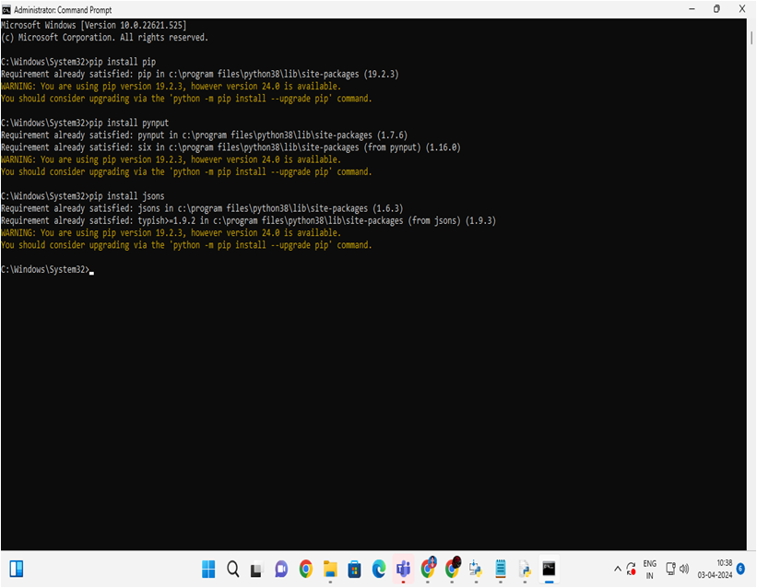
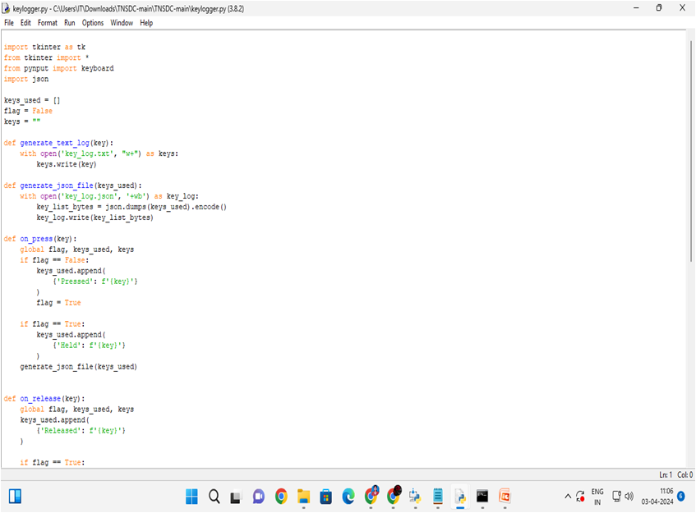
Program &Deploy

Slide 14
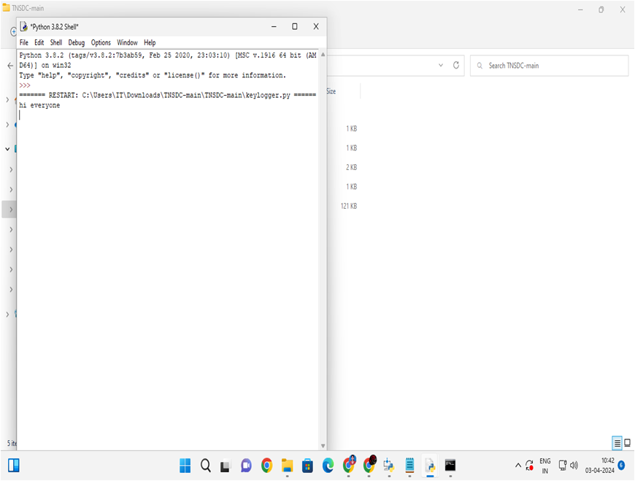
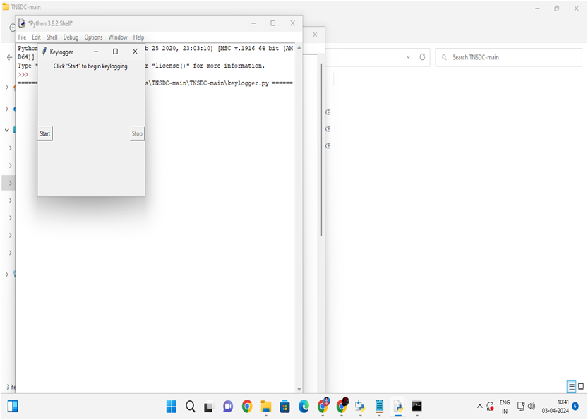
Result

Slide 15
Result
Enhanced Security
Improved Detection Accuracy
Real-Time Alerting
Secure Communication
Scalability and Flexibility
Compliance and Regulatory Compliance
User Empowerment

Slide 16
Conclusion
deployment of the advanced anti-keylogger solution represents a pivotal step towards fortifying cybersecurity defenses in the face of evolving digital threats. By integrating sophisticated algorithms, encryption techniques, and real-time monitoring capabilities, this solution offers a comprehensive approach to detecting and mitigating keylogging activities effectively.
Heightened Security:
Enhanced Detection Accuracy:
Proactive Threat Mitigation:
User Empowerment and Awareness
Scalability and Compliance:

Slide 17
Future scope
Integration of advanced threat intelligence for more accurate detection.
Incorporation of behavioral biometrics for enhanced user authentication.
Extension of protection to IoT and mobile devices.
Implementation of Zero Trust Architecture for proactive security.
Adoption of AI-driven threat hunting and response.
Exploration of blockchain for data integrity assurance.
Continuous improvement through user feedback loops.
Enhancement of cross-platform compatibility and integration capabilities.

Slide 18
References
Academic Journals: IEEE Security & Privacy, ACM Transactions on Privacy and Security, Journal of Cybersecurity
Industry Reports: Symantec, McAfee, Kaspersky, CrowdStrike
Conferences: RSA Conference, Black Hat, DEF CON
Official Documentation: NIST, ISO/IEC, OWASP

Slide 19
THANK YOU

