Slide 1


Slide 2
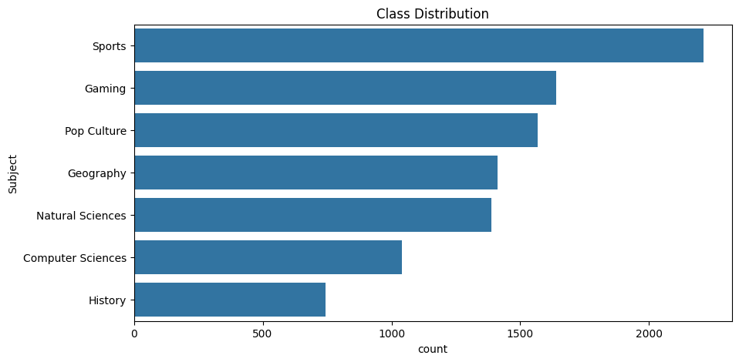
EDA – Class Distribution
Dataset Imbalance
Significant variation in the number of samples across classes.
Sports has the highest representation (~2,200+ samples).
History is the smallest class (~750 samples).

Slide 3
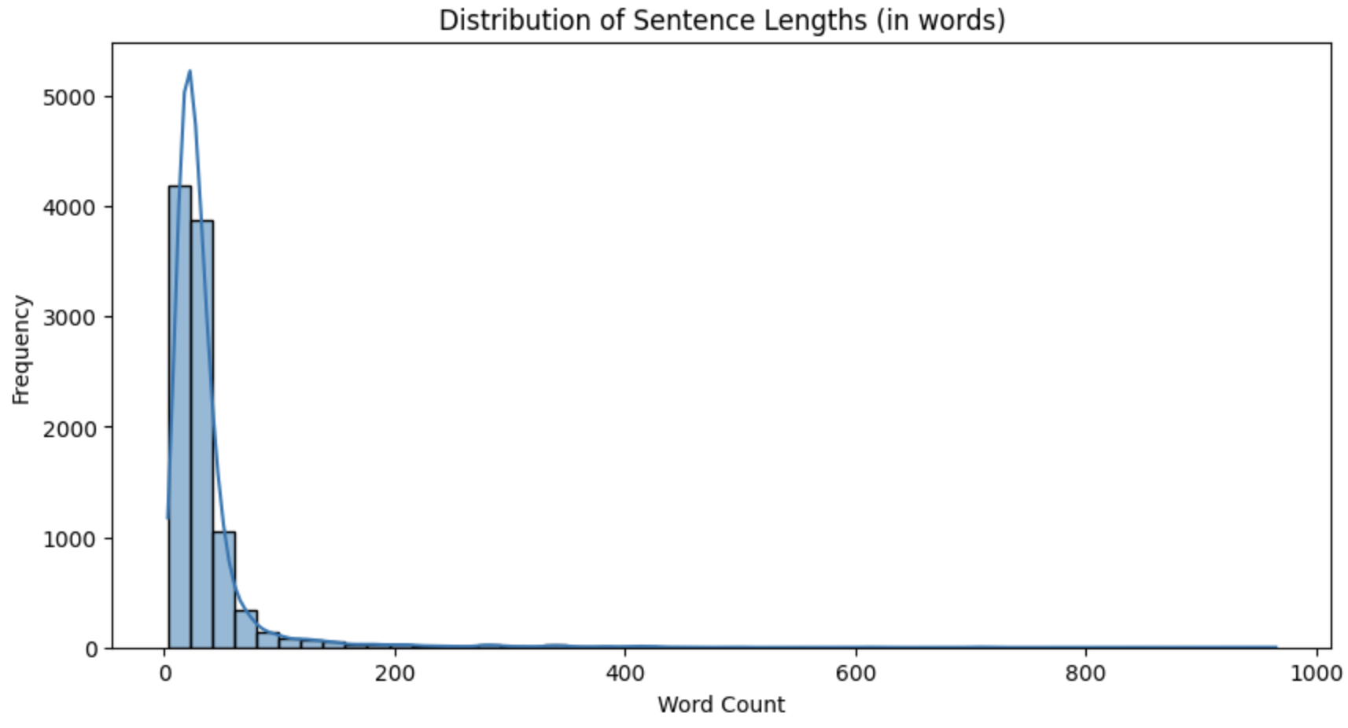
Sentence Length Analysis
Highly Skewed Distribution
Most sentences are short, with word counts between 5–30 words.
Long sentences (>100 words) are rare.
Most sentences are short (5–30 words) →
TF-IDF works well on short to medium texts because it captures key words and phrases without relying on long-range context.
Very long sentences are rare, so deep sequence models like BERT may not have much extra contextual advantage early on.

Slide 4
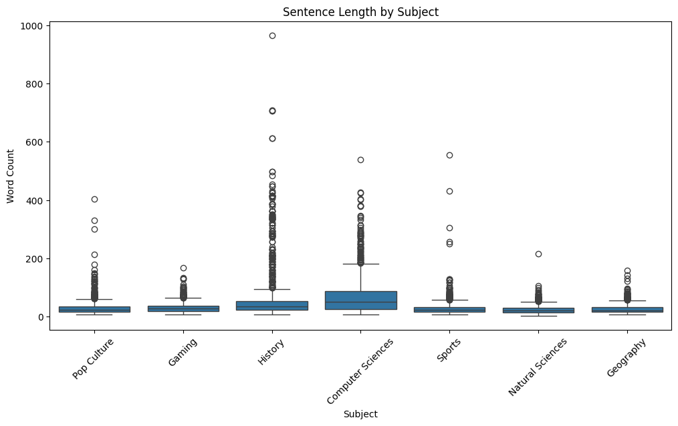
Sentence Length by Class
The chart compares sentence length (word count) across different subjects.
History and Sciences show the highest median and widest spread in sentence lengths.
Culture, Gaming, Sports, Geography have shorter and more consistent sentence lengths.
Many outliers exist in all categories, especially in History and Sciences, indicating occasional very long sentences.
Distribution is skewed right, with most sentences clustered at lower word counts.

Slide 5

Top 3 words
Top words in 'Pop Culture': korean: 208 pop: 191 marvel: 165
1
Top words in 'Gaming': game: 1176 player: 353 steam: 248
2
Top words in 'History': french: 260 war: 205 attack: 192
3
Top words in 'Computer Sciences': system: 691 data: 459 language: 297
4
Top words in 'Sports': team: 459 game: 382 league: 350
5
Top words in 'Natural Sciences': plant: 257 light: 180
6
Top words in 'Geography': cave: 405 park: 145 reef: 126
7

Slide 6
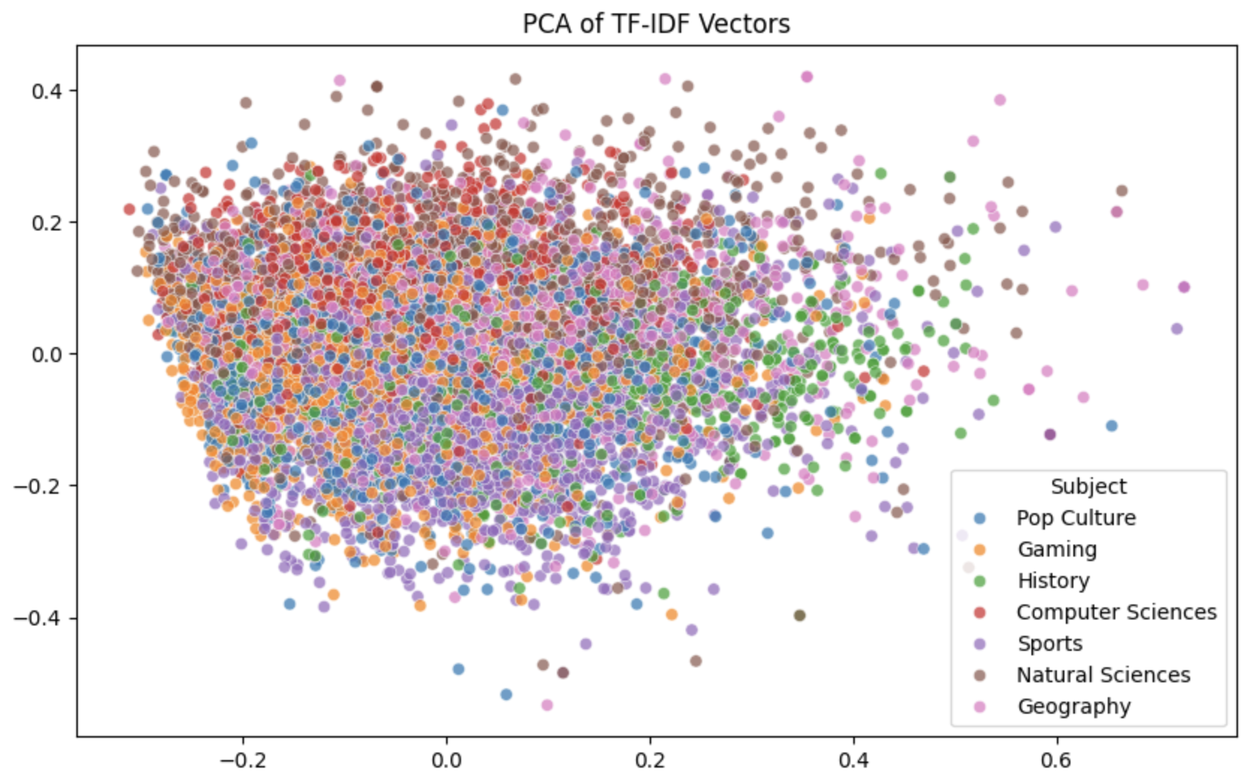
Class Overlap Check via TF-IDF + PCA/TSNE (Optional Visualization)

Slide 7
Why TF-IDF + Logistic Regression Fits This Dataset
Sentence Length Distribution
Most sentences are short (5–30 words) →
TF-IDF works well on short to medium texts because it captures key words and phrases without relying on long-range context.
Class Distribution
Some imbalance exists (Sports is dominant, History is smallest) →
Logistic Regression allows easy integration of class weights to handle imbalance, improving macro-F1.
Domain Vocabulary
top-words analysis shows strong topic-specific.
TF-IDF naturally highlights these discriminative terms, making it effective for topic classification.
Efficiency
TF-IDF + Logistic Regression is fast to train, interpretable, and easy to tune (e.g., n-grams, min_df).
Enables quick iterations for feature engineering before committing to high-cost transformer training.
Baseline Benchmark
Provides a performance benchmark to compare against BERT or other deep models.
If macro-F1 is already competitive, it can be the final model for production due to low inference cost.

Slide 8
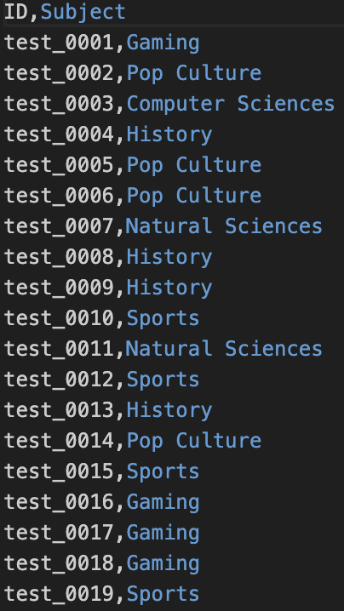
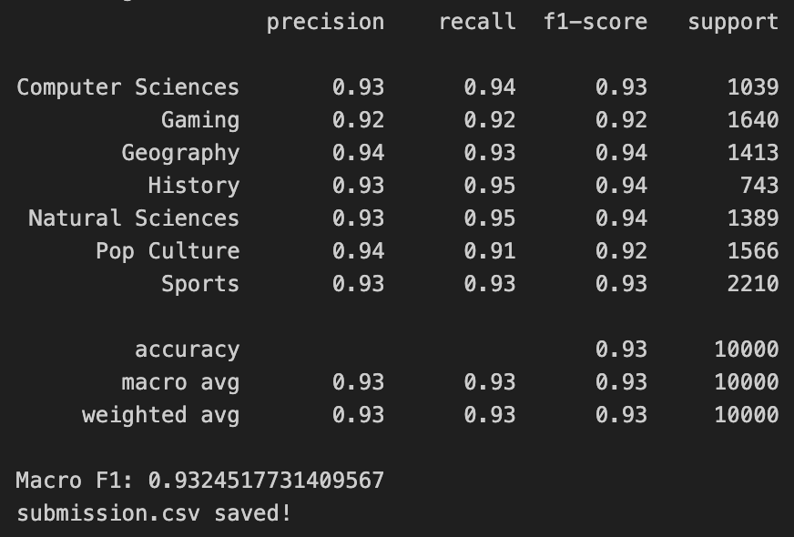
Classification report and results

