Slide 1
Estimating Calorie Count from Food Images using Deep Learning
Chitra Gopalaiah – DTSA 5511 Final Project
Notes:
Hello everyone! This project combines deep learning and nutrition science to estimate the calorie count of foods based only on images.

Slide 2
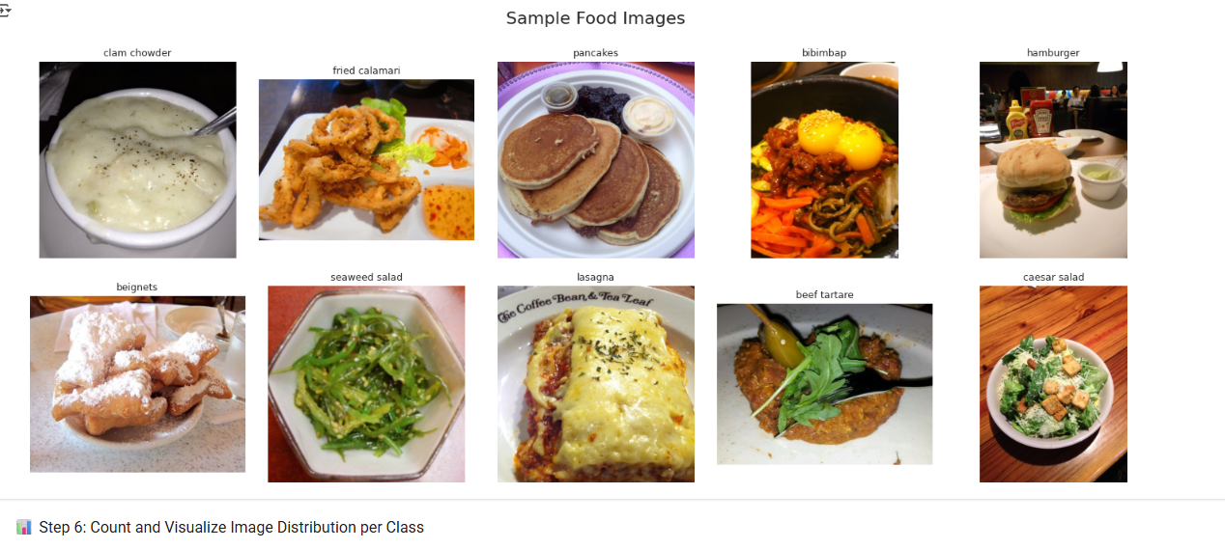
Sample Food Images
Notes:
Here are examples from the Food-101 dataset. It includes 101 food classes such as bibimbap, clam chowder, and pancakes. The images vary significantly in lighting and angle, making classification a challenge.

Slide 3
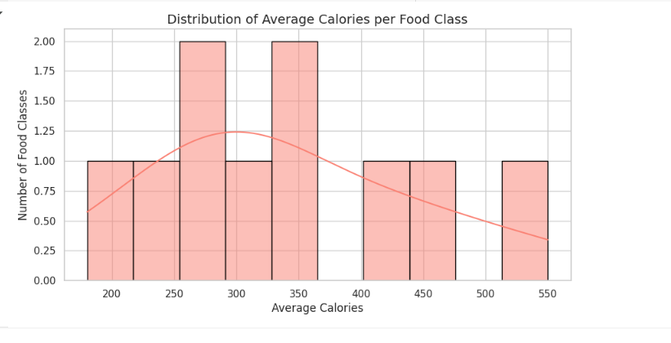
Top 20 Food Classes by Image Count
Notes:
The dataset is fairly balanced across classes. This plot shows the top 20 food classes with the most image instances, like apple pie, beef tartare, and beignets.

Slide 4
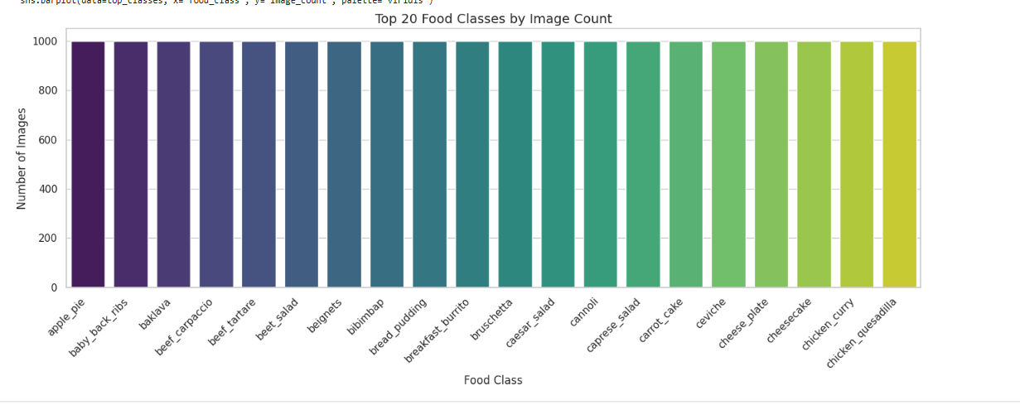
Distribution of Average Calories per Food Class
Notes:
Since actual calorie values weren't provided, I mapped each food class to a typical calorie estimate. Most foods fall between 250 and 450 calories.

Slide 5
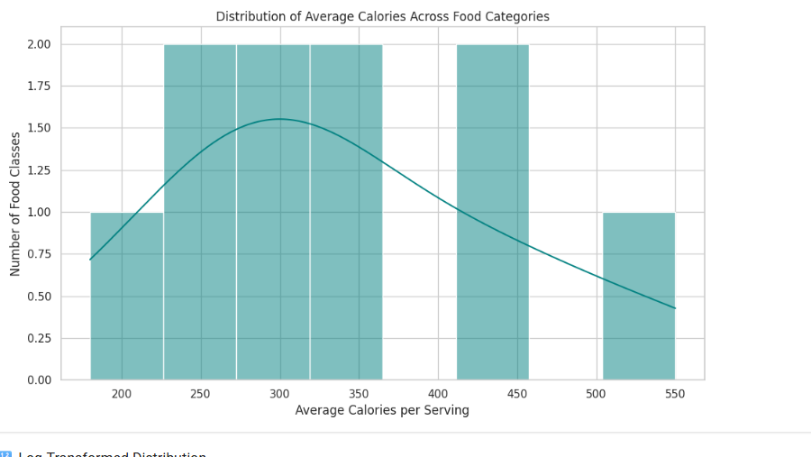
Average Calories Across Food Categories
Notes:
We also visualized the calorie distribution to understand model input features. This helped us observe skewed distributions that might affect regression performance.

Slide 6
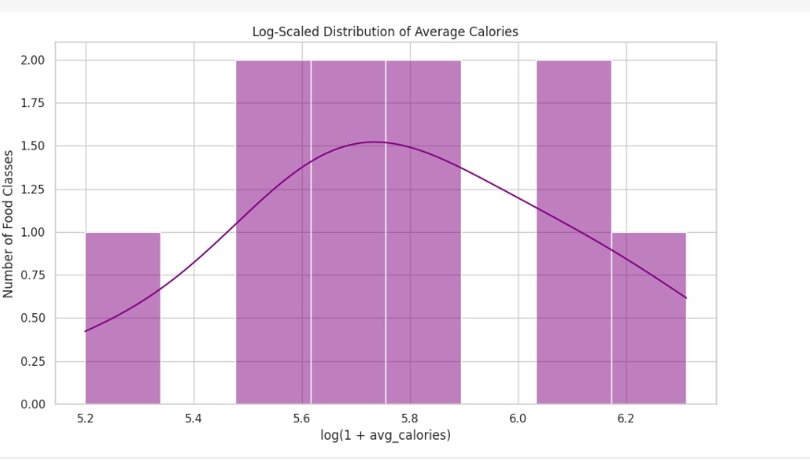
Log-Scaled Calorie Distribution
Notes:
To reduce skew, we applied a log transformation. This normalizes the distribution and benefits regression performance, especially for models like Linear Regression.

Slide 7
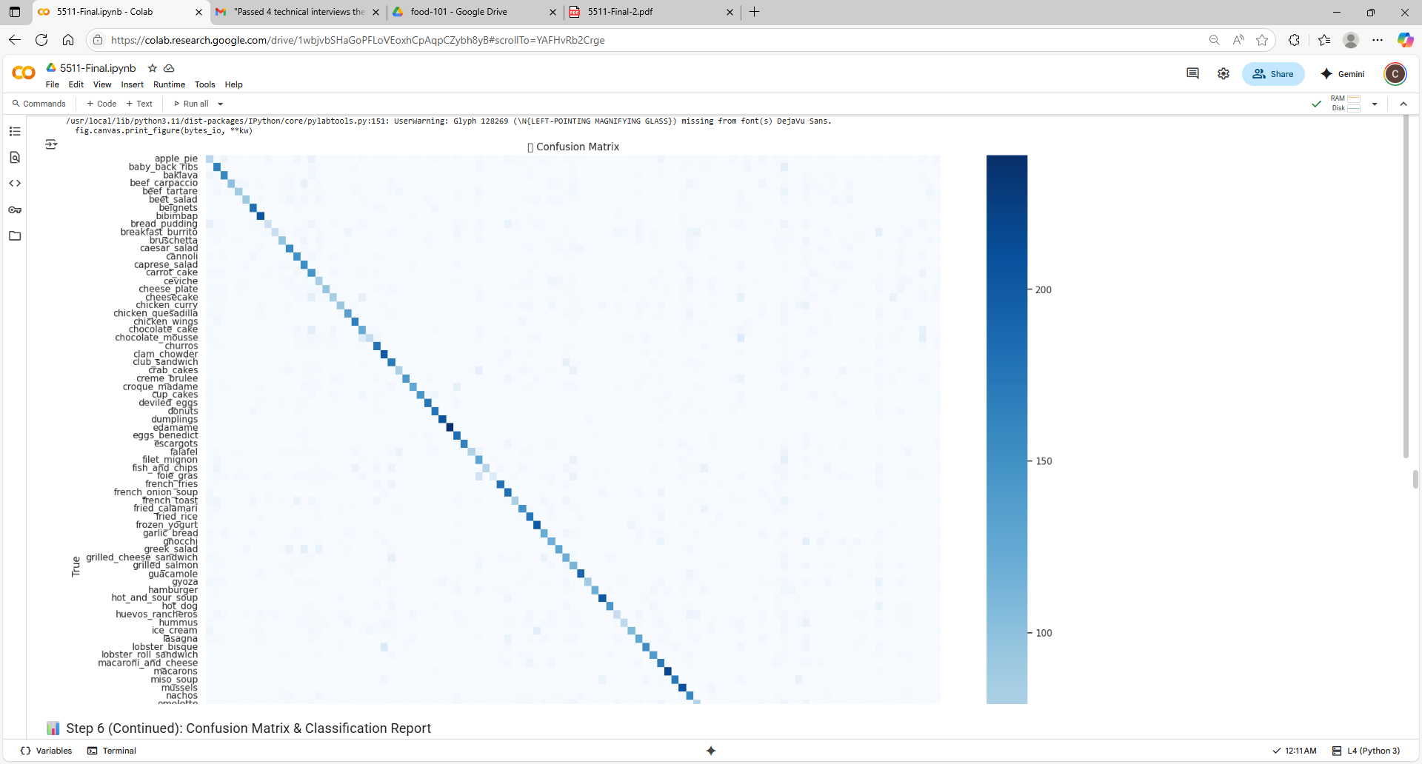
Confusion Matrix – CNN Classification
Notes:
This confusion matrix shows the classification accuracy of our CNN. Most predictions are along the diagonal, indicating correct predictions, though some confusion exists between visually similar foods.

Slide 8
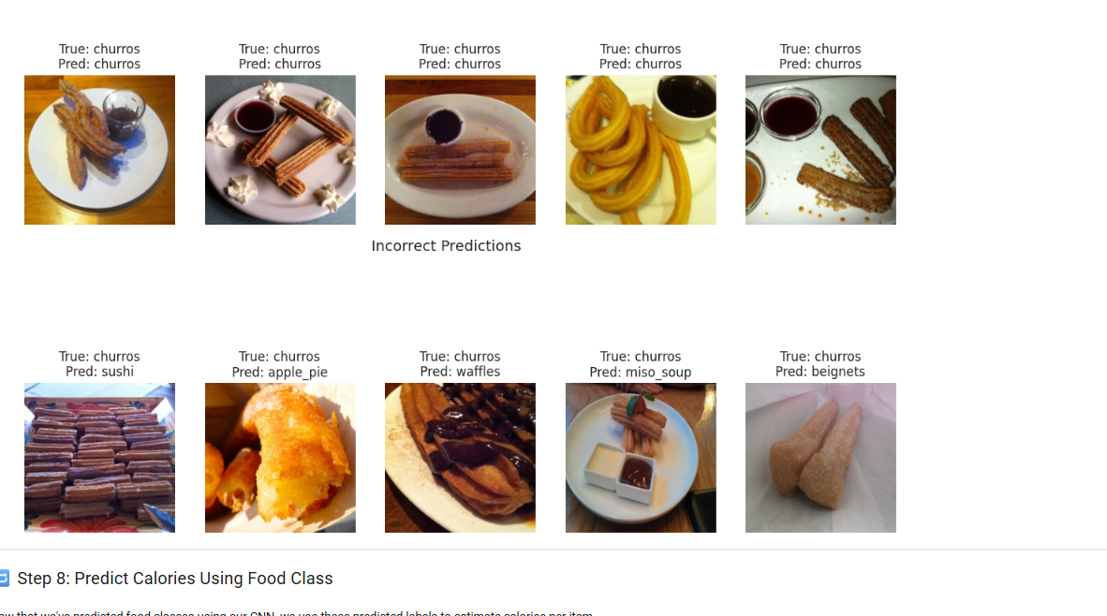
Correct vs Incorrect Food Predictions
Notes:
Here's a look at correct and incorrect predictions. As you can see, the model sometimes confuses churros with similar shapes like waffles or beignets.

Slide 9
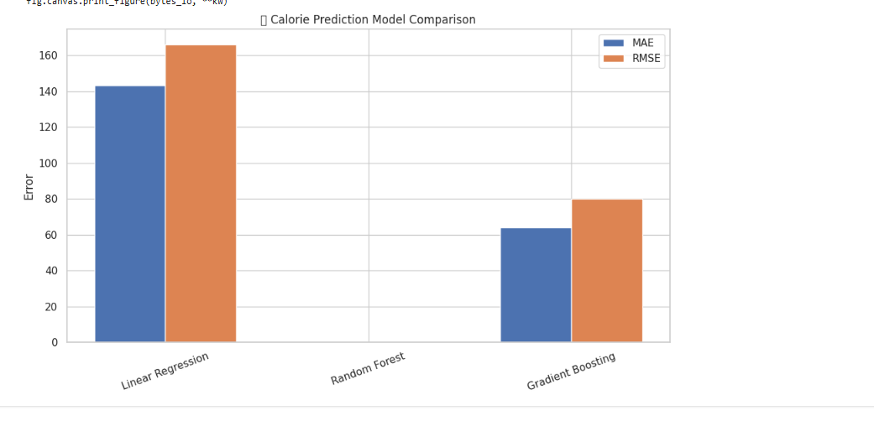
Calorie Prediction Model Comparison
Notes:
After classification, I used regression models to predict calories. Gradient Boosting gave the best performance, followed by Random Forest. Linear Regression performed the worst due to its assumptions.

Slide 10
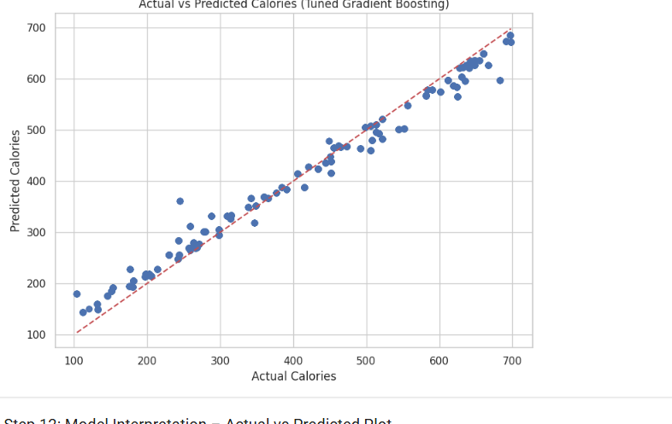
Actual vs Predicted Calories (Tuned Gradient Boosting)
Notes:
This scatter plot shows how close our Gradient Boosting model predictions were to the true calorie values. The red line indicates a perfect prediction. Most points are tightly clustered around this line, showing strong performance.

Slide 11
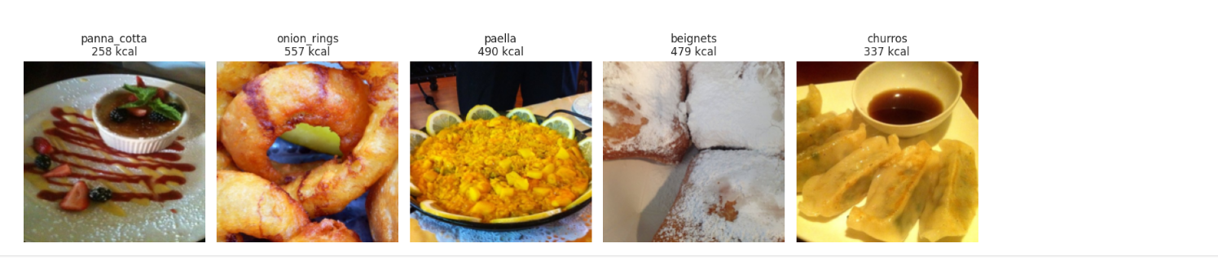
Sample Calorie Predictions by Food Type
Notes:
Here are some examples of the final calorie predictions by food type. You can see panna cotta predicted at 258 kcal and onion rings at 557 kcal. These outputs help illustrate the model’s practical application.

Slide 12
Dataset Overview & Source
📂 Dataset: Food-101
- 101 food categories (balanced)
- ~75,000 training images
- ~25,000 test images
- Each image labeled by food name only (no calorie or ingredient info)
🌐 Source:
- Food-101 dataset by Lukas Bossard et al.
- Retrieved from Kaggle: https://www.kaggle.com/datasets/kmader/food41
Notes:
The dataset used in this project is Food-101, created by Lukas Bossard and available on Kaggle. It contains 101 food categories with over 100,000 labeled images. The dataset does not contain calories, ingredients, or portion size, so we had to augment it with external calorie estimates.

Slide 13
Key Takeaways & Conclusion
✅ Deep learning + calorie estimation is feasible
✅ ResNet18 effectively classified food types
✅ Gradient Boosting achieved best calorie prediction (RMSE: 24.56)
✅ One-hot encoding of predicted class was sufficient input for regression
Notes:
This project showed that calorie estimation from images is possible using deep learning. While classification was relatively accurate, calorie prediction relied heavily on approximate mappings. Still, Gradient Boosting provided solid performance using only class labels as input.

Slide 14
Future Work
🔮 Potential Enhancements:
- Use object detection to estimate portion size
- Train with datasets containing real calorie values
- Incorporate ingredients, preparation methods, and side dishes
- Explore multi-modal learning (image + text)
- Deploy as a mobile/web app for nutrition estimation
Notes:
Future enhancements could make this model far more accurate and useful. We could use object detection for portion size, train on real calorie data, and even incorporate recipe or ingredient text. Ultimately, this approach could power consumer tools for dietary tracking.

