Slide 1
Classical NLP Pipeline for Sentiment Classification
Premium Research Presentation | IMDb Reviews
Research Focus
• End-to-end NLP pipeline • Sparse text representation • Classical vs neural modeling • Practical performance analysis
Core Message
Good feature representation can outperform higher model complexity.
Shahab Azmi | Chitransh Kumar Gupta
HSE University
A comparative study of TF-IDF, Logistic Regression and Neural Networks
MSc Mini Project | NLP Sentiment Analysis on IMDb

Slide 2
Problem Statement & Objectives
Research Motivation
Dataset
Objectives
Movie reviews contain rich opinion signals, but text must be transformed before machines can classify sentiment.
This project investigates whether classical NLP can still compete strongly in a practical sentiment task.
IMDb review dataset
50,000 labeled reviews
Balanced binary classes
Train / Test split
Build a clean NLP pipeline
Compare unigram vs bigram TF-IDF
Evaluate Logistic Regression and Neural Network
Interpret what actually drives performance
MSc Mini Project | NLP Sentiment Analysis on IMDb

Slide 3
Methodology & Workflow Diagram
Raw Reviews
Preprocessing
TF-IDF
Training
Evaluation
Preprocessing Logic
Feature Representation
Models Used
Lowercase conversion
Removal of HTML tags
Removal of non-alphabetic symbols
Whitespace normalization
TF-IDF (Unigram)
TF-IDF (Bigram)
Captures term importance and short context
Logistic Regression
Feedforward Neural Network
Compared under the same pipeline
MSc Mini Project | NLP Sentiment Analysis on IMDb

Slide 4
Model Design & Architecture
Logistic Regression
Neural Network
A strong linear baseline for sparse high-dimensional features.
Trained with max_iter = 1000
Evaluated on both unigram and bigram TF-IDF vectors
Input → Hidden Layer (128) → ReLU → Output (2 classes)
Optimizer: Adam | Loss: CrossEntropy
Trained for 5 epochs on unigram TF-IDF vectors
Input 5000
Hidden 128
Output 2
MSc Mini Project | NLP Sentiment Analysis on IMDb

Slide 5
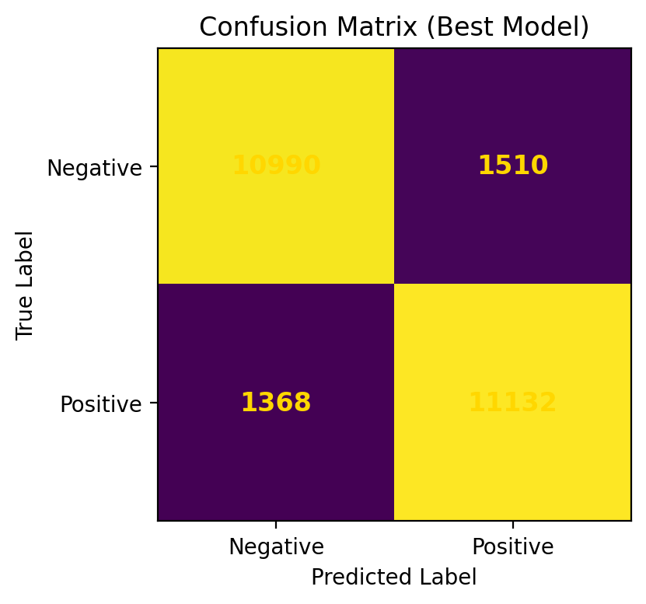
Results, Graph & Error Analysis
Best Model
Logistic Regression + Bigram TF-IDF
Accuracy: 88.55%
Most balanced prediction across classes
Key Interpretation
Bigram features improved contextual understanding, while Logistic Regression remained more compatible with sparse TF-IDF vectors than the neural network.
MSc Mini Project | NLP Sentiment Analysis on IMDb

Slide 6
Conclusion & Future Scope
Conclusion
Future Scope
TF-IDF with Logistic Regression delivered the strongest overall performance.
Bigram representation gave a measurable gain over unigram.
This study shows that better representation can matter more than higher complexity.
Improve preprocessing using lemmatization and negation handling
Tune the neural network more deeply
Compare with dense embeddings and transformer-based models
Final Insight: In practical NLP, the right pipeline often beats unnecessary complexity.

