Slide 1
N
AI / ML BUSINESS CASE STUDY
Predicting Subscriber Churn at Netflix
Using Logistic Regression to identify at-risk subscribers before they cancel
Part A · Business Problem, Data, Solution, Impact & Recommendations
Prepared for: AI/ML Coursework Submission

Slide 2
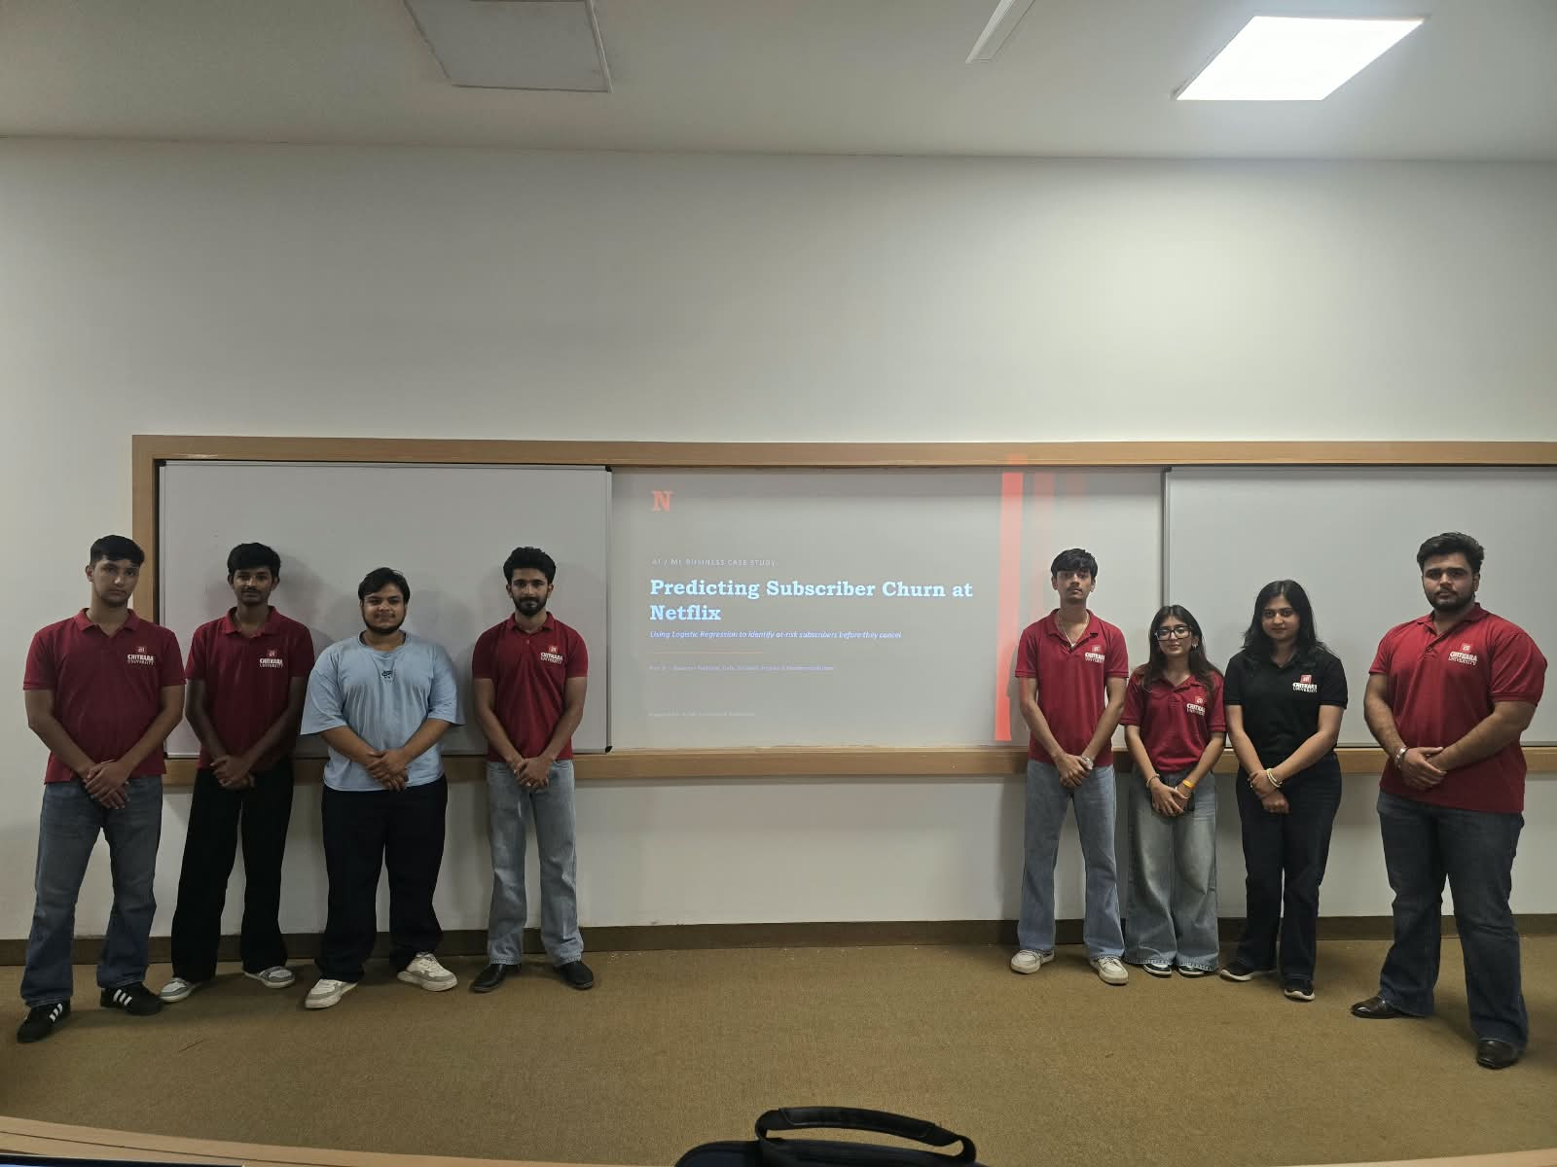
Aditya Sharma, Chitransh, Daksh Goyal, Ishant, Armaan Kalia, Angel, Pranjal, Hirday

Slide 3
SECTION 1
Company & Industry Introduction
What Netflix does
Netflix is a global streaming entertainment company delivering movies, TV series, documentaries, and original content to subscribers over the internet, on demand, across TVs, mobiles, tablets, and computers.
Who its customers are
Individual and household subscribers across 190+ countries, spanning multiple age groups, income levels, and content preferences, who pay a recurring monthly/annual subscription fee.
Products & services
Tiered streaming plans (Basic, Standard, Premium), an ad-supported plan, downloadable offline content, personalized recommendations, and increasingly, games and live content — all bundled into a single monthly subscription.
300M+
Paid subscriber
memberships worldwide
190+
Countries with
active service
Subscription
Primary revenue
model
Netflix Subscriber Churn | AI/ML Business Case Study
2

Slide 4
SECTION 2
Business Problem: Subscriber Churn
Churn = a paying subscriber cancels their Netflix membership. Every cancellation is lost recurring revenue and a signal that something in the experience failed.
1
2
3
4
Revenue at risk
Costly to replace
Early warning matters
Competitive pressure
Subscription revenue depends entirely on retention — churn directly reduces Monthly Recurring Revenue.
Acquiring a new subscriber (marketing, promotions) costs far more than retaining an existing one.
Most churn signals build up over weeks — engagement drop, payment failures — before the actual cancellation.
Disney+, Amazon Prime Video, and others make switching easy, so proactive retention is a competitive necessity.
Netflix Subscriber Churn | AI/ML Business Case Study
3

Slide 5
SECTION 3
Data Required to Predict Churn
A churn model learns from subscriber behavior recorded over time. This case study uses the following feature set:
Tenure (months)
Weekly watch hours
How long the subscriber has held their account — newer accounts churn more.
Average hours streamed per week — a direct measure of engagement.
Logins per month
Support tickets (90 days)
How often the subscriber opens the app — a proxy for habit strength.
Number of support/help requests — frequent issues signal frustration.
Payment failures (90 days)
Plan tier
Failed billing attempts — a strong, immediate churn trigger.
Basic, Standard, or Premium — pricing sensitivity differs by tier.
Additional real-world sources: billing/CRM system, streaming logs, customer-support platform, and subscription-management records.
Netflix Subscriber Churn | AI/ML Business Case Study
4

Slide 6
SECTION 4
AI/ML Solution: Classification
Logistic Regression
Where this fits in ML technique choice
A supervised classification algorithm that predicts the probability a subscriber will churn (Yes/No), based on labeled historical outcomes.
Supervised Learning → Logistic Regression ✓
Other supervised options: Random Forest, XGBoost, SVM
Binary outcome: subscriber churns or stays — a natural fit for classification
Unsupervised alt. use: K-Means clustering for segmentation
Every feature gets one clear weight — easy to explain to non-technical stakeholders
Outputs a probability score, so the business can rank subscribers by risk
Why not jump straight to a more complex model?
Logistic Regression is chosen first for transparency and explainability — the exact formula behind every prediction can be shown to management, satisfying Responsible-AI expectations before scaling to more complex models.
Fast to train and deploy at Netflix's subscriber scale
Netflix Subscriber Churn | AI/ML Business Case Study
5

Slide 7
SECTION 5
How the Solution Works
Business Data
AI/ML System
Prediction
Business Action
Business Outcome
Underlying ML Pipeline
1
→
2
→
3
→
4
→
5
→
6
Data Cleaning
Preprocessing
Train/Test Split
Model Training
Evaluation
Prediction
In practice: Each month, Netflix's subscriber data (tenure, watch hours, logins, support tickets, payment history, plan tier) is fed into the trained Logistic Regression model. The model outputs a churn probability for every active subscriber. Subscribers above a risk threshold are automatically flagged and routed to the retention team — for a personalized offer, a proactive support call, or a free upgrade month — before they cancel.
Netflix Subscriber Churn | AI/ML Business Case Study
6

Slide 8
MODEL SNAPSHOT
Model Results (Demonstration Run)
Trained on 3,000 synthetic subscriber records built to mirror the feature set above (80/20 train-test split).
89.7%
14.5%
0.69
0.53
Overall accuracy
Base churn rate
Precision (churn class)
Recall (churn class)
What drives churn risk (model coefficients)
Reading the weights
Negative = reduces churn risk
Positive = increases churn risk
Longer tenure and higher weekly watch hours are the strongest retention signals. Payment failures and support tickets are the strongest churn triggers — ideal targets for early intervention.
Netflix Subscriber Churn | AI/ML Business Case Study
7

Slide 9
SECTION 6
Business Impact
1
2
3
Better customer retention
Reduced revenue loss
Personalized services
Flag at-risk subscribers weeks before cancellation, enabling timely, targeted offers.
Even a small drop in monthly churn compounds into significant retained subscription revenue.
Retention offers (discounts, upgrades, content nudges) are tailored to each subscriber's risk drivers.
4
5
6
Faster decision-making
Improved forecasting
Automation of outreach
Retention and support teams get a ranked, prioritized risk list instead of reacting after cancellation.
Aggregated churn probabilities feed more accurate subscriber-growth and revenue forecasts.
High-volume, low-risk cases can trigger automated emails/offers, freeing agents for complex cases.
Netflix Subscriber Churn | AI/ML Business Case Study
8

Slide 10
SECTION 7
Challenges, Risks & Responsible AI
Data privacy & security
Bias & fairness
Viewing history and payment data are sensitive; must be stored and processed under strict access controls.
Model must be checked so it doesn't unfairly penalize subscribers by region, plan tier, or demographic group.
Transparency
Incorrect predictions
Business and support teams need to understand why a subscriber was flagged, not just the score.
False positives waste retention budget; false negatives mean preventable churn goes unnoticed.
Over-reliance on automation
Model drift
Retention actions should keep a human-in-the-loop for high-value or sensitive accounts.
Subscriber behavior shifts over time (new competitors, pricing changes) — the model needs regular retraining.
Netflix Subscriber Churn | AI/ML Business Case Study
9

Slide 11
SECTION 8
Recommendation to Management
Adopt a phased churn-prediction rollout, starting with a transparent, explainable model before scaling complexity.
Pilot
01
Integrate
02
Personalize
03
Scale & Govern
04
Deploy Logistic Regression on a subset of subscribers; validate predictions against real cancellations.
Feed monthly risk scores into the retention team's CRM workflow with clear, explainable reasons.
Match retention offers (discount, upgrade, support call) to each subscriber's specific risk driver.
Expand to the full base with bias audits, human review for edge cases, and scheduled model retraining.
Netflix Subscriber Churn | AI/ML Business Case Study
10

Slide 12
GIT HUB LINKS:
CHITRANSH: https://github.com/chitransh2573bbafai25-pixel
ARMAAN KALIA: https://github.com/armaankalia-16
DAKSH GOYAL: https://github.com/settings/profile
ADITYA SHARMA: https://github.com/AdityaSharma145
ANGEL: https://github.com/angelpiplani39-arch
PRANJAL: https://github.com/Pranjal2922
HIRDAY:https://github.com/hirdaykohli
ISHANT: https://github.com/isshhaanntt

Slide 13
Key Takeaway
A simple, explainable model can meaningfully reduce Netflix's subscriber churn — if paired with fast retention action and responsible oversight.
Thank You
Questions & discussion welcome

