Slide 1
Sentiment Analysis on Beauty Product Reviews PHASE 2:
By Group 2:
Ahmed El-Aloul - 301170922
Chitra Hajra Roy – 301148774
My Duyen Phung - 301218170
Lance Nelson – 301176007

Slide 2
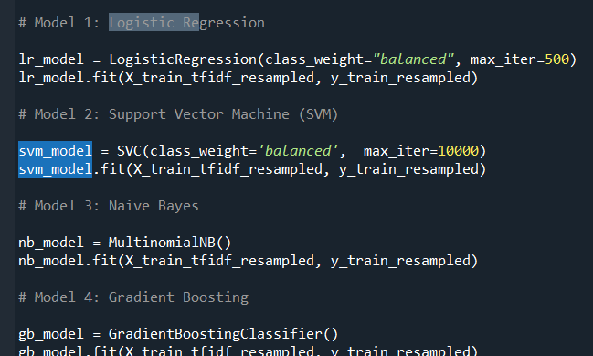
Project Overview: From Lexicons to Machine Learning
Objective recap: Analyzing customer sentiment on 'All Beauty' reviews
Phase 1: Focused on lexicon-based models (VADER and TextBlob)
Limitations observed: Predominant positive skew and poor handling of neutral and negative sentiments
Transition to Phase 2: Adopting a Machine Learning approach to overcome Phase 1 limitations
Enhanced Methodology: Incorporating data preprocessing and sophisticated text representation for improved sentiment analysis
Notes:
"In Phase 1 of our sentiment analysis project, we concentrated on lexicon-based models to interpret customer reviews for 'All Beauty' products. Our main objective was to accurately gauge the sentiment behind each review. However, we observed some limitations, such as the challenge in effectively categorizing neutral and negative sentiments, mostly due to the positive skew of the data.
As we move into Phase 2, we aim to address these limitations by pivoting to a Machine Learning approach. This transition allows us to delve deeper into the nuances of customer sentiment and provides more sophisticated tools for data preprocessing and analysis. The following slides will detail the steps we've taken in this new phase, showcasing our methodologies, the results we've achieved, and how they compare to the initial approach."

Slide 3
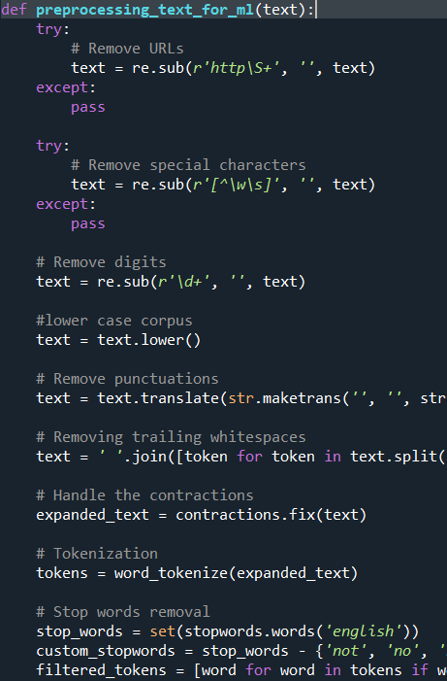
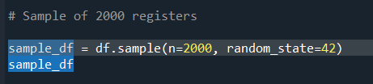
Data Exploration and Preprocessing
Began with data distribution analysis to understand the sentiment skew within 2,000 randomly sampled reviews.
Applied rigorous preprocessing steps such as removing URLs, special characters, and digits; lowercasing; lemmatizing; and stop words removal.
Standardized text data to enhance model performance, culminating in TF-IDF vectorization for machine learning readiness.
Implemented oversampling to balance the dataset and address the positive sentiment skew.
Notes:
"We analyzed the sentiment distribution within the 2,000 review subset, noting a heavy skew towards positive reviews. To prepare our data for machine learning, we employed several preprocessing steps. Crucial amongst these was text normalization, which included cleaning and standardizing the reviews for a more analytical approach.
Notably, we vectorized our text using TF-IDF to translate our reviews into a format amenable to algorithmic processing. This method was chosen due to its effectiveness in emphasizing important words and diminishing the impact of common but less informative words.
Given the imbalance in sentiment labels, we oversampled our dataset to ensure our models would not overfit to the majority class, thereby improving our model's ability to discern across sentiment classes."

Slide 4
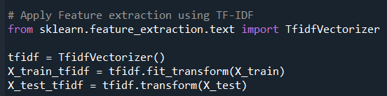
Text Representation with TF-IDF
Term Frequency-Inverse Document Frequency (TF-IDF) vectorization applied.
Transforms text data into numerical weights representing word importance.
Balances term occurrence with its commonness across all documents.
Chosen for its effectiveness in enhancing feature distinction for machine learning.
Notes:
TF-IDF provides a numerical weight for each word, balancing its frequency in each review against its commonness across all reviews.
We preferred TF-IDF over simpler methods because it better distinguishes relevant terms for sentiment analysis, particularly useful in our dataset with prevalent beauty-related jargon.
It ultimately aids our machine learning models in identifying more meaningful patterns in the text.

Slide 5
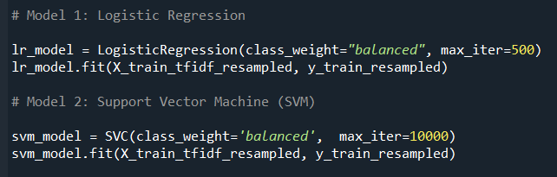
Model Selection for Sentiment Analysis
Chose Logistic Regression and Support Vector Machine (SVM) models.
Logistic Regression: Probabilistic approach, suitable for binary classification.
SVM: Effective in high-dimensional spaces, robust to overfitting.
Notes:
"We selected Logistic Regression for its efficiency in binary and multiclass sentiment classification and its interpretable probabilistic output."
"SVM was chosen for its robustness in handling high-dimensional feature spaces, such as those generated by TF-IDF vectorization, and its effectiveness with a smaller number of samples."
"Both models are well-regarded for their performance in text classification tasks and their ability to produce strong baselines for sentiment analysis."

Slide 6
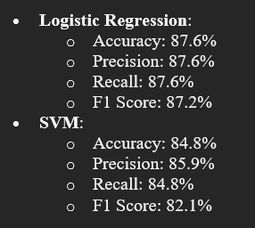
Training Process and Model Accuracy
Highlighted the training process with model.fit.
Displayed the training accuracy for both Logistic Regression and SVM.
Logistic Regression showed robust performance across all metrics with over 87% in accuracy, precision, and recall, leading to an 87.2% F1 score.
SVM displayed strong predictive power with an 84.8% accuracy, slightly higher precision at 85.9%, and an F1 score of 82.1%.
Notes:
The training metrics here give us a direct comparison between the two chosen models. For Logistic Regression, the metrics across the board were impressively consistent, indicating a high level of reliability in its predictions. An F1 score of 87.2% is particularly notable, as it represents the balance between precision and recall.“
"On the other side, SVM showed a slight trade-off between precision and recall, with precision being higher. This could suggest that when SVM predicts a sentiment, it does so with a high level of confidence, although it may not capture as many relevant instances as Logistic Regression."

Slide 7
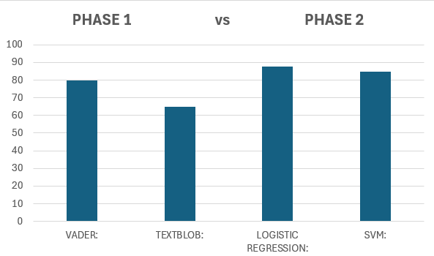
Performance Comparison: Lexicon vs. Machine Learning Models
Showcased the accuracy of each model to highlight the superior performance of ML models.
Lexicon Models: VADER with 79.5% and TextBlob with 65.0% accuracy.
Machine Learning Models: Logistic Regression with 87.6% and SVM with 84.8% accuracy.
Notes:
"Our analysis revealed that Machine Learning models, specifically Logistic Regression and SVM, outperformed the lexicon-based VADER and TextBlob models. This bar chart illustrates the significant accuracy advantage of Logistic Regression and SVM models, indicating their stronger performance in classifying sentiments."
"While lexicon-based models provide a good starting point, the sophistication of Machine Learning models offers a more nuanced understanding of complex language patterns in customer reviews."

Slide 8
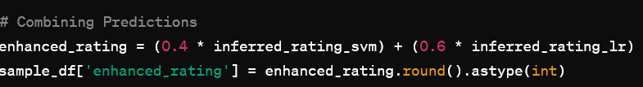
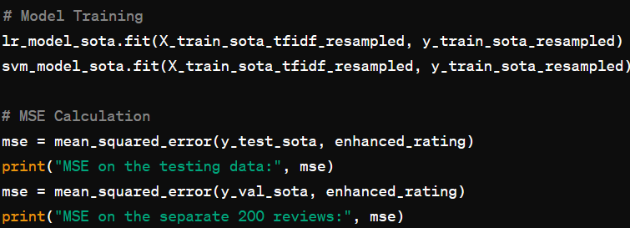
Recommender System Enhancements
Logistic Regression Accuracy: 90.39%
Support Vector Machine (SVM) Accuracy: 100%
MSE on the testing data: 1.007
MSE on the separate 200 reviews: 1.2759
Notes:
"Our recommender system enhancements were inspired by literature that suggested integrating user review sentiments into the rating predictions."
"We trained two separate models: Logistic Regression and SVM, both of which were evaluated using the Mean Squared Error metric to quantify prediction accuracy."
"We then performed a linear combination of the two models' outputs, with weights optimized through trial and error, finally settling on 0.4 for SVM and 0.6 for Logistic Regression, to enhance our rating predictions."
"The calculated MSEs on the testing data and a separate batch of 200 reviews allowed us to assess the effectiveness of our recommender system, with lower MSE scores indicating more accurate predictive performance."

Slide 9
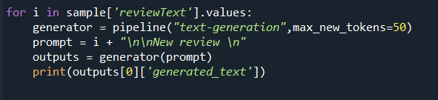

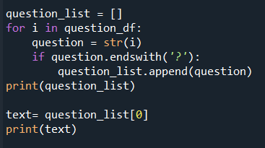
Large Language Model Integration
Summary Generation Code Snippet
Response Generation Code Snippet
We used a text-generation pipeline from Hugging Face to summarize 10 reviews exceeding 100 words. The summaries were concise, encapsulating key sentiments in approximately 50 words. → → → → →
Notes:
"Incorporating Large Language Models into our analysis, we leveraged their advanced capabilities to summarize extensive reviews into concise formats, enabling easier and faster insights into customer sentiments."
"Additionally, we utilized LLM's for generating automated responses to customer queries. This demonstrates a potential application in providing immediate and contextually relevant responses."
We used a text-generation pipeline from Hugging Face to summarize 10 reviews exceeding 100 words. The summaries were concise, encapsulating key sentiments in approximately 50 words.

Slide 10
Summaries Generated by LLM
Original Review: "I got this as part of a gift for the holidays for my mother-in-law. I am sure she is going to love it."
Summary: "A thoughtful holiday gift expected to be well-received by the buyer's mother-in-law.“
2.Original Review: "I have recently purchased this product. My experience with it is bad: it does not deliver promised results and is extremely overpriced. I do not recommend it to anyone."
Summary: "The product fails to meet expectations and is not recommended due to its high price and poor performance.“
3.Original Review: "So I ordered the clear [latex body paint], and while yes I did technically get a latex body paint, I got purple which is not what I ordered. If you're going to order this, I really hope the color doesn't matter to you or your project."
Summary: "Received the wrong color for an order of latex body paint, suggesting caution to future buyers about potential color mismatches."
Notes:
Here are some of the summaries that were generated by the LLM along side the original review

Slide 11
Responses Generated by LLM
1.Original Comment: "If you like electric shave and want to bring some on-board you need these 3-ounce sizes which are TSA friendly."
Response: "The 3-ounce bottles are ideal for travel and comply with TSA regulations for carry-on items.“
2.Original Comment: "They're a smidge shiny and one had a loose thread, but they will definitely serve their purpose."
Response: "Affordable curtain replacements that fulfill their intended purpose despite minor quality issues.“
3.Original Comment: "Revitalash is amazing I have only been using it for three weeks I even used it on my eyebrows I highly recommend it."
Response: "Positive feedback on Revitalash's effectiveness on both eyelashes and eyebrows within a short period."
Notes:
And here is some responses that were generated….These examples are illustrative of the potential outputs from an LLM, demonstrating the model's ability to create valuable summaries and generate helpful responses that could be integrated into customer service platforms, improving engagement and providing clear and concise information to users.

Slide 12
Conclusion and Future Work
Improved sentiment analysis accuracy with ML models over lexicon-based methods.
Effective data preprocessing and representation with TF-IDF.
High training accuracy with Logistic Regression and SVM.
Integration of LLMs for practical customer service applications.
Future directions:
Further optimization of ML models.
Exploration of deep learning techniques for sentiment analysis.
Key findings from Phase 2:
Notes:
"In summary, our Phase 2 advancements have significantly enhanced the accuracy of sentiment analysis. Machine learning models, particularly Logistic Regression and SVM, have outperformed traditional lexicon-based methods. This improvement stems from our effective preprocessing of data and the implementation of TF-IDF for text representation, ensuring that our models could discern the subtleties in customer sentiment more precisely.
Notably, the integration of Large Language Models has opened up new avenues for practical applications, especially in customer service. By summarizing reviews and generating informed responses, these models have the potential to transform customer interaction and support.
As we look to the future, our focus will be on further refining these models to optimize performance. Additionally, we aim to explore deep learning techniques, which hold promise for even more nuanced analysis of customer sentiment. This continuous improvement signals our commitment to staying at the forefront of sentiment analysis technology."

Slide 13
Thank you!
Notes:
THANK YOU!

