Slide 1
SMART COMMUNICATION – PSC193
PIP104 University Project-II
Review-3
Batch Number:
Roll Number | Student Name
20211CBD0007 | Chitrika M
20211CBD0014 | Anupama Haridas
20211CBD0053 | Athmakuru Deepthi
Under the Supervision of,
Dr. SRINIVASAN T R
Professor / Associate Professor / Assistant Professor
School of Computer Science & Engineering
Presidency University

Slide 2
Abstract
The initiative aims to develop an e-commerce platform for rural artisans, particularly in the textiles and handicrafts sectors, using the MERN (MongoDB, Express.js, React, Node.js) framework. The platform provides a structured marketplace for artisans to showcase and sell their handmade products, with MongoDB Atlas ensuring secure data management and React offering a responsive user interface. Key features include various payment methods (Cash on Delivery and online payments), an event creation tool for boosting visibility, and global market access. The platform's goal is to empower artisans by offering a scalable, secure, and user-friendly digital solution that promotes collaboration and connects them to a wider audience.

Slide 3
Introduction
Textiles & Handicrafts: The Lifeline of Rural Communities
Traditional textiles and handicrafts, which play a crucial role in sustaining rural livelihoods in India, reflect the unmatched skill and creativity of local artisans; however, despite their craftsmanship and cultural significance, these artisans often struggle with limited visibility and recognition on a global scale, and this project seeks to bridge that gap by creating a comprehensive digital platform that not only highlights their work but also connects them to broader markets, enabling them to expand their reach, increase sales, and preserve their cultural heritage.

Slide 4
Literature Review
Sl.no. | Paper Title | Proposed Model | Results | Drawbacks
1. | Traditional Handicraft Marketplaces(Physical Stores and Exhibitions) | Face-to-face customer interaction through physical stores or exhibitions. | Builds trust with customers by allowing them to physically inspect products | High operational costs (rent, staffing) and inaccessibility for artisans in remote areas.
2 | General E-Commerce Platforms (e.g., Amazon, eBay) | General e-commerce platforms that provide global reach and logistics support. | Allows artisans to access a wide customer base and benefit from easy-to-use interfaces. | High competition from mass-produced goods, making it hard for handmade products to stand out. Limited focus on promoting cultural or artisanal value
3 | Unspoken Craft: e-commerce Artisan-Specific Marketplaces (e.g., Etsy, Craftsvilla) | Marketplaces focused on handcrafted and unique items, with features like product storytelling and customization. | Helps artisans attract niche audiences and provides specialized features for artisanal products. | High seller competition and visibility challenges without paid advertising. Fees (e.g., listing, transaction) cut into profits.
4 | Social Media Commerce (e.g., Instagram, Facebook Shops) | Social media platforms offering direct access to global audiences with free tools for shop creation. | Potential for viral marketing and direct customer engagement without upfront costs. | Lack of built-in payment or logistics support. Artisans need to be tech-savvy and active on social media for promotion. Visibility depends on algorithms and often requires paid ads.

Slide 5
5 | Government-Supported Platforms (e.g., India Handloom Brand, Handloom Mark Scheme) | Government-backed platforms that promote artisan products with reduced fees. | Government support lends credibility and legitimacy to products, often at lower commissions. | Limited marketing reach compared to private e-commerce platforms. Bureaucratic processes and slower adoption of new technology make the platform less user-friendly.
6 | EPICRAFT- Ecommerce for Artisans (MERN-Based Custom E-Commerce Solutions (e.g., Epicraft)) | Custom-built platforms using the MERN stack (MongoDB, Express.js, React, Node.js) for scalability and full control over branding and features. | Fully customizable, scalable, and secure. Technologies ensure seamless transactions and good performance when hosted on platforms like Heroku and Netlify. | Higher upfront cost and effort for development and maintenance. Artisans may need ongoing technical support post-launch.
7 | Mobile-Only Marketplaces (e.g., Meesho) | Mobile-centric platforms that make it easy for artisans to sell products using smartphones. | High mobile penetration, especially in rural areas, enables access to marketplaces via smartphones. Features like WhatsApp integration simplify communication with customers. | Limited functionality compared to full e-commerce platforms, smaller screen sizes, and reduced capabilities. Focuses more on reselling, which may not align with artisanal needs.
8 | NGO and Non-Profit Platforms (e.g., Sasha, Dastkar) | Platforms that empower artisans through fair wages and ethical trading conditions, while providing training and support. | Focuses on ethical practices and training for sustainability. | Limited scalability and global reach, often focusing on small groups of artisans. Dependence on donations or external funding affects long-term sustainability. Lacks advanced technology and features compared to private e-commerce platforms.

Slide 6
Proposed Method
Website for Artisans: Bridging the Gap
The proposed work aims to improve the platform by adding key features such as secure online payment options (credit/debit cards, UPI, digital wallets) with PCI-DSS compliance, and an enhanced event management system with RSVP, scheduling, reminders, and real-time chat. Sellers will have tools for inventory management, sales analytics, and bulk product uploads. AI-driven recommendations will personalize the user experience, while multi-language support and currency conversion will ensure global accessibility. Community-building features like forums and collaboration spaces will foster engagement. Enhanced communication between buyers and sellers will be supported through live chat, product Q&A, and feedback. A mobile app will be developed for better access and interaction. The platform will incorporate search, authentication, product sorting, and event display algorithms to enhance functionality.

Slide 7
Objectives
Empowering Artisans Through Technology
Empower craftsmen: Create a platform where craftsmen may promote and sell their handmade products directly, eliminating intermediaries and increasing profit margins.
Increase Market Visibility: Broaden artists' reach by linking them with a worldwide audience, making their items more accessible to shoppers.
Assure Product Authenticity: Implement a verification mechanism to assure product authenticity, which will create customer trust while also conserving the integrity of traditional crafts.
Simplify Transactions: Enable secure and seamless transactions with integrated payment gateways, providing a hassle-free experience for both buyers and sellers.

Slide 8
Methodology
How It Works
Account Registration: Artisans create profiles and upload their work.
Sales Tracking & Analytics: Statistics provided for sales, rank, earnings, and views.
Mutual Collaboration: Artisans can create and join events, promoting shared growth.
Transparency: Initially, cash-on-delivery (COD) options ensure trust.
Advanced Features: Once verified, multiple payment options become available.

Slide 9
SYSTEM DESIGN & IMPLEMENTATION
The e-commerce platform connects artisans and customers for the display and purchase of handicrafts. It features a React frontend with dynamic functionality, including a navigation bar, product list, cart management, and checkout process. The cart state is managed using React' s useState and can be expanded with React Context or Redux as complexity grows . The backend handles product, user, cart, and order information, with API endpoints for product listing, cart operations, and order processing. An optional database (e.g., MongoDB) stores product, cart, and order data. The system flow involves users selecting categories, adding products to the cart, and completing checkout. Payments can be processed through Razorpay or PayPal. The frontend is hosted on Netlify, while the backend can be deployed on Heroku. Future features include user authentication, product search, reviews, and a mobile app version.

Slide 10
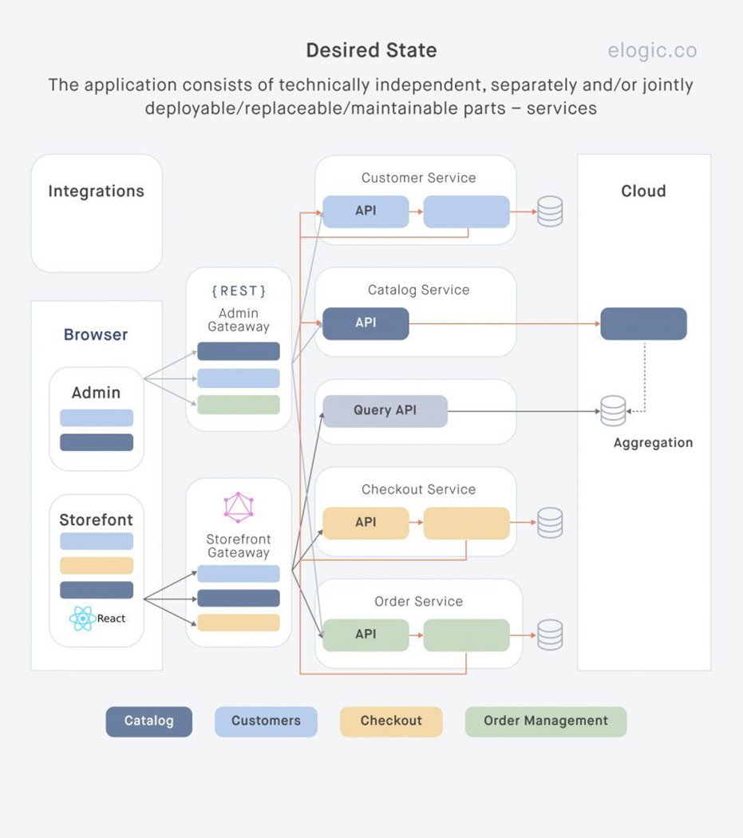
Architecture Diagram

Slide 11
Timeline of Project
Project Timeline Overview
Duration: 3 Months (12 Weeks)
Start Date: September 1, 2024
End Date: November 30, 2024

Slide 12
Phase Completion Milestones
• Week 2: Project Planning Complete
• Week 3: Development Environment Ready
• Week 7: Core Features Implemented
• Week 9: System Integration Complete
• Week 11: Testing Complete
• Week 12: Project Deployment & Handover

Slide 13
Timeline of Project by Gantt Chart
 | 2 | 4 | 6 | 8 | 10 | 12
Data Collection
Literature Survey
Development of Architecture
Deployment and Integration
Continuous Improvement
Report Writing

Slide 14
Expected Outcomes
Anticipated Impact of the Platform
Boost in artisan visibility on both local and international fronts.
New revenue streams via digital commerce.
Strengthened collaboration within artisan communities.
Assurance of product authenticity through transparent transactions.

Slide 15
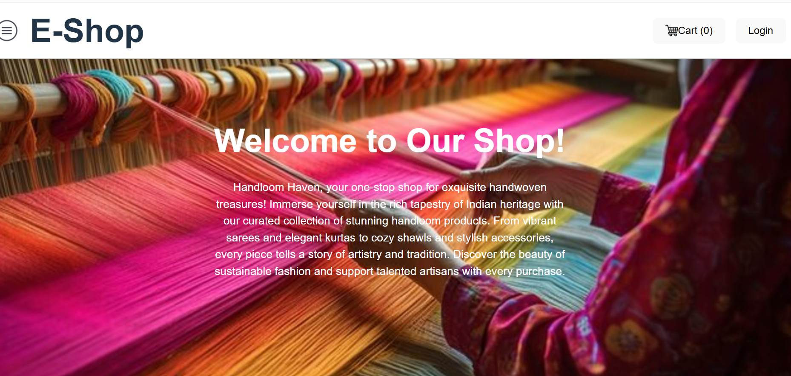
Home Page

Slide 16
Source code:
Checkout:
import React from "react";
import "./styles.css";
export const Checkout = ({
showCart,
setShowCart,
cartItems,
updateQuantity,
removeFromCart,
calculateTotal,
handleCheckout,
}) => {
return (
<>
{showCart ? (
<div className="cart-menu">
<div className="cart-container">
<div className="cart-header">
<h2>Shopping Cart</h2>
<button onClick={() => setShowCart(false)} className="cancel-button">

Slide 17
Conclusion
Smart Communication for a Stronger Artisan Economy
This platform acts as a bridge between artisans and the global marketplace.
With modern technology, rural craftsmanship can find its rightful place on the world stage.
Our initiative not only provides economic opportunities but also preserves cultural heritage.

Slide 18
Github link
https://github.com/chitrika003/smartcommunication.git

Slide 19
References
https://d1wqtxts1xzle7.cloudfront.net/105081538/E_Commerce_Website_for_Artisans
https://www.researchgate.net/profile/HubertEscaith/publication/356931583_Technolog Ecommerce_and_Handicrafts_When_traditional_creators_meet_21st_Century_businessmodels.pdf
https://d1wqtxts1xzle7.cloudfront.net/105081538/E_Commerce_Website_for_Artisans-libre.pdf?1692280230=&response-content-disposition=inline%3B+filename%3DE_Commerce_Website_for_Artisans.pdf
file:///C:/Users/CHITRIKA/OneDrive/Documents/Downloads/PaperpublishedKIIT-Dec-2019.pdf
https://voiceofresearch.org/Doc/Dec-2016/Dec-2016_7.pdf
https://www.researchgate.net/profile/Purvi-Derashri/publication/369742097_India's_Technological_Roadmap_for_MSMEs_Governance

Slide 20
Thank You

