Slide 1
Vaayu Putras
Forecasting Wind Energy

Slide 2
Existing Problem
Wind energy can’t be stored
Wind energy is non-dispatchable energy
Purpose of predicting wind energy is to help energy suppliers

Slide 3

Our Goal
Provide Power Predictions for Any Wind Farm on Earth.

Slide 4
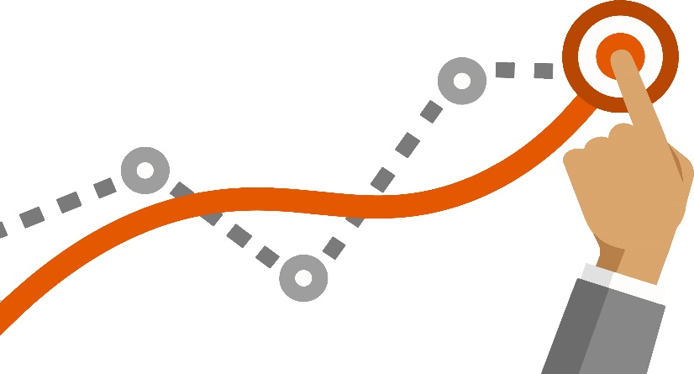
The Approach
Deep learning (LSTM architecture) approach is used for predicting wind power based on weather conditions prevailing on site of Wind Farm.
Highly correlated feature used in modelling like Wind Speed.
The Idea of “Train for Some, Use for All”

Slide 5

Train for Some, Use for All
How to train model from data of some Wind farms and use it for Power prediction of any Wind farm and not lose Accuracy?
Insights from exploring The Domain of Wind Power
Power Curve Scaling

Slide 6
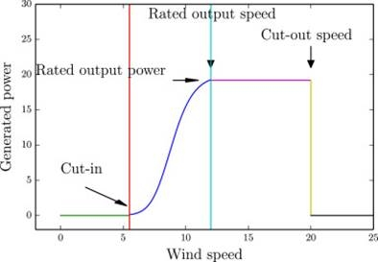
Factors Affecting Wind Power
Cut-in Speed
Cut-out Speed
Power Curve

Slide 7
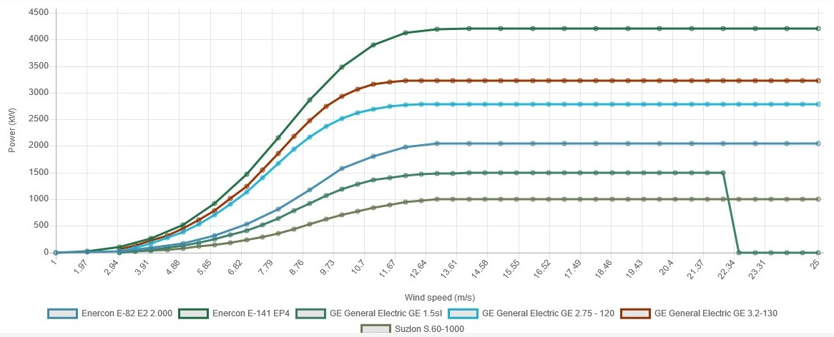
Power Curve Scaling

Slide 8
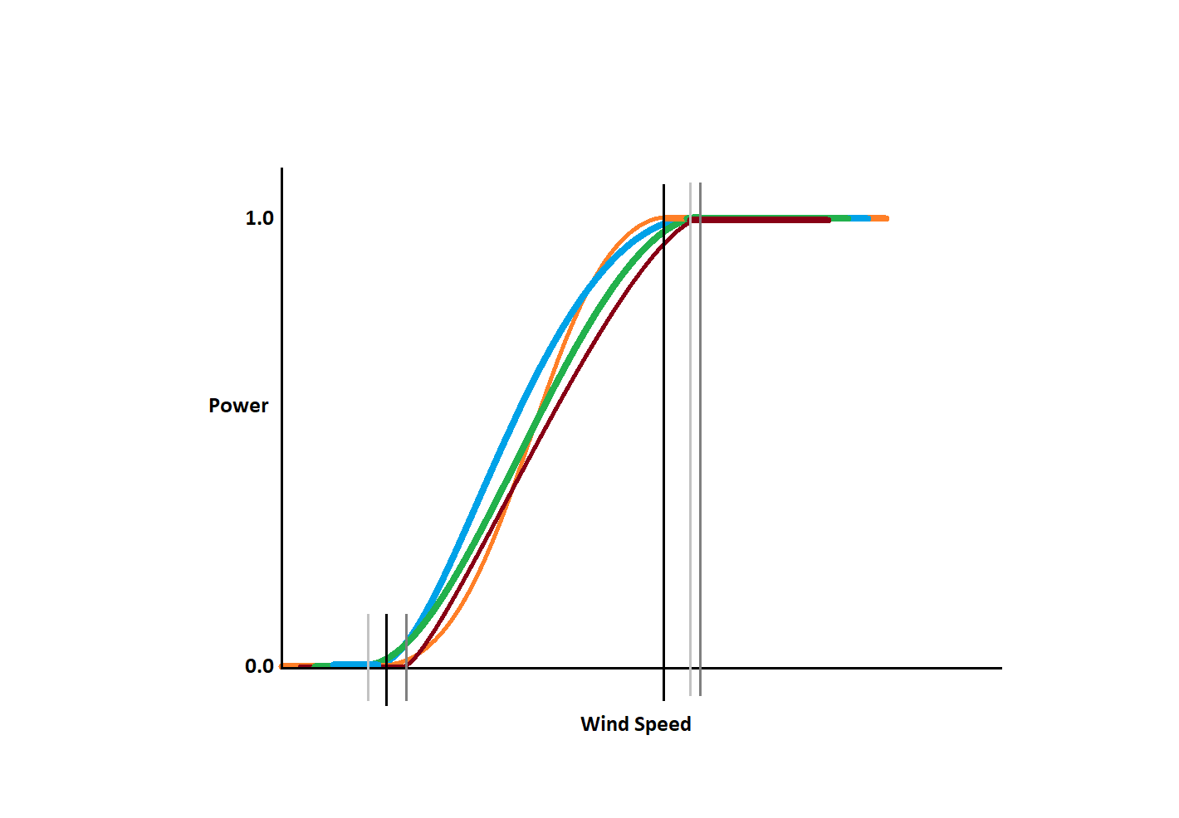
Power Curve Normalization

Slide 9
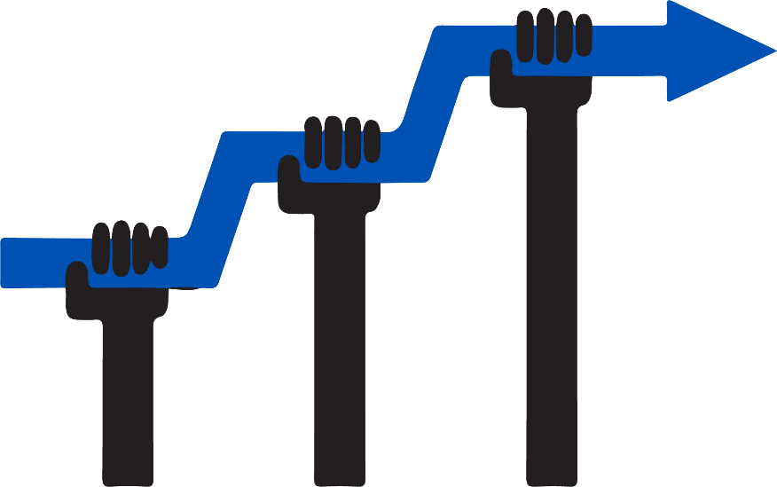
Further Accuracy Improvements
Functionality for Potential Wind Farm Owners to Contact Us and Get Personalized Model Trained for their own Wind Farm for highly accurate Power Predictions.
Future Scope : Automated Model Training

Slide 10
Services
Services
Login/Signup
Wind Farm Power prediction
Wind Farm Economics Calculator
General Prediction
Prediction for specific data
For Selected wind farm
Other than selected wind farm
[Authenticated user only]
[Authenticated user only]
[Allow any user]
[Allow any user]

Slide 11
Provide data in different way
REST API
Chatbot
Website

Slide 12
REST API
API
Power Prediction
Economics Calculator
Not Authenticated User
Authenticated User
For 72 hrs
Foe Specific Hour
For 72 hrs
For Specific Hour
INPUT : Wind Farm name
OUTPUT : 72hrs prediction of that wind farm
INPUT : Wind Farm Name,hour
OUTPUT : Prediction Of that hour
INPUT : API key(In header)
OUTPUT : 72hrs prediction of user's wind farm
INPUT : API key(In header), hour
OUTPUT : Prediction Of that hour
INPUT : FCR, IC,WFC,CF,RPKwh,LLC
OUTPUT : AEP, LRC,OAM, P_{cost to gen,} T_{ae,} I_{g,,} P_{a,} ROI, BEP

Slide 13
Chatbot
Chatbot
Greetings
General
Power Prediction
Economics Calculator
Terminology
Anything Else
Good Morning
Good Afternoon
Good Evening
Hello
General About You
General Connect to Agent
General Agent Capabilities
General Ending
General Negative Feedback
General Positive Feedback
Not Authenticated User
Authenticated User
Prediction for Not Authenticated User
Prediction For Authenticated User
Understanding Wind Farm Related Terminology
Economics Calculator Service
General Human or Bot

Slide 14
Thank You

