Slide 1
PARELLEL FACE RECOGNITION USING SVD
Mentor: Kshitij
Team Members:
Chittaranjan Rath (2018201007)
Prakash Nath Jha (2018201013)
Nitish Srivastava (2018201012)

Slide 2
Work Flow
Data Collection
Data Pre Processing
Data Analysis
Implementation :
K Means
KNN
Average
Ensemble Approach
Comparison of Approaches
Conclusion

Slide 3
Data Collection
Uses various images with faces in the images.
Following are the Data Collection sources ( Depth 255 ):
https://www.cl.cam.ac.uk/research/dtg/attarchive/facedatabase.html
Image format : “.pgm”
Width * Height : 112 * 92
Subject ( Images per Subject ) : 40 ( 8 )
https://cswww.essex.ac.uk/mv/allfaces/faces94.html
Image format : “. jpg
Width * Height : 180 * 200
Subject ( Images per Subject ) : 152 ( 20 )
https://cswww.essex.ac.uk/mv/allfaces/faces95.html
Image format : “. jpg”
Width * Height : 196 * 196
Subject ( Images per Subject ) : 72 ( 20 )
http://vision.ucsd.edu/~iskwak/ExtYaleDatabase/ExtYaleB.html
Image format : “. jpg”
Width * Height : 168 * 192
Subject ( Images per Subject ) : 38 ( 64 )

Slide 4
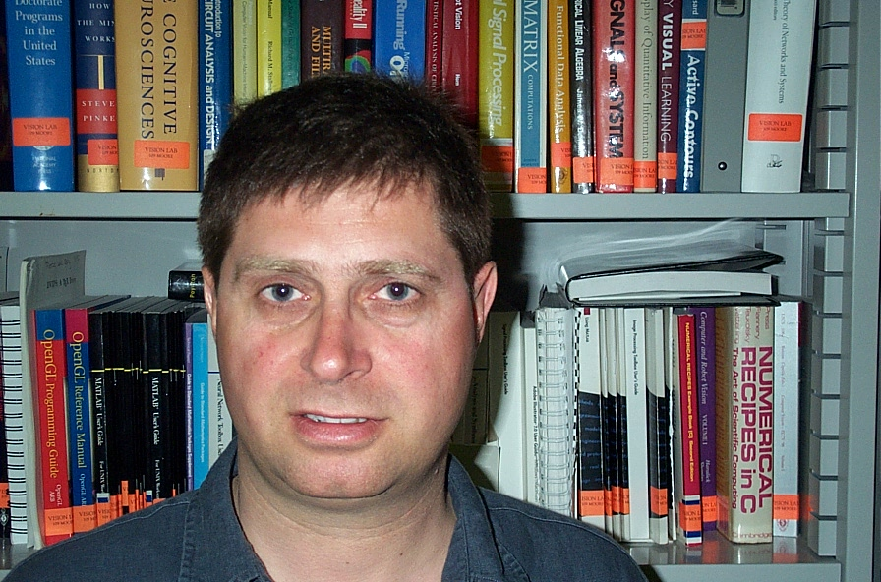
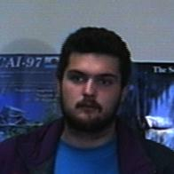
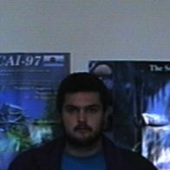
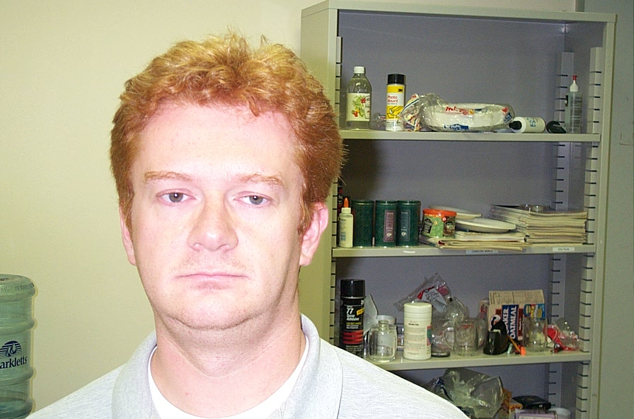
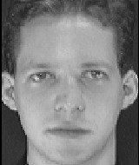
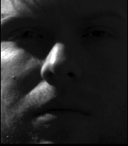
SAMPLE IMAGES CONSIDERD
Image Considered
Image NOT Considered

Slide 5
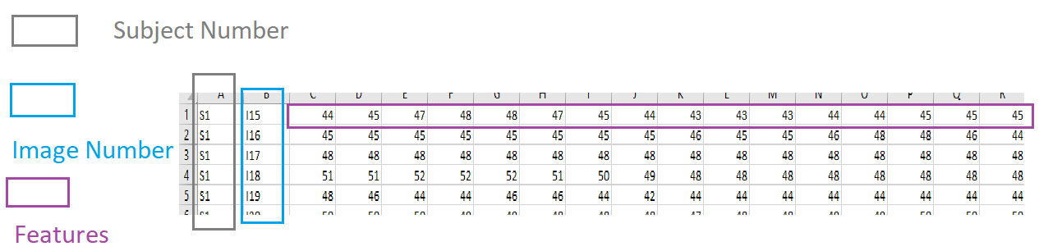
Data PRE-PROCESSING
Converted image to pixels using python library.
Data Set Name | Type Of DataSet | Rows | Column
cl.cam.ac.uk | Small | 432 | 10,304
Faces95 | Large | 1008 | 38,416‬
Faces94 | Large | 2128 | 36000
Yale | Large | 2,432 | 32,256‬

Slide 6
Data PRE-PROCESSING
Performed SVD on image dataset.
Kept Threshold of retaining 90 % of information.
Uses Eigen Library for Performing SVD
As per metrics following is no of feature(s) / column(s) :
https://www.cl.cam.ac.uk/research/dtg/attarchive/facedatabase.html
Column Considered With PCA : 224
https://cswww.essex.ac.uk/mv/allfaces/faces94.html
Column Considered With PCA : 963
https://cswww.essex.ac.uk/mv/allfaces/faces95.html
Column Considered With PCA : 592
http://vision.ucsd.edu/~iskwak/ExtYaleDatabase/ExtYaleB.html
Column Considered With PCA : 748

Slide 7
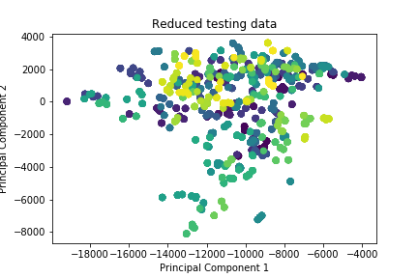
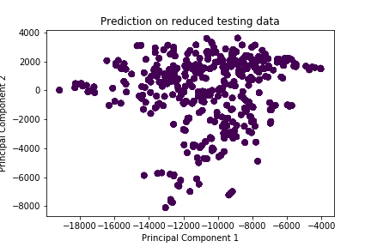
KMEans Implementation
Reduced testing Faces 95
Faces 95

Slide 8
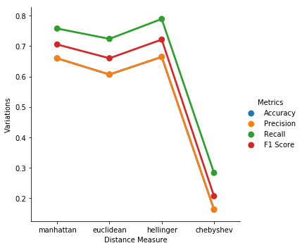
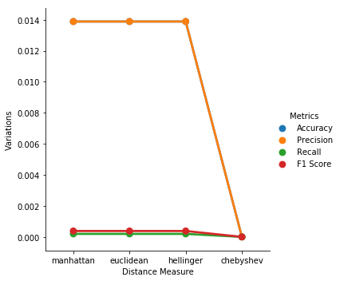
KMEans Implementation
RIGHT CONTRA…. ( keeping reference of Previos Slide)

Slide 9
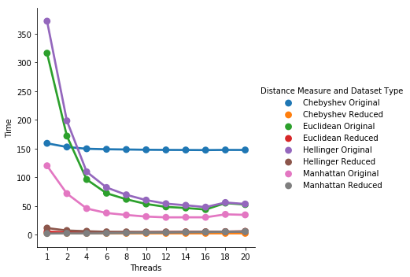
KMEans Implementation

Slide 10
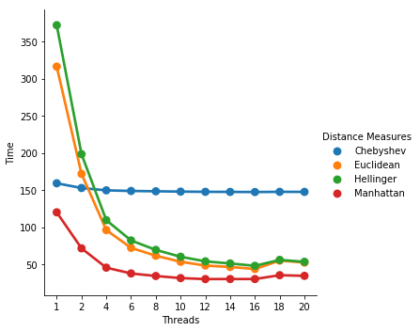
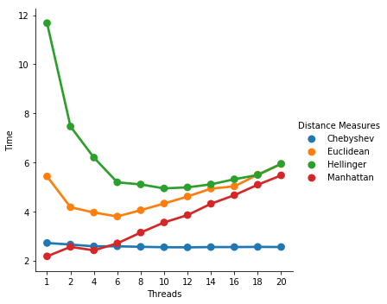
KMEans Implementation
Only For Original vs REDUCED FaCE 95

Slide 11
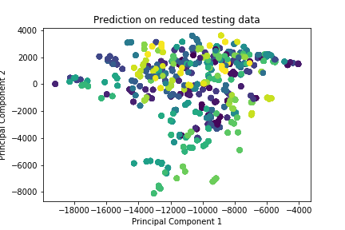
KNN STARTED
Reduced and Predicted testing FACE 95

Slide 12
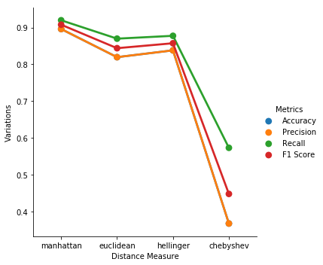
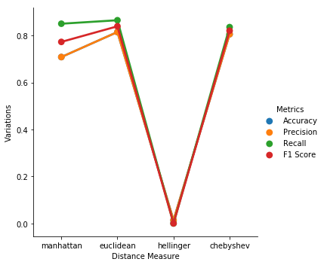
KNN
Reduced and Predicted testing FACE 95

Slide 13
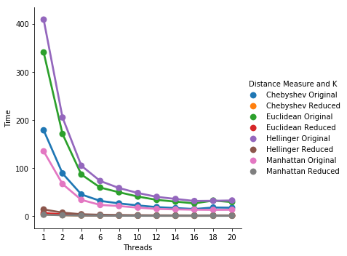
KNN
Reduced and Predicted testing FACE 95

Slide 14
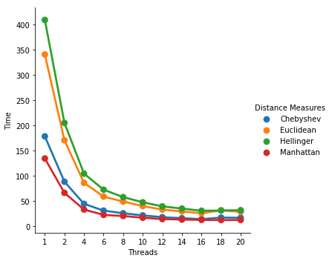
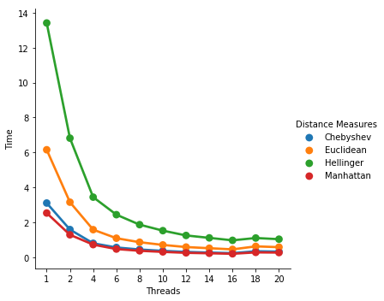
KNN
ON ORIGINAL and redcued thread vs time Faces 95

Slide 15
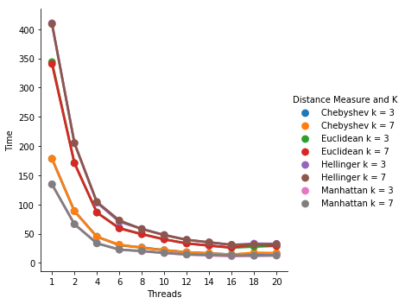
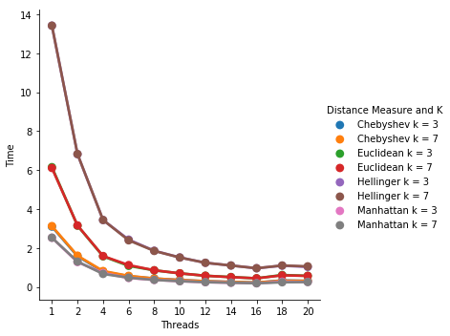
KNN
ON ORIGINAL and redcued Faces 95

Slide 16
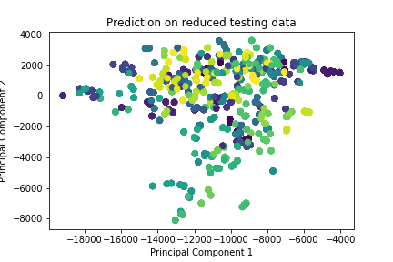
AVERAGE FACES STARTED
Reduced AND PREDICTED testing FACES 95

Slide 17
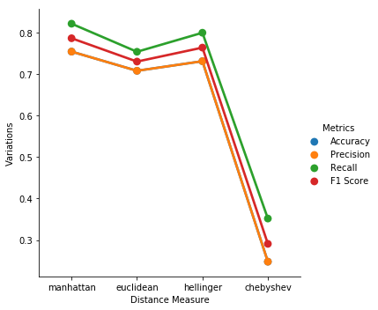
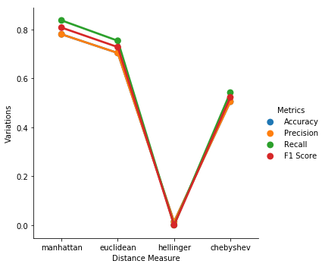
AVERAGE FACES
ORIGINAL and REDUCED testing FACE 95

Slide 18
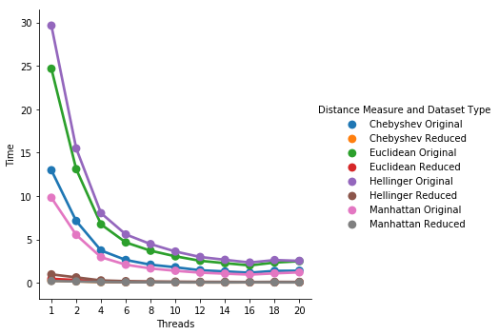
AVERAGE FACES
Reduced and Predicted testing FACE 95

Slide 19
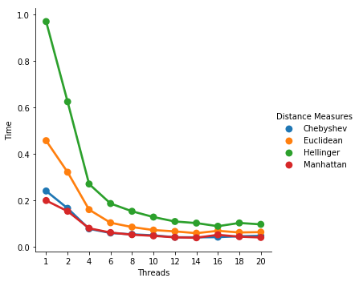
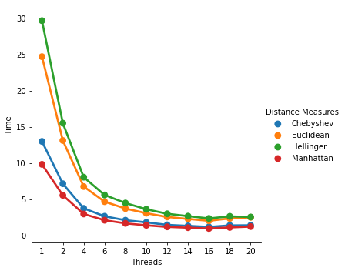
AVERAGE FACES
ON ORIGINAL and redcued Faces 95

Slide 20
Implementation APPROACHES
KMeans
Start
Perform SVD
KNN
End
Average

Slide 21
OBSERVATIONS ON DataSET

Slide 22
OBSERVATIONS BASED ON Criteria
Based on Problem Statement :
Based on approaches applied , model is underperforming because it’s quiet difficult to manually interpret problem statement.
Most content of problem statement is not directly related to problem in hand.
As inferenced from word cloud there are only less things observed.
Based on Solution :
Multiple Solution has been considered for each problem.
Linear SVC performs well on Solution without using any word embedding.
LSTM underperformed because English language based word embedding is used.

Slide 23
CONCLUSIONS
LSTM is under-performing as to Linear SVC because of loosing programming language semantics.
Post Handling class Imbalance , we observed better performance.
Considering multiple solution for particular problem aids to better performance.

Slide 24
Thank you

