Slide 1
PARALLEL FACE RECOGNITION USING SVD
Team Members:
Chittaranjan Rath (2018201007)
Prakash Nath Jha (2018201013)
Nitish Srivastava (2018201012)

Slide 2
Work Flow
Data Collection
Data Pre Processing
Implementation :
K Means
KNN
Average Face
Ensemble Approach
Comparison of Approaches
Conclusion

Slide 3
Data Collection
Uses various images with faces in the images.
Following are the Data Collection sources ( Depth 255 ):
https://www.cl.cam.ac.uk/research/dtg/attarchive/facedatabase.html
Image format : “.pgm”
Width * Height : 112 * 92
Subject ( Images per Subject ) : 40 ( 8 )
https://cswww.essex.ac.uk/mv/allfaces/faces94.html
Image format : “. jpg
Width * Height : 180 * 200
Subject ( Images per Subject ) : 152 ( 20 )
https://cswww.essex.ac.uk/mv/allfaces/faces95.html
Image format : “. jpg”
Width * Height : 196 * 196
Subject ( Images per Subject ) : 72 ( 20 )
http://vision.ucsd.edu/~iskwak/ExtYaleDatabase/ExtYaleB.html
Image format : “. jpg”
Width * Height : 168 * 192
Subject ( Images per Subject ) : 38 ( 64 )

Slide 4
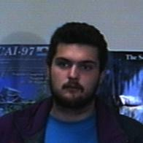
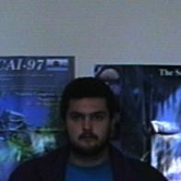
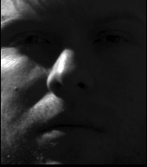
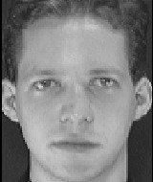
SAMPLE IMAGES
Image Considered
These image data set were considered , as many images has less noisy background.

Slide 5
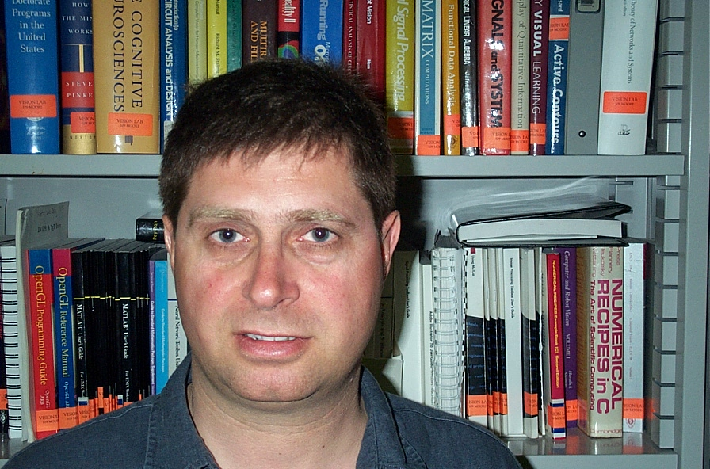
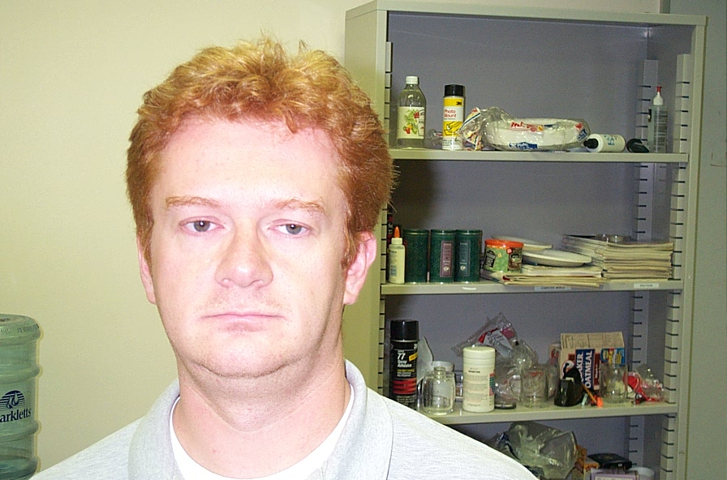
SAMPLE IMAGES
Image NOT Considered
Dataset containing these images had a lot of noisy background. Hence not considered.

Slide 6
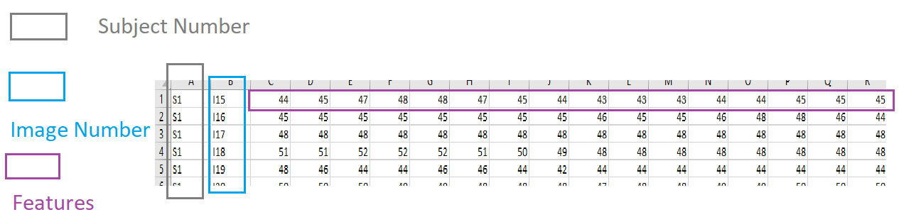
Data PRE-PROCESSING
Converted image to pixels using python library.
Data Set Name | Type Of DataSet | Rows | Column
cl.cam.ac.uk | Small | 432 | 10304
Faces95 | Large | 1008 | 38416‬
Faces94 | Large | 2128 | 36000
Yale | Large | 2432 | 32256‬

Slide 7
Data PRE-PROCESSING
Performed SVD on image dataset.
Kept Threshold of retaining 90 % of information.
Uses Eigen Library for Performing SVD
As per metrics following is no of feature(s) / column(s) :
https://www.cl.cam.ac.uk/research/dtg/attarchive/facedatabase.html
Column Considered With PCA : 224
https://cswww.essex.ac.uk/mv/allfaces/faces94.html
Column Considered With PCA : 963
https://cswww.essex.ac.uk/mv/allfaces/faces95.html
Column Considered With PCA : 592
http://vision.ucsd.edu/~iskwak/ExtYaleDatabase/ExtYaleB.html
Column Considered With PCA : 748

Slide 8
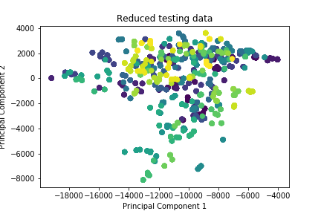
Exploratory Data ANALYSIS(FACES95)
Presenting two Principal Component .
No Cluster can be observed, as the data point of particular subject is scattered through out the graph. E.g. Green Color
Classes shown by different color are over lapping.
May not get good accuracy on kmeans from here ( to delete )

Slide 9
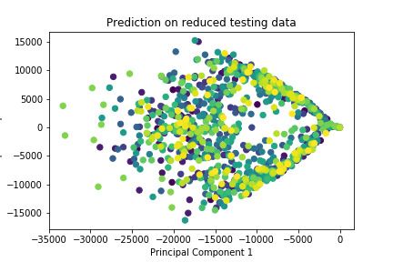
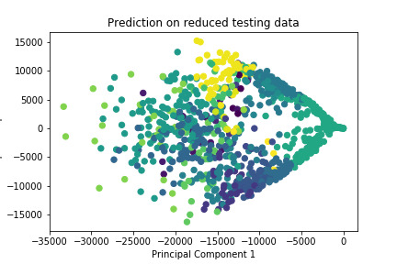
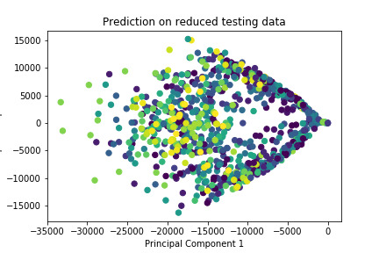
Exploratory Data ANALYSIS ON YALE
Original Data Set
Average Face
KNN Predicted

Slide 10
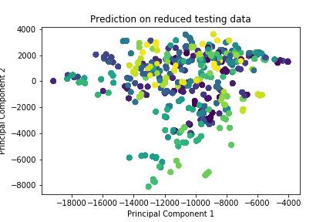
ENSEMBLE ON FACE 95 DATASET
From Right part , predictions are done on basis of all the three approaches and average out the performance metrices.

Slide 11

KNN IMPLEMENTATION
On Face 95 Data Set
Presenting two Principal Component .
Above results are for k = 3, observing good result for the same as to that of kMeans.

Slide 12
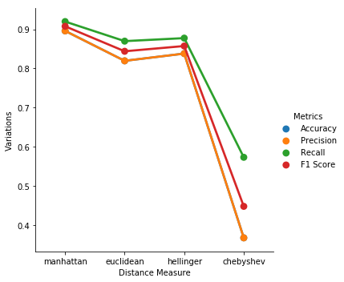
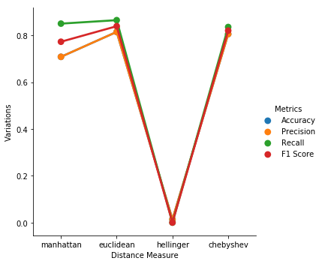
KNN IMPLEMENTATION
On reduced dataset , Hellinger underperform as scalar value have possibility of non positive number post performing SVD.
But Hellinger is good on original data set , because of depth of image from 0-255.
Because of performing SVD , information is getting lost so we can see the difference in terms of accuracy with reduced as to that of original dataset.

Slide 13
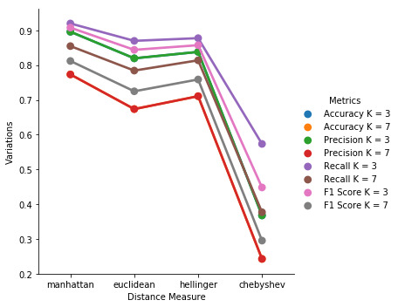
KNN IMPLEMENTATION
For k = 3 and K = 7 ; irrespective of distance measures k = 3 will perform better based on F1 score measure.

Slide 14
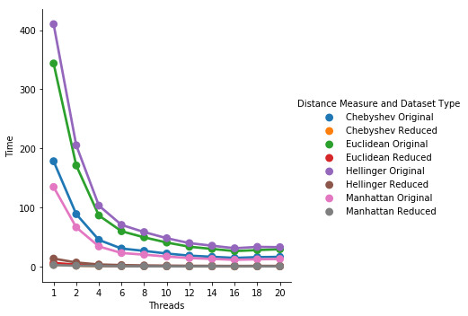
KNN IMPLEMENTATION
Because of applying SVD , time for reduced dataset is less.
For K = 3.
As observed , post #thread of 16 , we are seeing a small spike. Because load distribution and overhead switching is good till 16 , but post that it is not doing well ; because may be overhead is more.

Slide 15
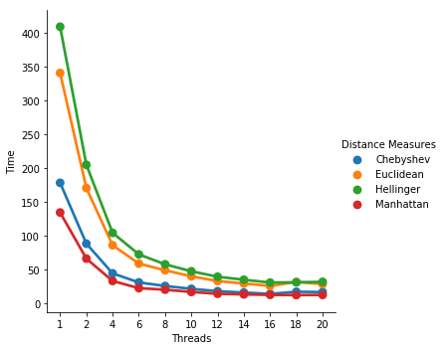
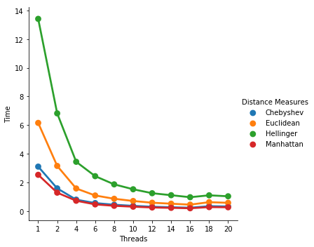
KNN IMPLEMENTATION
After #thread post 16 , we are seeing a small spike in execution time.

Slide 16
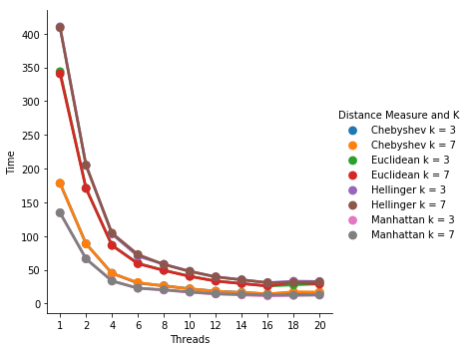
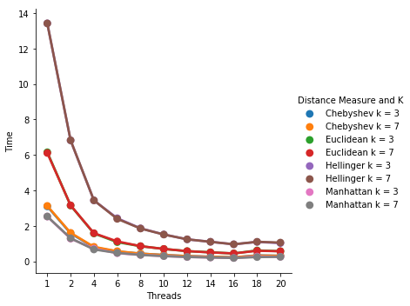
KNN IMPLEMENTATION
As we see overlapping graph for all distance measure for k = 3 and k =7. Reason of it , is there will be not much marginal difference in time while computation.
As computation in Euclidean and Hellinger is more, hence net time taken for both is comparatively high than Manhattan and Chebyshev.

Slide 17
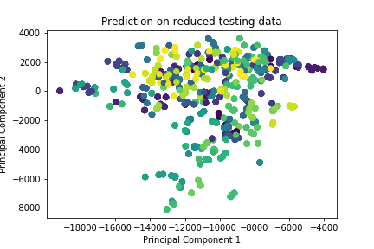
AVERAGE FACES IMPLEMENTATION
Presenting two Principal Component .
An special case for K-Means , with considering best possible centroid locations are given, which are average for the classes.
Observed from above , it is performed very well on testing data.

Slide 18
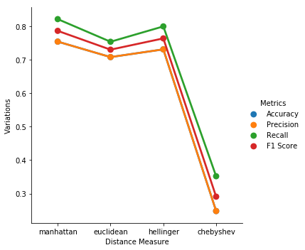
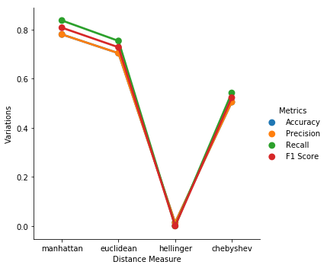
AVERAGE FACES
On reduced dataset , Hellinger underperform as scalar value have possibility of non positive number post performing SVD.
Now Hellinger is good on original data set , because of depth of image from 0-255.
Because of performing SVD , information is getting lost so we can see the difference in terms of accuracy with reduced as to that of original dataset.
Overall , Manhattan and Euclidean distances are more robust as to that of other distance measures.

Slide 19
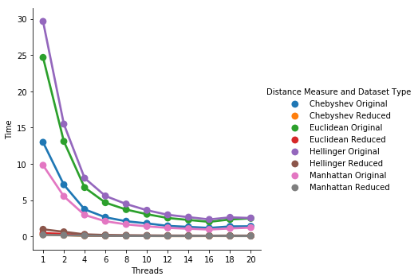
AVERAGE FACES
Because of applying SVD , time for reduced dataset is less.
Observation is less time taken for implementation as to that of kNN , because we are performing parallel centroid mean computation ( independent of other classes )

Slide 20
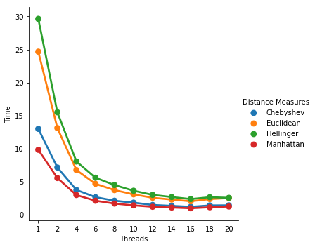
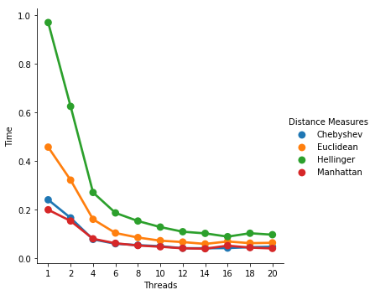
AVERAGE FACES
After #thread post 16 , we are seeing a small spike in execution time.
As computation in Euclidean and Hellinger is more, hence net time taken for both is comparatively high than Manhattan and Chebyshev.

Slide 21


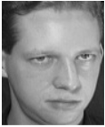

SAMPLE OF AVERAGE FACE
Actual Face
Average Face

Slide 22
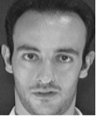



ACTUAL V/S PREDICTED
Implementation
Actual Face
Predicted Face
KMeans
KNN
Average

Slide 23
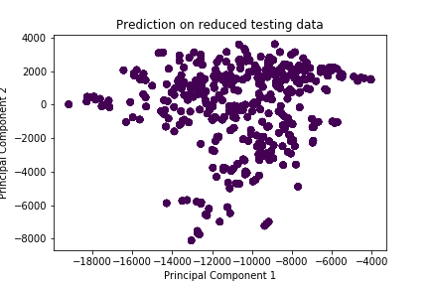
KMEans Implementation
From Right part , all points gets associated to single cluster.
All cluster may belong to same class ( to del )

Slide 24
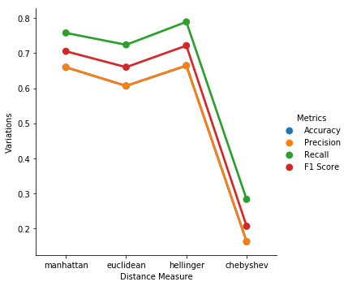
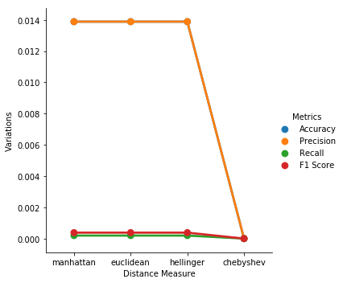
KMEans Implementation
On Face 95 Data Set
For observed data set(s), Chebyshev is underperforming ( low on F1 Score ).

Slide 25
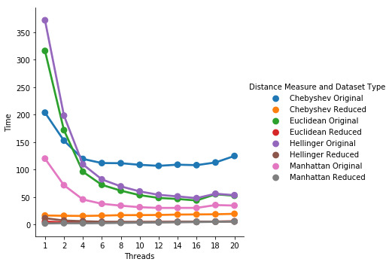
KMEans Implementation
Because of applying SVD , time for reduced is less.
As observed , post #thread of 16 , we are seeing a small spike. Because load distribution and overhead switching is good till 16 , but post that it is not doing well ; because may be overhead is more.

Slide 26
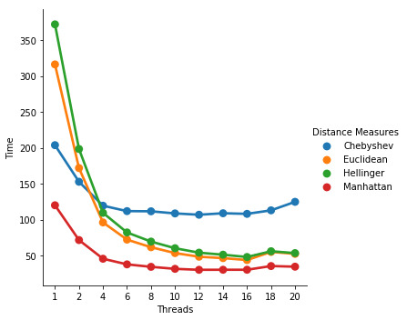
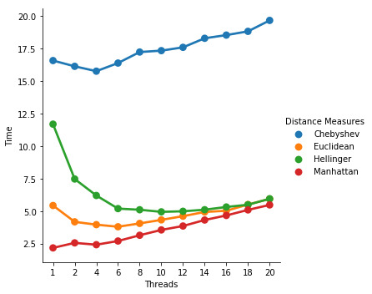
KMEans Implementation
Because of applying SVD , time for reduced is less shown by time axis ( right fig ).
Due to thread overhead ( by increasing threads ) , time is increasing.
Possible reasons are Synchronization in memory ; thread overhead ( to delete ).
Because of implementation perspective Chebyshev is not with pragma implementation how it should be ( to delete )

Slide 27
Implementation APPROACHES
KMeans
Start
Perform SVD
KNN
End
Average
Ensemble Approach

Slide 28
PARELLISED Code SNIPPET
Not Used Barrier
Not Used schedule static ; dynamic ; guided :
Because dynamic memory allocation is being done ( vector push back ) and we do not know the size of vector before hand especially in kmeans implementation.

Slide 29
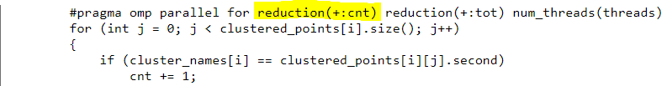
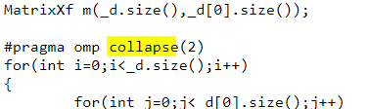
PARELLISED Code SNIPPET
Usage of Reduction :
Usage of Collapse :
Usage of Parallel For :
No Wait :
Variations based on number of threads
False Sharing has been prevented for Chebyshev distance in parallel.

Slide 30
CONCLUSIONS

Slide 31
Thank you

