Slide 1

[Samsung PRISM] Mid Review Report
Database System for Devices Launched in the Market
Worklet ID: SE22KLU
Team
College Professor(s): Dr. B Bikram Kumar
Students:
Arza Hashitha
Gumma Chittaranjan
Thota Hemanth Kasinadh
Department: CSE
Date: 5 Aug 2019

Slide 2

Worklet template

Slide 3
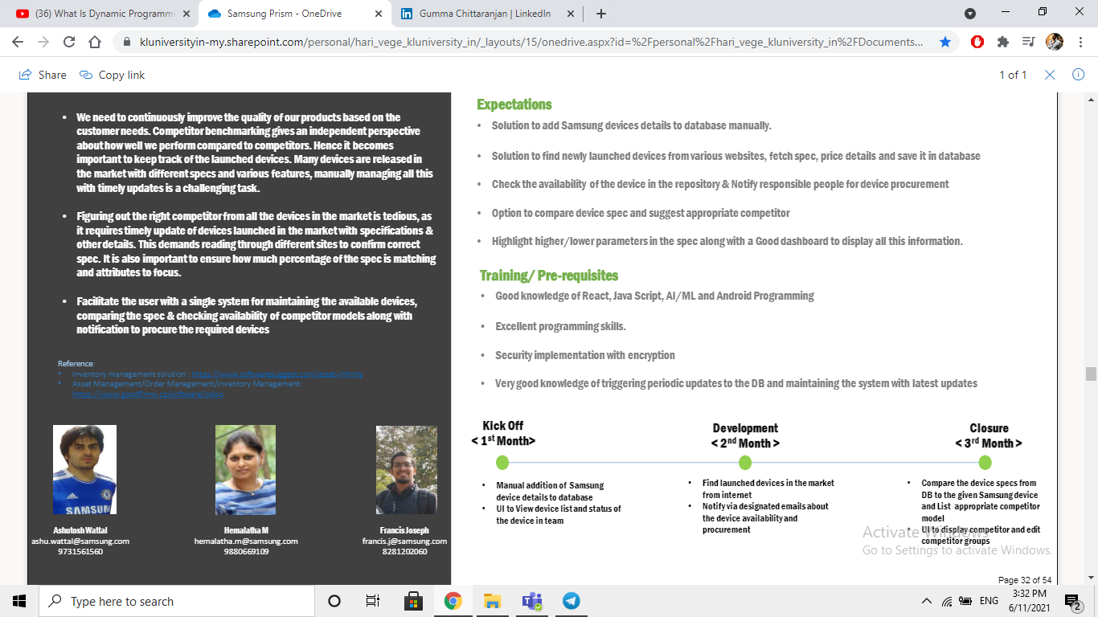
Database System for Devices Launched in the Market
Notes:
-

Slide 4
Proposed Approach / Solution
Concept Diagram :
( Clear detailed schematic / block diagram / flow chart depicting the proposed concept / solution )

Slide 5
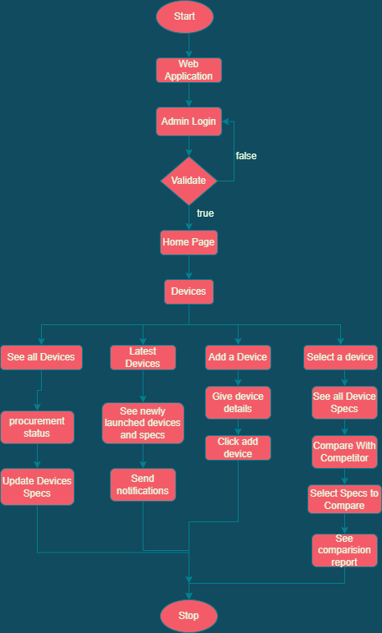

Slide 6
Dataset(s) Analysis / Description
Dataset Capture / Preparation / Generation :
(Discuss the dataset generation process or if downloaded data provide details of what data & from where it was obtained etc… - 2 to 3 bullets only)
By using web scraping we generated competitor data.
Competitor Data was collected from this website https://www.gsmarena.com/
Dataset Understanding / Analysis :
(Provide 2 to 3 bullets about what is your understanding of the data / opinion about the data)
The data is about the specifications of the various competitor mobile devices.
Collected data is not in required format for comparison.
Dataset Pre-Processing / Related Challenges (if any) :
(List out the challenges you fore see in data handling wrt problem definition – 2 to 3 bullets only)
Need to change the format of the collected data.
Missing data have to be replaced with the actual values.

Slide 7

Experimental Results / Simulations / Observations
Results :
(provide numerical data / bar charts / plots / images / videos / tabulated results etc. Use full slide or multiple slides up to max 3 slides to demonstrate the results)

Slide 8
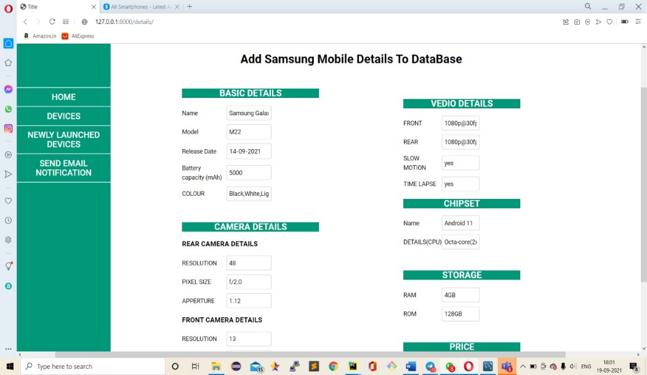
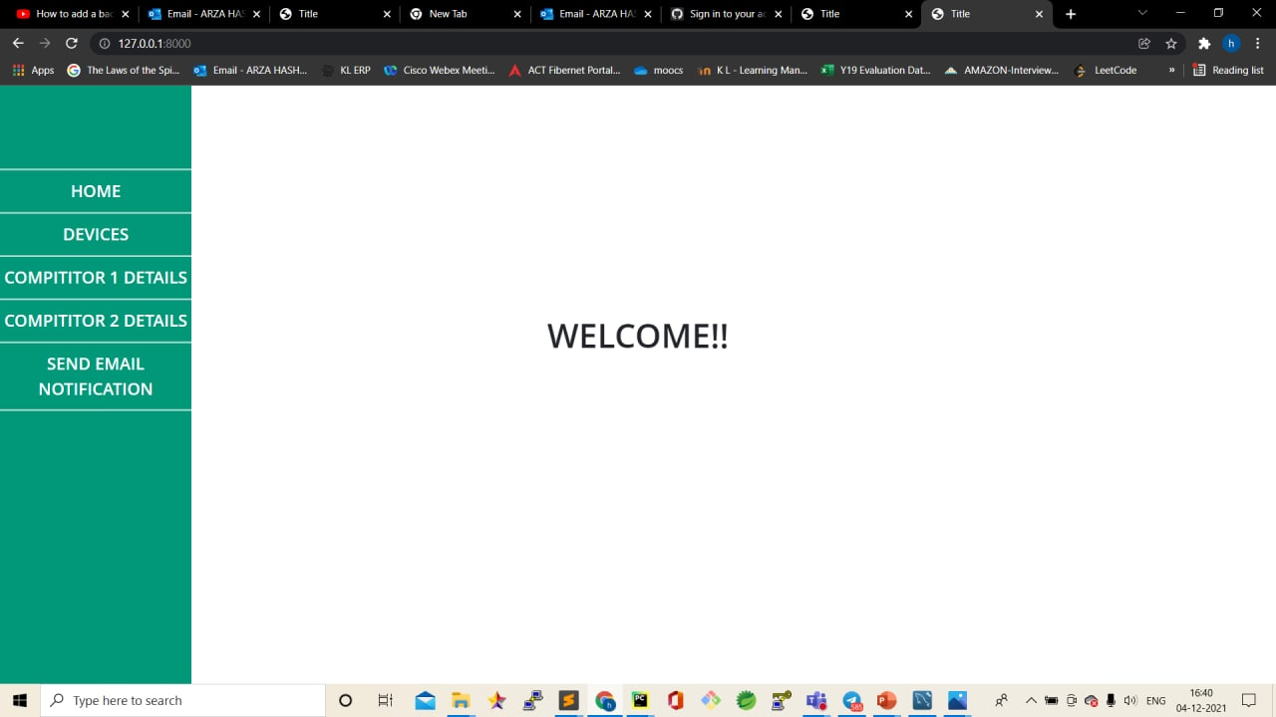
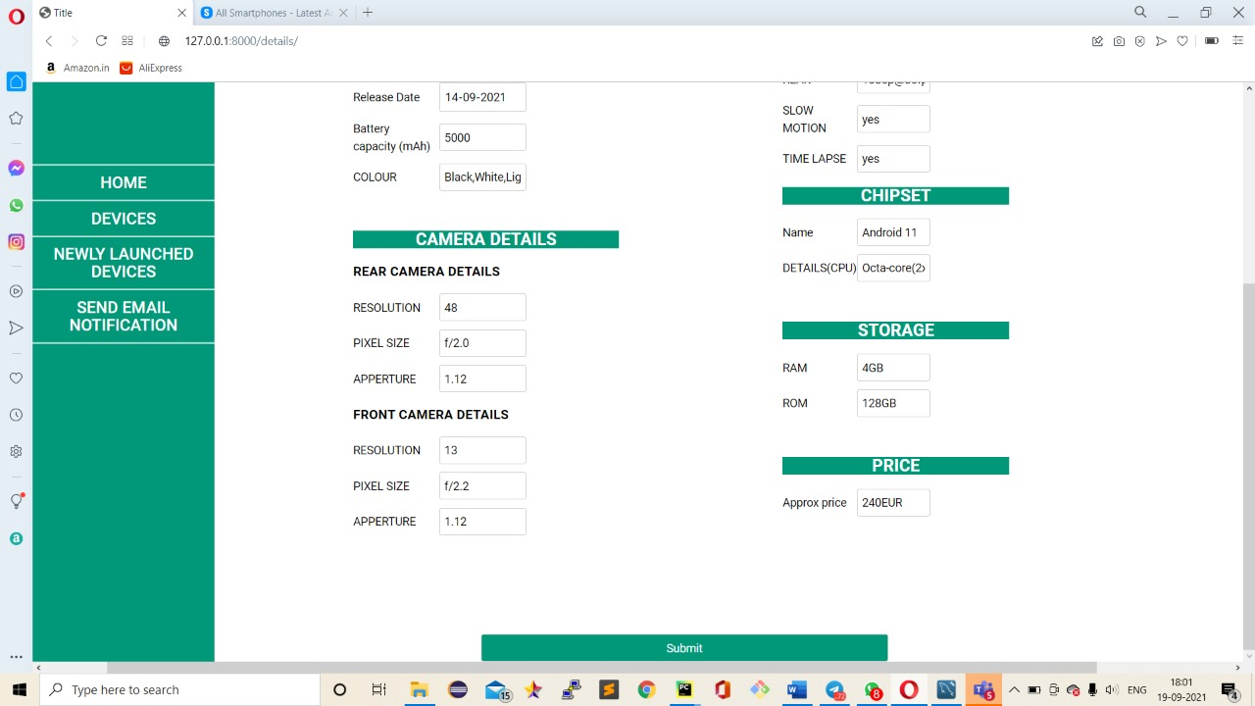
Adding Samsung devices to database
Home Page

Slide 9
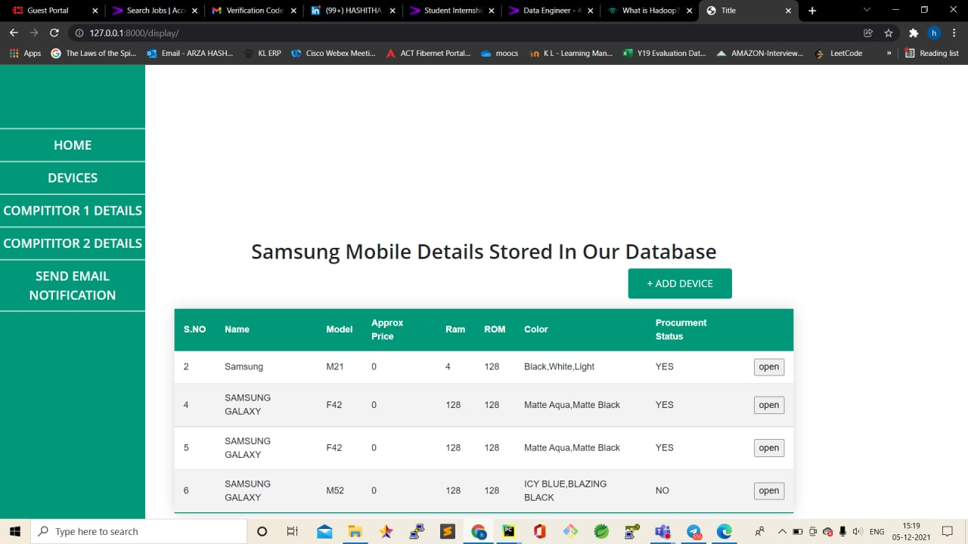
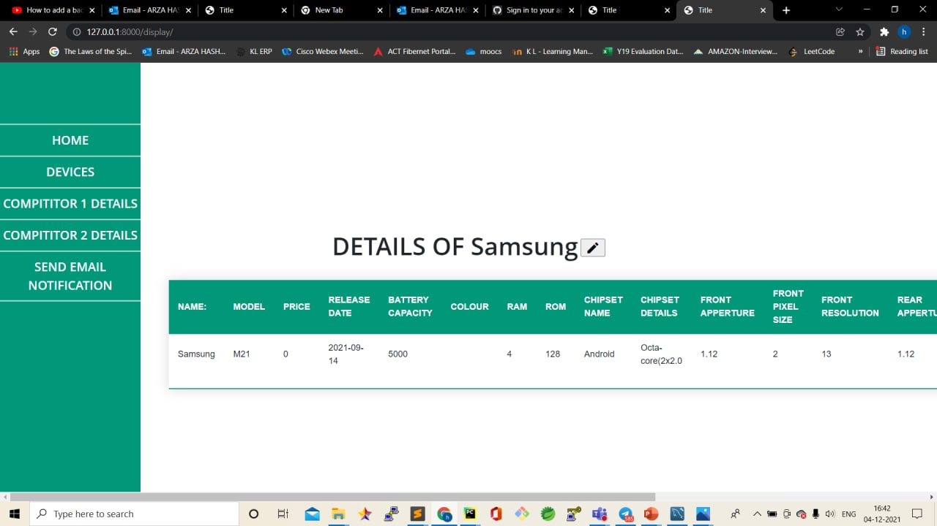
All Samsung Devices
Selected Device specs

Slide 10

UpdatingSamsung device specifications

Slide 11
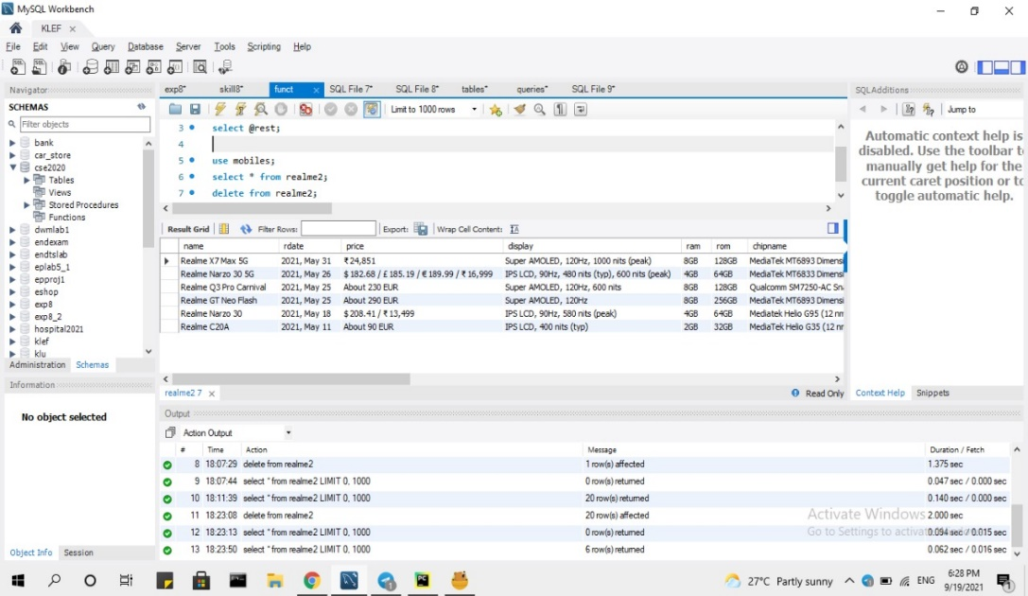
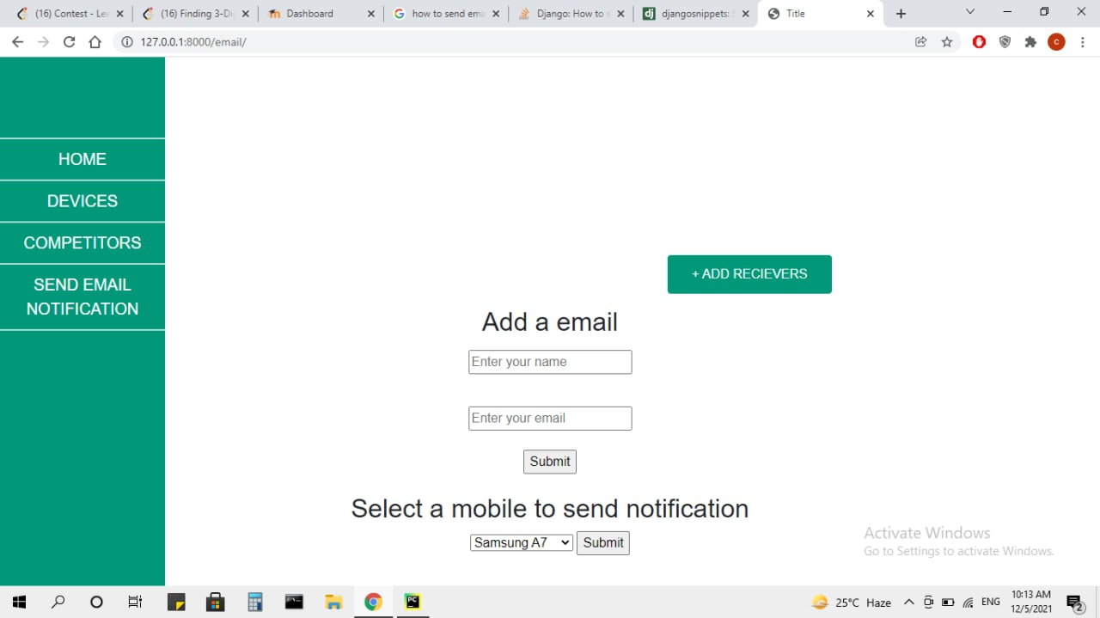
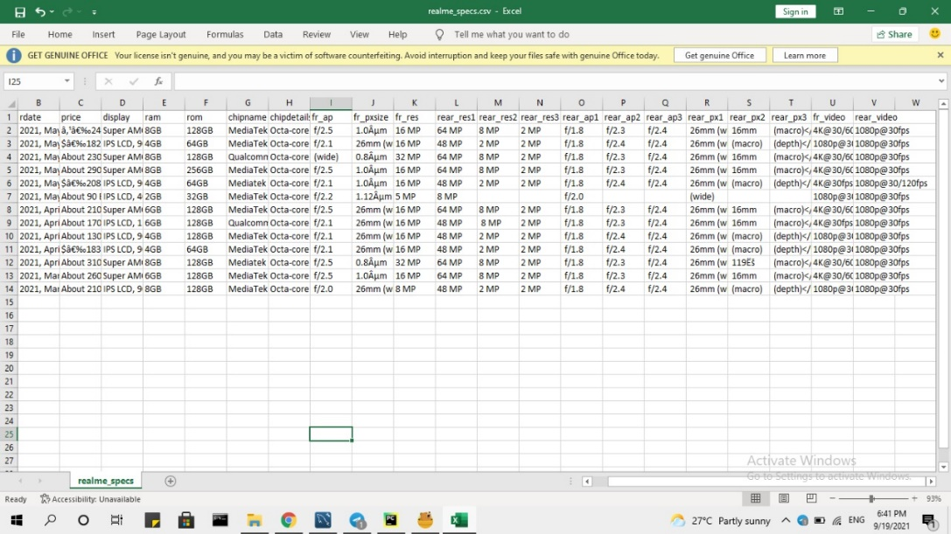
Scraped competitor data
Add emails/Send Notification

Slide 12
Major Observations / Conclusions & Challenges :
(provide details about your findings, experimental opinion – Use separate slide if necessary)
Data needs to do some data preprocessing before comparison.
Choosing the right competitors
Data collected by web scraping is not in a required format.
Web pages not allowing too many request for crawling the data.

Slide 13
Further Plan to Complete Project
Final Probable Deliverables :
(Discuss in the form of bullets, what are the next steps to complete the solution, any road blocks / bottlenecks, any support needed from SRIB)
Next Steps
Comparison and highlighting.
Changing UI
Updating competitors
IP Target / Plan :
(Any possibility of papers / patentable ideas / innovative aspects that can lead to patentable ideas)
Comparison report (Highlighting specs)

Slide 14
Further Plan to Complete Project
Completion Plan:
(High level plan to complete the project in next 8 weeks after review, in format below)
Week 1 to 2
Step 1
Step 2
Week 3 to 4
Step 1
Week 5 to 6
Step 1
Step 2
Week 7 to 8
Step 1
Step 2
Step 2
Data preprocessing
User friendly UI
Choosing Comparison Algorithm
Comparison backend logic creation
Displaying comparison based on colors
Comparison UI selection
Updating competitors for comparison
Testing and website hosting
Challenges Anticipated:
Choosing right comparison algorithm
Displaying comparison report with a proper UI
Git Upload details:
Uploaded

Slide 15
Thank you

