Slide 1
Database system for Devices Launched in the Market
Faculty name:
Dr. Bikram Kumar
Student Team:
Worklet ID: SE22KLU
Name | Id Number
Arza Hashitha | 190030102
Gumma Chittaranjan | 190030561
Thota Hemanth Kasinadh | 190031616

Slide 2
Problem Definition and Expected KPI’s
To build a Database System that stores Samsung mobile specifications and compare the specifications with the competitors and the system have other features like notifying about procurement status and scraping competitor mobile specifications from internet.
Expected KPI’s
Manual addition of Samsung device details to database
UI to view device list and status of the device
Find launched devices in the market from internet (Competitor)
Notify via designated emails about device availability and procurement
Compare device specifications from database to the given Samsung device and list appropriate competitor model
UI to display competitor and edit competitor groups

Slide 3
KPI’s Achieved till now and New expectations
KPI’s Achieved
Manual addition of Samsung device details to database
UI to view device list and status of the device
Find launched devices in the market from internet (Competitor)
Notify via designated emails about device availability and procurement
New Expectations
Have to focus more on camera specification and highlight those.

Slide 4
Technical Challenges and how Team Solved these
Faced difficulty in choosing right specifications required.(We Solved this by focused on important specifications required for comparison)
Faced difficulty in scraping competitor specs from the webpages like we are getting too many requests while fetching data from a web page. ( So we solved this by using Library called Beautiful Soup)
Extracting required data from entire scraped html pages. (Solved this by using Beautiful Soup python library)

Slide 5
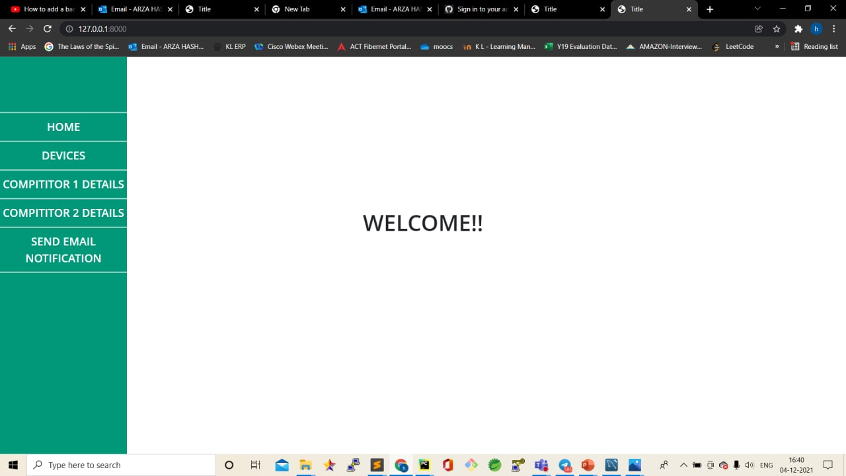
Results

Slide 6
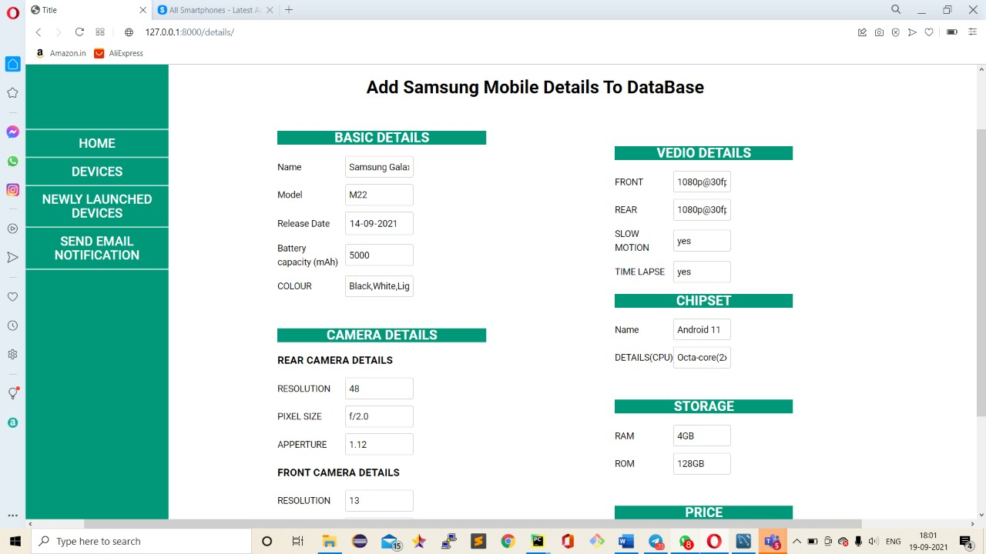
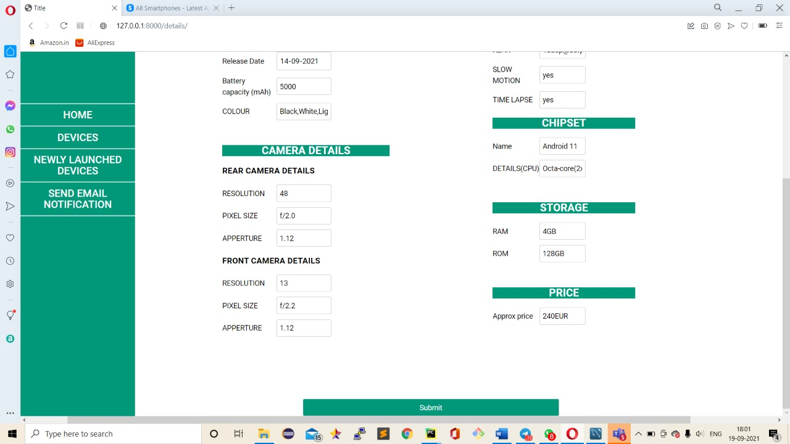
Adding Samsung device specs

Slide 7
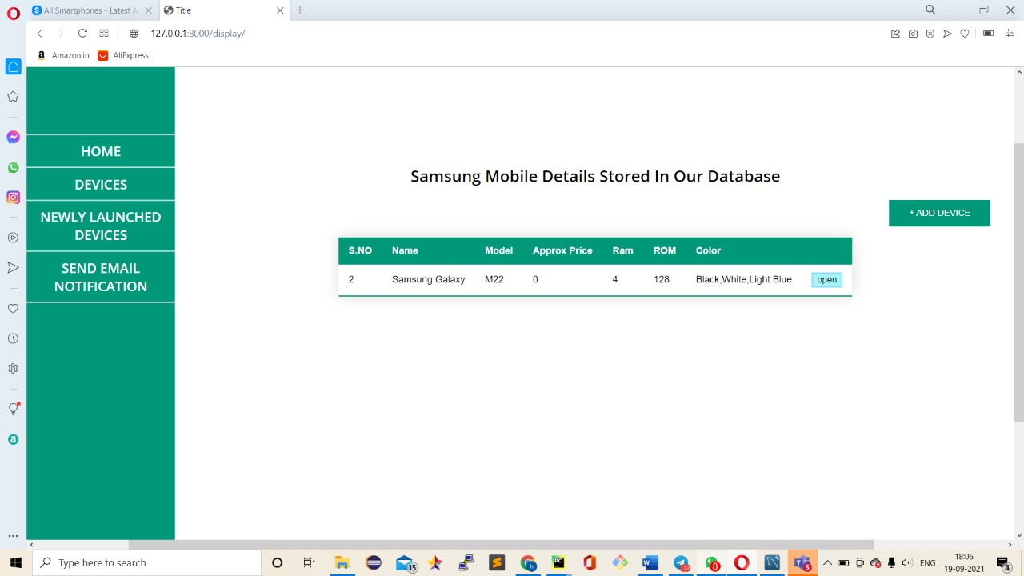
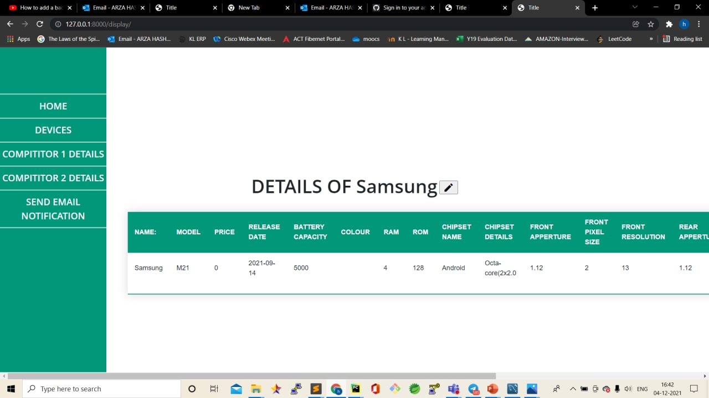
Samsung mobiles List view
Selected mobile all specifications

Slide 8
Editing Samsung device specifications

Slide 9
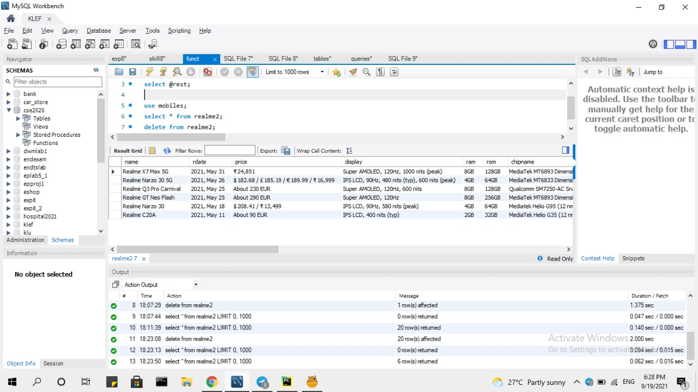
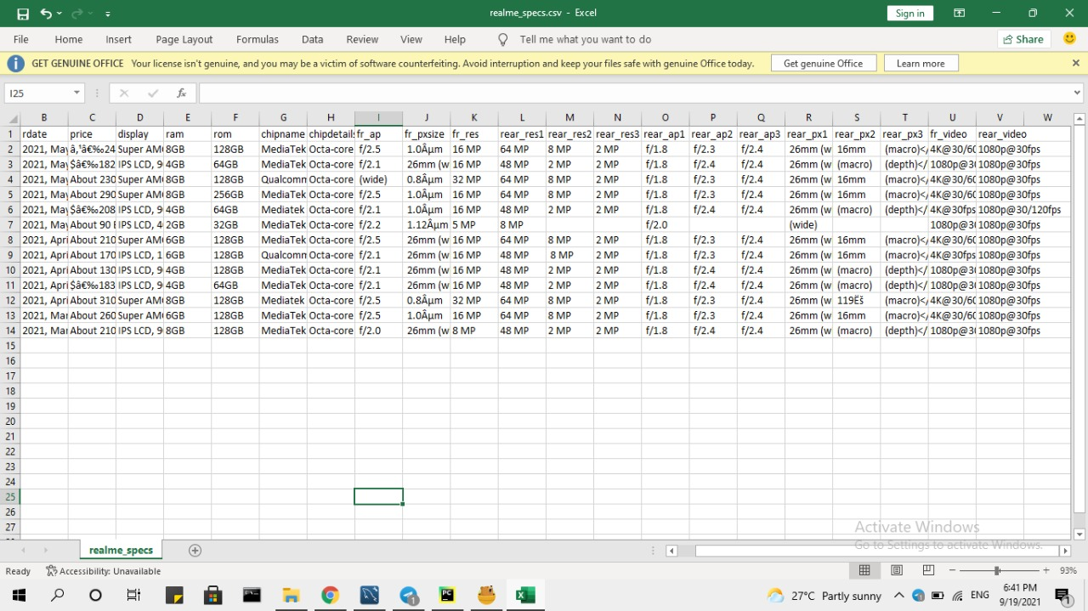
Scraped Competitor Data

Slide 10
Observations based on the results obtained
Data needs to do data preprocessing before comparison.
Data collected by web scraping is not in a required format.

Slide 11
Outcomes
Final outcomes or key take away wrt KPI’s or Metrics mentioned
Manual addition of Samsung device details to database
UI to view device list and status of the device
Find launched devices in the market from internet (Competitor)
Notify via designated emails about device availability and procurement

Slide 12
Git Links
https://github.com/chittaranjan30561/Database-System-SE22KLU-

