Slide 1

Work-let Name: Database System for devices launched in the Market
Worklet Details
Worklet ID: SE22KLU
College Name: K L University
Manual addition of Samsung Device details to Database
Displaying all Samsung Device Details in a List
So many specifications to store and maintain in database
Manual addition of device specifications is time consuming and sometimes it may cause errors while adding.
KPIs achieved till now
Any Challenges/ Issues faced
Next Steps
Adding newly launched devices in the market to the database.
Notifying via emails about device procurement, availability and status
Comparing Samsung devices with other competitors.
Manual addition of Samsung Device details to Database
Displaying all Samsung Device Details in a List
Key Achievements/ Outcome till now
Date: xxxxxxx

Slide 2
Our Work

Slide 3
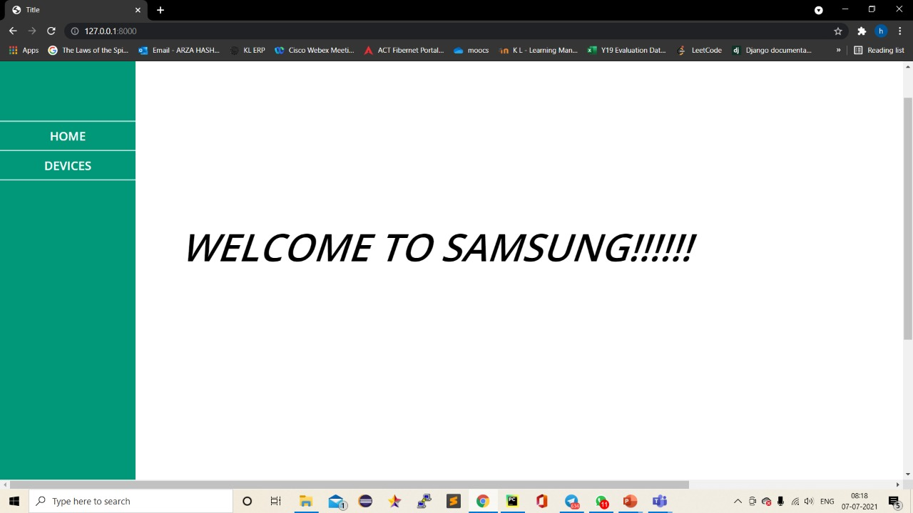

Slide 4
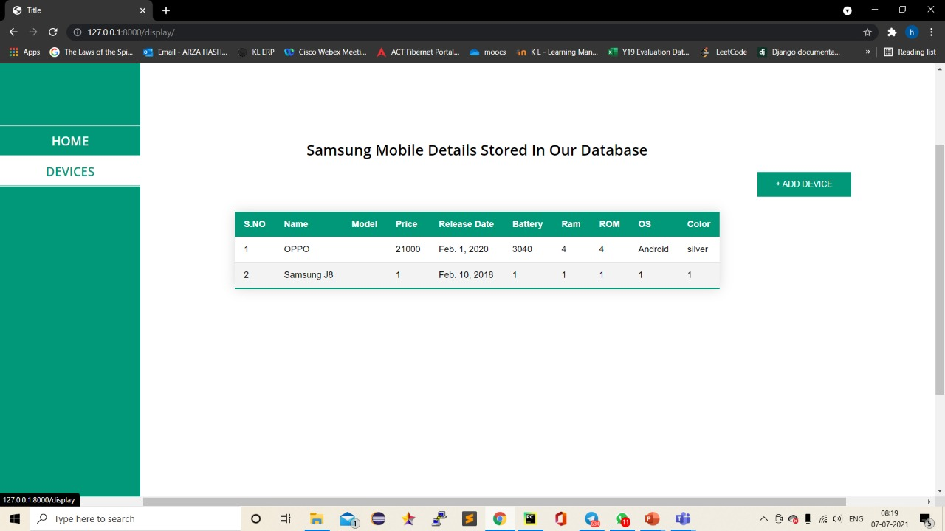

Slide 5
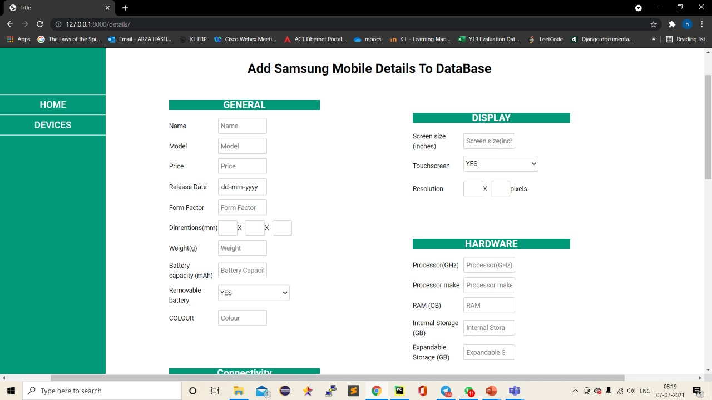

Slide 6
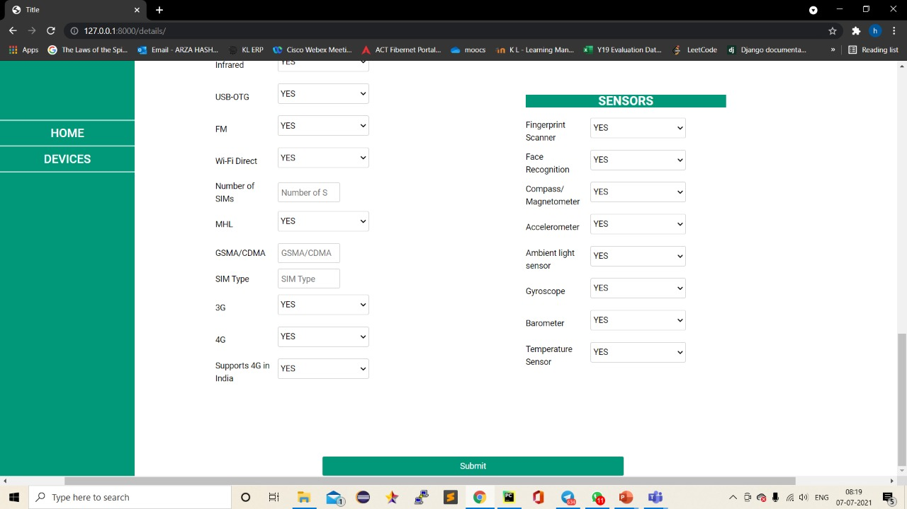

Slide 7
Roles

Slide 8
Name | Id Number | Role
Arza Hashitha | 190030102 | Front End
Gumma Chittaranjan | 190030561 | Back End
Thota Hemanth Kasinadh | 190031616 | Back End

